Slide 1
Slow-Moving Shocks and Fast-Moving ICMEs
Kristoff Paulson, David Taylor,
Charles Smith, Bernie Vasquez
and Qiang Hu
Paulson et al., Space Weather, submitted (2012).

Slide 2
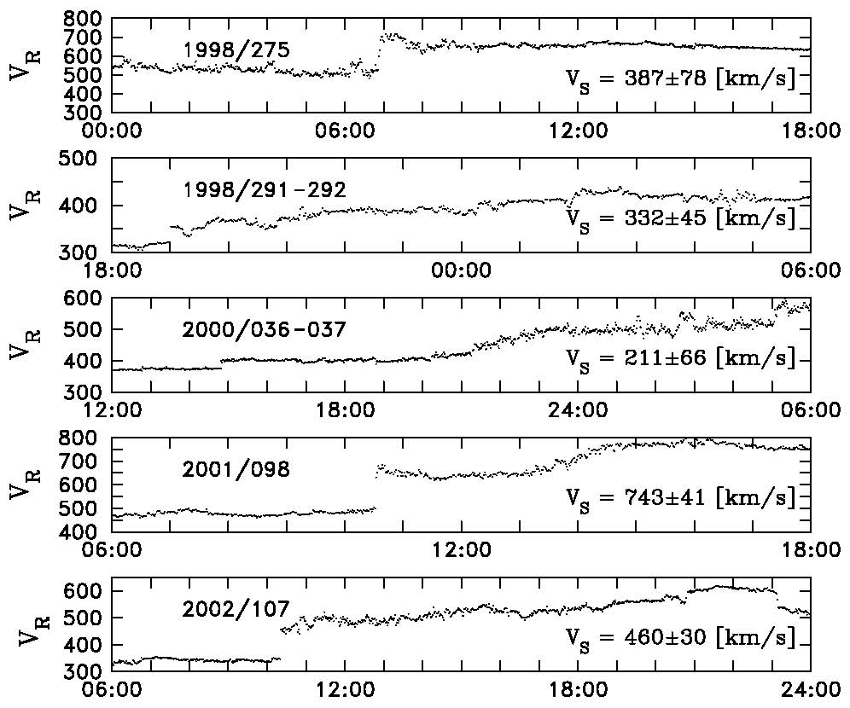

Slide 4
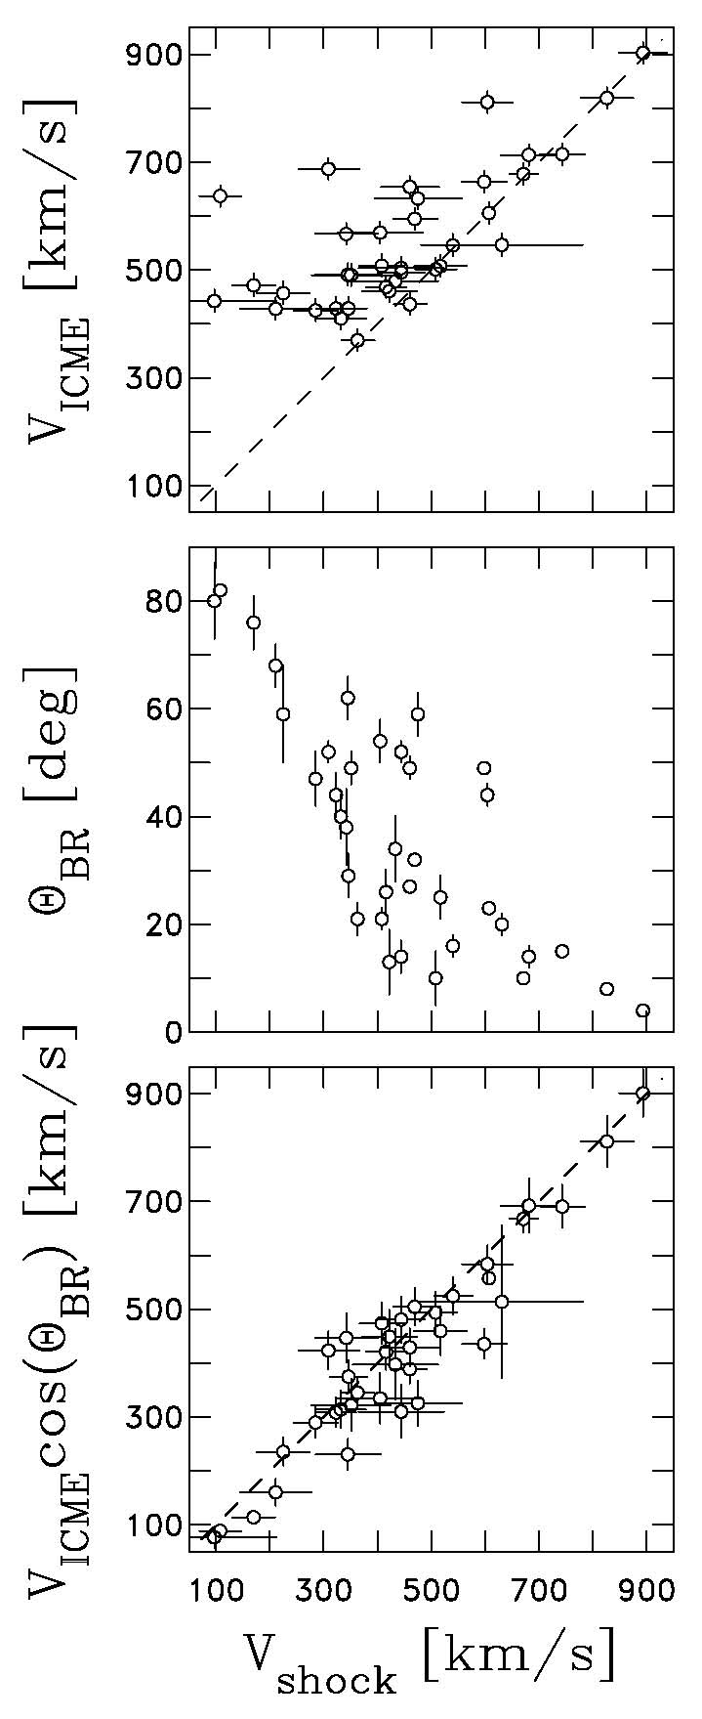
We can obtain the peak ICME speed within 12 hrs of the shock passage. This reaches deep within the ICME (typically). There is considerable disagreement with the computed shock speed in the spacecraft frame.
We compute the shock normal direction.
The two speeds are rectified according to:
V_{shock} = V_{ICME} cos(Θ_{BR})
We can reverse this relation!!!

Slide 5
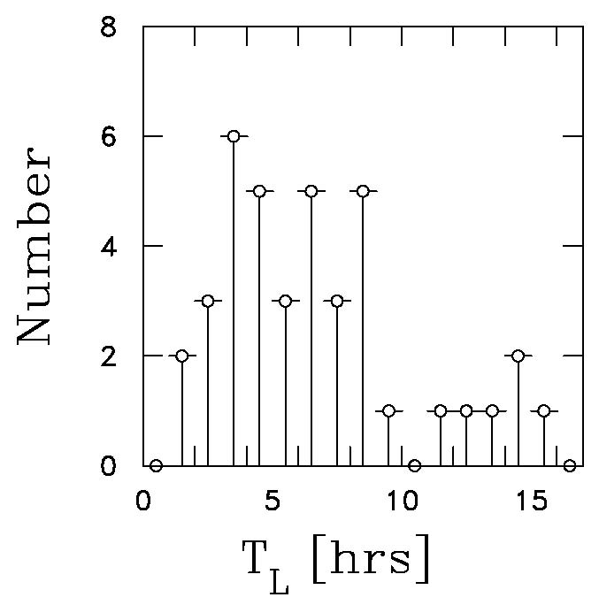
Lag Times
Lag time T_{L} is the time between shock crossing and arrival of peak ICME speed.
Note the considerable range in values from a few to 10 hours with some as long as 15 hrs.
At present we have no predictive ability for forecasting the arrival time of the peak ICME speed.

Slide 6
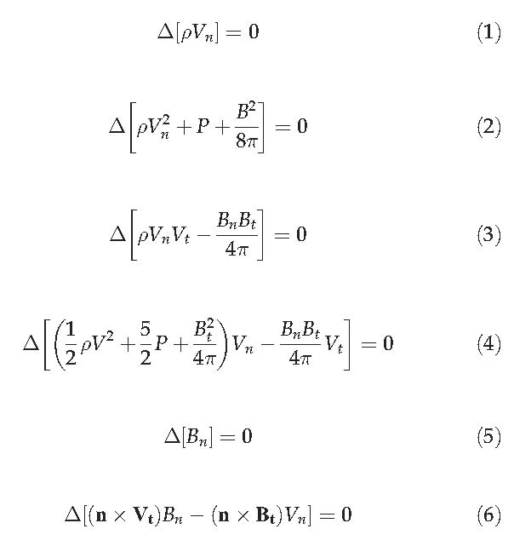
Automated Shocks for Space Weather
We have developed an automated shock solution code that finds shocks in the ACE RTSW data and solves the R-H equations for jump conditions and shock speed and normal.
See ACE Science Center
The problem is that weak shocks are very hard to find and discriminate from normal background fluctuations.
Any ideas?
We don’t want to “cry wolf” too often!
Vorotnikov et al., Space Weather, 6, S03002, 2008.
Vorotnikov et al., Space Weather, 9, S04001, 2011.

Slide 7
Summary and Problem
Weak, slow-moving shocks are often the harbinger of fast-moving ejecta to follow.
We can predict that speed in real time.
ACE is presently running a fully automated, real-time shock code finding shock candidates and performing a R-H analysis.
Gives us shock speed, compression, and normal.
Our only indication of a real shock is a statistically significant jump in parameters.
Weak shocks still have large uncertainties.
Weak shocks are the hardest to capture and analyze.

