Slide 1
Spectroscopic observations of CMEs
New England Space Science Consortium Meeting, UNH, 10/24/2012
Hui Tian
Harvard-Smithsonian Center for Astrophysics
Collaborators: Scott W. McIntosh, Steve Tomczyk

Slide 2
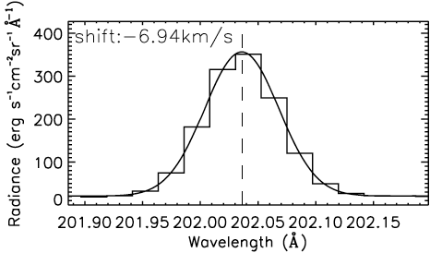
Spectroscopic observations
Slit spectrograph
HINODE/EIS
Small FOV, low cadence
More spectral sampling
Narrow-band tunable filter instrument
CoMP
Large FOV, high cadence
Less spectral sampling
Line profiles are broadened: thermal, non-thermal, instrumental
Doppler shifts due to motions along LOS
Intensity is a measure of the amount of emitting material
Asymmetry: additional emission component

Slide 3
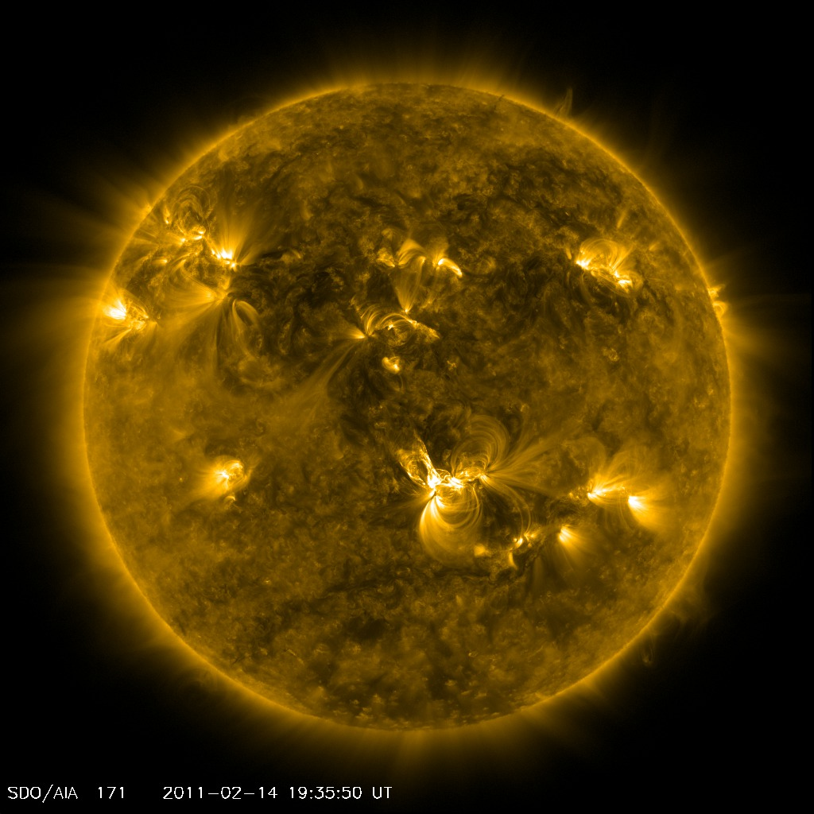
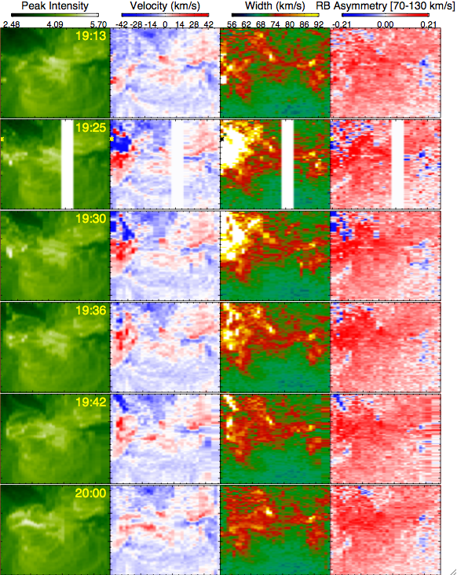
EIS observations of CMEs
Notes:
3-D evolution

Slide 4
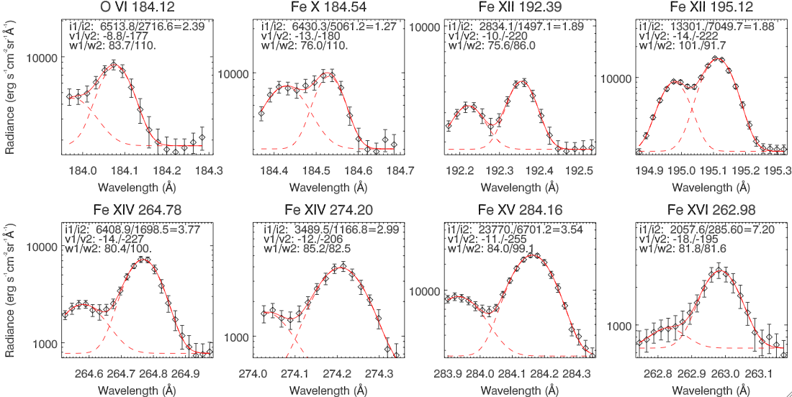
Strong high-speed outflows associated with CMEs
Line profiles in CMEs are characterized by two components
A nearly stationary background
A strong high-speed (~200 km/s) component representing emission of the ejecta
Calculate the real speed: v=Sqrt(v_{pos}²+v_{los}²)=300 km/s

Slide 5
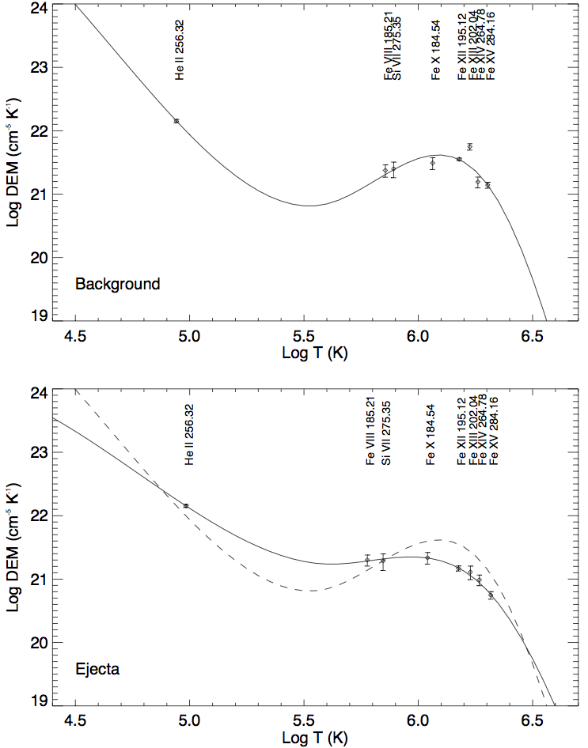
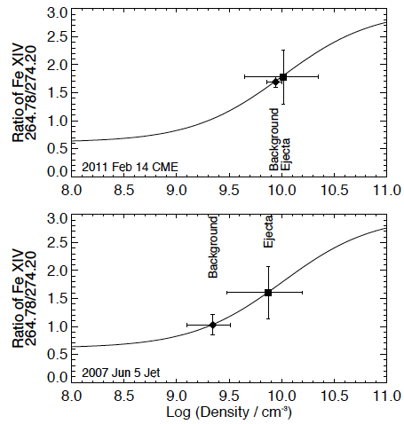
Density & Temperature diagnostics
Compared to the background
higher density in the ejecta
almost evenly distributed in Log T = 5.3-6.1
Mass of the ejecta
CME loop: 2.5 × 10¹⁴ g
EUV Jet: 5 × 10¹³ g

Slide 6
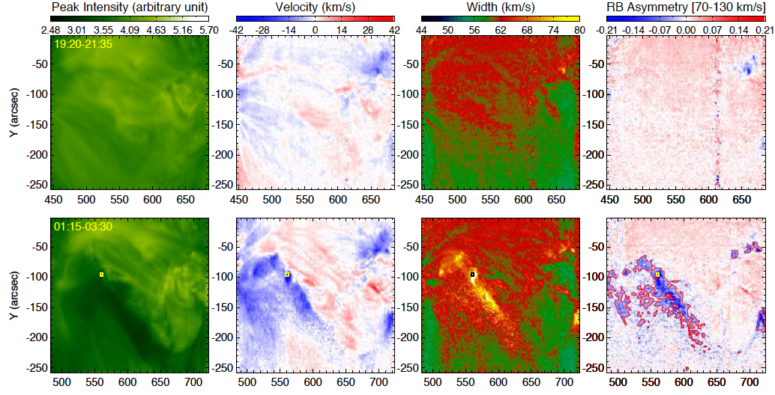
CME-induced coronal dimming

Slide 7
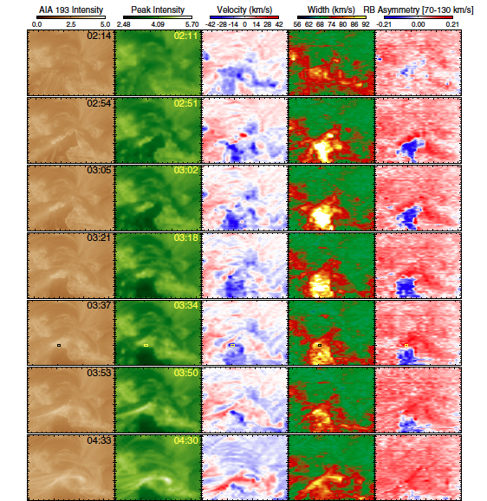

Slide 8
Weak high-speed outflows from post-CME dimming regions
Two emission components
A nearly stationary background
A weak high-speed (~100 km/s) component representing outflows
Blue shift of 10-50 km/s and enhanced line width are caused at least partly by the superposition of the two components
SGF can not reflect the real physics, assuming everything is moving at a uniform speed
A small portion of the materials in the dimming region are flowing outward at a speed around 100 km/s

Slide 9
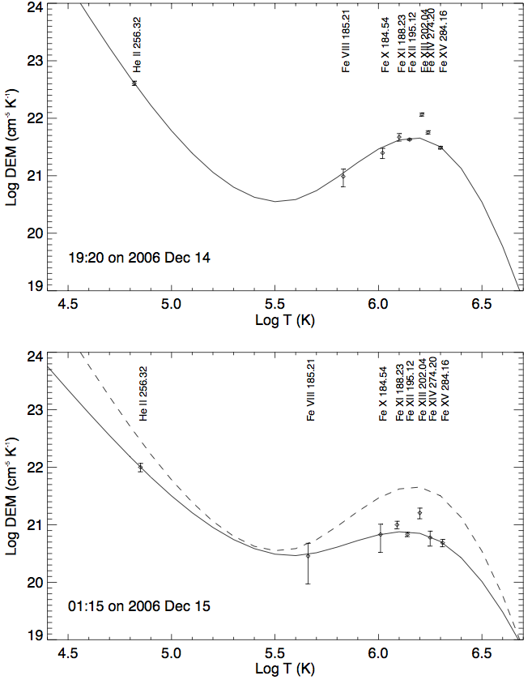
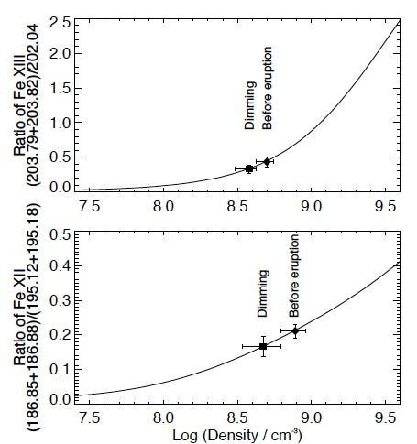
Density & Temperature diagnostics
Dimming is an effect of density decrease rather than temperature change
Dimming is mainly due to the escape of materials with a temperature of log T ~ 6.1

Slide 10
Mass loss in the dimming region
The estimated mass loss in the dimming region is about 20-60 % of the CME mass
A significant part of the CME material is coming from the region where dimming occurred subsequently
Calculate outflow density by assuming an equivalence
of the total mass supplied by the outflow and the mass loss in the corresponding dimming region

Slide 11
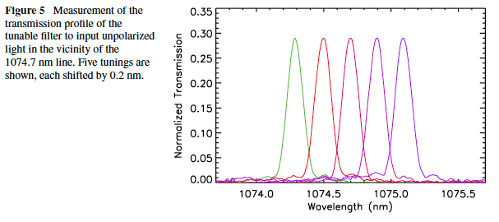
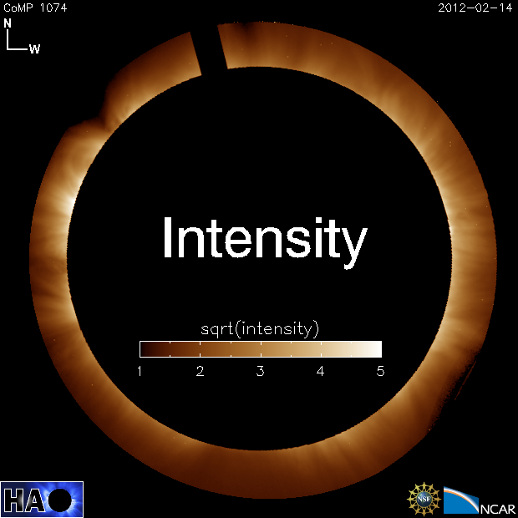
CoMP: Coronal Multi-channel Polarimeter
Locations
Mauna Loa Solar Observatory: almost daily observations since October 2010
Spectral sampling:
Fe XIII 1074.7/1079.8 nm and He I 1083.0 nm
Images of each polarization state at 3 or 5 spectral positions
FOV: 1.05 to 1.4 Rsun
Spatial Resolution: 4.46”/pixel
Cadence: typically 30 s or 50 s
Tomczyk et al. 2008, Sol. Phys.
Notes:
Small FOV

Slide 12
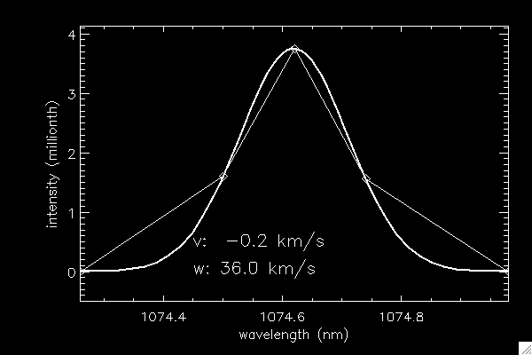
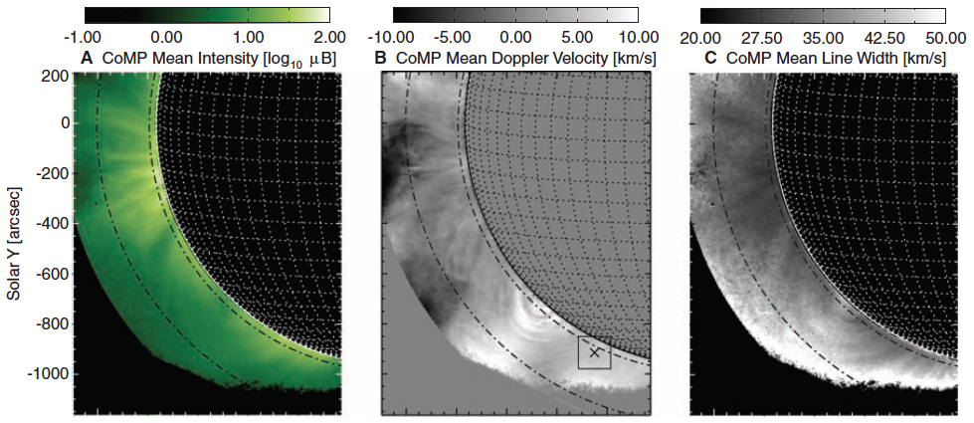
Stokes I
Line intensity: amount of plasma
Velocity: plasma motion in LOS
Line width: unresolved plasma motion
Tomczyk et al. 2007, Science

Slide 13
2011 Dec 30 CME

Slide 14
2011 Dec 07 CME
CMEs are usually associated with greatly increased Doppler shift and enhanced line width. The perturbation is much weaker in intensity.
The significant changes of Doppler shift are probably largely associated with the coronal response to the mass eruptions and lateral expansion of CMEs.
The increased line width might be caused by the enhanced flow inhomogenuity and turbulence in various substructures of CMEs in the LOS direction.

Slide 15
2012 May 26 CME
Partial halo CME: quickly-developed large-scale disturbance (EUV wave?) in the Doppler shift and line width (mainly at the west limb).
The perturbation in intensity is not as obvious as in Doppler shift and line width.
LASCO-C2 observed this CME 20 minutes later. CoMP observations might provide a cheap and low-risk means of space weather monitoring.

Slide 16
Conclusion
With spectroscopic observations, we can separate the pure ejecta emission from the background emission. Density, temperature, mass and LOS speed of the CME ejecta can be calculated based on UV spectroscopic observations
A small portion of the plasma in the dimming is flowing outward at a speed of ~100 km/s. These outflows should play an important role in the refilling of the corona and possibly mass supply to the solar wind
CoMP provides simultaneous high-cadence (30 s) observations of coronal line intensity, Doppler shift and line width, density, linear/circular polarization for the first time. These measurements might be useful to constrain models of CMEs
CMEs are associated with dramatic changes of Doppler shift and line width. Observations of halo-CMEs by CoMP-like instrument may provide a cheap and low-risk means of space weather monitoring
References:
Tian et al. 2012, ApJ, 748, 106
Tian et al. 2013, Sol. Phys., to be submitted
Next: the IRIS Mission

Slide 17
Interface Region Imaging Spectrograph (IRIS)
Slit spectrograph + Slit-jaw imaging
(3 spectral ranges) (4 passbands)
Fast scans
(~5 s)
Super high spatial resolution
(1/3”)
CME emission and dynamics at Chromospheric and TR temperatures
Fine structures of CMEs
FOV: 120”*175” for SG, 175”*175” for SJI

Slide 18
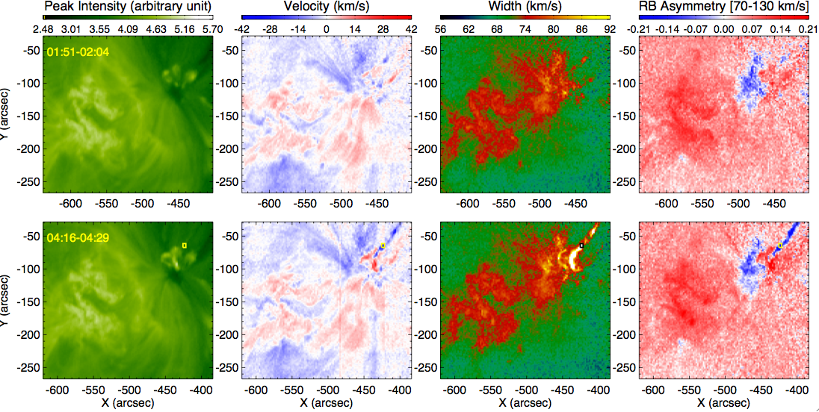
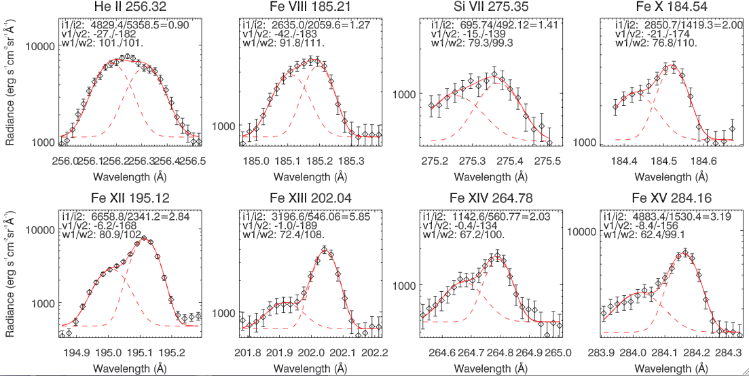
Spectroscopic observations of EUV jets
Two well-separated components
A nearly stationary background
A high-speed component (~160 km/s) representing the emission of the jet
Calculate the real speed: v=Sqrt(v_{pos}²+v_{los}²)=223 km/s

Slide 19
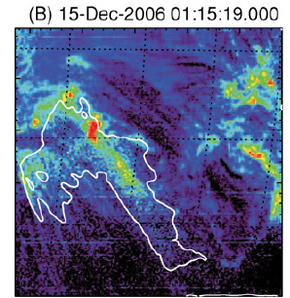
Spectroscopic observations of coronal dimmings
Attrill et al. 2010, Sol. Phys.
McIntosh, ApJ, 2009
~20 km/s Blue shift: outflows refilling the corona
Enhanced line width: growth of wave amplitude
Notes:
When CMEs leave the Sun, sometimes we see greatly reduced emission of the corona. This is called coronal dimming.

Slide 20
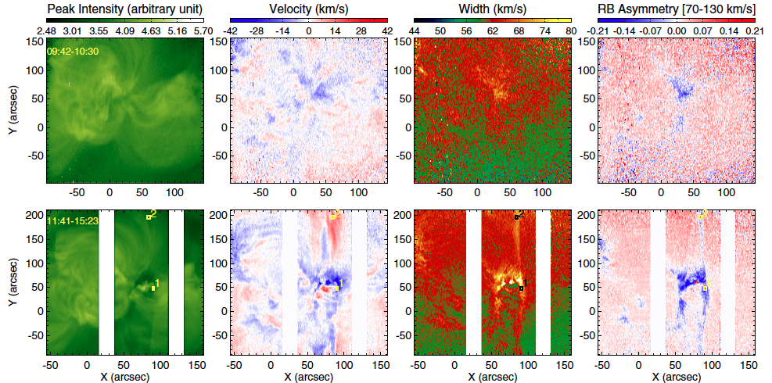
Other examples

Slide 21
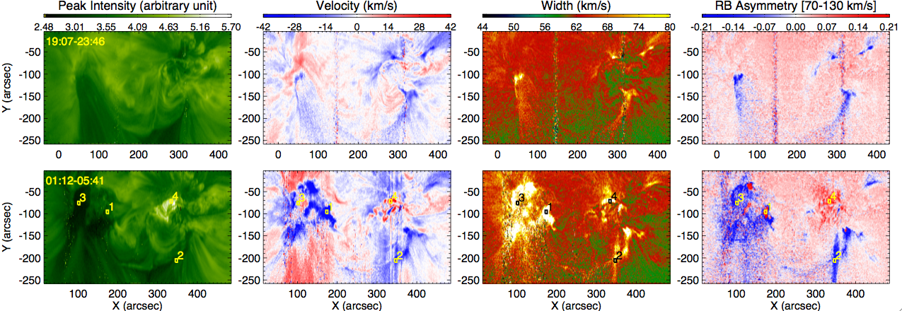
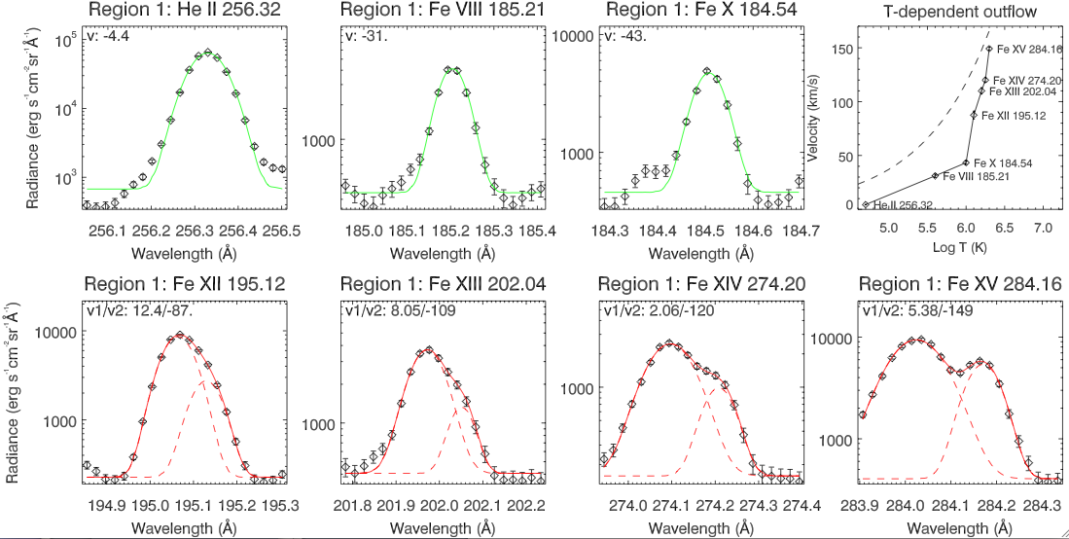
Immediately outside the (deepest) dimming regions
Our RB asymmetry analysis is able to detect them
Evaporation flows
Notes:
caused by the enhanced thermal conduction or nonthermal electron beams along reconnecting field lines, or induced by the interaction between the opened field lines in the dimming region and the closed loops in the surrounding plage region

Slide 22
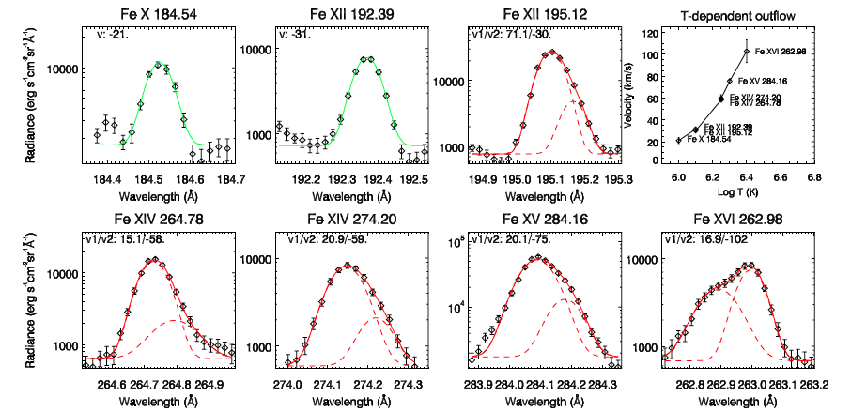

Slide 23
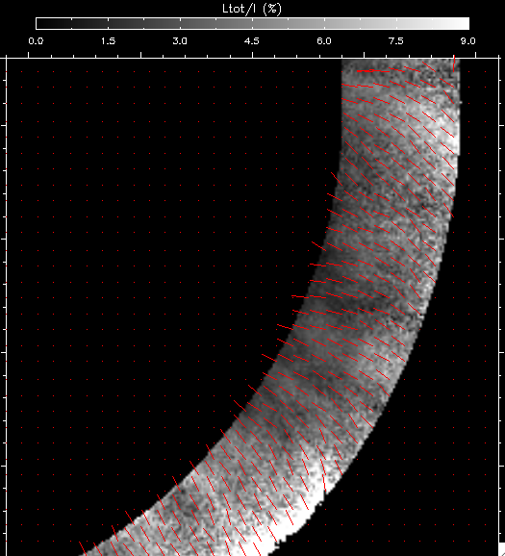
Stokes Q, U, V
Circular Polarization (V): LOS magnetic field strength from longitudinal Zeeman effect
Linear Polarization (Q,U) from resonance scattering effect
Degree of linear polarization (L_{tot}/I)
Azimuth of B (POS magnetic field direction)
L_{tot}=(Q²+U²)^{1/2}
ϕ=0.5 atan (U/Q)

Slide 24
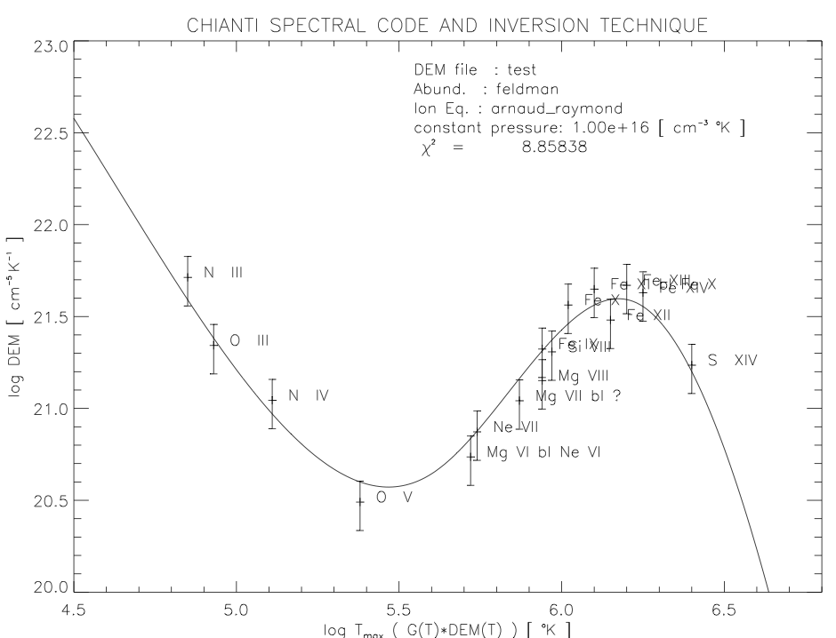
What IRIS can do
Joint observation with other instruments like HINODE/EIS
CME kinematics and plasma properties at a broad range of T
Flows and plasma diagnostics of flares
Waves triggered by CMEs & flares
Red: IRIS lines
Blue: EIS lines
C II
Ni II
Fe II
Si IV
Fe XII
Fe X
Fe XIV
Si VII
O IV
Fe VIII
Fe XVI
Fe XXI

