Slide 1
He/H variation in the solar wind over the solar cycle
Justin C Kasper
Smithsonian Astrophysical Observatory
NESSC (CfA)
27 October 2008

Slide 2
Who is involved
Kasper (SAO)
Bennett Maruca (Harvard University), new analysis of Wind Faraday Cup data
Alan Lazarus, Mike Stevens (MIT), He/H variation over Carrington rotation and solar cycle
Harlan Spence, Nicholeen Viall (BU): short period He/H variation in the solar wind
Sarah McGregor (BU): Mapping solar wind He/H to solar sources

Slide 3
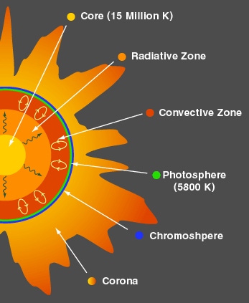
Relative abundance of helium
He/H (ratio by number density) within the solar core is 10%
Matching observed radius and luminosity (Guzik & Cox, 1993)
Solar Interior ~ 8% within convection zone
Helium becomes singly ionized then neutral within ~ 0.02 Rs (Basu & Antia 1995).
Solar corona ~ 4.5%
Few direct measurements, but He/H ~ 4.5% (Lamming, 2004)
Transport of He from convection zone through transition region to corona is poorly understood
model H, H+, He, He+ and He+2 consistently (Hansteen et al 1994))
simulations must boost drag x10 to produce coronal He/H
Solar Wind 0-30%
He/H is the most variable quantity in the solar windHe/H is no more than 4.5% of quiet solar wind
He/H can rise to 30% in ejecta (50% of mass flux!)

Slide 4
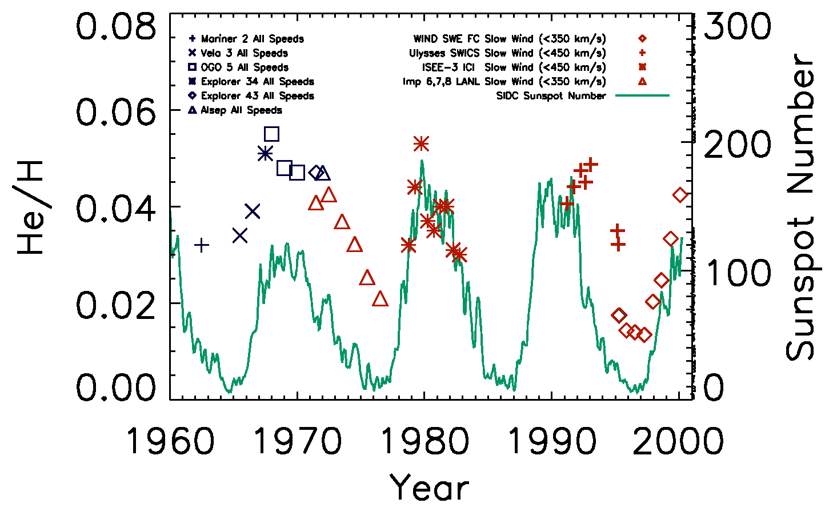
The solar wind helium abundance
He/H from 1960-2000 increases with solar activity
Aellig et al 2001
Ogilvie and Hirshberg (1974); Feldman et al (1978)
Why does He/H vary over the solar cycle?

Slide 5
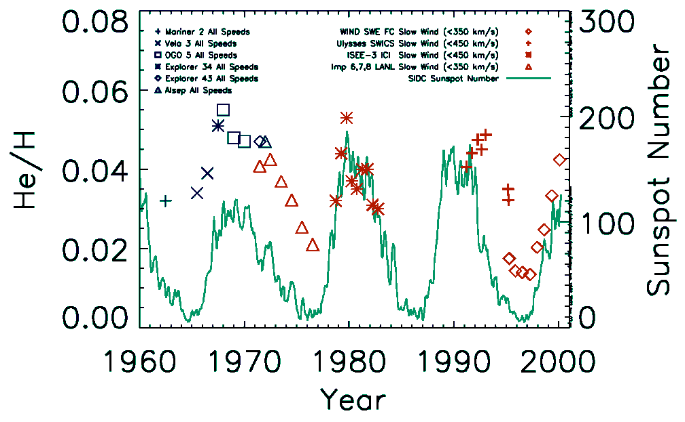
Helium and magnetic fields
Helium spectral lines in stellar atmosphere
Helium in solar wind (1960-2000)
Glagolevskij et al (2006)
Aellig et al (2001)
Bp Stars (“p” for Peculiar)
~ 10x solar mass
Young Bp stars poor in helium
Strong magnetic fields 10kG
Ogilvie and Hirshberg (1974); Feldman et al (1978)
He/H in solar wind correlated with solar cycle

Slide 6
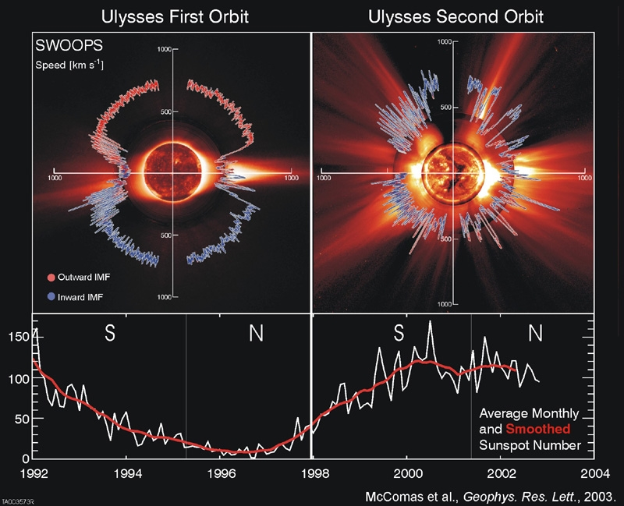
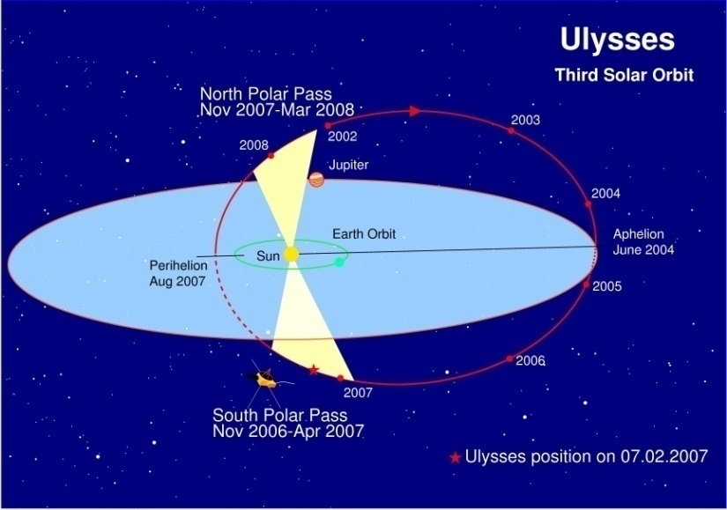
Variation of solar wind speed
Latitude structure over the solar cycle

Slide 7
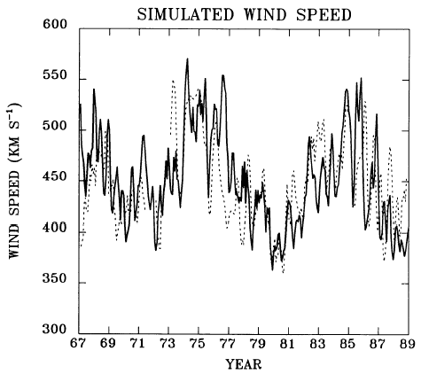
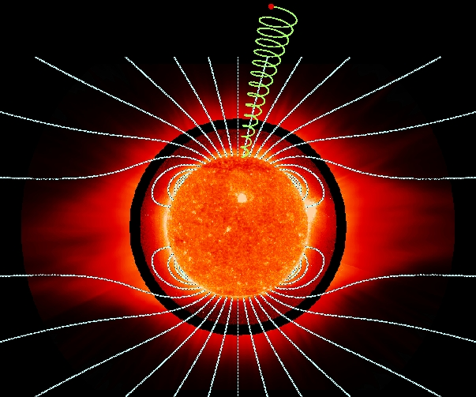
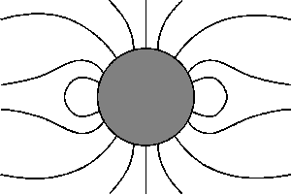
Variation of solar wind speed
Speed related to magnetic expansion
Parker (1958) model of solar wind: supersonic acceleration in DeLaval nozzle
Modification: field expansion controls the nozzle
Source surface
(Wang, 1993)

Slide 8
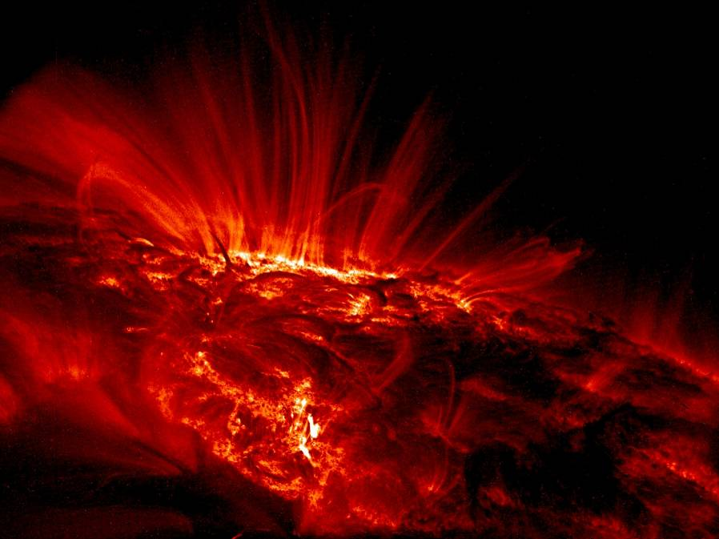
The link between speed and He/H
Regulation of Coulomb drag
Helium does not experience the Parker mechanism directly
Instead Coulomb coupling to accelerated hydrogen is needed
Early explanation for dependence on level of solar activity:
  Observation: Solar wind near magnetic reversal, the heliospheric current sheet (HCS), has low He/H
  Slow solar wind near HCS, and HCS more often in equatorial plane during solar minimum
  Fast wind and CMEs, seen more at maximum, have high He/H
So is dependence just due to wind speed changing?

Slide 9
Wind Faraday Cup Observations
He/H over solar cycle
Wind/SWE
  Aellig et al study [2001]
  Kasper et al. [2007]
He/H linear with speed during solar minimum
  In agreement with expansion – drag argument
Signal vanishes during solar maximum!
Modulation returned in 2004-2005 for lowest speeds
Why does speed dependence vanish?
Higher resolution analysis
Updated version of Aellig et al [2001] Figure 2

Slide 10
Six-Month Periodicity
Carrington rotation averages of He/H in two narrow speed windows during solar minimum
Fit Carrington averages with sinusoid
Six month periodicity
Maxima in He/H as Earth leaves heliographic equatorial plane
Consider:
  Significance
  Offset A₀
  Amplitude A₁
He/H
latitude

Slide 11
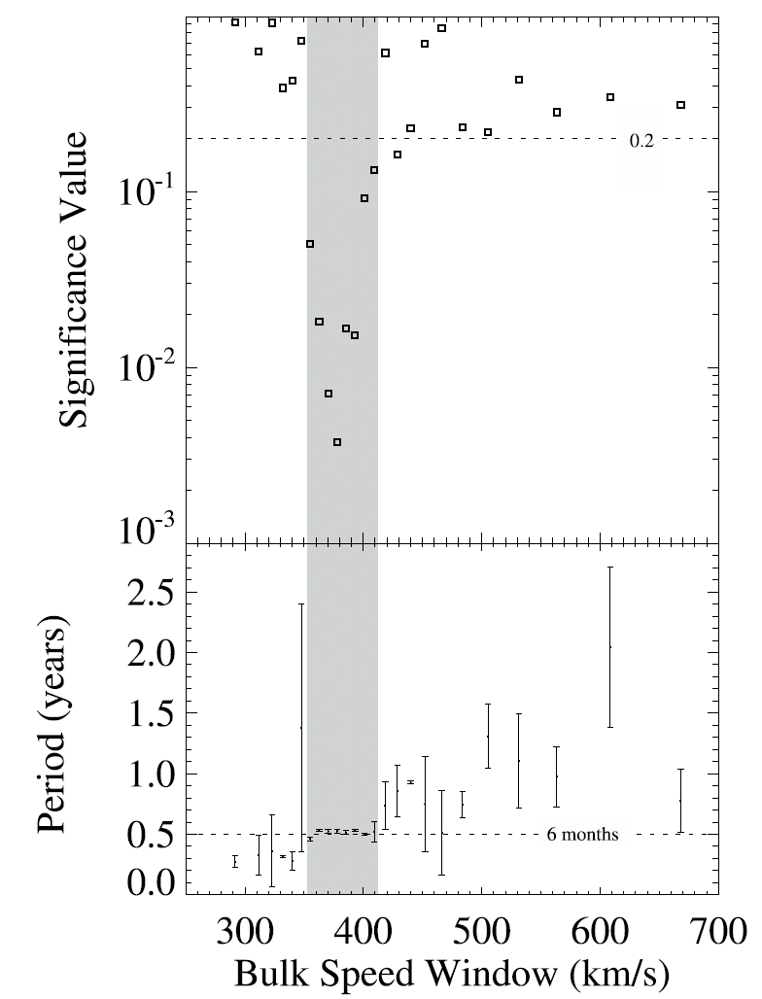
Carrington rotation He/H averages
Lomb-Scargle spectral analysis
428 km/s
362 km/s

Slide 12
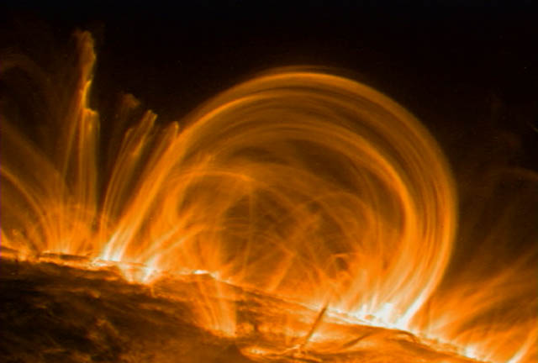
Possible explanation for latitudinal gradient
Long lived magnetic loops
Previous models have two flaws
  Magnetic topology is simple – expanding field
  Structures are stationary in time
New time dependent models introduce gravitational settling
  Endev et al. (2005)
  Helium settles to bottom of loops
  Decreased He/H at loop top
Another option: washed out differential flow
TRACE

Slide 13
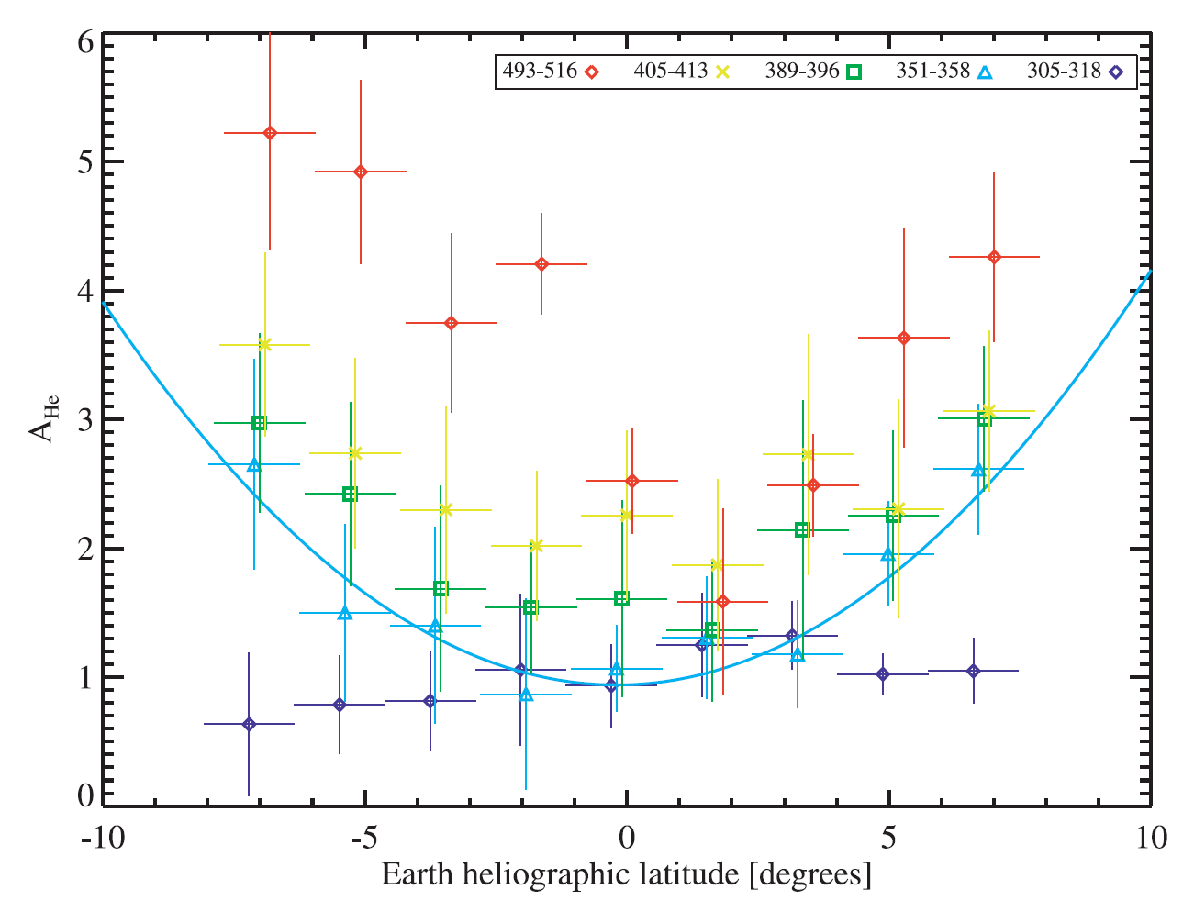
Observations sorted by latitude

Slide 14
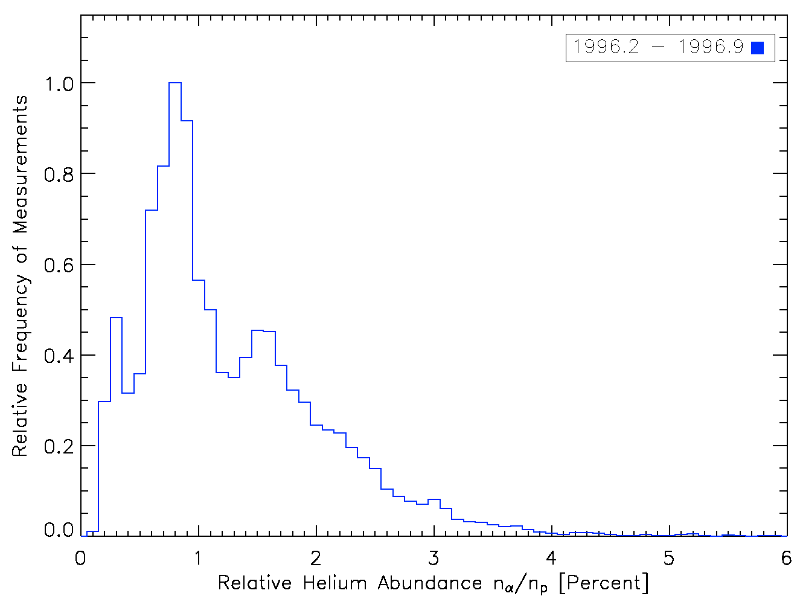
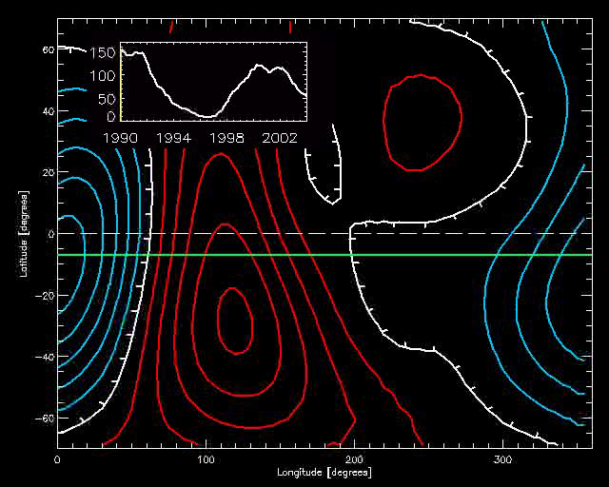
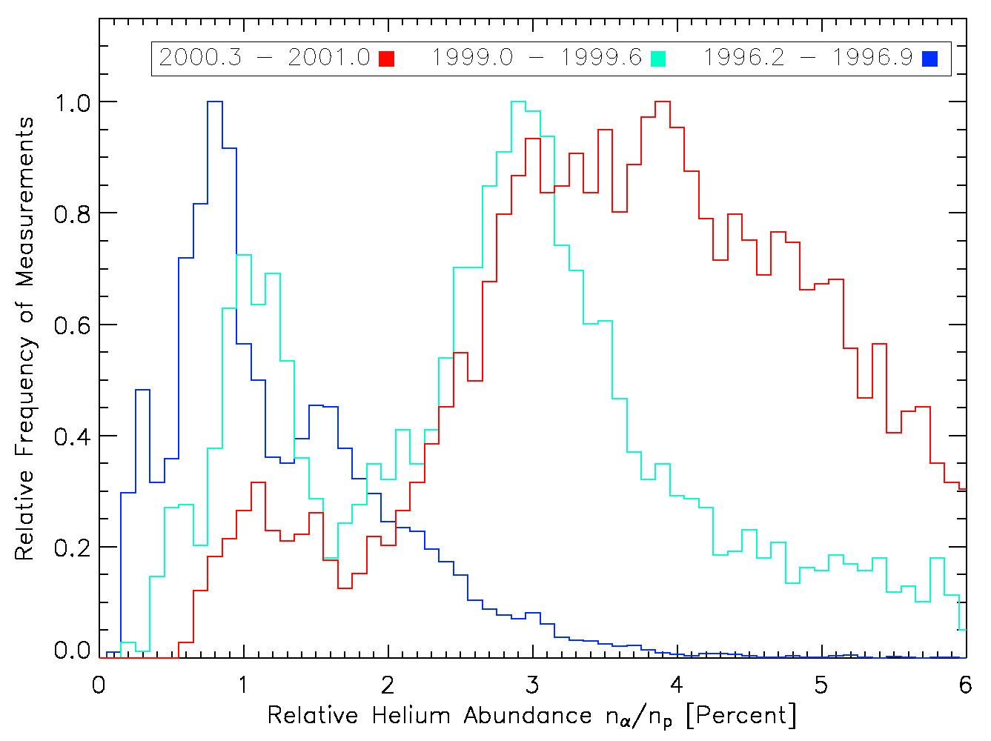
Two sources of slow solar wind?
300-320 km/s solar wind

Slide 15
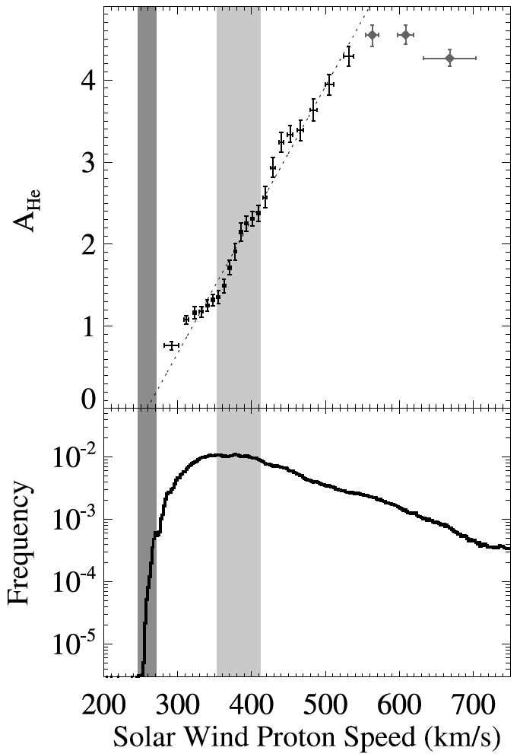
Dependence of A₀ on speed
A₀ is an extremely linear function of V for speeds between 275-500 km/s
This is not predicted analytically or numerically
Extrapolates to a “vanishing speed” of 265 km/s

Slide 16
Dependence of A₀ on speed
A₀ is an extremely linear function of V for speeds between 275-500 km/s
This is not predicted analytically or numerically
Extrapolates to a “vanishing speed” of 265 km/s
Histogram of distribution of solar wind speed at 1 AU over mission
Why does this correspond to lowest observed solar wind speeds?

Slide 17
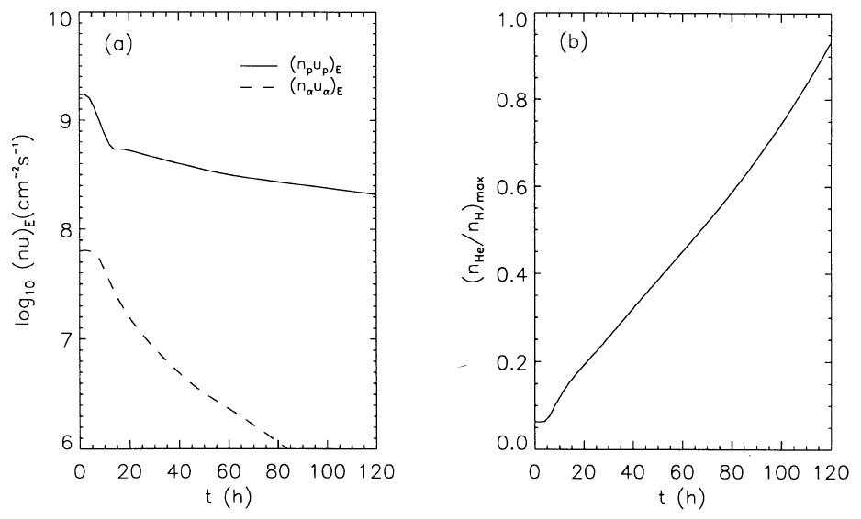
Hypothesis: Helium in corona impedes solar wind escape and acceleration
Escaping hydrogen
and helium fluxes
Fraction of
helium in corona
Hansteen et al., ApJ, 1994

Slide 18
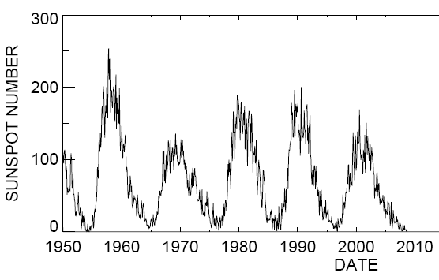
Current solar minimum
Processed Wind data up through this August
Examine He/H in the current solar minimum
NASA/MSFC

Slide 19
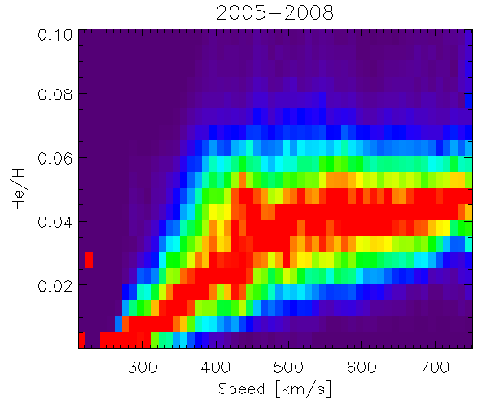
Linear dependence with speed is back
Observations from last three years show solid relationship between He/H and speed
Cleaner than last solar minimum by eye

Slide 20
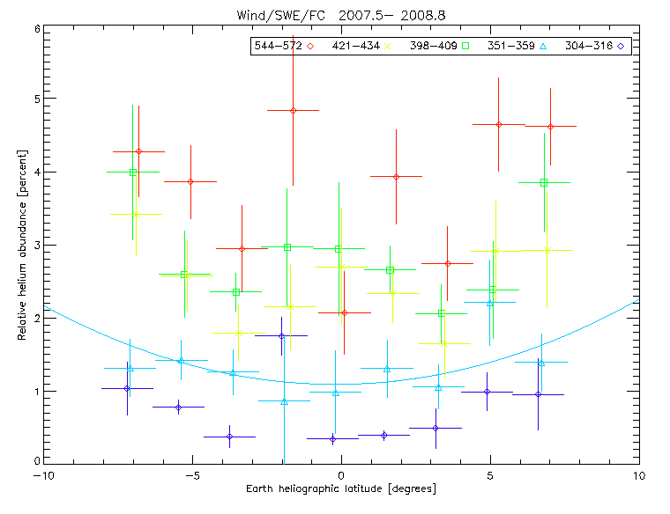
Possible return of latitude dependence
Last 1.3 years of data begin to see slight latitude dependence
More like a “W” shape than a “V” shape with latitude
HCS not yet aligned with equator this minimum
Need to wait or use a mapping model

Slide 21
Conclusions
Solar minimum He/H dependence on speed (and implied vanishing speed) have returned
  Should get more precise value for minimum speed
Latitude gradient not seen yet
  Wait for HCS to align with equator
  Employ mapping methods to relate to coronal structure
Additional work
  Composition and charge state data with ACE – are there freeze-in temperature or minor ion abundance gradients?
  Relate He/H variation on small timescales to non-steady solar wind sources

Slide 22
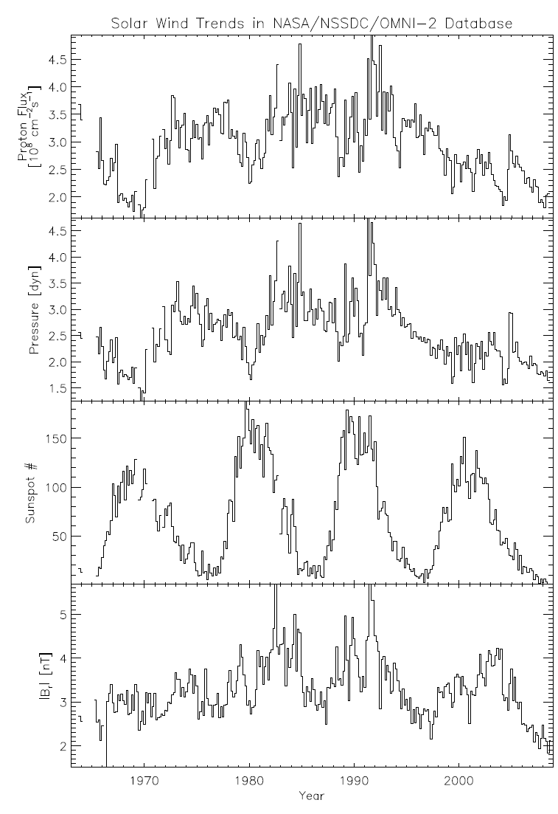

Slide 23
