Slide 1






10 Years of ISN Flow with IBEX
Informing IMAP Observations
E. Möbius¹, J. Bower¹
M. Bzowski², S.A. Fuselier^{3,4}, D. Heirtzler1, M.A. Kubiak² H. Kucharek¹, M.A. Lee¹, D.J. McComas⁵, N. Schwadron¹ P. Swaczyna⁵, J.M. Sokol², P. Wurz⁶
¹Space Science Center, University of New Hampshire
²Space Research Centre, Polish Academy of Science
³Southwest Research Institute, San Antonio
⁴University of Texas, San Antonio
⁵Department of Astrophysical Sciences, Princeton University
⁶Physikalisches Institut, Universität Bern
Support by: NASA Explorer Program & Polish Academy of Sciences

Slide 2
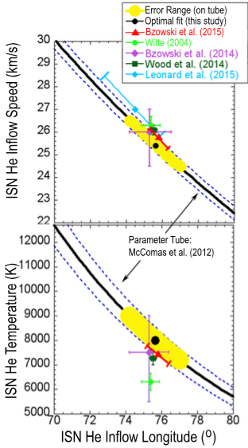
IBEX ISN Flow Observations Lead to Narrow Parameter Tube
Precision ISN Flow Vector Needed
→B_{ISM}-V_{ISM} Plane →IS Plasma Flow around HP
IBEX ISN Analysis Results
in a Narrow 4D Tube, expressed as
V_{ISN∞}, T_{ISN}, β_{ISN∞}(λ_{ISN∞})
• Velocity Vector close to Ulysses GAS
• T_{ISN} substantially higher
Independent Flow Longitude Determination?
1) ISN Peak provides “Parameter Tube”
- with high precision
- identify or constrain temporal variations
2) Longitude Variation of Pickup Ion cut-off
to determine λ_{ISN∞}
Schwadron et al. 2015
→ Complementary ISN Method to Full χ² Analysis
Notes:
Check on Jonathan’s talk

Slide 3
IBEX-Lo Key Observables of the Interstellar Neutral (ISN) Flow
ISN Flow Peak
- Longitude
- Latitude
Angular Width
Ratio:
T/V²_{ISM}
V’_{Th}
V’_{ISN}(1 AU)
Mach Cone
In Observer Frame
While providing excellent statistics
IBEX Observations limited in Ecliptic Longitude

Slide 4

Complementary Method to Obtain the ISN Flow Vector
1) Peak Longitude λ_{ISN Peak}
of ISN Bulk Flow from IBEX
→ V_{ISN∞}(λ_{ISN∞})
2) Symmetry line of Pickup
Ion Cut-Off Speed
with Ecliptic Longitude
→ λ_{ISN∞}
Pickup Ion Cut-Off Analysis
Showed Closed Solution for
ISN Peak as a function of Longitude λ, avoids 1 Expansion
→ 3rd Version of Expansion Model (M Lee)
See Marty’s Talk

Slide 5
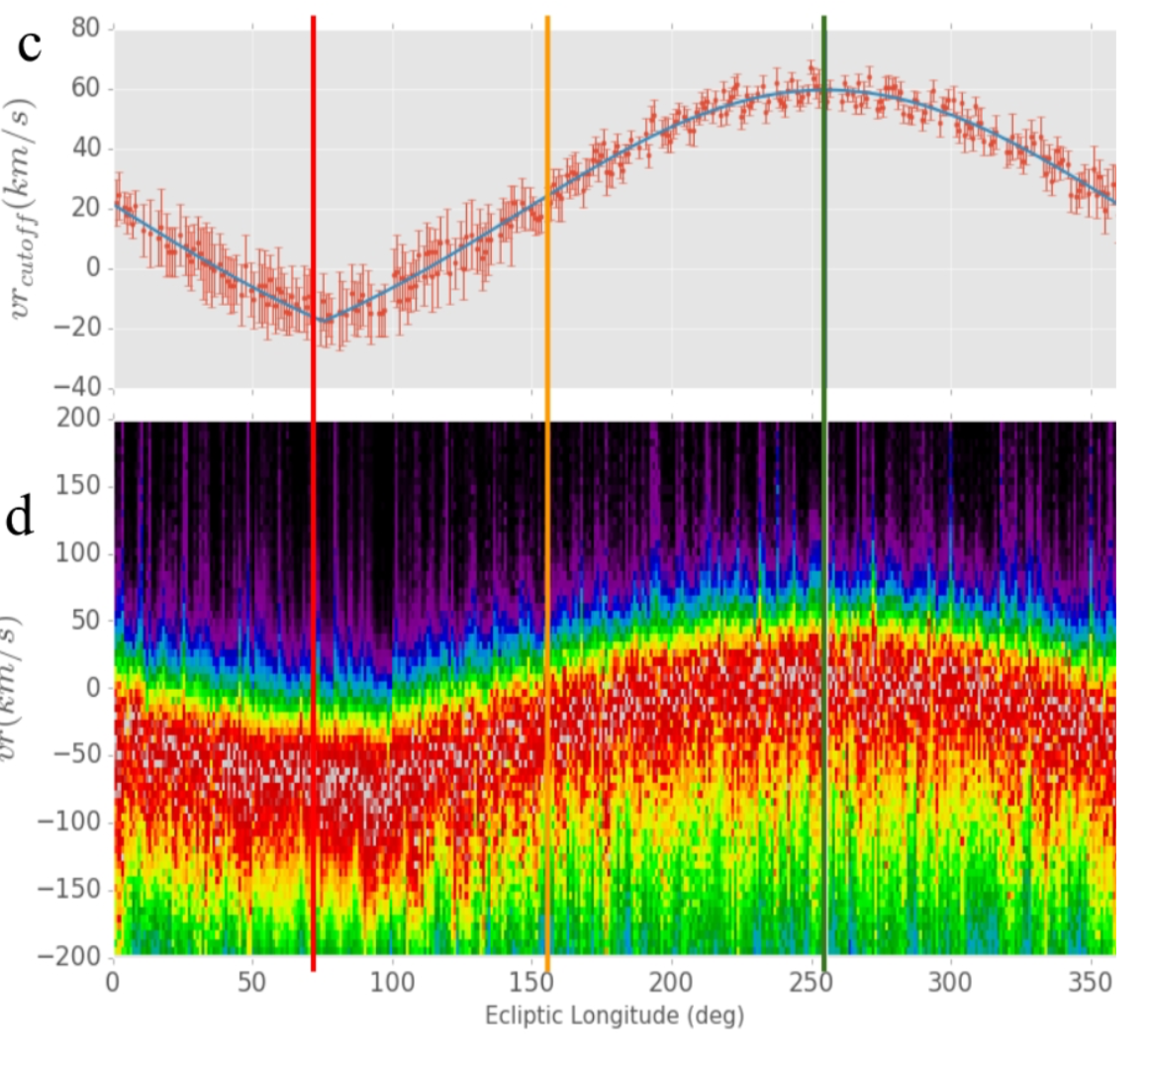
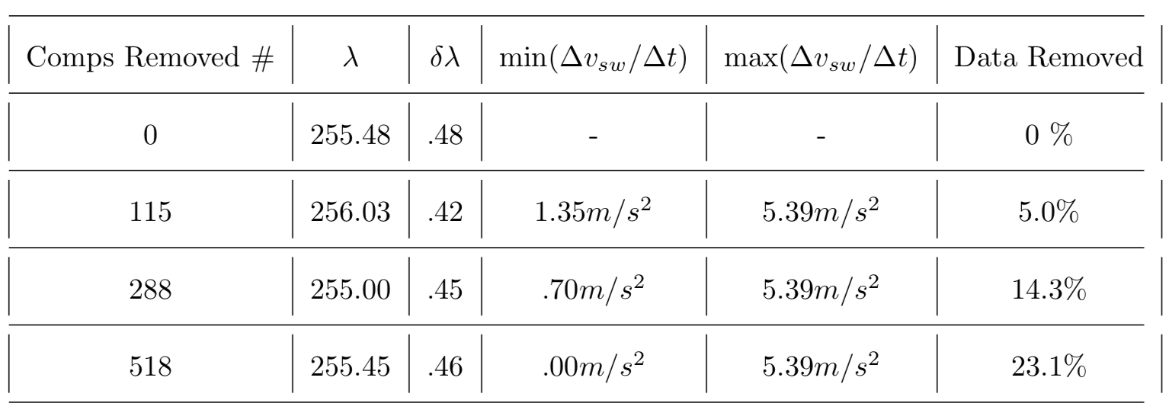
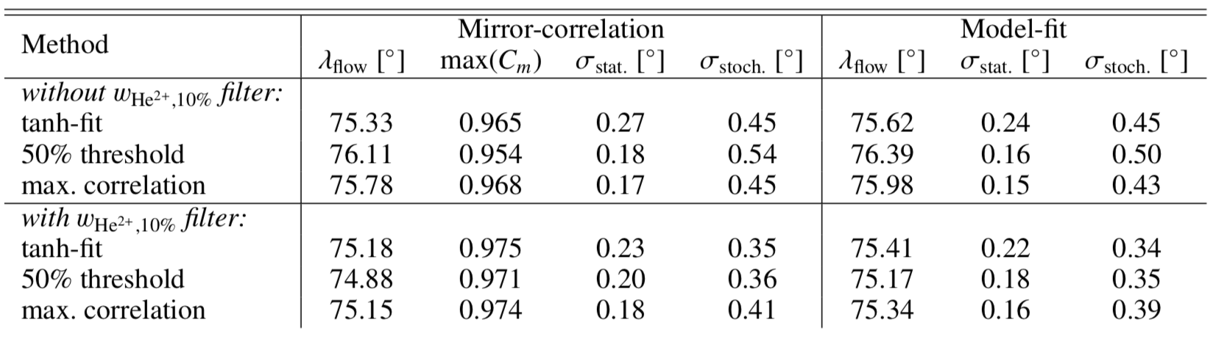
Complementary Method to Obtain the ISN Flow Vector
Bower et al., 2018 (in prep.)
Filtered for Compression Regions
7
7
7
7
Filtered for Suprathermal Tails
Taut et al., 2017

Slide 6
Complementary Method to Obtain the ISN Flow Vector
1) Peak Longitude λ_{ISN Peak}
of ISN Bulk Flow from IBEX
→ V_{ISN∞}(λ_{ISN∞})
- Best Statistics:
Spin Integrated Flux
- Model Independent up to:
λ_{ISN Peak} →V_{ISN∞}(λ_{ISN∞})
- Bell-weather for
effects from Ionization and
Energy Dependent Efficiencies
- Expand to IBEX accessible Longitudes → Constrain λ_{ISN∞}
- May become usable to assess temporal variations

Slide 7
Method to Obtain ISN Flux as Function of Ecliptic Longitude
Spin-Integrated Rate as Function of Longitude
Each Orbit (ISN Good Times) in E-Step 1-4 (15-110 eV)
χ² Fit to obtain Rate at ISN Flow Perihelion
- At Sun-Pointing of Spin Axis, corrected for S/C Velocity
and at selected ε_{E} from Sun-Pointing (up to +5º)
as in Möbius et al. (2012) & Leonard et al. (2015)
- Linear Fit → tests more consistent than quadratic
Transform Flux to Phase Space Density
Correct for Ionization
Subtract He Secondary component (Kubiak et al. 2016)
Touch this briefly

Slide 8
IBEX Observation at Perihelion
PSD to Flux Transformation
In Ecliptic Plane
From Möbius et al. 2012
ISN Observation at λ_{Ecl} < λ_{Peak}
(Downwind of Flow Peak)
From Lee et al. 2015

Slide 9
IBEX Observation at Perihelion
PSD to Flux Transformation
In Ecliptic Plane
From Möbius et al. 2012
ISN Observation at λ_{Ecl} > λ_{Peak}
(Upwind of Flow Peak)
From Lee et al. 2015

Slide 10
ISN Peak Location 2013-18 for 15, 29, 55, 110 eV (E1-4)
Performed Analysis
for 2009-2018
2009-2011 require extra step to compensate for data throughput
typically lead larger errors
If IBEX-Lo Efficiency independent of Energy
→ λ_{Peak} same for E1-4
E1-3 agree within Error Bar but λ_{Peak} larger for E4
Additional years reduce Error
Produce robust & stable result

Slide 11
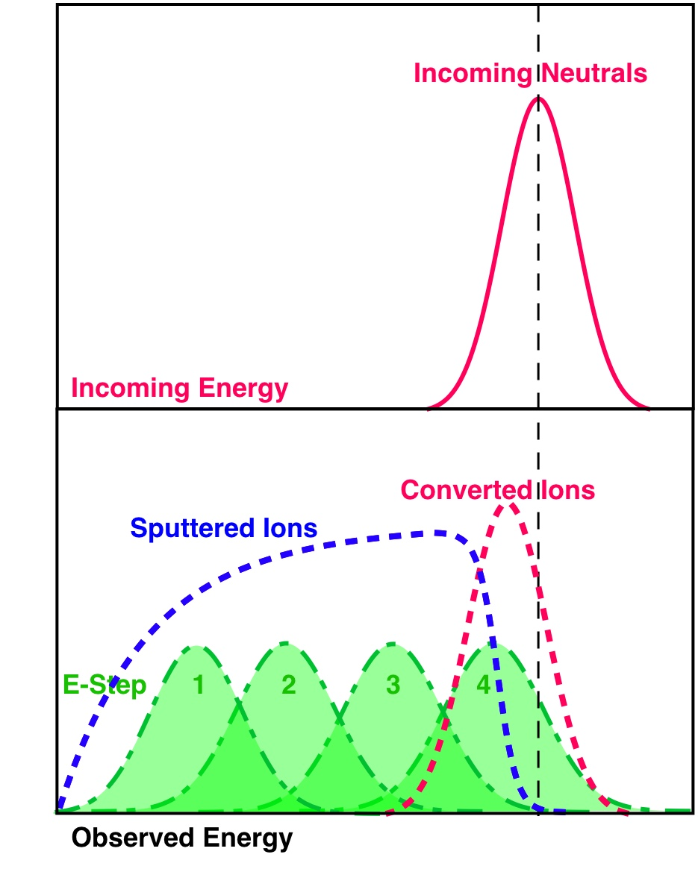
Energy Distribution of Sputtered H⁻ Ions
In contrast to
Atom-Negative Ion Conversion Sputtering produces
a broad Energy Distribution with a sharp Cut-Off
For He (E_{ISN} = 120 – 140 eV) over E1-3 with Cut-off at E4
Changes in E_{ISN} for He
shift Sputtered Ion Distribution across E-Steps
→ Compare Ratios of Rates normalized to ISN Flow E_{i}/E_{ISN}
IBEX-Lo Energy Steps

Slide 12
IBEX-Lo Efficiency Variation
Using He ISN Flow as constant source of known bulk Energy
IBEX-Lo Relative Efficiencies largely independent of E_{ISN}
With U_{PAC} = 7kV, noticeable difference for E-Step 4 (110 keV)
Notes:
As long as we stay away from substantial Secondary He contributions (at small ecl.l,ongitudes) and ISN H contributions at large longitudes, the relative efficiencies remain the same within a few % (measurement uncertainties) from 2013 through 2017. The calibration curve only changed with the IBEX-Lo PAC voltage.
PAC voltage affects the collection of sputtered particles, especially in the low energy steps. Important for secondary He observations!

Slide 13

IBEX-Lo Efficiency Variation
Use 2013 – 2018 data
and 2009-10 data
Except for early Orbits (affected by Secondary He)
and late Orbits
(affected by ISN H)
all 2013-18 and all 2009-10 ratios arrange on a curve
Results can be used as
Relative Calibration Curves
Calibration different for U_{PAC} =16 kV & U_{PAC} =7 kV
Possible with IMAP:
→ Finer Energy Coverage
→ Large Range of Input E_{ISN}
Notes:
As long as we stay away from substantial Secondary He contributions (at small ecl.l,ongitudes) and ISN H contributions at large longitudes, the relative efficiencies remain the same within a few % (measurement uncertainties) from 2013 through 2017. The calibration curve only changed with the IBEX-Lo PAC voltage.
PAC voltage affects the collection of sputtered particles, especially in the low energy steps. Important for secondary He observations!

Slide 14
ISN Peak as Function of
Observation Energy
Fit Results at Sun-Pointing
λ_{Peak} for E2 slightly below (but within Error Bars)
and for E4 noticeably above
that for E3
→ consistent
with Efficiency Variation
Sputter Efficiency appears constant in E-Step 3
→ Use this E-Step next

Slide 15
ISN Peak as Function of Pointing
E-Step 3
Increasing Elongation from Sun → λ_{Peak} to larger Longitude

Slide 16
ISN Peak Elongation (ε_{E})
As a Function of Ecliptic Longitude
For 2013-18 we can go
up to ε_{E} = 5º
Comparison with Simulated Variation
of λ_{Peak} with longitude:
Reasonable match
without any corrections
ε_{E} = 5º
Variation in Elongation simulated
for λ_{ISN∞} = 75.6º V_{ISN∞} = 25.46 km/s

Slide 17
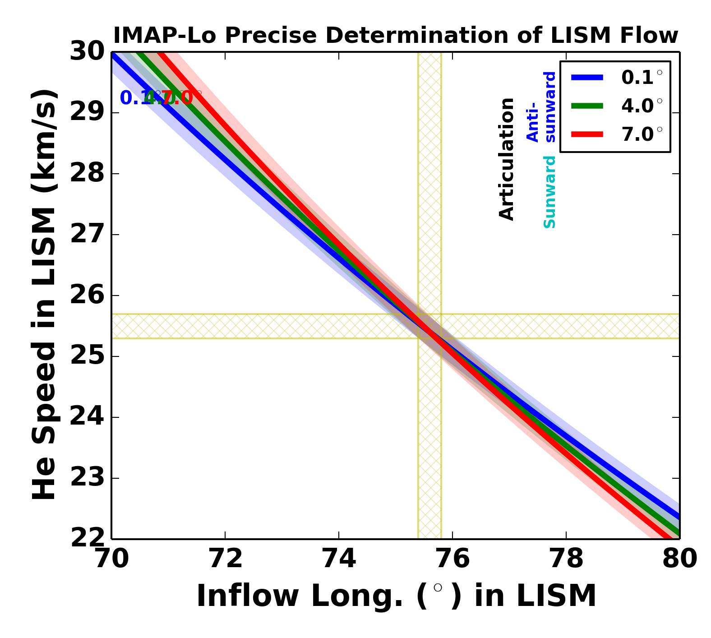
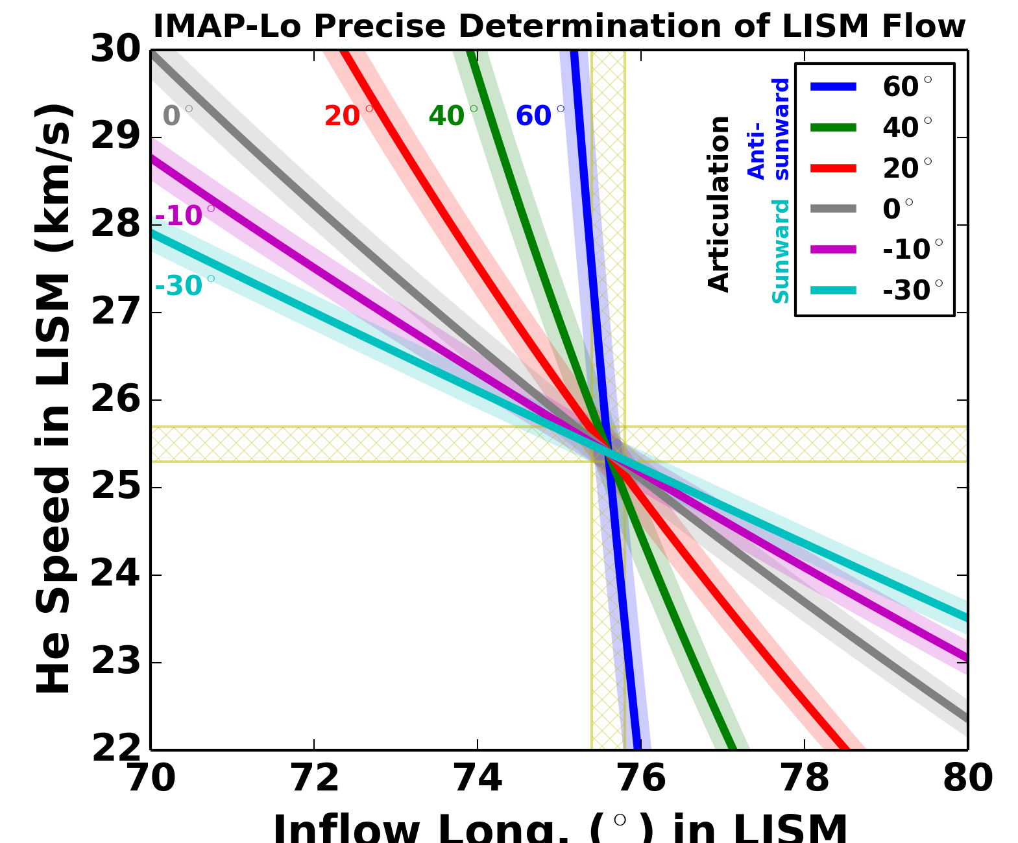
ISN Peak Elongation (ε_{E}) with IMAP-Lo Pivot Platform
Viewing λ_{Peak} at different Elongation
Equivalent to crossing
“ISN Parameter Tubes”
Based on technical constraints IBEX Extension only to ε_{E} ≈ ±7º
IMAP-Lo will be on a Pivot Platform
→ Allows tracking of the ISN
almost at all longitudes
→ Substantial reduction of Errors
→ Boosts collection of D, O & Ne
→ Tomography of Secondary ISN
Also includes PUI Observations!
IBEX-Limit
IMAP-Lo
Notes:
Summarize different drivers for breaking “Degeneracy:”, include PUI-Cut-Off here

Slide 18
Conclusions & Outlook
IBEX Viewing of ISN Flow near Perihelion at 1 AU leads to 4-D ISN Parameter Tube; eg V∞, β∞, T(λ∞)
Drivers that Break the IBEX Degeneracy
1) Latitude Peak Variation with Observer Longitude
2) Latitude Width Variation with Observer Longitude
3) Longitude Peak as Function of Elongation from Sun
1) & 3) have been used as Standalone Methods
All Drivers contribute to full χ² Optimization
Analysis performed for ISN He in all 4 E-Steps
→ E-Dependent Efficiency – Constant in E3 (55 eV)
Because of IMAP keep Sun-Pointing → Time Evolution
Full Range available with IMAP-Lo Pivot Platform!

Slide 19
Questions?

Slide 20
Method to Obtain ISN Flux as Function of Ecliptic Longitude
Spin-Integrated Rate as Function of Longitude
Each Orbit (ISN Good Times) in E-Step 1-4 (15-110 eV)
χ² Fit to obtain Rate at ISN Flow Perihelion
- At Sun-Pointing of Spin Axis, corrected for S/C Velocity
and at selected ε_{E} from Sun-Pointing (up to 5º)
as in Möbius et al. (2012) & Leonard et al. (2015)
- Linear Fit → tests more consistent than quadratic
Transform Flux to Phase Space Density
Correct for Ionization
Subtract He Secondary component (Kubiak et al. 2016)
Notes:
Add Fig. 2 from paper

Slide 21
Determination of the ISN Peak in Phase Space Density (PSD)
To obtain the location
of the ISN Bulk Velocity
the Peak in PSD is needed
IBEX observes the ISN Flux at 1 AU as a function
of Spin Angle and Longitude
Shown is the Expected Phase Space Distribution

Slide 22
Determination of the ISN Peak in Phase Space Density (PSD)
IBEX observes the ISN Flux
at 1 AU as a function
of Spin Angle and Longitude
Shown is the Expected
Phase Space Distribution
Transformation of Spin Integrated
Rate to PSD affected by
- 1 Speed Variation, 2 Ionization
& 3 E-Dependent Efficiency
4 Secondary He affects
the Peak Location in Opposite Direction
1, 2 & 4 are of the same Order

