Slide 1
Effects Of the Solar Cycle
on the Interstellar Hydrogen Signal
F. Rahmanifard, A. Galli, N. Richards, N. A. Schwadron, E. Möbius, H. Kucharek, M. Bzowski, P. Wurz, D. Heirtzler, M. A. Lee, J. M. Sokół, I. Kowalska-Leszczynska, M. A. Kubiak,S. A. Fuselier, and D. J. McComas

Slide 2
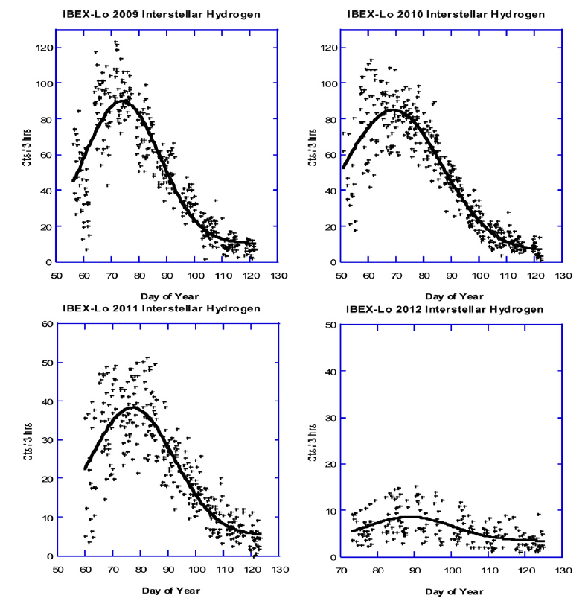
Interstellar Hydrogen (ISH) Trajectory – Early Observations
2009
2010
2011
2012
Adapted from Möbius et al. (2012)
IS Neutrals have the same bulk speed
Their energy scales with their mass
Bent toward the Sun
H atoms slower due to radiation pressure
H atoms might be diverted outward
Saul et al. (2013)
Signal drops off in 2012 to near background levels
H Peak moves to larger Longitude with Solar Activity
2

Slide 3
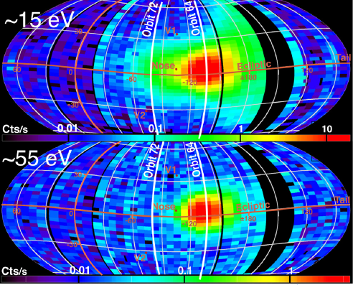
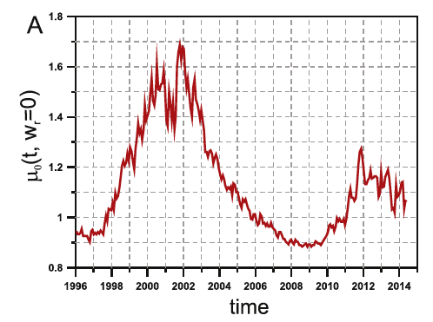
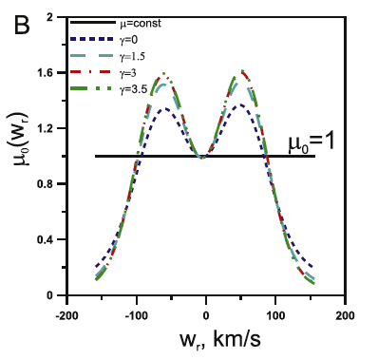
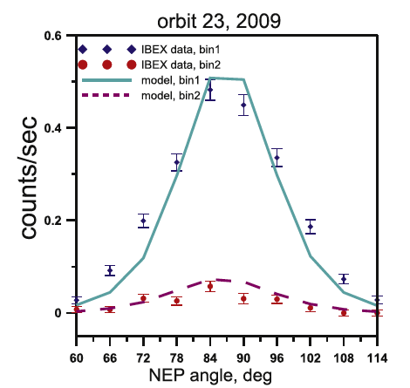
ISH Parameters Based on Early Observations
ESA1
ESA3
Katushkina et al. (2015):
Used global self-consistent kinetic-MHD model of the heliospheric interface.
Found parameters of the primary and secondary particles at 90 AU.
Used their model inside 90 AU, separately for primary and secondary particles.
Schwadron et al. (2013)
Count rate in ESA 3 (ISN He) peaks in orbit 64
Count rate in ESA 1 (ISN H and He) is broader
ISN H peak occurs in orbit 72
Schwadron et all performed a chi-square analysis to find the solar radiation pressure and ISN H parameters.
μ₀ = 1.26
β = 3.7x10⁻⁷ s⁻¹
γ = 3.5
χ² = 6.82
3

Slide 4
aFINM - ISH Primary and Secondary - IBEX Data Sensitivity
We used Analytical Full Integration Model (aFINM), which is:
limited to the boundaries of the heliosphere
Stationary, Axisymmetric (using averaged values for ionization and radiation parameters)
Based on consevation of energy (using radiation pressure as a conservative force)
Primary and secondary ISH parameters are adopted from Bzowski et al. work (based on He parameters).
Charge-exchange rates are from Bzowski et al. [2013] work.
Photoionization values are from Sokół et al.
Since the distribution peak of the ISN H falls between the two energy channels, its signal is very sensitive to the variation of solar parameters and calibration coefficients of the instrument.
4

Slide 5
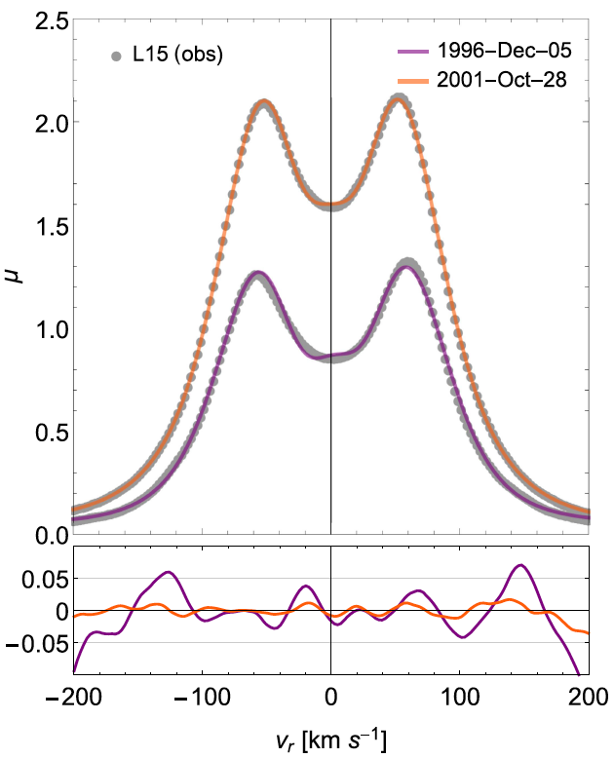
Radiation Pressure dependence on Radial Velocity and Time
ISN H atoms travel through the Heliosphere for ~ 20 years.
Radiation pressure variations with time and radial velocity can be essential to this problem.
Since F_{rad} is proportional to 1/r² only in the last year/months of their travel ISN H atoms feel this force.
V_{r} drops dramatically close to 1 AU.
Kowalska-Leszczynska et al. (2018)
5

Slide 6
Radiation Pressure dependence on Radial Velocity and Time
A hypothetical H atom that starts from x=100 AU and y=-1 AU with v_{x}=- 20 km/s and v_{y}=0 in 1998
far from the Sun:
Temporal variations of μ not significantly affect the negligible net force
Radial velocity remains constant
H atom travels on a straight line
Close to the Sun:
Net force becomes large enough to reflect the temporal variations of μ
Radial velocity drops to zero
μ₀ can be a good approximation for μ
ISN H trajectory can be approximated by a hyperbola

Slide 7
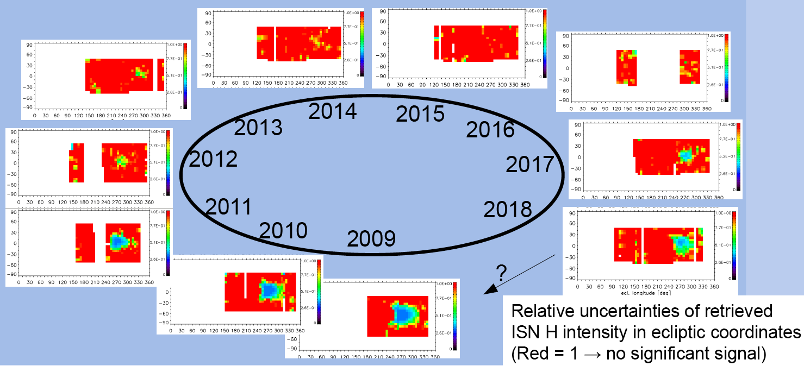
ISN H Disappearance and Re-appearance with Solar Cycle
Galli et al. (2018)
6

Slide 8
ISH Signal Peak Longitude Varies with Time
2011
The peak longitude (λ_{peak}) of the ISH signal for each season was obtained from a chi-square fit of the data to a Gaussian.
We found the radiation parameter for which, the aFINM results and observed ISH signal peak at the same longitude.
7

Slide 9
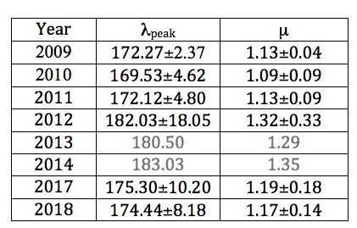
ISH Signal Variations With Solar Cycle
results for sector 14 (latitude = 84-90 deg)
λ_{peak} increases from 2009 to 2012
In 2013 and 2014 we have too few data points with values above statistical zero to be fit to a Gaussian distribution using chi-square analysis
In 2015 there is almost no non-zero data point
2016 is excluded from ISH analysis because of the different energy stepping of IBEX-Lo
In 2017 and 2018 the signal is back and its λ_{peak} shows a decrease as expected
8

Slide 10
Conclusions
We showed how radiation pressure affects the ISN H signal peak as a function of solar activity over the course of an almost full solar cycle.
These results can be expanded to other sectors.
In this analysis we focused on ESA1 data.
Open question: All model predict a larger flux to be seen in ESA2 than in ESA1. The continuing issue may be correctable by improving the energy response functions for Hydrogen. This is planned work for the immediate future.
9

Slide 11




Modeling the Radiation Pressure
Kowalska-Leszczynska et al. (2018)
10

Slide 12
Radiation Pressure dependence on Radial Velocity
To examine the effect of radial dependence of F_{rad}:
An individual H atom moving under F_{g} and F_{rad}, once using 2012 (solar maximum) and once using 2017 (solar minimum) profile, trajectory and v_{r} are plotted:
Solar Maximum
Solar Minimum
11

Slide 13
Radiation Pressure dependence on Radial Velocity
To add the time variability:
we used profiles from 1998 to 2018
F and v_{r} behave as in a constant radiation pressure case until close to 1 AU
At ~ 1 AU the the atom sees the force field in 2017 and acts as in the solar minimum case with mu <1
12

Slide 15
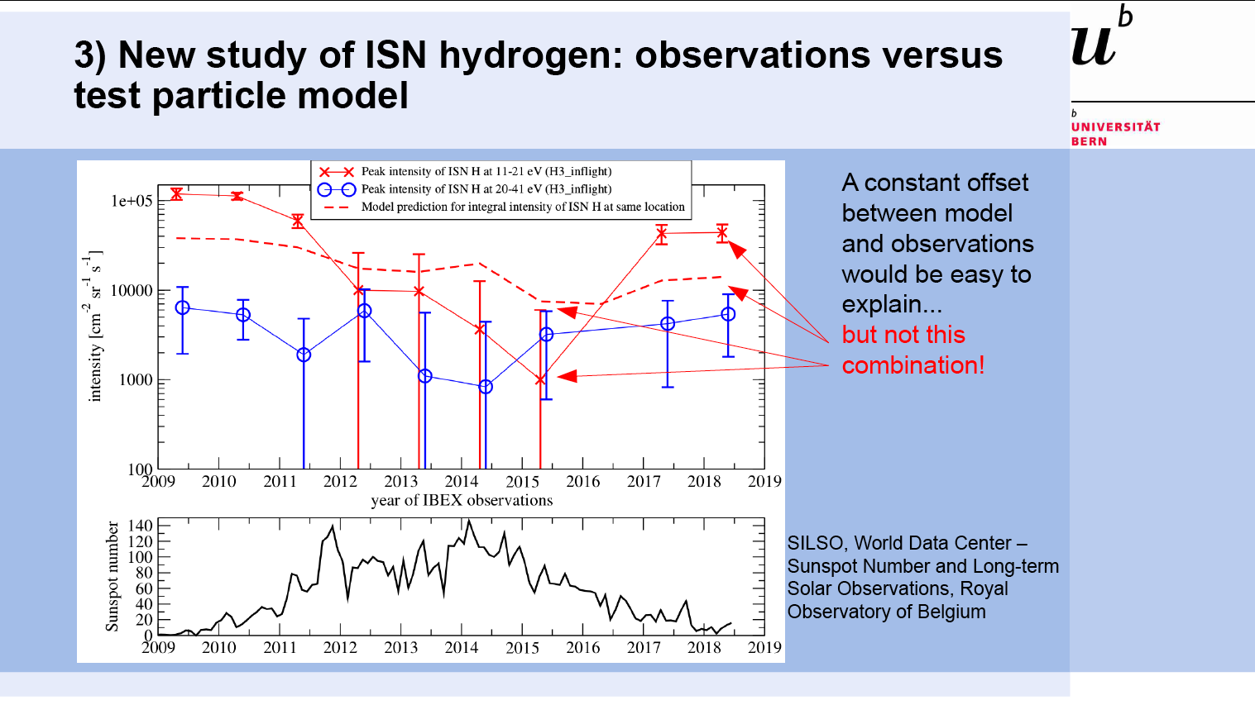
13

Slide 16
ISH parameters (Bzowski et al.):
n_{pri} = 0.030 cm⁻³
T_{pri} = 7443 K
v_{pri} = 25.784 km/s
λ_{pri} = 255.745 deg
ϕ_{pri}= 5.169 deg
n_{sec} = 0.054 cm⁻³
T_{sec} = 16300 K
v_{sec} = 18.744 km/s
λ_{sec} = 251.57 deg
ϕ_{sec} = 11.95 deg
14

Slide 17
1) [Bzowski et al., A&A 326, 497, 396,1997]
(2) due to the fact that the slowest H atoms are not able to reach 1 AU since the overcompensating radiation pressure diverts them out earlier.

