Slide 1
Predicting the ENAs from the “Croissant” Heliosphere
Marc Kornbleuth
NESSC Meeting 27
November 19, 2018

Slide 2
Collaborators
Dr. Merav Opher, Boston University
Adam Michael, Boston University
Dr. James Drake, University of Maryland

Slide 3
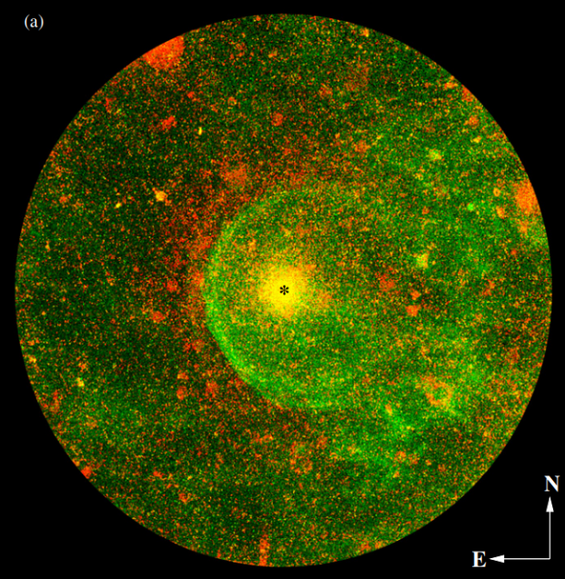
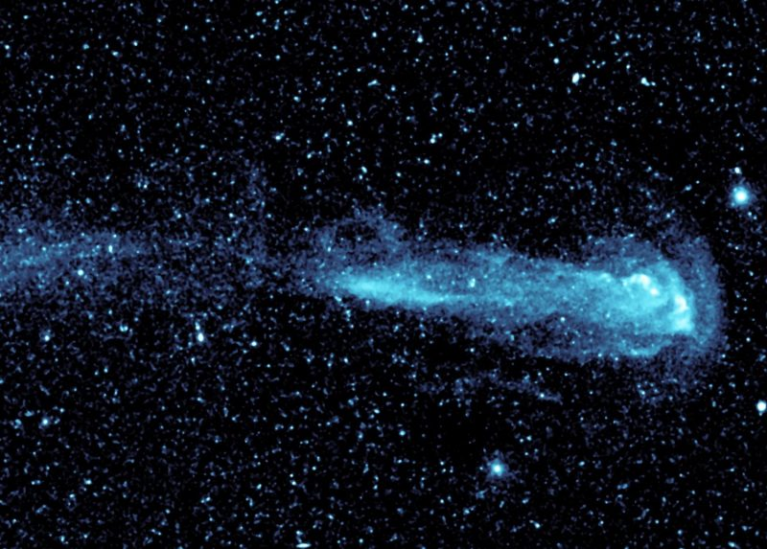
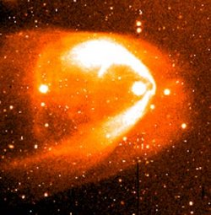
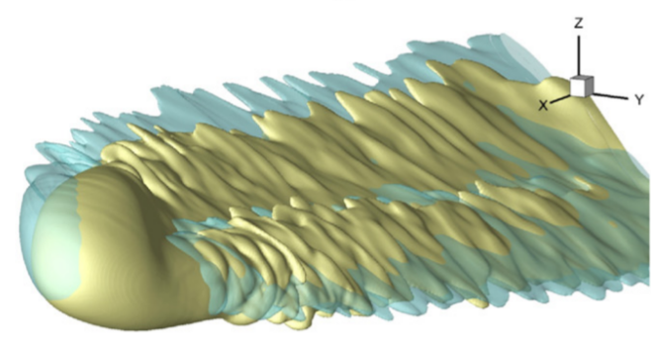
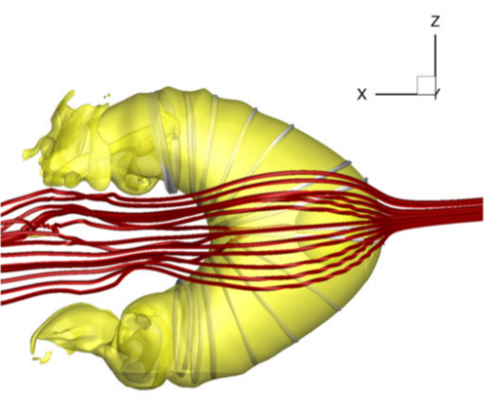
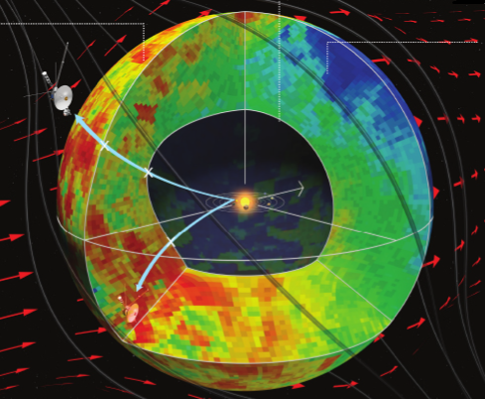
Views of the Heliosphere
IRC+10216 (GALEX UV)
Sahai & Chronopoulos (2010)
Mira
GALEX UV
BZ Cam
Casalegno, Conselice, et al.
Dialynas et al. (2017)
Pogorelov et al. (2015)
Opher et al. (2015)

Slide 4
Features of the “Croissant” Heliosphere
Collimation of the solar wind plasma
Turbulence
Opher et al. (2015)
Notes:
Turbulence leads to mixing

Slide 5
ENA Modeling of the “Croissant”
Partition Total Thermal Energy at Termination Shock (Zank et al. 2010):
Ratios at nose from Malama et al. (2006):
Vary PUIs along Termination Shock:
Include Extinction along Streamlines (Zirnstein
et al. (2017):
Kornbleuth et al. (2018)
Notes:
Locally created not included

Slide 6
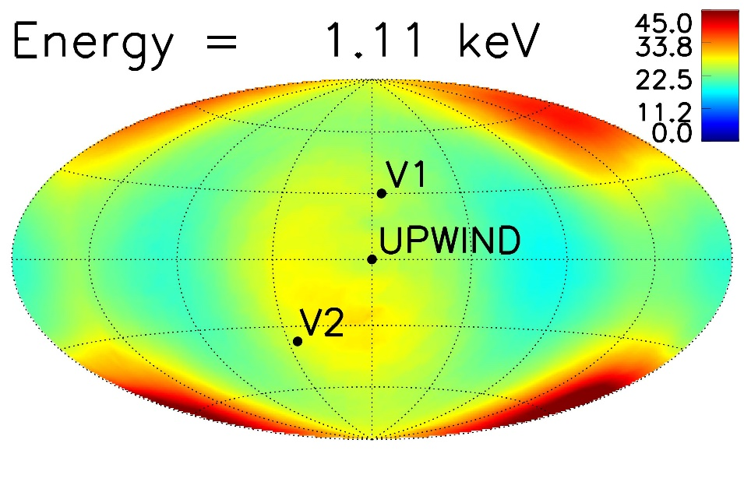
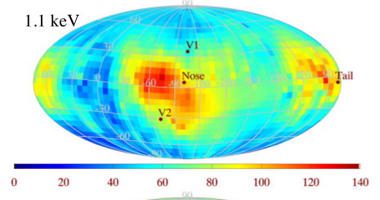
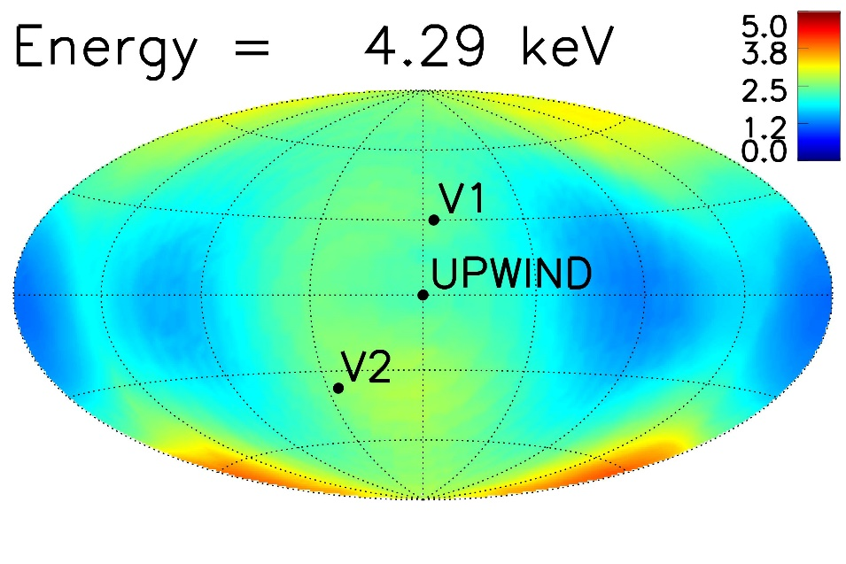
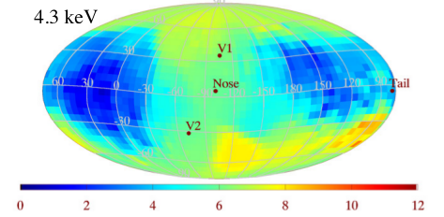
ENA Modeling of the “Croissant”
Maps from Schwadron et al. (2014)
Using IBEX Data
Maps from Kornbleuth et al. (2018)
Using “Croissant” Heliosphere
Notes:
Uniform Solar Wind

Slide 7
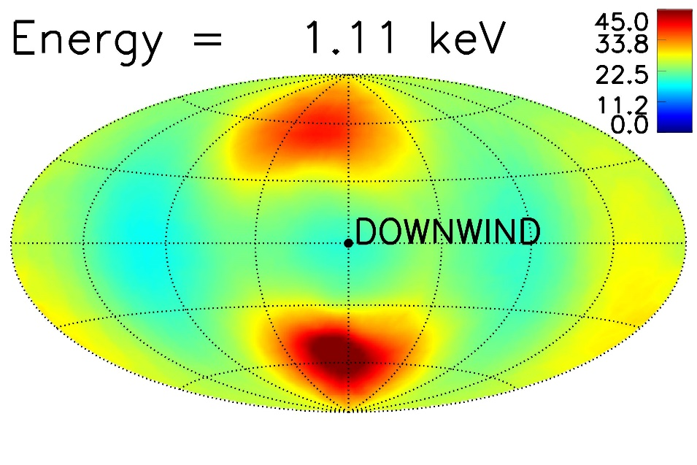
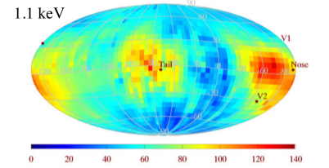
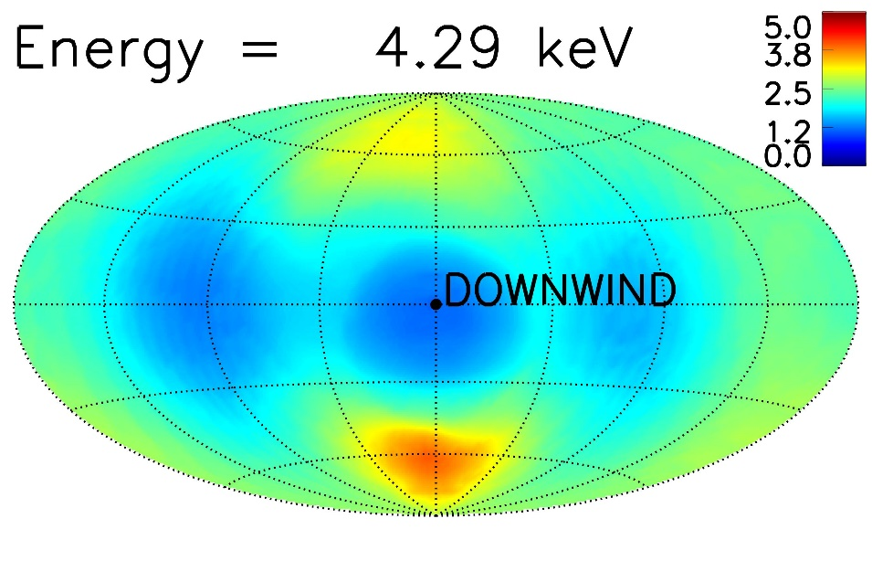
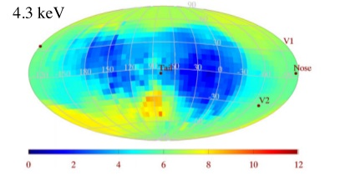
ENA Modeling of the “Croissant”
Maps from Schwadron et al. (2014)
Using IBEX Data
Maps from Kornbleuth et al. (2018)
Using “Croissant” Heliosphere

Slide 8
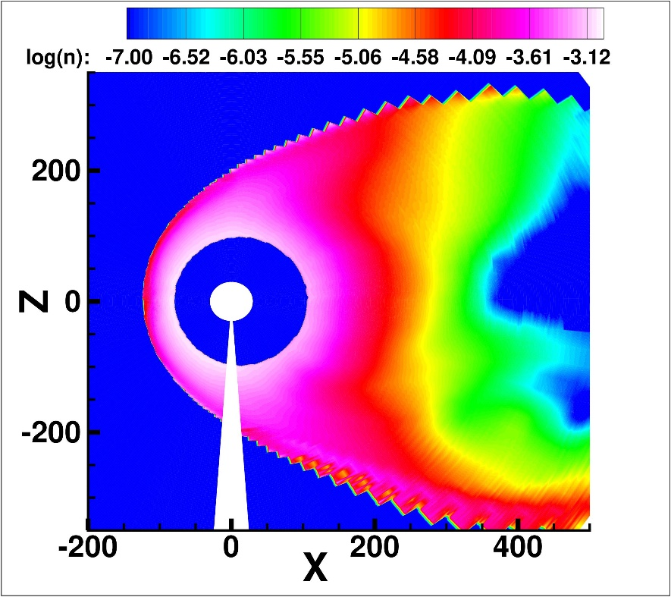
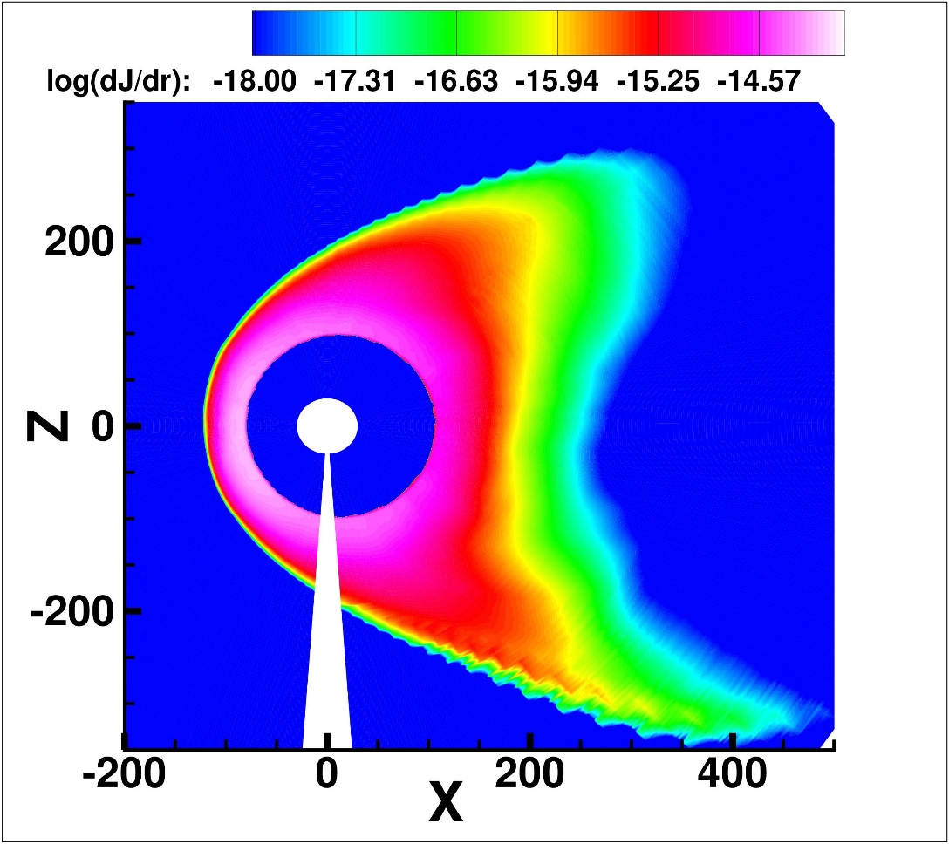
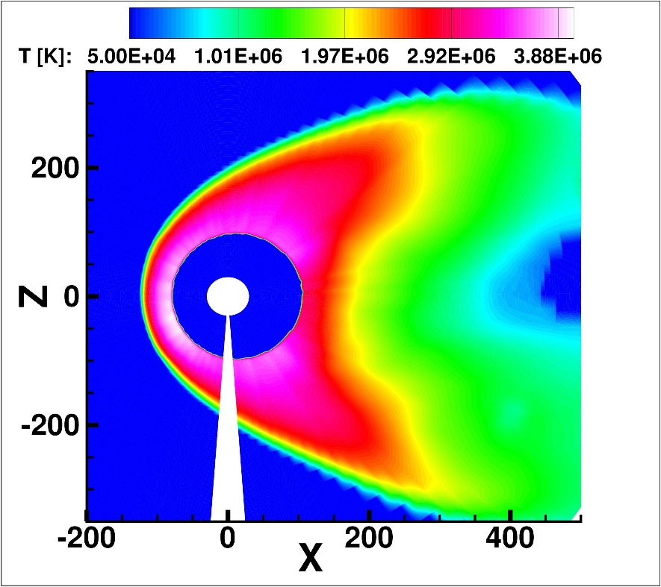
ENA Modeling of the “Croissant”
Kornbleuth et al. (2018)
Notes:
4 keV Meridional

Slide 9
Material Between the Lobes
X=1000 AU Plane
Michael et al. (2018)

Slide 10
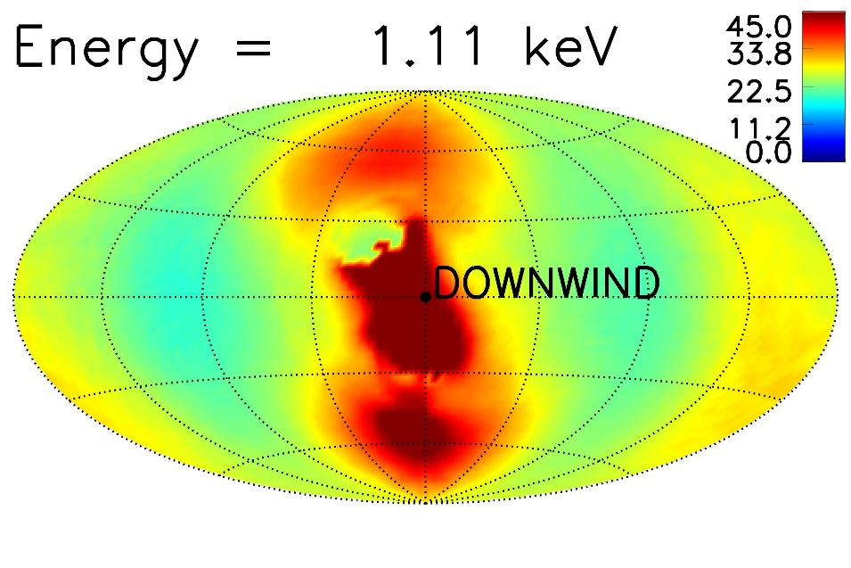
ENA Modeling of the “Croissant”
Not Including Region Between the Lobes
Map from Schwadron et al. (2014)
Including Region Between the Lobes
Kornbleuth et al. (2018)
Notes:
15% np
10Tp

Slide 11
Effect of Fast/Slow Wind
Uniform Solar Wind (@30 AU):
$$n_{SW}=8.74 × {10}^{−3} {cm}^{−3}$$
$$v_{SW}=417 km/s$$
Latitudinally Varying Solar Wind (@30 AU):
Provornikova et al. (2014)

Slide 12
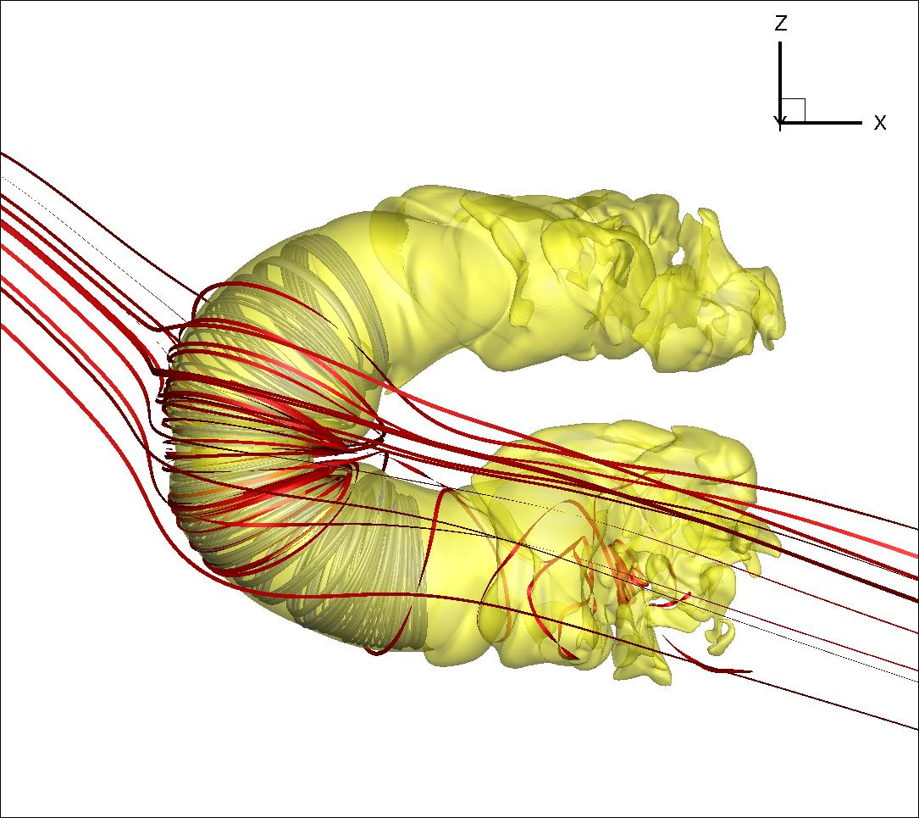
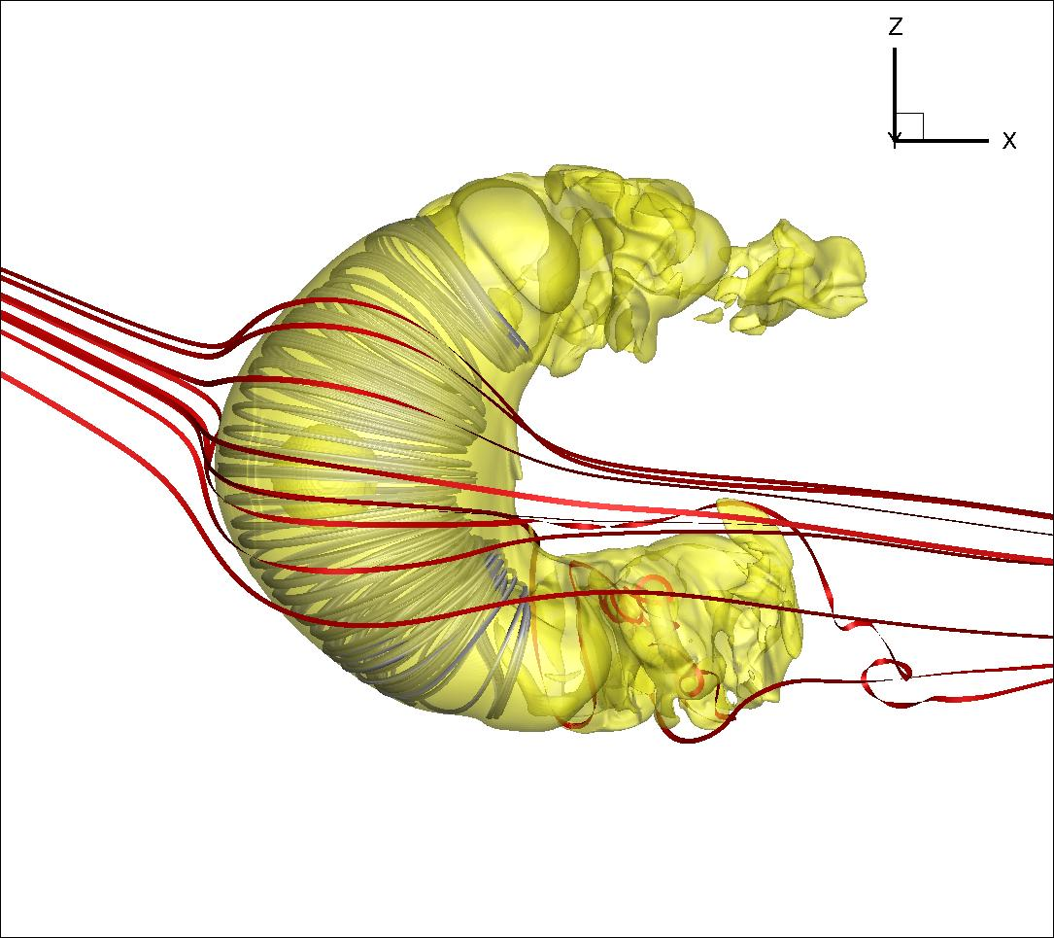
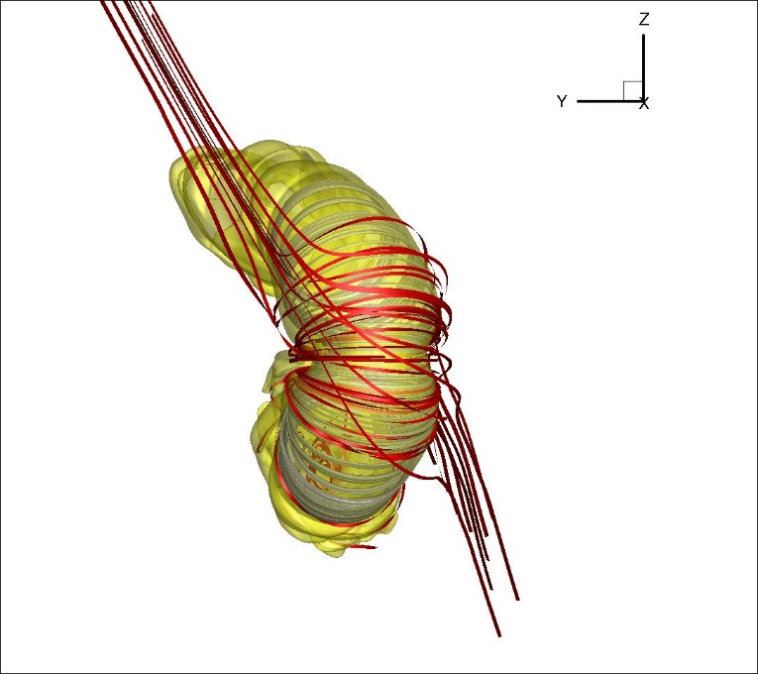
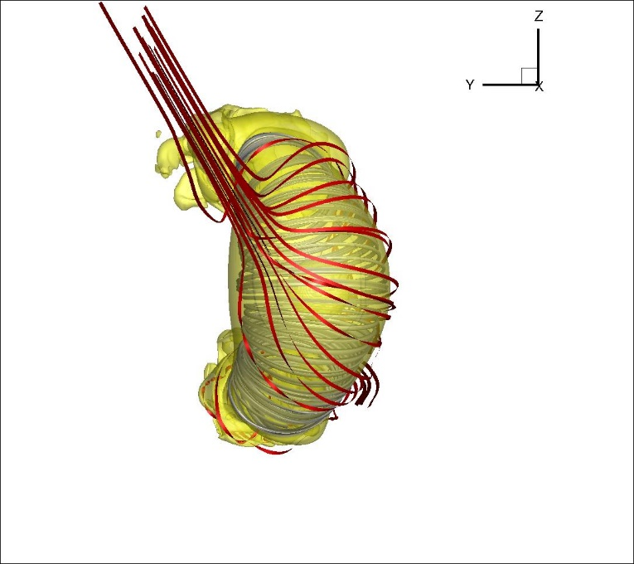
Fast/Slow Wind
Uniform Wind
Notes:
Thinner heliosphere @ low lats

Slide 13
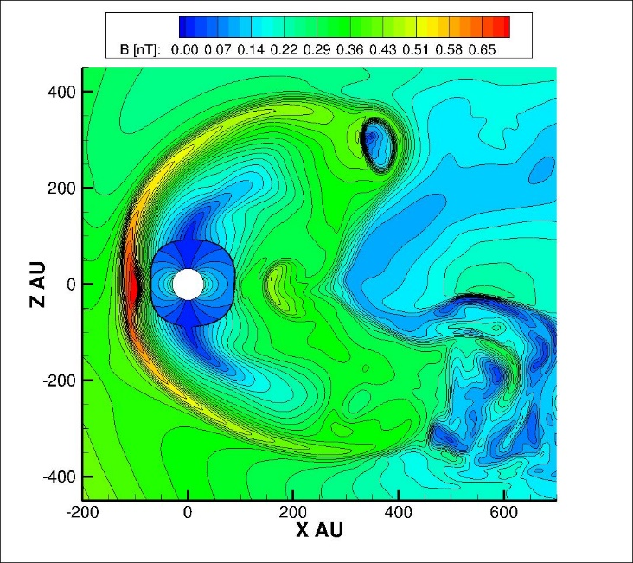
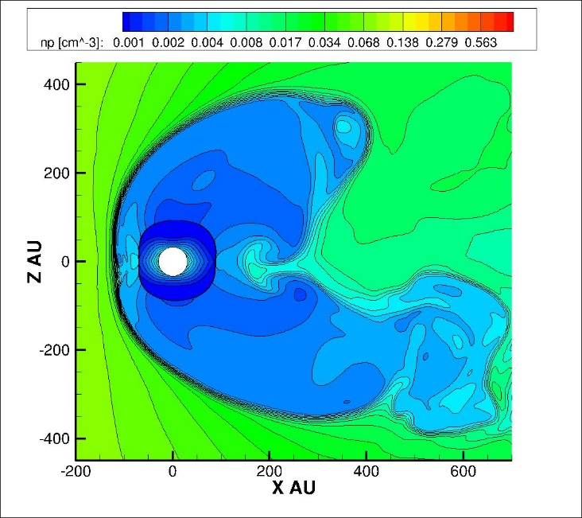
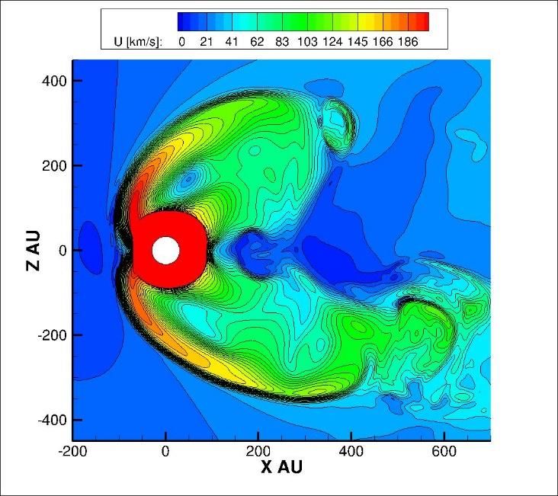
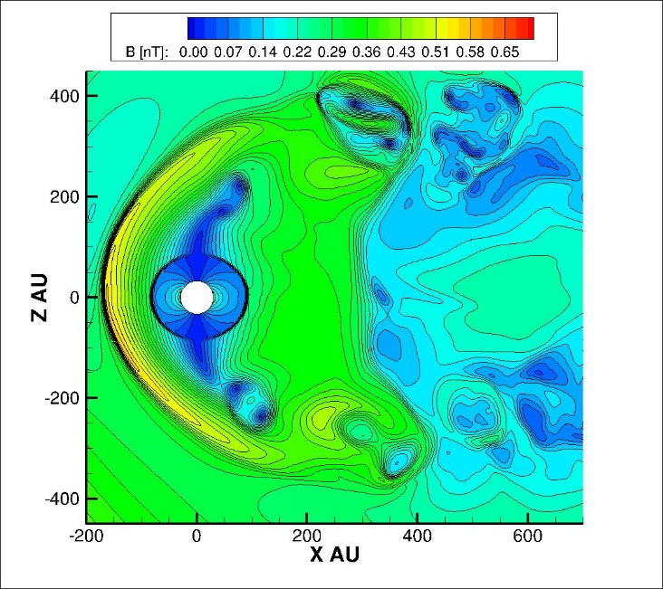
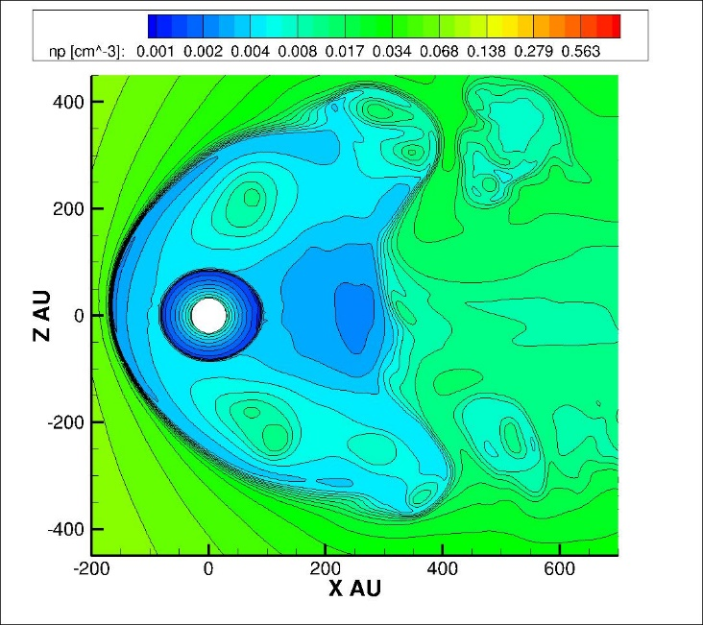
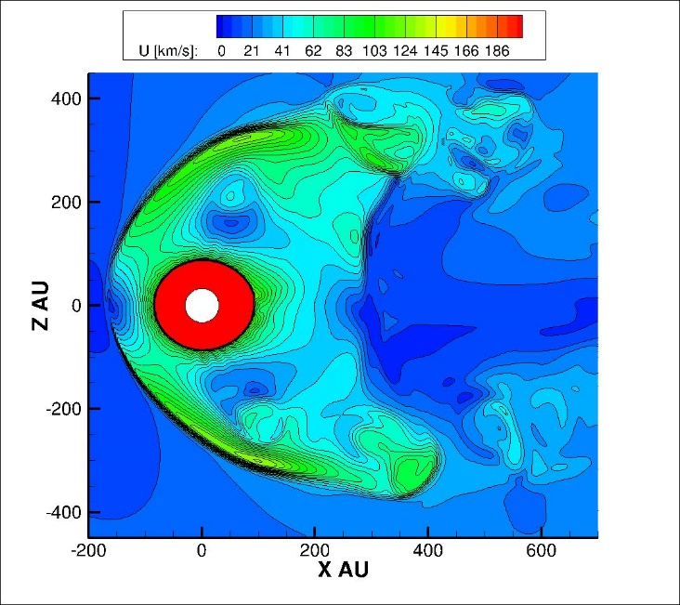
Latitudinally Varying Solar Wind; Meridional Plane
Uniform Solar Wind; Meridional Plane

Slide 14
Conclusions
Collimation in “Croissant” Heliosphere leads to an increase in ENA flux at high latitudes in the tail direction
Inclusion of material between the lobes leads to an increase in low latitude heliotail signal in ENA maps
Incorporating a latitudinally-varying solar wind yields a thinner heliosphere at low latitudes
Next step: model ENA maps for latitudinally-varying solar wind and incorporate time dependence

Slide 15
Termination Shock Comparison

