Slide 1
The OH-PT Model
A Kinetic-MHD Model of the Outer Heliosphere
Adam Michael
NESSC Meeting 27
11/19/2018
Collaborators: Dr. M. Opher, Dr. V, Tenishev, Dr. G. Toth, and Dr. D. Borovikov

Slide 2
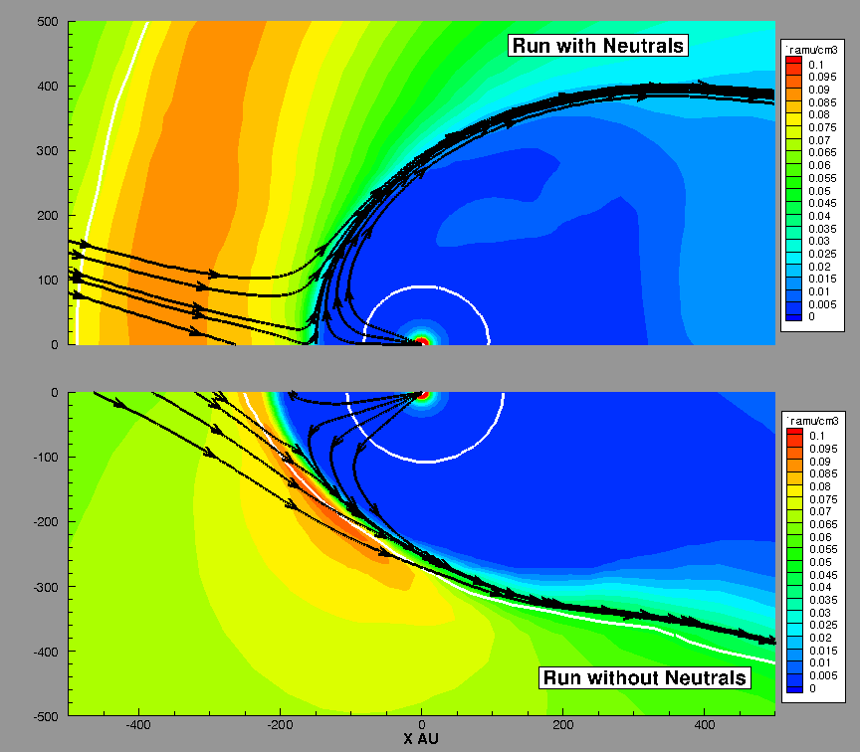
Importance of Neutral Hydrogen
HP
V_{LISM}
TS
Z AU
TS
HP
Baranov & Malama 1993 & Zank et al. 1996

Slide 3
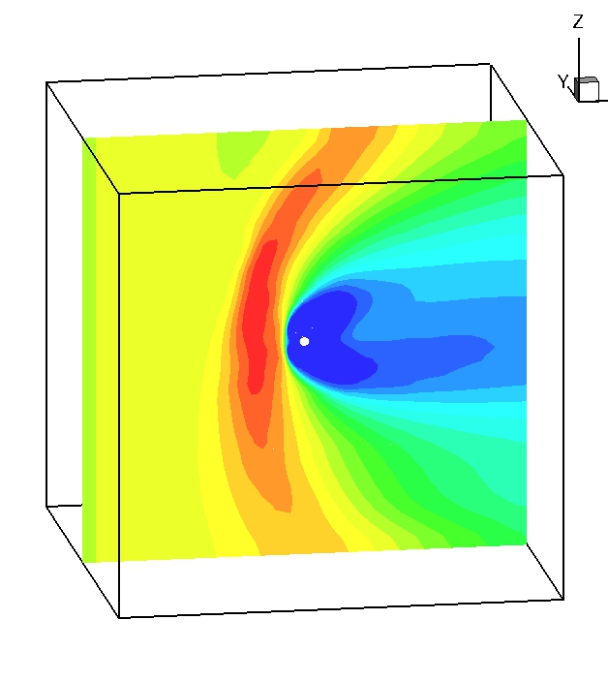
Outer Heliosphere Model
3D multi-fluid ideal magnetohydrodynamic (MHD) simulation
  Based on BATS-R-US solver within the Space Weather Modeling Framework (SWMF)
    Opher et al. 2003, Toth et al. 2012
Single plasma fluid
  Pick up ions assimilated immediately into the solar wind
Four-fluid approximation for interstellar neutral hydrogen
  Supersonic solar wind
  Heliosheath
  ISM in between bow shock and heliopause
  Pristine ISM
4
3
1
Inflow
2
3000 AU
Notes:
Treat plasma as a fluid that responds to E and M forces

Slide 4
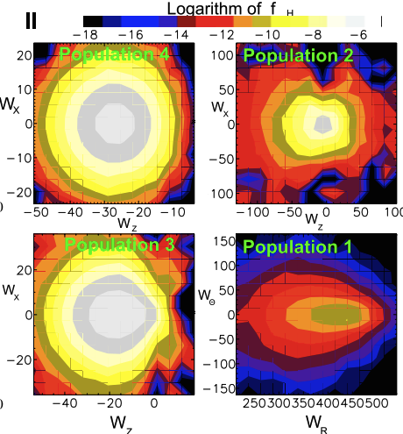
Problem with the Fluid Approximation
Velocity Distribution Functions
Originally described neutrals as a separate fluid(s)
Mean free path of neutrals through the heliosphere ~100 AU
  Izmodenov et al. (2000)
On scale of heliosphere: dominant interaction for neutrals is charge-exchange
Izmodenov et al. (2009)

Slide 5
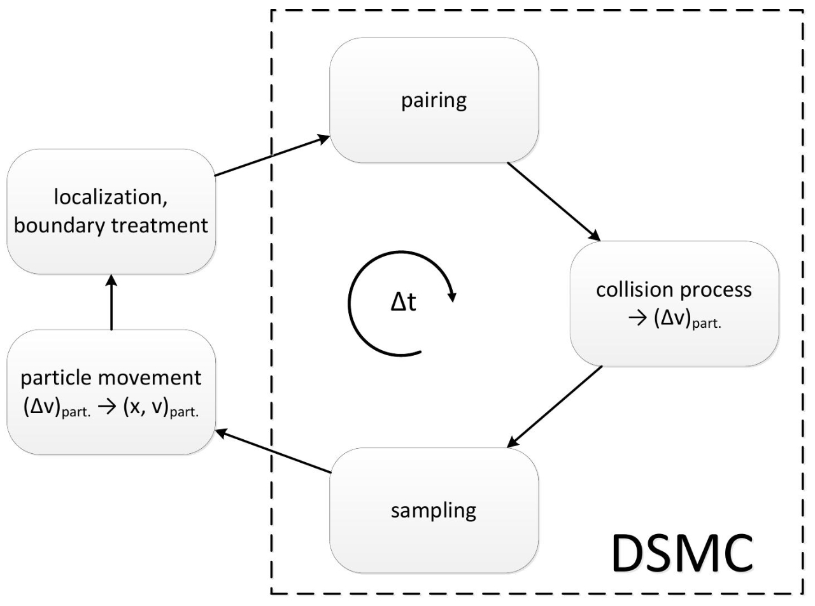
Modeling the Neutrals Kinetically
  Has bee done using Direct Simulation Monte Carlo (DSMC) models
Solves the Boltzmann Equation
  Does not assume a Maxwellian Distribution Function
  The flow is modeled by the movement of simulation particles
DSMC model Schematic
Credit: M. Pfeiffer
Notes:
It is a method for computing the motion of neutral flows directly using simulation particles instead of solving fluid conservation equations
The DSMC method models fluid flows using simulation molecules which represent a large number of real molecules in a probabilistic simulation to solve the Boltzmann equation. Molecules are moved through a simulation of physical space in a realistic manner that is directly coupled to physical time such that unsteady flow characteristics can be modeled
Solves the neutrals kinetically without assuming anything about their distribution function (unlike a fluid, naturally)
Need to apply this to outer heliosphere where there is no neutral neutral collision and no force acting on them (travel on straight lines) just need charge-exchange

Slide 6
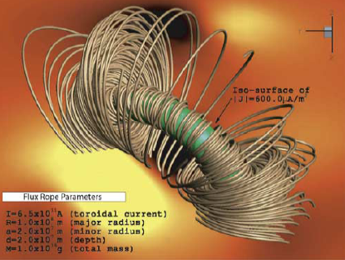
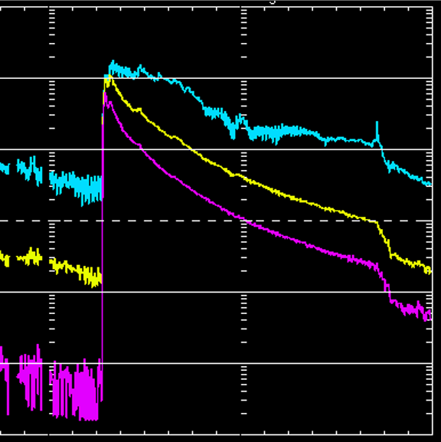
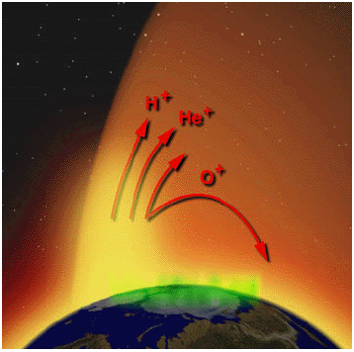
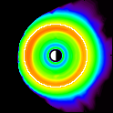
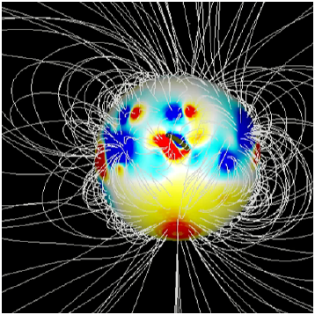
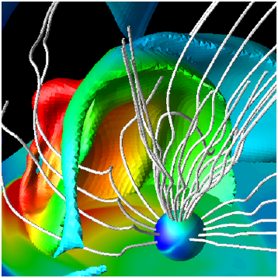
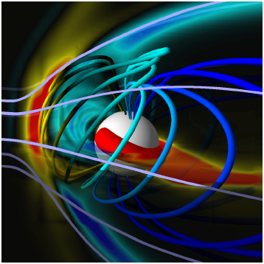
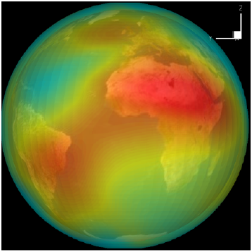
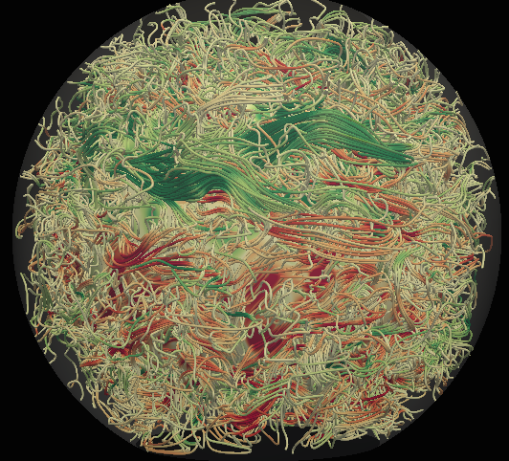
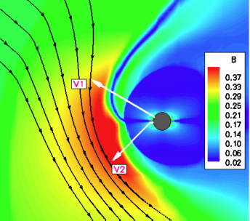
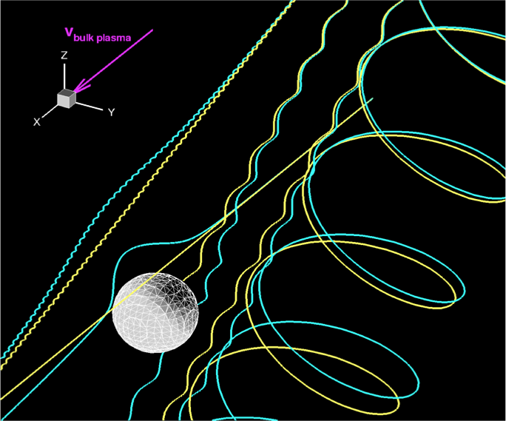
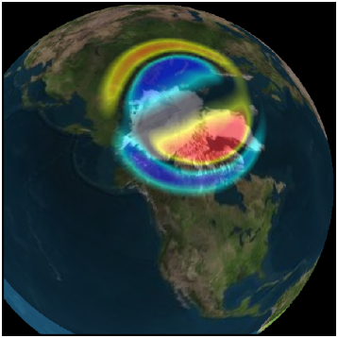
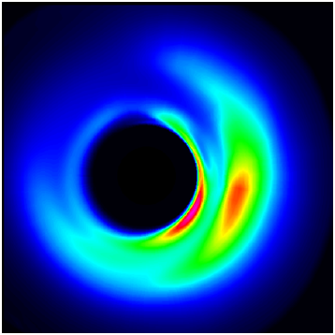
SWMF
The Sun-Earth system consists of many different interconnecting domains that are independently modeled traditionally
The framework incorporates physics models with minimal changes.
The framework can be extended with new models and components.
Compiles coupled codes into a single executable that runs both simultaneously
Flare/CME
Observations
Upstream
Monitors
SWMF Control & Infrastructure
Eruption
Generator
Radiation
Belts
Solar
Energetic
Particles
Particle in Cell
Polar Wind
Inner
Heliosphere
Magneto-grams,
rotation tomography
Couplers
F10.7 Flux
Gravity
Waves
Solar Corona
Global
Magnetosphere
Thermosphere
& Ionosphere
3D Outer
Heliosphere
Particle
Tracker
Inner
Magnetosphere
Convection
Zone
Ionospheric
Electrodynamics
Radars
Magnetometers
In-situ
Image Credit: Gabor Toth
Notes:
A software framework is a universal, reusable software environment that provides particular functionality (Wikipedia)
The Sun-Earth system consists of many different interconnecting domains that are independently modeled traditionally.
Each physics domain model is a separate application, which has its own optimal mathematical and numerical representation.
Our goal is to integrate models into a flexible software framework.
The framework incorporates physics models with minimal changes.

Slide 7
SWMF
PT Component
Based on the code – Adaptive Mesh Particle Simulator (AMPS)
  A global 3D DSMC model (Tenishev 2008)
Solves the Boltzmann Equation
Non-equilibrium dusty gas flow of ions and neutrals
  Comets, planetary satellites and exospheres
  Includes particle collisions and chemistry
The Sun-Earth system consists of many different interconnecting domains that are independently modeled traditionally
The framework incorporates physics models with minimal changes.
The framework can be extended with new models and components.
Compiles coupled codes into a single executable that runs both simultaneously
Flare/CME
Observations
Upstream
Monitors
SWMF Control & Infrastructure
Eruption
Generator
Radiation
Belts
Solar
Energetic
Particles
Particle in Cell
Polar Wind
Inner
Heliosphere
Magneto-grams,
rotation tomography
Couplers
F10.7 Flux
Gravity
Waves
Solar Corona
Global
Magnetosphere
Thermosphere
& Ionosphere
3D Outer
Heliosphere
Particle
Tracker
Inner
Magnetosphere
Convection
Zone
Ionospheric
Electrodynamics
Radars
Magnetometers
In-situ
Image Credit: Gabor Toth
Notes:
AMPS has photo-ionization and photo-dissociation and 3 different molecular and collisional models

Slide 8
OH-PT Model
Determines when and where charge exchange will occur for each neutral particle
n_{p}, v_{p,} B, T_{p}
Plasma
Neutrals
Solves for the global distribution of the the plasma
Generates an ENA from the local plasma distribution
Outer Heliosphere
BATS-R-US (MHD)
Particle Tracker
AMPS (Monte Carlo)
S_{ρ}, S_{ρv}, S_{ε}
Calculates the source terms to the MHD equations as done by Malama (1991)
Notes:
The OH-PT model couples the BATS-R-US solution for the plasma with the AMPS kinetic solution of the neutrals to form a self-consistent model of the heliosphere. Every time the components are coupled, BATS-R-US passes the plasma parameters to AMPS. The charge-exchange process occurs within AMPS which handles which handles each event on a particle by particle basis, as done by Malama (1991). AMPS calculates the charge exchange rate using the charge exchange cross section between a proton and a neutral hydrogen from Lindsay & Stebbings (2005) and determines when and where an atoms will undergo charge exchange. When an event occurs, AMPS selects a random proton from the local plasma distribution and creates an energetic neutral atom (ENA) with the same properties as well as calculate the loss of momentum and energy to plasma. The source terms to the continuity, momentum, and energy equations of the plasma are a sum of individual events over a period of time that occur in each cell. AMPS then passes the source terms back to BATS-R-US and are used to update the corresponding continuity, momentum, or energy equation.

Slide 9
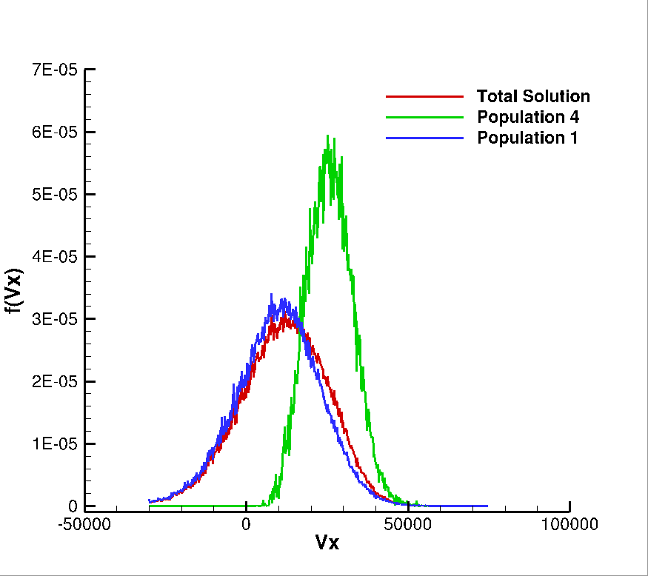
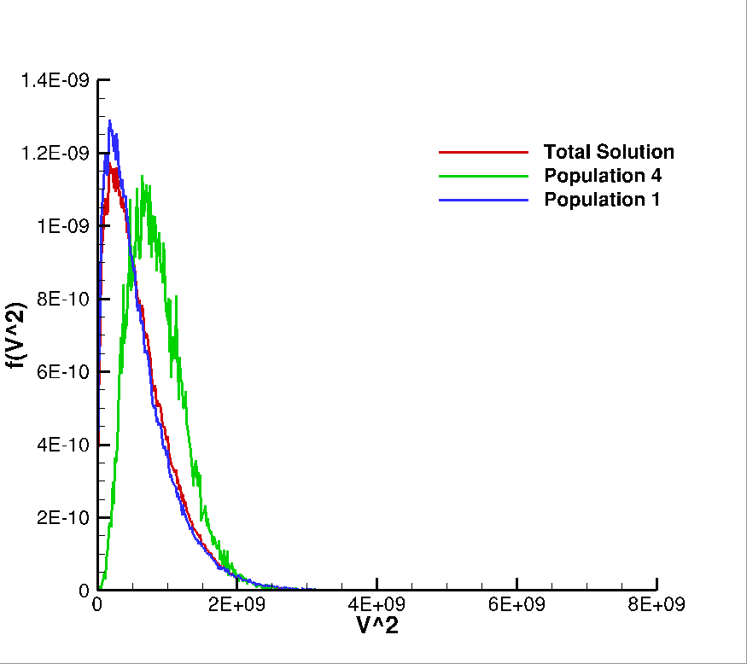
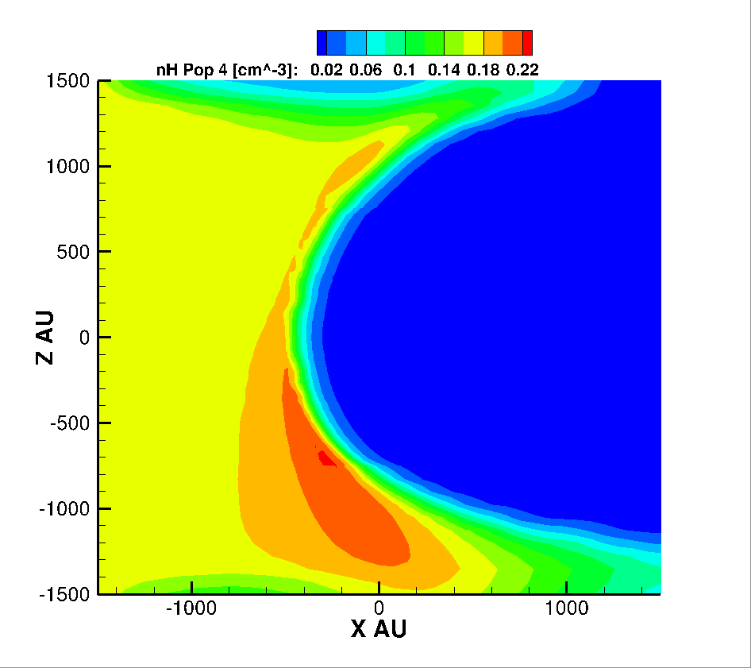
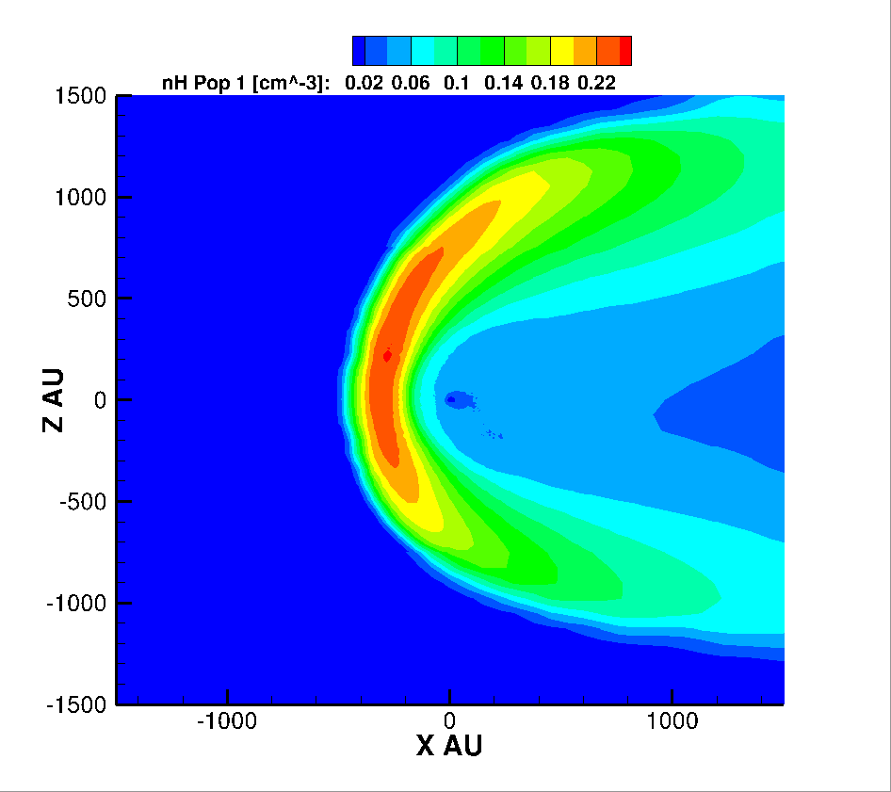
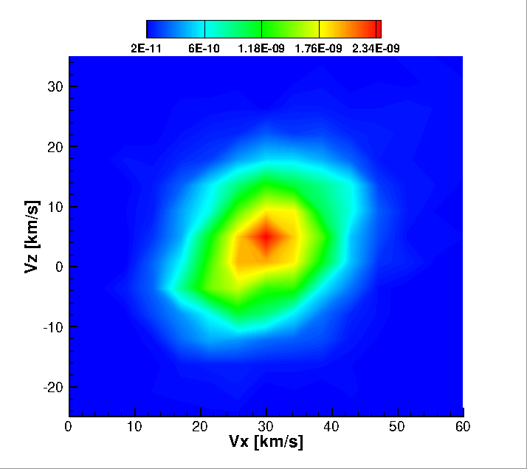
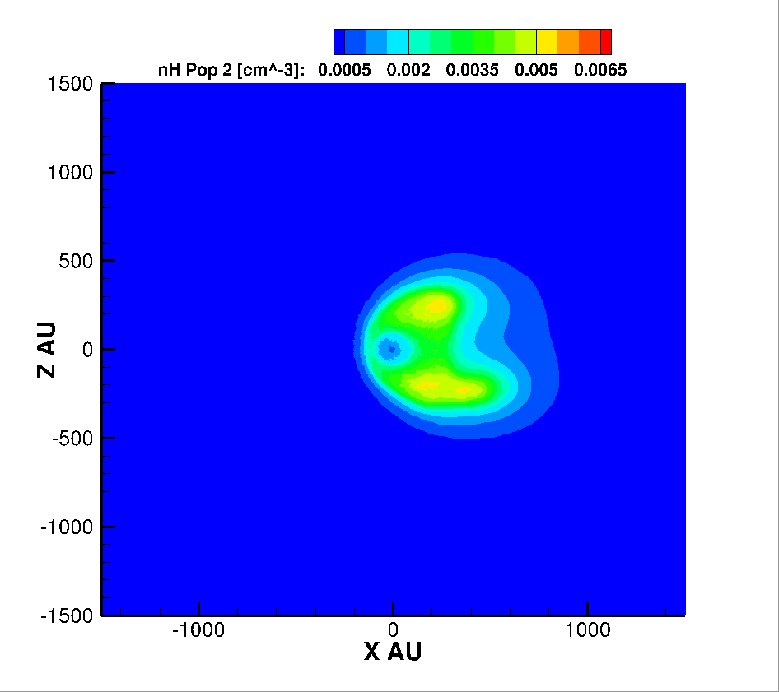
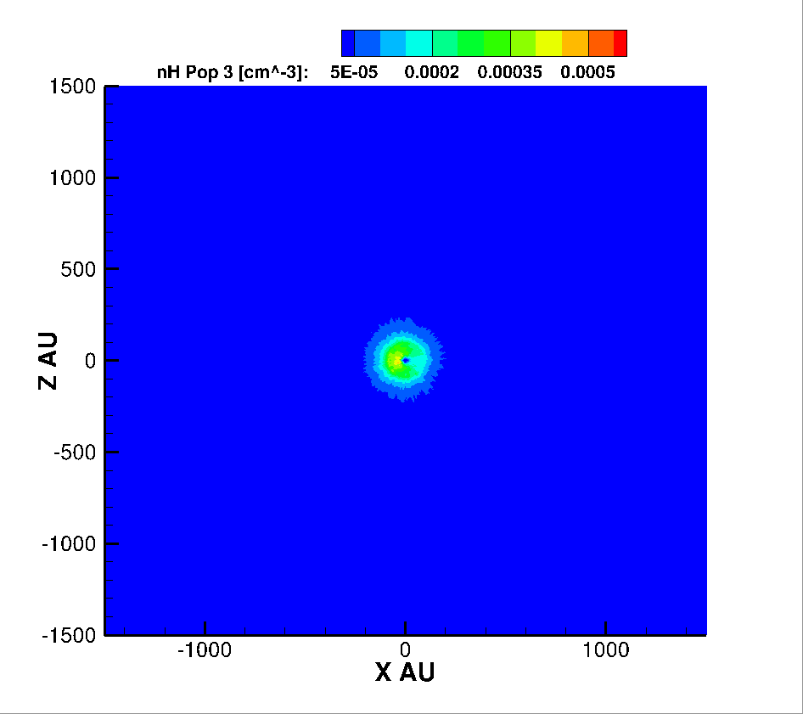
Model Capabilities
Single plasma fluid
AMPS can model just under 1 billion test particles within the domain
  Can also run the code in hybrid mode to model even more particles
Tag each neutral depending on where it was created (4 populations)
Can model up to 4 energy bins of nH
  Useful to make ENA maps
Can produce 1D distribution functions and velocity distribution functions
  At any location
  For total solution and by population
ISM
Disturbed ISM
HS
Supersonic SW
Notes:
OH output is exactly the same as previous model

Slide 10
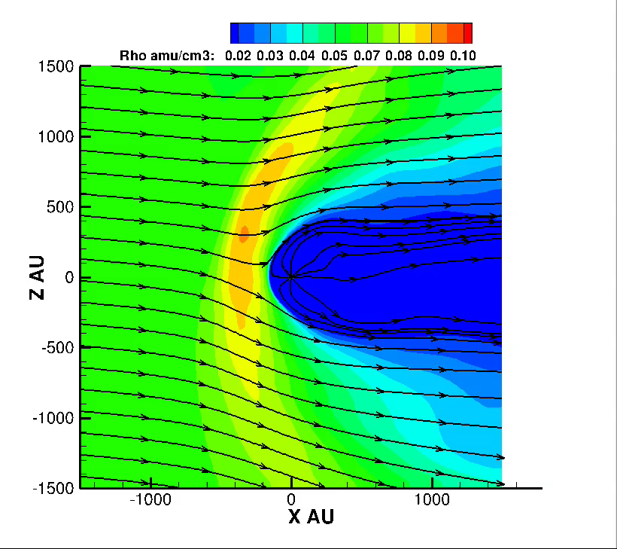
Model Run

Slide 11
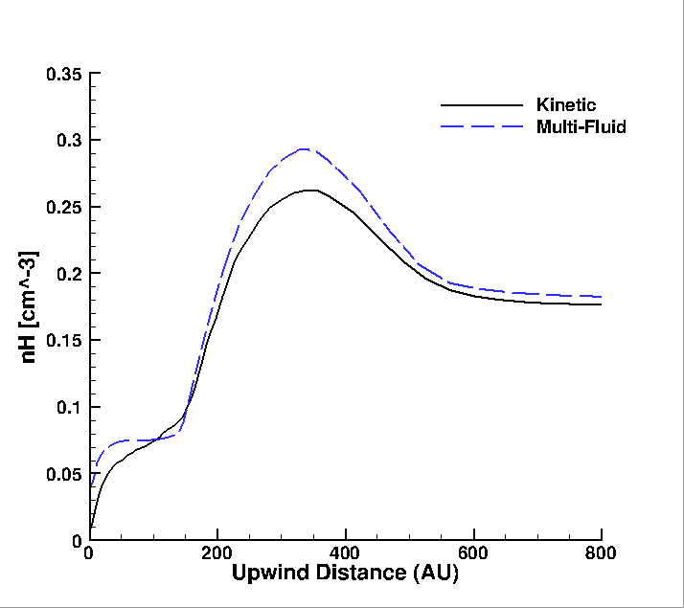
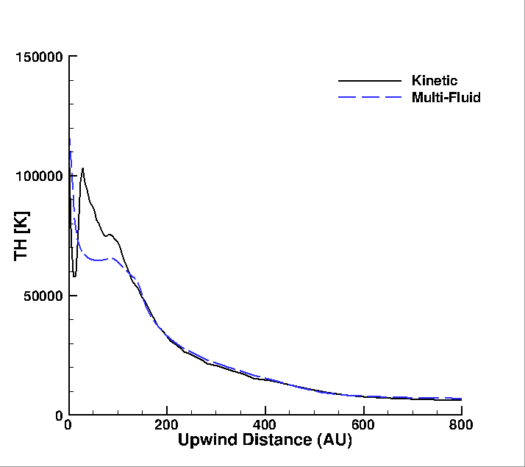
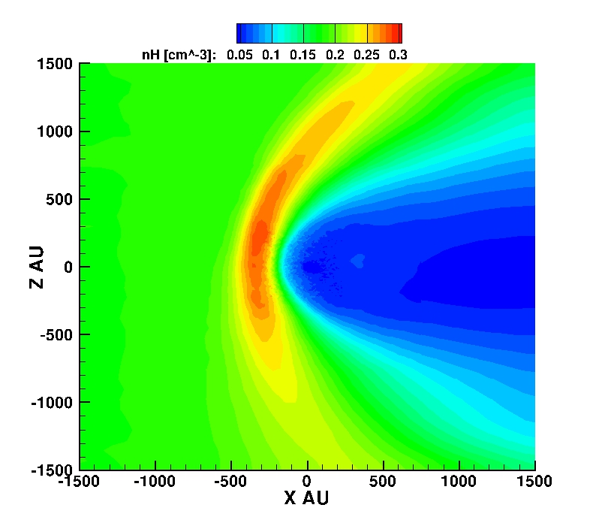
Calibration & Comparison to Multi-Fluid Model
OH-PT Model
n_{H}
T_{H}
Inner Heliosphere
1D Cuts
Hydrogen Wall
n_{H}
T_{H}
Kinetic
4 Neutral Fluids
From
Alexashov & Izmodenov (2005)
Notes:
No data with which to calibrate, V1V2 don’t measure the neutrals
Also can compare 1D cuts of each population to see how they evolve with distance

Slide 12
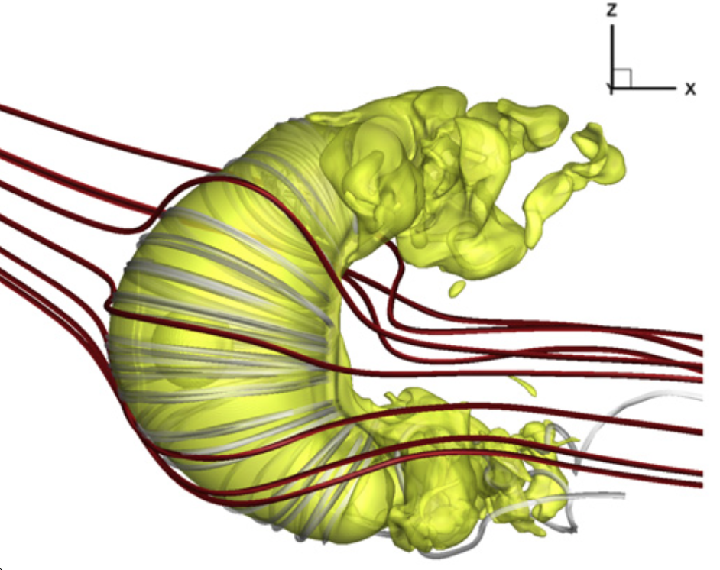
Future Directions for the OH-PT Model
Test how the kinetic neutrals affect the shape of the heliosphere
Provides a much more accurate neutral solution from which we can compare to the ENA maps of IBEX
Long term: Extend the OH-PT model to describe the plasma as two fluids – thermal solar wind and pick up ions (PUIs)
Even Longer term: Allow AMPS to model the PUIs kinetically
Opher et al. (2015)

Slide 13
Extra Slides

Slide 14

Impact of Neutrals on the Plasma
ISM
neutral
SW ion
Pick-up
ion
Energetic Neutral
Atom
V_{H}=25 km/s
V_{p}=500 km/s
V_{p}=25 km/s
V_{H}=500 km/s
Continuity Eq.
S_{n} ~ ∆n/t = 0
Momentum Eq.
S_{p} ~ ∆(mv)/t
Induction Eq.
Energy Eq.
S_{E} ~ ∆(1/2mv²)/t

Slide 15
Parallel Layout and Execution
LAYOUT.in for 20 PE-s
SC/IH GM IM/IE
ID ROOT LAST STRIDE
#COMPONENTMAP
SC 0 9 1
IH 0 9 1
GM 10 17 1
IE 18 19 1
IM 19 19 1
#END
Credit: Gabor Toth

Slide 16
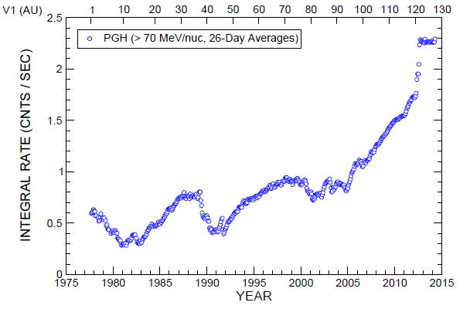
Cosmic Ray Diffusion in the HS
Cosmic Ray measurements at Voyager 1
Galactic cosmic rays (GCRs) - highly energetic charged particles that permeate the ISM
Harmful to us
  Damaging to satellites
  major obstacle to long term human spaceflight
75% of GCRs entering the heliosphere are shielded by the HS
The heliosphere is a shields >75% of the cosmic rays from the Milky Way
Heliosheath
Credit: Ed Stone
Notes:
GCRs are high energy particles that persist throughout the Galaxy, higher energy than the CRs generally in the solar system, particles could remove particles from the atmosphere and destroy spacecraft and satellites, very harmful to humans
Therefore important to study the Solar wind magnetic field in the HS
Like to think of us as both data rich, with the high resolution data that we have from the V1&V2, and data poor since we only have them in two directions with much of the hleiosphere with no insitu data. We are not only the boundary of the solar system but potentially the boundary between space physics and astronomy, therefore we use numerical models to help us understand the environment

Slide 17
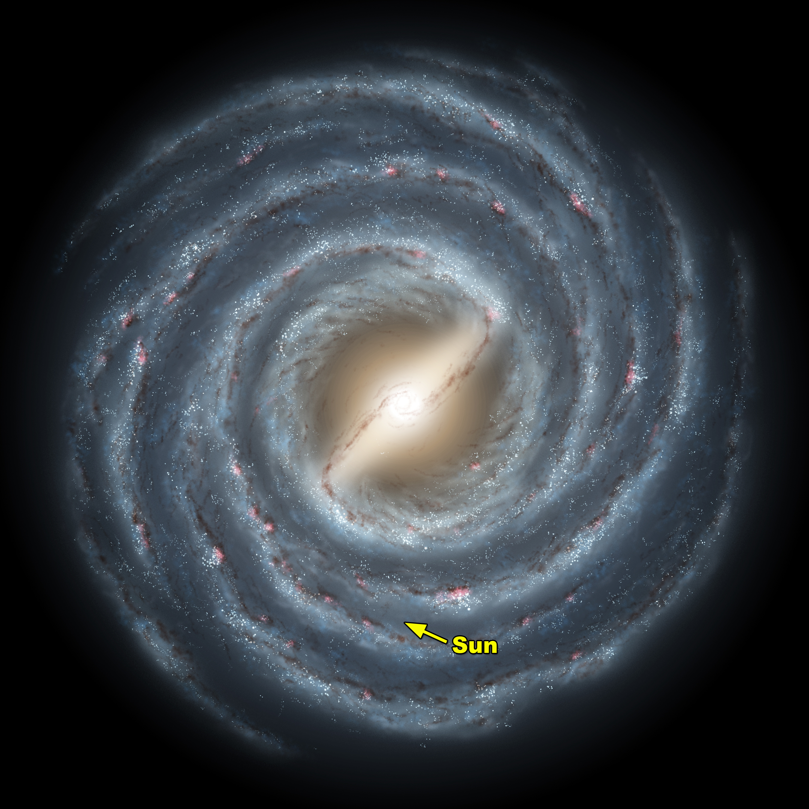
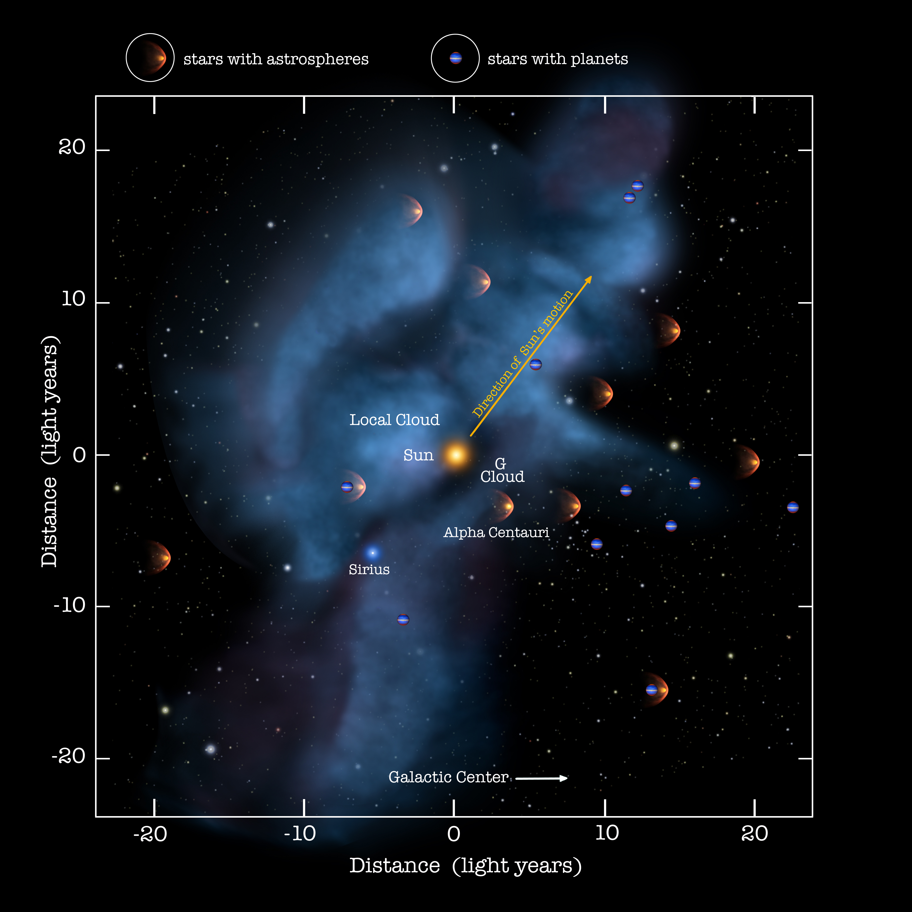
The Interstellar Wind
Image credit: Seth Redfield
Notes:
like all stars, the Sun moves through partially ionized ISM. on the left shows the sun’s location in the MW while the right is a blow up of the local vicinity around the sun. As the sun moves through the ISM at 26 km/s it creates a “wind”. This interstellar wind interacts with the SW and forms the heliosphere.
The very sparse, hot gas of the Local Bubble is the result of supernovae that exploded within the past ten to twenty million years, 300 light years across, we have been moving through it for the last five to ten million years

