Slide 1
Low-Frequency Magnetic Waves due to Interstellar (and Other) Pickup Ions
Charles W. Smith
University of New Hampshire
Charles.Smith@unh.edu
New England Space Science Consortium, Nov. 19, 2018

Slide 2
I’ll Focus on Four Very Recent Papers
Argall et al., Observation of Magnetic Waves Excited by Newborn Interstellar Pickup He+ Observed by the Voyager 2 Spacecraft at 30 AU, The Astrophysical Journal, 849, 61 (2017). (Erratum: The Astrophysical Journal, 854, 77 (2018).)
Hollick et al., Magnetic Waves Excited by Newborn Interstellar Pickup Ions Measured by the Voyager Spacecraft From 1 to 45 AU. I. Wave Properties, The Astrophysical Journal, 863, 75 (2018).
Hollick et al., Magnetic Waves Excited by Newborn Interstellar Pickup Ions Measured by the Voyager Spacecraft From 1 to 45 AU. II. Instability and Turbulence Analyses, The Astrophysical Journal, 863, 76 (2018).
Hollick et al., Magnetic Waves Excited by Newborn Interstellar Pickup Ions Measured by the Voyager Spacecraft From 1 to 45 AU. III. Observation Times, The Astrophysical Journal Supplement, 237, 34 (2018).

Slide 3
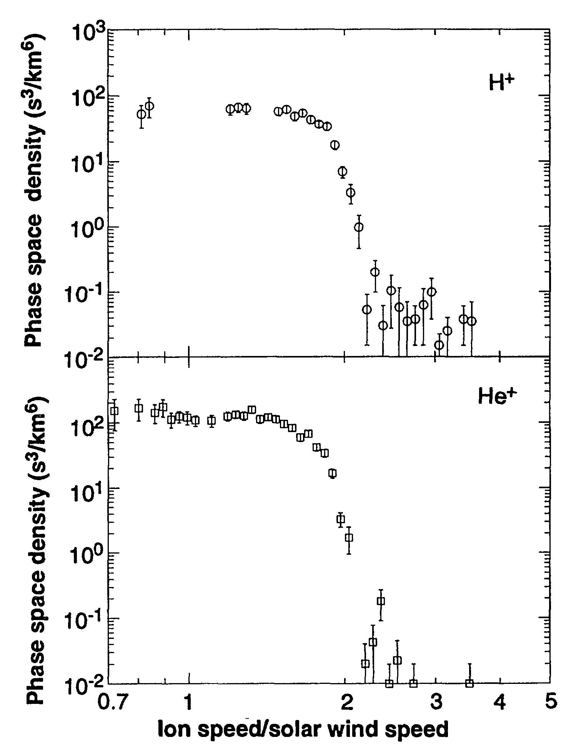
Measured PUIs
Neutral interstellar atoms transit the heliosphere at V<<V_{SW} until ionized by (1) charge exchange with solar wind ions or (2) photoionization by solar UV.
Once ionized they orbit the background magnetic field generating magnetic waves that are largely Sunward propagating and left-hand polarized in the spacecraft frame.
Efficient ionization produces a neutral hydrogen cavity at ~3 AU.
Pickup ions give up a few percent of their energy to wave production.
This energy is required to explain heating of the background ions in the outer heliosphere.
Gloeckler, Science, 261, 70, 1993.

Slide 4
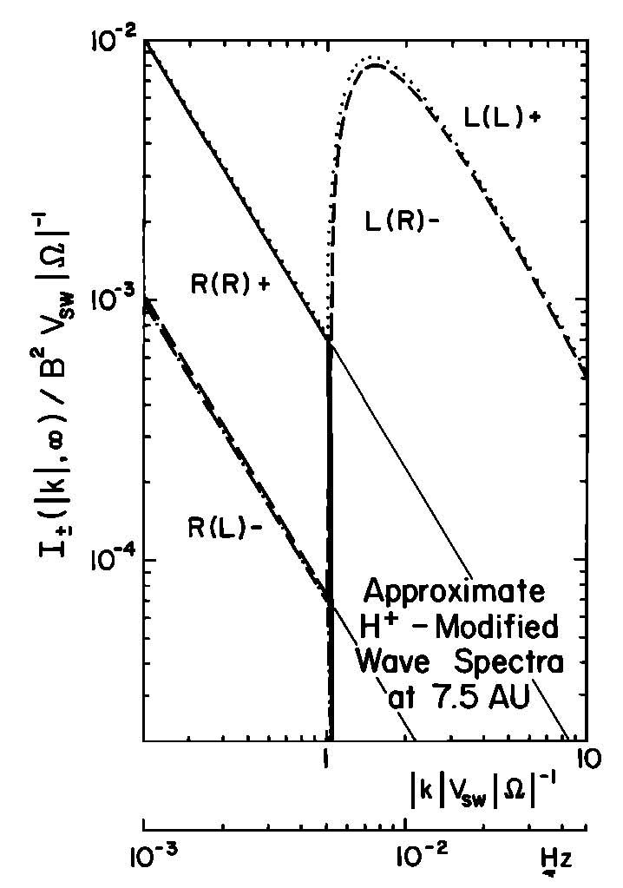
Lee & Ip, JGR, 92, 11041, 1987
Develop a theory for the asymptotic wave growth that slowly accumulates energy over lifetime of the plasma element.
There are 4 key features:
Waves are only seen at f_{sc} > f_{ic}.
Waves are Sunward propagating.
Waves are left-hand polarized in the spacecraft frame.
Marty does assume accumulation of energy over lifetime of plasma.

Slide 5
We’ve Been Working the Problem for Some Time
Joyce, et al., Excitation of low-frequency waves in the solar wind by newborn interstellar pickup ions H+ and He+ as seen by Voyager at 4.5 AU, The Astrophysical Journal, 724, 1256-1261, 2010.
Joyce, et al., Observation of Bernstein waves excited by newborn interstellar pickup ions in the solar wind, The Astrophysical Journal, 745, 112, 2012.
Cannon, et al., Ulysses observations of magnetic waves due to newborn interstellar pickup ions. 1. New observations and linear analysis, The Astrophysical Journal, 784, 150, 2014.
Cannon, et al., Ulysses observations of magnetic waves due to newborn interstellar pickup ions. 2. Application of turbulence concepts to limiting wave energy and observability, The Astrophysical Journal, 787, 133, 2014.
Argall, et al., ACE observations of magnetic waves arising from newborn interstellar pickup Helium ions, Geophysical Research Letters, 42, 9617-9623, 2015.
Aggarwal, et al., Voyager observations of magnetic waves due to newborn interstellar pickup ions: 2 to 6 AU, The Astrophysical Journal, 822, 94, 2016.
Fisher, et al., A survey of magnetic waves excited by newborn interstellar He+ observed by the ACE spacecraft at 1 AU, The Astrophysical Journal, 830, 47, 2016.
Cannon et al., Listing of 502 Times When the Ulysses Magnetic Fields Instrument Observed Waves Due to Newborn Interstellar Pickup Protons, The Astrophysical Journal, 840, 13 (2017).
Argall et al., Observation of Magnetic Waves Excited by Newborn Interstellar Pickup He+ Observed by the Voyager 2 Spacecraft at 30 AU, The Astrophysical Journal, 849, 61 (2017). (Erratum: The Astrophysical Journal, 854, 77 (2018).)

Slide 6
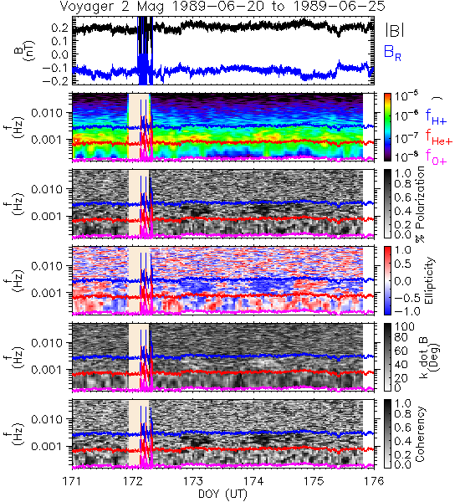
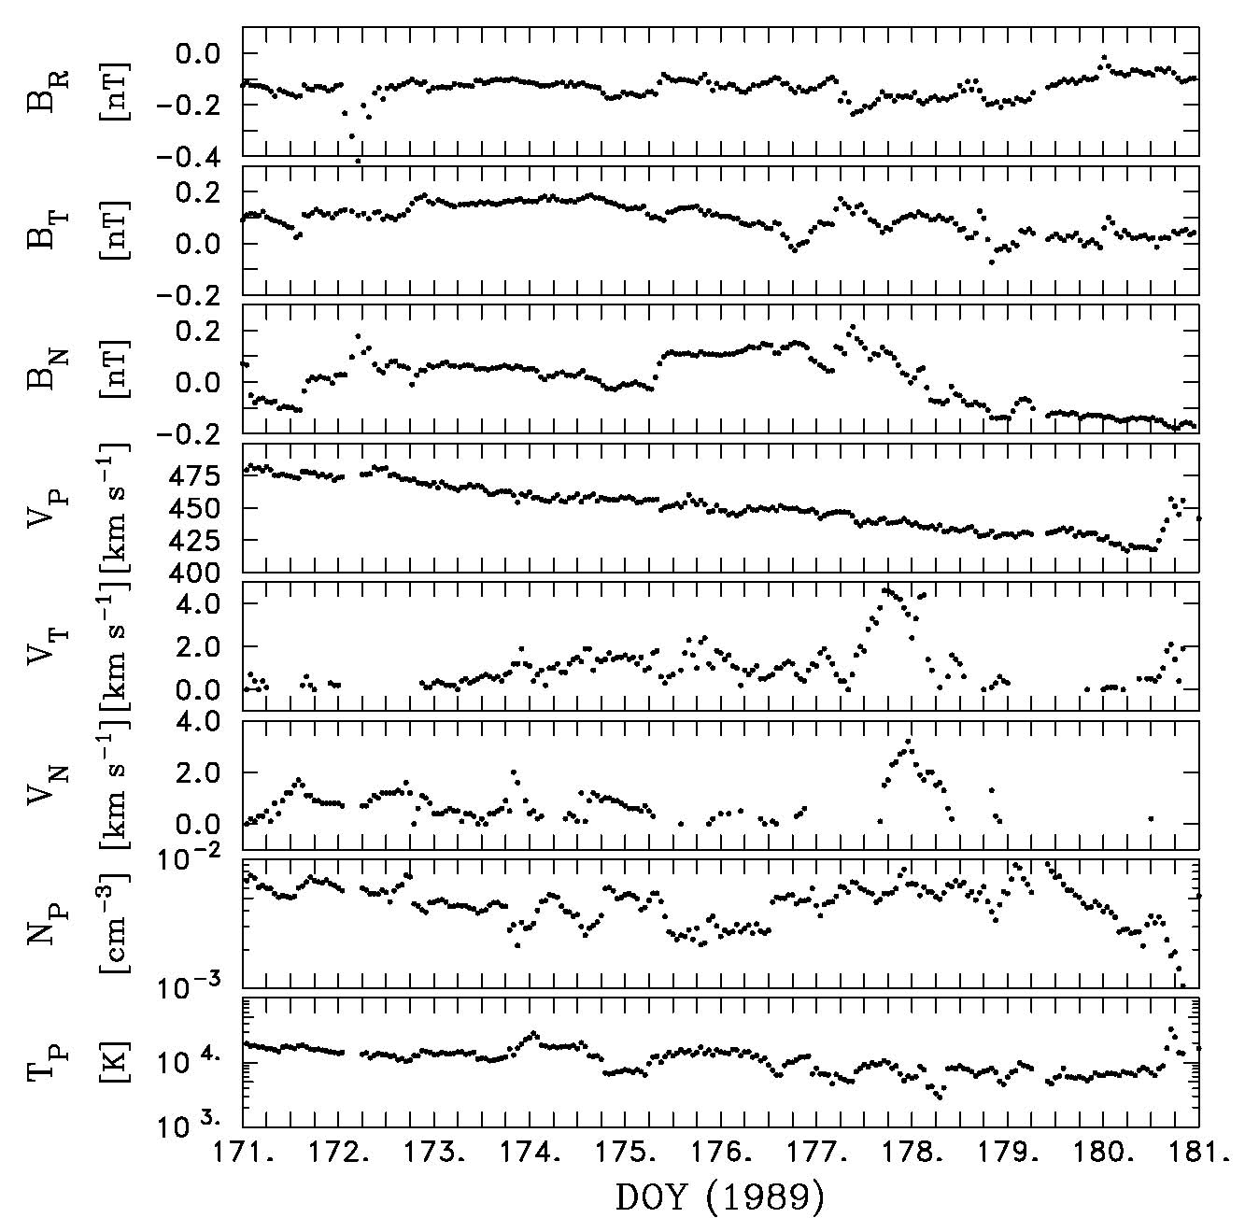
Argall et al., ApJ, 849, 61, 2017

Slide 7
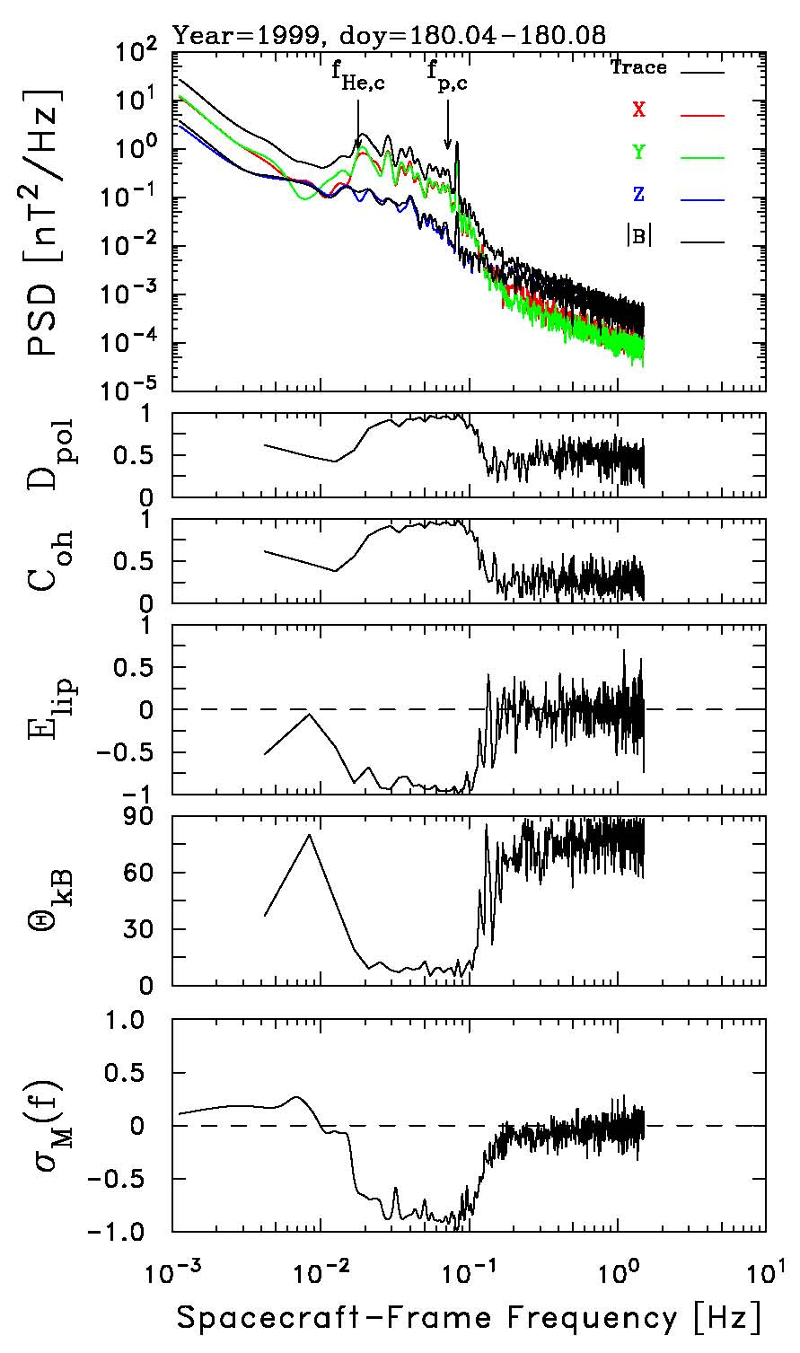
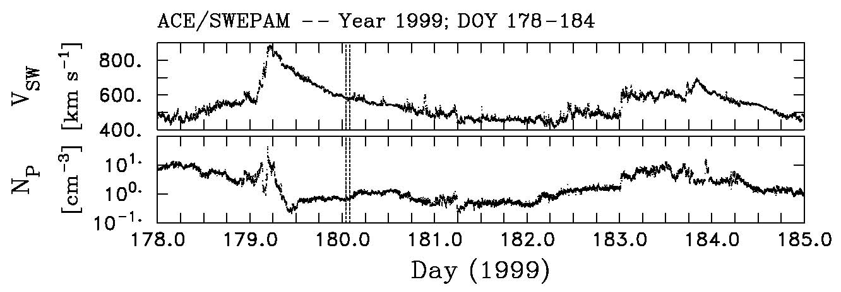
Argall et al., GRL, 42, 9617-9623, 2015
Waves show all the expected characteristics when a more detailed analysis is performed.
The event shown exists within a rarefaction interval (below).

Slide 8
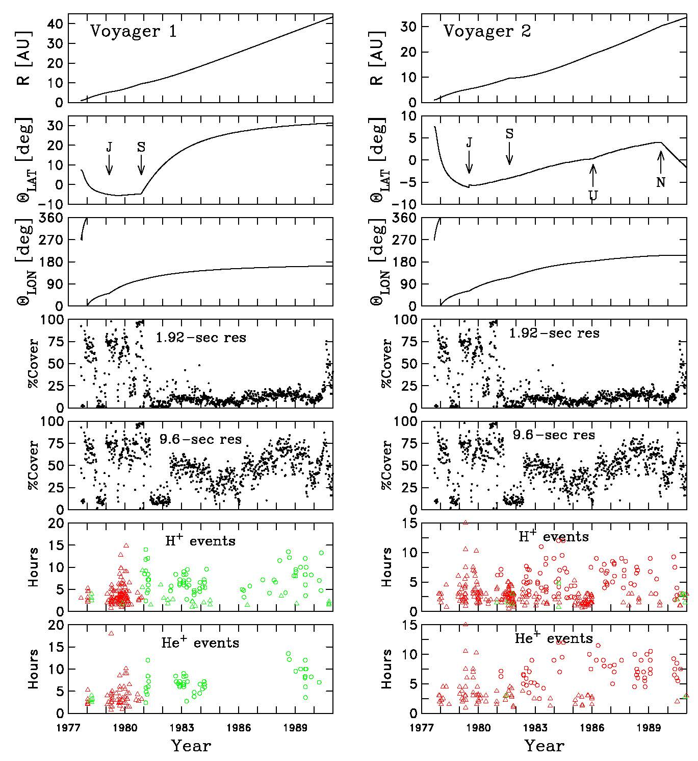
Hollick et al., ApJ, 863, 75, 2018.
This is what 667 wave events look like.
We use both Voyager 1 & 2 magnetic field and thermal ion data.
We use 1.92 sec MAG data and 9.6 sec MAG data when the former is not available.
We eliminate shock-associated and planet-associated waves.

Slide 9
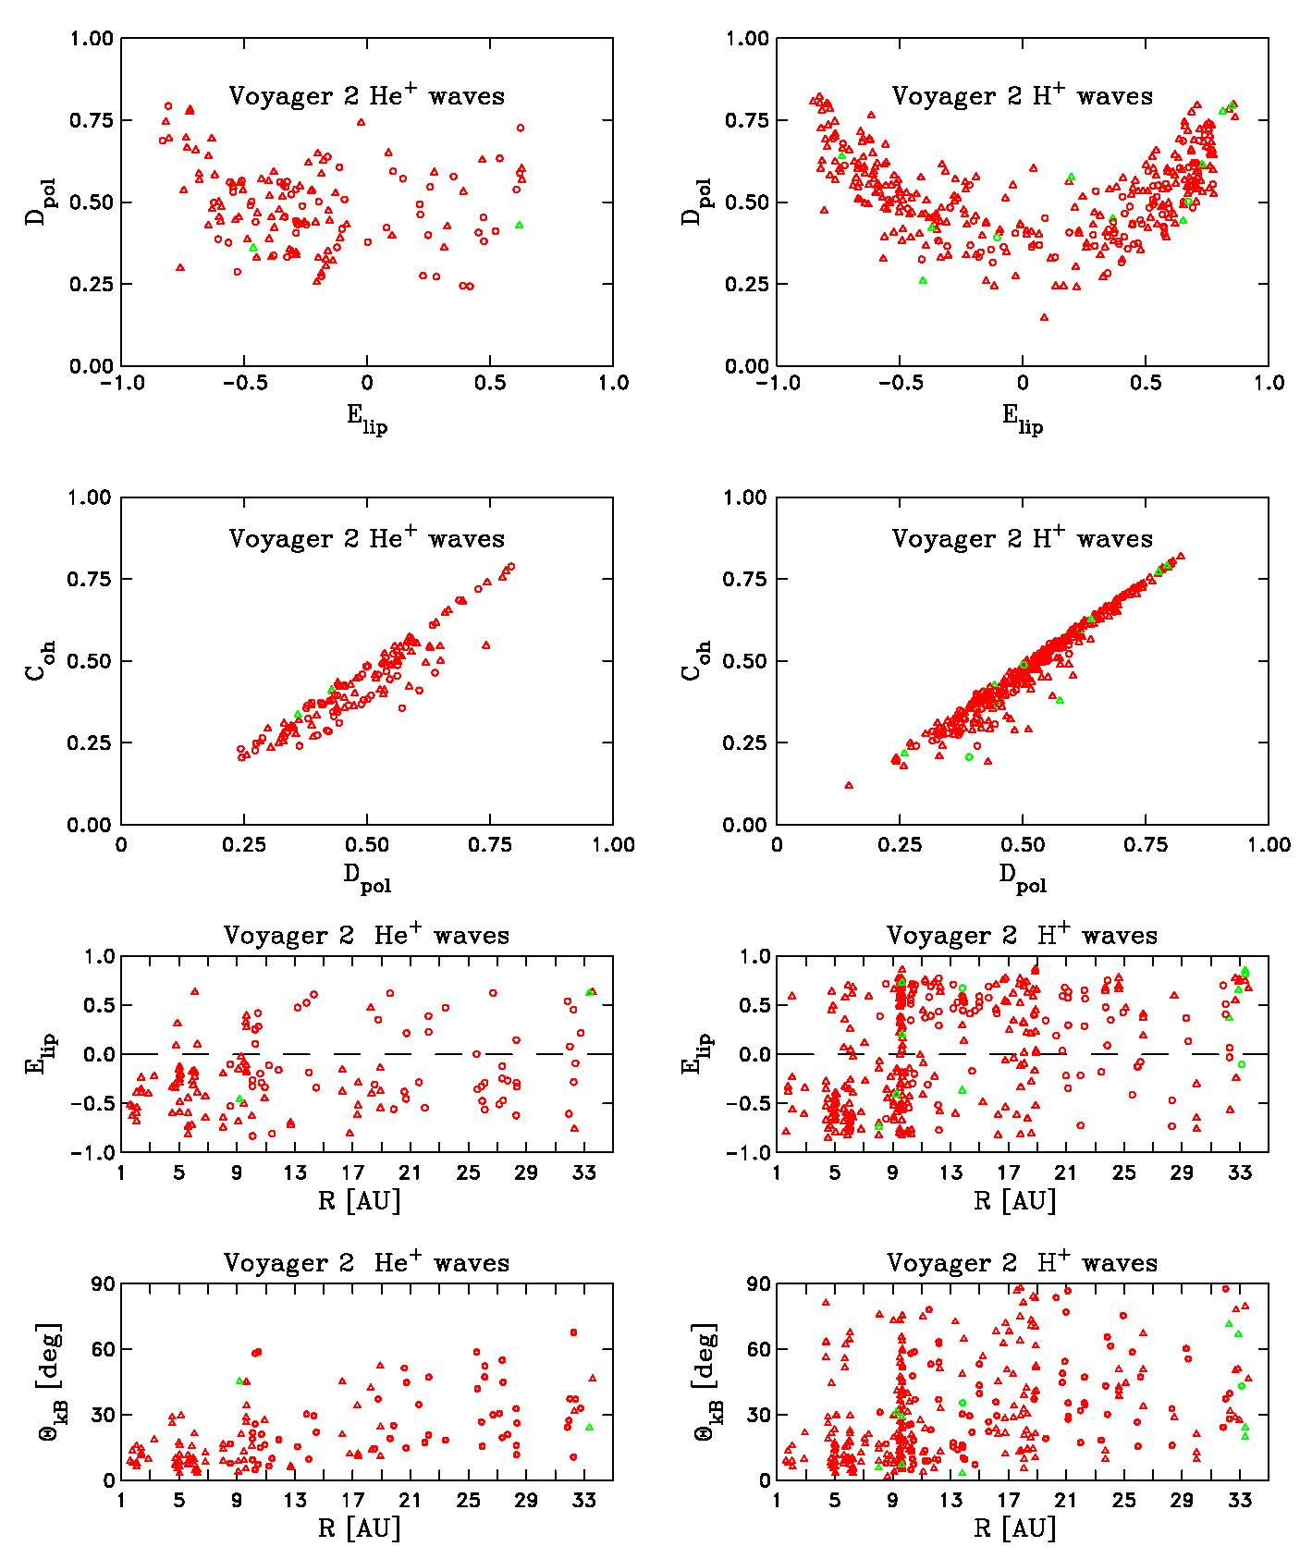
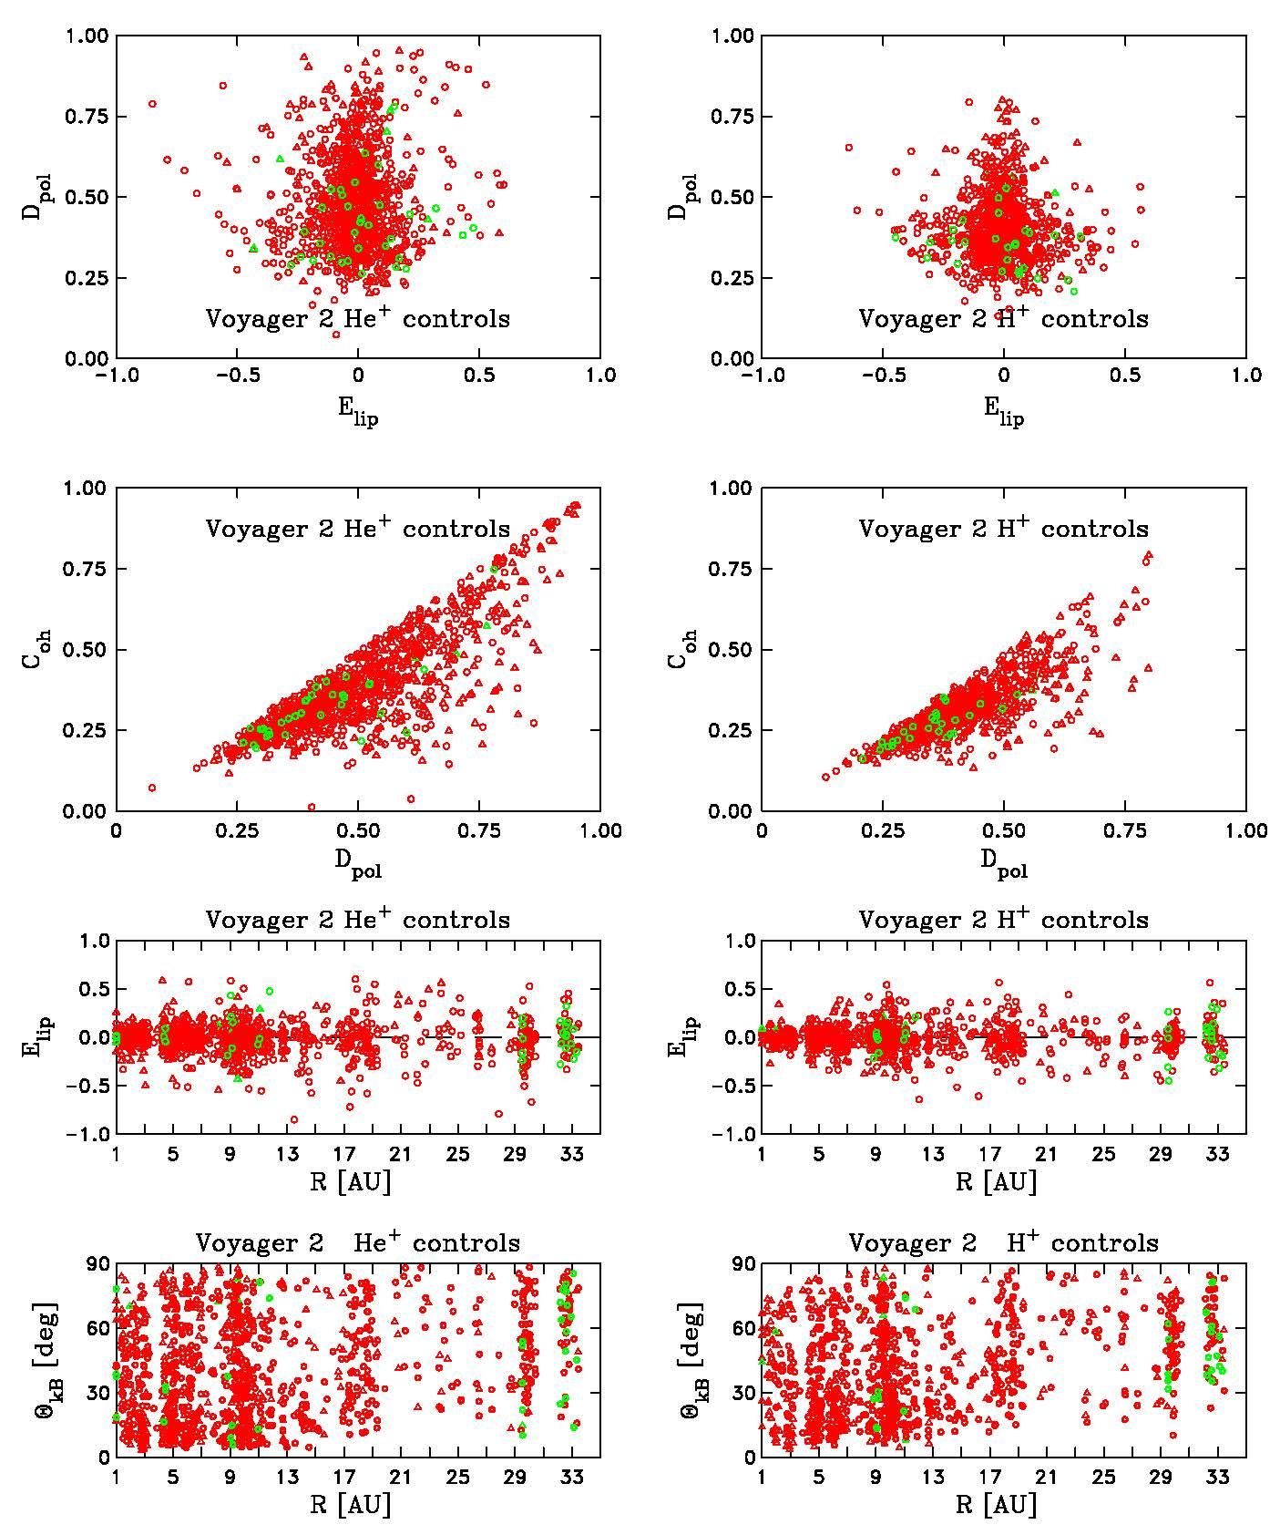

Slide 10
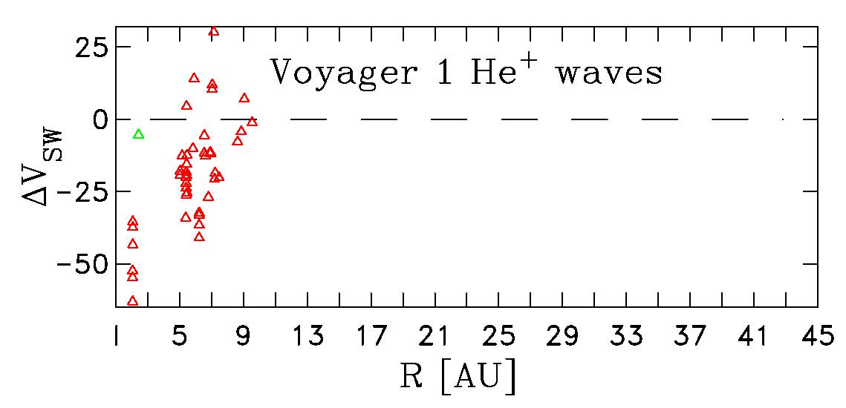
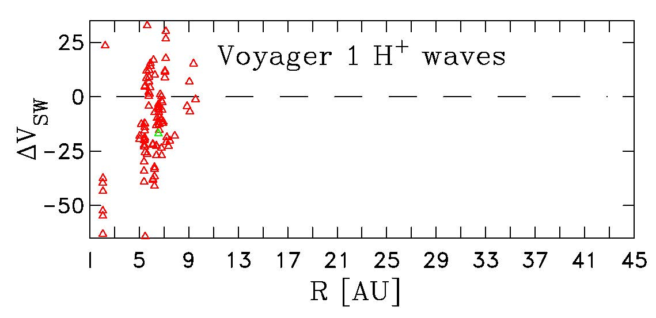
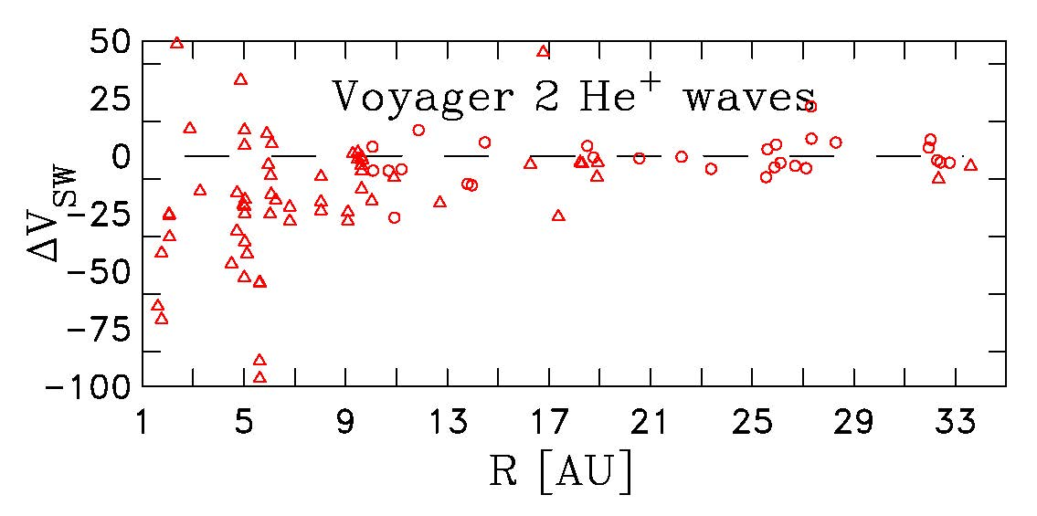
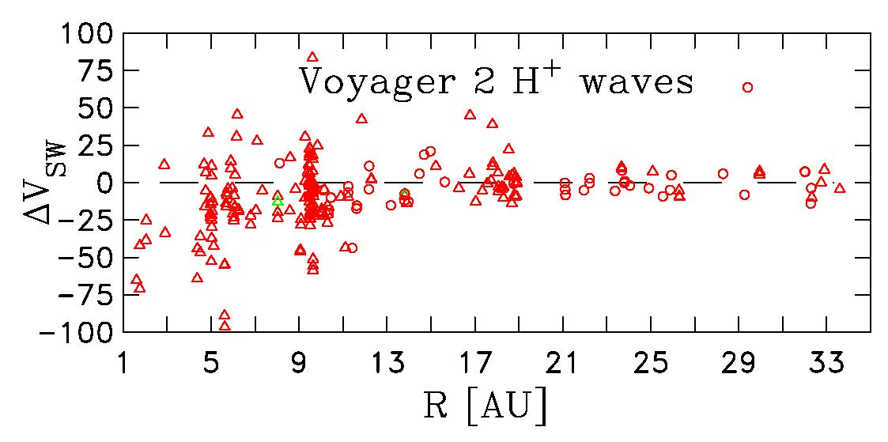

Slide 11
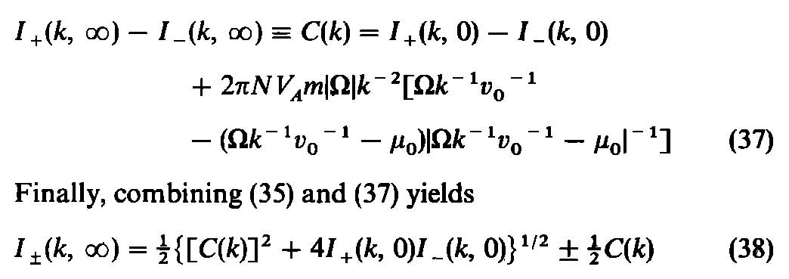
Lee & Ip, JGR, 92, 11041, 1987

Slide 12
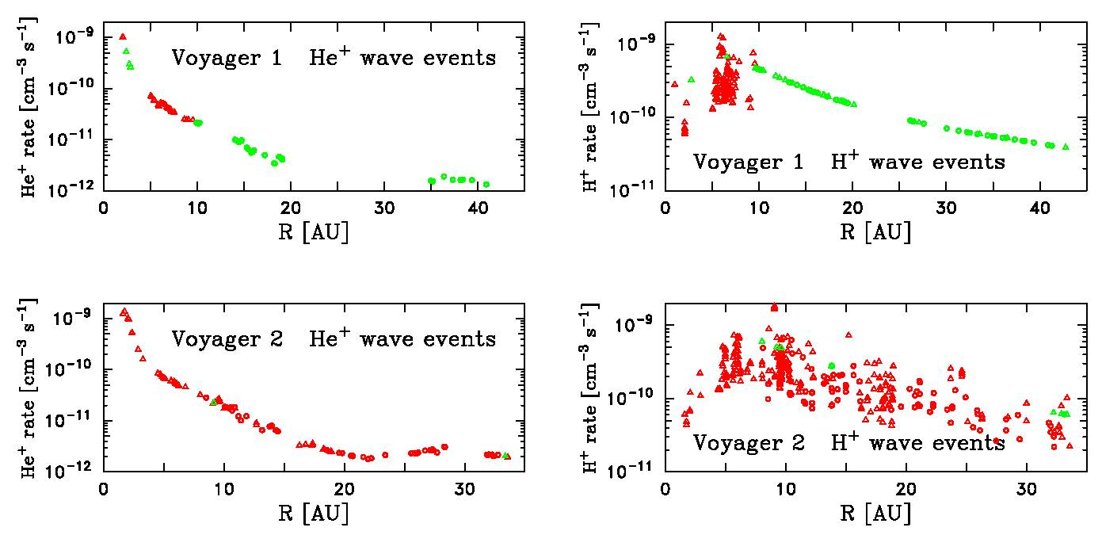
Hollick et al., ApJ, 863, 76, 2018.

Slide 13
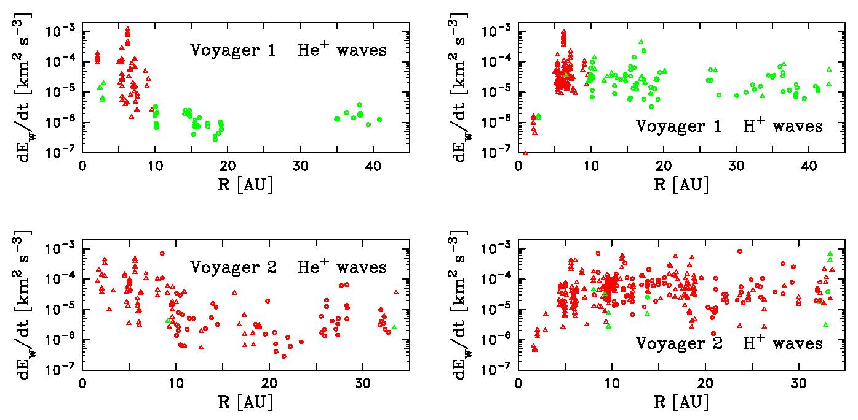
Hollick et al., ApJ, 863, 76, 2018.

Slide 14
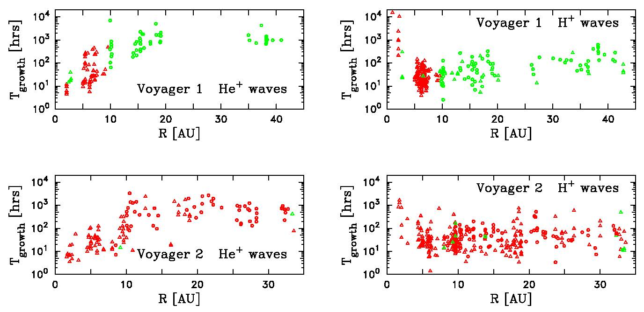
Hollick et al., ApJ, 863, 76, 2018.

Slide 15
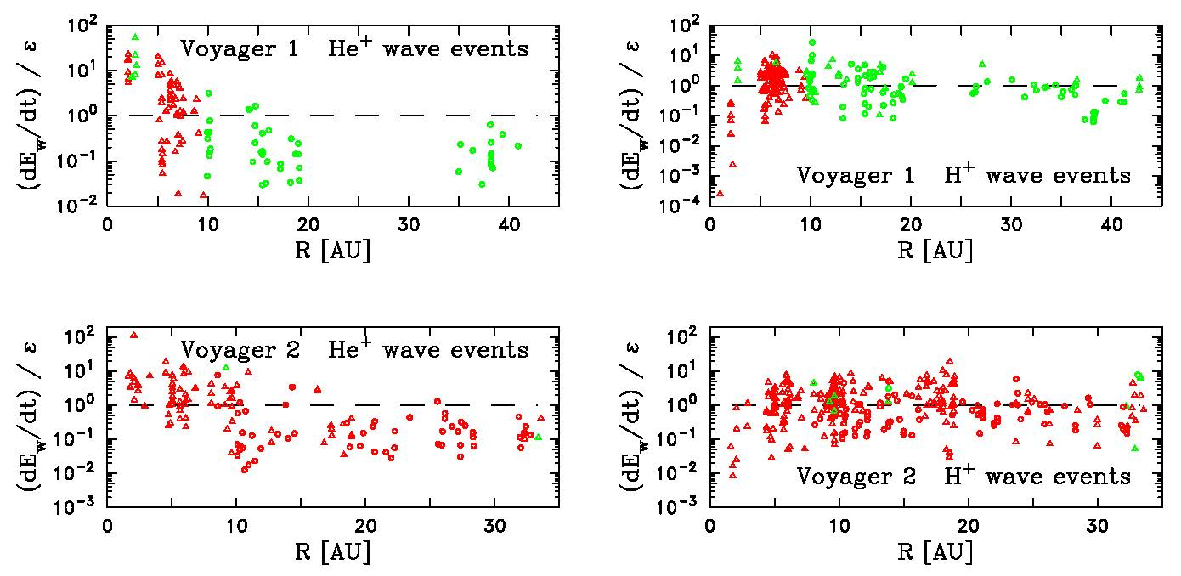
Hollick et al., ApJ, 863, 76, 2018.

Slide 16
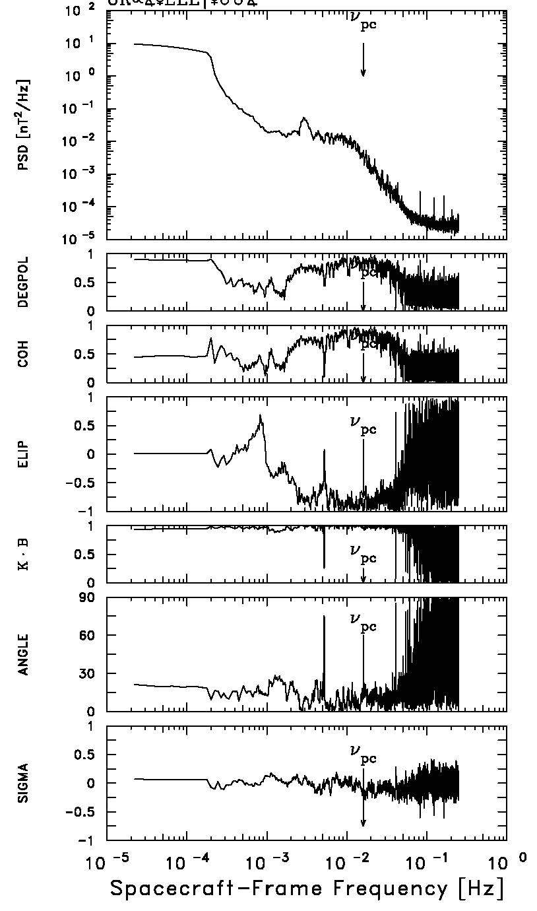
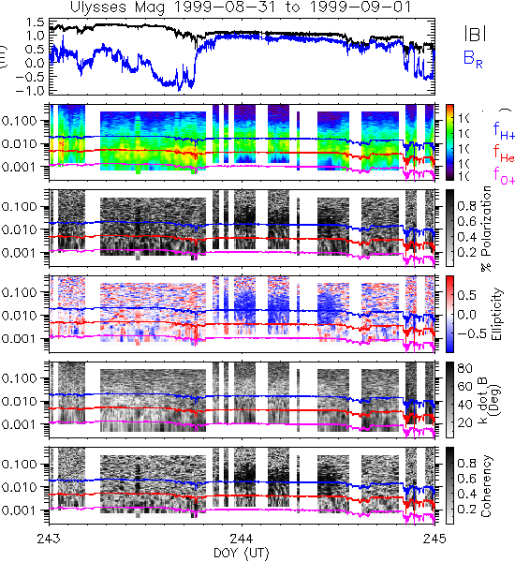
Ulysses Observations

Slide 17
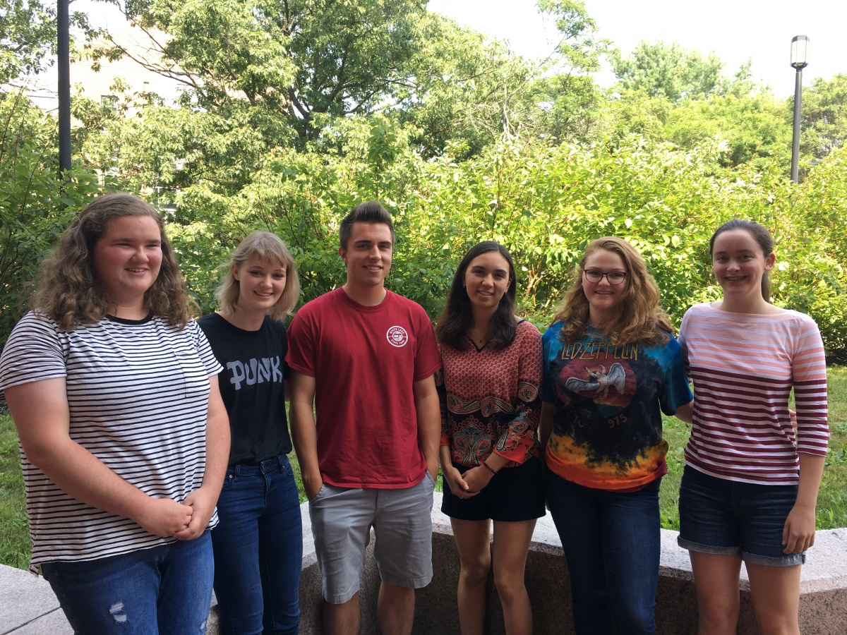
Ally Bickford (UNH Fresh., ACE shocks) Sophia Hollick (RPI Soph., Voyager)
Abbey Watson (HS Jun., Ulysses) Julia Fitzgibbons (UNH Soph., ACE turb.)
Zack Pine (BU Soph., Voyager turb.) Ana Marchuk (HS Sen., Ulysses)

Slide 18
We Have a Lot of Co-Authors:
Poornima Aggarwal
Matt Argall (UNH)
Leonard F. Burlaga (GSFC)
Maciej Bzowski (SRC, PAS)
Brad Cannon (now at FSU)
Meghan K. Fisher (UNH)
S. Peter Gary (Space Science, Inc)
Jason A. Gilbert (U Mich)
Perry C. Gray
Sophia Hollick (now at RPI)
Phil Isenberg (UNH)
Colin Joyce (UNH)
Marzena A. Kubiak (SRC, PAS)
Neil Murphy (JPL)
Raquel G. Nuno (SDU or UCLA)
Zack Pine (now at BU)
John D. Richardson (MIT)
Nathan Schwadron (UNH)
Ruth Skoug (LANL)
Justyna Sokol (SRC, PAS)
David K. Taylor
Bernie Vasquez (UNH)
Thomas H. Zurbuchen (NASA HQ)

Slide 19
We’ve Been Working the Problem for Some Time (1/3)
Murphy, et al., Further studies of waves accompanying the solar wind pick-up of interstellar hydrogen, Space Science Reviews, 72(1-2), 447-453, 1995.
Joyce, et al., Excitation of low-frequency waves in the solar wind by newborn interstellar pickup ions H+ and He+ as seen by Voyager at 4.5 AU, The Astrophysical Journal, 724, 1256-1261, 2010.
Smith, et al., Ulysses and Voyager observations of waves due to interstellar pickup H+ and He+, Proceedings of Ninth Annual International Astrophysics Conference: Pickup Ions Throughout the Heliosphere and Beyond, AIP Conf. Proc. 1302, pp. 186-191, 2010.
Joyce, et al., Observation of Bernstein waves excited by newborn interstellar pickup ions in the solar wind, The Astrophysical Journal, 745, 112, 2012.
Cannon, et al., Ulysses observations of magnetic waves due to newborn interstellar pickup ions. 1. New observations and linear analysis, The Astrophysical Journal, 784, 150, 2014.
Cannon, et al., Ulysses observations of magnetic waves due to newborn interstellar pickup ions. 2. Application of turbulence concepts to limiting wave energy and observability, The Astrophysical Journal, 787, 133, 2014.
Argall, et al., ACE observations of magnetic waves arising from newborn interstellar pickup Helium ions, Geophysical Research Letters, 42, 9617-9623, 2015.
Aggarwal, et al., Voyager observations of magnetic waves due to newborn interstellar pickup ions: 2 to 6 AU, The Astrophysical Journal, 822, 94, 2016.

Slide 20
We’ve Been Working the Problem for Some Time (2/3)
Fisher, et al., A survey of magnetic waves excited by newborn interstellar He+ observed by the ACE spacecraft at 1 AU, The Astrophysical Journal, 830, 47, 2016.
Cannon et al., Listing of 502 Times When the Ulysses Magnetic Fields Instrument Observed Waves Due to Newborn Interstellar Pickup Protons, The Astrophysical Journal, 840, 13 (2017).
Smith et al., Observations of Low-Frequency Magnetic Waves due to Newborn Interstellar Pickup Ions Using ACE, Ulysses, and Voyager Data, Sixteenth Annual International Astrophysics Conference 2017 - Turbulence, Structures, and Particle Acceleration Throughout the Heliosphere and Beyond, Journal of Physics: Conference Series, 900, 012018 (2017).
Argall et al., Observation of Magnetic Waves Excited by Newborn Interstellar Pickup He+ Observed by the Voyager 2 Spacecraft at 30 AU, The Astrophysical Journal, 849, 61 (2017). (Erratum: The Astrophysical Journal, 854, 77 (2018).)
Hollick et al., Magnetic Waves Excited by Newborn Interstellar Pickup Ions Measured by the Voyager Spacecraft From 1 to 45 AU. I. Wave Properties, The Astrophysical Journal, 863, 75 (2018).
Hollick et al., Magnetic Waves Excited by Newborn Interstellar Pickup Ions Measured by the Voyager Spacecraft From 1 to 45 AU. II. Instability and Turbulence Analyses, The Astrophysical Journal, 863, 76 (2018).
Hollick et al., Magnetic Waves Excited by Newborn Interstellar Pickup Ions Measured by the Voyager Spacecraft From 1 to 45 AU. III. Observation Times, The Astrophysical Journal Supplement, 237, 34 (2018).

Slide 21
We’ve Been Working the Problem for Some Time (3/3)
Hollick et al., Magnetic Waves Excited by Newborn Inner Source Pickup H+ Measured by the Voyager Spacecraft Inside 3 AU, in preparation.
Hollick et al., Magnetic Waves Excited by Newborn Pickup H+ Near Jupiter, in preparation.
Smith et al., MESSENGER Observations of Low-Frequency Magnetic Waves due to Inner Source Pickup Protons Inside 1 AU, in preparation.
And I have two young women building a data base of He+ waves in the Ulysses data now.
Pine et al., Voyager Observations of Turbulence from 1 to 45 AU: Turbulent Transport and Heating of the Solar Wind, in preparation.
I’ll draw on these papers freely to demonstrate what we’ve been learning with additional references for background.
Here is the punch line: This is one of the few instances where turbulence is stronger than the kinetic physics we normally study.

Slide 22
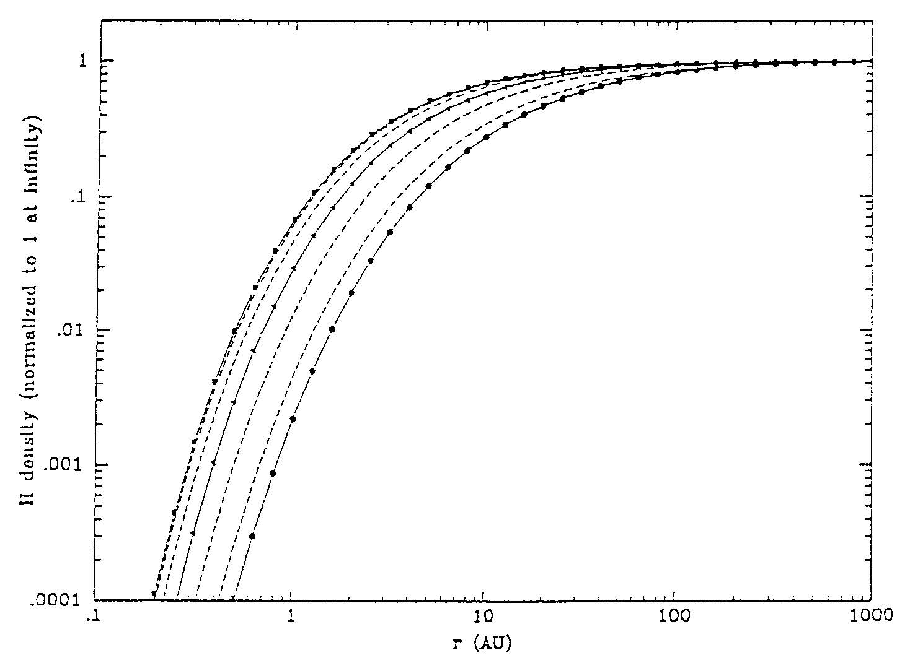
The is a neutral hydrogen cavity inside 3 AU
Ionization of neutral H is accomplished primarily by charge exchange with solar wind p+.
Ionization becomes so efficient inside 10 AU that the number density of neutral H atoms decreases exponentially.
Depending on heliolongitude, the number density is a factor of 10 below interstellar levels.

Slide 23
Here’s the Bad News:
The scattered PUI only gives up about 4% of it’s energy.
There are < 10⁻¹ neutral particles/cm³ (going out to 30 AU)
  The rate of ion production is ~ 10⁻¹⁰ particles / cm³-sec.
That makes the instability very weak!
It takes a long time to accumulate an observable amount of energy.
  It takes hours to days!
Interplanetary turbulence does not let energy sit around too long.

Slide 24
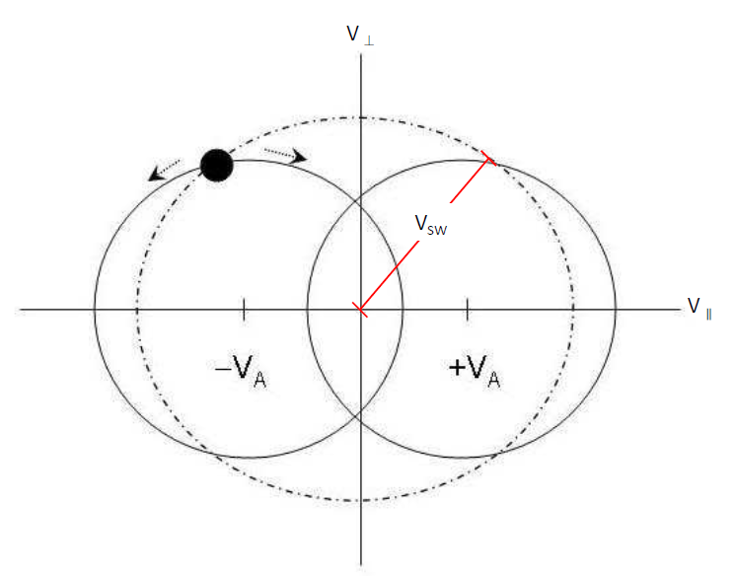
PUI Theory
Immediately after pickup, PUIs have an initial distribution in velocity space.
They may then be resonant with ambient waves and scatter to isotropy in the wave frame.
When this happens, the PUI loses energy in the solar wind frame and this energy goes into the resonant waves.
The effects of newborn PUIs in a ring distribution were first modeled by Lee and Ip (1987) and later modified by Isenberg (1996) to account for the effects of a fluctuating magnetic field.
Pickup ion in velocity space.

Slide 25
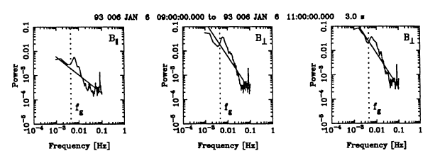
Murphy et al., SSR, 72(1-2), 447-453, 1995
The only prior observation of PUI waves was made by Murphy et al. (1996).
They generated power spectra from Ulysses magnometer data and looked for power and polarization signatures at the proton cyclotron frequency.
They found events tended to occur when the IMF was highly radial.

Slide 26
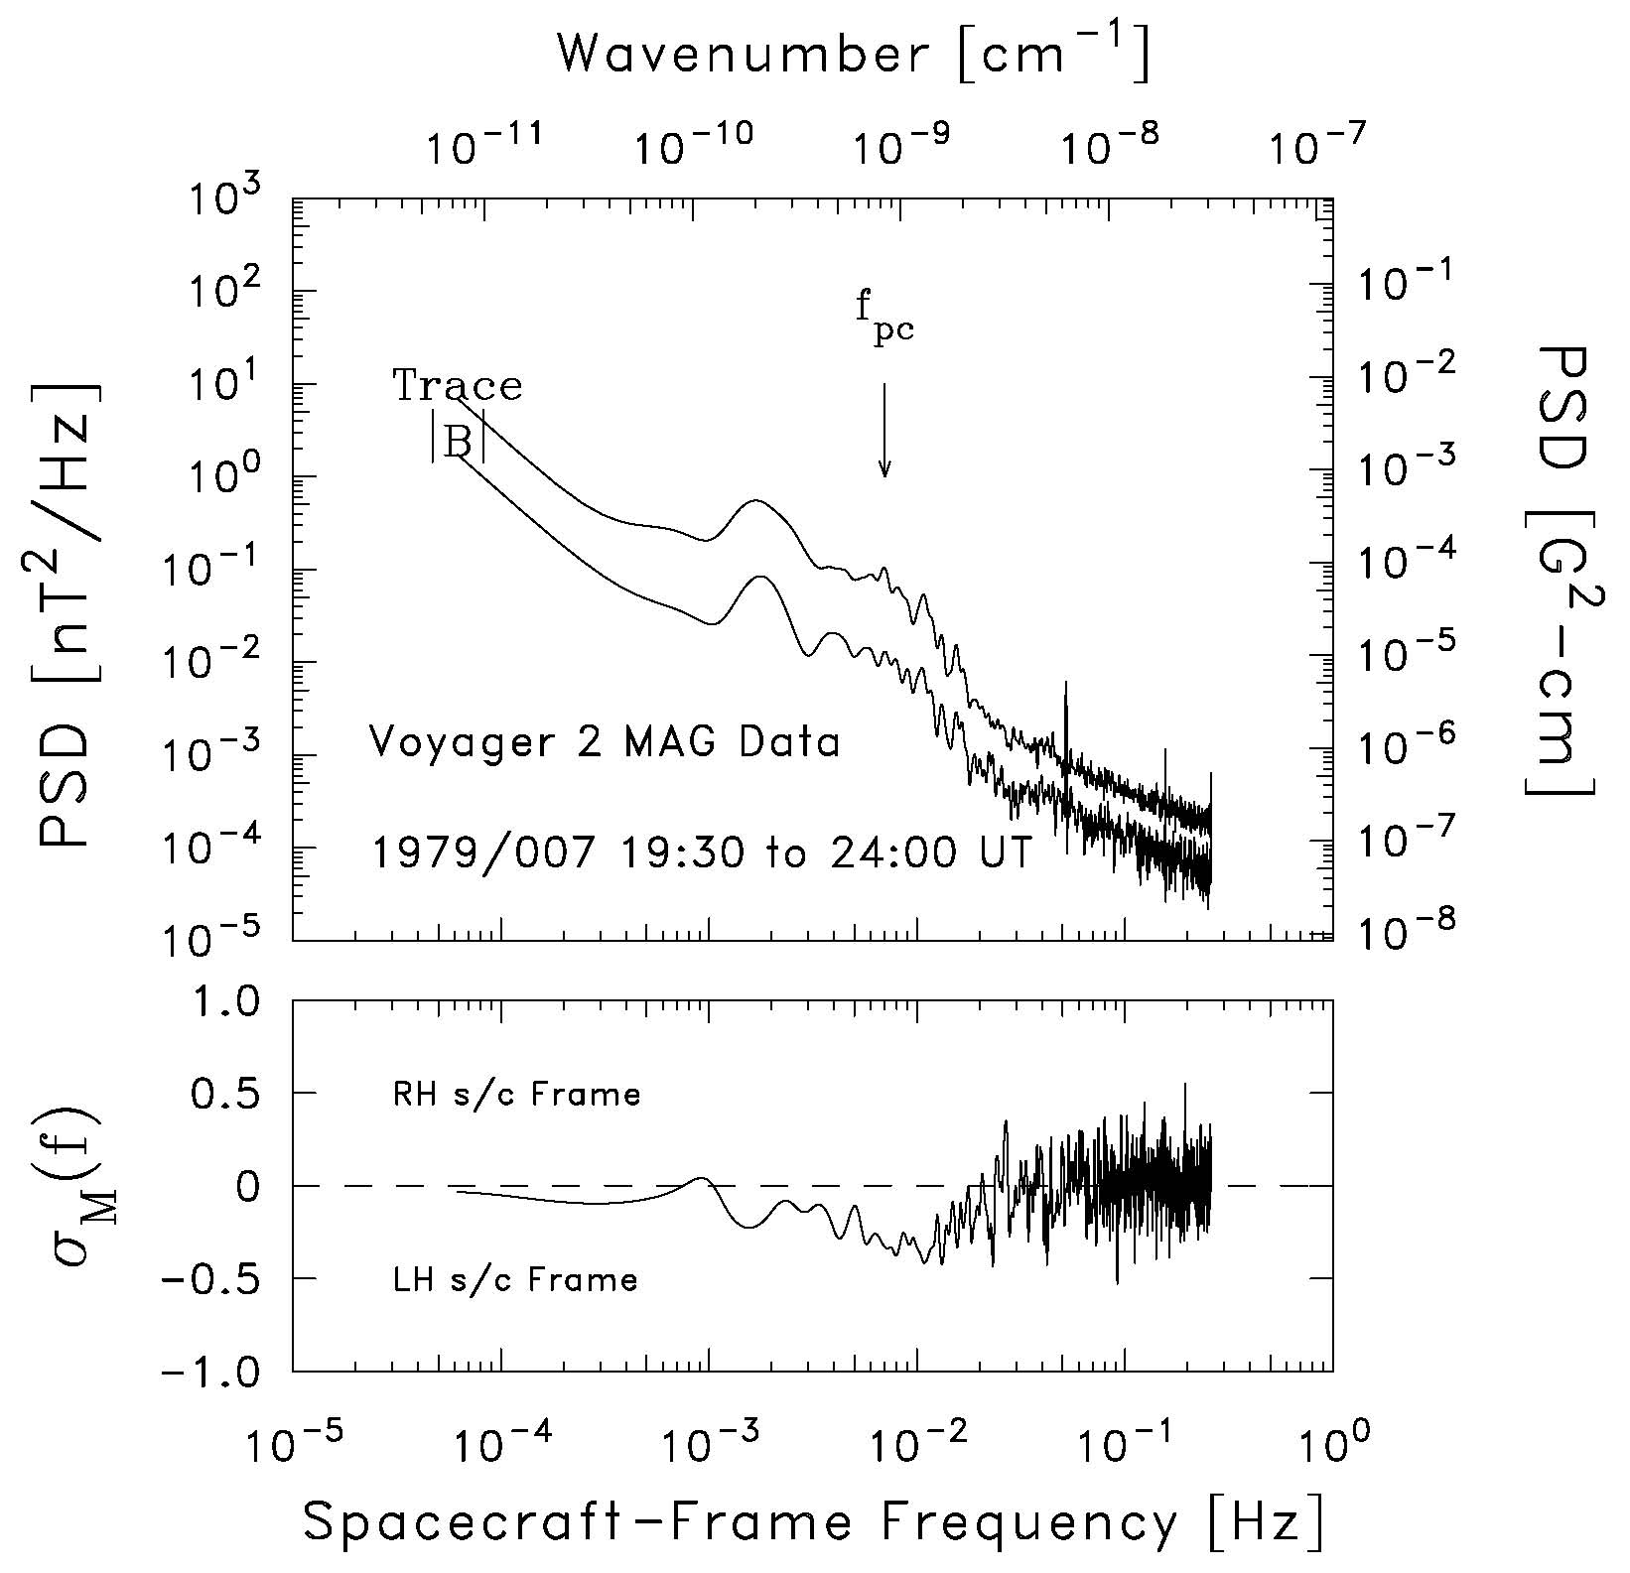
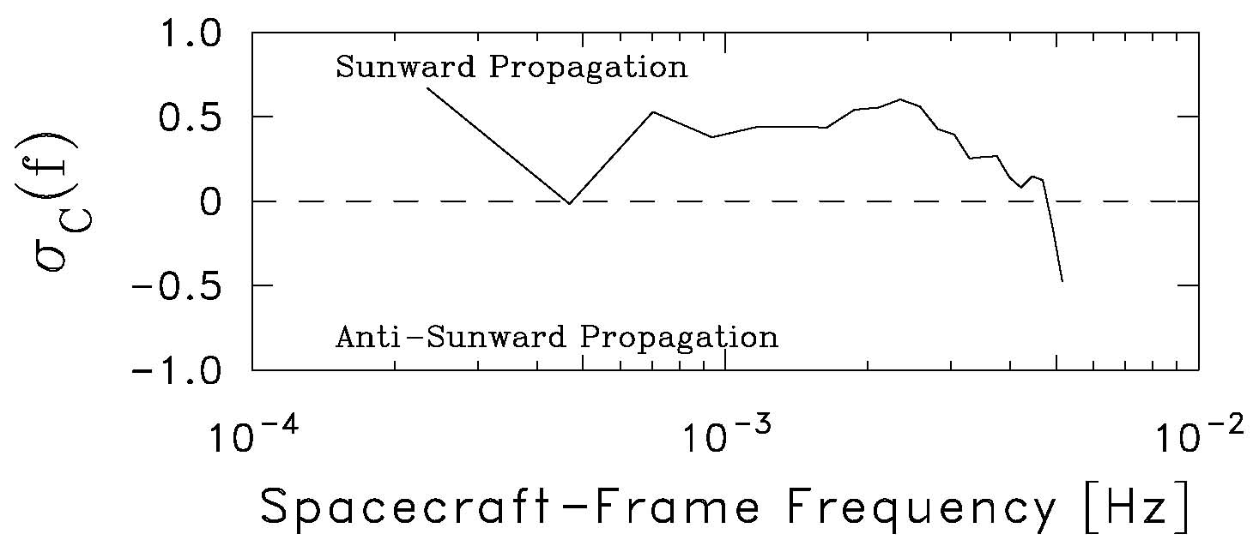
Joyce et al., ApJ, 724, 1256-1261, 2010
Spectral analysis reveals power enhancements at the proton cyclotron frequency and the He+ cyclotron frequency.
Strongly suggests excitation by newborn ions originating from interstellar neutrals.
Location at 4.5 AU is on the edge of the H⁺ cavity, but He⁺ intensity is not diminished.
We see a significant signature in the helicity spectrum of the event. When combined with the computed normalized cross helicity of the event, we show that the waves are sunward propagating fast mode waves.

Slide 27
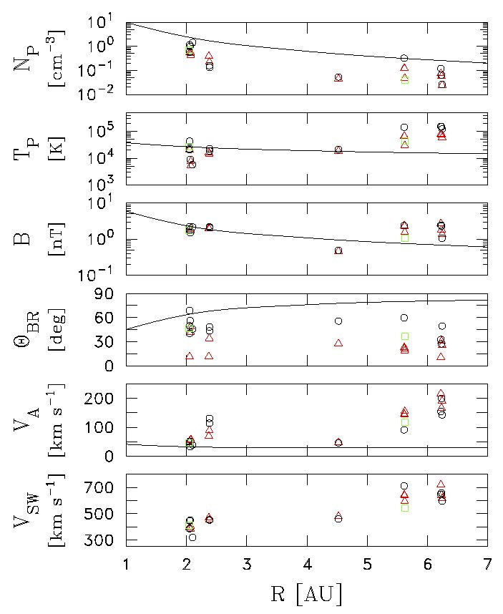
Aggarwal et al., ApJ, 822, 94, 2016
We had a growing suspicion that the waves could best be found in rarefaction regions.
Pornima Aggarwal, an undergraduate at the time, repeated the Joyce approach and found an additional 11 events inside 6.5 AU.

Slide 28
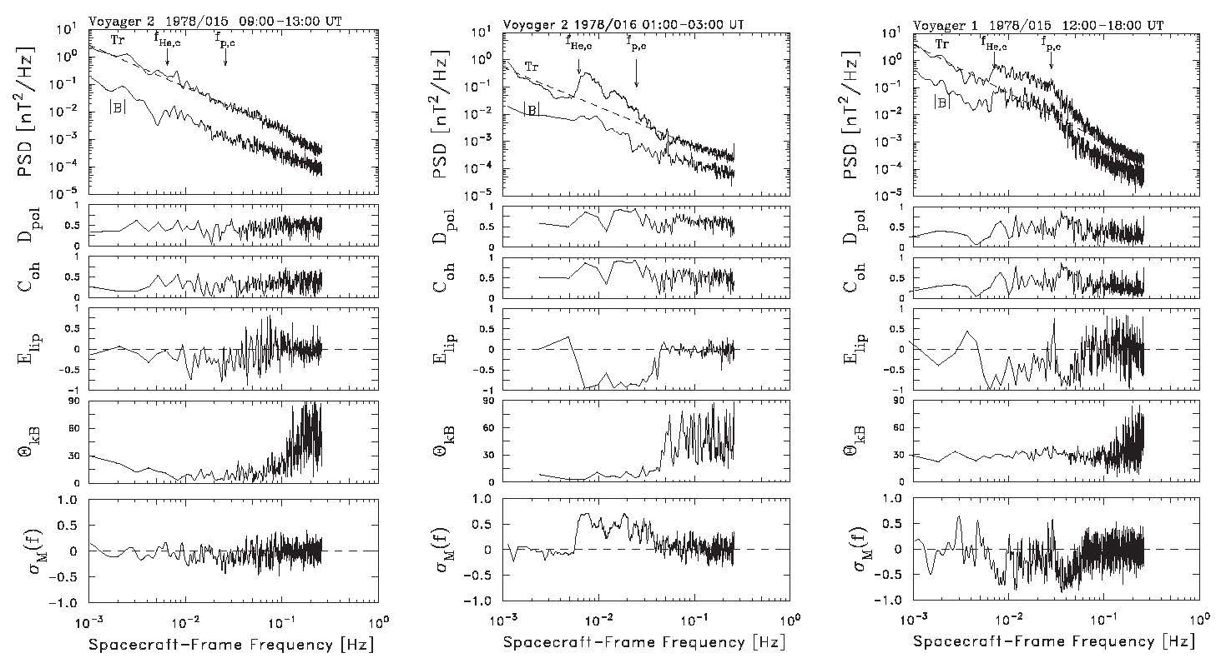
Aggarwal et al., ApJ, 822, 94, 2016

Slide 29
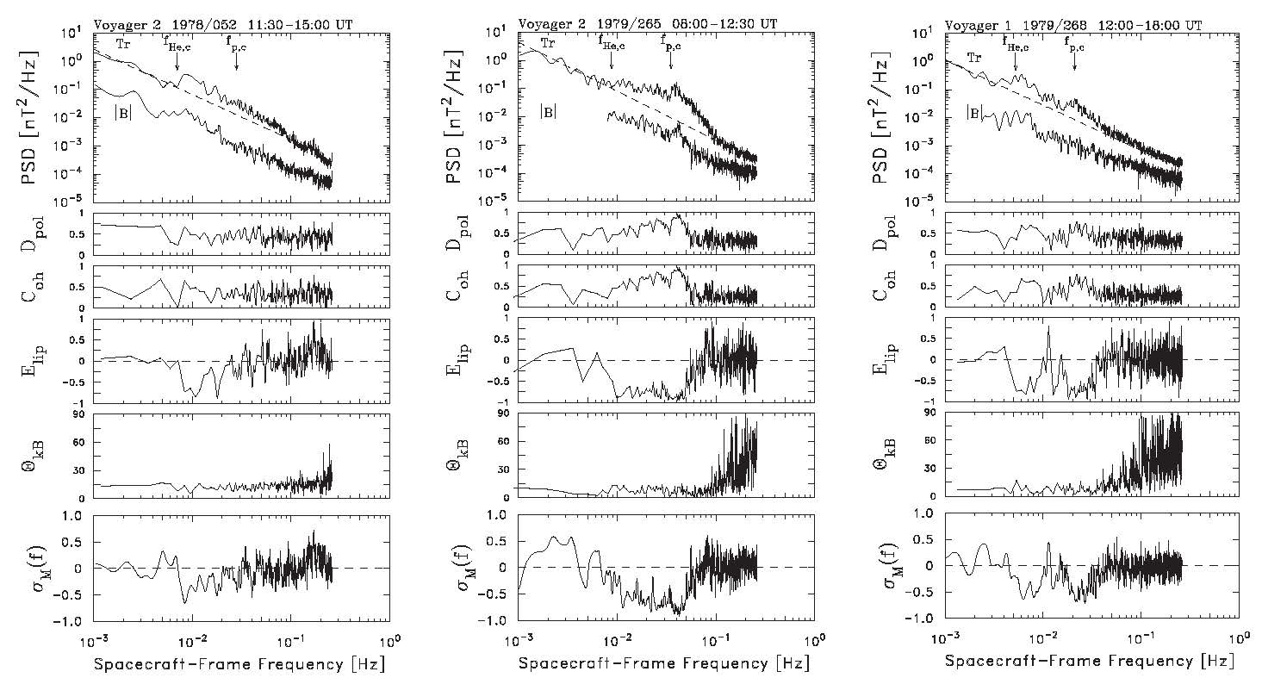
Aggarwal et al., ApJ, 822, 94, 2016

Slide 30
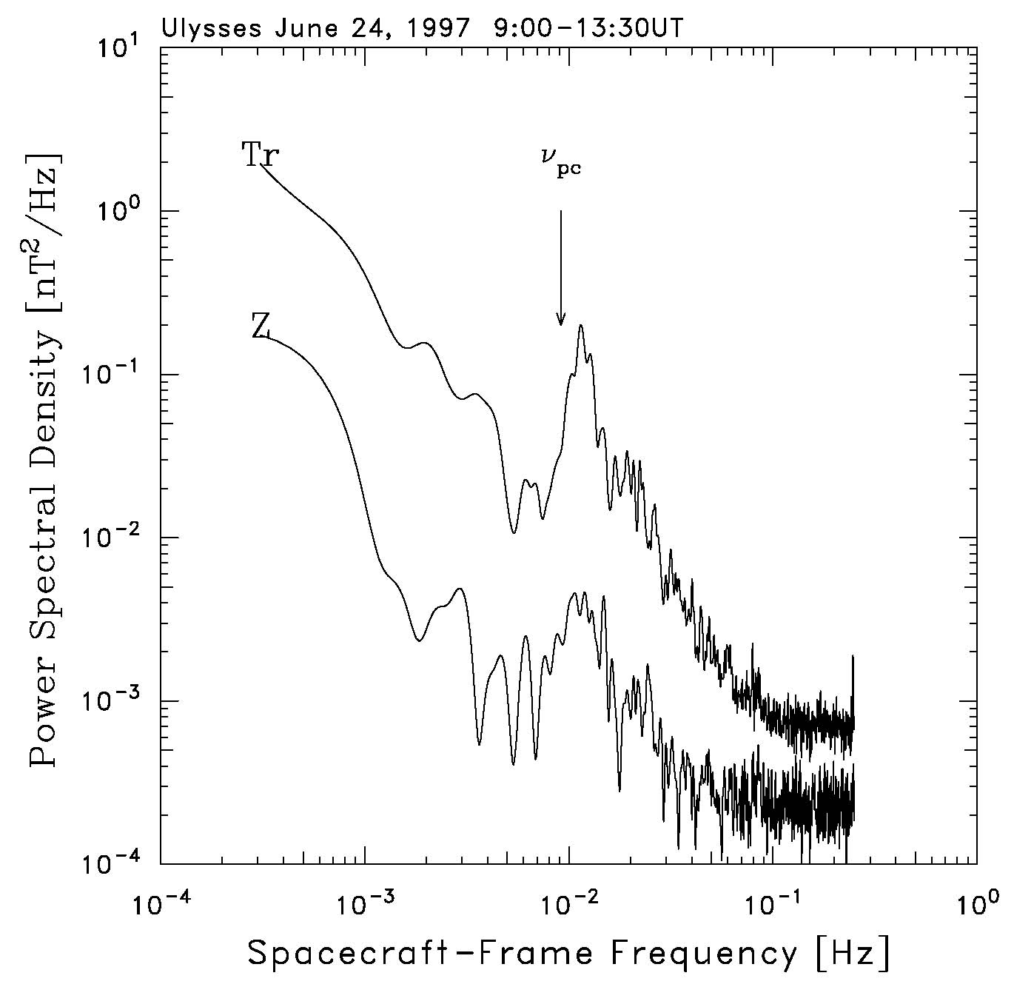
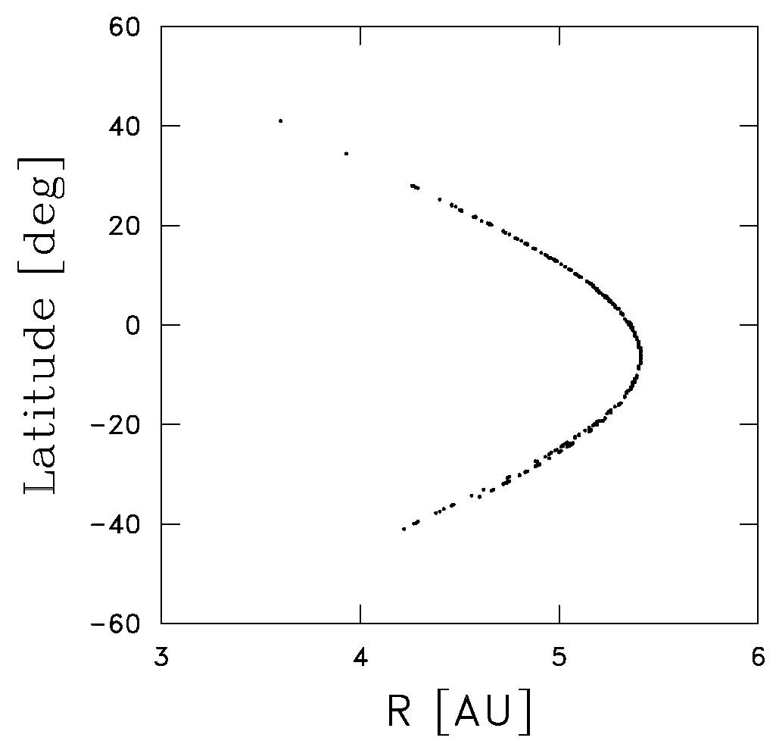
Cannon et al., ApJ, 784, 150, 2014
Waves appear at spacecraft frame frequencies slightly greater than the cyclotron frequency of the associated particle species.
They should be transverse, Sunward propagating, and left-hand polarized in the spacecraft frame.

Slide 31
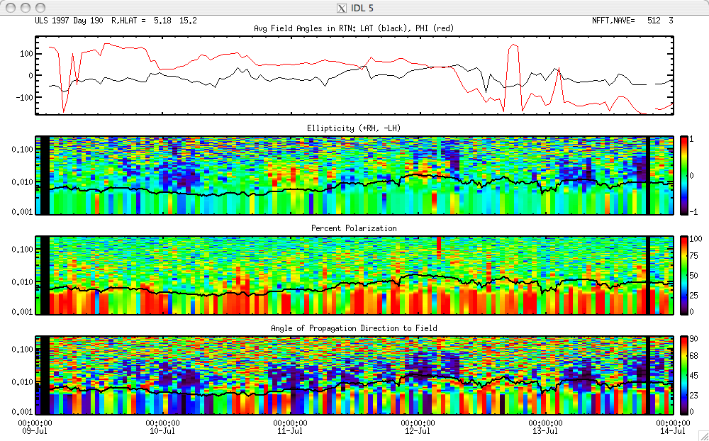
Ulysses Data – 502 Events (Spectrogram Technique)

Slide 32
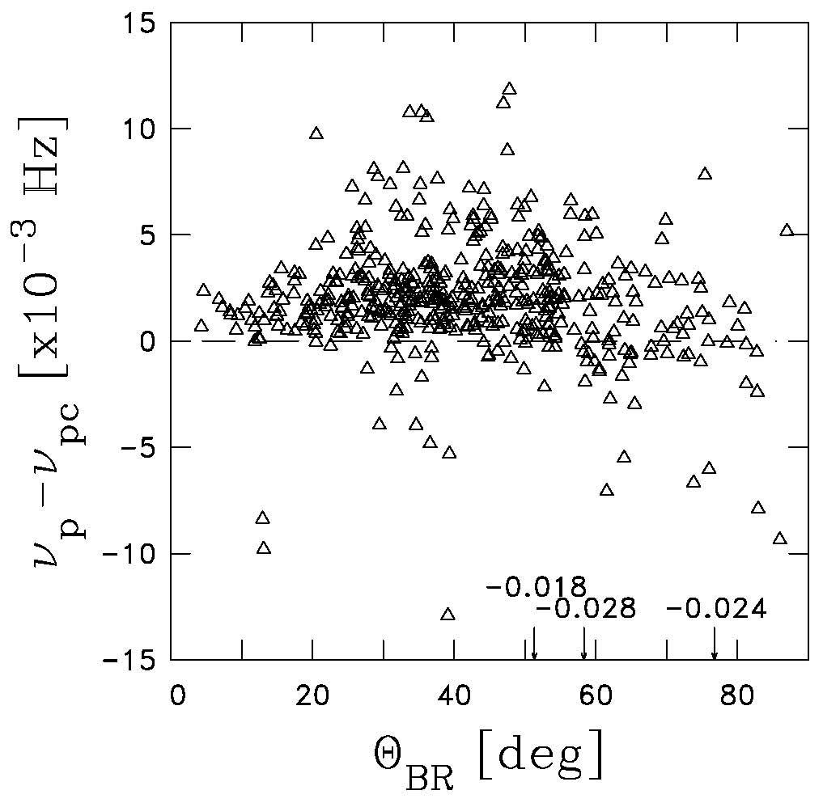
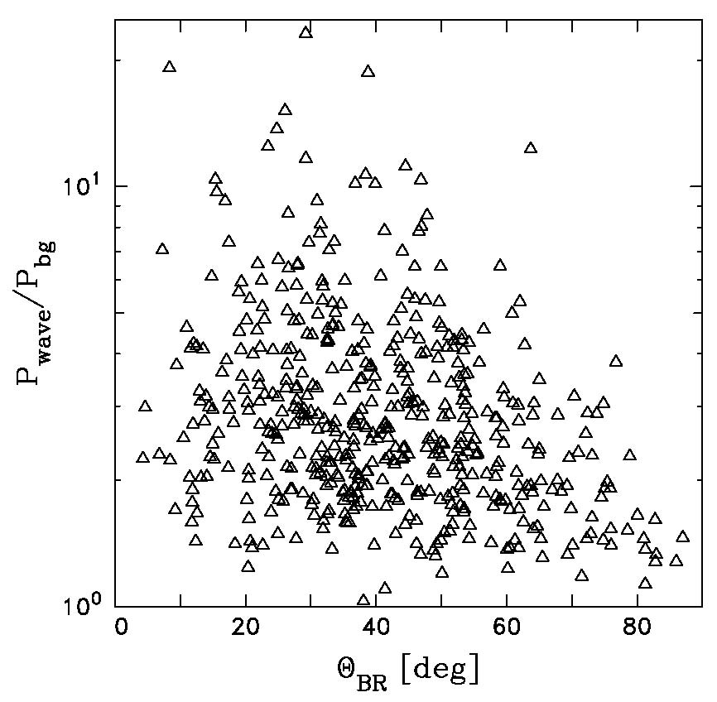
Cannon et al., ApJ, 784, 150, 2014

Slide 33
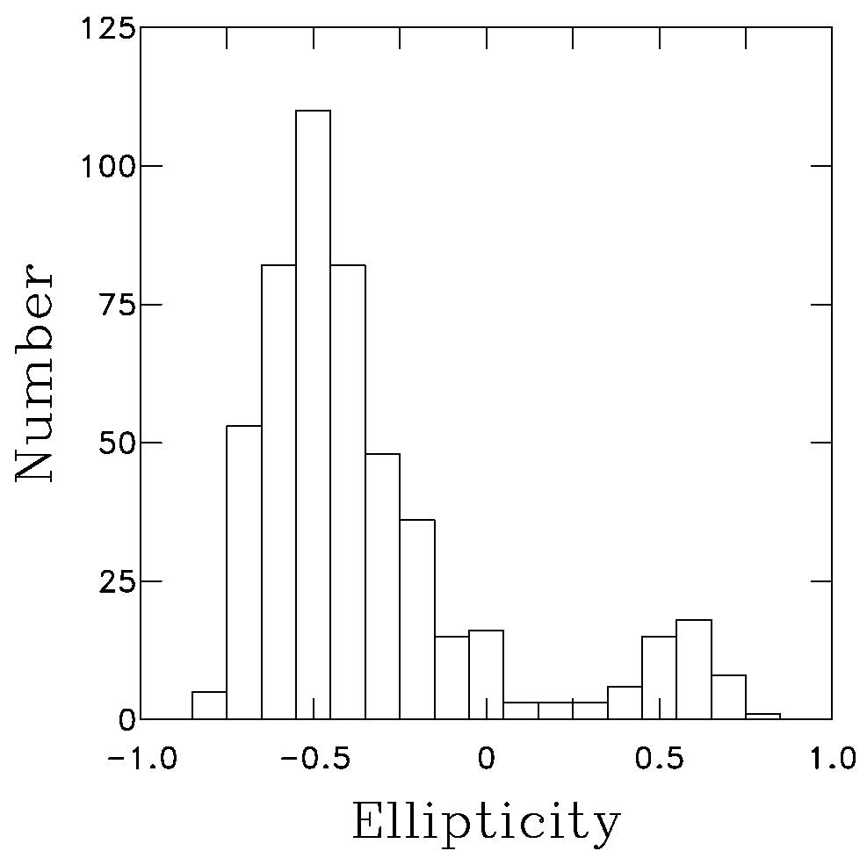
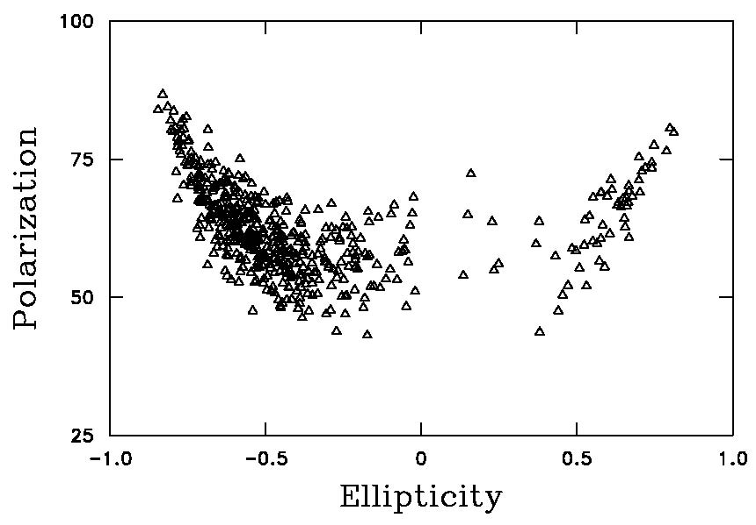
Cannon et al., ApJ, 784, 150, 2014

Slide 34
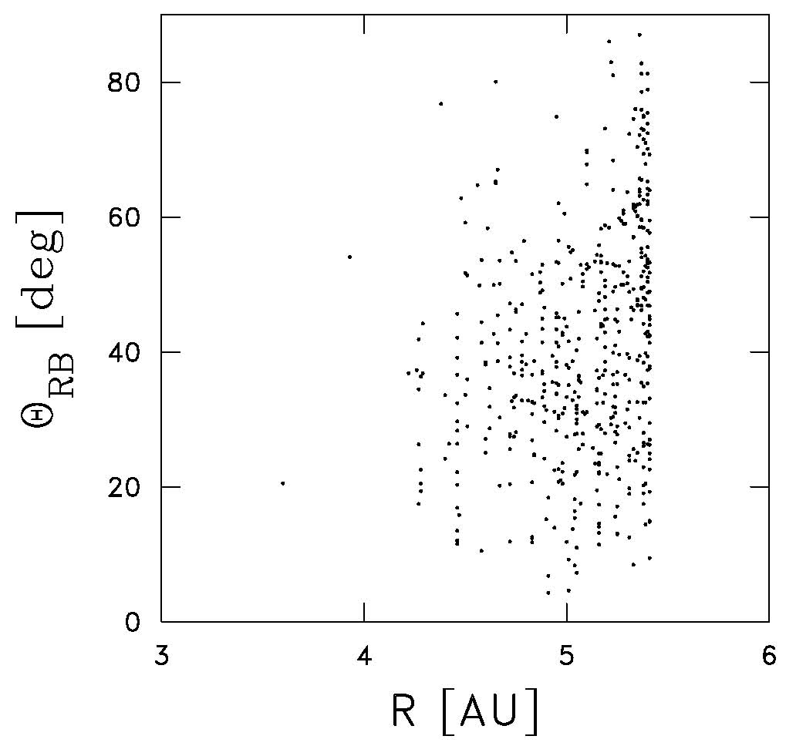
Cannon et al., ApJ, 784, 150, 2014
Ulysses observations of waves due to interstellar pickup H+ are seen beyond 4 AU and tend to be greatest in number beyond 5 AU.
This is what is expected of the “hydrogen cavity” as the neutral atoms are depleted inside ~ 5 AU.

Slide 35
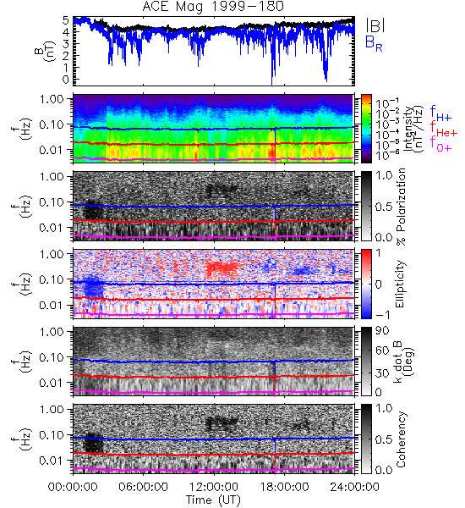
Argall et al., GRL, 42, 9617-9623, 2015
Found waves due to pickup He+ in ACE/MAG data.
Waves are seen at f_{He+,c} < f_{sc} < f_{p,c}.
We also find dissipation signatures, waves due to energetic electrons, etc.
Waves due to interstellar H⁺ are unlikely given the interstellar hydrogen cavity and could be difficult to distinguish from shock-accelerated H⁺.

Slide 36
Argall et al., GRL, 42, 9617-9623, 2015
Waves show all the expected characteristics when a more detailed analysis is performed.
The event shown exists within a rarefaction interval (below).

Slide 37
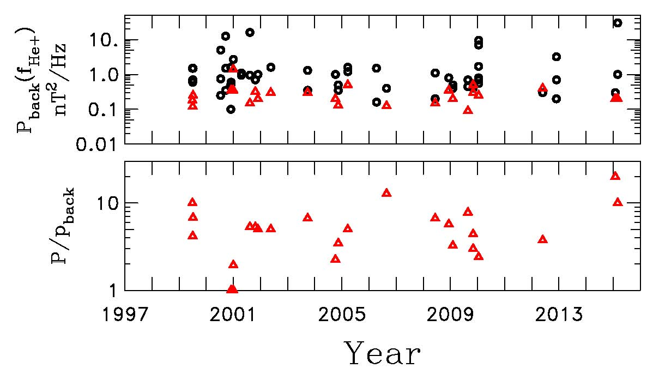
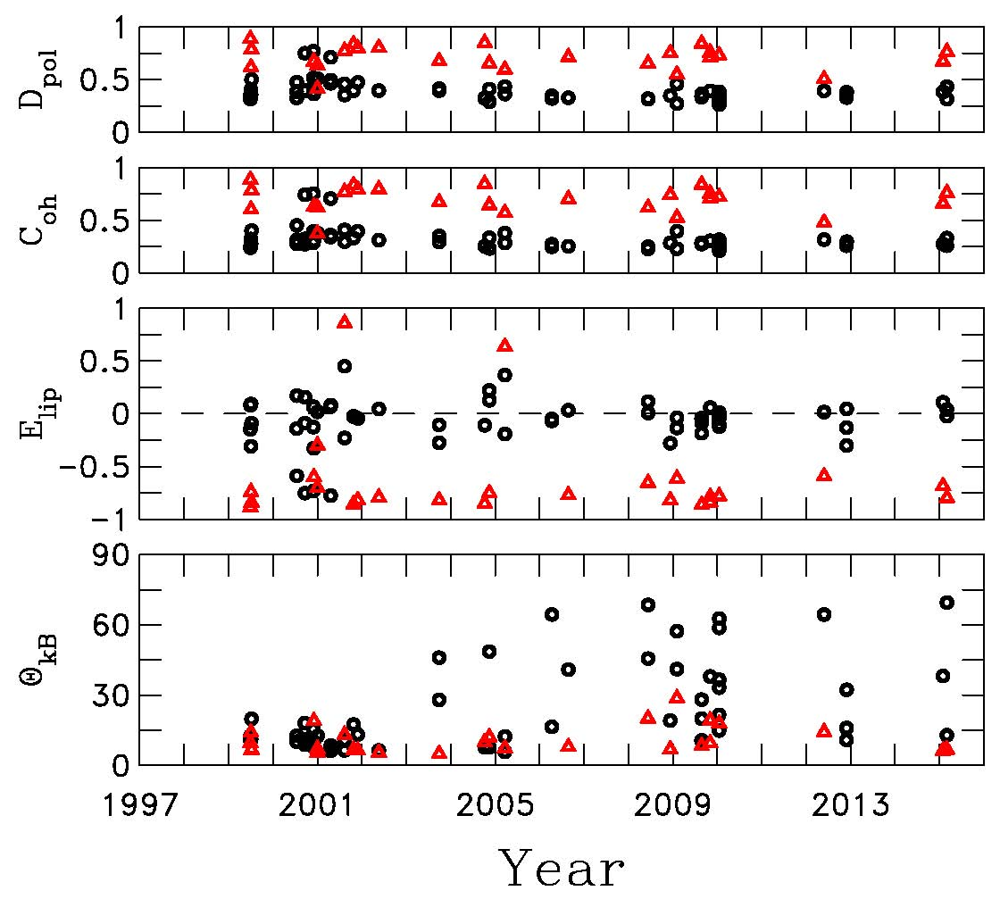
Fisher et al., ApJ, 830, 47, 2016

Slide 38
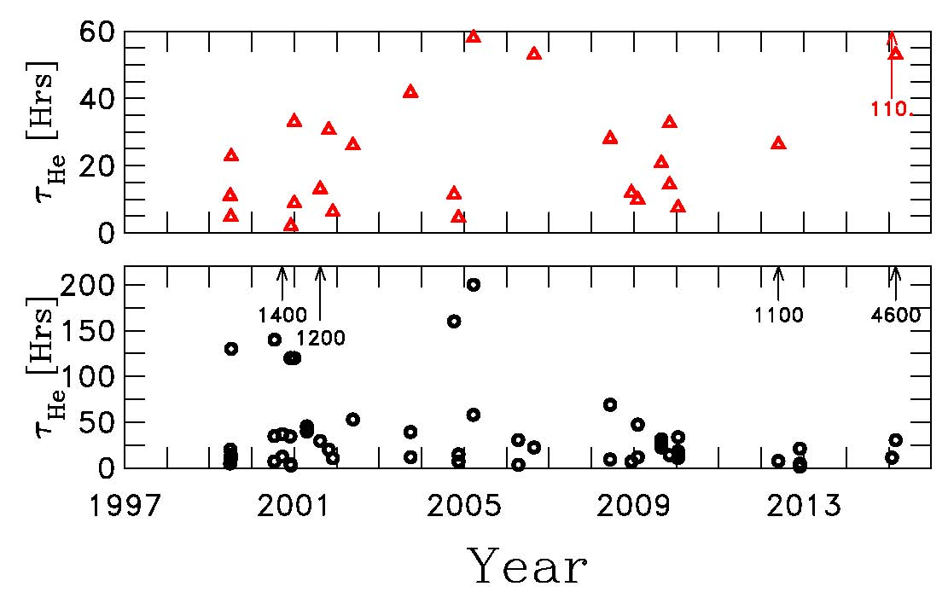
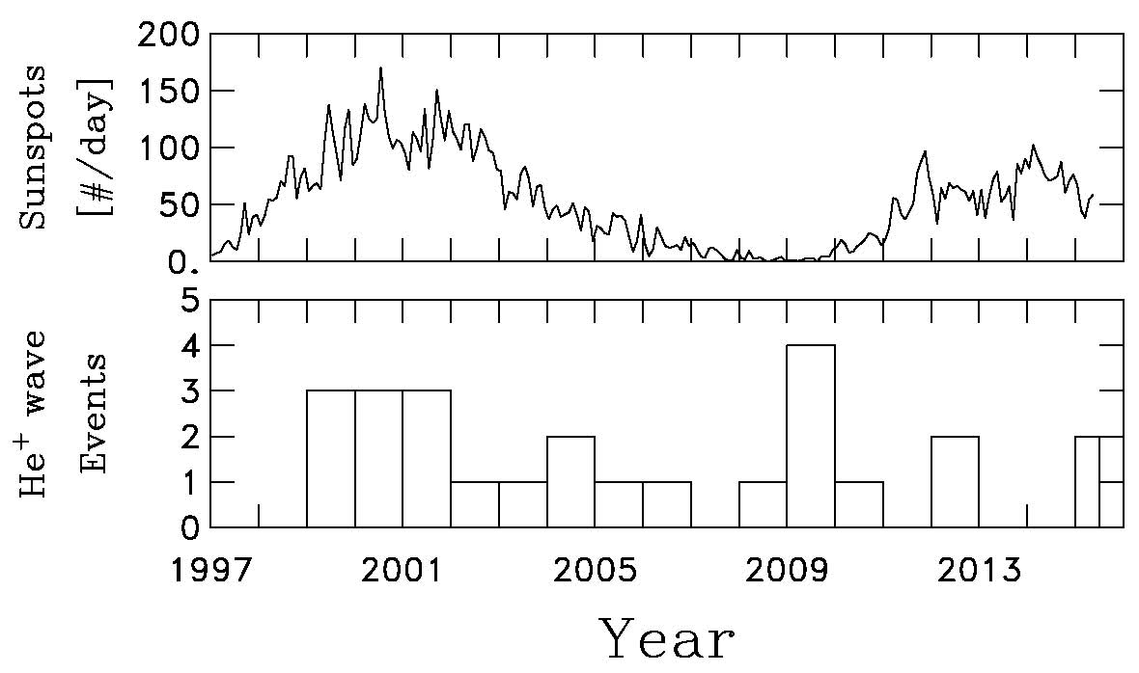
Fisher et al., ApJ, 830, 47, 2016

Slide 39
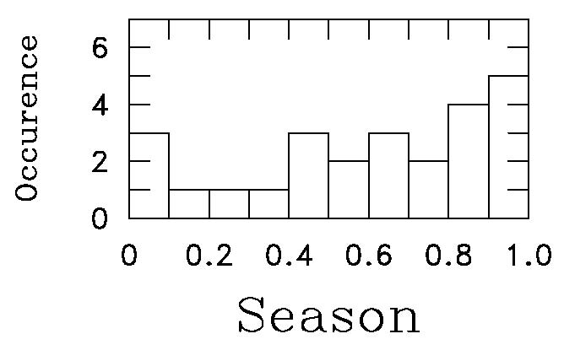
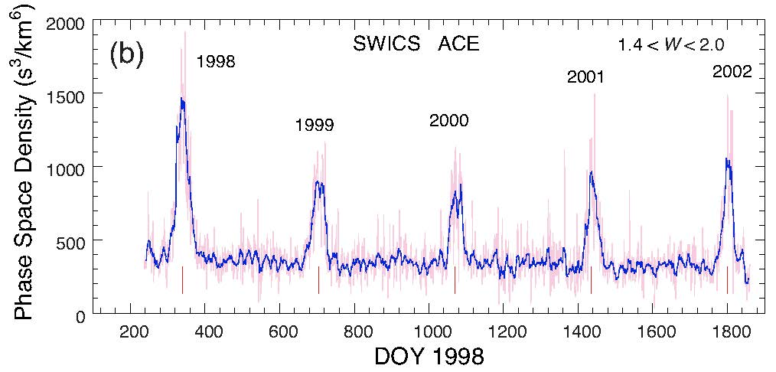
Fisher et al., ApJ, 830, 47, 2016
Despite statistics of small numbers, there is a slight increase in the number of He+ events in December and January when ACE is passing through the He+ focusing cone.
Gloeckler et al., Astron. Astrophys., 426, 845, 2004 →

Slide 40
Argall et al., ApJ, 849, 61, 2017

Slide 41
Hollick et al., ApJ, 863, 75, 2018.
This is what 667 wave events look like.
We use both Voyager 1 & 2 magnetic field and thermal ion data.
We use 1.92 sec MAG data and 9.6 sec MAG data when the former is not available.
We eliminate shock-associated and planet-associated waves.

Slide 42
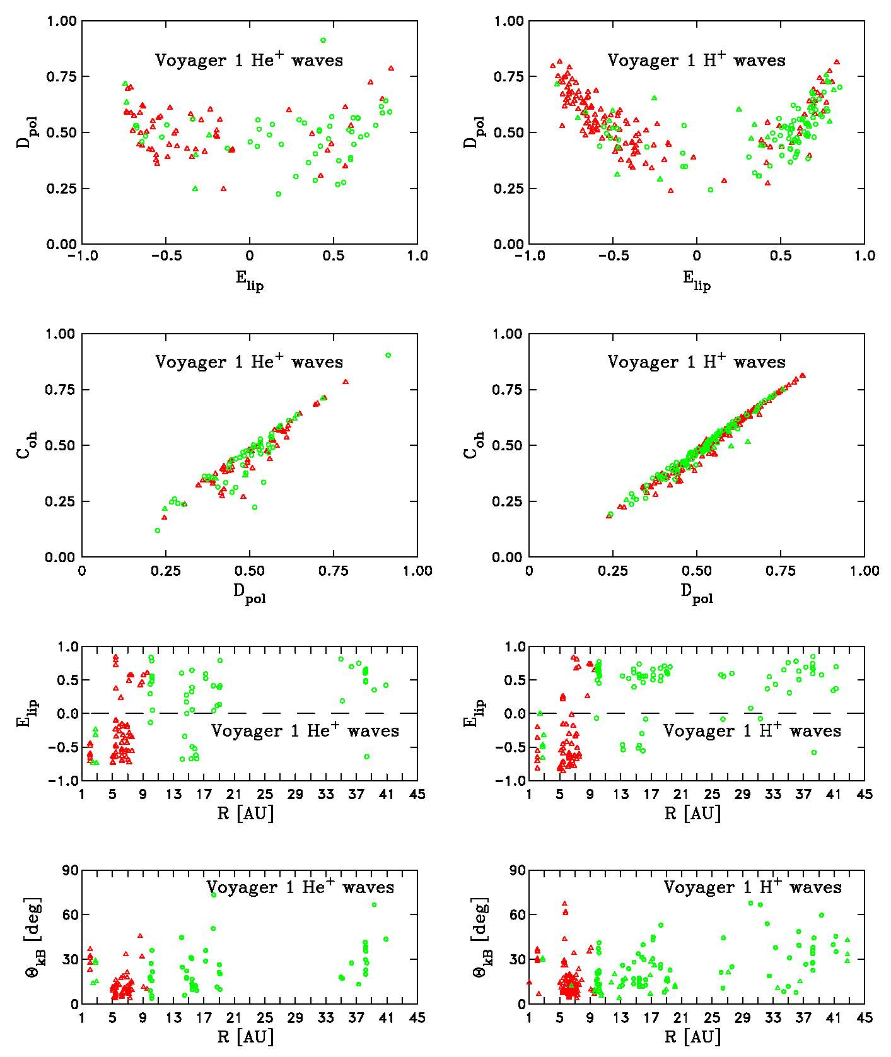
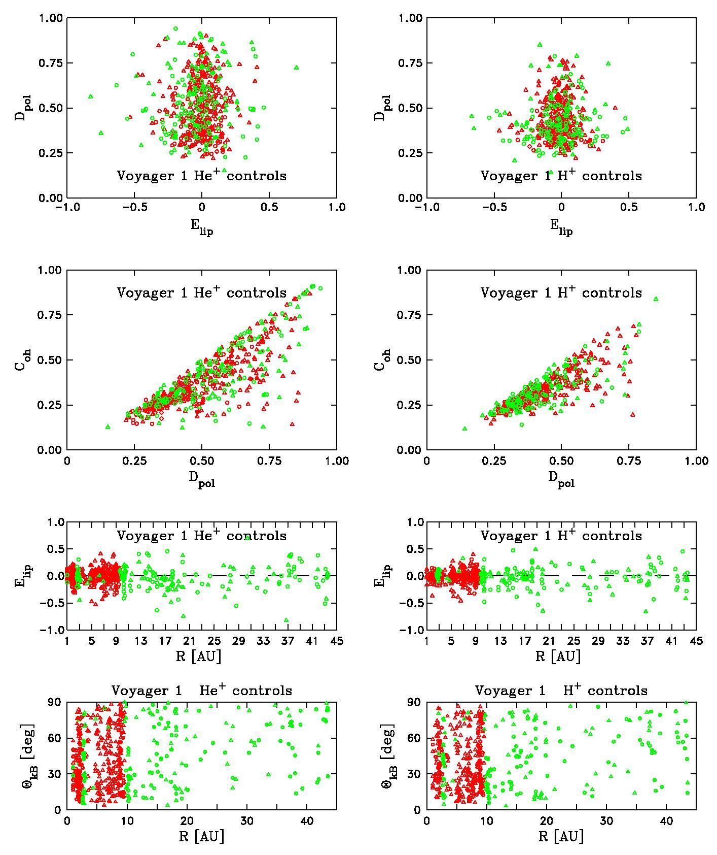

Slide 45
Lee & Ip, JGR, 92, 11041, 1987

Slide 46
Hollick et al., ApJ, 863, 76, 2018.

Slide 47
Hollick et al., ApJ, 863, 76, 2018.

Slide 48
Hollick et al., ApJ, 863, 76, 2018.

Slide 49
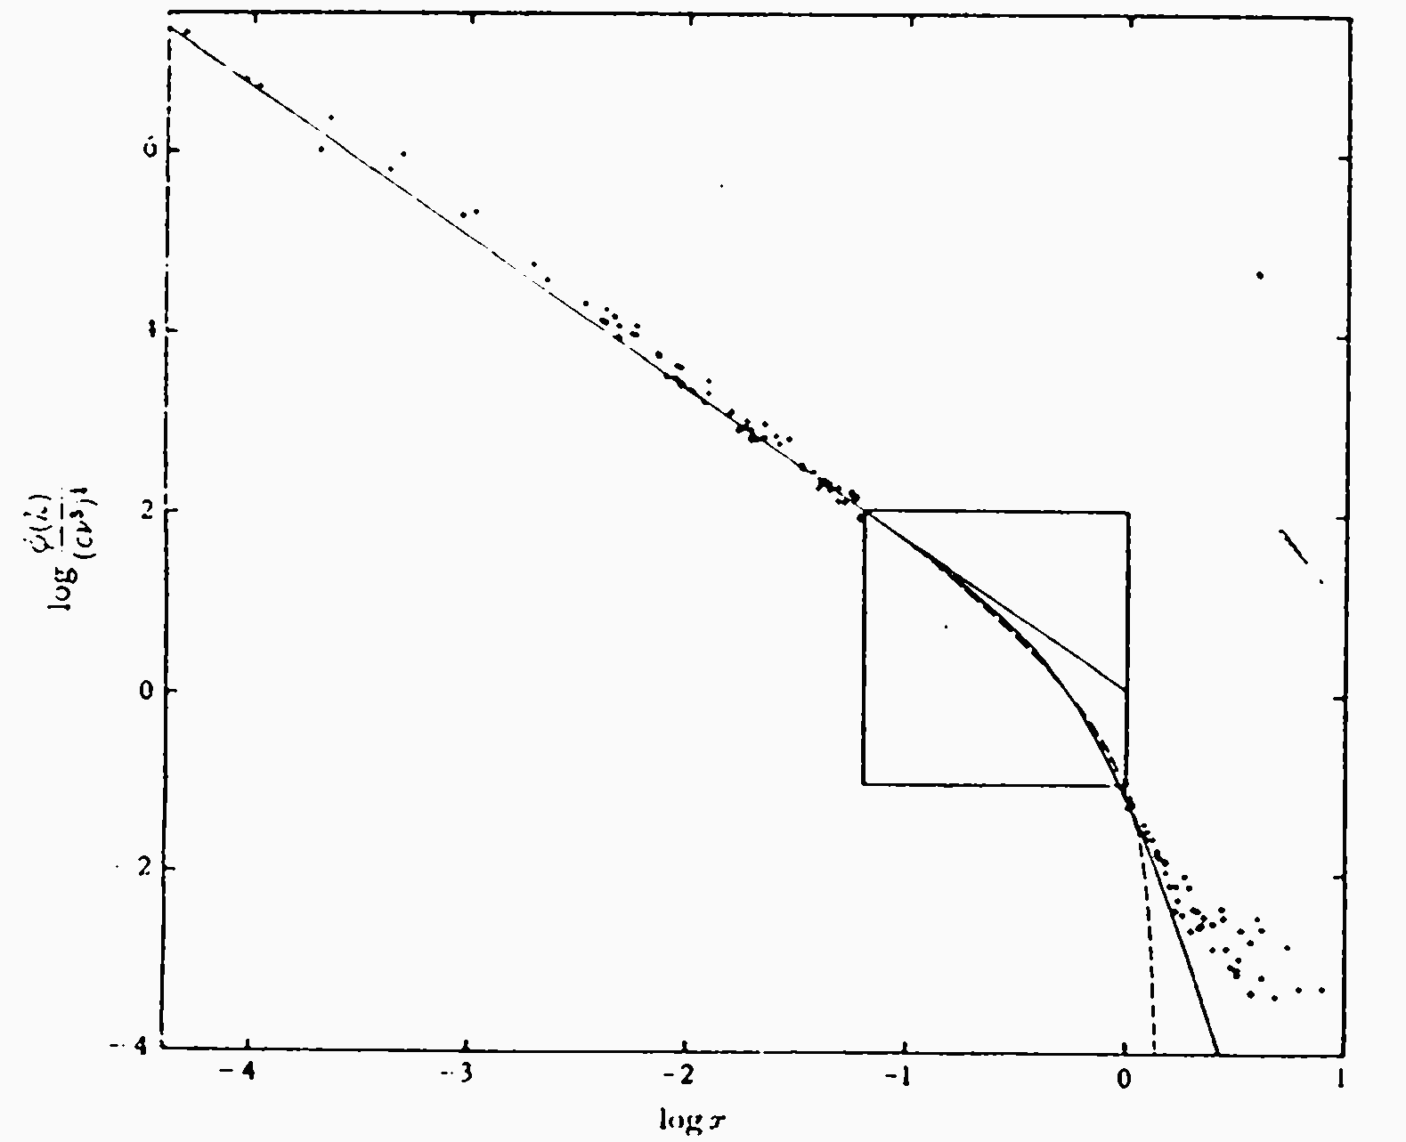
Interplanetary Spectrum
Grant, Stewart, and Moilliet, J. Fluid Mech., 12, 241, 1962.
f ⁻¹ “energy containing range”
ε = δV³/L
f ^{-5/3}
“inertial range”
P(k) = A_{K} ε^{2/3} k^{−5/3}
The energy scales that drive
the turbulence are different
from those where dissipation
occurs.
Magnetic Power
f ⁻³
“dissipation range”
→ Spectral cascade moves the energy through the spatial scales driven by the large-scale structures of the system.
Few hours
0.5 Hz

Slide 50
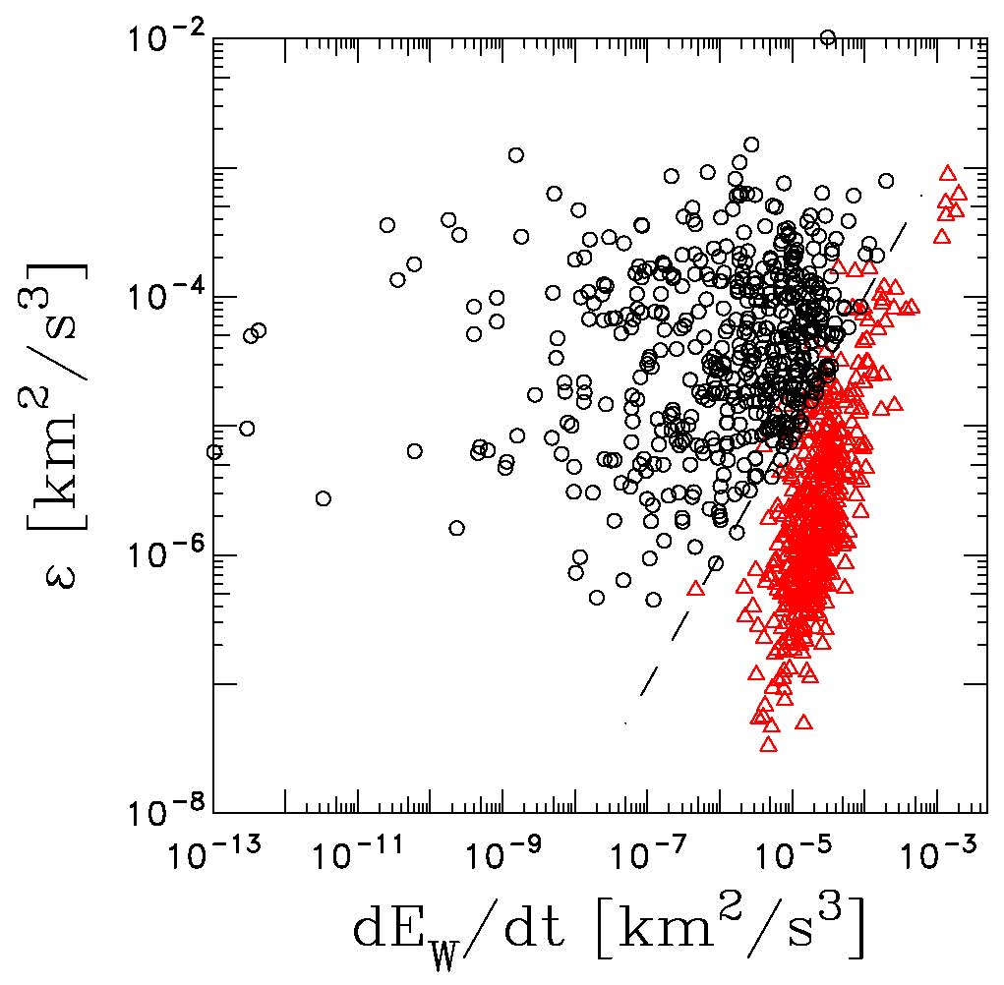
Cannon et al., ApJ, 787, 133, 2014
If we apply Kolmogorov (1941) scaling for the turbulent cascade of energy to the solar wind:
We can compare the rate of wave energy growth to the rate that turbulence reforms the energy and moves it to smaller scales for dissipation.

Slide 51
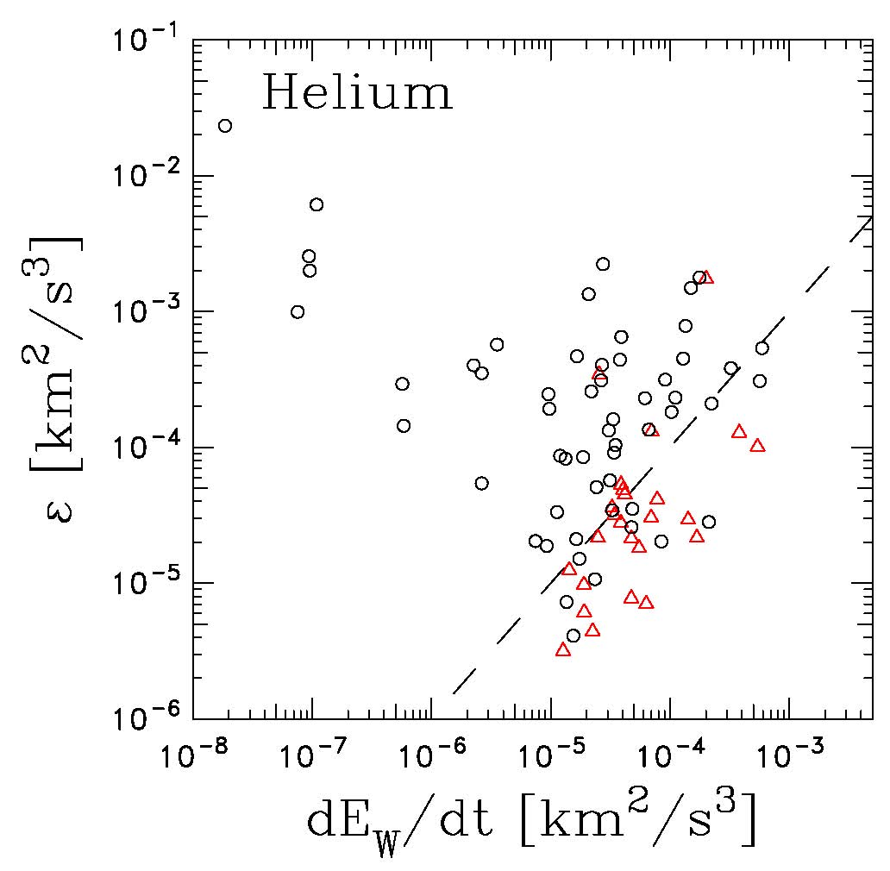
Fisher et al., ApJ, 830, 47, 2016.
Cannon et al., ApJ, 787, 133, 2014.

Slide 52
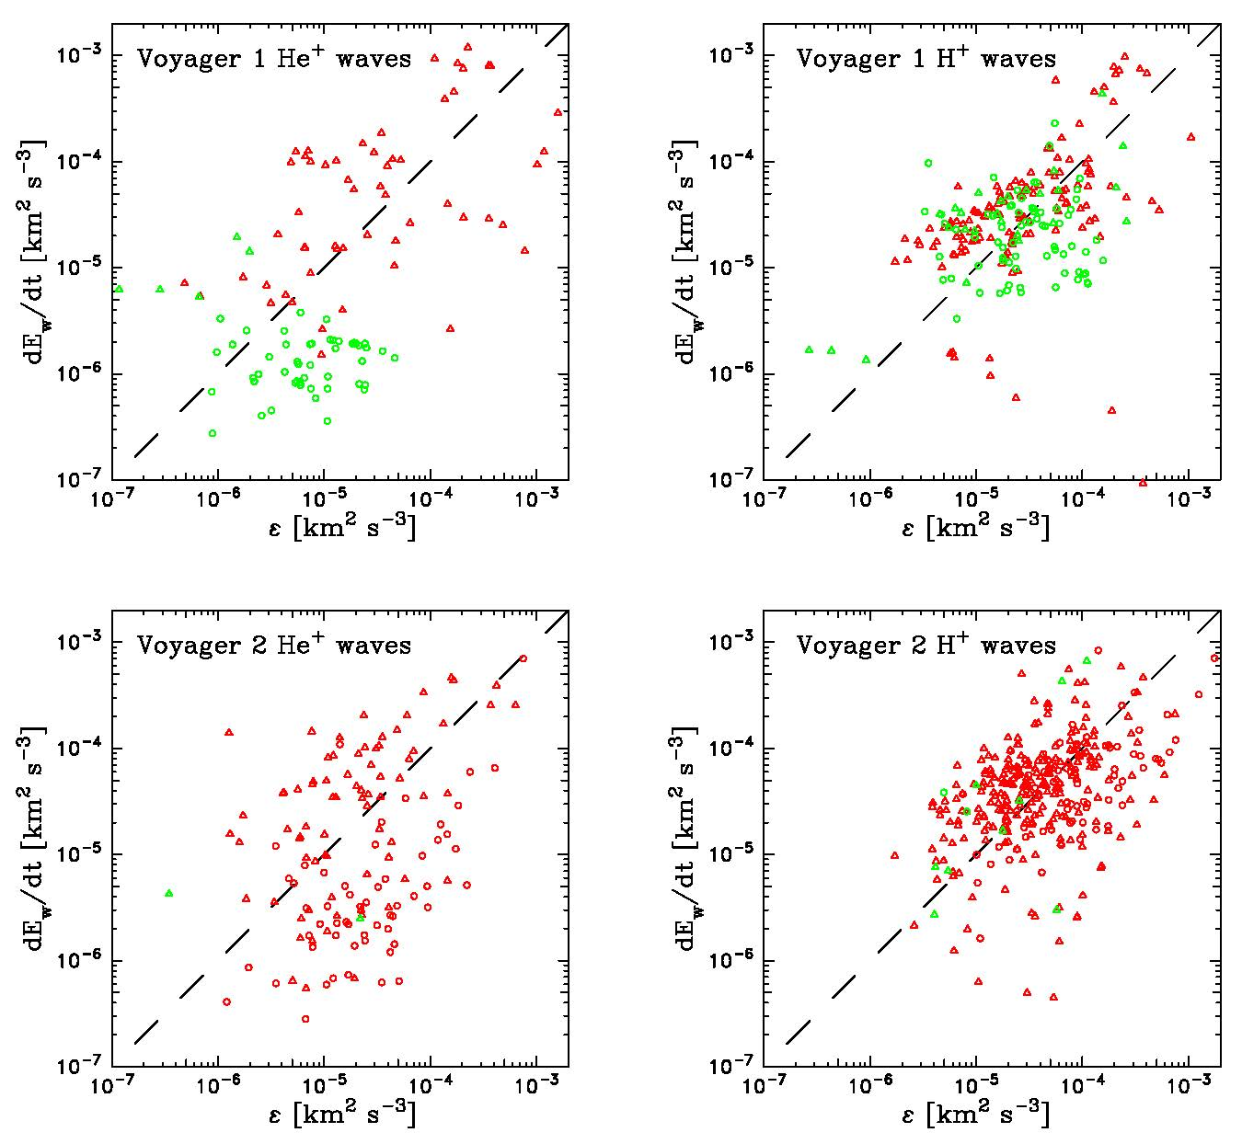

Waves
Controls

Slide 53
Hollick et al., ApJ, 863, 76, 2018.

Slide 54

Hollick et al., ApJ, 863, 76, 2018.

Slide 55
Ulysses Observations

Slide 56
Transport Theory
Zhou, Y., and W. H. Matthaeus, Models of inertial range spectra of interplanetary magnetohydrodynamic turbulence, J. Geophys. Res., 95, 14,881-14,892, 1990.
Zank, G. P., W. H. Matthaeus, and C. W. Smith, Evolution of turbulent magnetic fluctuation power with heliospheric distance, J. Geophys. Res., 101, 17,093-17,107, 1996.
Matthaeus, W. H., G. P. Zank, C. W. Smith, and S. Oughton, Turbulence, spatial transport, and heating of the solar wind, Phys. Rev. Lett., 82(17), 3444-3447, 1999.
Smith, C. W., W. H. Matthaeus, G. P. Zank, N. F. Ness, S. Oughton, and J. D. Richardson, Heating of the low-latitude solar wind by dissipation of turbulent magnetic fluctuations, J. Geophys. Res., 106, 8253-8272, 2001.
Isenberg, P. A., C. W. Smith, W. H. Matthaeus, Astrophys. J., 592, 564-573, 2003.
Isenberg, P. A., Astrophys. J., 623, 502-510, 2005
Breech, B., W. H. Matthaeus, J. Minniie, S. Oughton, S. Parhi, J. W. Bieber, and B. Bavassano, Geophys. Res. Lett., 32, L06103, 2005.
Smith, C. W., P. A. Isenberg, W. H. Matthaeus, and J. D. Richardson, Turbulent heating of the solar wind by newborn interstellar pickup protons, Astrophys. J., 638, 508-517, 2006.
Breech, B., W. H. Matthaeus, J. Mininie, J. W. Bieber, S. Oughton, C. W. Smith, and P. A. Isenberg, J. Geophys. Res., 113, A08105, 2008.
Cranmer, S. R., W. H. Matthaeus, B. A. Breech, and J. C. Casper, Empirical constraints on proton and electron heating in the fast solar wind, Astrophys. J., 702, 1604-1614, 2009.
Ng, C. S., A. Bhattacharjee, D. Munsi, P. A. Isenberg, and C. W. Smith, Kolmogorov versus Iroshnikov-Kraichnan Spectra: Consequences for Ion Heating in the Solar Wind, J. Geophys. Res., 115, A02101, doi:10.1029/2009JA014377, 2010.
Isenberg, P. A., C. W. Smith, W. H. Matthaeus, and J. D. Richardson, Astrophys. J., 719, 716-721, 2010.
Oughton, S., W. H. Matthaeus, C. W. Smith, B. Breech, and P. A. Isenberg, Transport of solar wind fluctuations: a two-component model, J. Geophys. Res., 116, A08105, 2011.
Zank, G. P., et al., Astrophys. J., 745, 35, 2012.
Usmanov, A. V., M. L. Goldstein, and W. H. Matthaeus, Astrophys. J., 788, 43, 2014.
Adhikari, L., G. P. Zank, R. Bruno, D. Telloni, P. Hunana, A. Dosch, R. Marino, and Q. Hu, Astrophys. J., 805, 63, 2015.
Adhikari, L. G. P. Zank, R. Bruno, D. Telloni, P. Hunana, A. Dosch, R. Marino, and Q. Hu, J. Physics: Conf. Ser., 642, 012001, 2015.
Usmanov, A. V., M. L. Goldstein, and W. H. Matthaeus, Astrophys. J., 820, 17, 2016.
Adhikari, L., Zank, G. P., Hunana, P., Bruno, R., D. Teloni, Q. Hu, D. Shiota, Astrophys. J., 841, 85, 2017.

Slide 57


Smith et al., ApJ, 638, 508, 2006

Slide 58

If wave energy is critical to explaining the heating of the solar wind in the outer heliosphere, the ability to observe the waves must be inhibited.
We can only find waves when growth exceeds the spectral transfer (cascade).

Slide 59

Pine et al., in preparation (transport).
Although we don’t see waves due to newborn interstellar PUIs most of the time, the energy input of wave excitation is always there.
H+ source is maximum on the walls of the H cavity.
He+ is a stronger source inside 5 AU.
Beyond 10 AU, heating the plasma is all about the interstellar ions!

Slide 60


Pine et al., in preparation (transport).

Slide 61


Hollick et al., in preparation (inner source).
From Zank, SSR, 89, 413, 1999.
How can interstellar PUIs excite waves inside 3 AU where turbulence is strong and ion production is weak?

Slide 62

Hollick et al., in preparation (inner source).

Slide 63


Hollick et al., in preparation (inner source).
If we take the computed growth times (below) and examine the ion production rates Sunward by the corresponding distance (left), we gain a factor of 5 to 10 in ion production rates.
Interstellar ion production is reduced closer to the Sun.
This points to an inner source explanation.

Slide 64


Hollick et al., in preparation (Jupiter).
The Voyager trajectories through the Jovian magnetosphere follow different paths.
The Voyager 2 outbound shock crossings are complicated and poorly resolved.
We excluded planet-related times from our interstellar PUI wave analysis.
Ness et al., Science, 206, 966, 1979.

Slide 65

Hollick et al., in preparation (Jupiter).

Slide 66

Hollick et al., in preparation (Jupiter).
Both the wave and control intervals around Jupiter have typical solar wind conditions. About 4 (?) wave events seen by Voyager 2 are in the magnetosheath during the outbound trajectory, but the sheath is very wind-like at that distance (high-ish Mach number, reasonable wind speed and density, etc.). However, we do not know to what extent the shock crossing may contaminate the data.

Slide 67

Hollick et al., in preparation (Jupiter).

Slide 68

Hollick et al., in preparation (Jupiter).

Slide 69


Hollick et al., in preparation (Jupiter).

Slide 70

Hollick et al., in preparation (Jupiter).

Slide 71
Ally Bickford (UNH Fresh., ACE shocks) Sophia Hollick (RPI Soph., Voyager)
Abbey Watson (HS Jun., Ulysses) Julia Fitzgibbons (UNH Soph., ACE turb.)
Zack Pine (BU Soph., Voyager turb.) Ana Marchuk (HS Sen., Ulysses)

Slide 72


Joyce et al., ApJ, 745, 112, 2012
Spectral analysis of event reveals two power enhancements at spacecraft frame frequencies near the Nyquist frequency.

Slide 73

Joyce et al., ApJ, 745, 112, 2012
Higher resolution plotting reveals that enhancements are indeed present due to magnetic fluctuations.
We see that the magnetic fluctuations are almost entirely perpendicular to the radial.
This suggests that the waves propagate radially, almost perpendicular to the mean field.

Slide 74


Joyce et al., ApJ, 745, 112, 2012
The helicity spectrum of this event shows no signature and thus the waves are not circularly polarized.
To get a better sense of the wave polarization, we create hodograms of the event.
This analysis reveals linear polarization, with fluctuations highly perpendicular to the mean IMF at the start of the event and developing more of a radial component in time.

Slide 75

Joyce et al., ApJ, 745, 112, 2012
The figure to the left shows the angle between the mean IMF and the radial, the wave frequency, and the angle between the fluctuations and the mean IMF during the course of the event.
We see that the fluctuations begin once the IMF becomes highly azimuthal.
We also confirm that the fluctuations begin highly perpendicular to the mean IMF, but become more radial as time goes on.

