Slide 1
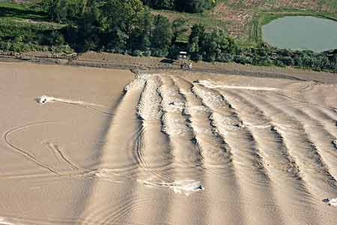
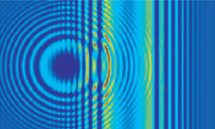

Magnetosonic Turbulence in the Inner Heliosheath
Bertalan Zieger¹, Merav Opher^{1,2}, Gábor Tóth³
¹Center for Space Physics, Boston University
²Astronomy Department, Boston University
³Department of Atmospheric, Oceanic, and Space Sciences, University of Michigan

Slide 2
Overview
Multi-Ion MHD Theory:
Three-fluid model of the solar wind (thermal ions, pick-up ions, electrons)
Linear and nonlinear waves
Dispersive shock waves
Numerical Simulations:
1-D multi-ion shock tube simulations of the termination shock and the heliosheath
Quasi-stationary waves, shocklets, instabilities, compressional turbulence
Validation With Voyager 2 Data:
Reconstruct observed termination shock structure
Determine the unknown pickup ion parameters
Explain observed features like current sheets, magnetic holes, and the probability distribution function of magnetic field increments

Slide 3
Multi-Ion MHD Equations
  Tóth et al., 2012

Slide 4
Multi-Ion MHD Equations
Let’s linearize these equations!
  Tóth et al., 2012

Slide 5
Linearized Continuity and Momentum Equations

Slide 6
General Dispersion Relation

Slide 7
How to Find the Dielectric Tensor?
Conductivity tensor:
Susceptibility tensor:
Dielectric tensor:

Slide 8
Dielectric Tensor
where
are the plasma frequency, gyrofrequency, and sound speed of particle species j.

Slide 9
Linear Dispersion Relation of Perpendicular Magnetosonic Waves in Warm Multi-ion Plasma
  Zieger et al., 2015
For the three-fluid solar wind (thermal ions, PUI, electrons):
Two linear plane wave solutions.

Slide 10
High-Frequency Fast Mode and Low-Frequency Fast Mode in the Three-Fluid Solar Wind
The fast mode splits
into a pick-up ion mode (F_{PUI}) and a thermal ion mode (F_{SW}).
Plasma parameters
upstream of the termination shock in the cold electron case:
n_{SW}= 0.0013 cm⁻³
T_{SW}= 4200 K
B= 0.067 nT
n_{PUI}= 0.7 n_{SW}
T_{PUI}= 8.6 MK

Slide 11
Necessary Condition for the Existence of Nonlinear Quasi-stationary Waves

Slide 12
Wave Number (k) Solutions of the Three-Fluid
Warm Plasma Dispersion Relation
Plasma parameters
upstream of the termination shock in the hot electron case:
n_{SW}= 0.0013 cm⁻³
T_{SW}= 4200 K
B= 0.067 nT
n_{PUI}= 0.25 n_{SW}
A_{PUI}= 0.2
T_{PUI}= 13.4 MK
T_{e}= 0.83 MK
  Zieger et al., 2015

Slide 13
Existence of Fast Magnetosonic Solitons and Oscillitons on Fluid Scale
Phase Velocity
FLUID
SCALE
ION
SCALE
A fast magnetosonic oscilliton is predicted at the fast magneto-sonic speed of the total fluid (U_{fm}) on fluid scale.
U_{fm}= 223 km/s
c_{PUI}= 344 km/s
ELECTRON
SCALE
Oscilliton
  Zieger et al., 2015

Slide 14
Existence of Dispersive Shock Waves in the Three-Fluid Solar Wind
Group Velocity
Two critical speeds: U_{fm} in F_{SW} at low frequencies and c_{PUI} in F_{PUI} at high frequencies.
Both fast modes are dispersive on fluid scale.
Dispersive shock waves
  Zieger et al., 2015

Slide 15
Subcritical Dispersive Shock Waves
Negative DSW
Positive DSW
  Biskamp, 1973
Subcritical dispersive shocks are expected to have either a trailing wave train or a precursor wave train depending on the shape of the dispersive relation.
The thermal ion shock is expected to have a trailing wave train because F_{SW} is negative dispersive.

Slide 16
Analytical Solution of Nonlinear Dispersive
Shock Waves in Eulerian Fluids
  Hoefer, 2014
Solutions of the nonlinear Korteweg – de Vries equations of Eulerian fluids (no viscosity and no heat conduction)
Negative (a) and positive (b) dispersive shock waves

Slide 17
Overturning of the Pickup Ion Wave
  McKenzie et al, 1993; Dubinin et al., 2006
Negative Sign (sonic point)
Positive Sign (critical locus)
Transforming to the frame moving at c_{s}:
if u_{p} = c_{s}
In multi-ion plasma, the sonic point is reached when the compressional wave becomes stationary.
Nonlinear steepening leads to
overturning of the wave.

Slide 18
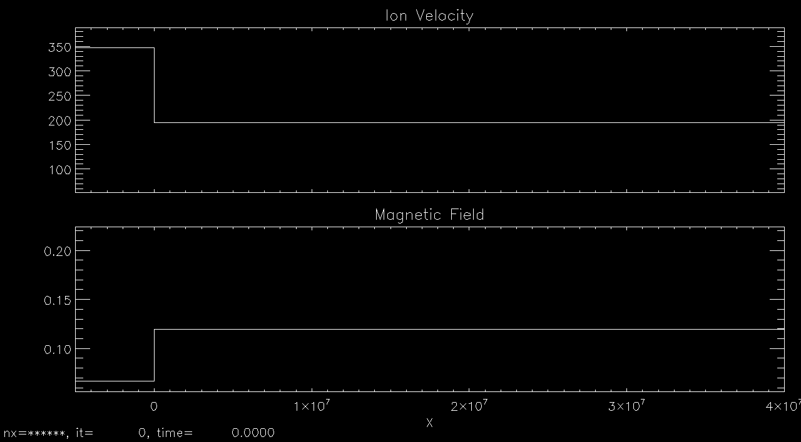
1-D Three-Fluid Shock Tube Simulation of the Termination Shock (TS3):
Ion Velocities and Magnetic Field

Slide 19
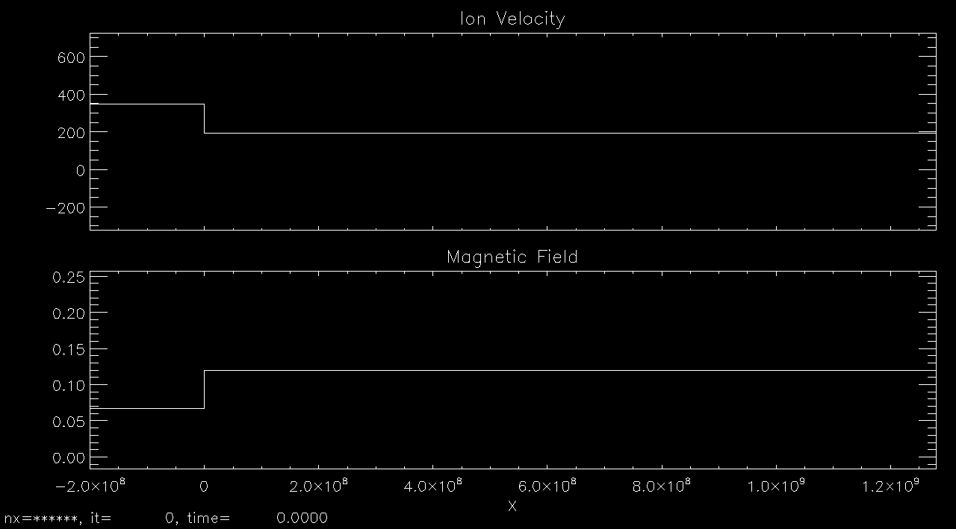
Heliosheath Turbulence

Slide 20
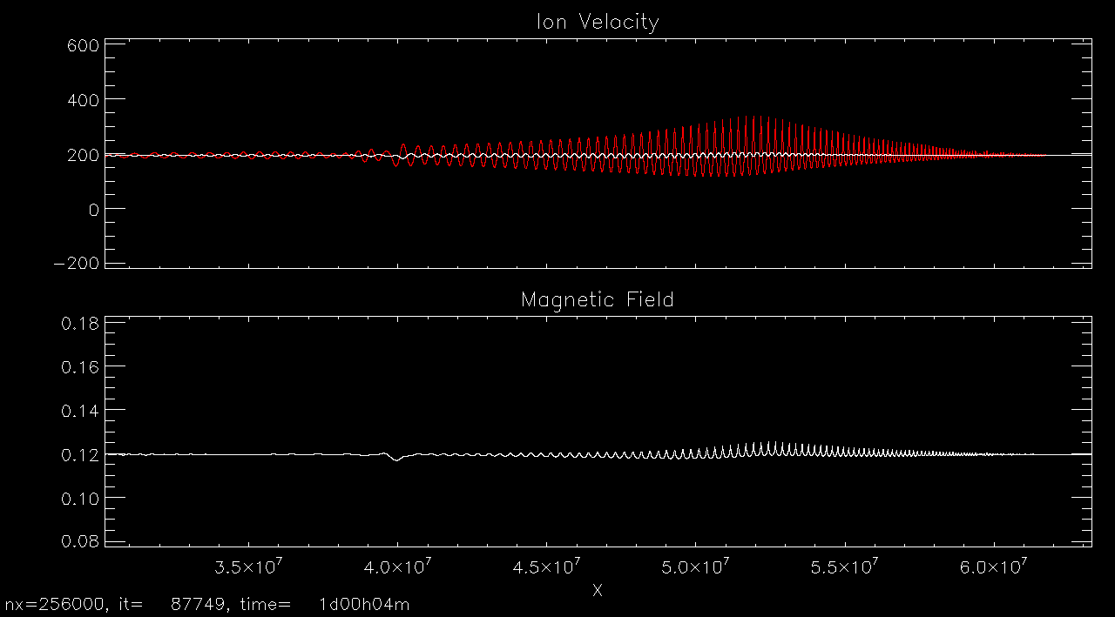
Pickup Ion Shocklets

Slide 21
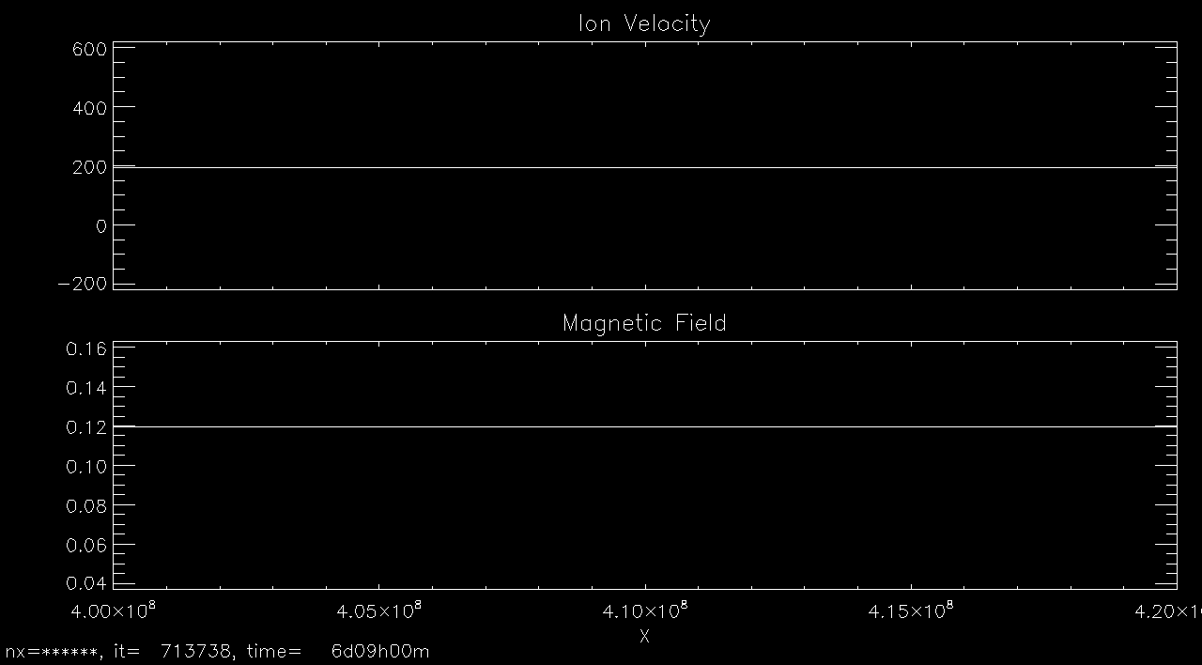
Magnetic Holes

Slide 22
Model Validation With Voyager 2 Data:
Hot Electron Case
Better fit to the downstream ion velocity and temperature.
The partial pressure of energetic electrons is included in the shock adiabatic equation.
n_{SW}= 0.0013 cm⁻³
T_{SW}= 4200 K
B= 0.067 nT
n_{PUI}= 0.25 n_{SW}
A_{PUI}= 0.2
T_{PUI}= 13.4 MK
T_{e}= 0.83 MK
p_{e}= 0.0173 pPa
  Zieger et al., 2015

Slide 23
Pick-up Ion Pressure Predicted by New Horizons
TS: Zieger, 2015
*
At the TS:
p_{PUI}/p_{SW}= 800
  Randol et al., 2013

Slide 24
Tsallis Distribution of Magnetic Field Increments
in the Heliosheath
PDF from Simulatin
PDF at Voyager 2

Slide 25
Velocity Distribution in the Oscilliton
Simulation
for Different PUI abundances
Voyager 2 Observation

Slide 26
Turbulence Spectra in the Inner Heliosheath

Slide 27
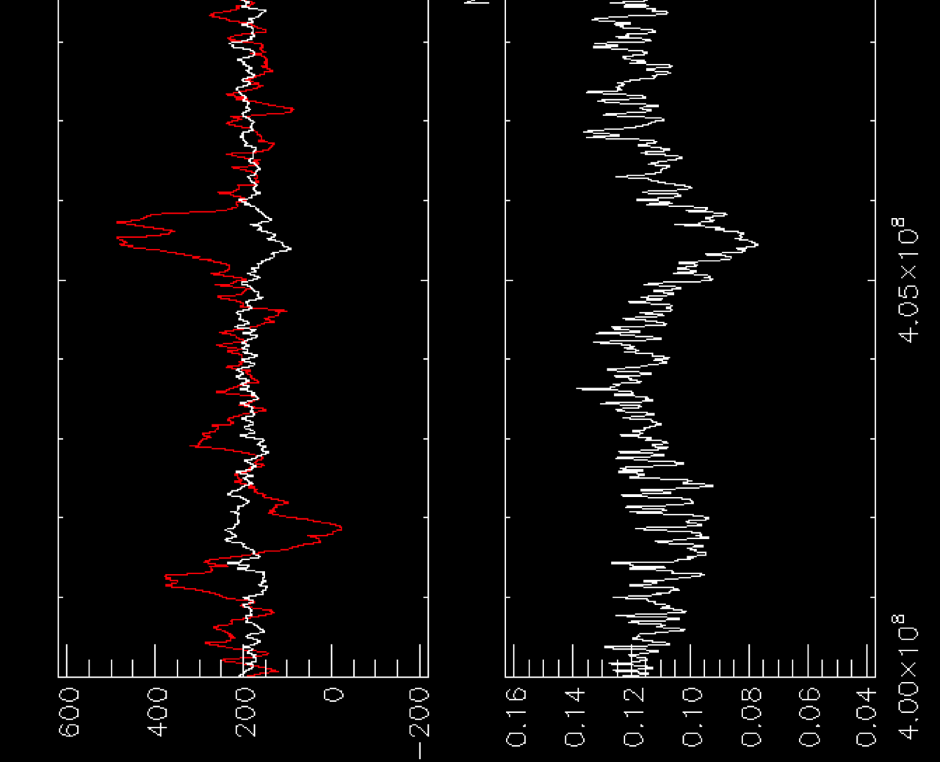
Magnetic Holes Produced by Pickup Ion Waves
Close to the Ion-Ion Resonance Frequency
  Burlaga et al., 2016

Slide 28
Conclusions
The termination shock is a high-β low-Mach number dispersive shock wave.
Multi-ion MHD simulations reproduce the microstructure of the termination shock, the foot , the ramp, the overshoot and the nonlinear wave train (oscilliton).
The oscilliton shows a Tsallis distribution in the magnetic field increments as observed by Voyager 2.
The best fitting multi-ion shock wave solution indicates that the pick-up ion abundance is 0.2, the pick-up ion temperature is 13.4 MK, and the apparent electron temperature is 0.83 MK upstream of the termination shock.
Overturning pickup ion waves produce shocklets (or thin current sheets) and strong magnetosonic turbulence in unipolar magnetic regions.
Magnetic holes are produced by downstream propagating pickup ion waves close to the ion-ion resonance frequency.

Slide 29
Thank You!

Slide 30
Dependence of the Termination Shock Structure on the Pick-up Ion Density (n_{PUI}/n_{SW})
Overshoot
Shocklet
Ramp
Foot
Wave train
  Zieger et al., 2015
The magnetic field profile consist of a foot, a ramp, an overshoot, and a nonlinear wave train (oscilliton).
The wavelength of the oscilliton and the magnitude of the overshoot strongly depend on the the pick-up ion density.

Slide 31
Constraining the Pick-up Ion Parameters
With the Shock Adiabatic Equation
Unknowns: n_{PUI1}, T_{PUI1}, p_{e1}
TS2: q= 2.07, V_{s}= 51.3 km/s
TS3: q= 1.78, V_{s}= -26.5 km/s
Normalized PUI Density
  Zieger et al., 2015

Slide 32
Self-consistent Energy Partitioning
Across the Termination Shock
The hydrodynamic energy loss of thermal ions is compensated by the hydrodynamic energy gain of pick-up ions and electrons so that the total MHD energy is conserved.
  Zieger et al., 2015

Slide 33
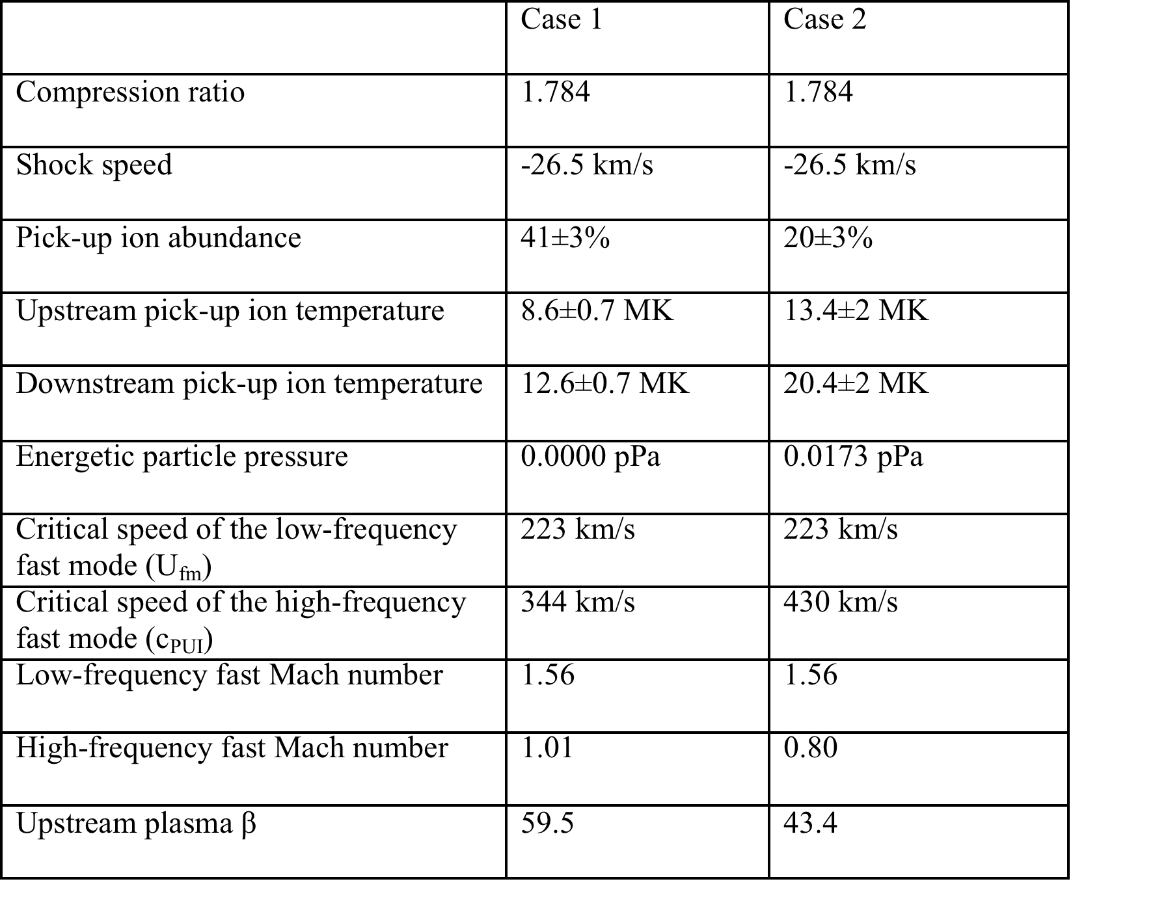
Multi-Fluid Shock Parameters of TS3
The termination shock is a high-β low-Mach number dispersive shock wave!

Slide 34
Polarization of the Oscilliton
Velocity
Magnetic Field
The oscilliton is elliptically left-hand polarized in the velocity in the plane perpendicular to the magnetic field and linearly polarized in the magnetic field in the direction of the ambient magnetic field.

Slide 35
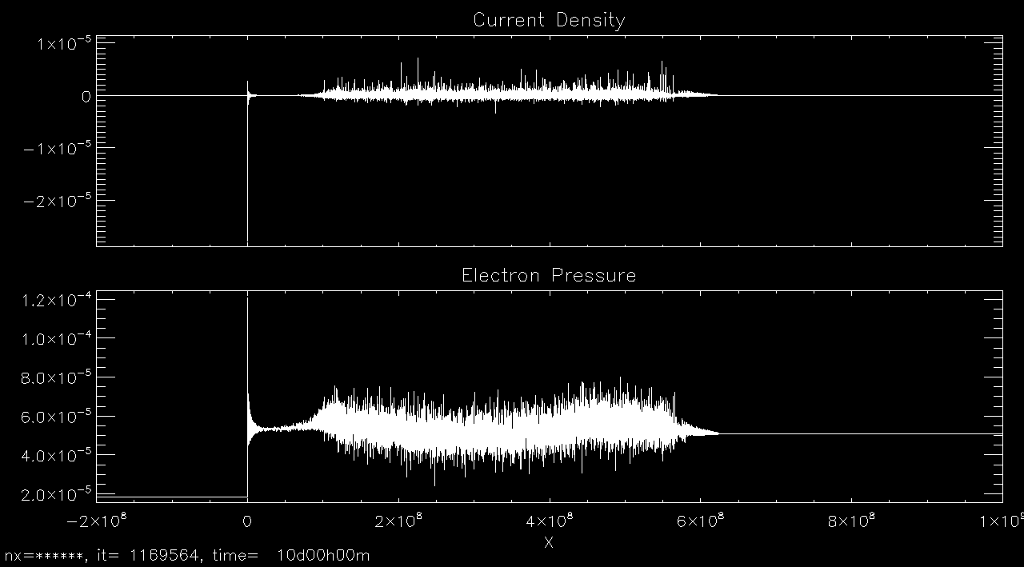
Perpendicular Current Density

Slide 36
Puzzles of the Voyager 2 Termination Shock Crossing
The solar wind remained superfast downstream of the shock.
The hydrodynamic energy did not conserve across the shock.
The termination shock is not a single-fluid MHD shock.
Mediated by pickup ions and suprathermal energetic particles.
Open Questions:
  How pick-up ions (PUI) affect the structure and thermodynamics of the termination shock?
  What is the PUI abundance and PUI temperature?
  What is the role of hot electrons?
  What is the origin of compressional turbulence in the heliosheath?

Slide 37
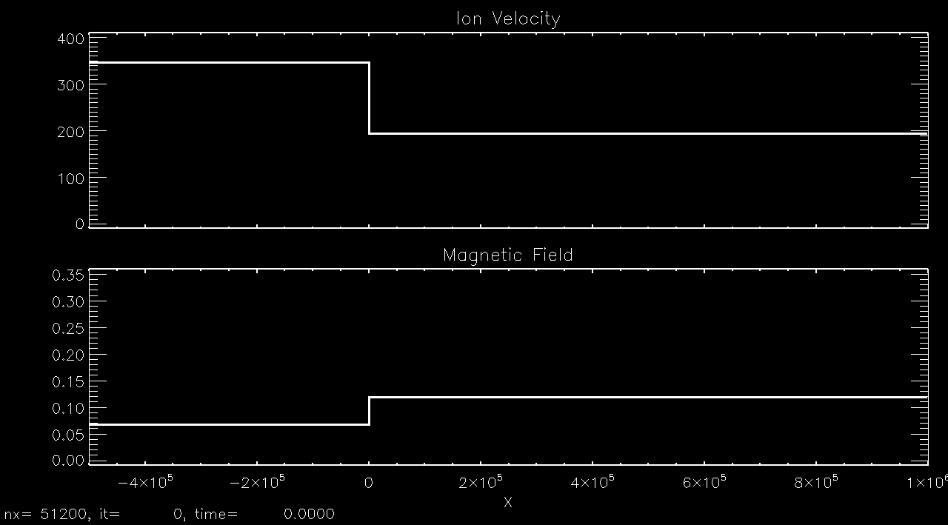

Microstructure of the Termination Shock
(TS3)

Slide 38
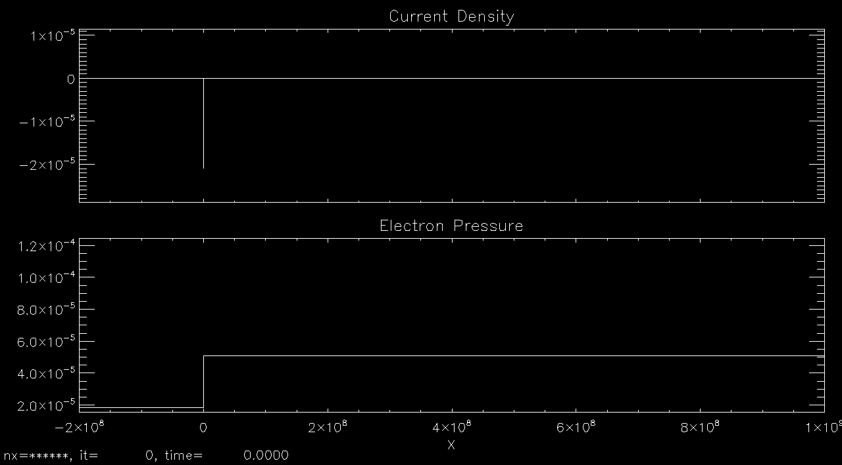

Perpendicular Current Density

