Slide 1
Separation of the IBEX Ribbon from the Globally Distributed Flux Using Nine-Year IBEX Data
N. Schwadron, D. J. McComas, S. A. Fuselier, M. Desai, and M. Dayeh, H. O. Funsten, P. Janzen and D. Reisenfeld, H. Kucharek, K. Fairchild, M. Bzowski, J. M. Sokol, and M. A. Kubiak, A. Galli and P. Wurz, E. R. Christian, R. DeMajistre, P. Frisch .. And IBEX team!!

Slide 2
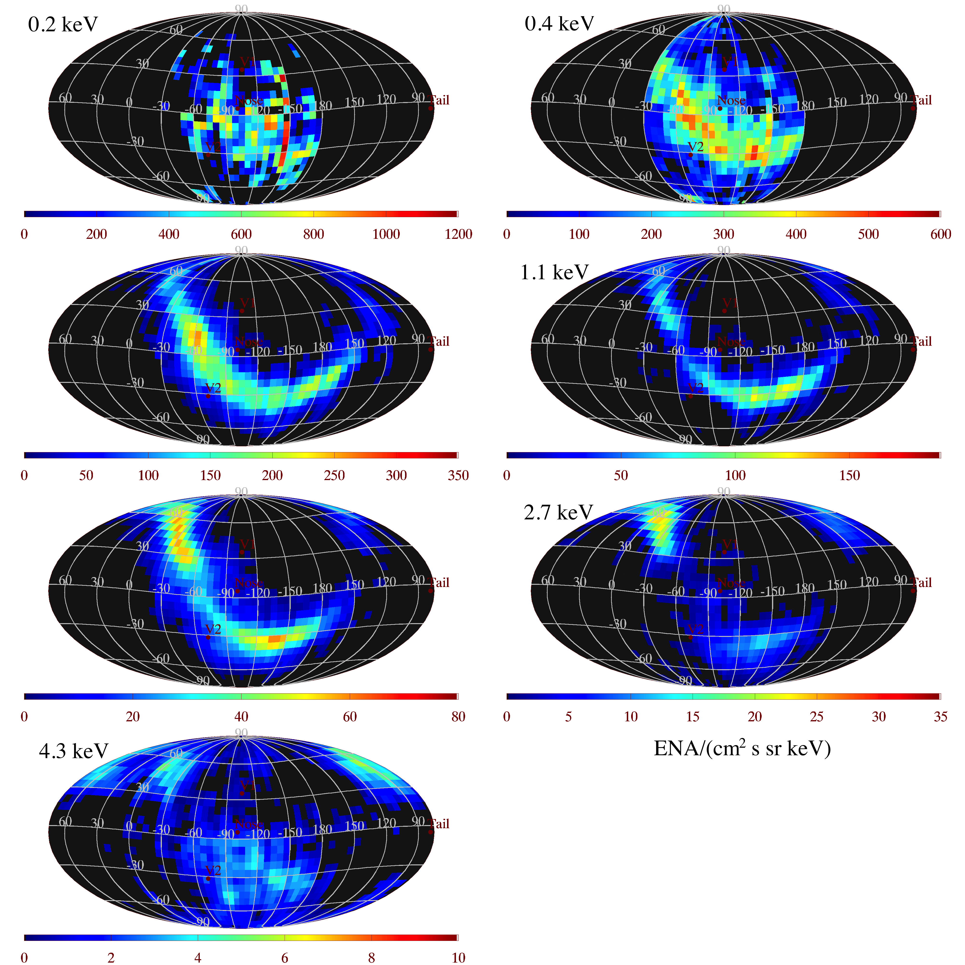
2009-
2014
0.7 keV
1.7 keV
IBEX Ribbon
Schwadron et al., Separation of the Ribbon from Globally Distributed Energetic Neutral Atom Flux Using the First Five Years of IBEX Observations, ApJSS, 215, 13, 2014

Slide 3
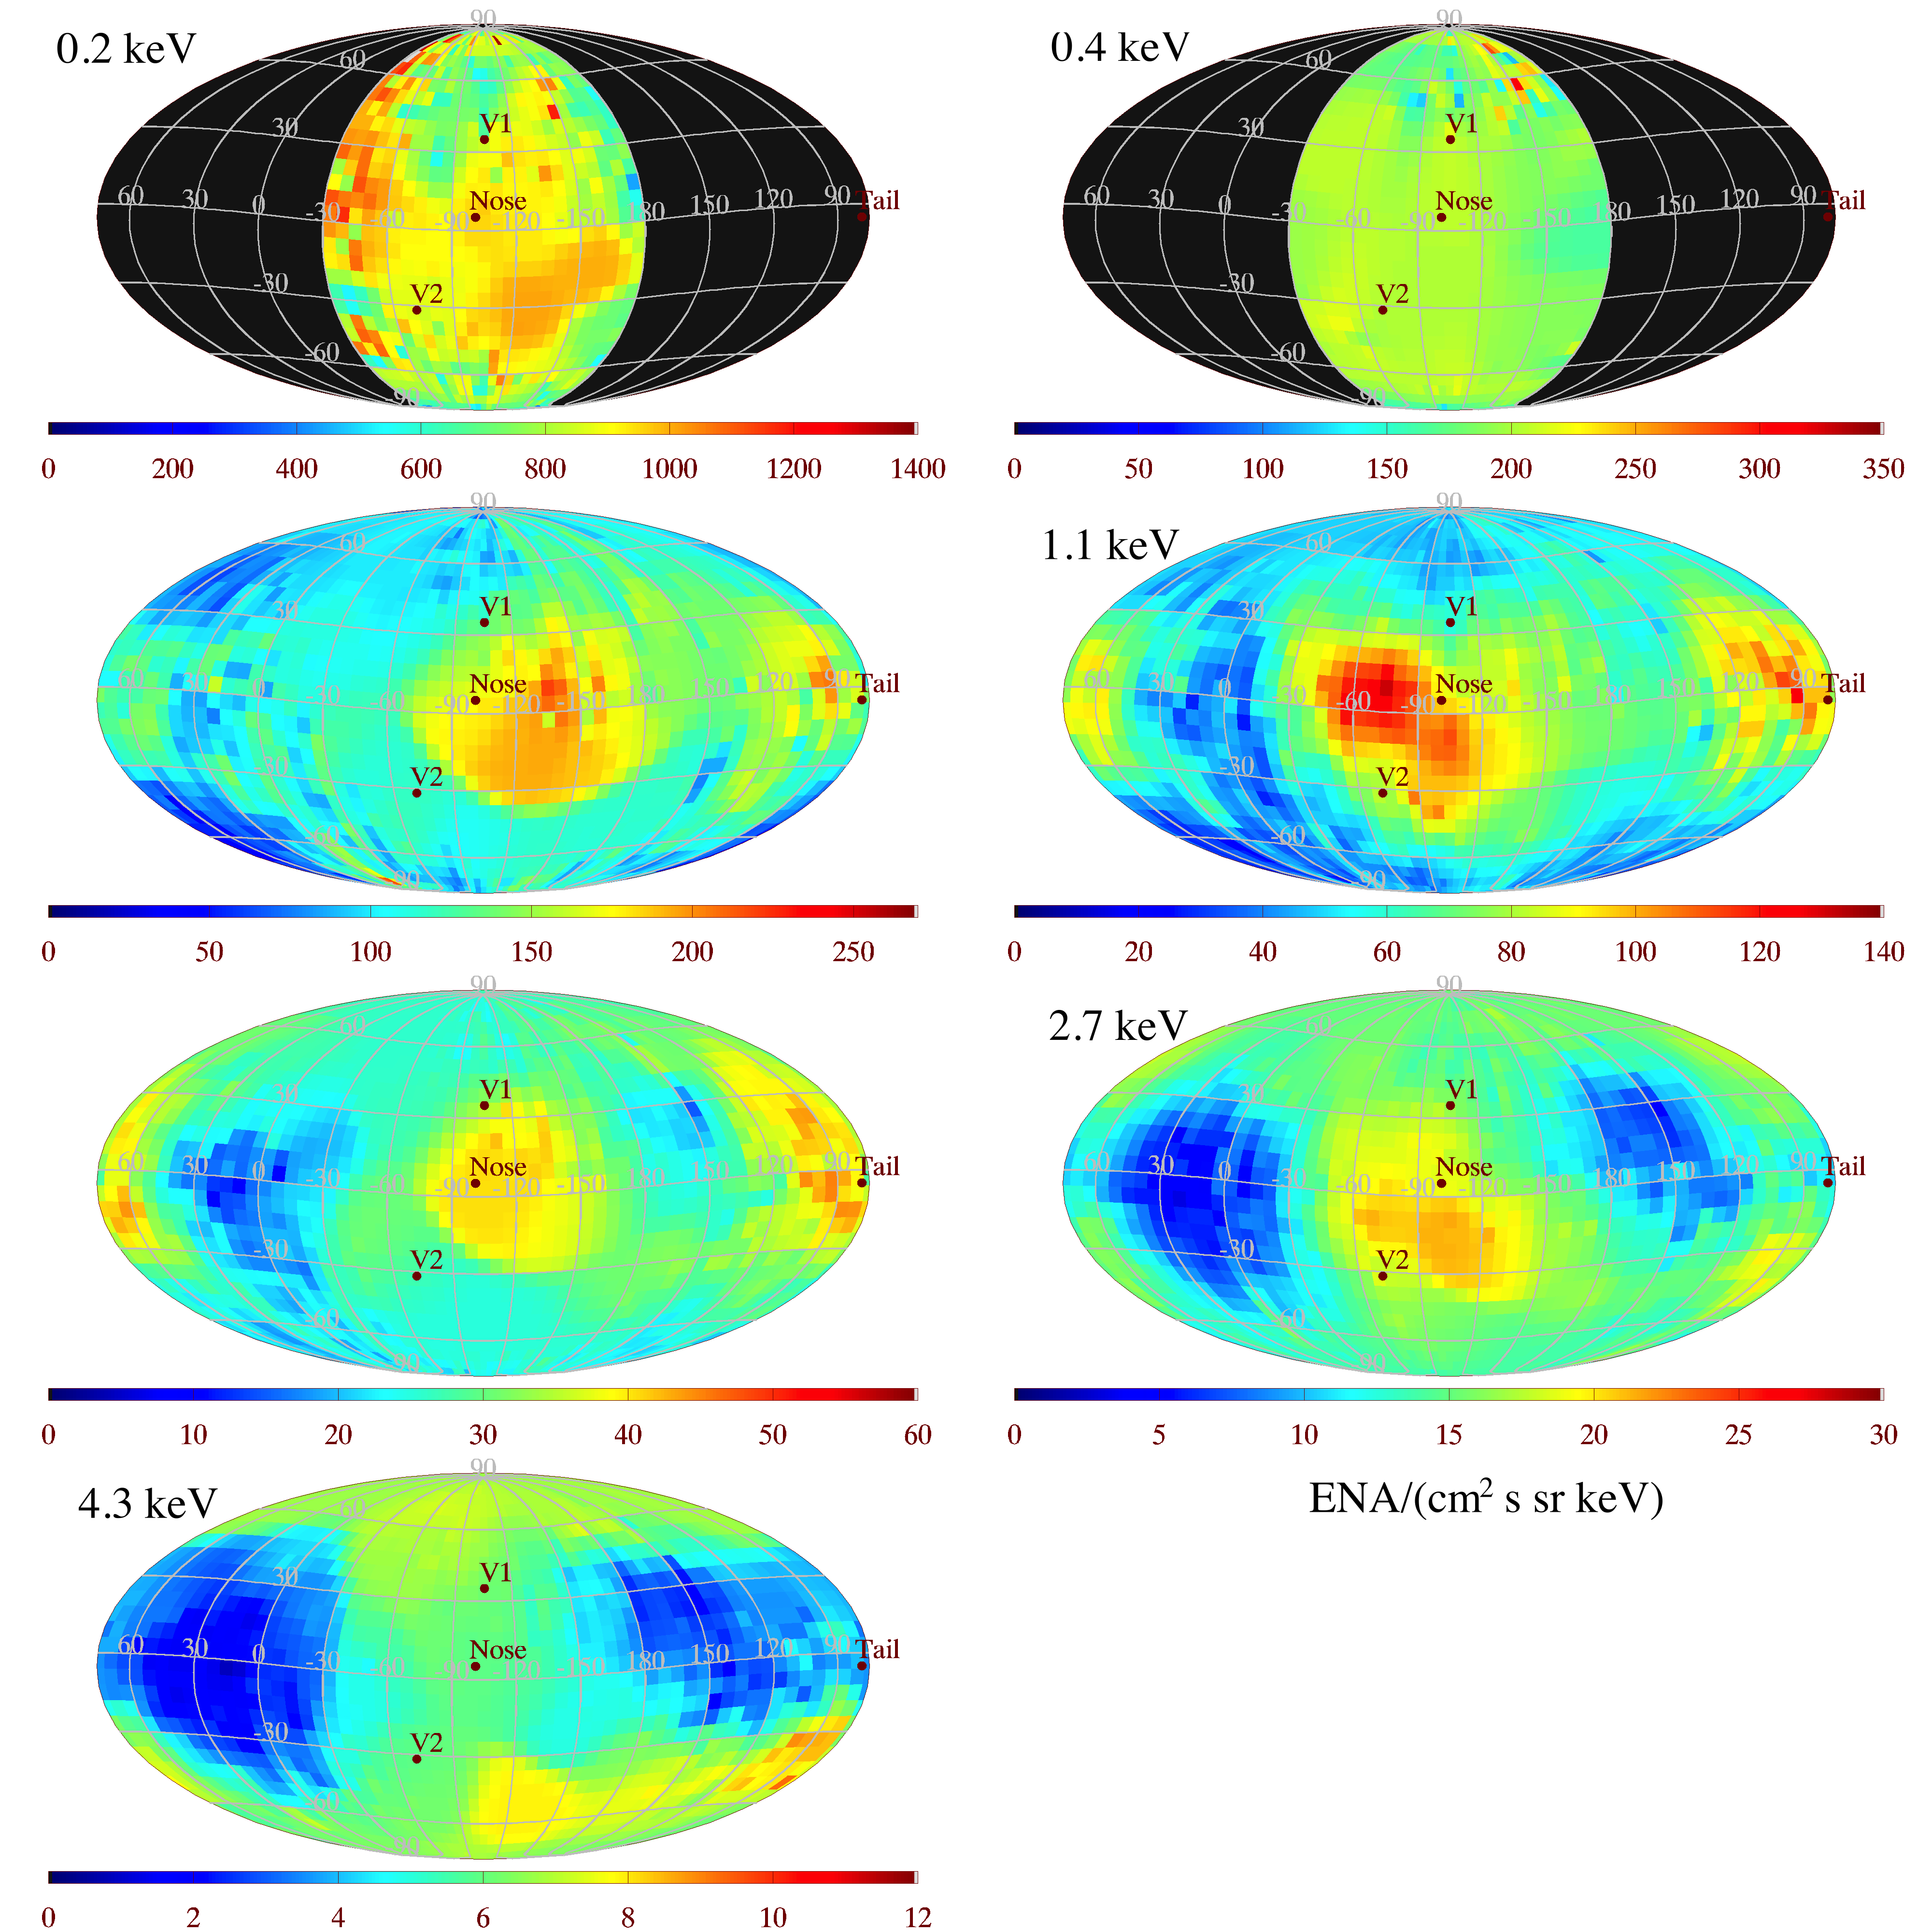
2009-
2014
0.7 keV
1.7 keV
IBEX Globally Distributed Flux
Schwadron et al., Separation of the Ribbon from Globally Distributed Energetic Neutral Atom Flux Using the First Five Years of IBEX Observations, ApJSS, 215, 13, 2014

Slide 4
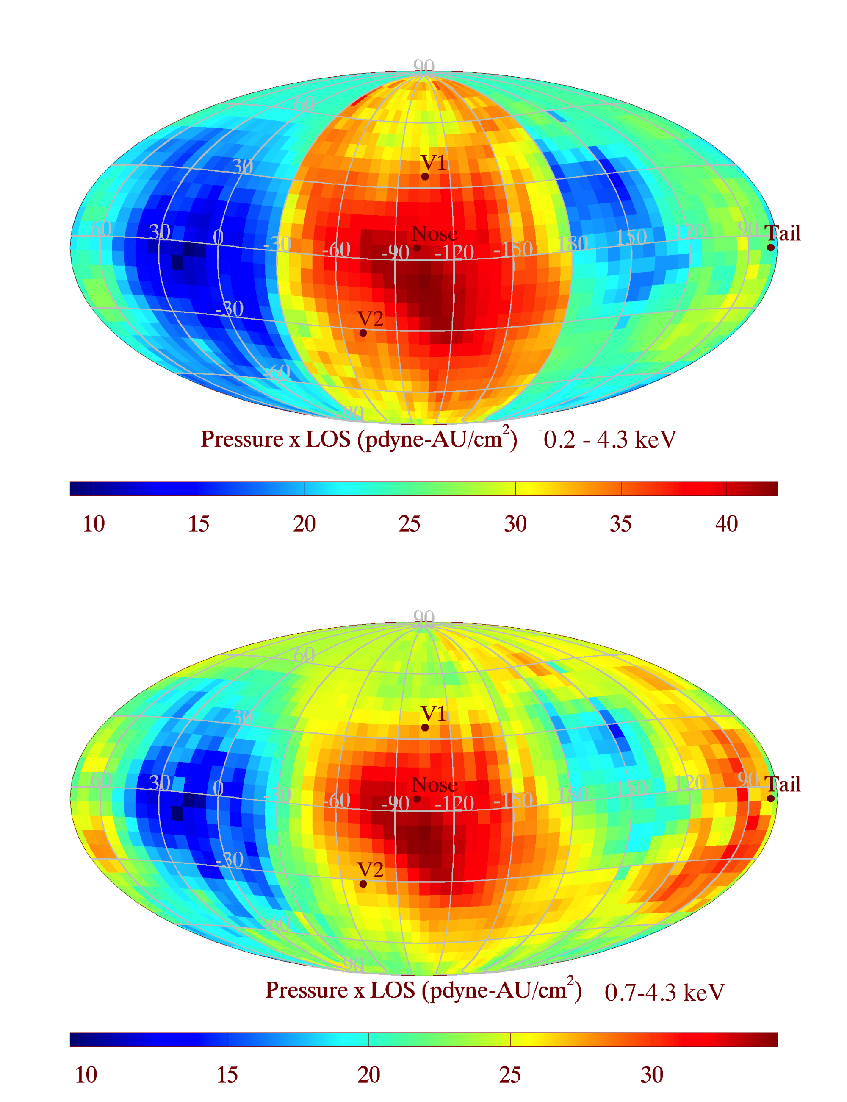
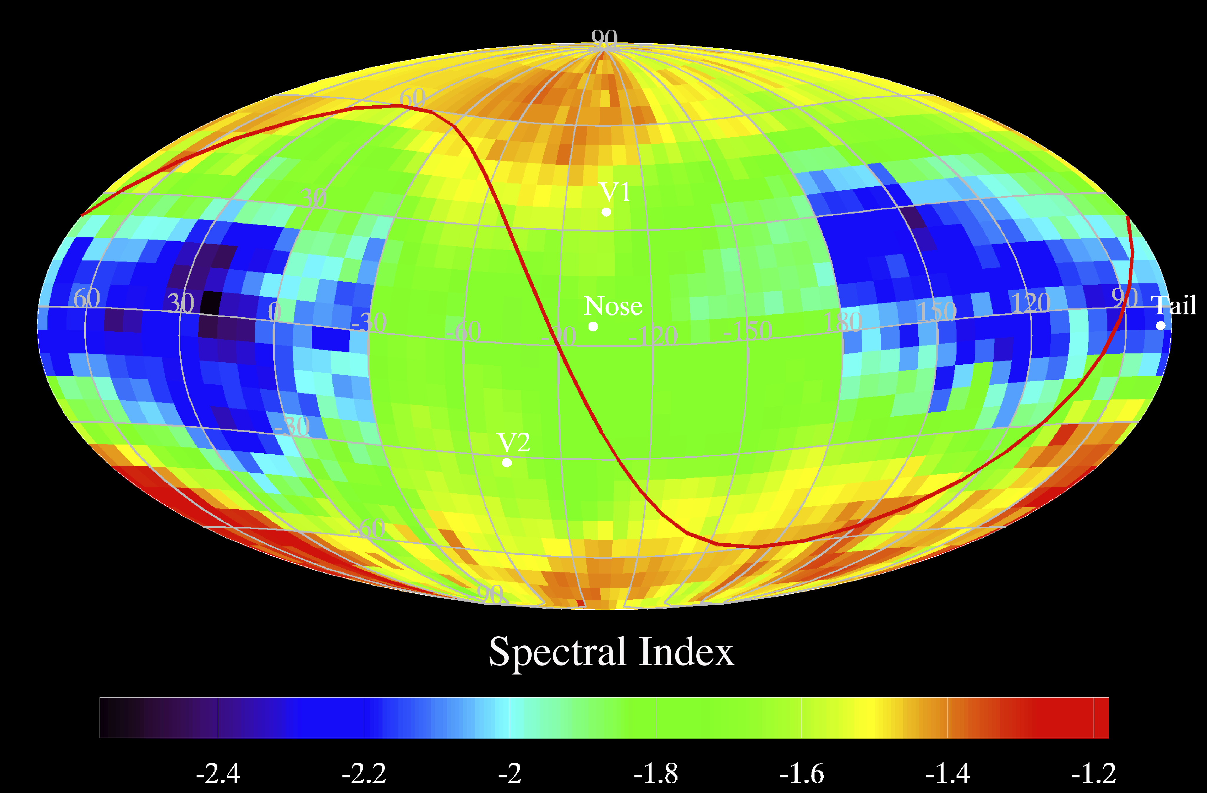
With Lo Ram Maps
Reminder of key results
Including pressure balance
Pressure balance with Heliosheath requires 3 µG LISM |B|
Note significant tail pressure
Offset Nose pressure
Hi Ram Maps only
Schwadron et al., The Astrophysical Journal Supplement Series, 215, 13, 2014

Slide 5
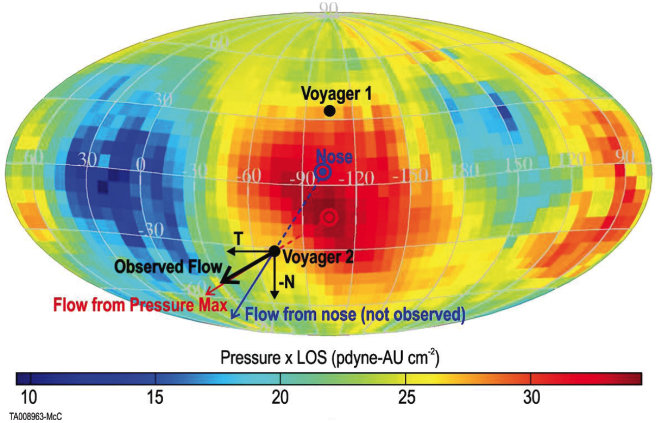
Deflection of Hsh Plasma by Pressure Maximum
McComas and Schwadron, ApJ, 795, LL17, 2014

Slide 6
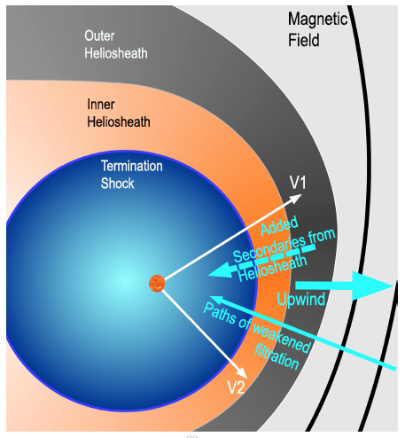
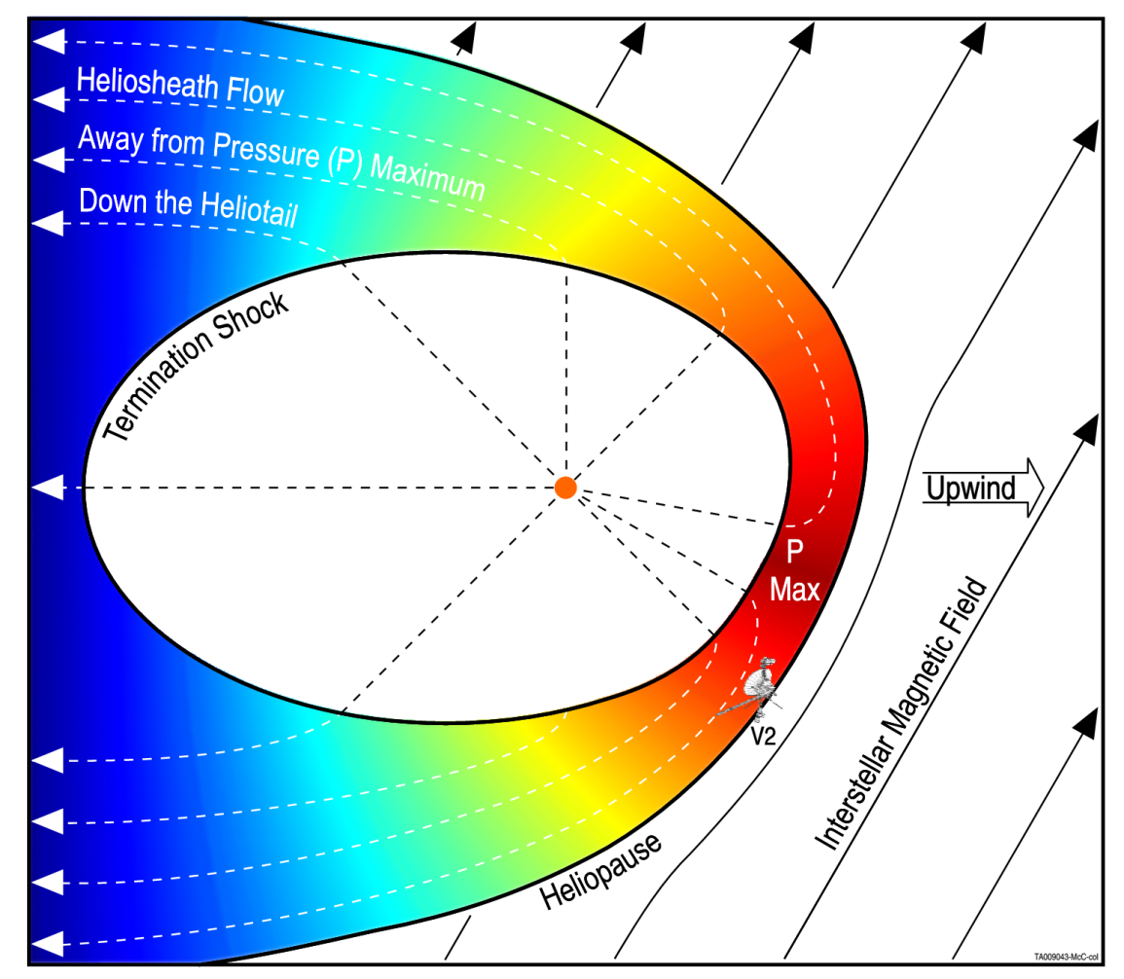
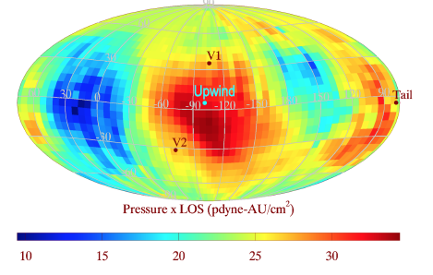
Connection to He Warm Breeze and O Filtration indications of LISM B influences
Schwadron et al., ApJ, 828, 81 2016

Slide 7
Time Evolving Heliosphere
~50% Erosion of ENA pressure from heliosheath (globally distributed ENA flux)
Schwadron et al., Solar Wind 14, 2015

Slide 8
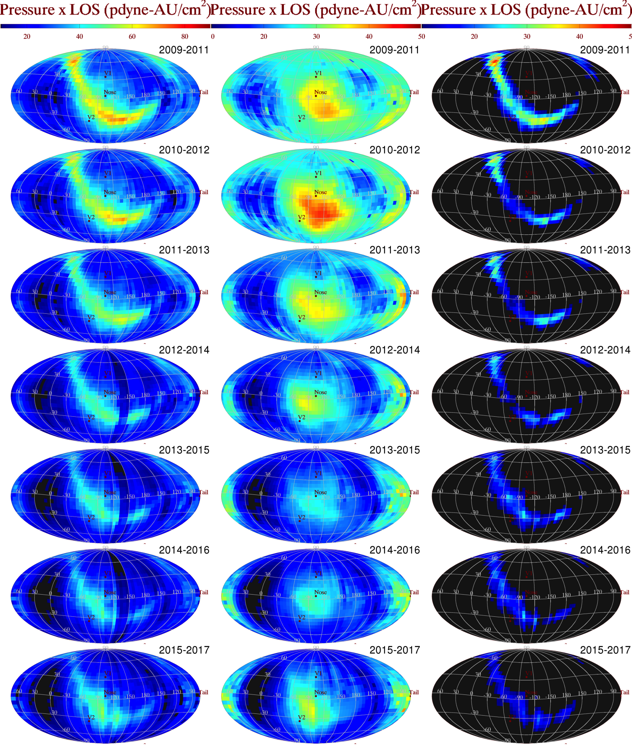
Total = GDF + Ribbon
Nose
10
90
10
50
10
50
2009-2011
2010-2012
2011-2013
P x LOS pdyne-AU/cm²
2012-2014
2013-2015
Schwadron et al., Submitted, 2018
2014-2016
2015-2017

Slide 9
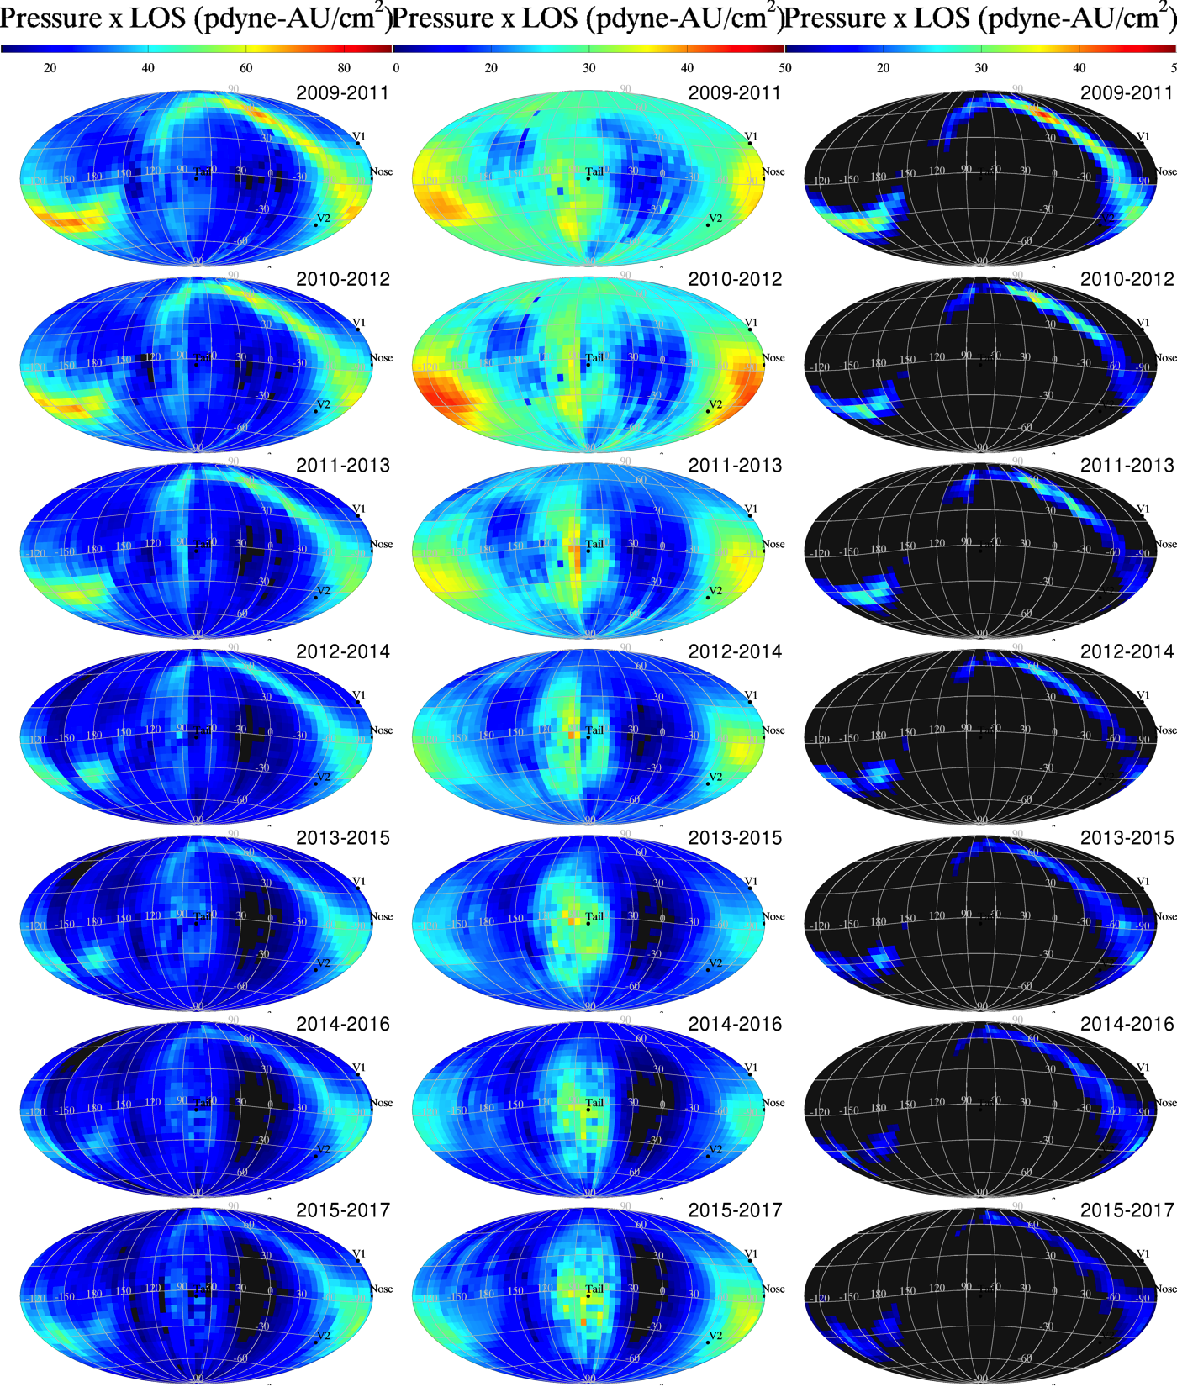
Total = GDF + Ribbon
Tail
10
90
10
50
10
50
2009-2011
2010-2012
2011-2013
P x LOS pdyne-AU/cm²
2012-2014
2013-2015
Schwadron et al., Submitted, 2018
2014-2016
2015-2017

Slide 10
GDF Timing Analysis
Propagation delay to account for:
Solar wind propagation to Termination Shock
Wave propagation through Heliosheath
ENA propagation time from Heliosheath to 1 AU
Minimum delay of 1.5 years
1 year pragation of solar wind to Termination Shock
0.5 year propagation of 4.3 keV ENA from TS → 1 AU
Maximum delay of 4.7 years
1 year pragation of solar wind to Termination Shock
0.6 year propagation of wave mode TS → Heliopause
1.9 year propagation of wave mode Heliopause → TS
1.2 year propagation of 0.7 keV ENA from TS → 1 AU
Schwadron et al., Submitted, 2018

Slide 11
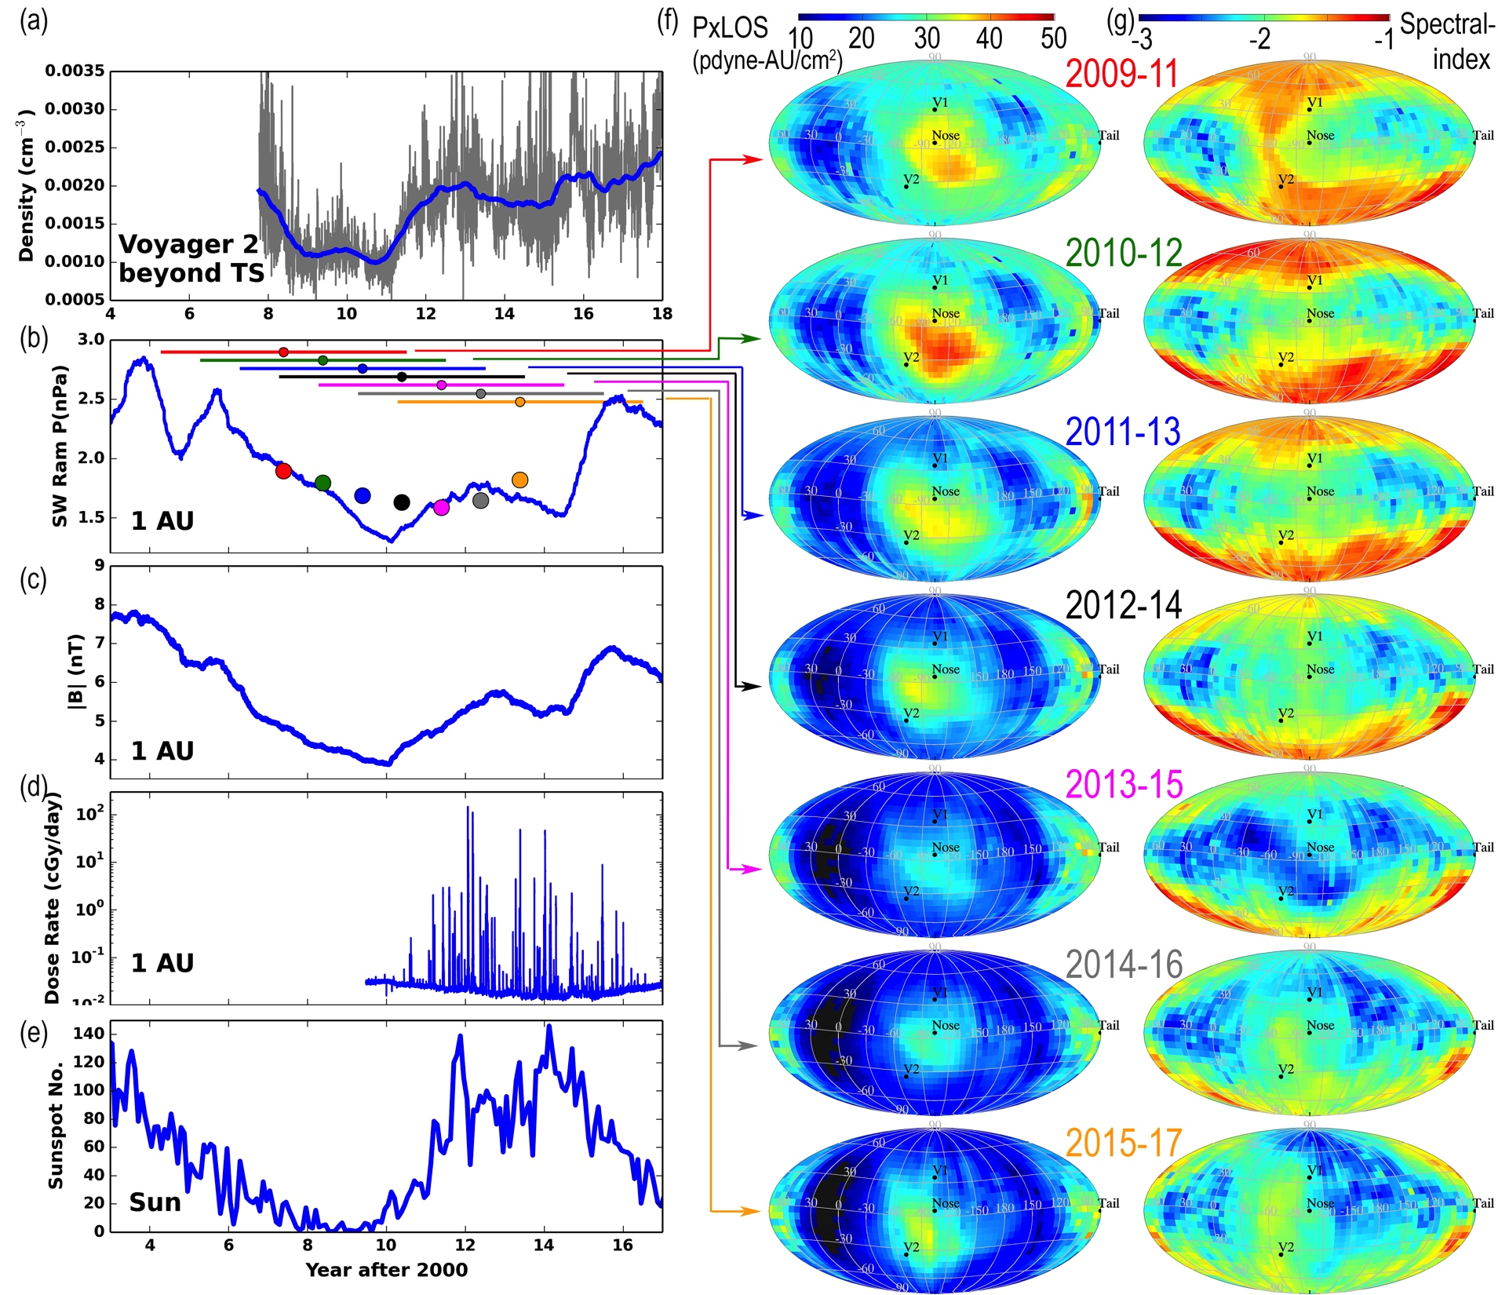
2009-2011
2010-2012
2011-2013
2012-2014
2013-2015
2014-2016
2015-2017

Slide 12
Ribbon Timing Analysis
140⁺⁸⁴₋₃₈ AU from Swaczyna et al. (2016)
Propagation delay (max 7.4 year) to account for:
2.4 year Neutral Solar wind propagation to Ribbon at 1 keV (max distance 224 au)
2.5 year charge-exchange survival time
2.4 year 1 keV ENA propagation time from Ribbon to 1 AU
Propagation delay (min 3.1 year) to account for:
0.55 year Neutral Solar wind propagation to Ribbon at 4 keV (min distaince 102 au)
2 year charge-exchange survival time
0.55 year 1 keV ENA propagation time from Ribbon to 1 AU
Schwadron et al., Submitted, 2018

Slide 13
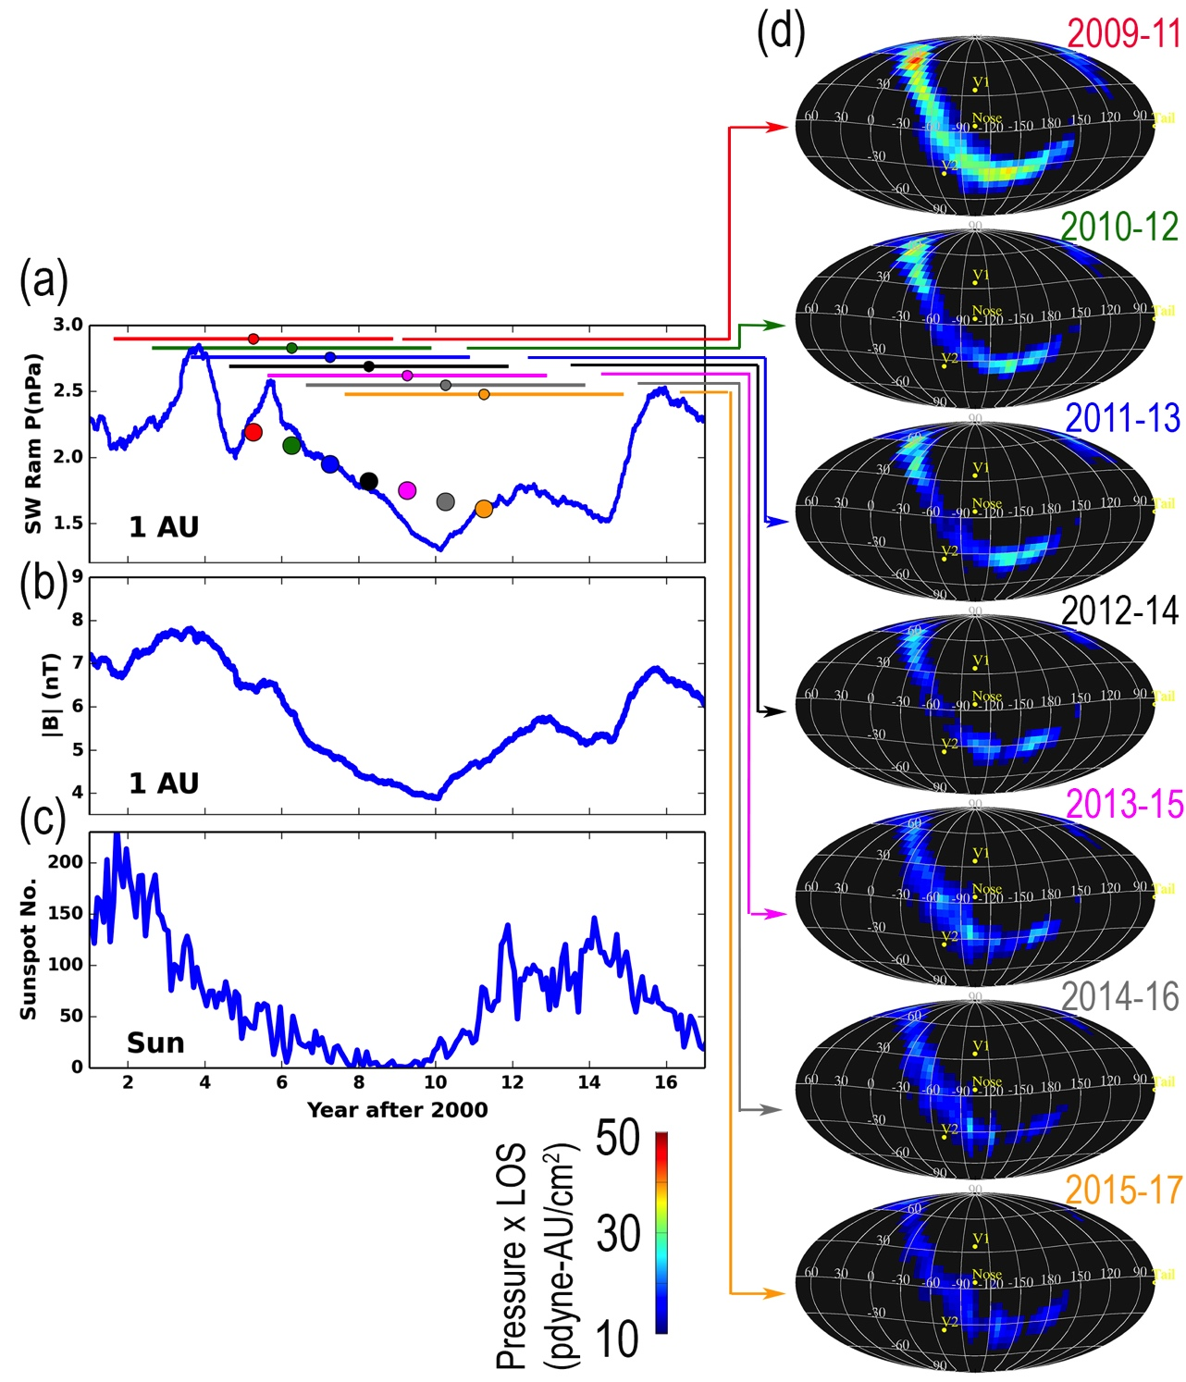
2009-2011
2010-2012
2011-2013
2012-2014
2013-2015
2014-2016
>2 year storage time important to match time-evolution
2015-2017

Slide 14
Conclusions
First report time-evolution of the IBEX Ribbon separated from the Globally Distributed Flux (GDF)
Time evolution of GDF consistent with expansion/cooling near the nose driven by decline of cycle 23 and compression/heating driven by rise of cycle 24
Time evolution of GDF near the tail fairly stable compared to nose
Time evolution of Ribbon consisten with >2 year storage time and consistent with secondary neutral wind hypothesis

Slide 15
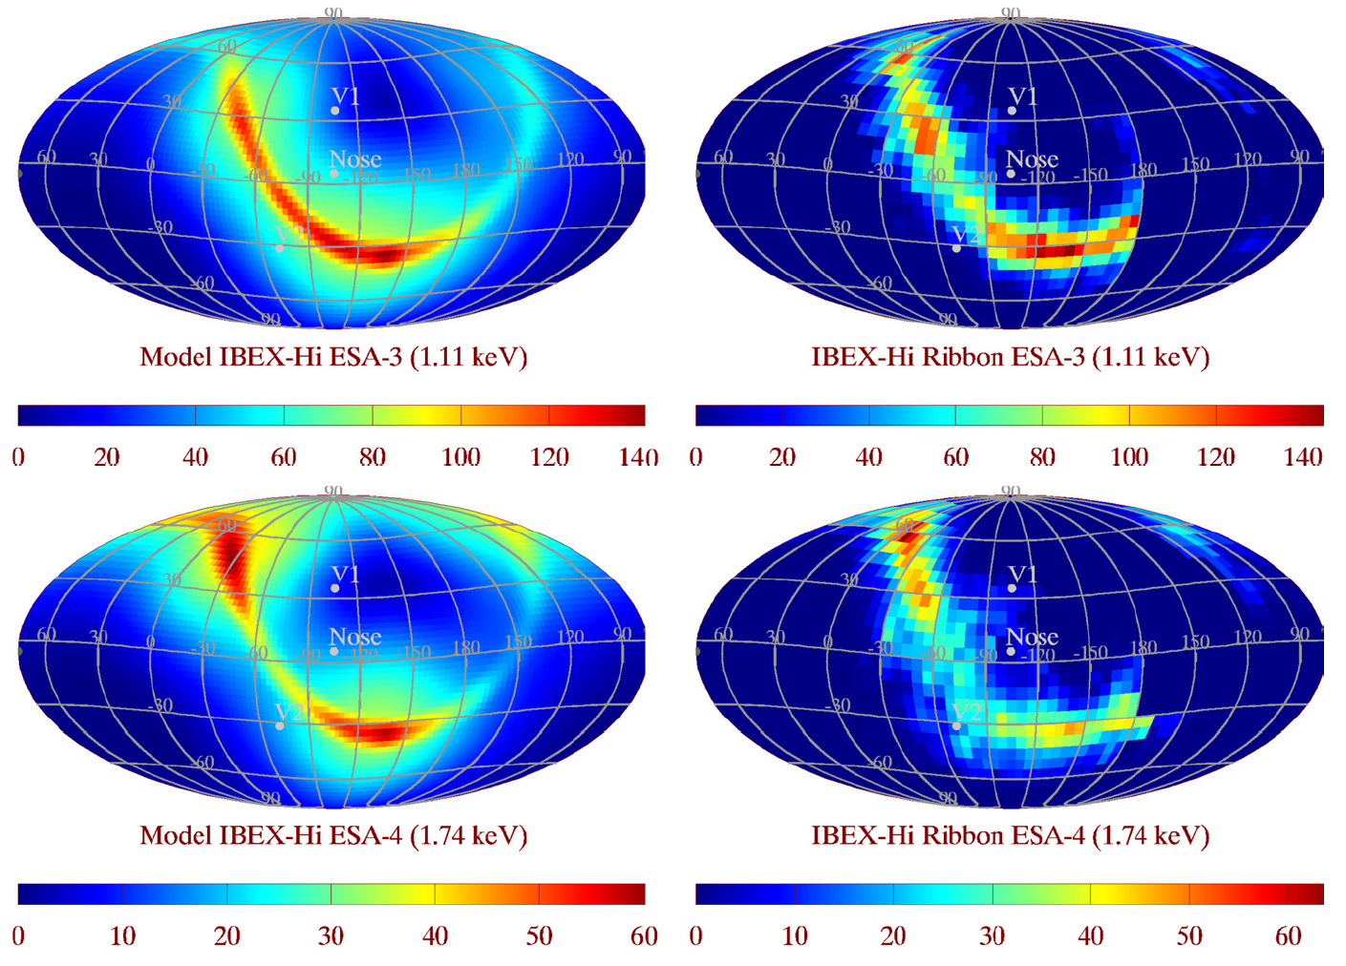
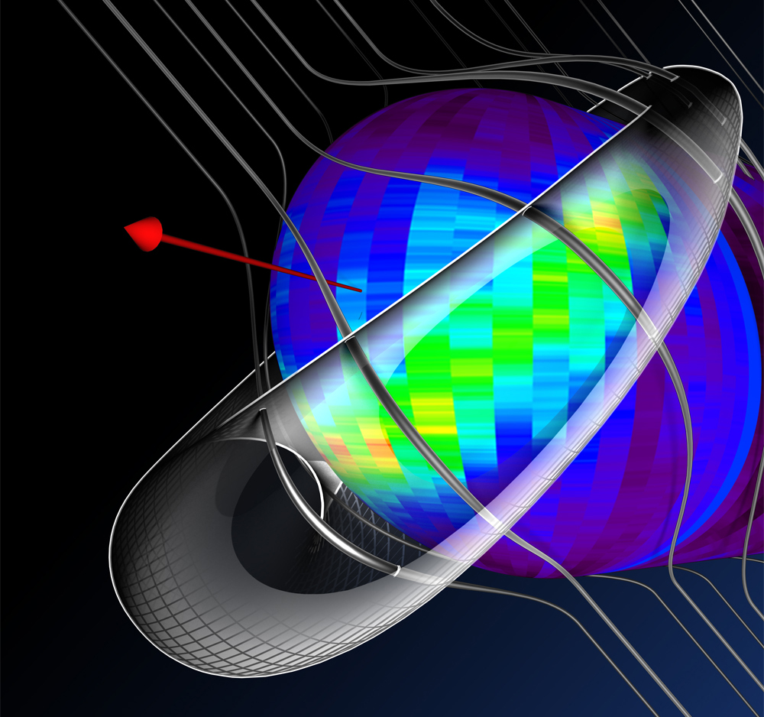
IBEX Ribbon from Secondary Solar Wind
Timing consistent with that used in Schwadron & McComas 764, 92, 2013 2013

Slide 16
Interstellar Mapping and Acceleration Probe (IMAP) A mission to understand the Origin of Particle Acceleration and its Fundamental Connection to the Global Interstellar Interaction

Slide 17
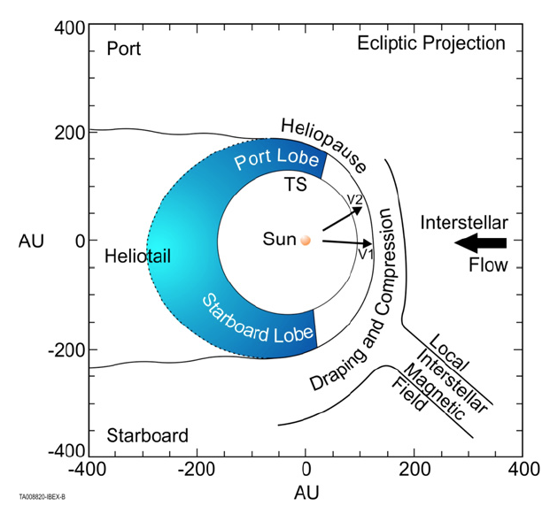
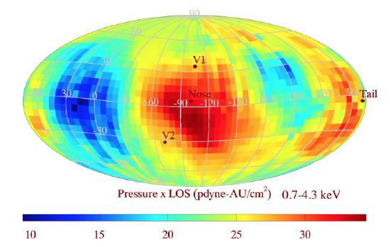
Draping and Compression of LISM field
Port
Starboard
Schwadron et al., ApJS, 2014

Slide 18
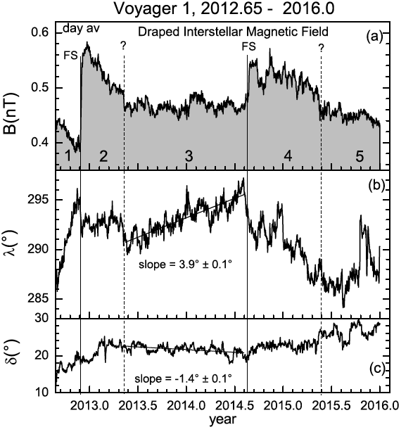
Recent Voyager 1 Data
Interval 1, decreasing B, plasma depetion layer? [Fuselier & Cairns, 2013]
Intervals 2 and 4: Shocks preceding or nearby
Interval 5: electron plasma oscillations observed, associated with nearby shock
Interval 3 the only undisturbed interval
Burlaga and Ness, ApJ, 2016

Slide 19
Incl. Recent V1 Data
Schwadron & McComas, Submitted, 2017

Slide 20
Incl. Recent V1 Data

Slide 21
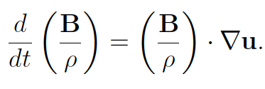
Deflection of Interstellar Magnetic Field
Faraday’s Law:
Rarefaction Region:

Slide 22
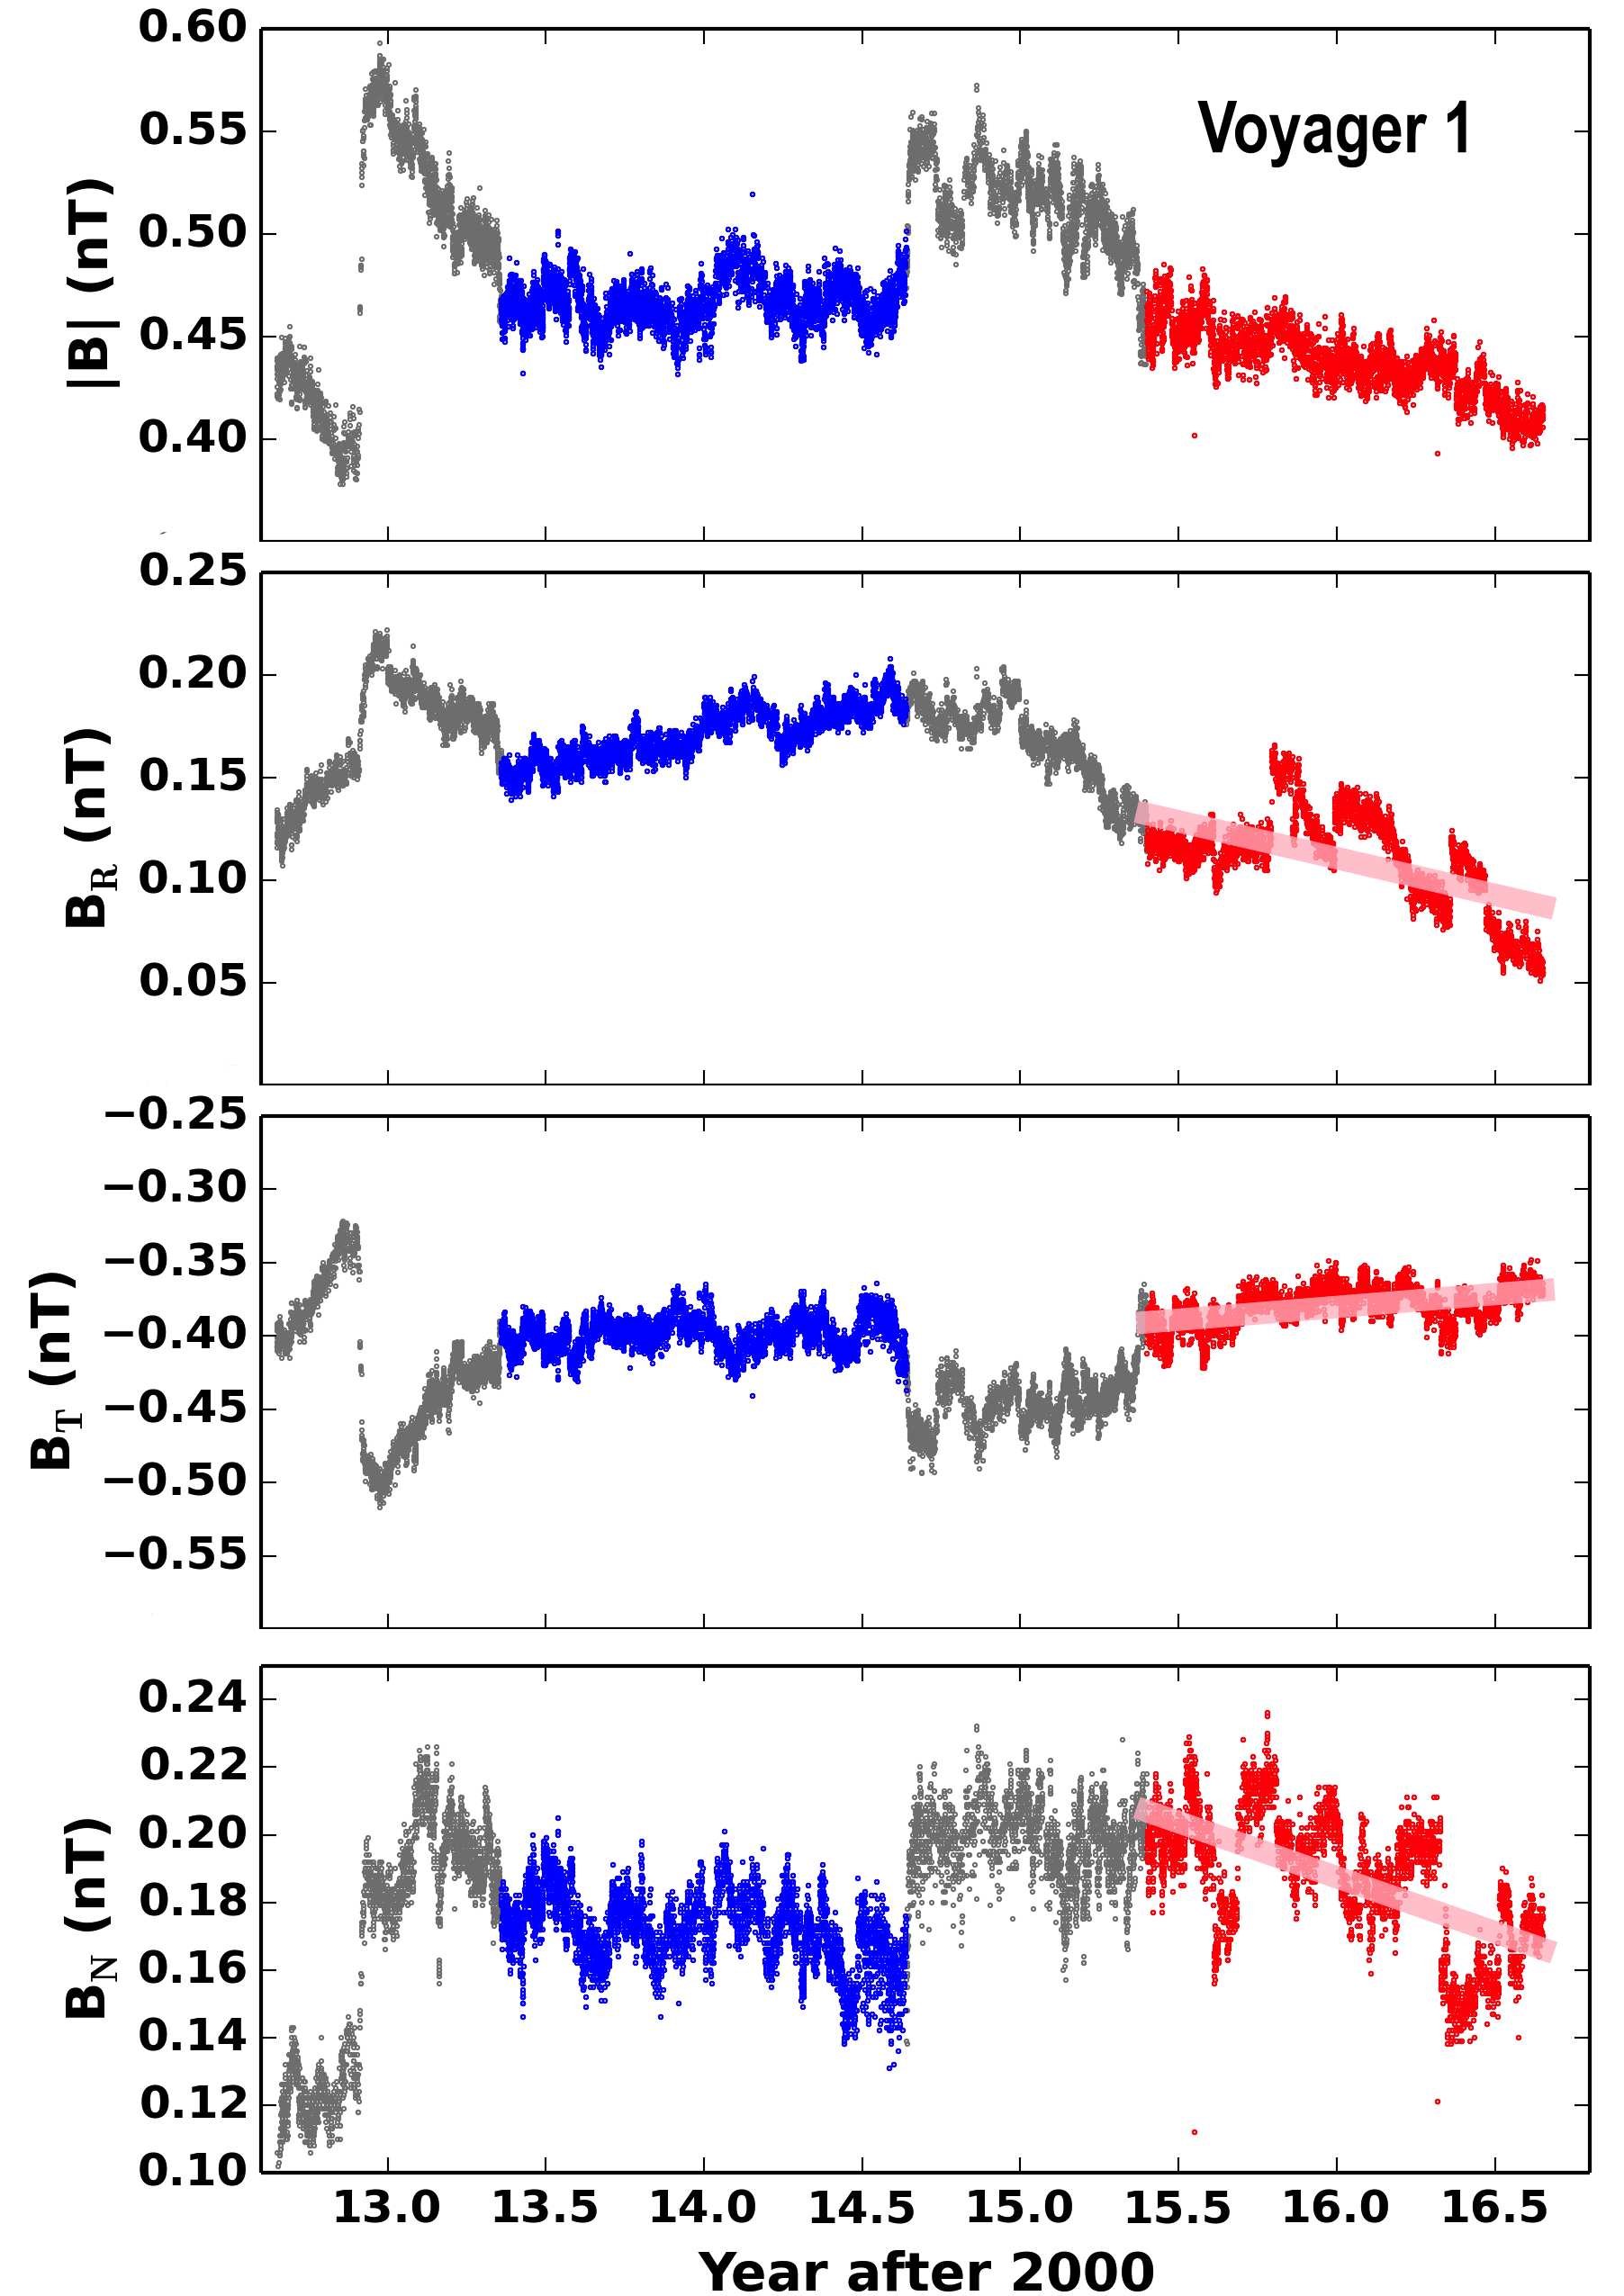
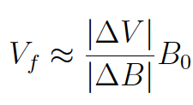
Rarefaction
Rarefaction region results:

Slide 23
Flow structure in Very Local Interstellar Medium
Two transit times:
To HP, 1.5 years
1 year to TS
0.5 year to HP
150 km/s flow
160 km/s wave speed
HP to V1
14 AU
plasma 50 km/s
V1 17 km/s
1 year
Schwadron & McComas, Almost Submitted, 2017

Slide 24
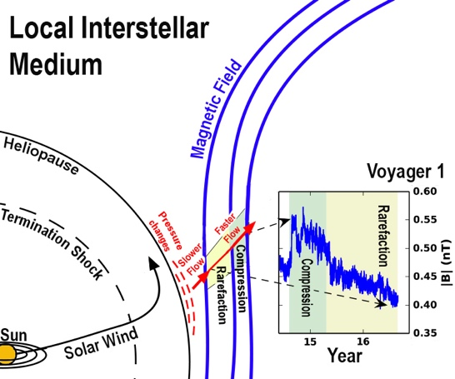

Slide 25
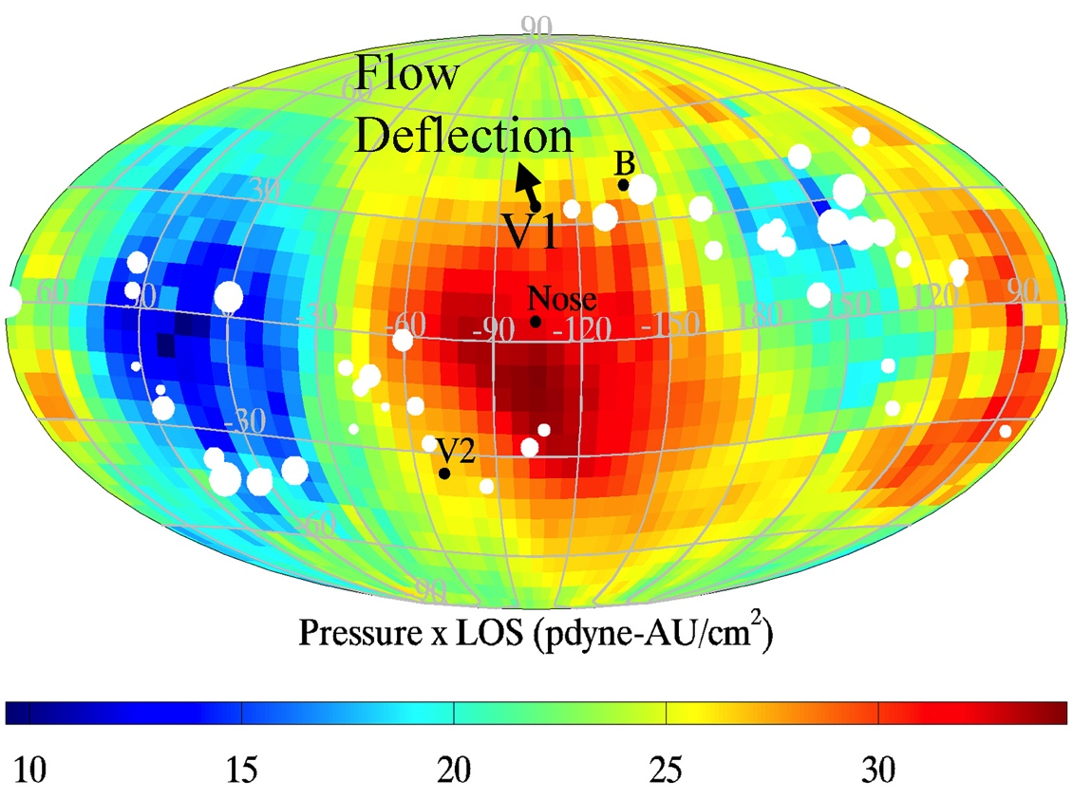
Flux Rope/CME directions
Flux Ropes:
Gopalswamy,
EP&S, 2014

Slide 26
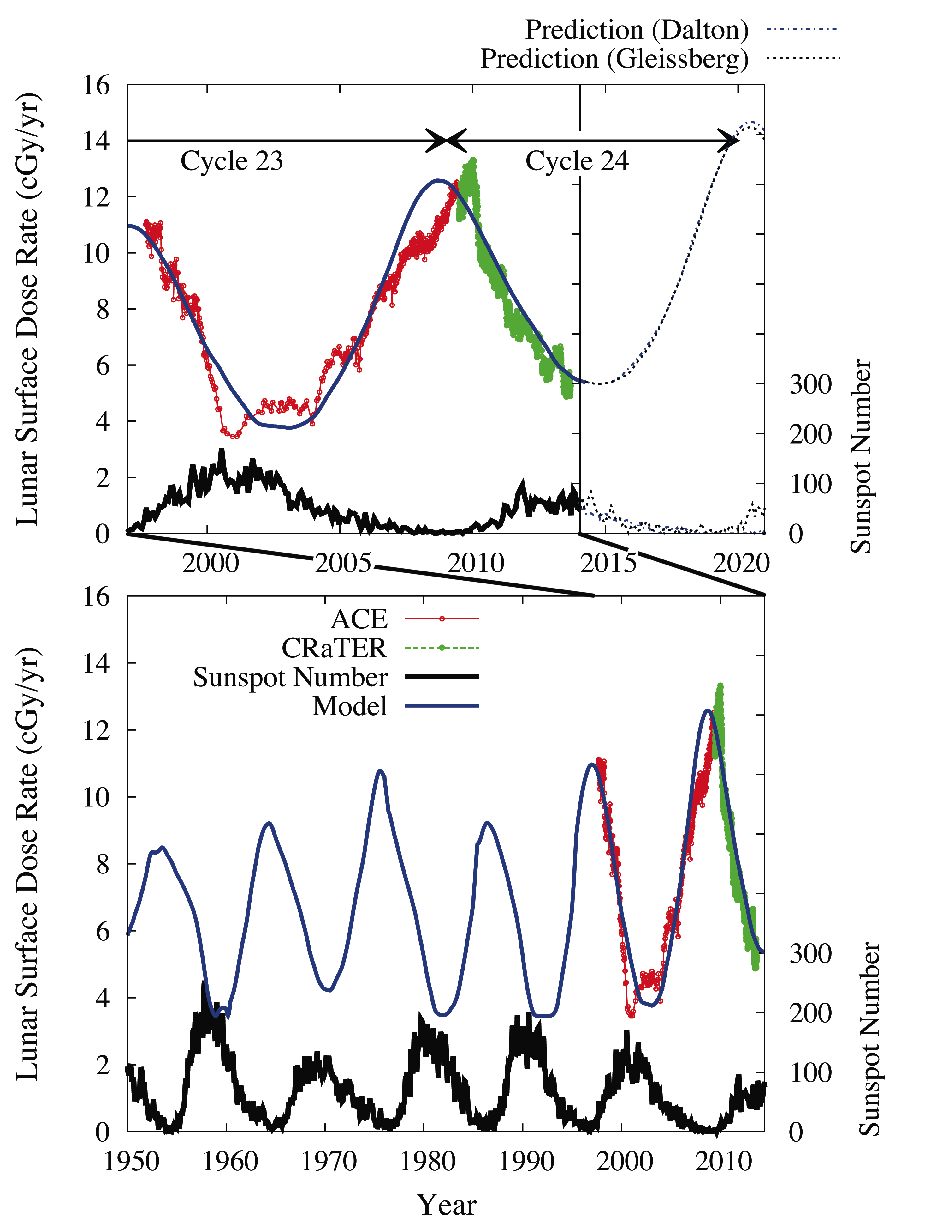
Schwadron et al., 2014
Schwadron et al., 2014

Slide 27
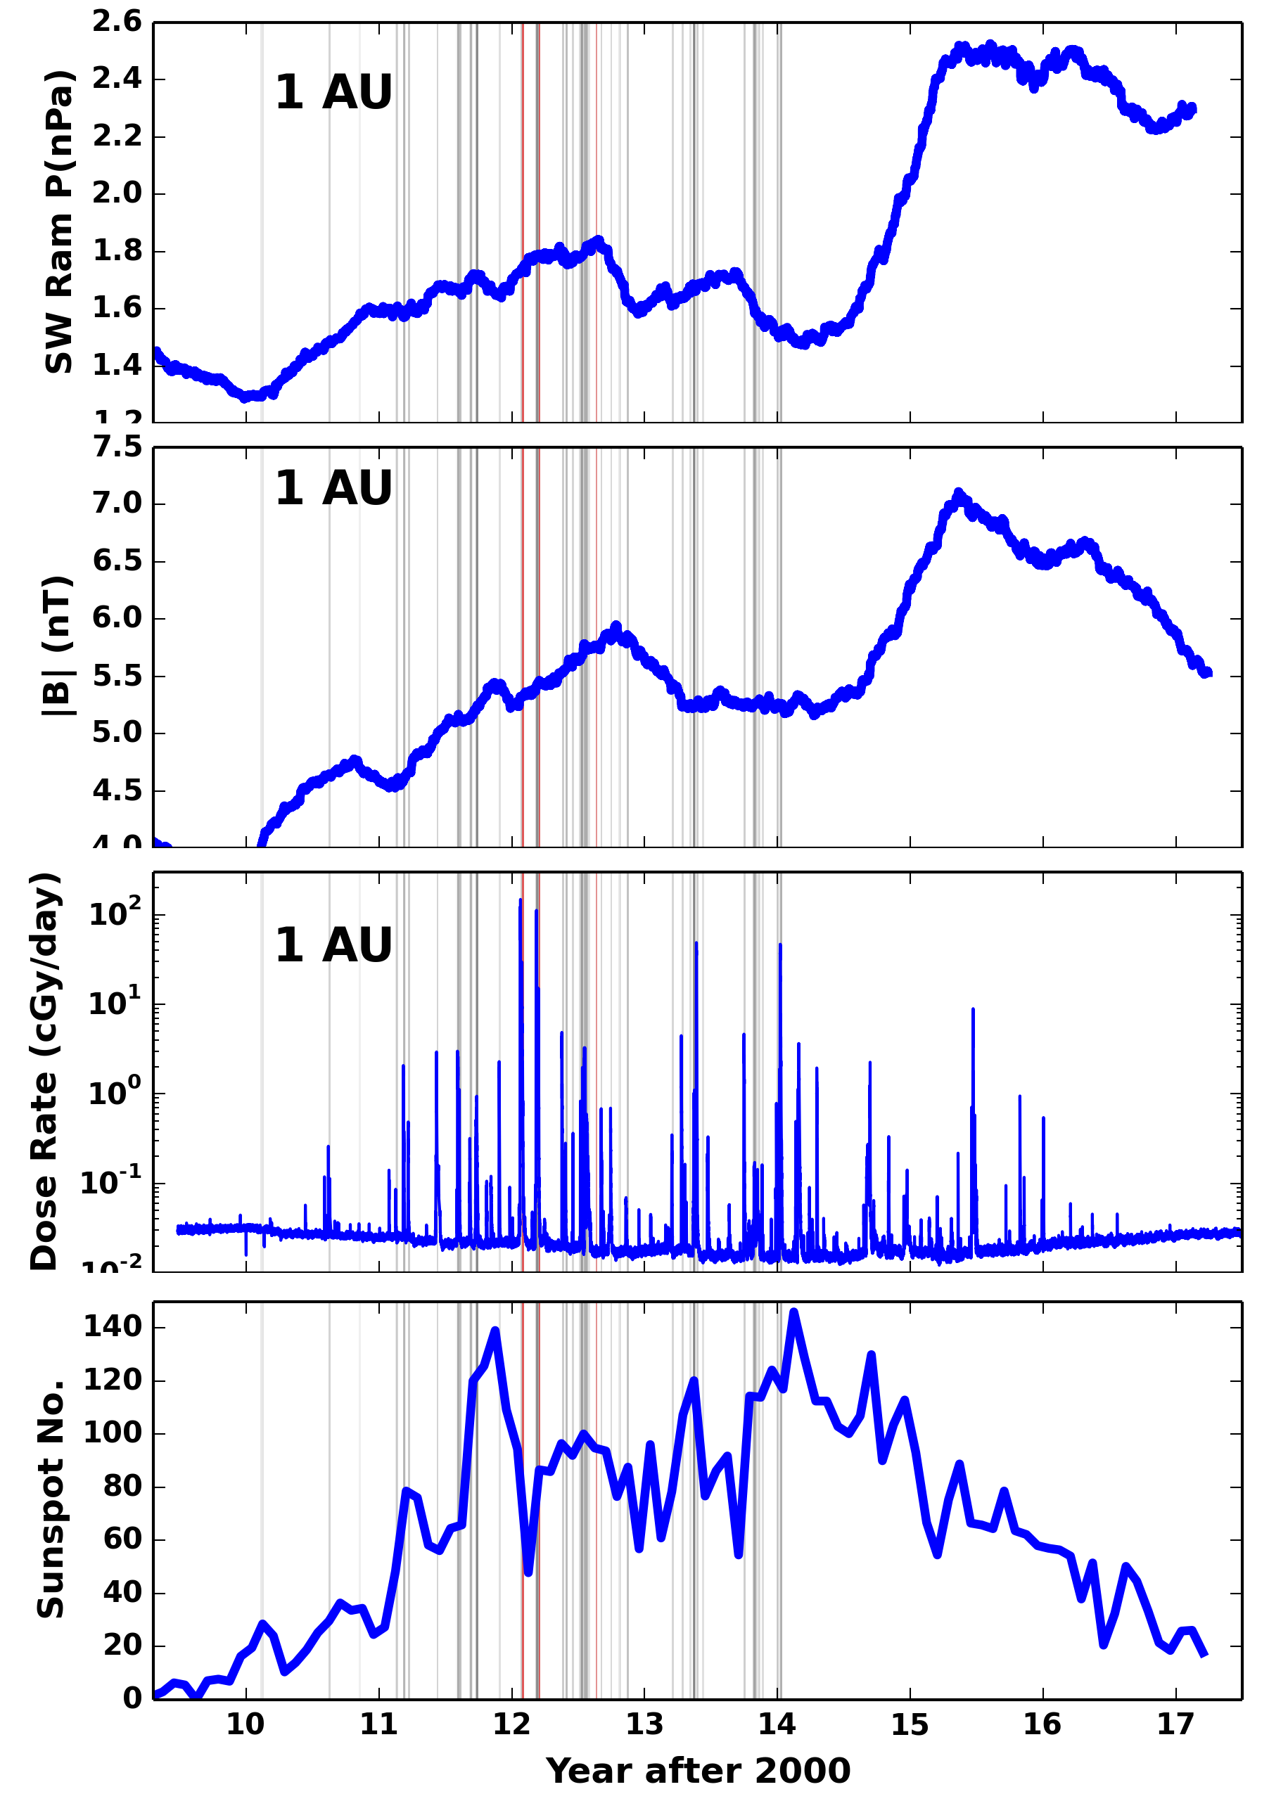
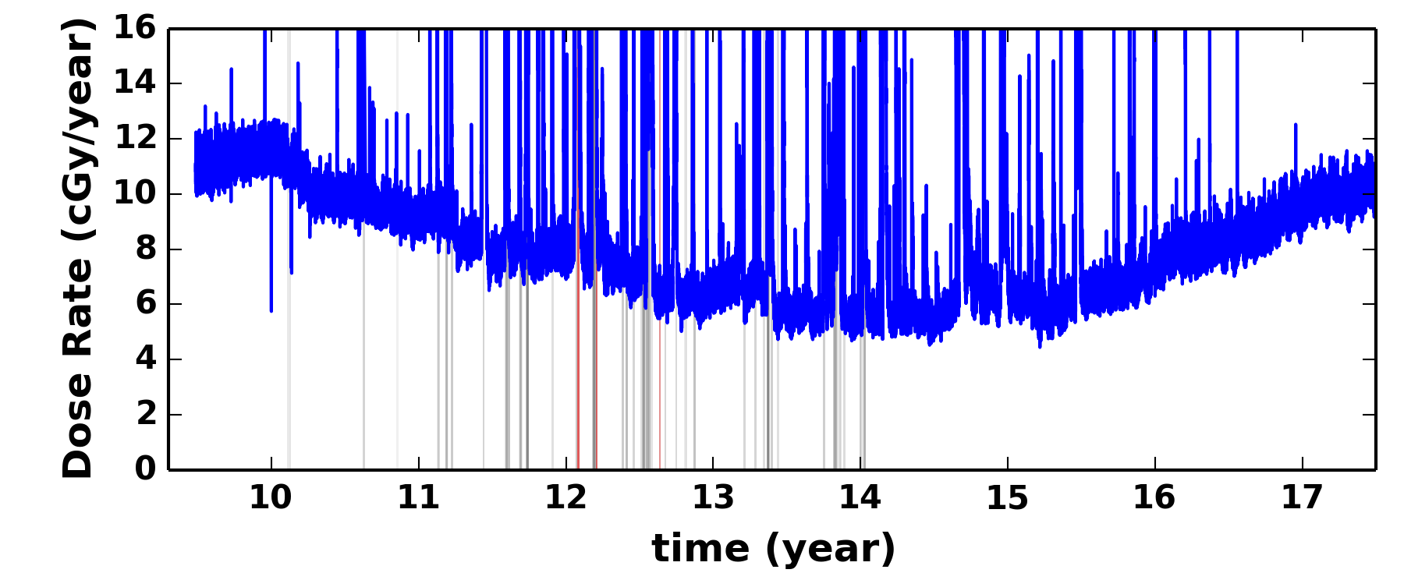
Evolution of Solar Cycle

