Slide 1

“L’essential est invisible pour les yuex”
Advancement requires that we understand and move beyond hidden boundaries
Entering a new realm of galactic exploration

Slide 2
Interstellar Mapping and Acceleration Probe (IMAP)
A mission to discover the Origin of Particle Acceleration and its Fundamental Connection to the Global Interstellar Interaction
Proposed: Oct 2017
Selected: 1 June 2018
Launch: 2024

Slide 3

























Slide 4
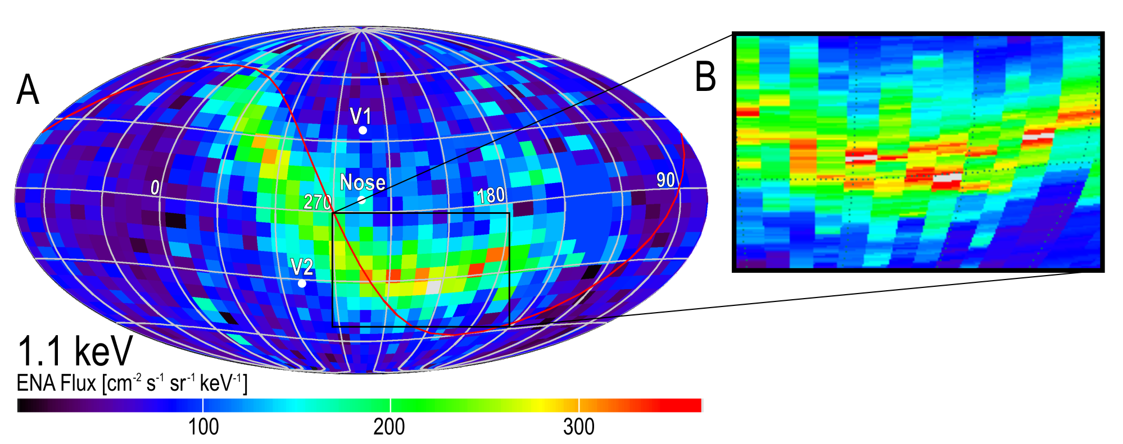
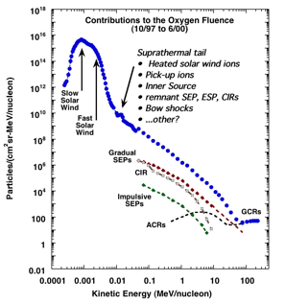
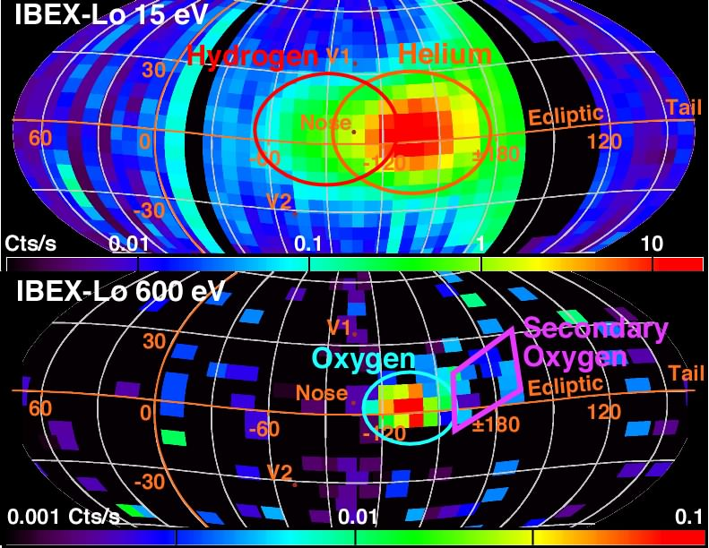
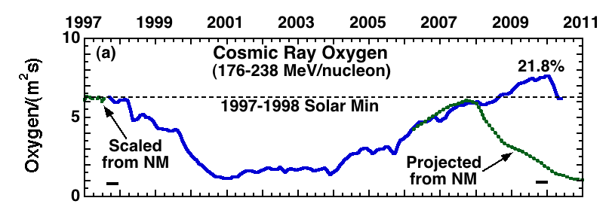
Interstellar Mapping & Acceleration Probe
+
Study Source Populations for SEPs
Including Suprathermal Tails
as well as Acceleration at Hi-Res
Monitor Space Weather from L1
Hi-Resolution ENA Images of the Heliosphere Boundary
Detailed Analysis of the ISM Flow for H, D, He, O & Ne
with Neutral Atoms and Pickup Ions
Study Interstellar Dust Flow and its Composition

Slide 5
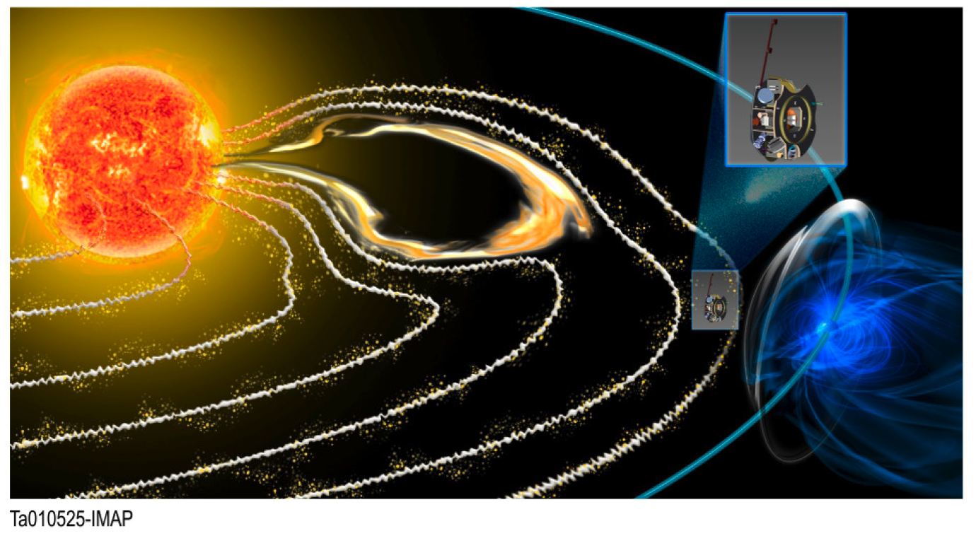
IMAP Orbits Sun-Earth L1

Slide 6
Comprehensive Science Payload

Slide 7
Interstellar Mapping and Acceleration
Probe (IMAP)
.. Civilizations next step into Galactic Exploration

