Slide 1
Secondary Neutral Atoms Observed by IBEX
¹Harald Kucharek, for the entire IBEX-lo Team
¹University of New Hampshire, Durham, NH, 03824

Slide 2
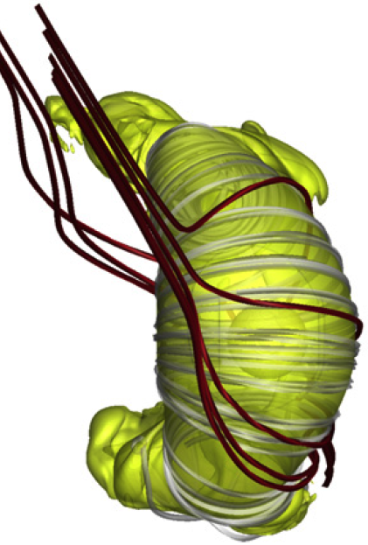
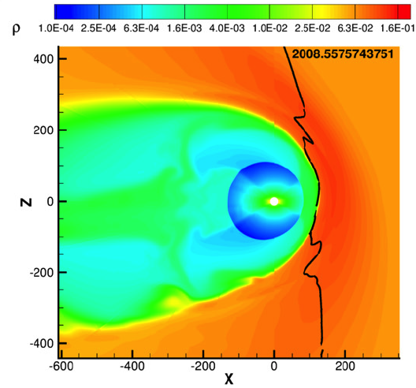
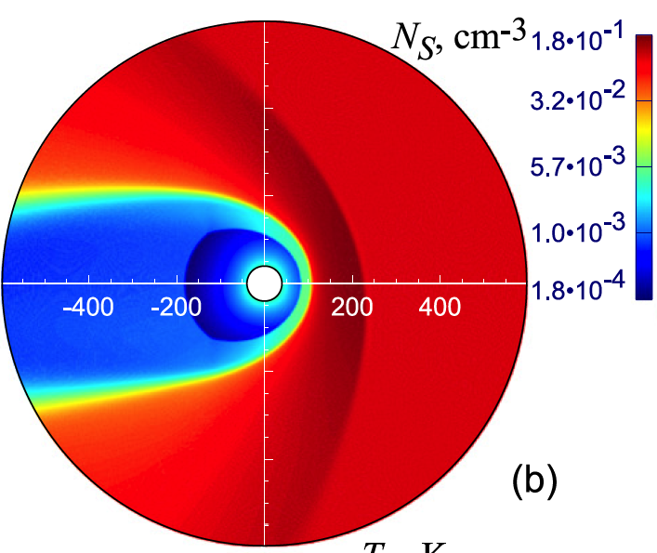
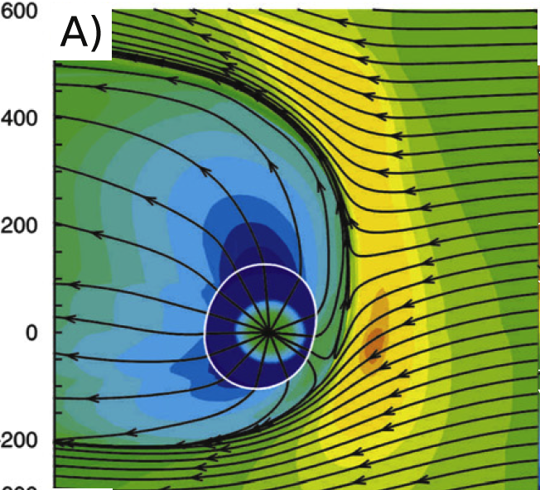
Introduction:
Global kinetic and/or fluid
computational models
[Izmodenov & [Pogorelov et al.,13] [Usmanov et al.,16] [Opher et al.,15]
Alexashov,15]

Slide 3
Motivation:
Can we remotely detect effects of the shape of the heliosphere from IBEX-lo sky maps?
Methodology: We use sky maps of interstellar helium because they are less affected by ionization and radiation pressure. Comparing theoretical models for the primary and secondary ENA population with IBEX-lo observations.

Slide 4
Primary vs. Secondary Component
He_{ISN}
He_{ISN (Primary)}
He_{ISN (Secondary)}
He_{ISN}
_{Charge exchange interction}
Helium is only measurable by it’s sputter products (mainly H, O)

Slide 5
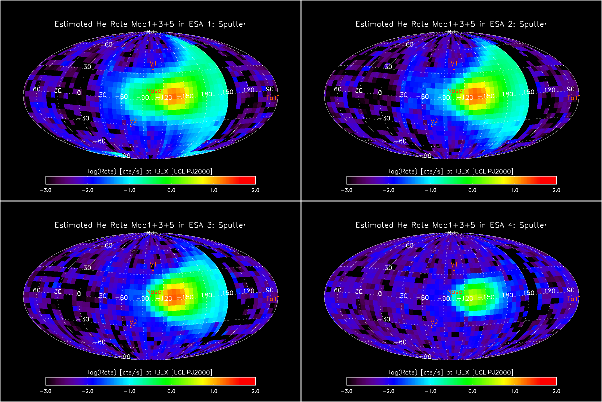
Interstellar Helium @ 1 AU
E=15 eV
E=29 eV
Sec ISN He
Sec ISN He
ISN H
ISN He
ISN He
E=55 eV
E=110 eV
Sec ISN He
ISN He
ISN He

Slide 6
IBEX-lo Helium Observation

Slide 7
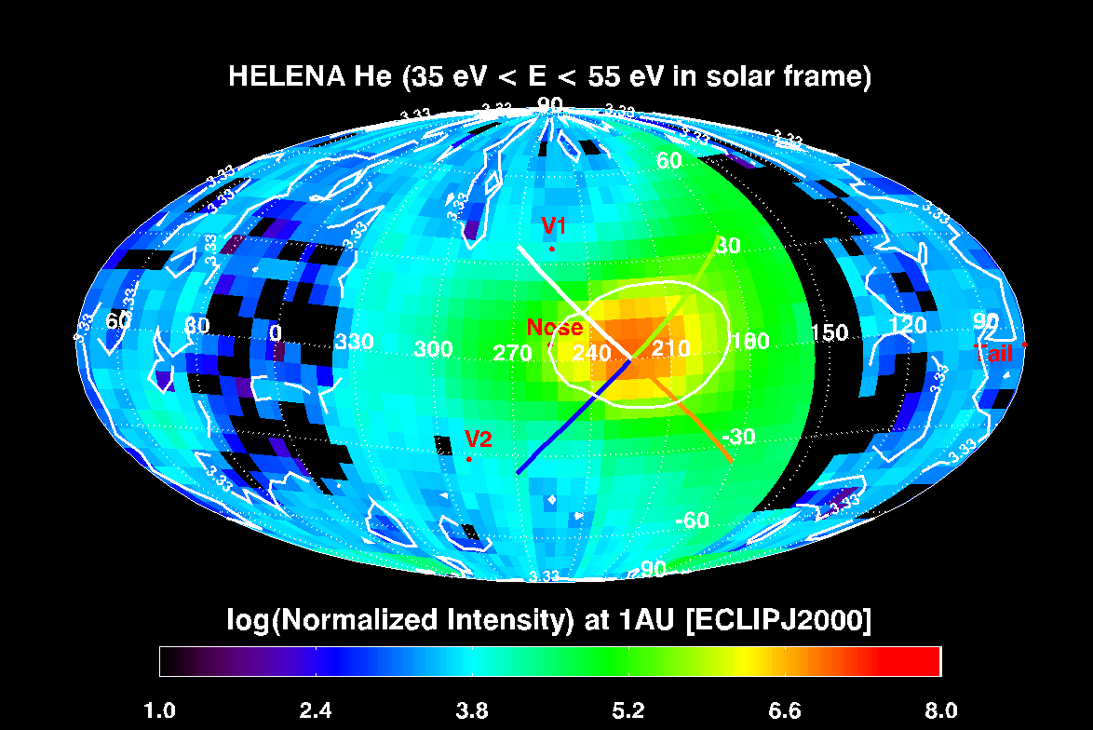
Helium Intensities Along Cut Lines

Slide 8
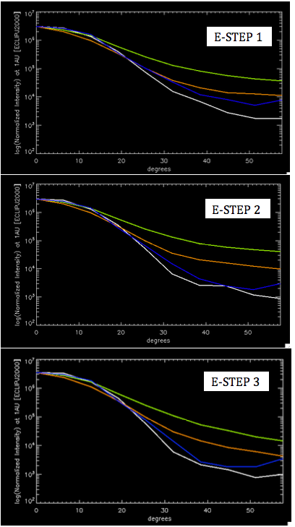
Asymmetries due to the global shape of the heliosphere.
Semi-analytic model using axis-symmetric obstacle (Isenberg et al., 2017)

Slide 9
Simple Analytic Model (Park et al. In preparation)

Slide 11
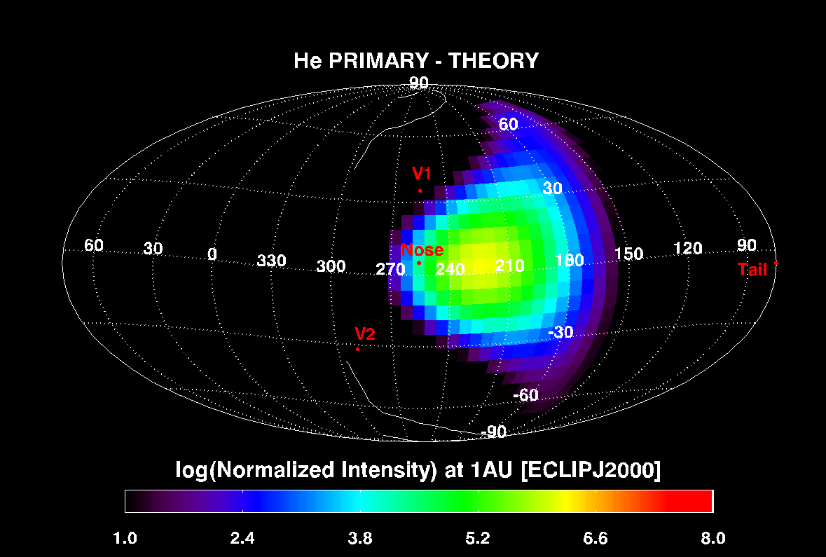
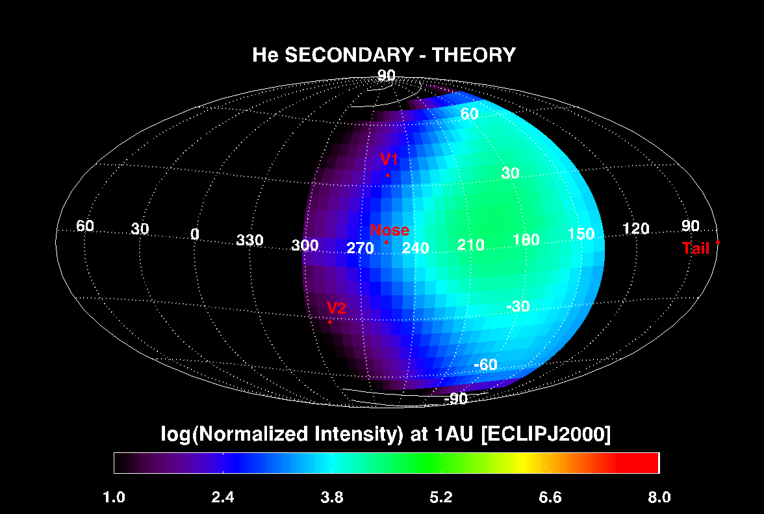
Theoretical Estimate for Sec. & Primary Component.

Slide 12
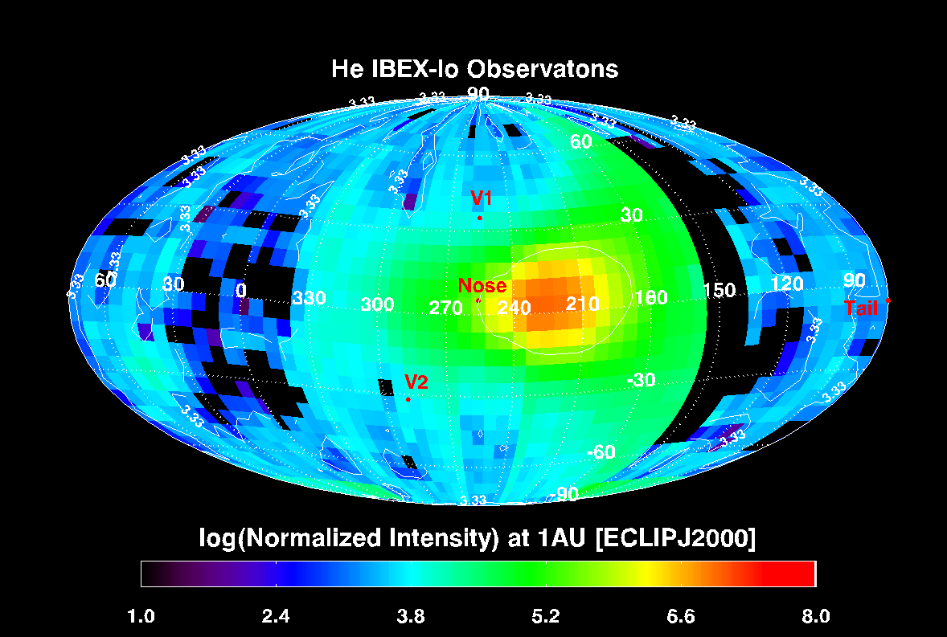
Energy step 1,2,3 vs. Energy step 2,3

Slide 13
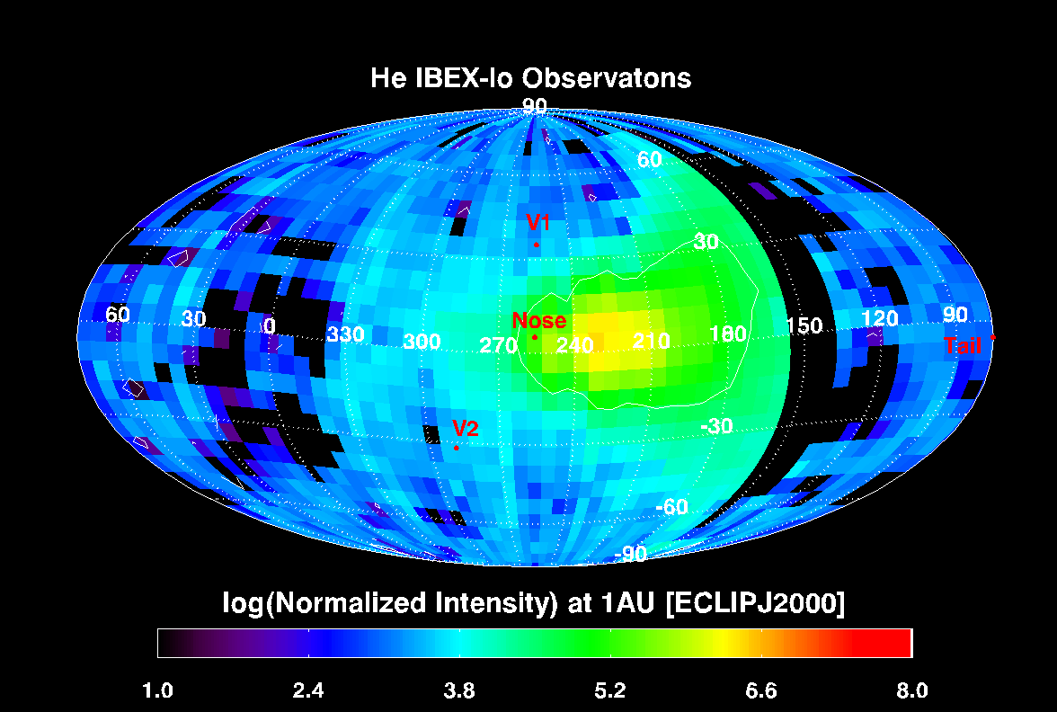
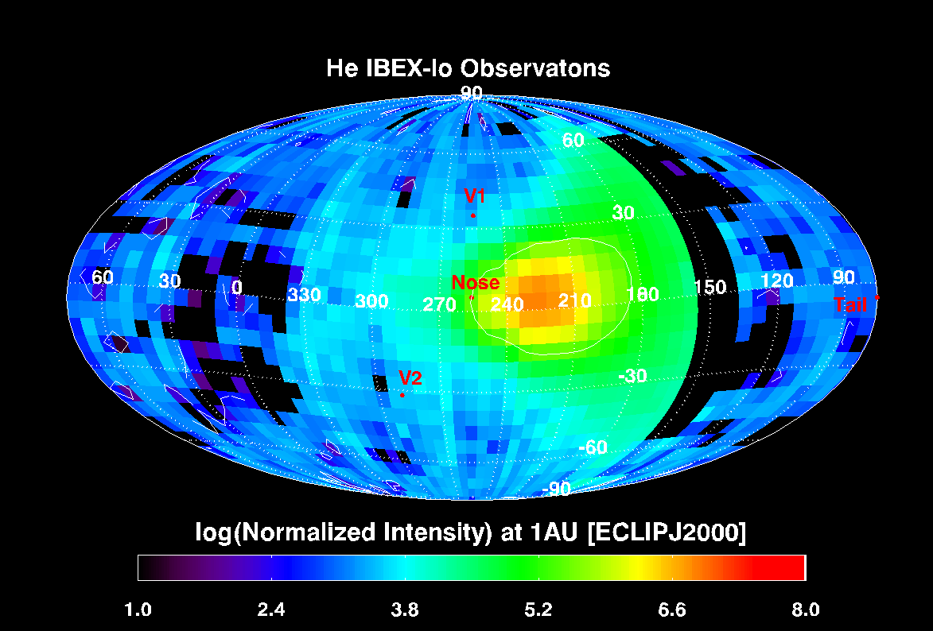
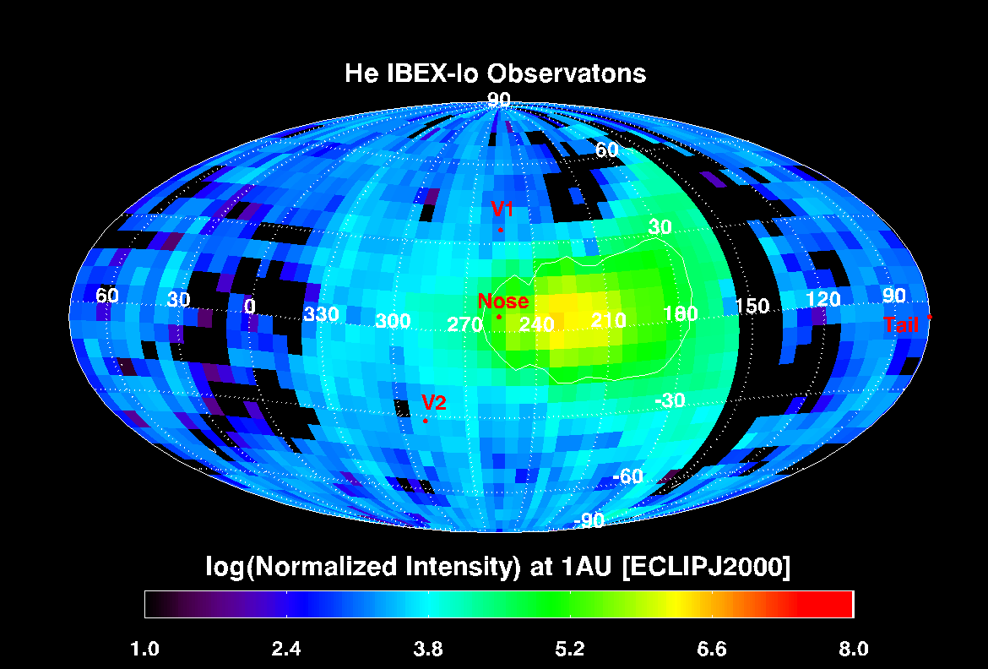
Observation vs. Theory (E-step 2,3)

Slide 14
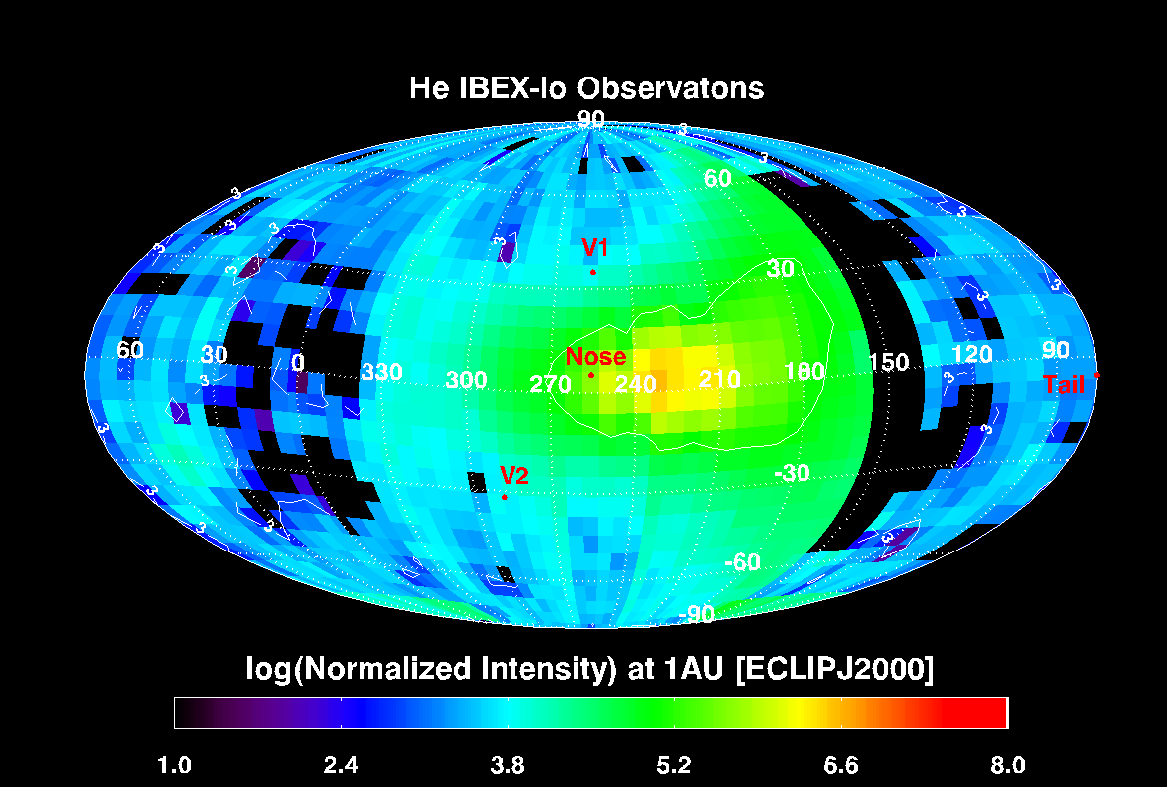
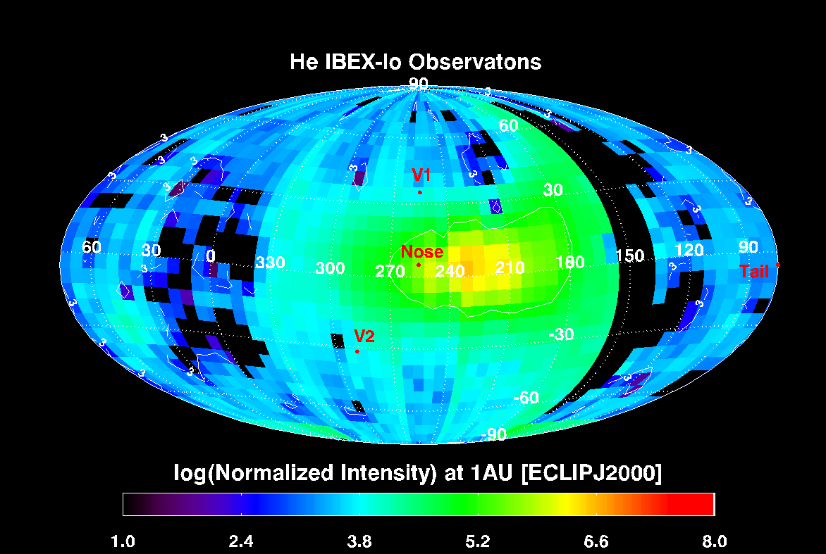
Observation vs. Theory
Part 2 (E-step 1,2,3)

Slide 15
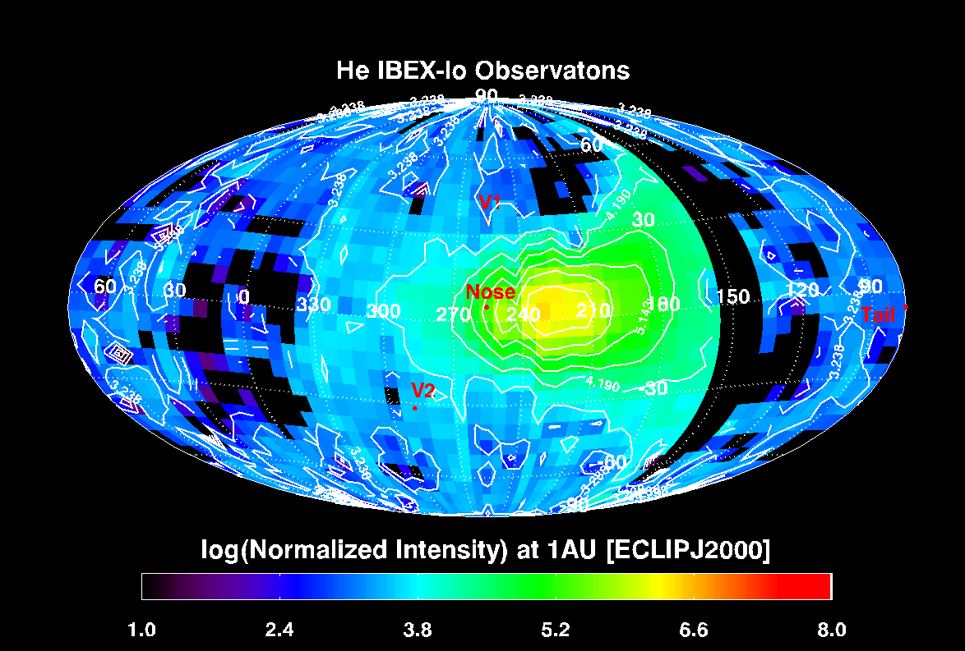
Energy step 2,3 --- primary and secondary removed.

Slide 16
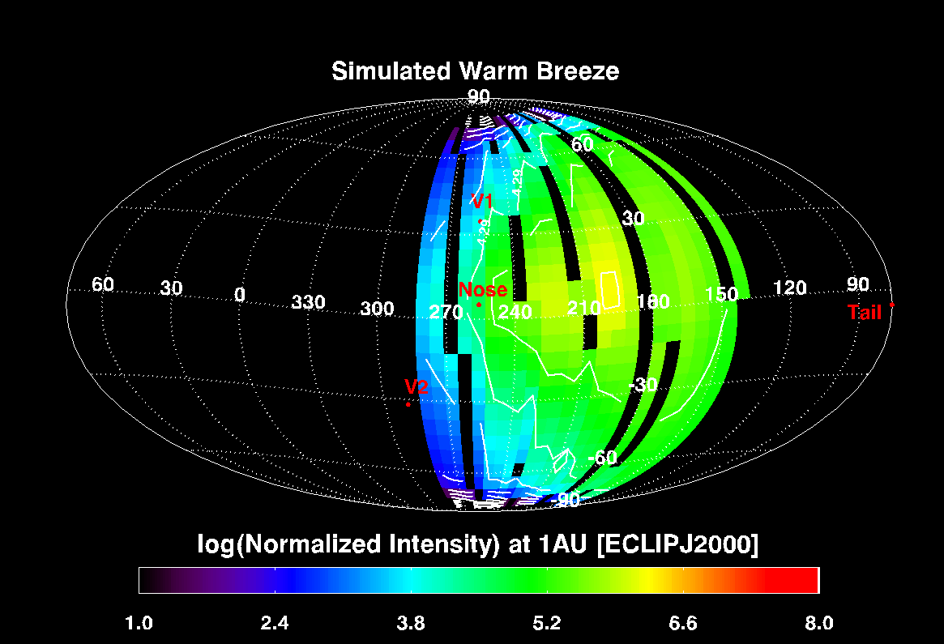
Warm Breeze simulations (Bzowski & Kubiak)
Simulation Model includes:
Shape of the heliosphere
Time dependent ionization
Charge exchange,
Etc.

Slide 17
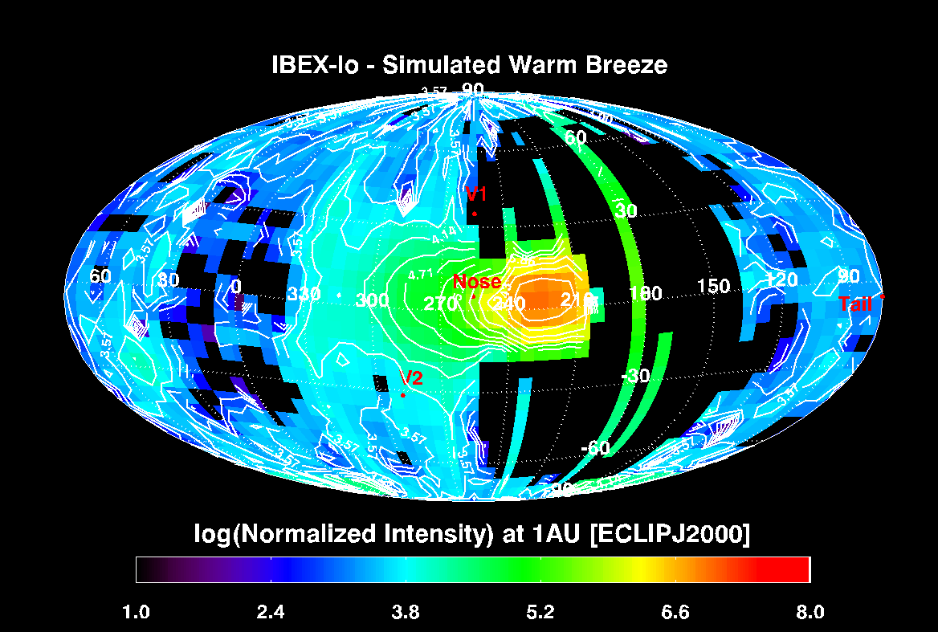
IBEX-lo He Observations: WB removed

Slide 18
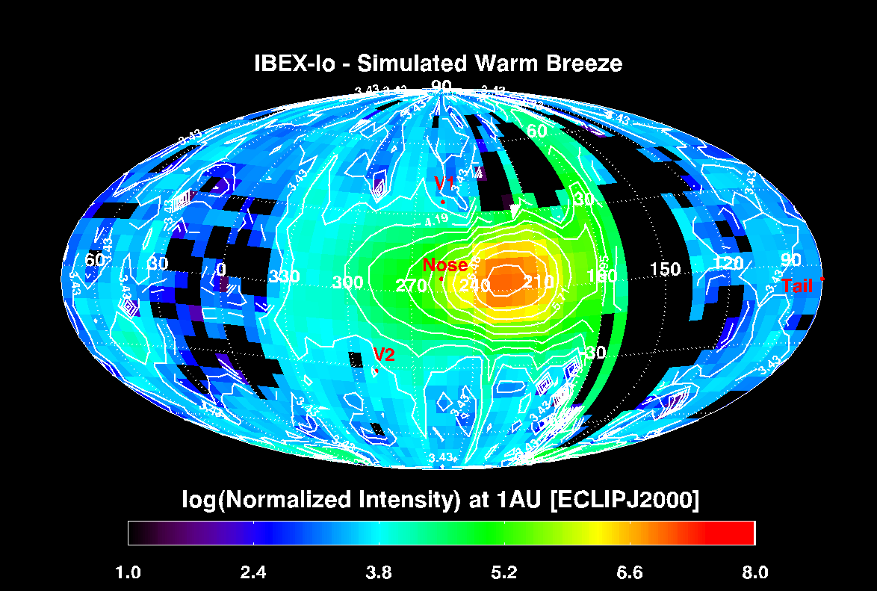
IBEX-lo He Observations: WB removed

Slide 19
Simple Model vs. Warschaw Model

Slide 20
Summary:
We produced sputter corrected IBEX-lo He maps.
We subtracted model predictions for the primary and the secondary ENA component as well as the Warm Breeze simulations.
While the WB simulations include a hyperbola shape for the heliosphere, the simple model assumes a spherical shape.
The two model show a different emission pattern which could be attributed to different shape of the heliosphere.

