Slide 1
Primary and Secondary Interstellar Flow Analysis
Xian Wu
P. Bochsler, M. Lee, H. Kucharek, T. Leonard, E. Moebius

Slide 2
Outline
Brief explanation of the heliospheric interface and secondary neutral production
Motivation of secondary component analysis
Analytical analysis of the Primary Interstellar Flow
Preliminary analysis of secondary oxygen data
Future work

Slide 3
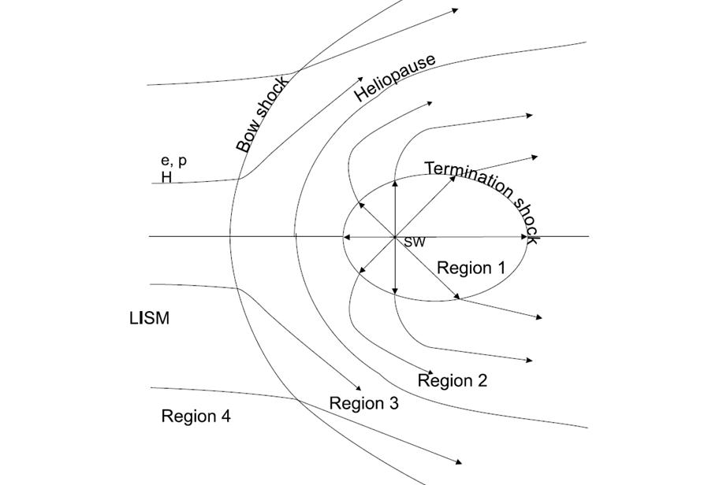
Schematic of Heliospheric Interface
Supersonic Solar Wind
Inner Heliosheath
Outer Heliosheath
Izmodenov 2007
Notes:
The solar wind forms a bubble in the local interstellar medium. This bubble is called the heliosphere. The size and properties of the bubble are determined by the manner in which the solar wind plasma and the partially ionized local interstellar medium are coupled. The solar wind is enclosed by the termination shock and is identified as region 1. Here, the termination shock is formed due to the deceleration of the supersonic solar wind. The shocked solar wind, the heliosheath, which is bounded by the termination shock and the heliopause is identified as region 2, while the interstellar medium is found beyond the heliopause. And the heliopause is a contact, or tangential discontinuity, which separates the solar wind plasma and the interstellar plasma component. The outer heliosheath is region 3 with disturbed interstellar plasma component flow. This flow may or may not form a bow shock depending on whether the interstellar flow velocity is supersonic. And the region 4 is the undisturbed interstellar gas flow, or say, “the pristine interstellar medium”.

Slide 4
Schematic of Heliospheric Interface
Primary Component
Izmodenov 2007
Notes:
This is the primary component. It’s coming from the local interstellar cloud and penetrate into heliosphere. On the way of its marching, some part of the flow is consumed by charge exchange. After the flow entering the region 1, some will turn into pickup ions.
Junhong talked about the pickup ions that are generated in Region 1. What you show here suggests that you mean pickup ions produced in Region 3. Please clarify!!

Slide 5
Schematic of Heliospheric Interface
Secondary Component
Primary Component
Izmodenov 2007
Notes:
Here is our secondary flow. It is generated between the bow shock and the heliopause, from the disturbed plasma in this region 3 and moving into the termination shock.
At this point, we may want to ask, when we observing this secondary component inside of region 1, what can we learn from the measurement?

Slide 6
Parent Distribution of Secondaries From the Heliopause to 1AU
Outer Heliosheath
Neutral Hydrogen
Plasma
Secondary Oxygen
O+
x
Fo+
vx
Fo+
vx
Fo+
vx
Heliosheath Plasma
Neutrals at 100 AU
Neutrals at 1 AU
Notes:
This slide shows the heliospheric interface and the diverted plasma whose distribution function could be obtained at 1AU from the secondary component
We show charge exchange between neutral hydrogen and oxygen ions as an example. The secondary oxygen of the interstellar neutral gas flow in the inner heliosphere stems from charge exchange with outer heliosheath ions. And heliosheath ions are diverted around the heliosphere. Therefore, this component contains information of the deceleration, deflection, and heating of the interstellar plasma in the boundary layer. In this case…( turn back to the picture!!!)

Slide 7
Motivation
The secondary component contains information on the boundary layer.
Observing the secondary component at 1AU provides us with a tool to understand the outer heliosphere.
With a powerful analytical method by Lee et al. (2011) that we used to study the primary ISM flow, we will now attempt to study the secondary component.
Let’s start with the method and its use for the primary flow
Notes:
This brings up the motivation of researching the secondary component.
The secondary component contains information of boundary layer, as I showed already.
Observing secondary component gives us chance to understand the outer heliosphere. It means, observing the resulting spatial distribution and flow pattern of several interstellar gas species with neutral atom imaging techniques allows us to unravel the physical conditions of the local interstellar medium and its interaction with the outer heliosheath.
It could be my further work in the next few months. IBEX-Lo is observing interstellar O, He, along with secondary O. It’s the first time the instrument in space has the capability to measure secondary component. After having the tool made by Marty for the primary component, I gonna use this tool and to see what could be learned from our analysis.

Slide 8
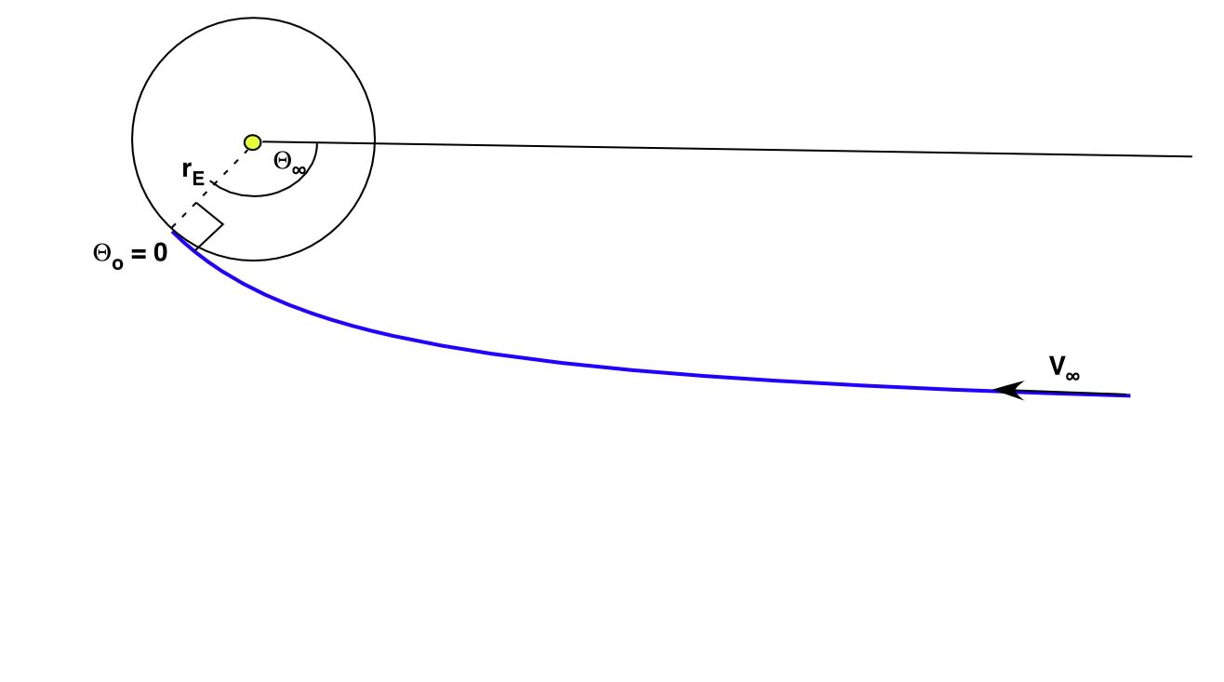
Strategy with Analytical Calculation for Primary Component
θ∞ = λ∞ + π - λ_{Observer}
Spring Equinox
λ∞
λ_{Observer}
Observation of Flow
at Perihelion
V∞ for each Orbit
Which means, for slower secondary flow, we should look at the earlier orbits for IBEX before primary counts dominated.
Notes:
The equation just describes the relation between the observer’s ecliptic longitude and the inflow speed at infinite.
You need to say a bit more here. And you can refer to my talk, since I covered this to some extent, but some repetition is good!

Slide 9
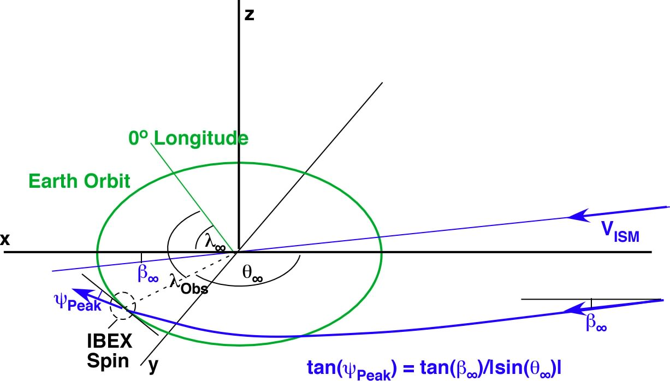
ISM Flow Geometry
θ∞ = λ∞ + π - λ_{Observer}
Analytical Method
Notes:
This one shows, if the inflow is coming with the angle beta_infinite in ecliptic latitude, then the instrument at the location of theta_infinte will observe this angle as psi_peak. So by using this relation, and the equation I presented on last slide, and the frame transformation, the analytical simulation could be obtained.
You can start by saying that the geometrical relation (the one in blue on the slide) is relatively straight forward and again only contains Lambda_Obs and Lambda_∞ as on the previous slide.
However, the frame transformation contains V_∞. So, you need also the relation from the previous slide, which leads to a more involved analytical solution that you will not present here.
Better break your explanation into several sentences!
There is still a comment on this slide!

Slide 10
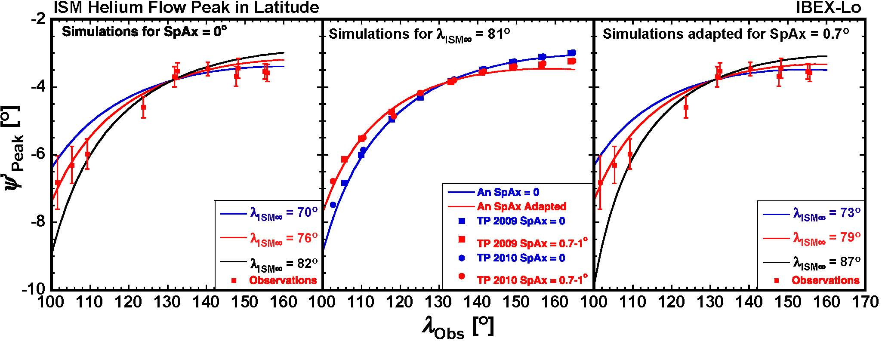
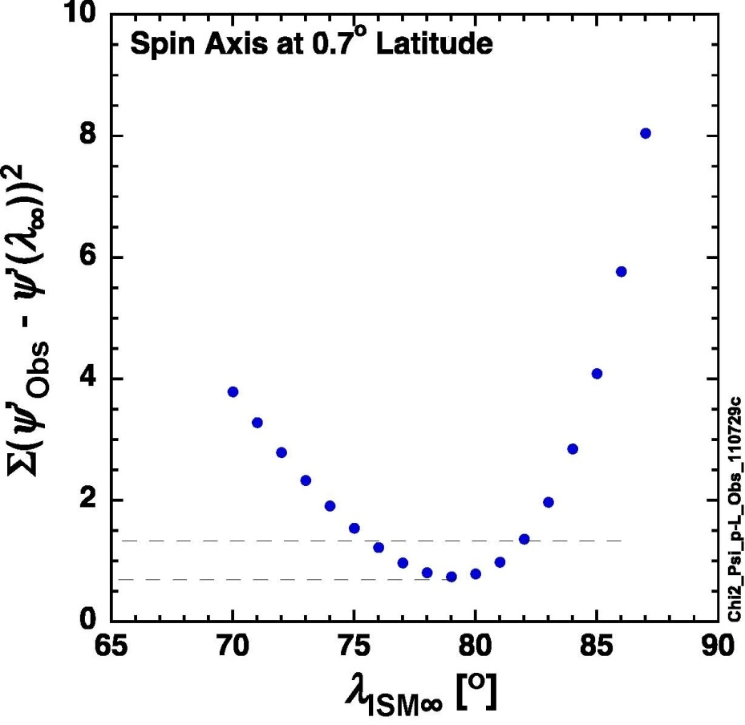
Build a relation between observer longitude and peak latitude combining the equations from previous slide.
Evaluate this analytical relation for λ_{ISM∞} as parameter with a least square method of the deviation between the analytical curves and the observed values.
The optimum range for the inflow longitude appears to be λISM∞=79°+3.0°(-3.5°)
A similar method could be used to study secondary Oxygen.
Moebius et al, 2011
Notes:
Before you go on to the secondary component. Lambda_ISM: ISM flow direction at infinite on ecliptic longitude
You also need to explain that the Psi_Peak(Lambda_Obs) curve describes a flow that can come from different longitudes and with any speed (i.e. the slower speed of the secondary component would still fall on this curve)
If the secondary peak is offset from this curve in Latitude, the flow comes from a different Latitude!
When you talk about the analytical curves show them on the plots and point to the observations when you mention those.

Slide 11
Data Selection for Secondary Oxygen analysis
Why is Oxygen?

Slide 12
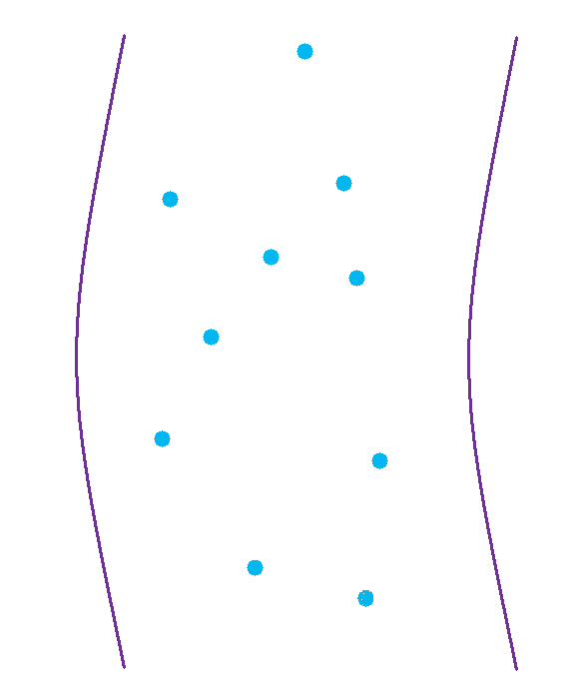
Data Selection for Secondary Oxygen analysis
Outer Heliosheath
Basic Relation:
 | Cross Section (σchex: cm²) | Density (nA: cm³) | Mean Free Path (λchex: AU)
H | 3.30×10⁻¹⁵ | 9.00×10⁻⁰² | 2.25×10⁺⁰²
He→ H+ | 2.12×10⁻²² | 9.00×10⁻⁰² | 3.50×10⁺⁰⁹
He → He+ | 2.85×10⁻¹⁵ | 1.50×10⁻⁰² | 1.56×10⁺⁰³
O | 1.50×10⁻¹⁵ | 9.00×10⁻⁰² | 4.95×10⁺⁰²
H+
The mean free path of charge exchange H and O is the same order as the thickness of the outer heliosheath.
L ≈ 100 AU
( Zank et al. in the IBEX Book)
Notes:
Which means, H and O play the most important part in the secondary component generation.

Slide 13
Data Selection for Secondary Oxygen analysis
Exclude magnetospheric ions and neutrals
To maximize statistics, include all times when attitude control system is blinded by Earth or Moon. These “despun data”, although to be improved with the Star Sensor, are good enough for the oxygen analysis.
Use data from IBEX energy step 5 and 6, which consist of oxygen and neon. ( Peter Bochsler’s talk)

Slide 14
The 1st year TOF despun Data for Oxygen
Background
Secondary Component
Orbit 11
Orbit 14
Orbit 15
Orbit 18
Primary Component
Notes:
The primary components is centered around Orbit 16. So, Orbits 15 through 18 belong to the Primary component!!
As you pointed out before, the Secondary component is found during earlier orbits (the neutrals are slower!!!)
I added a dashed line at Latitude 0 deg. You see an indication that what you refer to as Secondary component seems to be shifted to more negative Latitude

Slide 15
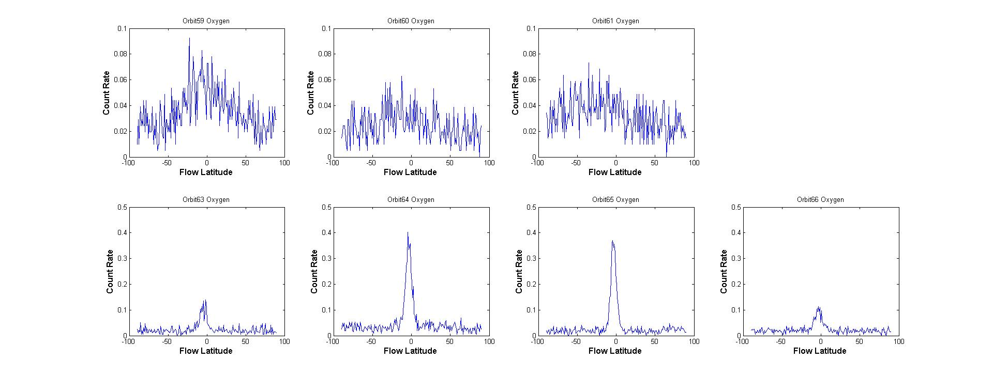
The 2nd year TOF despun Data for Oxygen
Background
Secondary Component
Orbit 59
Orbit 62
No Data
Orbit 63
Orbit 66
Primary Component
Notes:
Conclusion:
We may need to
- combine several orbits each year and/or combine orbits over consecutive years
- and/or use methods that work effectively with low counting statistics
Such a the Maximum Likelihood method

Slide 16
Strategies of Data Analysis
Coping with low counting statistics: Adding up counts number for multiple energy steps, multiple orbits, even multiple data sets for different years( it needs to be careful with the ecliptic longitude changing for each orbits)
Background subtraction: 1. Averaging over a wide range( 0-40 deg&180-360 deg in spin angle) 2. Or, fitting the background with a Gaussian function
Using Maximum likelihood method to pinpoint the parameters for secondary component. (continued on next slide)

Slide 17
Maximum Likelihood Method for Secondary (and Primary) component
Example: Sum oxygen counts of energy step 5 and 6, for orbit#63
$n_{i}$: Observed counts for each bin
$μ_{i}$: Simulated counts for each bin
$μ_{B}$: Simulated background
$P_{i}$: Possibility
$x_{max,1}$: Peak position for primary flow
$x_{max,2}$: Peak position for secondary flow
So:
$$μ_{i}\left(x_{i}\right)=Ce^{−\frac{{\left(x_{i}−x_{max,1}\right)}^{2}}{σ_{1}^{2}}}+De^{−\frac{{\left(x_{i}−x_{max,2}\right)}^{2}}{σ_{2}^{2}}}+μ_{B}$$
And, $P_{i}\left(μ_{i}\right)=\frac{e^{−μ}μ^{n_{i}}}{n_{i}!}$
Then, the likelihood function: $L=\prod_{i=1}^{N}{P_{i}\left(μ_{i}\right)}$
The parameters could be obtained by calculating partial derivatives:
$\frac{∂lnL}{∂C}=0$, $\frac{∂lnL}{∂D}=0$, $\frac{∂lnL}{∂x_{max,1}}=0$, $\frac{∂lnL}{∂x_{max,2}}=0$, $\frac{∂lnL}{∂σ_{1}}=0$, $\frac{∂lnL}{∂σ_{2}}=0$,

Slide 18
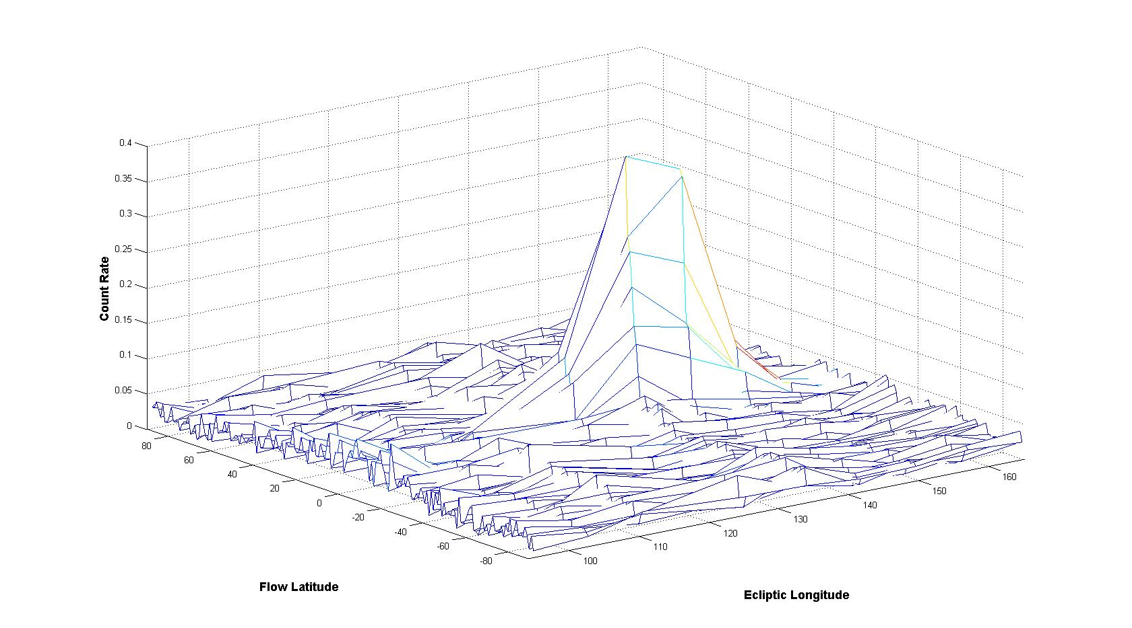
The 2nd Year Count Rate for Oxygen in 2D
Primary Peak
Signs of Secondary flow
80
0
-80
Notes:
I am torn whether we should even show this at this point!
We could only claim “signs” of the secondary component, if this view is show in comparison with the other side, and that one shows a steep fall-off.
Definitely, show at most this one slide!

Slide 19
Future Work: Maximum Likelihood Method in 2D
The secondary component appears better separated as a foot of the primary peak in 2D.
Fitting the secondary flow in ecliptic latitude and longitude at the same time would provide extra constraints and improved accuracy in the situation of low counting statistics and relatively high background.

Slide 20
Task List for Secondary Component analysis
Build the distribution function for the secondary component for each orbit
Extract the 3rd year Oxygen mode data and merge them into the analysis
Apply the existing analytical method for the primary component to this round of analysis
Use the MLM in 2D to try to obtain better constraints and accuracy

Slide 21
Thank you!

