Slide 1
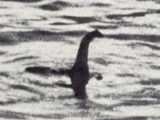
Maximum Likelihood Fitting of the Interstellar Neutral Gas Flow as Observed by IBEX for Comparison with Analytical Modeling
Trevor Leonard
Space Science Center & Physics Department
University of New Hampshire
November 16, 2011

Slide 2
Motivation
During an orbit the ecliptic longitude of IBEX changes, thus altering the IBEX-Lo center of field of view.
The evolution of the ISM Flow is observed over each orbit and can be extrapolated to exact Sun pointing.
IBEX observations are most valuable at exact perihelion of the ISM Flow trajectories for comparison with analytical calculations.
T. Leonard, UNH SSC, for the IBEX Team NESSC Mtg UNH, Nov 2011

Slide 3
First Task: Determination of the Flux Peak
Determining the flux evolution over each orbit and extrapolating to exact perihelion will give the ISM Flow flux as a function of IBEX ecliptic longitude which helps determine the bulk flow velocity
A Maximum Likelihood Fit of good time periods is used to determine an angular range of +/-3σ from the peak location to calculate the flux
This flux determination method is not sensitive to small changes in the peak location so we are able to utilize de-spun data
T. Leonard, UNH SSC, for the IBEX Team NESSC Mtg UNH, Nov 2011

Slide 4
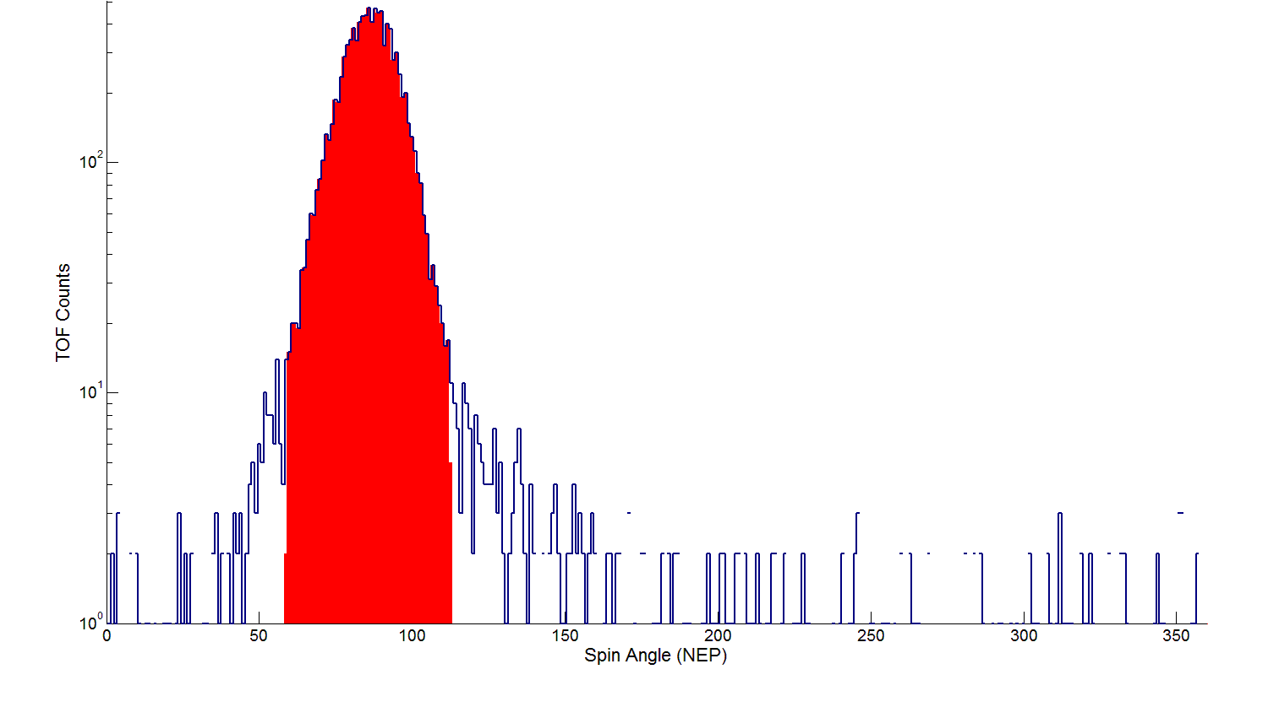
Count Rate Angular Range
+/-3σ angular range
T. Leonard, UNH SSC, for the IBEX Team NESSC Mtg UNH, Nov 2011

Slide 5
Determination of Flux Peak cont.
Obvious anomalies are removed from the count rate data set including:
Absence of counts
180˚ crossings
Magnetosphere interference
Electron rate spikes (ISN List)
T. Leonard, UNH SSC, for the IBEX Team NESSC Mtg UNH, Nov 2011

Slide 6
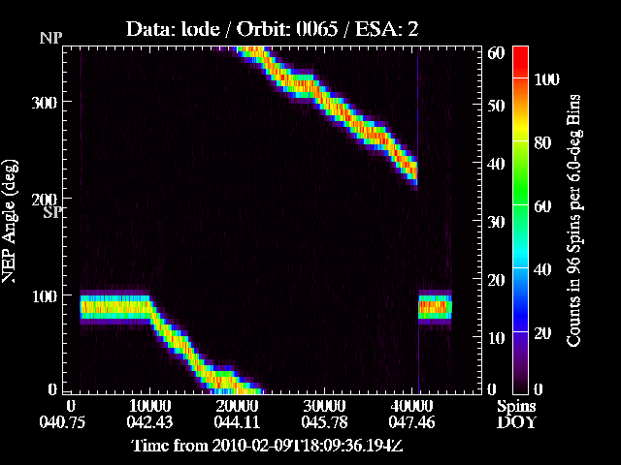
Integral Counts

Slide 7
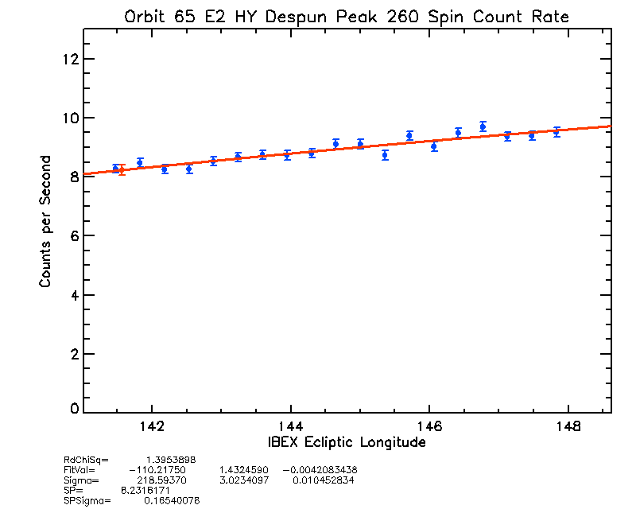
Orbit 65 E2 De-spun Golden HY
Exact Sun Pointing

Slide 8
Hardware Histogram Correction
A correction coefficient can be calculated from the comparison of the hardware histogram rates and direct event rates.
The hardware histogram data can not be despun so the correction must be calculated using data without spin problems.
T. Leonard, UNH SSC, for the IBEX Team NESSC Mtg UNH, Nov 2011

Slide 9
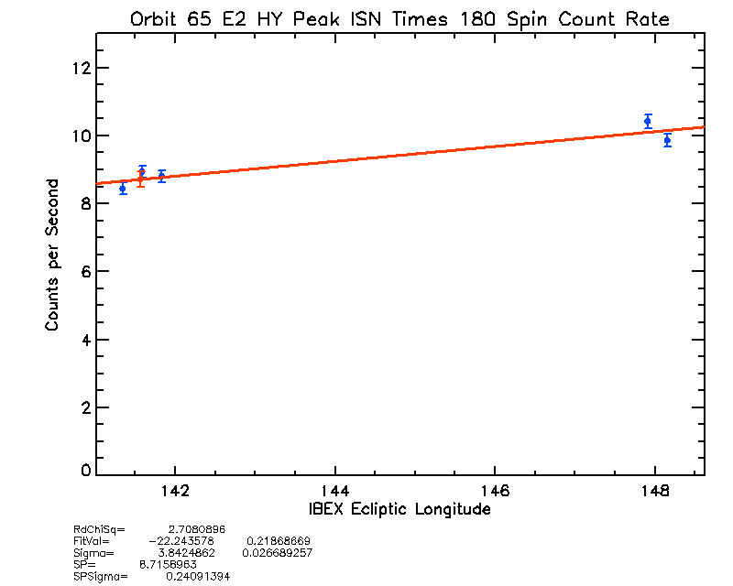
Orbit 65 E2 Gold HY Corrected
Exact Sun Pointing

Slide 10
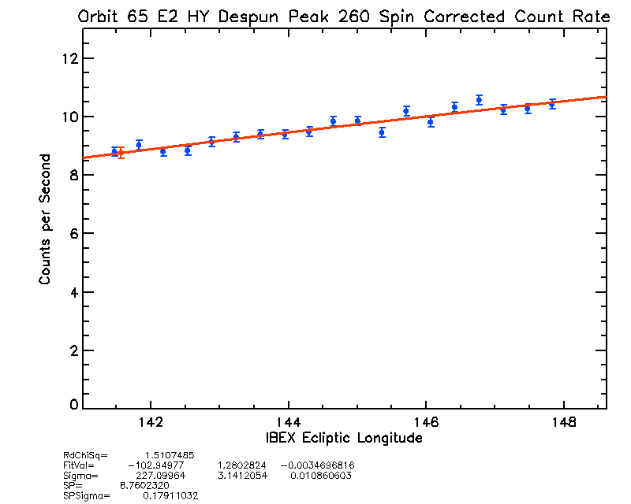
Orbit 65 E2 De-spun Gold HY Corrected
Exact Sun Pointing

Slide 11
Second Task: Determination of ISM Peak Latitude
The peak latitude can be found by determining the evolution of the angular peak location over the orbits and extrapolating to exact perihelion
This analysis is sensitive to anomalies in the data and thus the usable data is limited to the ISN List, which does not contain despun data
The good time data is binned into time periods and a Maximum Likelihood Fit is used to determine the peak location in latitude
T. Leonard, UNH SSC, for the IBEX Team NESSC Mtg UNH, Nov 2011

Slide 12
Orbit 65 E2
T. Leonard, UNH SSC, for the IBEX Team NESSC Mtg UNH, Nov 2011

Slide 13
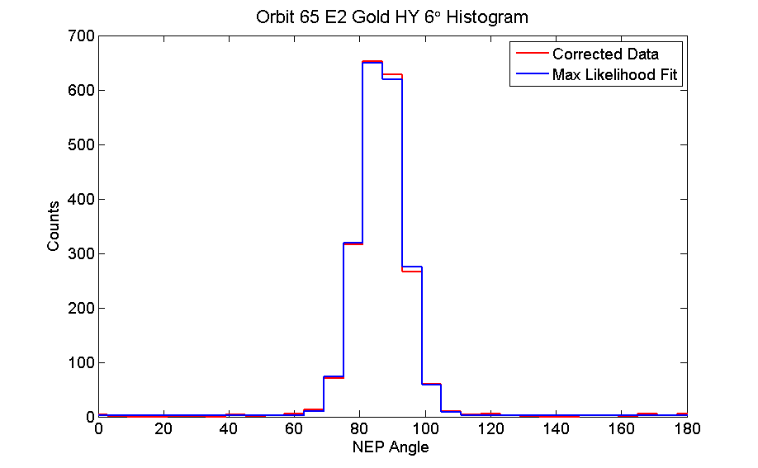
Orbit 65 E2 Gold HY Maximum Likelihood Fit
T. Leonard, UNH SSC, for the IBEX Team NESSC Mtg UNH, Nov 2011

Slide 14
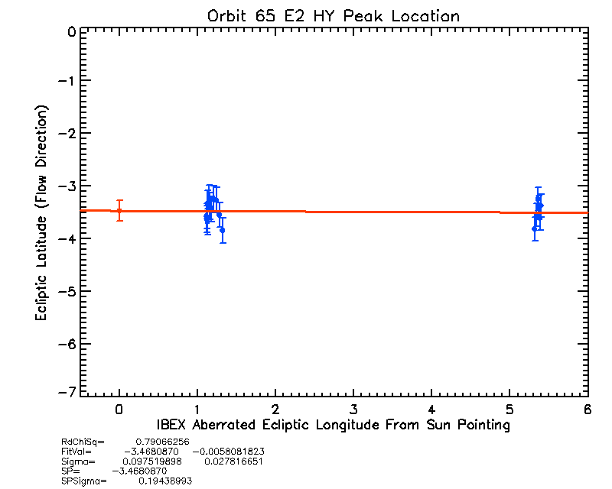
Orbit 65 E2 Gold HY Corrected Peak Location
Exact Sun Pointing

Slide 15
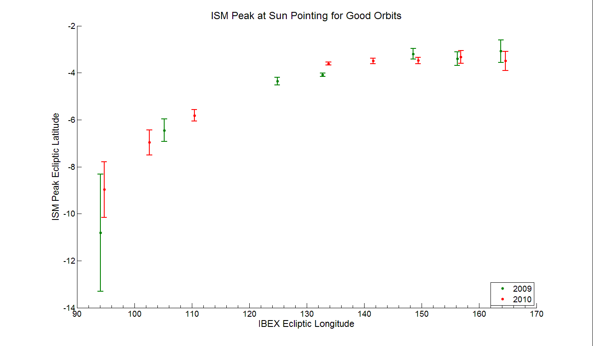
Total Good Orbit Peak Location
2009 Data
2010 Data
T. Leonard, UNH SSC, for the IBEX Team NESSC Mtg UNH, Nov 2011

Slide 16
Conclusion
The relationship between the peak flux and IBEX ecliptic longitude is well defined.
Determining the peak location and sigma looks promising but more data is needed, and the Star Sensor may be able to provide a better de-spinning process.
The hardware histogram data provides a correction for the loss of direct event data during high count rate orbits.
T. Leonard, UNH SSC, for the IBEX Team NESSC Mtg UNH, Nov 2011

Slide 17
Future Work
Instrumental losses still persist in the data.
Currently work is progressing with both software and hardware simulators of the IBEX-Lo instrument.
The simulations will help provide a better understanding of the instrument function.
Characterizing the instrument is part of an ongoing investigation of the temperature of the ISM Flow.
T. Leonard, UNH SSC, for the IBEX Team NESSC Mtg UNH, Nov 2011

