Slide 1
The Ionization of the Local Interstellar Cloud
Jonathan Slavin
Harvard-Smithsonian Center for Astrophysics

Slide 2
The Need for LIC Ionization Modeling
Heliosphere models rely on n_{e} and n_{H} as inputs (along with B_{ISM}, v_{ISM,} etc.)
Our information from observations is mostly indirect and averaged over the line of sight
Even for the more direct observation of n_{H} in situ, the filtration by charge exchange – and the most direct observation, n_{He}, doesn’t give us information on the ionized He. Observations toward nearby stars indicate He is substantially ionized (based on N(HI)/N(HeI))

Slide 3
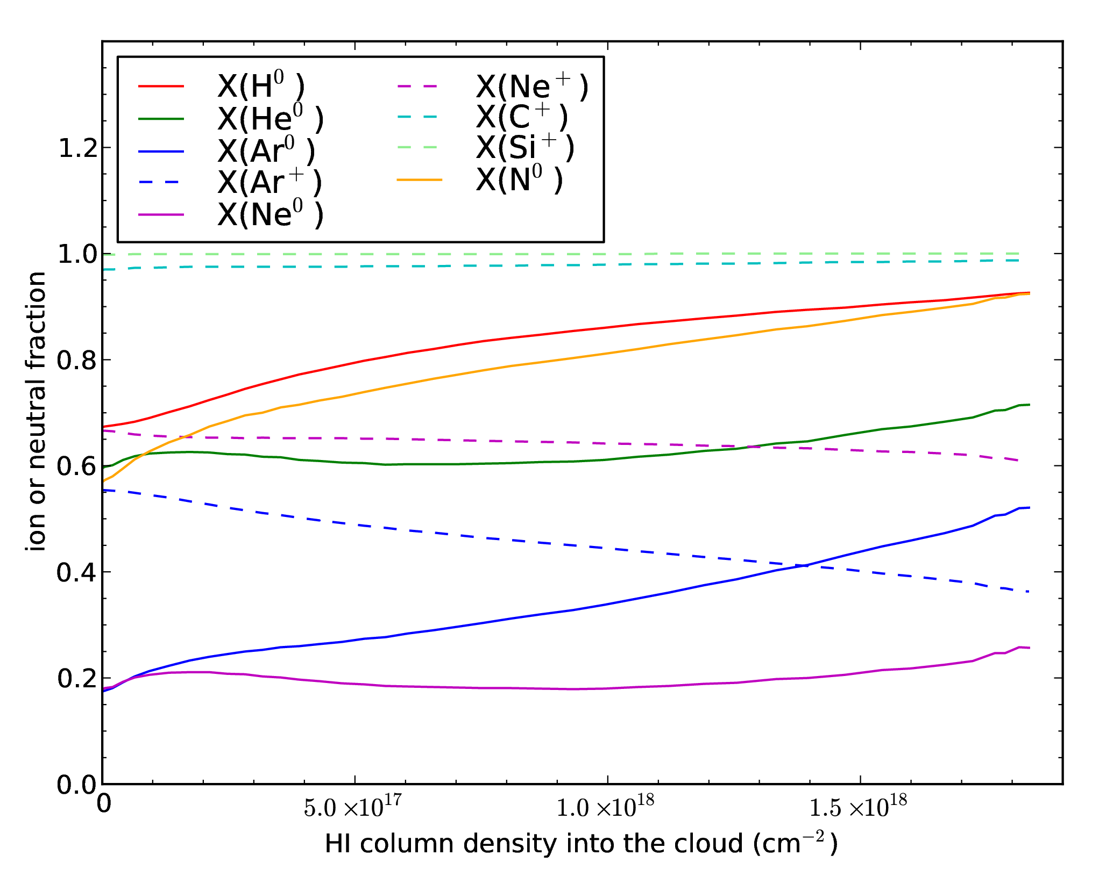
Modeled ionization gradient
Radiation transfer model assumes plane parallel cloud.
Ionization and thermal balance is calculated at each point.
H ionization varies substantially with depth into the cloud, while He ionization is relatively flat.

Slide 4
State of Local Interstellar Cloud Ionization
Nearly all of our information on LIC ionization comes from absorption line data toward nearby stars
One essential question for modeling LIC ionization: photoionization equilibrium or not?
If cloud is out of ionization equilibrium, then link between ionization state, temperature and radiation field is broken
Non-equilibrium recombination allows for more ionization of H, He than n_{e} and T implies for equilibrium
If LIC is in photoionization equilibrium, what is the ionizing radiation field?

Slide 5
Model for ε Canis Majoris Line of Sight (Slavin & Frisch 2008)
Using observed FUV background interstellar radiation field (ISRF) + observed stellar EUV field + modeled diffuse soft X-ray/EUV field as inputs to radiative transfer calculation ➔ ionization and heating sufficient to explain T and n_{e}
ε CMa is strongest source of stellar EUV flux – makes 1-D radiative transfer a reasonable approximation
ε CMa has very complete dataset of absorption lines
predictions for the circumheliospheric ISM based on idea that LIC is the cloud surrounding the heliosphere

Slide 6
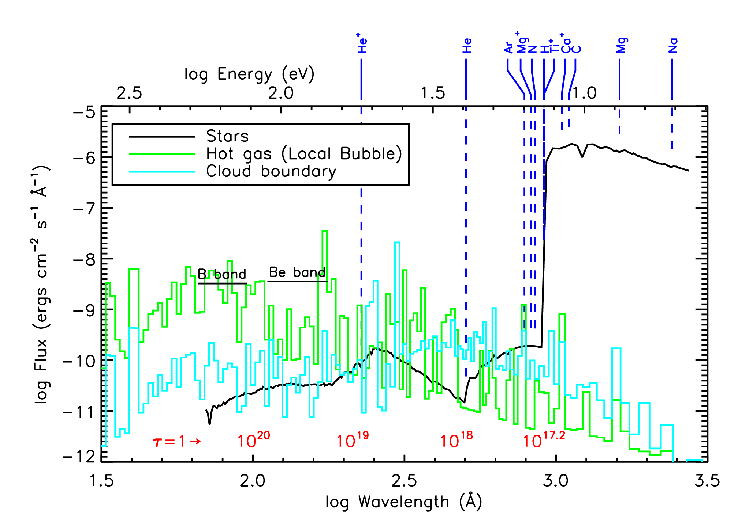
Model radiation field (Slavin & Frisch 2008)

Slide 7
What about other lines of sight?
Needs for creating well-constrained photoionization model:
Mg II, Mg I, S II (and/or CII), and C II* - minimum necessary to derive good limits on n_{e}, T
Fe II, O I also important for constraining gas phase abundances and cooling; Si II helps for dust composition
N(H I) toward ε CMa, and some idea of geometry of the LIC for the line of sight is needed for radiative transfer calculation

Slide 8
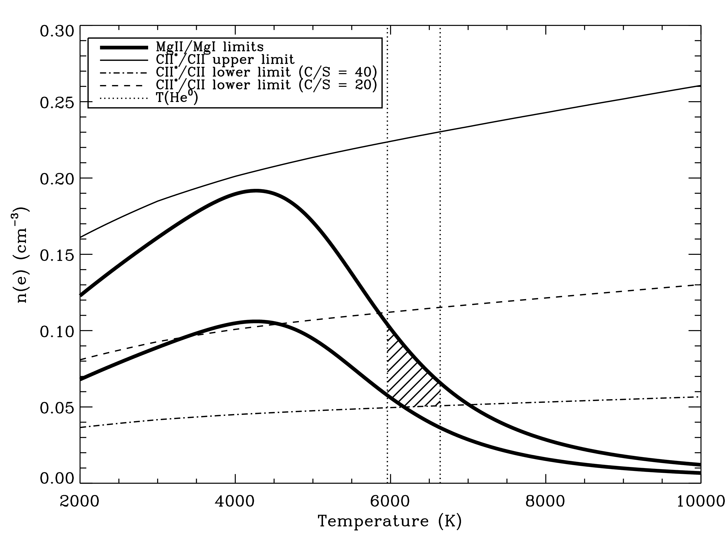
Determining n_{e} from MgII/MgI and CII*/CII
Results for ε CMa

Slide 9
Ionization Constraints from Sirius (α CMa) Line of Sight
Advantages to α CMa line of sight:
known to be very close, 2.3 pc, so no possibility of confusion of LIC gas with more distant absorption
direction very close to ε CMa – radiation field should be very similar
Disadvantages:
No CII* absorption observation
Mg II/Mg I can give upper limit on n_{e} but no tight limits on T. If T constrained some other way, can get limits on n_{e}

Slide 10
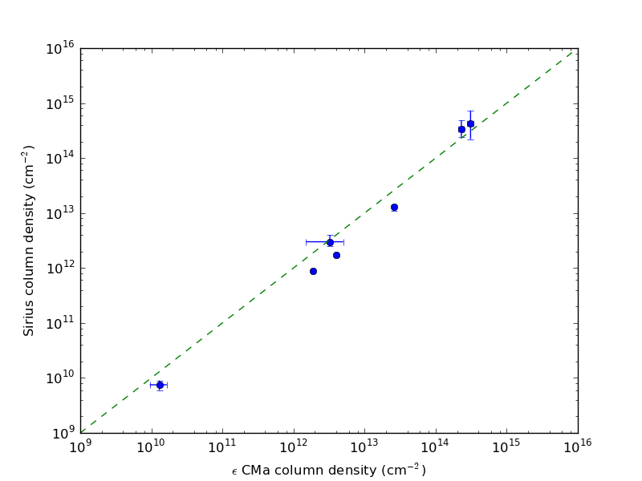
ε Canis Majoris vs. Sirius data
Some ions seem consistent between the two lines of sight – others don’t
O I
C II
Si II
N I
Mg II
Fe II
Mg I
MgII/MgI consistent between the two lines of sight, 310 ± 80 vs. 230 ± 50.
HI doesn’t seem to fit the pattern

Slide 11
Non-equilibrium ionization and the LIC
NEI may be present if the LIC was shocked or otherwise heated/cooled more quickly than the recombination timescale
2 main arguments against the importance of NEI for LIC:
LIC appears to be very quiescent dynamically – no evidence for expansion or contraction
ionization of Ar I – when compared to O I indicates that its ionization is dominated by photoionization
Argument in favor of NEI: cloud appears to show shock destruction of dust, but shock may have been long ago

Slide 12
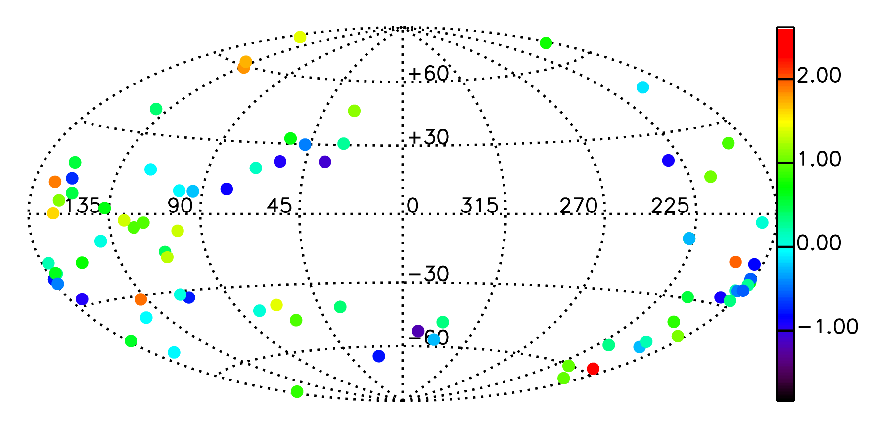
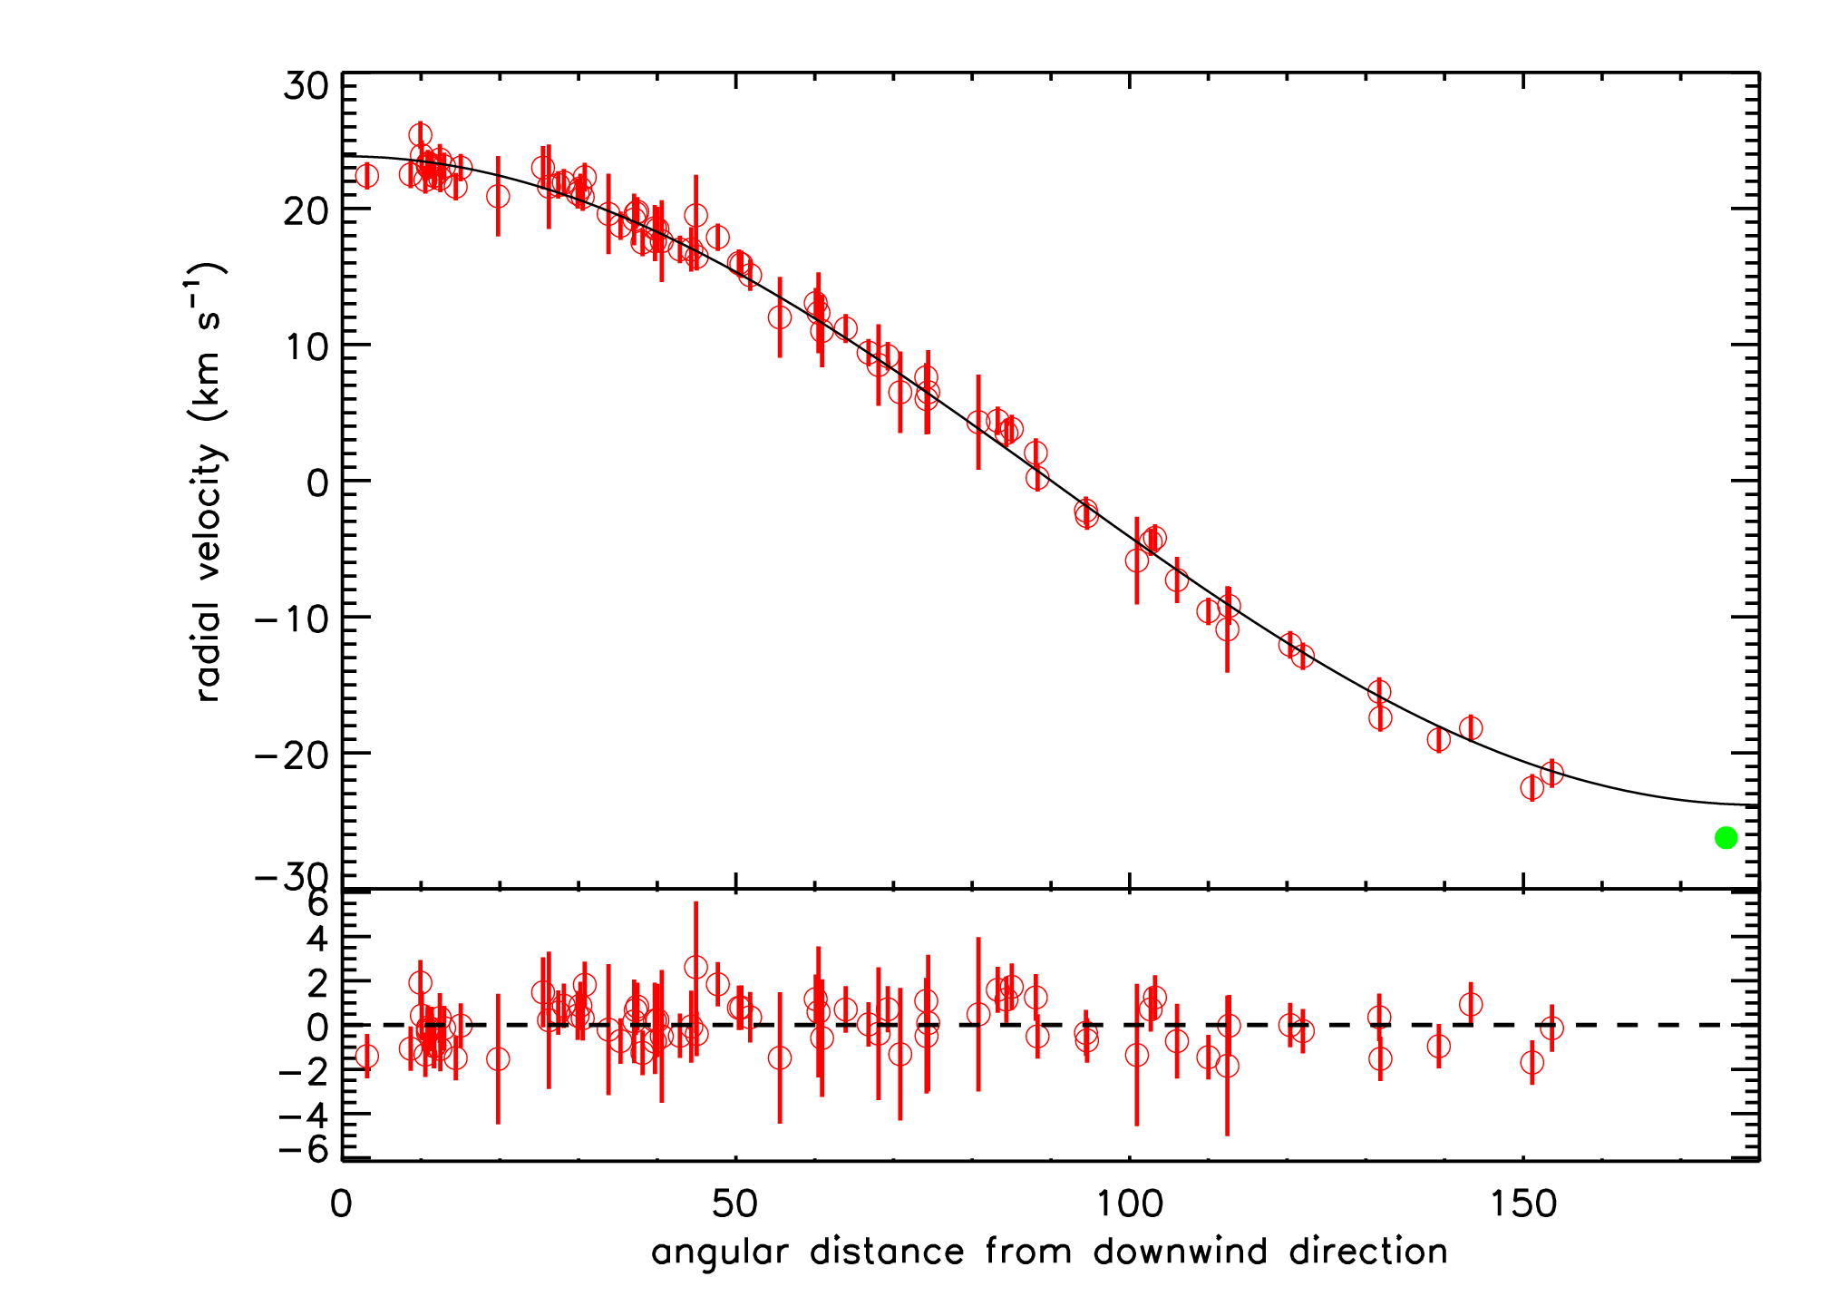
Evidence that LIC is dynamically quiescent – no signs of shock
No systematic deviation from single vector direction over the sky
Excellent fit to single vector direction – no sign of deviation from solid body motion
Also, turbulent velocity found to be small ~ 2-3 km/s

Slide 13
Summary
Photoionization models are needed for the LIC – but inputs are not very well constrained
The LIC appears to be very quiescent, arguing for assumption of equilibrium ionization
Models that explain the LIC ionization on the ε CMa line of sight do not seem to work for Sirius line of sight
More lines of sight need to be investigated – both with new observations and modeling – to better constrain the LIC ionization

