Slide 1
Estimation of the neon/oxygen abundance ratio at the
heliospheric termination shock and in the local interstellar
medium from IBEX observations
P. Bochsler¹, L. Petersen², E. Möbius, N.A. Schwadron
Space Science Center and Department of Physics, University of New Hampshire,
8 College Road, Durham, NH 03824, U.S.A.
P. Wurz, J.A. Scheer
Physikalisches Institut, University of Bern, Sidlerstrasse 5, CH-3012 Bern, Switzerland
S.A. Fuselier
Lockheed Martin Advanced Technology Center, 3251 Hanover St., Palo Alto, CA 94304,
U.S.A.
D.J. McComas
Southwest Research Institute, 6220 Culebra Rd., San Antonio, TX 78238, U.S.A.
University of Texas at San Antonio, San Antonio, TX, 78249, U.S.A.
M. Bzowski
Space Research Centre, Polish Academy of Sciences, Bartycka 18 A, PL 00-716 Warsaw,
Poland
P. C. Frisch
Department of Astronomy and Astrophysics, University of Chicago, 5640 S. Ellis Ave.,
Chicago, IL 60637, U.S.A.

Slide 3
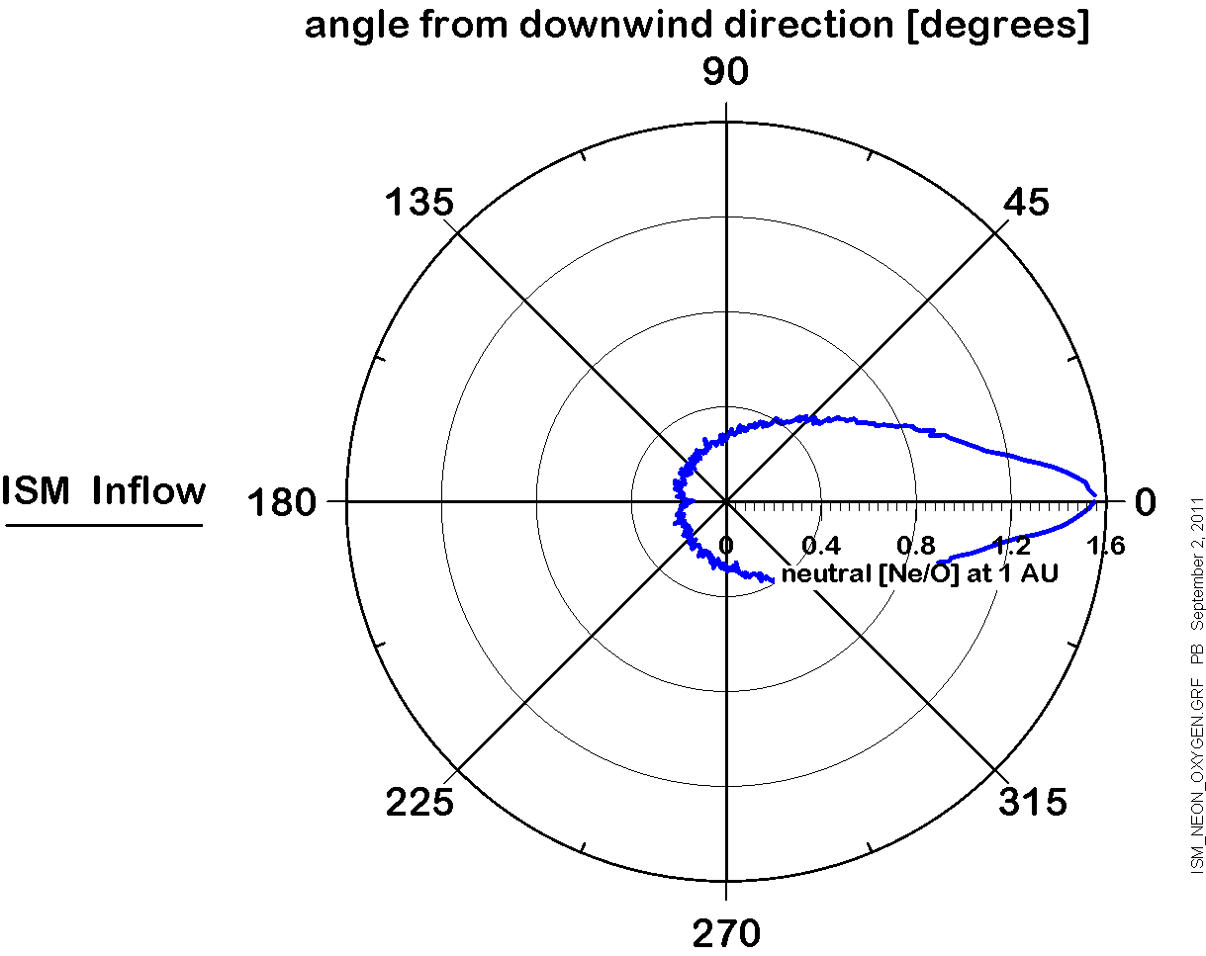

Slide 4
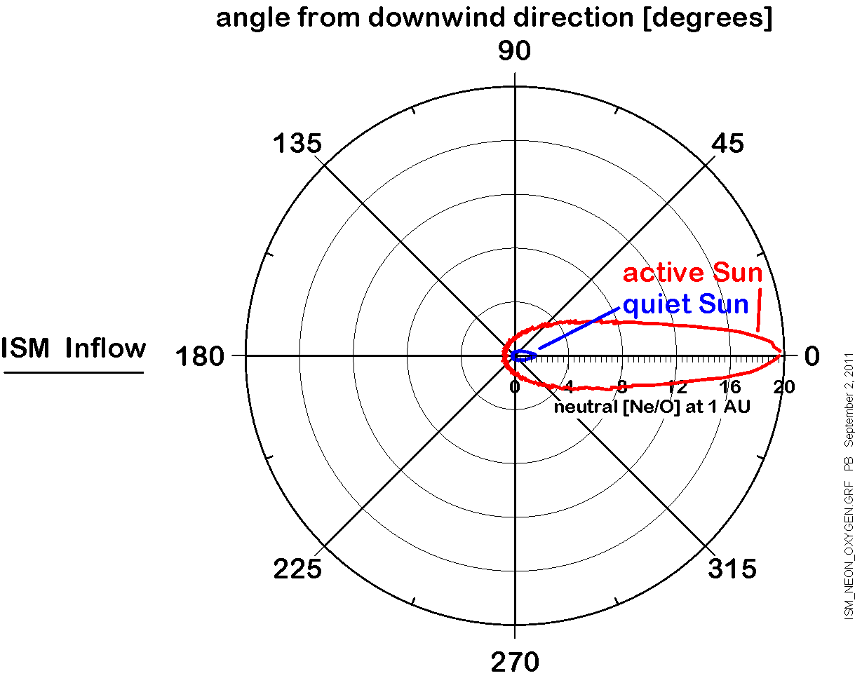

Slide 5
Measurement technique
conversion can produce negatively charged oxygen but no
charged neon
impacting neutrals (including Ne) also produce charged
sputter products from conversion surface, i.e. C⁻ O⁻
Thus we can detect a mixture of converted oxygen particles
and of sputter products, namely C and O

Slide 6
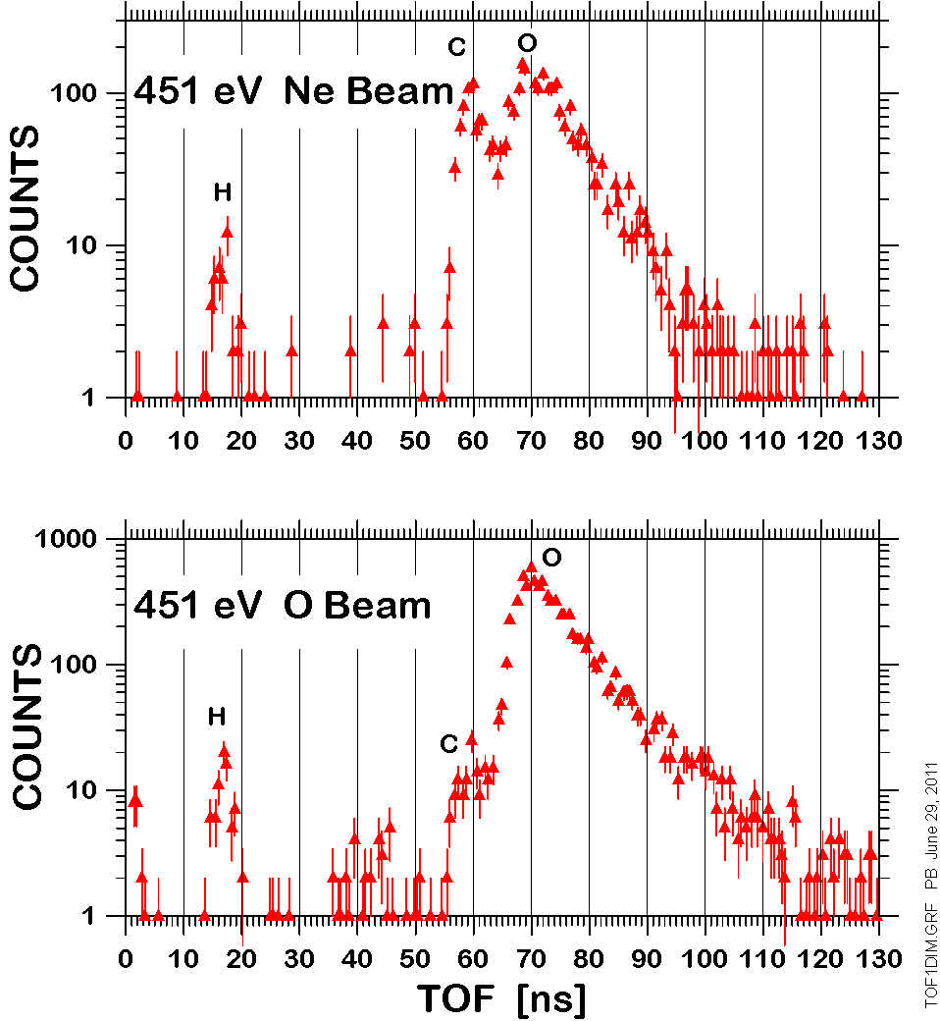

Slide 7
Gaussian: (e.g., sputtering and electronic
deceleration)
Exponential: (e.g., nuclear interaction)
Convolution:

Slide 8
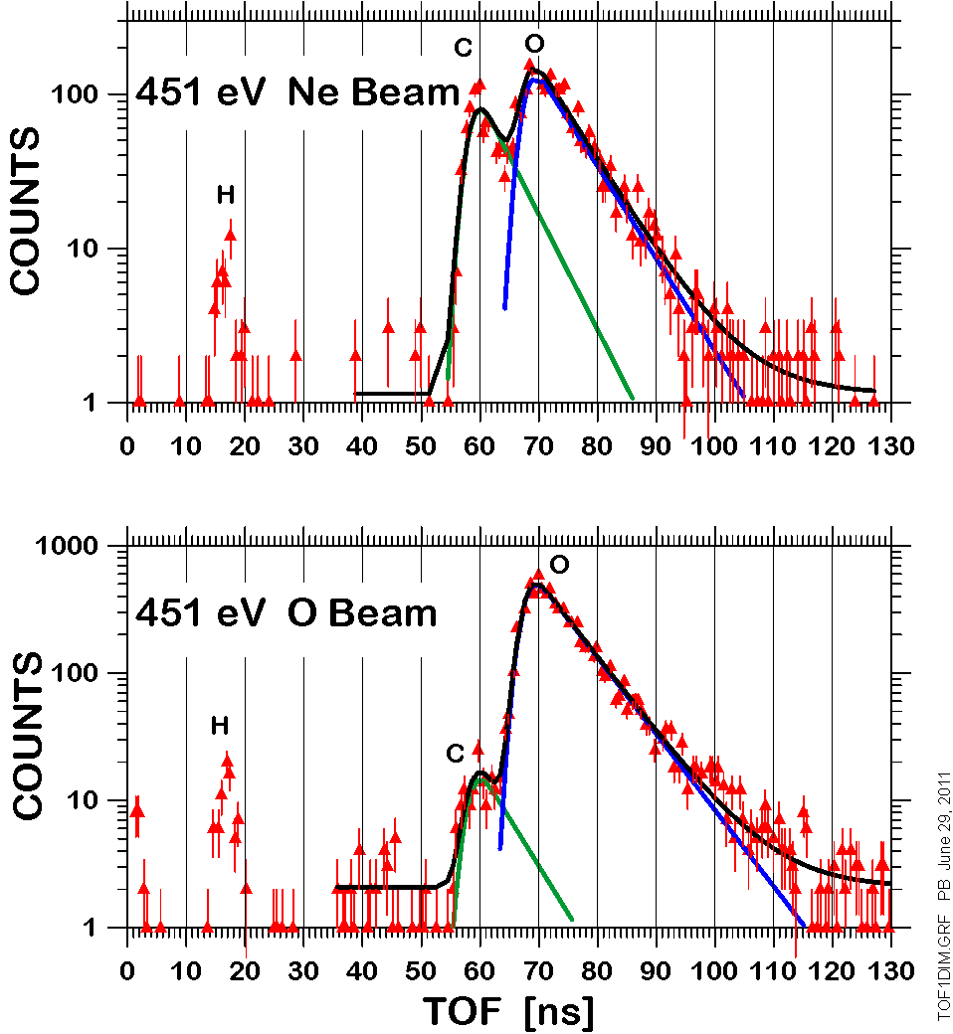

Slide 9
x C/O ratio measured in flight 0.217 ± 0.024
α C/O ratio from a pure neon beam 1.280 ± 0.082
β C/O ratio from a pure oxygen beam
0.0489±0.0032
γ ratio of detection efficiencies for C and O
0.40 ± 0.14

Slide 10
From the observation at 1 AU extrapolate to
the termination shock
ν_{ion,1AU} ionization rate at 1 AU (with 1/r² – dependence)
r_{o} 1 AU
θ, θ∞ true anomalies at site of observation and at infinity
V speed of neutral at 1AU

Slide 11
From the termination shock to the undisturbed interstellar medium…

Slide 12
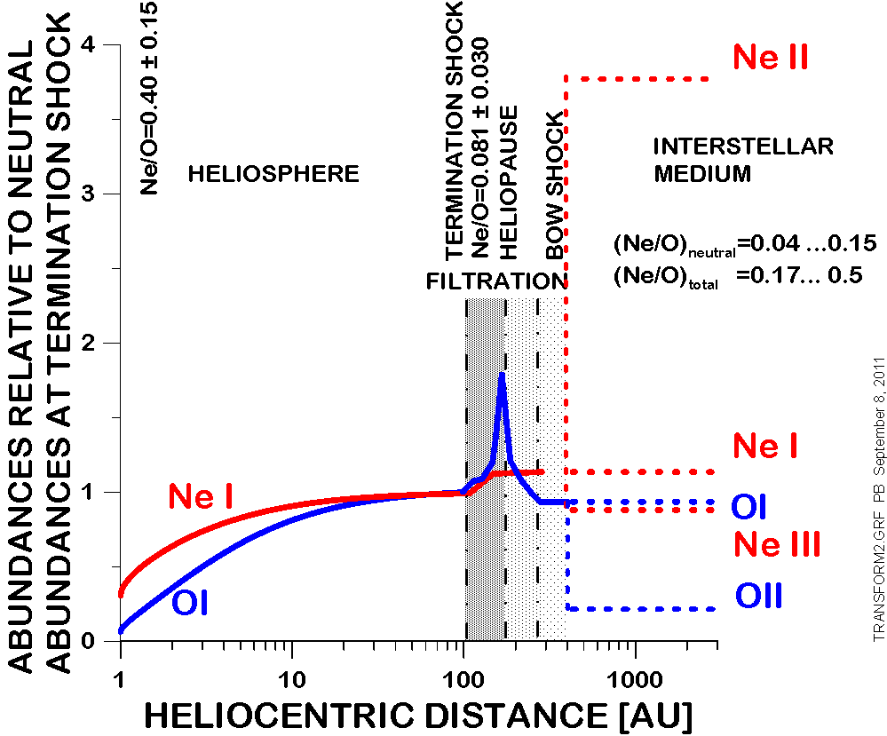

Slide 13
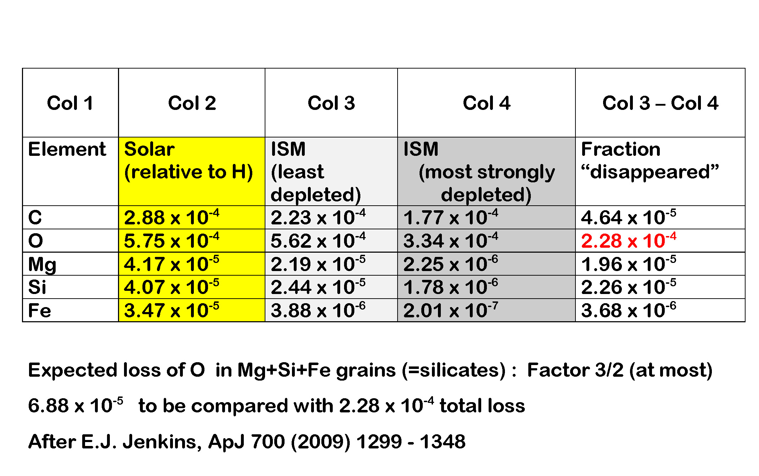

Slide 14
Conclusions I:
Neutral Ne/O in the inner heliosphere is interesting not so much for determining the total Ne/O abundances in the undisturbed ISM
but for the fact …
that both elements appear in different ionization states and in different chemical configurations in the ISM, i.e., a large fraction of interstellar oxygen seems hidden in ices
and that both elements undergo different processes at the interface

Slide 15
Conclusions II (and wishlist…)
Temporal (and spatial) variability will hopefully help to disentangle various processes at the interface
Refined models of processes occurring at the interface involving other elements might help as well
Re-evaluation of calibration and in-flight data with refined method (using all available information on TOF1 and TOF2) desirable
Re-calibration with emphasis on absolute yields of pure Ne and O beams

