Slide 1
Observational Constraints on the Interplanetary Hydrogen (IPH)
Flow and the Hydrogen Wall
John T. Clarke
Boston University
NESSC meeting
UNH 16 November 2011

Slide 2
Observations of Interplanetary Hydrogen
Voyager UVS:
brightness maps with helio. distance ~1980 - present
SOHO / SWAN:
brightness maps and absorption cell: 199X – present
HST H Ly alpha line profiles:
GHRS near Mars May 1991
GHRS upwind, downwind, cross-flow 1994 - 1996
STIS cross-flow June 2000
upwind March 2001
STIS near Mars May 2001
STIS upwind TBD spring 2012

Slide 3
LINE-OF
SIGHT
INTERSTELLAR WIND (H, He)
H
SCATTERING OF SOLAR LY-ALPHA
BY HYDROGEN ATOMS
SOHO
EARTH ORBIT
IONISATION CAVITY FROM
CHARGE-EXCHANGE WITH
SOLAR IONS

Slide 4
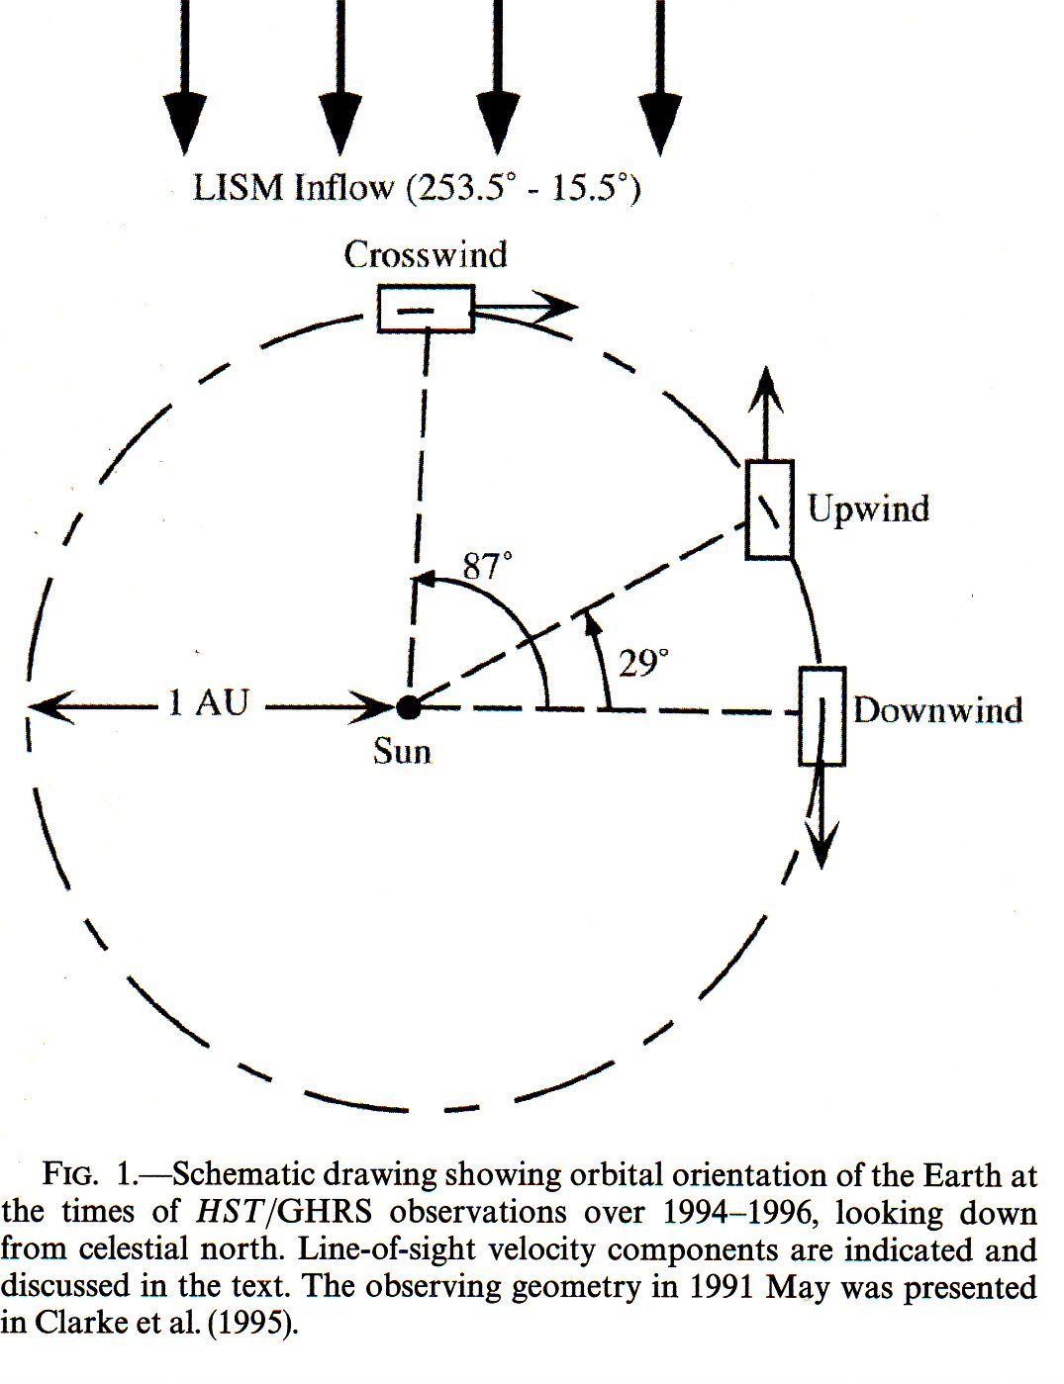
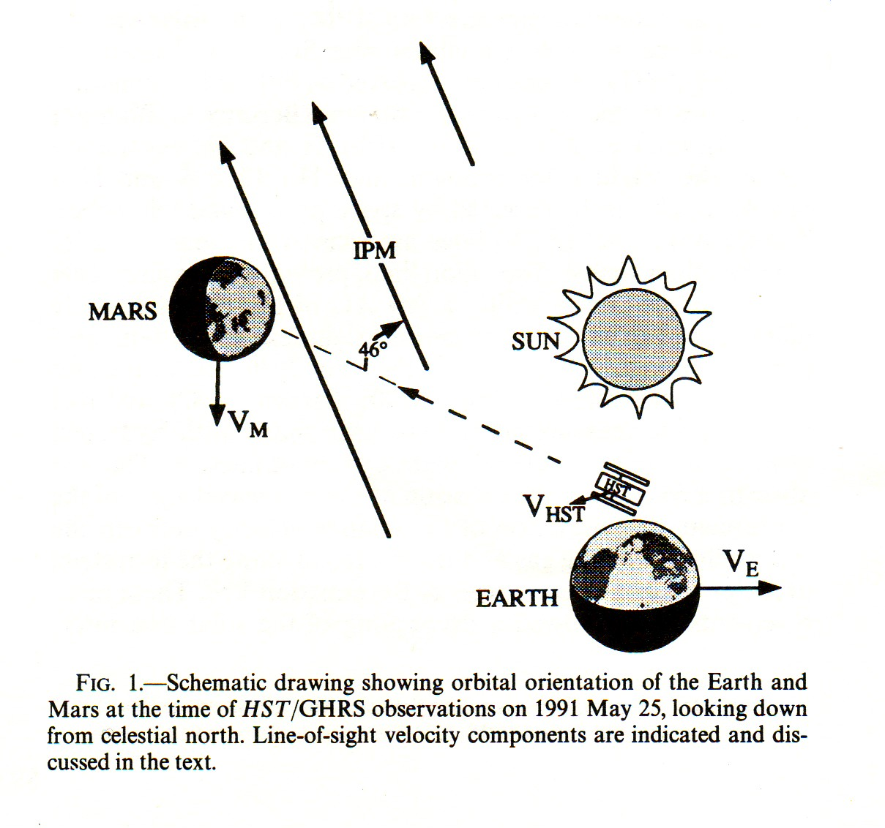
Observing the Interplanetary Flow with HST
HST at high spectral resolution can
separate IP Hydrogen Ly α (IPH)
from geocoronal emissions by
Doppler shift using Earth orbit
motion and flow:

Slide 5
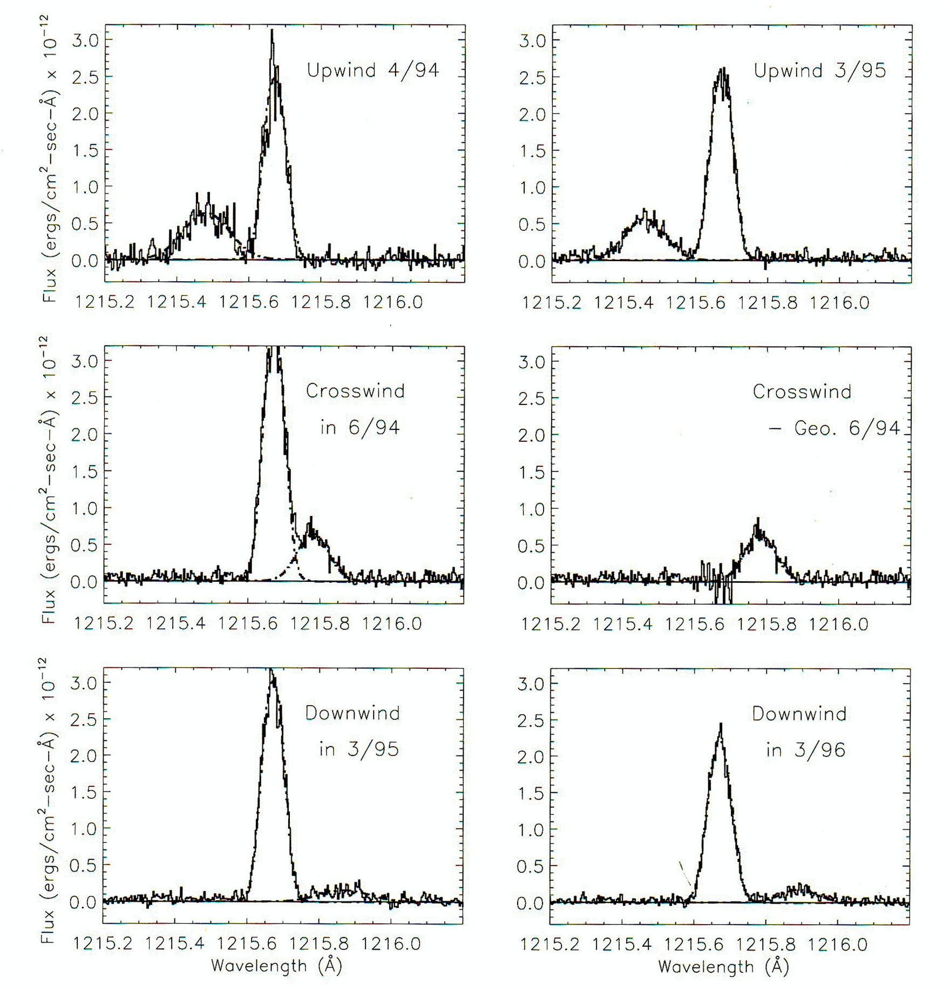
HST GHRS Spectra from 1994-1996
Spectra show bright
geocoronal emissions
at rest wavelength
1215.67 Å
Doppler-shifted IPH
emissions are cleanly
separated upwind and
downwind, not
crosswind…
Best fits can be made
to line center
(velocity) and line
width (temperature,
assumes Voigt profile)

Slide 6
HST GHRS Spectra Results (1996)
Upwind spectrum showed inflow speed near the Sun of
18-21 km/sec
This requires a slowing of several km/sec compared with
ISM flow at large distances, interpreted as modification
of the flow by charge exchange at the interface
Effective temperature values ~20,000 K larger than expected,
can be attributed to modification at interface plus changes
with solar activity, important to measure differences
parallel and perpendicular to the flow
Line of sight to Mars expected to have very small column
of IPH atoms due to ionization, observed brightness of
IPH emission larger than expected, uncertainty due to
2 arc sec aperture location on disc of Mars

Slide 7
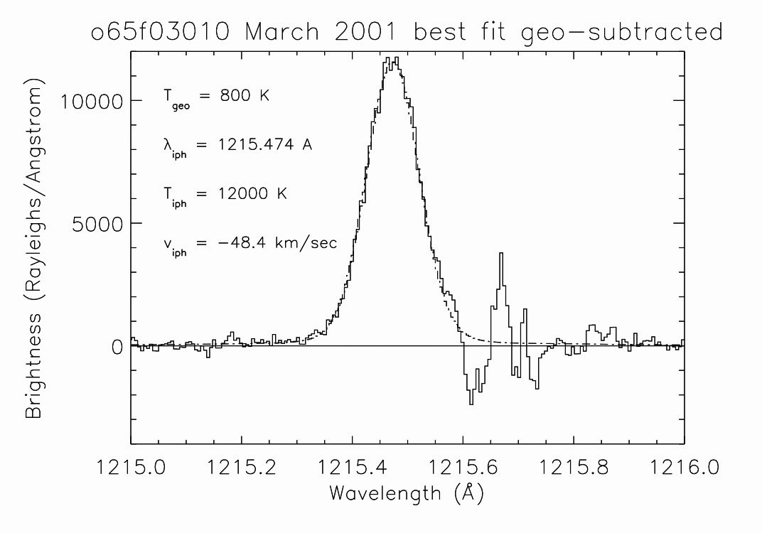
HST STIS Upwind Spectrum in March 2001
Upwind velocity and temperate consistent with SWAN
measurements near solar max., but require large value of μ
HST spectrum shows full line profile (SWAN must assume
symmetric profile, and cannot look directly upwind),
consistent with Voigt profile = maxwellian velocity distribution

Slide 8
Upwind profile fits with hot model (Lallement et al.):
Best fit requires large value of μ near solar max., consistent
with crossflow spectra, line shape not exactly fit by model

Slide 9
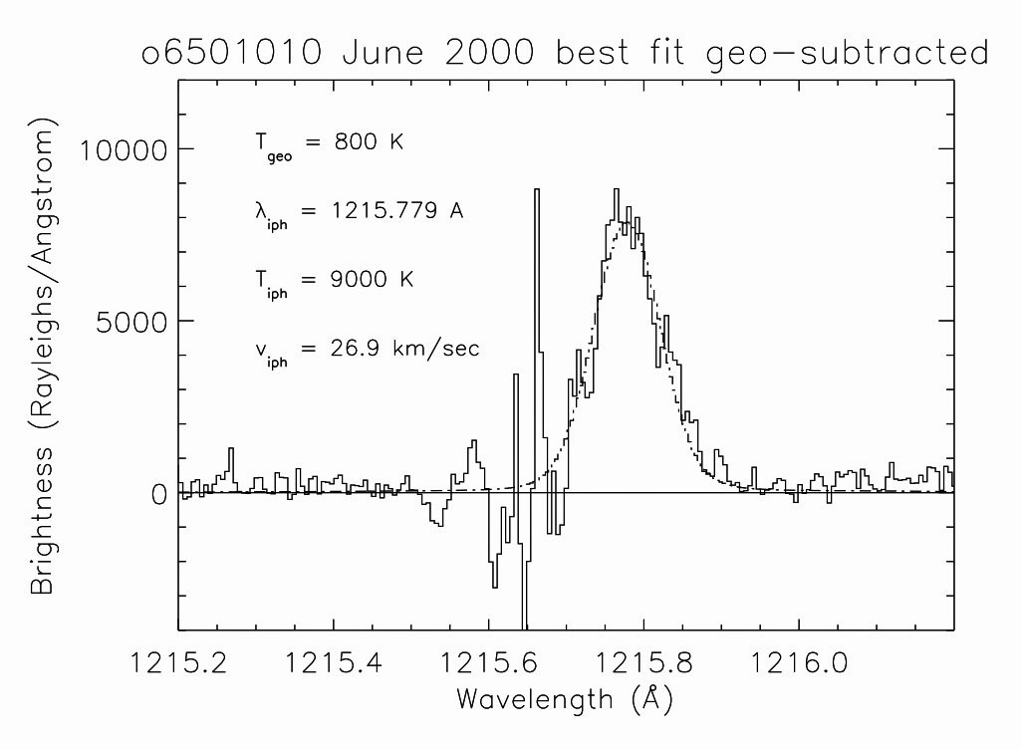
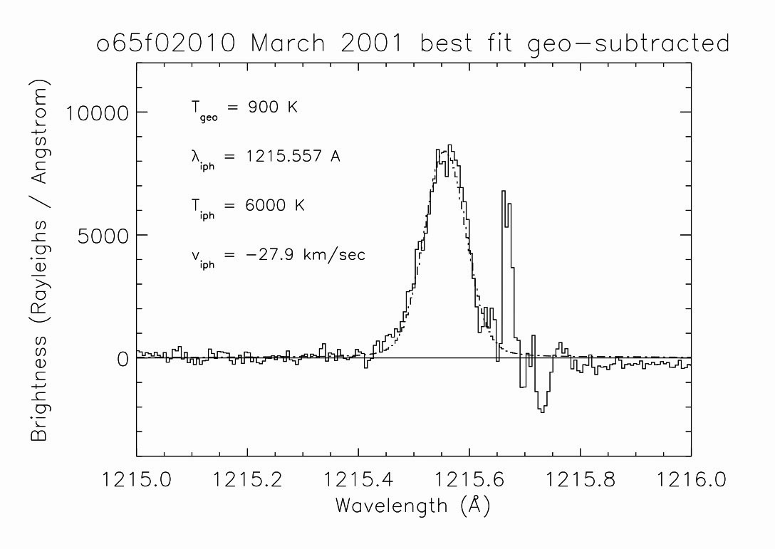
HST STIS Crossflow Spectra in June 2000
Line center can be measured accurately, comparing flow
speeds perpendicular to the flow along both flanks gives
constraint on μ = effective focussing, need large value
Geocoronal line subtraction leaves large residual on IPH line
wing, gives large uncertainty to temperature fit, values
depend on assumed line profile… but crossflow line is clearly
narrower/colder than flow direction

Slide 10
HST STIS Spectra Results
Upwind inflow speed near the Sun ~ 21 km/sec confirmed by
STIS spectra, supports slowing at interface
Higher S/N STIS spectra give lower effective temperature
values upwind than measured with GHRS, but this is near
solar max., GHRS was near solar min…
Crossflow spectra show nearly parallel flow near Sun, due to
selection effects consistent with large μ in hot model
Line of sight to Mars measured again using STIS, with long
aperture and spatial resolution we can derive more accurate
column in inner solar system, closer to expected low value

Slide 11
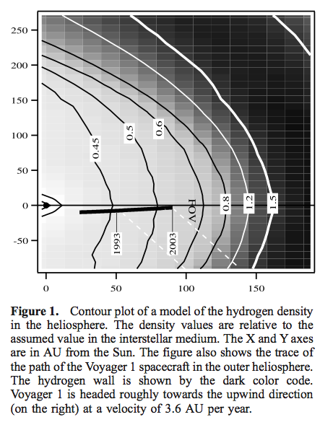
Quemerais et al. 2003
Voyager UVS observations of
H Ly alpha emission with
distance from the Sun allow
the determination of H
density contours:
Data from 1993 – 2003 ->
Fall-off rate in intensity and
density changes over time
Suggested change in H density
near the interface with time

Slide 12
Hydrogen “Wall”
First detected in absorption of broad H Ly alpha emission
from nearby stars by Wood and Linsky 1996
H atoms have different LOS velocity distribution at the
interface with ISM due to deceleration – shows up in
absorption signature
H atoms are decelerated and local density increases at
the interface
Hydrogen wall consistent with Baranov-Malama model runs
(Izmodenov et al. 2002)

Slide 13
Bertaux et al. 2005
Updated analysis of SWAN all sky maps of H Ly alpha emission
show strong dependence on solar latitude
Ionization rate of H atoms is ~2 times stronger along the
equator than at the poles
Ratio varies with solar activity: factor of 2 at solar min.,
nearly uniform at solar max
Result has strong implications for ENA imaging…

Slide 14
Quemerais et al. 2006
Continuing observations of H inflow speed with SOHO/SWAN
and comparison with HST/STIS line profile indicate H
inflow speed varies between 21-26 km/sec:
“Between 1996 to 2001, the mean line shift of the inter- planetary Lyman α line changes from a LOS velocity of 25.7 km s−1 to 21.4 km s−1 in the solar rest frame. “

Slide 15
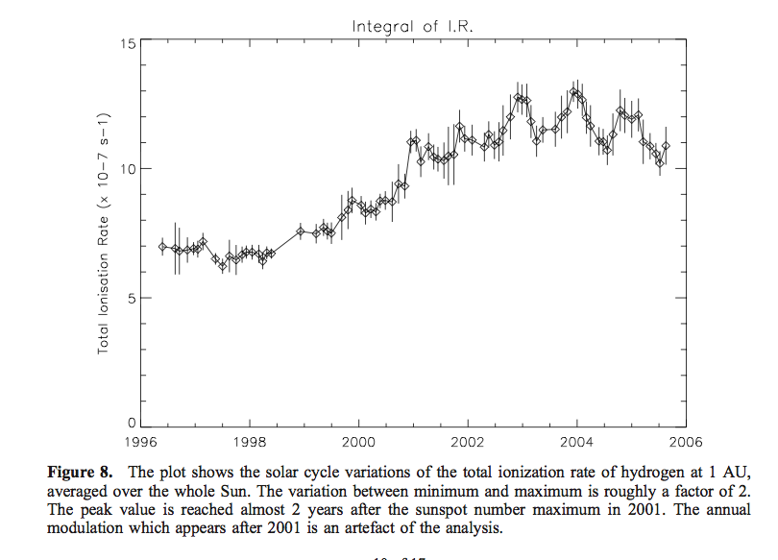
Quemerais et al. 2006
From SOHO/SWAN all-sky maps of H Ly alpha emission
they derive ionization rate and changes of 10 year period
Rates derived depend on absolute calibration (see FONDUE
web site – ISSI group results):
http://bdap.ipsl.fr/fondue/

Slide 16
Lallement et al. 2011
Updated analysis of SWAN data obtained same result as
earlier Quemerais analysis:
H inflow direction offset from helium flow direction
by ~ 4 degrees
Interpretation is that there is a distortion of the heliosphere
by an interstellar magnetic field
H and He flow vectors indicate magnitude and direction of
the distortion, and set constraints on the local B field

