Slide 1
Modeling and observations of pickup ion distributions in one solar cycle
JH. Chen¹, E. Möbius¹, P. Bochsler¹, G. Gloeckler², P. A. Isenberg¹,
M. Bzowski³, J. M. Sokol³
¹Space Science Center and Department of physics,
University of New Hampshire, NH, USA
²Department of Atmospheric, Oceanic, and Space Sciences,
University of Michigan, MI, USA
³Space Research Centre, Polish Academy of Science, Poland

Slide 2
Outline
Introduction
PUI phase space distribution
Motivation
Variations of PUI distribution
Simulation
Modeling PUI distribution
Conclusions
Notes:
I am gonna give a brief introduction to PUI phase space distribution. Then the motivation of this work, and the simulation conclusions

Slide 3
PUI Phase Space Distribution
Assume Isotropic Distribution
Initial pickup and Ring Distribution
Fast Pitch-Angle Scattering
Adiabatic Cooling
Source of Interstellar PUIs
Notes:
Here we discuss a simple model, assume it is an isotropic distribution, to form this distribution, we have three processes: Initial pickup and Ring Distribution, Fast Pitch-Angle Scattering which transforms the ring distribution into a spherical shell, Adiabatic Cooling which shrinks the spherical shell. Source of the interstellar PUI is neutrals from the neutral gas which penetrate into the heliosphere.

Slide 4
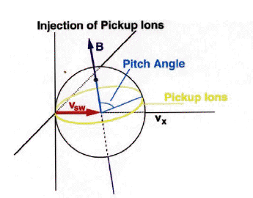
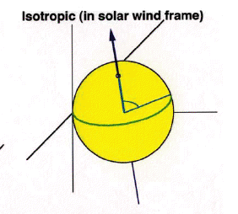
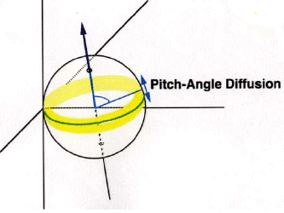
PUI Phase Space Distribution
Initial Ring Distribution
Pitch Angle Diffusion
Isotropic Distribution
Fig1. PUIs velocity distribution immediately after picked up
Fig2. Pitch-Angle diffusion
Fig3. Distributions fills a sphere shell in velocity space
Average IMF
Notes:
1.After the neutral atoms ionized, they will be picked up by the IMF, And then gyrate along the magnetic filed, since ions are continuously created from the source, a ring distribution are formed in solar wind.
2. After initially distributed in solar wind, they will be scattered in PA at fluctuations of the IMF, This transforms the initial ring distribution into an isotropic spherical shell in velocity space.
3. the PUIs will transport outward with solar wind volume expansion, the ions are adiabatically decelerated which makes the spherical shell shrinks as it moves away from sun

Slide 5
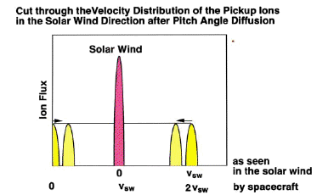
PUI Phase Space Distribution
Adiabatic Cooling
Spherical shell shrinks
as it moves away from sun
Fig4. Shrinkage by Adiabatic Cooling
Phy954,E. Moebius
${\left(\frac{v}{v_{sw}}\right)}^{3}={\left(\frac{r}{r_{0}}\right)}^{2}$
Notes:
3. After the spherical shell formed, ions are adiabatically decelerated when they transport outward with solar wind volume expansion , this cooling leading to a velocity v at the observer r0 satisfies the power law , then the spherical shell shrinks as it moves away from sun

Slide 6
Mapping of the Neutral Source
Mapping of Radial Neutral Gas Distribution into PUI Velocity Distribution
Mapping of the source distribution over the radial distance from the sun into a velocity distribution based on adiabatic cooling
As a consequence of mapping, the slope of the PUI distribution is a diagnostics for the radial distribution of neutral gas and thus the ionization rate (loss rate)
$${\left(\frac{v}{v_{sw}}\right)}^{1.5}=\left(\frac{r}{r_{0}}\right)$$
Notes:
With this power law equation, we can also map the radial neutral gas distribution into the PUI velocity distribution.
Conservation of Particles

Slide 7
Motivation
Previous Paradigm
Completely Adiabatic Cooling Implies
Expansion Solar Wind as 1/r²
Immediate Isotropization of PUIs
Yet: Is Cooling truly Completely Adiabatic?
Notes:
In previous isotropic distribution, we treat it as a Completely Adiabatic Cooling which implies:
Fast P.A scattering makes the distribution Immediate Isotropization .

Slide 8
Motivation
Cooling behavior depends on how solar wind expands(~$1/{r^{n}}$)
${\left(\frac{v}{v_{sw}}\right)}^{3}={\left(\frac{r}{r_{0}}\right)}^{n}$
Assumed n=2,$α=\frac{3}{n}$(Vasyliunas & Siscoe et al. 1976)
Nobody had actually tested this assumption seriously, except recently Saul et al. 2009. Since the data set used was only from Solar Min, they couldn't separate out the ionization rate effects in a straight forward way.
How well the PUIs are isotropized and coupled to IMF
Notes:
Vasyliunas & Siscoe predicted a population of interstellar PUIs on the solar wind, assume solar wind expansion as 1/r^2, so n=2, alph is 3/2,
besides, we wanna know How well the PUIs are isotropized and coupled to IMF
based on this motivations we want to test in detail the assumption that PUI will cool in the expanding solar wind for a wide range of ionization rate in one solar cycle.

Slide 9
Modeling PUI Distribution
PUI Distribution determined by Cooling & Ionization
Mapping of the Neutral source:
Along Inflow Axis to simplify the problem
by use of ACE SWICS June data each year
$$f\left(w\right)=α\frac{1}{4π}\frac{υ_{ion}r_{0}}{v_{sw}^{}v_{max}^{3}}N\left[\left(r=r_{0}{\left(w\right)}^{α}\right)\right]{\left(w\right)}^{α−3}$$
$$v_{max}=v_{sw}+v_{ISM}$$
$$v_{ISM}=\sqrt{v_{∞}^{2}+2\frac{GM_{S}}{R_{}}}$$
Observables Used:
Ionization Rate
Solar Wind Speed
Other Parameters:
VISM_Infinite
Neutral Inflow density at infinite
$$N(r)=N_{0}e^{\left.−Λβ(\sqrt{1+2/βr}−1\right)}$$
Notes:
We start by using v&s model, the isotropic distribution function and considering the non-zero injection speed of ions. W is the ion speed divided by the max speed which is the vsw+neutral inflow speed. We solve for a steady-state density of neutrals as a function of heliocentric distance on the upwind direction. This will simplify the problem by use of ACE SWICS June data each year.

Slide 10
Modeling PUI Distribution
Integration over instrument FOV & $ΔE$
Differential Flux Density:
Counting Rate:
Model PSD(S/C Frame):
$$\frac{dJ}{dEdΩ}=\frac{1}{ΔEΔΩ}\iiint_{ΔEΔΩ}{\left.f(w′\right)}w′^{3}dw′dφcosθdθ$$
$$C_{m}=\frac{dJ}{dEdΩ}×ΔE×G$$
$$\left.F_{m}(w)=378.4×{\left(m/q\right)}^{2}×({C_{m}}/{E^{2}}\right)$$
Notes:
Then we integrate the isotropic distribution function over the instrument field-of-view and energy steps. Omega is the instantaneous solid angle.
The constant 378.4 includes the calculated instrument isotropic GF and unit conversion factors. F(s3/km6)

Slide 11
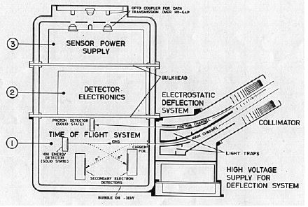
Instrument Description ACE SWICS
Deflection Analyzer Characteristics
ACE SWICS
Main Channel
Geometrical Factor :
Directional: $2×{10}^{−2}cm^{2}$
Field-Of-View: ${69}^{0}×{10}^{0}$
E/q Range(Kev/q): 0.49~100.0
Analyzer Resolution: 6.4%
Step Size: 1.0744
Deflection Analyzer
Post-Acceleration
Time-Of-Flight
Residual Energy Measurement
Fig6. Cross-Section of SWICS sensor
Notes:
Before entering the TOF/Energy telescope (main channel) or the Energy-only telescope (auxiliary channel), the ions see a ~23 kV drop in potential across the inner and outer shells of the cylindrical housing, thereby accelerating most positively charged ions to energies above the solid state detector (SSD) thresholds and allowing an energy measurement. The main channel ions enter the TOF telescope by passing through a carbon foil, producing secondary electrons that are detected by the start microchannel plate (MCP). The ions then travel the 10 cm length of the telescope and hit one of three Au-Si solid state detectors, which emits secondary electrons collected by the stop MCP. If the ion is energetic enough to trip the SSD threshold, the SSD provides a residual energy measurement. With the time-of-flight, the residual energy, and the energy-per-charge (from the deflection system), the ion can be identified by the calculated mass and mass-per-charge. If an energy measurement is not possible (i.e., the ion's residual energy is not above the SSD threshold), only a mass-per-charge calculation is made. The auxiliary channel consists of an SSD and yields counting rates as a function of energy-per-charge.

Slide 12
Observed PSD
Observed PSD
1. ACE SWICS $He^{+}$ PSDs June 1999~2010
2. Along Inflow Axis
3. Ionization Rate : Integrated over the last year
from SOHO CELIAS/SEM
Notes:
We have predicted the PSD measured by SWICS in the simulation. The4 observed PSD we used is the ACE SWICS $He^{+}$ PSDs June 1999~2010. in order to compare with the observed PSD, we in simulation we set the cooling index alpha as free parameter to let the comparison freely adjust. The best alpha we get is an average value over the entire transport.

Slide 13
Comparison With Observed PSD
Method
Fitting Process
1. W=V/Vsw~[1.4,1.8] to stay away from cut-off
2. Power Law Fit: F(w)~$w^{k}$
Comparison
1. Free Parameter: Cooling Index $α$
2. Let the comparison freely adjust
3. $α$ is an average value over the entire transport
Notes:
For both simulated and observed PSD, we select the PSD with the W between 1.4 and 1.8 to make sure they are beyond the cut-off, for the selected observed PSD, we use the power law to fit it, so we can get power low index and uncertainty each year. For the simulated PSD, we can get different power indices for different cooling indices when we do the same process. In order to match the observed PSD, and get the same power low index, we set the cooling index as free parameter to let the comparison freely adjust to make sure we can get the best cooling index.
The best alpha we get is an average value over the entire transport.

Slide 14
Preliminary Results For All June
Year | I.R(${{10}^{−8}}/s$) | Cooling Index | Uncertainty
1999 | 11.9153 | 1.70 | 0.06
2000 | 13.8633 | 1.76 | 0.06
2001 | 13.5494 | 1.89 | 0.06
2002 | 13.4215 | 1.39 | 0.07
2003 | 9.87737 | 1.60 | 0.07
2004 | 8.45401 | 1.50 | 0.07
2005 | 7.28385 | 1.17 | 0.07
2006 | 6.52786 | 1.68 | 0.07
2007 | 5.83816 | 1.46 | 0.08
2008 | 5.41314 | 1.36 | 0.08
2009 | 5.42009 | 1.33 | 0.08
2010 | 6.25528 | 1.67 | 0.08
Notes:
We did the simulation and comparison for ALL JUN from 1999 to 2010. the ionization rate and best cooling index alpha are listed here. In the preliminary results, we just get two cases which could match the assumed cooling index 1.5 in vasyliuna siscoe’s model.

Slide 15
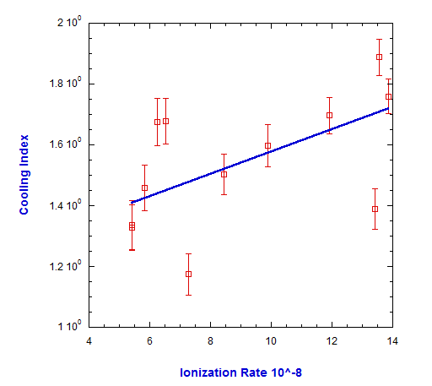
Preliminary Results For All June
Correlation Coefficient
P-value
$$r=0.496$$
$$p=0.11$$
Notes:
The correlation between the cooling index and ionization rate seems to be not so strong.

Slide 16
The Case of Perpendicular IMF
Year | I.R(${{10}^{−8}}/s$) | Cooling Index | Uncertainty
1999 | 11.9153 | 1.83 | 0.05
2000 | 13.8633 | 2.06 | 0.06
2001 | 13.5494 | 1.96 | 0.07
2002 | 13.4215 | 1.75 | 0.07
2003 | 9.87737 | 1.57 | 0.10
2004 | 8.45401 | 1.37 | 0.09
2005 | 7.28385 | 1.12 | 0.08
2006 | 6.52786 | 1.56 | 0.09
2007 | 5.83816 | 1.43 | 0.09
2008 | 5.41314 | 1.55 | 0.11
2009 | 5.42009 | 1.46 | 0.08
2010 | 6.25528 | 1.75 | 0.11
Notes:
We did another simulation and comparison for the case of Perpendicular IMF for each JUN.

Slide 17
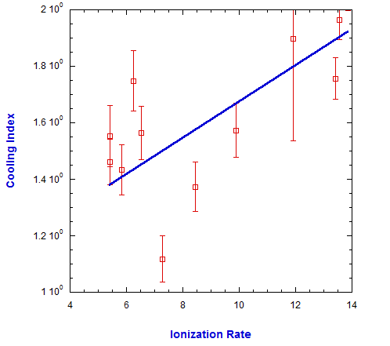
The Case of Perpendicular IMF
Correlation Coefficient
P-value
Better correlation because
PUIs don’t need scattering
to be accessible to the
Instrument. It is no longer dependent on scattering rate, however, other influence parameters like Nsw, strength of IMF, wave power haven't been taken out
$$r=0.716$$
$$p=0.011$$
Notes:
PUIs vary with other parameters:
Nsw, strength of IMF, wave power
They have not been taken out

Slide 18
Cooling Index Variation with Solar Wind Speed
2003: $\overline{v_{sw}}=637.43$ km/s
2009: $\overline{v_{sw}}=364.63$ km/s
Region | Mean Vsw | Cooling Index | Error
$$≤\overline{v_{sw}}$$ | 535.52 | 1.16 | 0.06
$$>\overline{v_{sw}}$$ | 716.70 | 1.51 | 0.10
Region | Mean Vsw | Cooling Index | Error
$$≤\overline{v_{sw}}$$ | 302.52 | 1.29 | 0.07
$$>\overline{v_{sw}}$$ | 421.16 | 1.57 | 0.12
Higher solar wind speed may correspond with
larger cooling index, this is maybe another example of hidden dependency we need to study
Notes:
In the simulation ,we also find that Cooling Index Varies with Solar Wind Speed. For the same year, we divided the data into to parts, one part has the solar wind speed less than the one month average solar wind speed, the other one has the solar wind speed greater than the one month average solar wind speed. Compare them with simulation separately.

Slide 19
Conclusions
We model the PUI distribution and compare them with a set of observations that are taken in the upwind direction for a wide range of ionization rate and in radial gradient of neutral distribution to test cooling behavior.
The cooling indices form the perpendicular IMF have a strong positive correlation with ionization rate, that may due to the large scale structure of solar wind and IMF, different expansion of solar wind, and different scattering properties.
Compare the simulated results with data for 2003 & 2009, we see that cooling index may depend on solar wind speed.

Slide 20
Conclusions
In the future work, we want to dig deeper to find out what is behind all the variations, further, to find out how the PUI transport works.

