Slide 1

Presented by Eberhard Möbius
UNH SSC & Physics Dept.
and Los Alamos National Lab
On Behalf of the IBEX Team
Supported by NASA Small Explorers
Collaborators on this Set of Projects:
P. Bochsler, M. Bzowski, D. Heirtzler, M. A. Kubiak
H. Kucharek, M. A. Lee, T. Leonard, N. A. Schwadron, X. Wu
S.A. Fuselier, G. Crew, D. J. McComas, L. Petersen, L. Saul
D. Valovcin, R. Vanderspek, P. Wurz
M. Hlond, G. Clark, M. O’Neill
Diagnosing the Neutral Interstellar Wind
with the Interstellar Boundary Explorer
NESSC Meeting, UNH, Nov 15, 2011

Slide 2
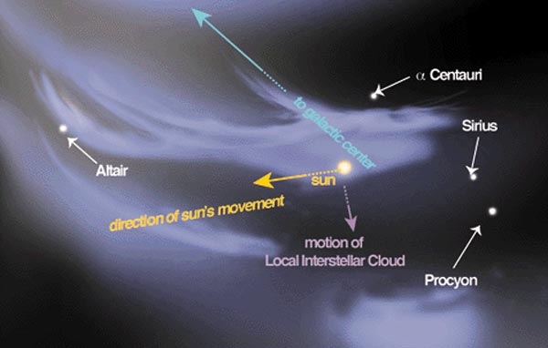
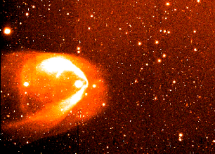
If We Could See Our Heliosphere from Outside …
ISM Wind
We have to Image this from Inside, but not with Light!
And we can Catch the Wind!
Courtesy P. Frisch

Slide 3
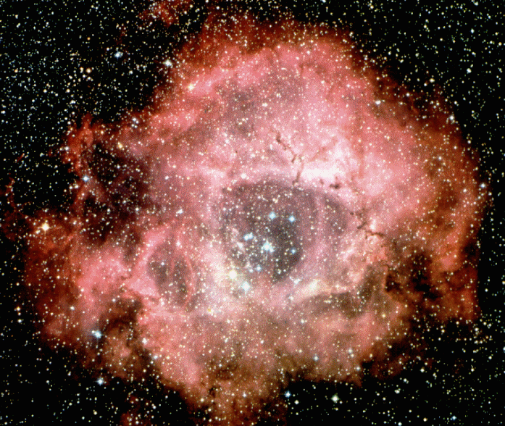

Observation of Interstellar Wind at 1 AU
How Come we can Catch the Wind here?
1967
Rosetta Nebula
≈700 AU
Fahr 1967
Showed that in-situ observation
of the LISM is possible at 1 AU!
“Strömgren Sphere”
Notes:
Add AMPTE picture on the right!!

Slide 4
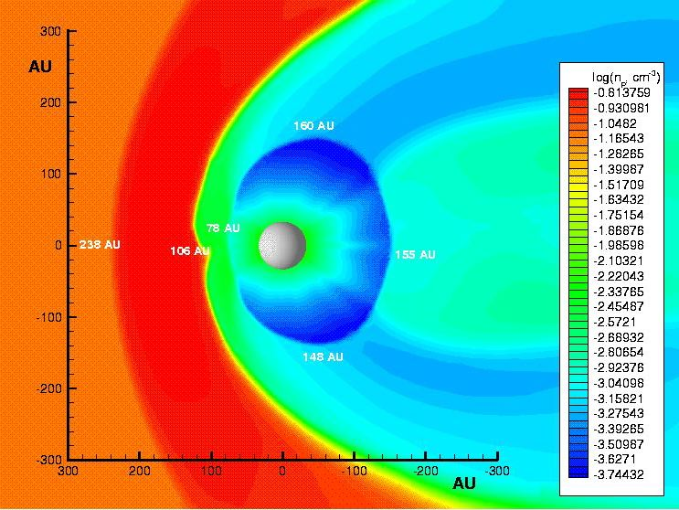
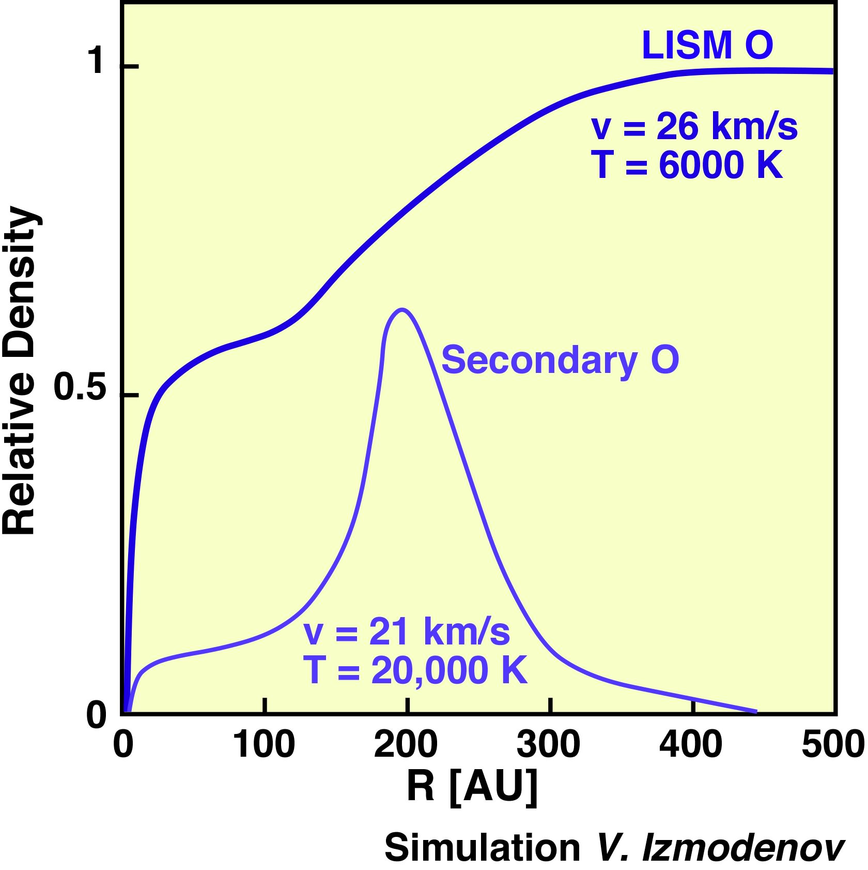
Plasma Interaction with the LISM
Plasma Density Contours
Blue & Green Solar Wind
Bow Shock?
He
He
Termination Shock
ISM ≈ 26 km/s
H & O
Charge Exchange
O, H
slow & hot
H⁺, O⁺
Heliopause
ISM
Orange - Pristine ISM
Red - Decelerated ISM
3D MHD Model T. Linde, Thesis

Slide 5
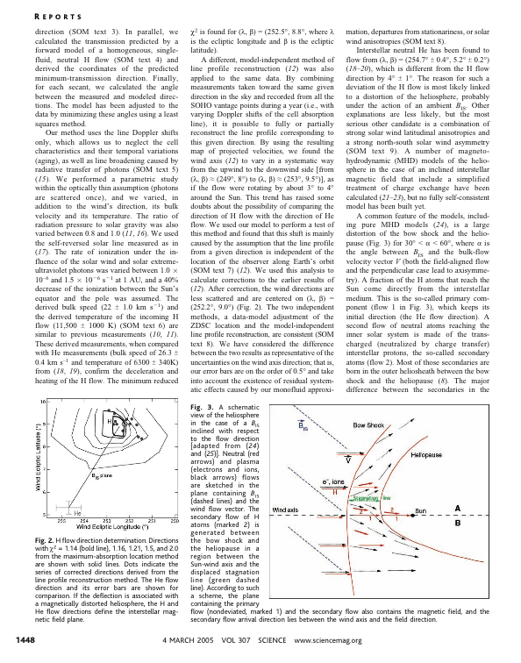
Ly α Observations Have Revealed
Deflected Flow of Interstellar H
Asymmetric ISM Magnetic Field
Deflects the Decelerated Flow
Izmodenov et al., 2005
B_{IS}
Primary
Plasma
H
Secondary
Latitude
Gas
He
Witte 2004
Longitude
Direct Neutral Observations
of several ISM Species Needed!
Lallement et al. 2005

Slide 6
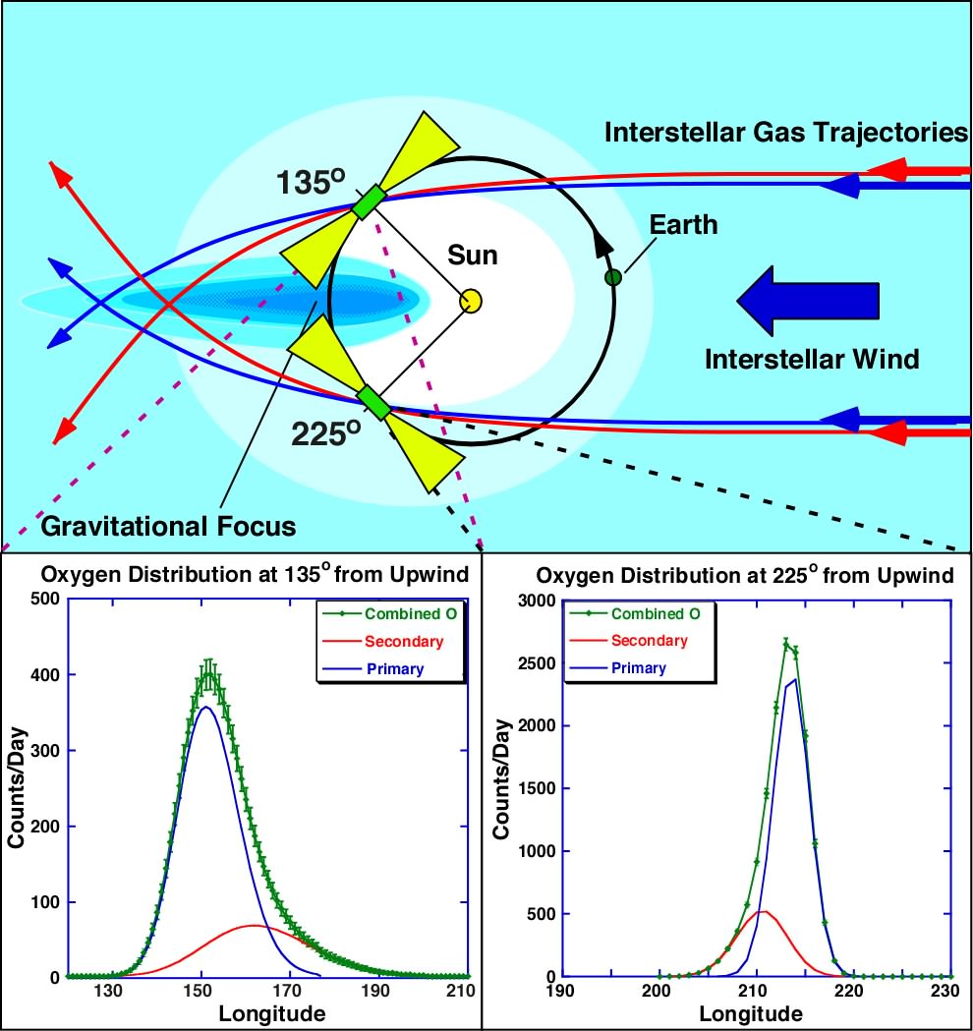
Does IBEX See the Interstellar Flow?
Oxygen Displaced,
Revealing
Temperature, Braking,
and Deflection
by IS Magnetic Field!
→Seeing Small Deviations
in Angle is Challenging
→ Best with
Simultaneous Observation
of Multiple Species
& Reference to Stars!
→ Get Primaries Right
First!
IBEX
Simulated Observation
in Longitude after
Izmodenov et al., 1997
Notes:
6
Add Lallement et al. Website

Slide 7
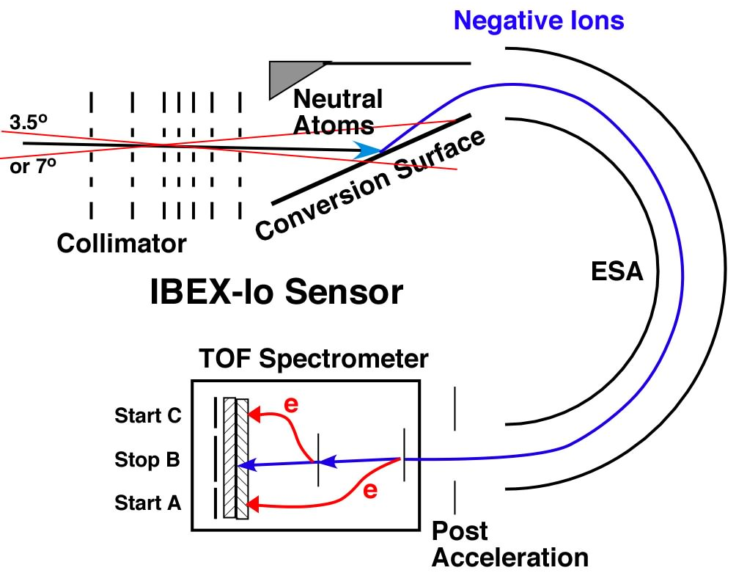
Neutral Gas Observation
Through Negative Ions: O, H ..
Oº
O⁻
Collimator Camera
Direction with
large area Collimator
Conversion into Ions
- Mass Spectrometer
Species Identification!
Negative Ions: O⁻, H⁻, .. at ≈incoming E
- Not for N, Ne or He (No N⁻, Ne⁻ & He⁻!)
But they Produce Sputter Products: O⁻,C⁻, H⁻
At lower E all the way to ≈0eV

Slide 8
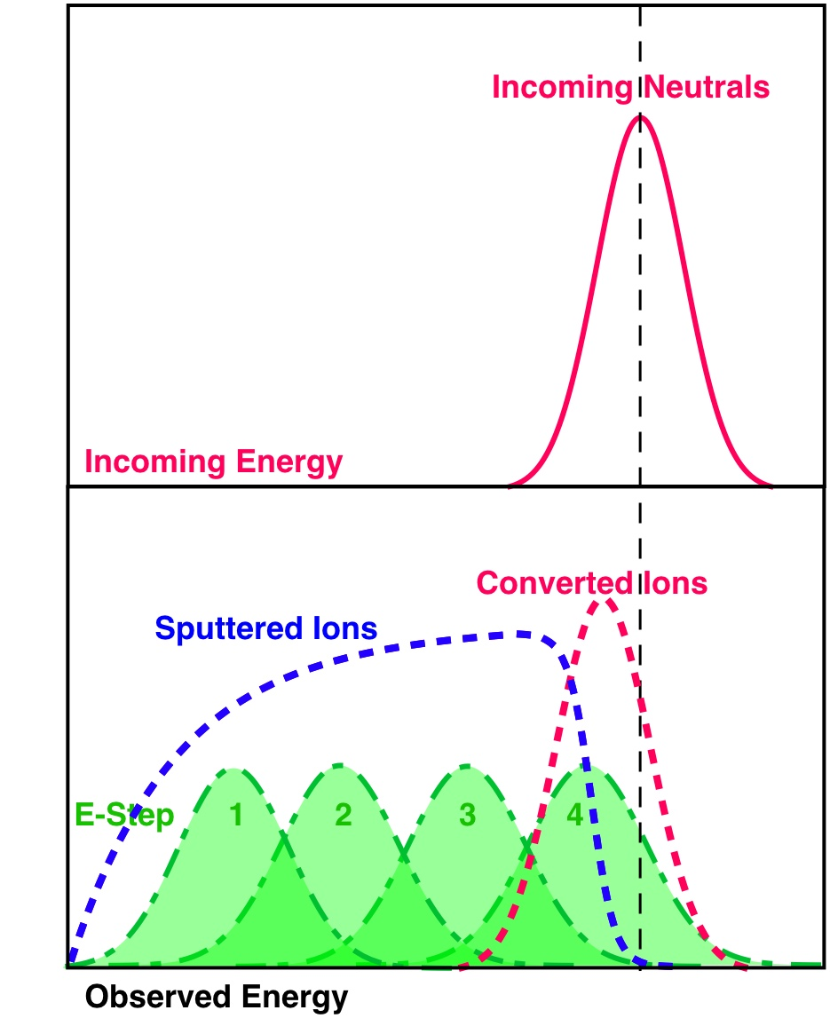
Neutral Observation with Negative Ions
Sputtering vs. Conversion of Ions
Negative Ions that stem from Conversion
retain Energy Info
Negative Ions that stem from Sputtering loose all their Energy Information
- To optimize Efficiency
a low E-Step is used
He & Ne
O & H

Slide 9
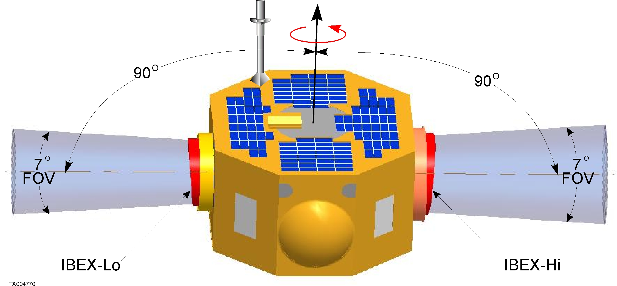
IBEX Spacecraft
Simple sun-pointed spinner (4 rpm)
Two huge aperture single pixel ENA cameras:
  IBEX-Lo (~10 eV to 2 keV)
  IBEX-Hi (~300 eV to 6 keV)
Notes:
Moore: Angle 95 degrees?
Dave: Angle is not critical. There is such gross oversampling at poles that that angle doesn’t matter.
????Trying to not let sun energy into apertures?
Dave: Don’t want sun to go into apertures.
Susan: Baseline is sunshade, 90 with 8 sunshade.
?????If pixels saw sun would they be damaged?
No: but background might be higher, measurement not as good
????Sunshades look canted
Dave: that’s intentional

Slide 10
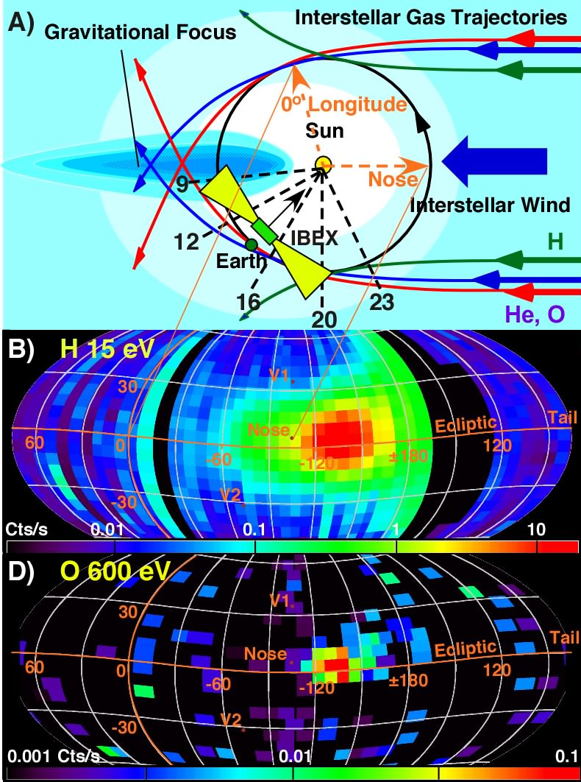
LISM Gas Flow in IBEX-Lo Maps
Interstellar Gas flow
clearly visible in IBEX-Lo Maps
Orbit 9 – 28 at 15 eV
Orbit 9 – 21 up to 110 eV
Orbit 14 – 18 at 280 & 600 eV
Flow peak seen in Orbit 16
from positive latitude
- Flow at 15 eV up to Orbit 28
consistent with LISM H
- Up to 110 eV in Orbit 9-21
consistent with LISM He
- At 280 & 600 eV in Orbit 14-18 consistent with LISM O
- Extension to higher latitude
and smaller longitude
Möbius et al., Science 2009
He
H
O
Notes:
I have asked Katy Goodrich and Jacob Siegel to turn the O 280 & 600 eV Map into logarithmic scaling of the Count Rate, as the other 2 maps.
10

Slide 11
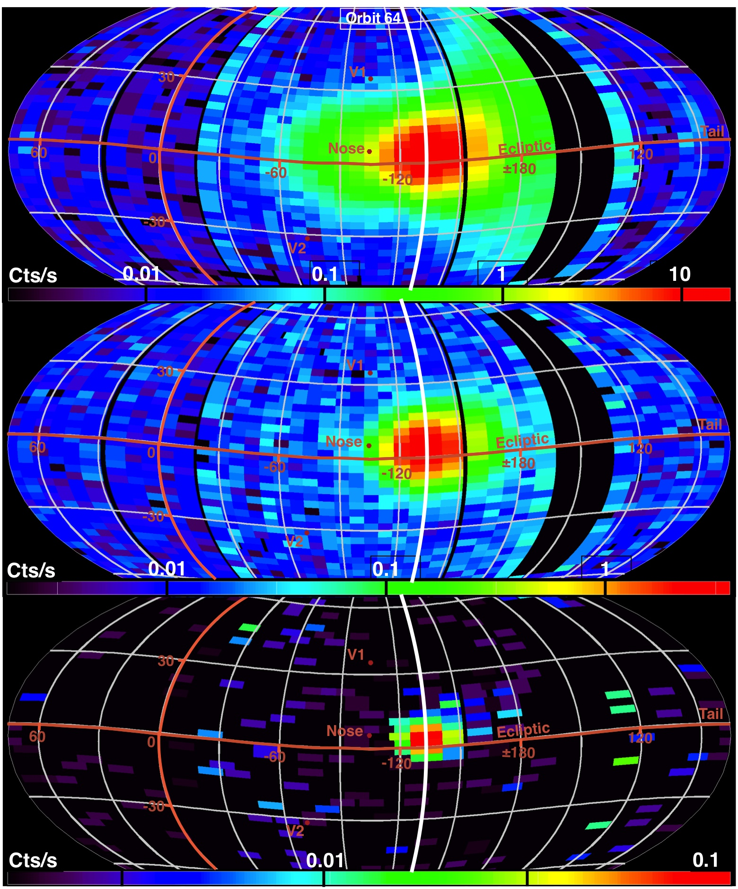
ISM Flow Observation in the Maps
IBEX-Lo 2010
Focusing Cone
ISM Flow is observed again in Spring
We see H, He, O & Ne
Now, we have Observations through the Focusing Cone
“Extension” of the
O Flow is persistent
But: He Flow Vector appeared to deviate from previous values!
E-Step 1 15 eV H
He
H
E-Step 4 110 eV H
He
E-Step 6 600 eV O
O + Ne
Notes:
Add results Saul & Bochsler paper

Slide 12
Paper Series on ISM Flow for ApJ Suppl
An Analytical Model of Interstellar Gas in the Heliosphere Tailored to IBEX Observations
M. Lee et al. In Press
Interstellar Gas Flow Parameters Derived from IBEX-Lo Observations in 2009 and 2010 - Analytical Analysis
E. Möbius et al. In Press
Neutral Interstellar Helium Parameters Based on IBEX-Lo Observations and Test Particle Calculations
M. Bzowski et al. In Press
Local Interstellar Neutral Hydrogen Sampled in-situ by IBEX
L. Saul et al. Revised
Estimation of the Neon/Oxygen Abundance Ratio at the Heliospheric Termination Shock and in the Local Interstellar Medium from IBEX Observations
P. Bochsler et al. In Press
Precision Pointing of IBEX-Lo Observations
M. Hlond et al. In Press
Talk by Martin Lee
Talk by Peter Bochsler

Slide 13
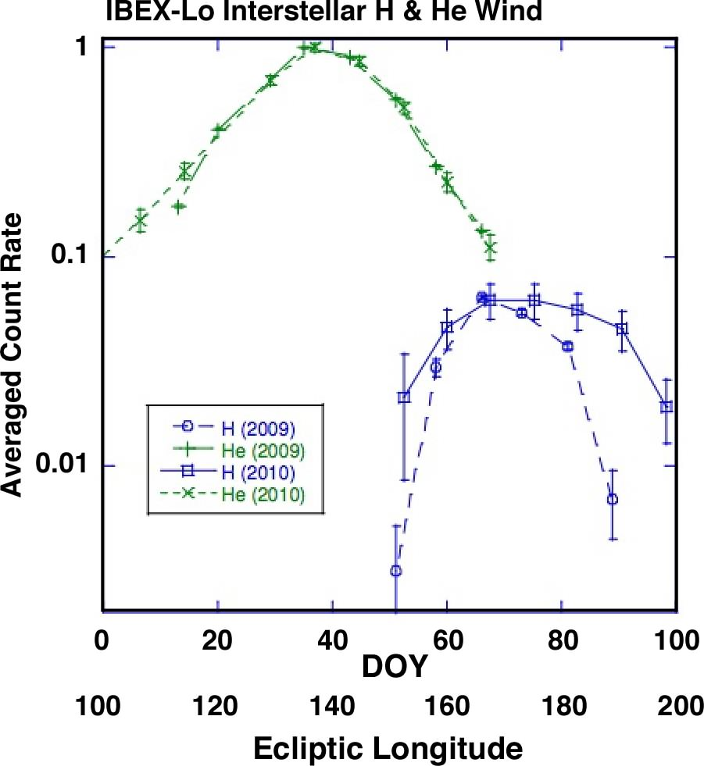
Interstellar He & H Flow
Separating He sputter products from H
allows to get the
H flow distribution
(with uncertainties)
Neutral H ISM
peaks at higher Ecliptic Longitude than He
→ strong Radiation Pressure Effects
Saul et al., Revised 2011

Slide 14
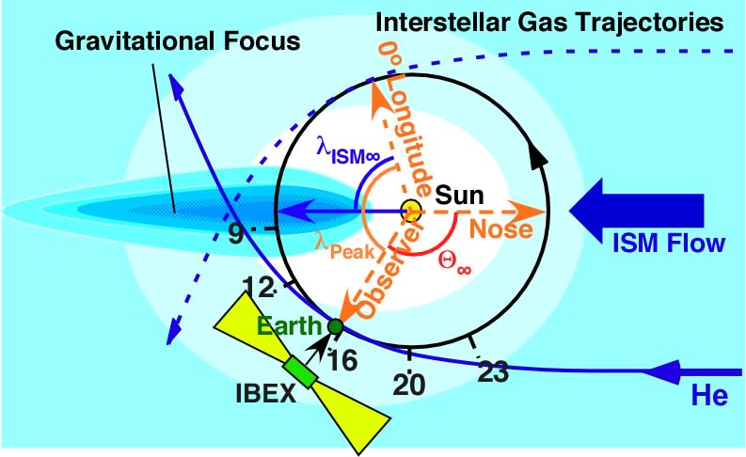
How IBEX Observes the Interstellar Flow
IBEX
IBEX is a Sun-Pointed Spinner with Radially Pointing Sensors
that Observe the ISM Flow at its Perihelion
Notes:
14
Add Lallement et al. Website

Slide 15
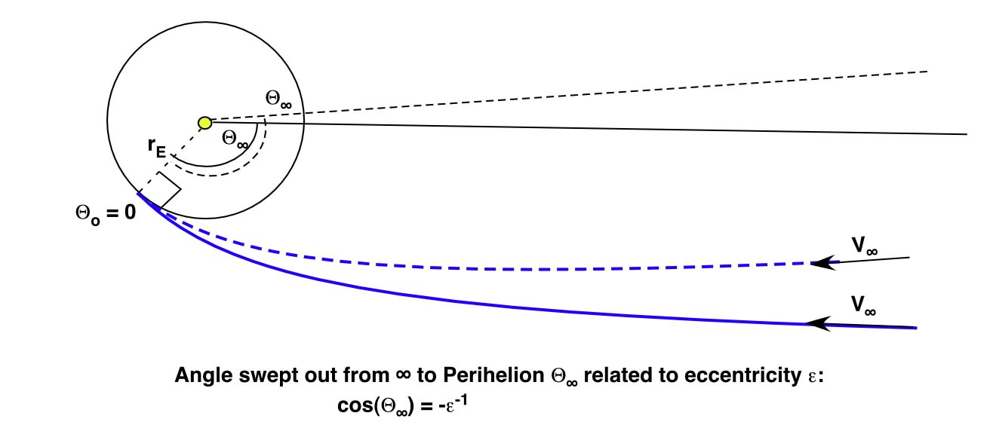
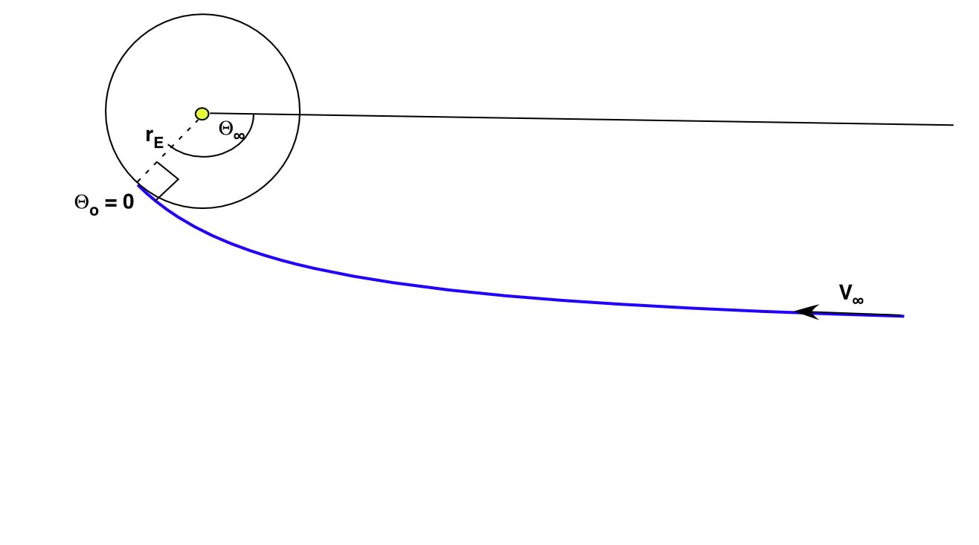
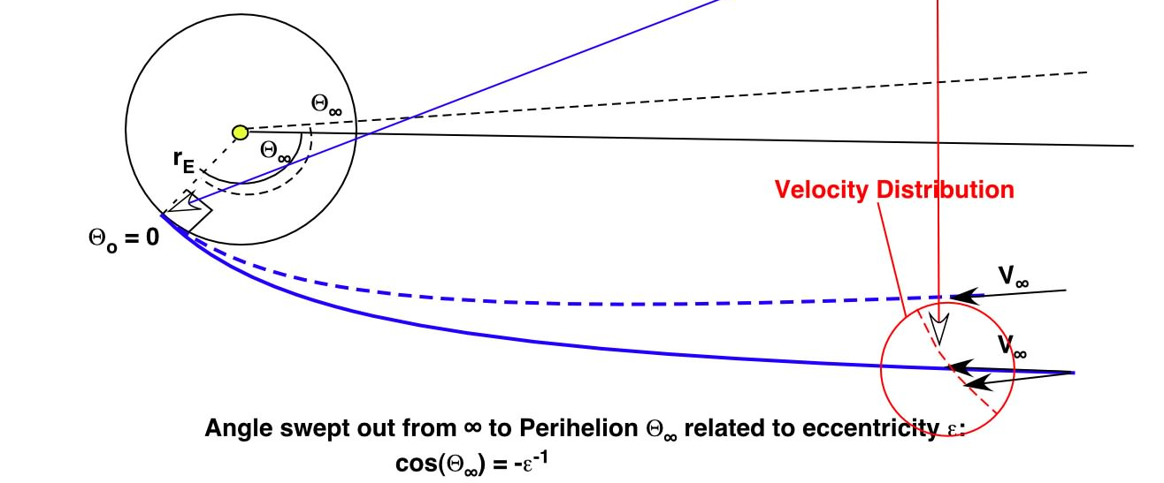
Strategy with Analytical Calculation
1) Relation for Inflow Angle λ∞ & Speed V∞
from Peak Rates at exact Sun Pointing!
Lee et al.
In Press 2011
θ∞ = λ∞ +180º - λ_{Observer}
Spring Equinox
λ∞
λ_{Observer}
2) Establish V∞, β∞, Mach# & T from Peak Orbit 16 & 64
3) Relations: V∞(λ∞), β∞(λ∞), T(λ∞)
4) Optimize V∞(λ∞), β∞(λ∞),T(λ∞) for all Orbits

Slide 16
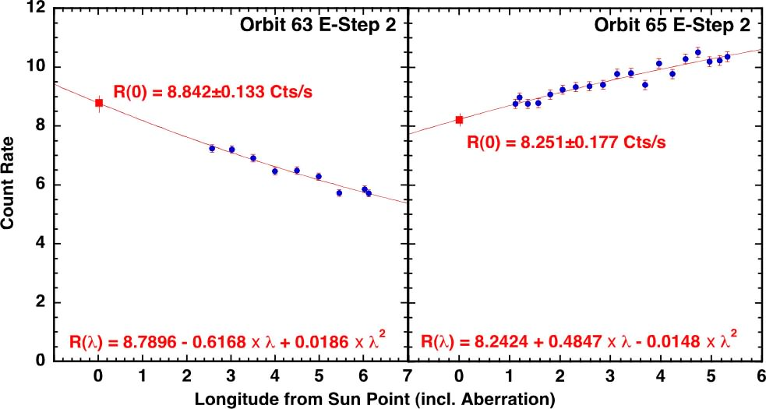
Extrapolation to Sun-Pointing
Future Improvements:
- Re-Pointing of Spin Axis at Apogee (no aberration, no extrapolation!)
- Compute R_{P}, Ψ_{P} as function of longitude from Perihelion
→ Fit only 1 Parameter, no-extrapolation! (all existing data!)
Talk by Trevor Leonard

Slide 17
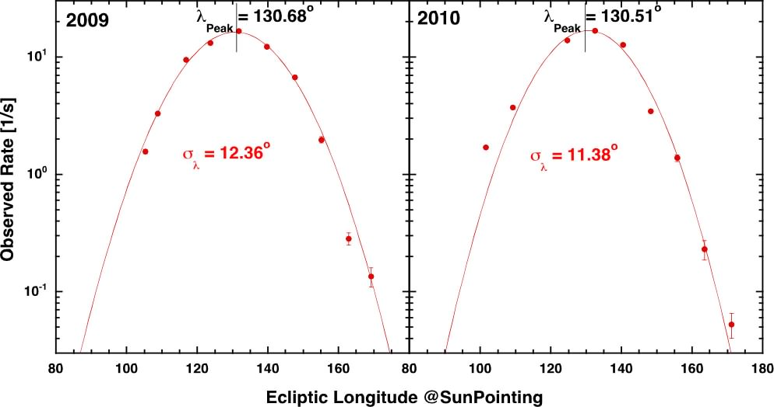
Gaussian Fit to Peak Rates
And 2009 & 2010 Comparison
• Correct for: Ionization loss along trajectory
V∞ is at Max of Phase Space Density, but observed is Flux!
• Consider Aberration due to S/C Motion & Elliptical Orbit the Earth
• -> Establishes Relations: V∞(λ∞), β∞(λ∞), T(λ∞)

Slide 18
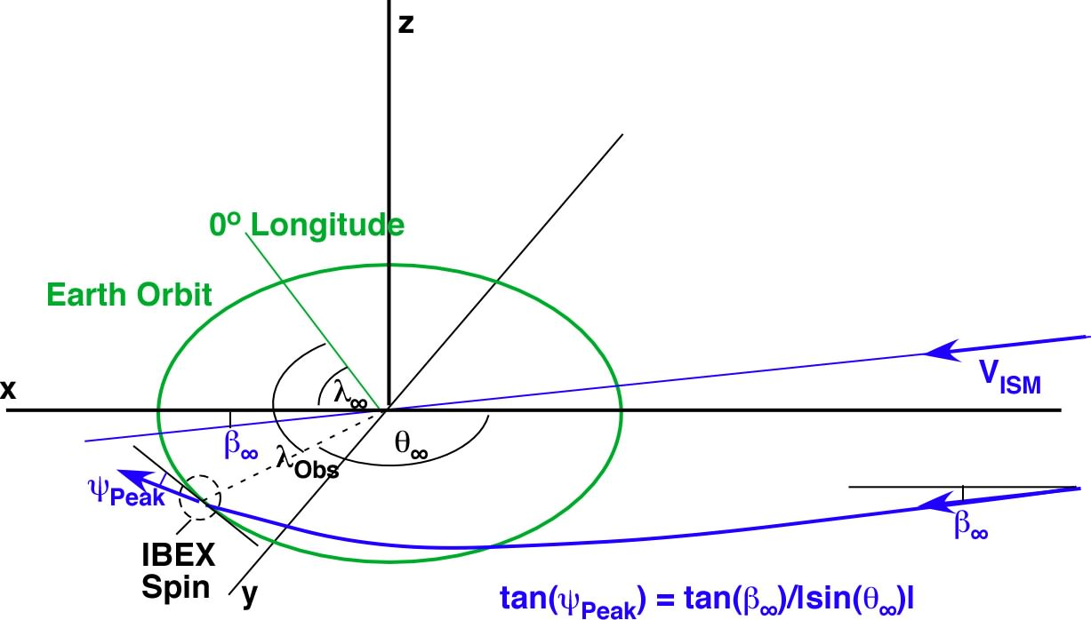
Strategy with Analytical Calculation
2-4) Relation between Ψ_{Peak} and β∞
In Rest Frame
IBEX Observation requires Frame Transformation Ψ_{P} → Ψ_{P}’
for Earth’s Motion

Slide 19
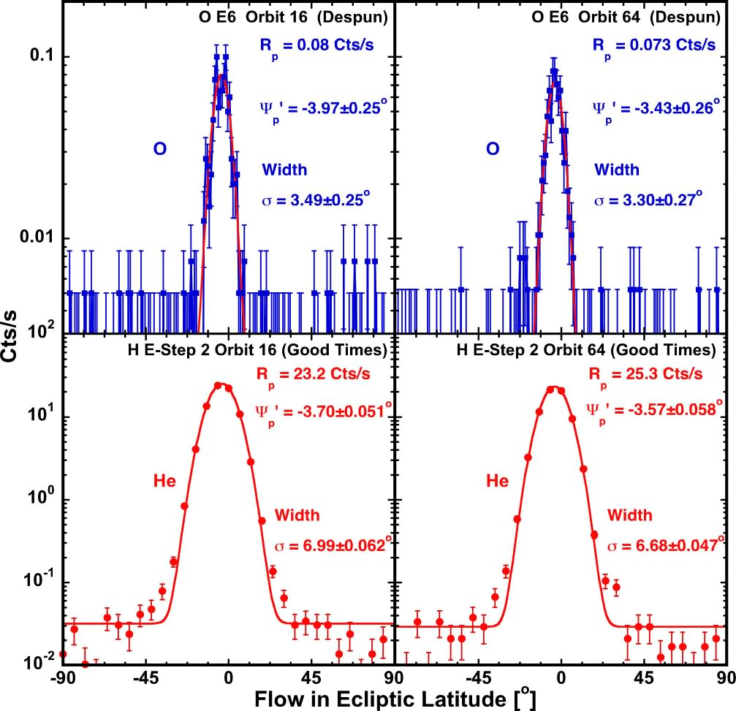
Latitude Peak Location & Width at Flow Maximum (Orbit 16 & 64 )
Peak stable
in Orbit 16&64
→ Average
O & He Peak same
within
uncertainties
O uncert. ±0.32º
incl. 0.2º
for Despun data
(Star Tracker
gets blinded
by Earth & Moon)

Slide 20
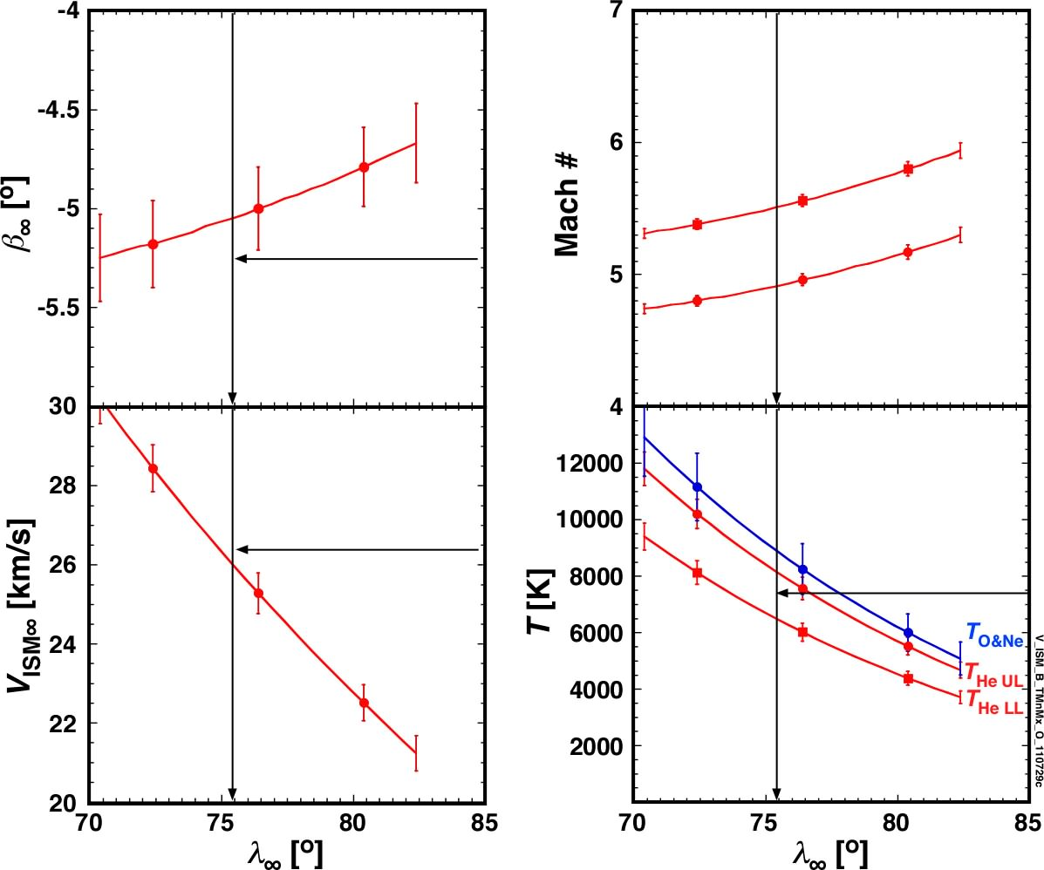
Consistent LISM Parameter Range
Narrow bands V_{ISM∞},β∞,T(λ∞)
based on:
- Longitude of Flux Maximum
- Peak Latitude & Width at Max
Currently, large uncertainty
in He Temperature due to
Data Transfer loss at High Rates
Witte 2004:
λ∞ = 75.4º
β∞ = -5.3º
V∞ = 26.4 km/s
T_{He} = 6300 K
→ To be narrowed next year
O&Ne Temperature
compatible with
isothermal LISM
if data transfer loss
is hardware limit
O temperature
could be higher??

Slide 21
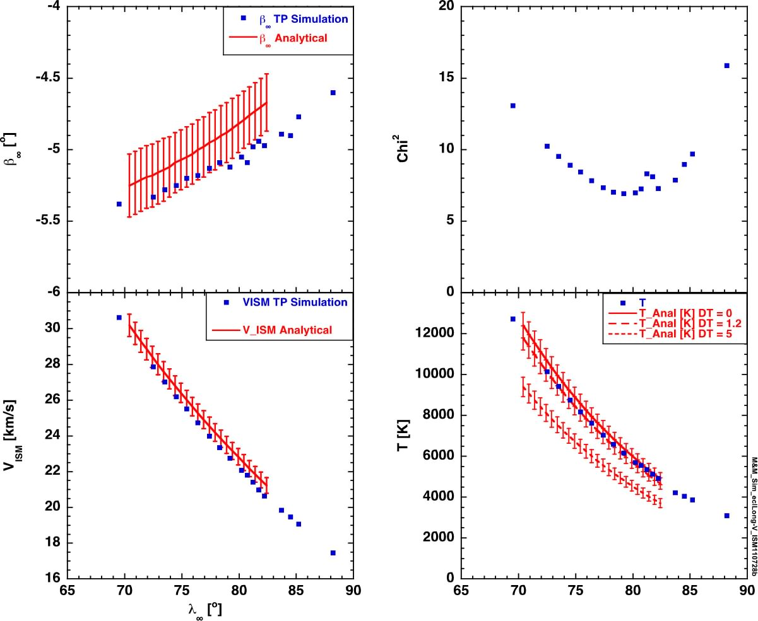
Comparison with Test Particle Model
Identical narrow bands
in V_{ISM∞},β∞,T(λ∞)
Red: Analytical
As shown before
Möbius et al 2011
(In Press)
Blue: Test Particle
Optimized for Chi²
Bzowski et al 2011
(In Press)

Slide 22
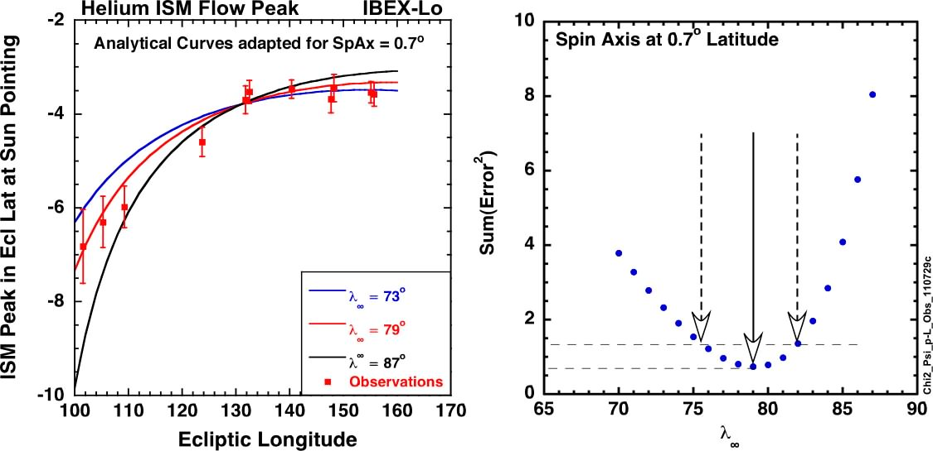
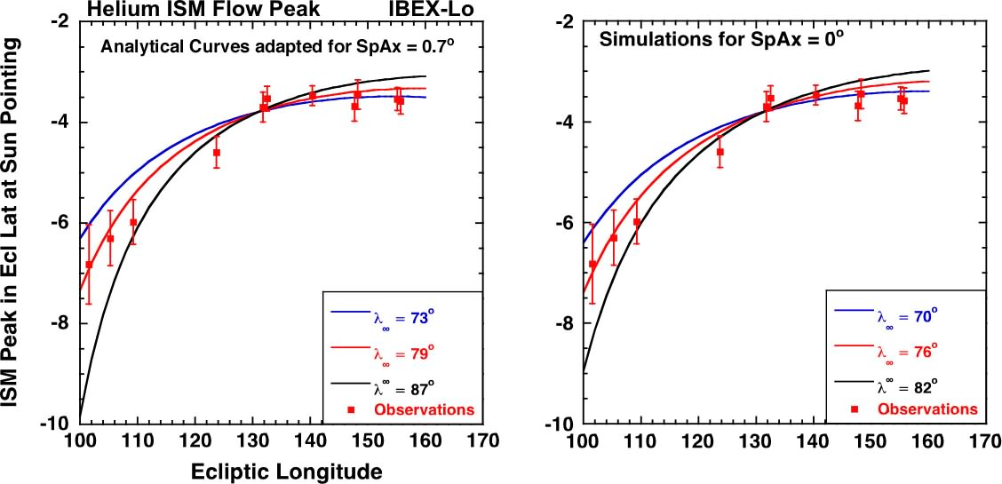
Homing in on Inflow Longitude
ψ_{p}’
λ∞
Talk by Xian Wu
Variation of Peak Location in Latitude with Observer Longitude Ψ_{p}’(λ_{Obs}) is sensitive to Inflow Longitude λ∞
Need to include exact Spin Axis pointing in Latitude
Provides mild constraint on λ∞
Notes:
Check left figure!!

Slide 23
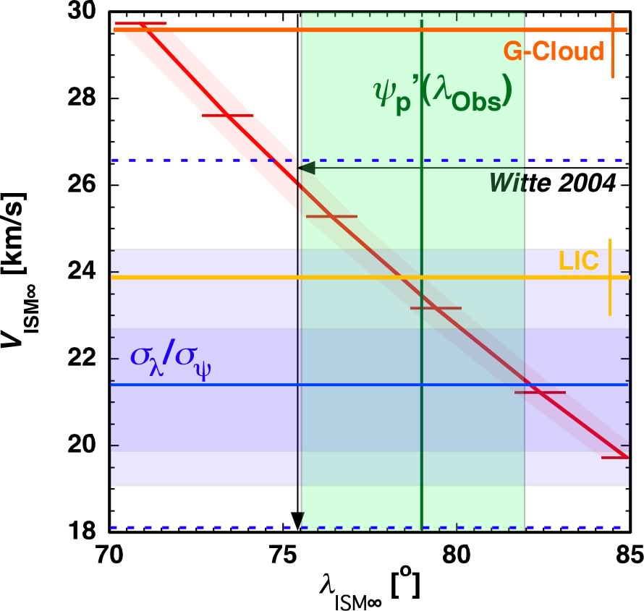
Constraining λ∞ as Remaining Value
Location of ISM Flow Peak
Provides narrow V_{ISM∞}(λ∞)
2 Constraints on V_{ISM∞} & λ∞
- Ψ_{p}’(λ_{Obs}) ≈±3.5º
- σ_{Ψ}/σ_{λ} at ISM Flow Peak
currently mild constraints
overlapping & consistent
Witte & Möbius et al 2004
at edge of current error bar
IBEX observations appear
to indicate V_{ISM} consistent with LIC value rather than between LIC and G-Cloud (Redfield & Linsky 2008)

Slide 24
Constraining λ∞ as Remaining Value
Location of ISM Flow Peak
Provides narrow V_{ISM∞}(λ∞)
2 Constraints on V_{ISM∞} & λ∞
- Ψ_{p}’(λ_{Obs}) ≈±3.5º
- σ_{Ψ}/σ_{λ} at ISM Flow Peak
currently mild constraints
Witte & Möbius et al 2004
at edge of current error bar
Future Improvements:
- Expansions of analytical method will allow fits
- Improved despinning with Star Sensor doubles data
- CEU tests and new mode narrows T measurements
- Variable spin axis pointing improves Ψ_{p}’(λ∞) sensing
Location of ISM Flow Peak
Provides narrow V_{ISM∞}(λ∞)
2 Constraints on V_{ISM∞} & λ∞
- Ψ_{p}’(λ_{Obs}) ≈±3.5º
- σ_{Ψ}/σ_{λ} at ISM Flow Peak
currently mild constraints
Witte & Möbius et al 2004
at edge of current error bar
And now a Look
at the Secondary O Component!
Where Does it Come from?
Remember the “Hot Spot” of the IS Plasma Flow!

Slide 25
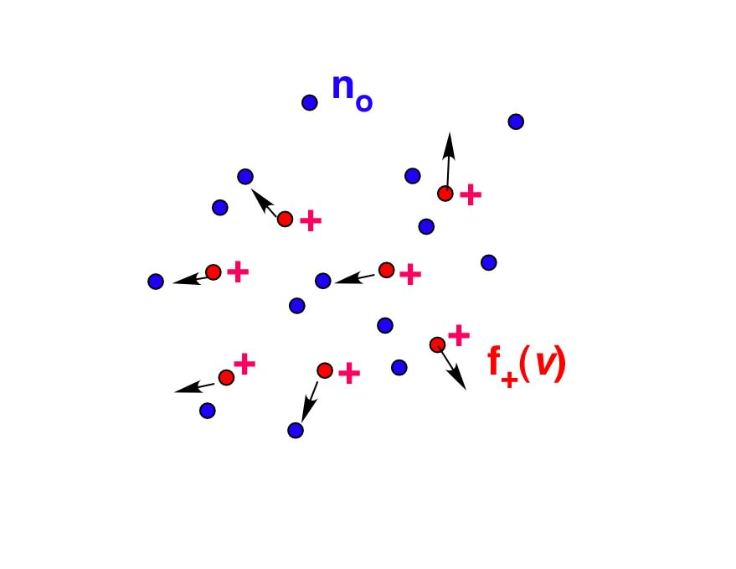
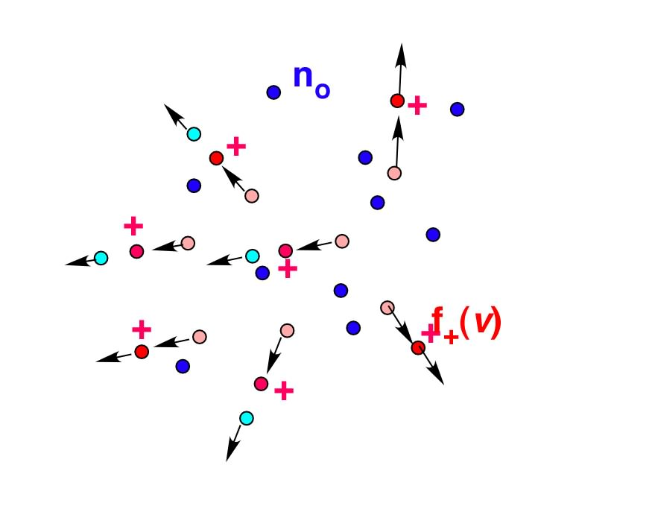
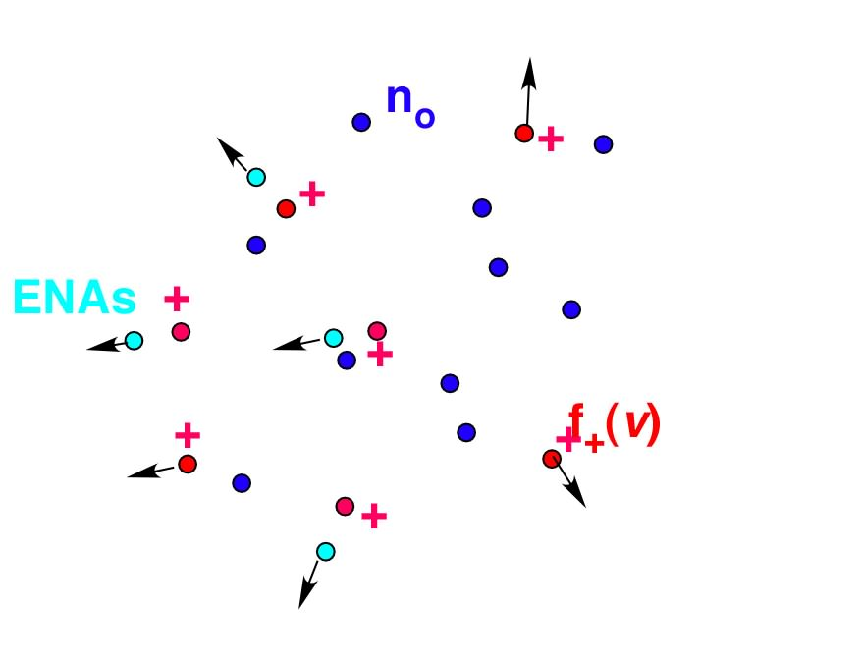
Energetic Neutral Atom (ENA) Observation
We want the Ion Distribution,
but they don’t make it to 1 AU!
Ions (e.g. inner & outer Heliosheath Plasma)
are immersed
in Neutral Atoms (ISM)
In collisions, Ions can take an electron and move on as Neutrals
at their Original Velocity
These ENAs continue on Straight Trajectories
like Photons

Slide 26
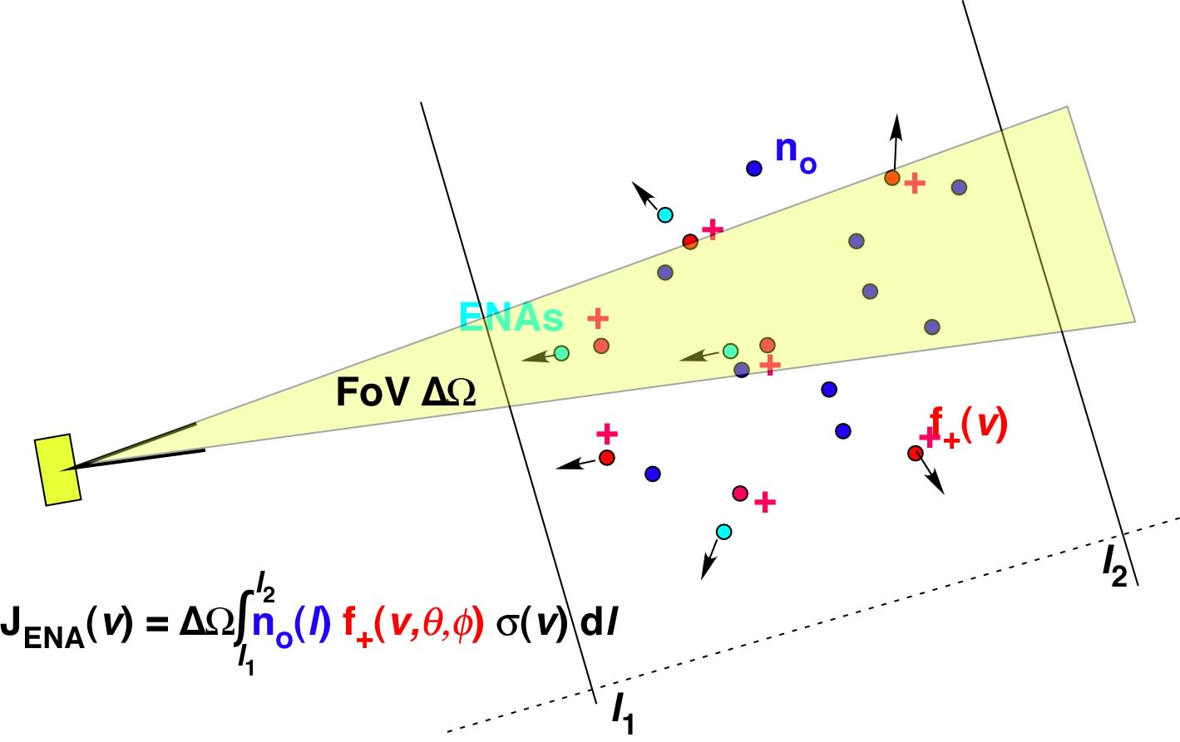
Energetic Neutral Atom (ENA) Observation
ENAs carry Info of the Ions to the Observer
Heliopause
Termination
Shock
Bow Shock?
Heliopause
Interstellar Wind
IBEX
Voyager
Of course, the Interstellar Wind is Seen Directly

Slide 27
O+Ne ISM Flow & Secondary Component
Primary O+Ne stable
in Latitude and Width
from 2009 – 2011
Rate stable 2009, 2010
at ≈2/3 in 2011: ν_{Ion} up
Asymmetry of Peak
Seen Clearly as Foot
Best in 2010
with Improved Statistics
Using Doubles
Primary Flow in 2011
Not comparable due to Hi-Res Mode

Slide 28
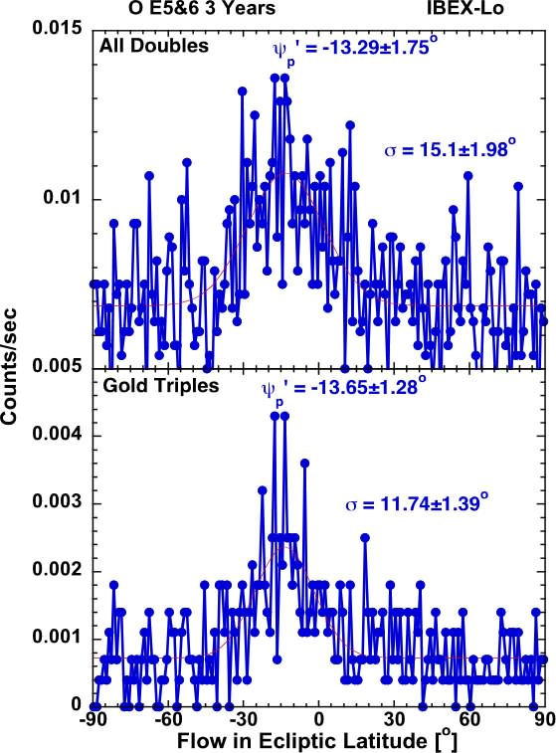
3 Years O Secondary Component
Let’s concentrate on the Secondary Component
Orb 11-13, 59-61, 107-109
Accumulation of 3 years indicates significant separate peak that is
at Lower Latitude relative
to Primary O+Ne ISM Flow
Also at Lower Longitude
→ Slower V∞ and/or
Lower Inflow λ∞
Talk by Xian Wu

Slide 29
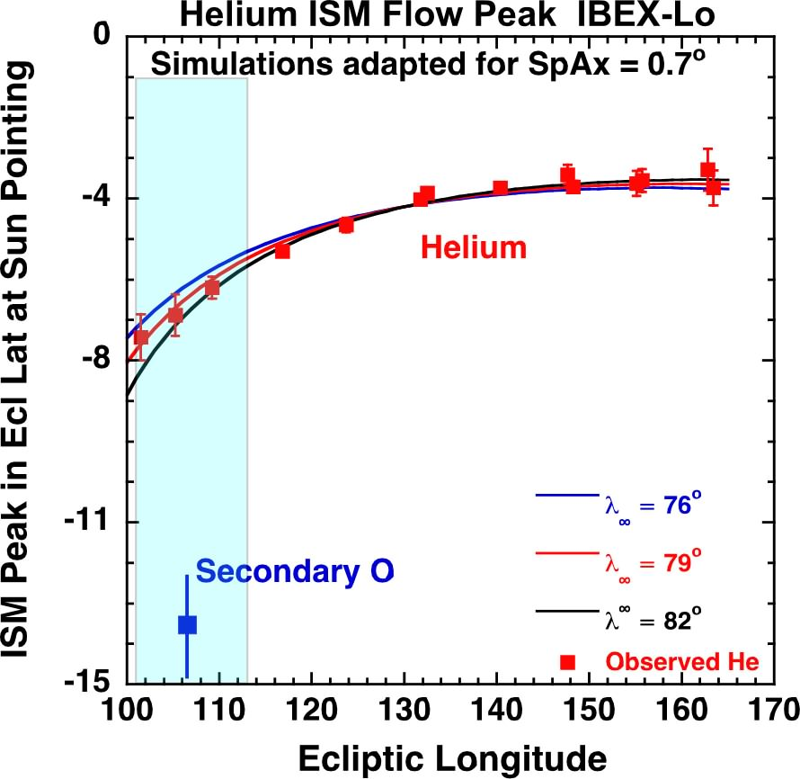
3 Years O Secondary Component
Secondary O Peak shifted
so far in Latitude
that lower speed
doesn’t explain location!
Incoming flow vector
at more negative latitude
of order 5-8º!
Direction consistent
with that of H in Lyα
Lallement et al. 2005
H is mix of components; O is separable
→ Excellent diagnostics for IS Magnetic Field
Also Applicable to O
Notes:
Check figure!!

Slide 30
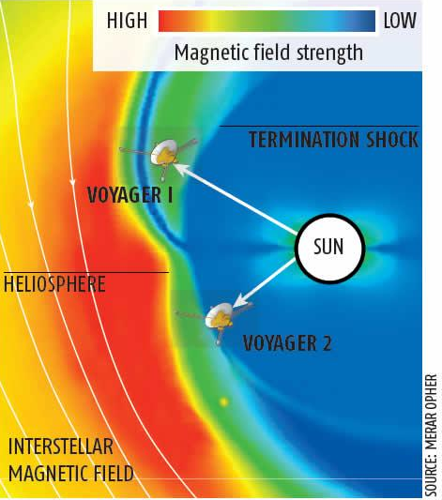
Voyagers Reveal
Asymmetric Heliosphere
After a journey
of ≈30 years
the Voyagers reached
the Termination Shock.
Dec 2004 94 AU
Our Heliosphere
is squashed by
Interstellar Magnetic Field
v_{ISM}
Aug 2007 83 AU
Strength: 1.8-2.5 µG
Direction: 30º-60º
B_{ISM}

Slide 31
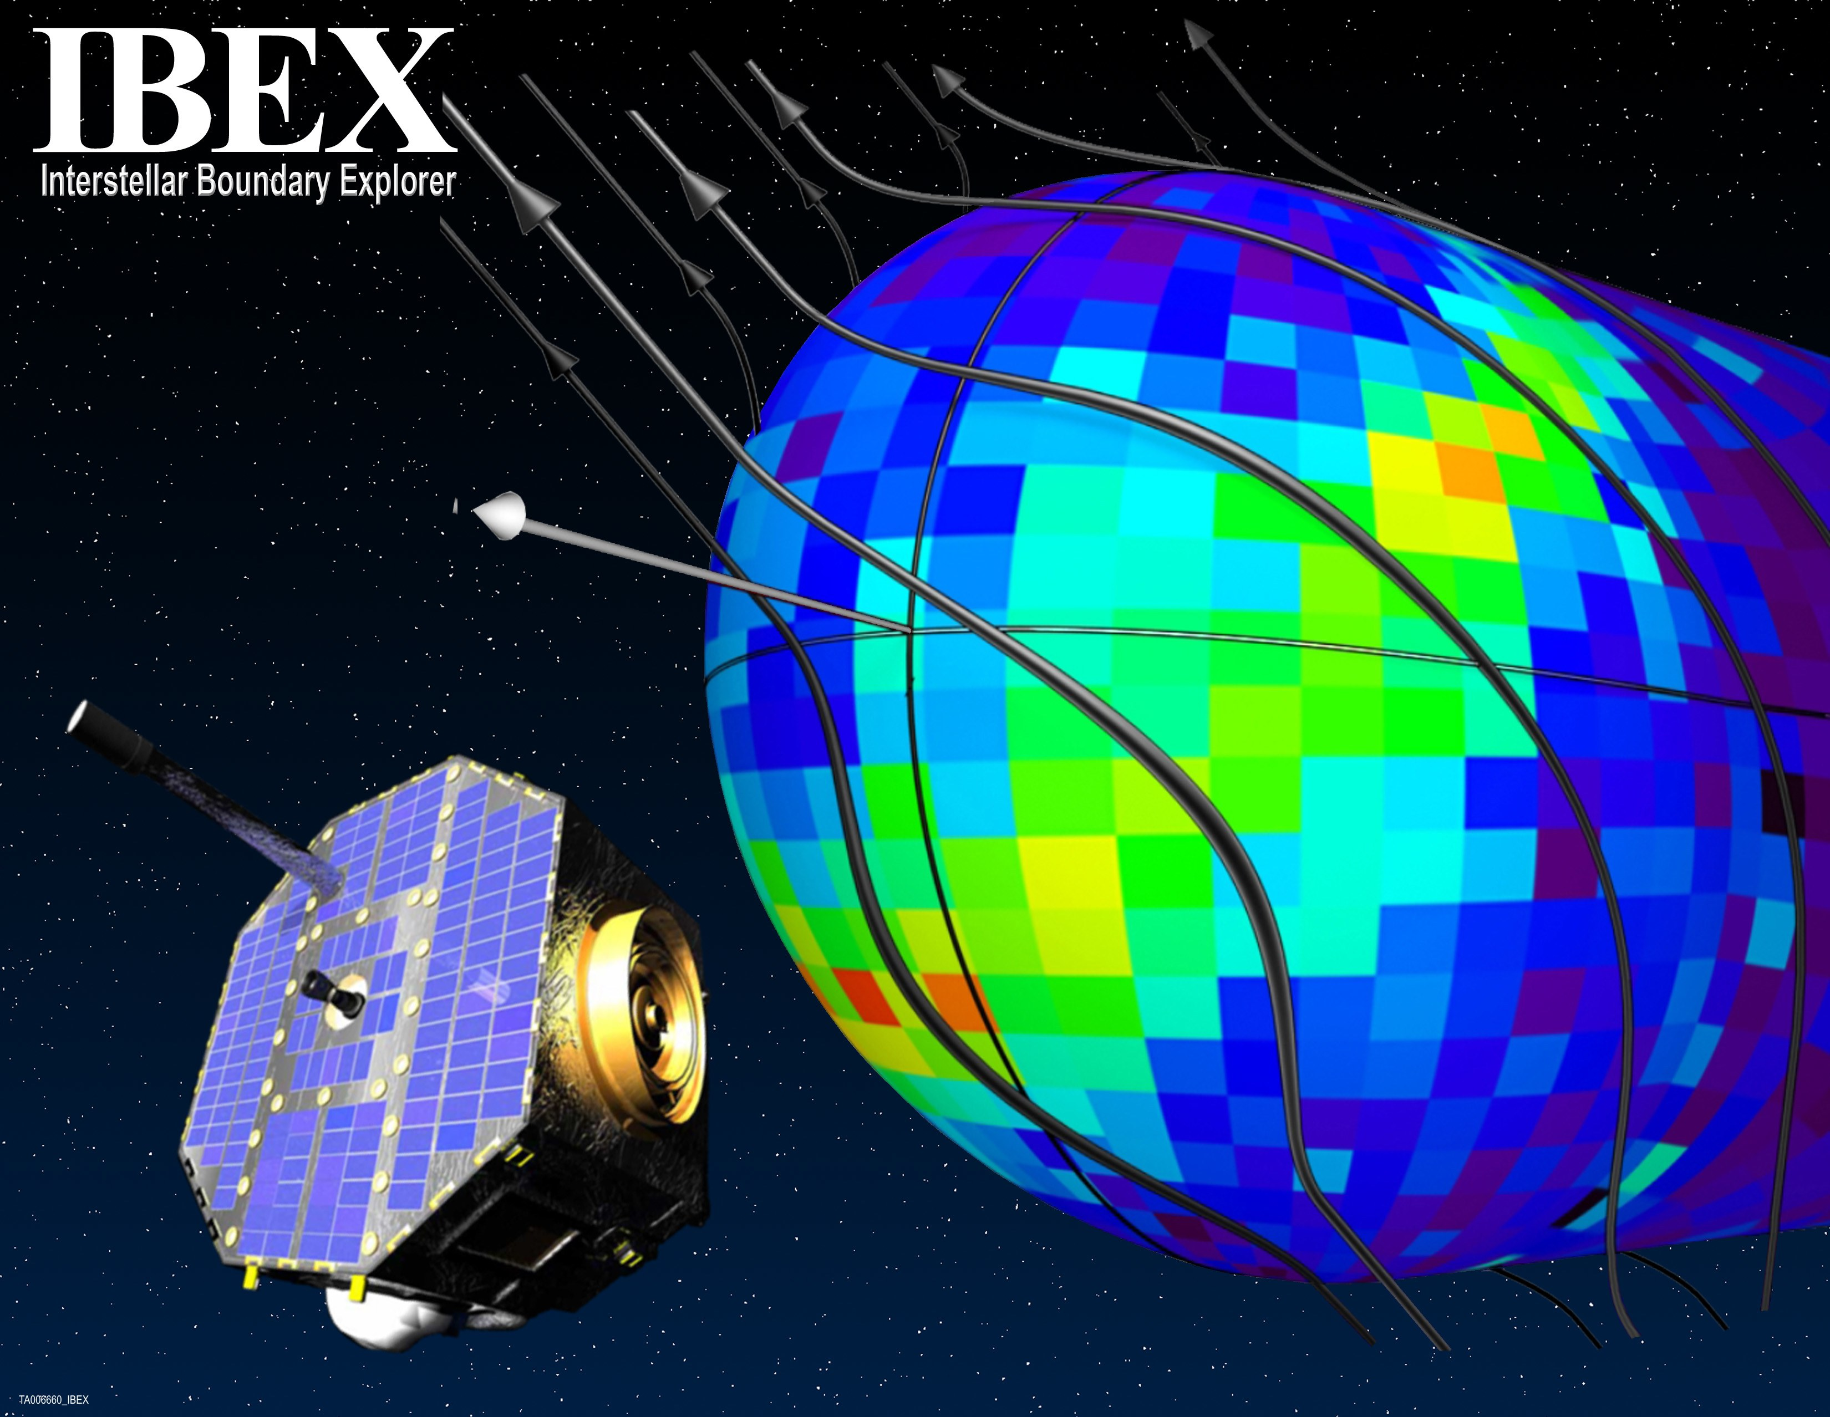
The View with IBEX - 2009
SWRI/Adler Planetarium

Slide 32
Summary & Outlook
IBEX observed for the first time simultaneously
the interstellar neutral H, He, O flow, and even Ne
H flow peak offset → strong radiation pressure effects
Based on analytical and test particle analysis
- He ISM parameters show a narrow V∞ & β∞(λ∞) relation
- ISM flow vector, marginally compatible with Witte & Möbius et al. 2004, appears to favor higher λ∞ and lower V∞ → Consistent with Sun still in LIC (Redfield & Linsky 2008)
He and O+Ne consistent with isothermal, T_{O} maybe higher
Ne/O ratio consistent with earlier PUI observations
higher than solar abundance → O maybe in grains
O shows substantial secondary component
latitude offset consistent with Lyα direction, but stronger
≥10 Year IBEX Mission possible with existing fuel!
New IBEX orbit doubles ISM flow observation points
Parameter variations allow huge accuracy improvements

Slide 33
Thank you!
We thank all the many individuals at the various institutions for their tremendous effort and dedication that made this program such a success.
Funding is Gratefully Acknowledged by:
  NASA Explorer Program
  Swiss PRODEX & Nationalfonds
  Polish Academy of Sciences
  Russian Academy of Sciences
  German Ministry of Science
IBEX Website: www.ibex.swri.edu

Slide 34
IBEX goes on!

