Slide 1
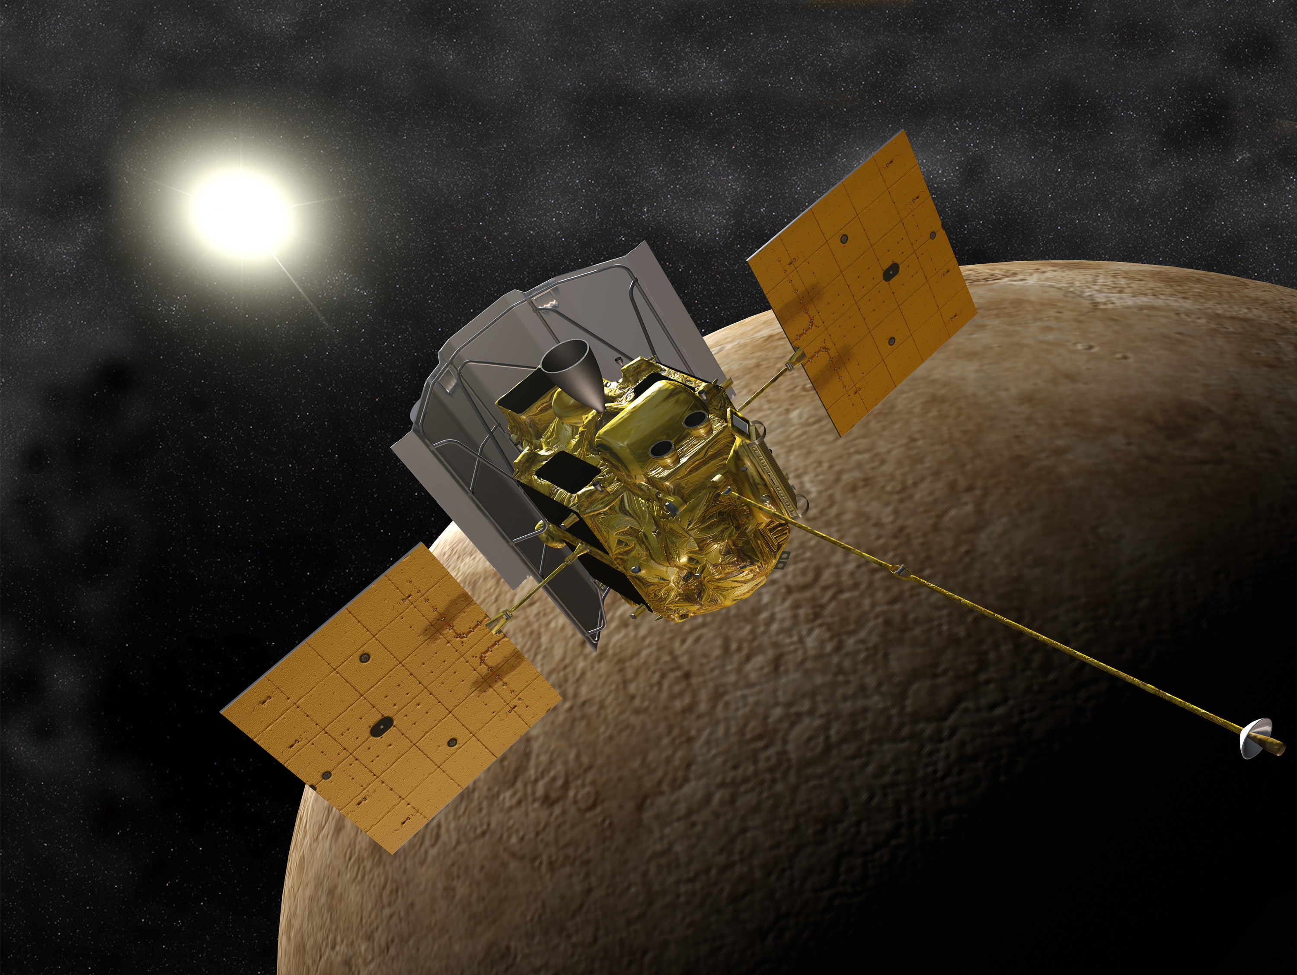
Predictions for Parker Solar Probe and Solar Orbiter:
ICME evolution and GCR modulation in the inner heliosphere
Reka M. Winslow (UNH)
reka.winslow@unh.edu
Noé Lugaz (UNH), Nathan Schwadron (UNH), Charles Farrugia (UNH), Jingnan Guo (UofKiel), Robert Wimmer-Schweingruber (UofKiel), Jody Wilson (UNH),
Colin Joyce (UNH), Andrew Jordan (UNH), David Lawrence (APL)
JHU/APL
28 February 2011
Notes:
Hi everyone, thanks very much to the organizers for the chance to present my work here. I’ll be talking about ICME propagation and ICME-driven GCR modulation in the inner heliosphere, with a special focus on making predictions in preparation for PSP and SO.

Slide 2
ICME Evolution: Science Questions
Many advances have been made in our understanding of ICME heliospheric evolution thanks to remote (ex. SOHO, STEREO) and in situ observations (ex. ACE, WIND, various planetary missions), and global Sun-Earth numerical simulations (ex. SWMF, WSA-ENLIL), although open questions remain.
We investigate 2 open issues:
Notes:
Part of our efforts at UNH are to make testable predictions for PSP and SO. I’m approaching this from the ICME side. There are a number of outstanding issues related to ICMEs, among which are what happens to them during propagation, and how they modulate GCRs.
For the purposes of this talk, I will focus on 2 of my recent studies of ICMEs in the innermost heliosphere to showcase how messenger data can be utilized, and what we can learn from these data in preparation for PSP and SO.
In both case studies we made use of multiple spacecraft and planetary alignments to observe icmes at multiple distances from the sun.
The first case study is of an ICME that was observed in near perfect alignment between messenger and stereo a. We investigated changes in this icme during propagation that arose due to interaction with the solar wind in less than 1 au.
In the second case study we investigated changes in Forbush decreases from Mercury to Mars during an icme that reached all the terrestrial planets.

Slide 3
ICME Evolution: Science Questions
Many advances have been made in our understanding of ICME heliospheric evolution thanks to remote (ex. SOHO, STEREO) and in situ observations (ex. ACE, WIND, various planetary missions), and global Sun-Earth numerical simulations (ex. SWMF, WSA-ENLIL), although open questions remain.
We investigate 2 open issues:
Does ICME complexity increase with distance from the Sun? Is change in complexity an inherent consequence of ICME propagation?
- Case study shows drastic change in complexity of ICME magnetic ejecta due to interaction with corotating structure in the solar wind.
Notes:
Part of our efforts at UNH are to make testable predictions for PSP and SO. I’m approaching this from the ICME side. There are a number of outstanding issues related to ICMEs, among which are what happens to them during propagation, and how they modulate GCRs.
For the purposes of this talk, I will focus on 2 of my recent studies of ICMEs in the innermost heliosphere to showcase how messenger data can be utilized, and what we can learn from these data in preparation for PSP and SO.
In both case studies we made use of multiple spacecraft and planetary alignments to observe icmes at multiple distances from the sun.
The first case study is of an ICME that was observed in near perfect alignment between messenger and stereo a. We investigated changes in this icme during propagation that arose due to interaction with the solar wind in less than 1 au.
In the second case study we investigated changes in Forbush decreases from Mercury to Mars during an icme that reached all the terrestrial planets.

Slide 4
ICME Evolution: Science Questions
Many advances have been made in our understanding of ICME heliospheric evolution thanks to remote (ex. SOHO, STEREO) and in situ observations (ex. ACE, WIND, various planetary missions), and global Sun-Earth numerical simulations (ex. SWMF, WSA-ENLIL), although open questions remain.
We investigate 2 open issues:
Does ICME complexity increase with distance from the Sun? Is change in complexity an inherent consequence of ICME propagation?
- Case study shows drastic change in complexity of ICME magnetic ejecta due to interaction with corotating structure in the solar wind.
How does ICME-driven GCR modulation change as the ICME propagates and evolves through the heliosphere?
  - Case study shows Forbush decrease steepest and deepest closest to the Sun.
Notes:
Part of our efforts at UNH are to make testable predictions for PSP and SO. I’m approaching this from the ICME side. There are a number of outstanding issues related to ICMEs, among which are what happens to them during propagation, and how they modulate GCRs.
For the purposes of this talk, I will focus on 2 of my recent studies of ICMEs in the innermost heliosphere to showcase how messenger data can be utilized, and what we can learn from these data in preparation for PSP and SO.
In both case studies we made use of multiple spacecraft and planetary alignments to observe icmes at multiple distances from the sun.
The first case study is of an ICME that was observed in near perfect alignment between messenger and stereo a. We investigated changes in this icme during propagation that arose due to interaction with the solar wind in less than 1 au.
In the second case study we investigated changes in Forbush decreases from Mercury to Mars during an icme that reached all the terrestrial planets.

Slide 5
ICME Evolution: Science Questions
Many advances have been made in our understanding of ICME heliospheric evolution thanks to remote (ex. SOHO, STEREO) and in situ observations (ex. ACE, WIND, various planetary missions), and global Sun-Earth numerical simulations (ex. SWMF, WSA-ENLIL), although open questions remain.
We investigate 2 open issues:
Does ICME complexity increase with distance from the Sun? Is change in complexity an inherent consequence of ICME propagation?
- Case study shows drastic change in complexity of ICME magnetic ejecta due to interaction with corotating structure in the solar wind.
How does ICME-driven GCR modulation change as the ICME propagates and evolves through the heliosphere?
  - Case study shows Forbush decrease steepest and deepest closest to the Sun.
We focus on ICME evolution in the innermost heliosphere, and make verifiable predictions for the upcoming Parker Solar Probe and Solar Orbiter missions.
Notes:
Part of our efforts at UNH are to make testable predictions for PSP and SO. I’m approaching this from the ICME side. There are a number of outstanding issues related to ICMEs, among which are what happens to them during propagation, and how they modulate GCRs.
For the purposes of this talk, I will focus on 2 of my recent studies of ICMEs in the innermost heliosphere to showcase how messenger data can be utilized, and what we can learn from these data in preparation for PSP and SO.
In both case studies we made use of multiple spacecraft and planetary alignments to observe icmes at multiple distances from the sun.
The first case study is of an ICME that was observed in near perfect alignment between messenger and stereo a. We investigated changes in this icme during propagation that arose due to interaction with the solar wind in less than 1 au.
In the second case study we investigated changes in Forbush decreases from Mercury to Mars during an icme that reached all the terrestrial planets.

Slide 6
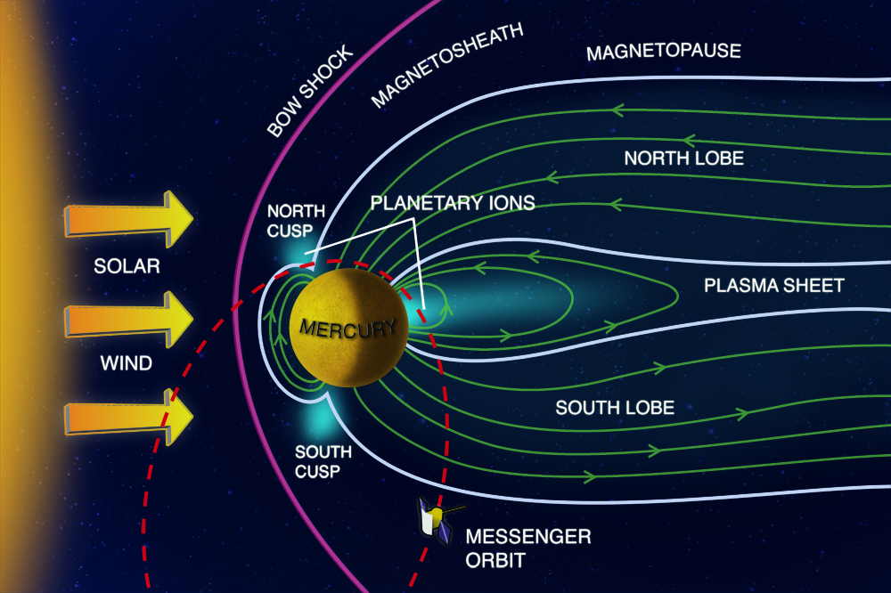
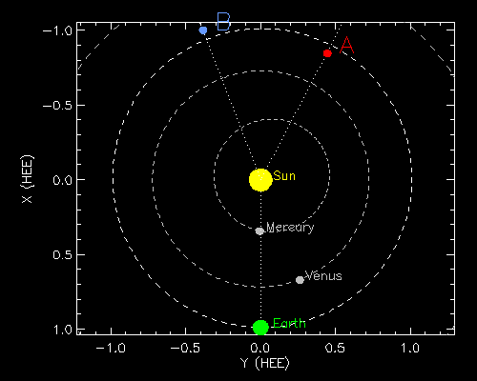
MESSENGER at 0.3 AU: Glimpse of environment soon to be explored by Parker Solar Probe and Solar Orbiter
MESSENGER (in Mercury orbit 2011-2015) – First spacecraft since 1980’s at < 0.5 AU.
- Significant limitations in terms of solar wind plasma observations, however, wealth of IMF data can be used for inner heliospheric studies
Notes:
For the last few years, my collaborators and I have made extensive use of MESSENGER observations in orbit around Mercury to study ICMEs in the near-solar environment and get a glimpse of the region that will soon be explored by the upcoming missions. Just a little bit about MESSENGER, it is the first spacecraft to visit this region near the Sun since Helios 1 and 2 in the 1980s, and it was in orbit around Mercury between 2011 and 2015. MESSENGER was significantly limited in its solar wind observations, however, due to its highly elliptical orbit around Mercury the spacecraft spent 40 to 80% of each orbit in the interplanetary medium, thus there is a wealth of imf data to explore.

Slide 7
MESSENGER ICME Database
Winslow et al. (2015) JGR
Use data from MESSENGER to study ICMEs near 0.3 AU in conjunction with spacecraft at larger heliocentric distances.
• Cataloged 69 ICMEs at Mercury between 2011 – 2015.
• Investigated key ICME property changes from Mercury to 1 AU.
Main results of statistical study:
• Agreement with previous studies for B vs. r
• Evidence that ICME deceleration continues past the orbit of Mercury.
Notes:
• This ICME database useful for multipoint spacecraft studies of recent ICMEs, as well as for model validation of ICME properties.
• ICME deceleration continues beyond the orbit of Mercury:
(1) Shallow speed decrease with distance,
(2) Average transit time from Sun to Mercury 20% faster than expected based on average transit times to 1 AU,
(3) Significantly shallower transit time dependence on initial CME speed observed at 1 AU compared to predictions based on MESSENGER

Slide 8
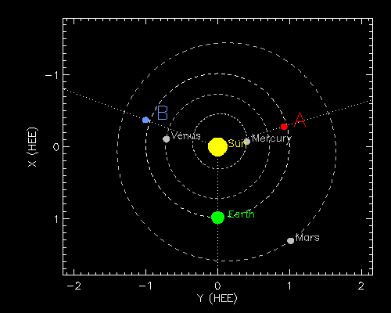
Magnetic Ejecta Evolution: Increased Complexity
Winslow et al. (2016) JGR
ICME from 29 December 2011 observed in longitudinal alignment at MESSENGER and STEREO A.
From force-free field modeling, orientation of the underlying flux rope has changed significantly in latitude and longitude between the two spacecraft.
Turbulent region with distinct properties within the flux rope at STEREO A, not observed at MESSENGER.
=> Interaction involving magnetic reconnection with the heliospheric plasma/current sheet dramatically alters the ICME magnetic field and increases complexity.

Slide 9
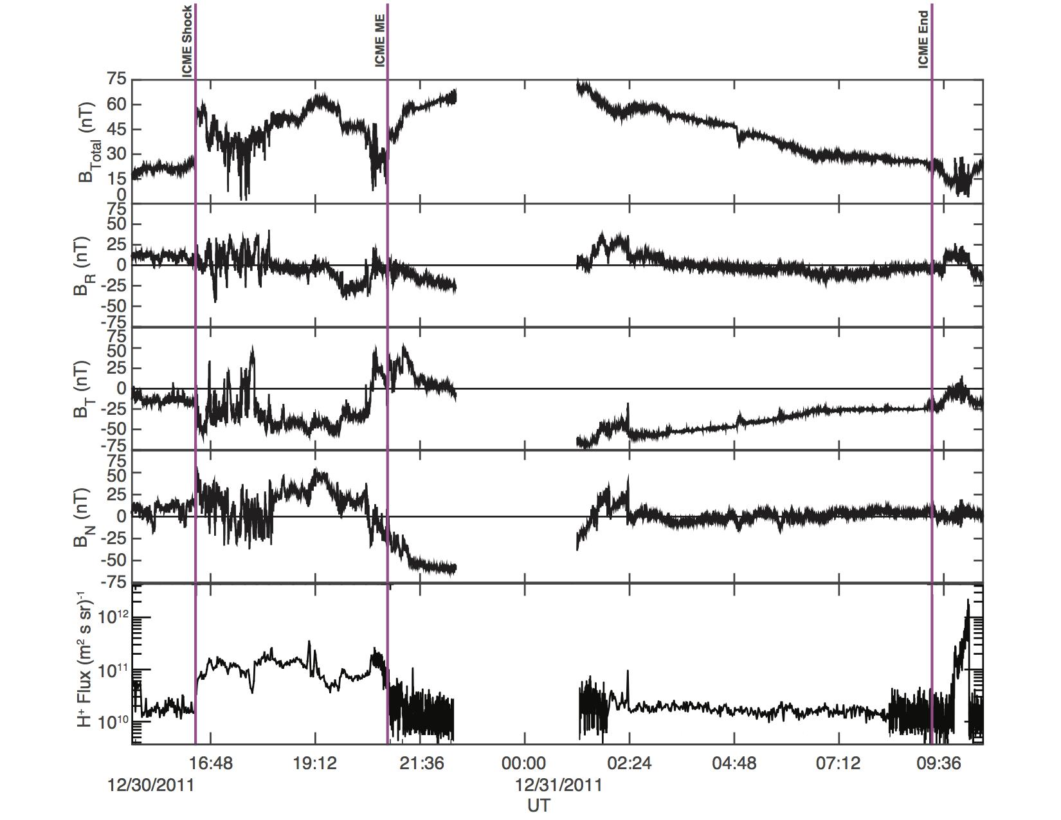
MESSENGER Observations
+B_{R} before ICME
Strong -B_{N} inside flux
rope
Rotation is observed in B_{T} and B_{N}; B_{T} dominant component
Notes:
So here is the data from MESSENGER, for this particular event we even had a proxy for the plasma density available. Gap due to magnetospheric passage. Strong -B_{N} inside flux rope. Rotation of the magnetic field vector is observed in the BT and BN components, with BT being the dominant field component in the ME. Overall a fairly straightforward icme, with shock, heath, magnetic ejecta.

Slide 10
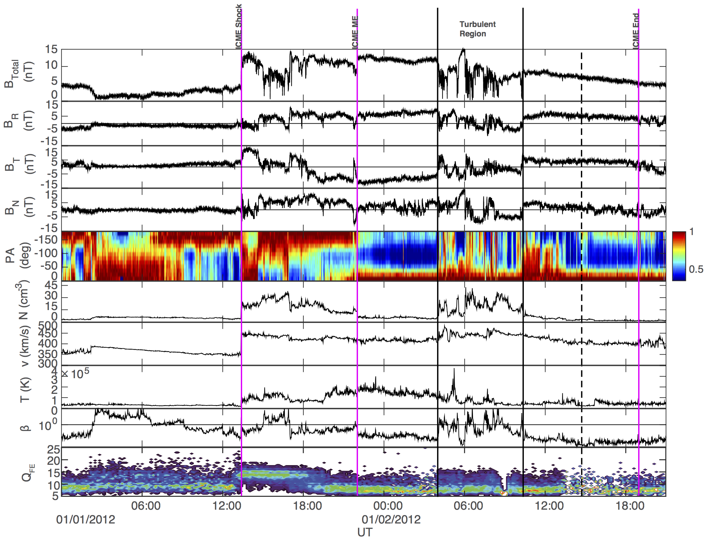
STEREO A Observations
-B_{R} before ICME
No strong -B_{N} inside flux rope
Flux rope orientation changed ∼80◦ in lat and ∼65◦ in lon.
0.5 impact parameter at both
S/C.
Bidirectional to unidirectional suprathermal electrons -> succession of closed to open field lines indicates reconnection.
Evidence for reconnection
Notes:
At stereo a, the ICME is indicated in the magnetic field, density, velocity, temperature, plasma beta, iron charge state, and suprathermal electron pitch angle distribution.
Despite the longitudinal alignment between the two spacecraft, the ICME looks significantly more disturbed than at MESSENGER.

Slide 11
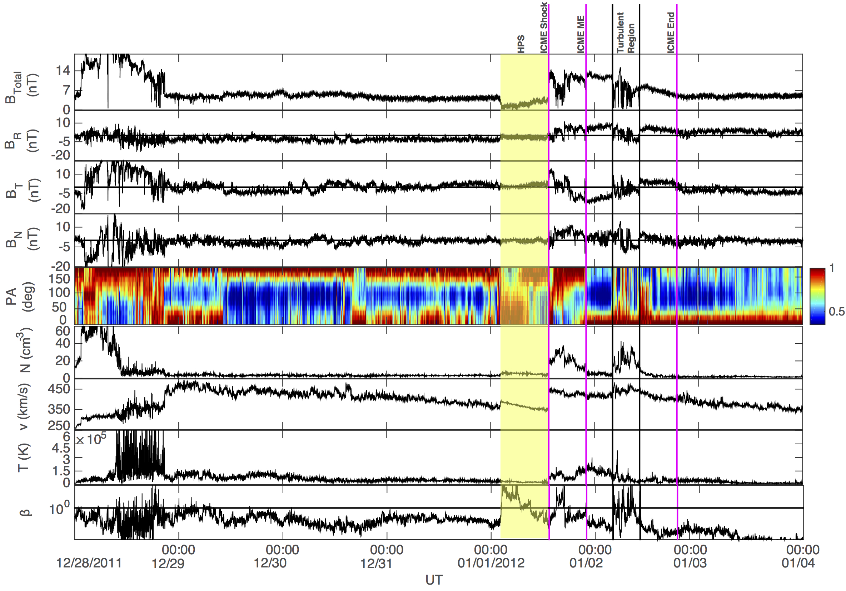
STEREO A – Extended view
Suprathermal electron strahl direction changes from 180º to 0º during ICME.
IMF Before ICME: +B_{R} at Mercury and -B_{R} at STEREO A.
Data and ENLIL simulation -> ICME caught up to and overtook part of heliospheric plasma sheet (HPS)/current sheet.
-B_{R}
HPS
ICME
+B_{R}
Notes:
The significant change observed in the flux rope orientation and the evidence for reconnection in the turbulent region imply strong interaction with the solar wind. To try to understand what happened, we took a closer look at the STEREO A data prior to the ICME arrival. We can see that Br is negative at STEREO before ICME arrival and positive after the ICME, whereas it was positive at Mercury before the ICME. This indicates that ICME encountered and overtook part of the heliospheric plasma sheet and current sheet during propagation between Mercury and 1 AU. This is further supported by the fact that the suprathermal electron strahl direction changes from 180 to 0 degrees during the ICME passage, and signatures of the heliospheric plasma sheet are also observed prior to the ICME arrival (very low B, increased density, high beta).

Slide 12
Steady state solar wind (ENLIL)
Just after ICME reached Mercury
Just before ICME reached STEREO A
Notes:
We also used ENLIL model simulations of the steady state solar wind to get a clearer picture of what caused the transformations in the ICME. ICME ejected into positive polarity IMF. The simulations show the HPS/HCS having passed by Mercury before the ICME reached it, while at STEREO A, the HPS/HCS arrives around the same time as the ICME. So the ICME overtook and likely dragged the HPS/HCS along with it. Likely turbulent region within the flux rope at STEREO A is highly compressed plasma from the HPS that was “engulfed” by the ICME. Interactions involving magnetic reconnection with corotating structures in the solar wind dramatically altered the ICME magnetic field.

Slide 13
Strong influence of disturbances in solar wind on ICMEs during propagation.
  ICME with simple initial structure made significantly more complex due to interaction with disturbances in solar wind.
  Direct evidence for solar wind induced alteration of magnetic topology within ICMEs.
Hypothesis: ICMEs are less complex closer to the Sun.
Significant implications for space weather forecasting
  Should serve as a caution on using very distant observations to predict geoeffectiveness of ICMEs.
Need for large-scale statistical studies of ICME events observed in conjunction at different heliocentric distances (PSP and SO primed for this)
  Determine how frequently significant changes in flux rope orientation occur during propagation. (e.g. Good et al. [2015] showcased an ICME with much more self-similar evolution)
Notes:
Results highlight need for large-scale statistical studies of ICME events observed in conjunction at different heliocentric distances to determine how frequently significant changes in flux rope orientation occur during propagation.

Slide 14
ICME-driven GCR Modulation: Forbush Decrease Evolution
Winslow et al. (2018) ApJ
Forbush Decreases (Fds):
Short-term drops in GCR flux associated with ICME passage.
Caused by:
  Changes in GCR diffusion coefficients at ICME shock/sheath,
  Closed field line geometry of ICME magnetic ejecta.
Indicate ICME related GCR modulation.
Main Goal:
Characterize Fd evolution in the inner heliosphere in preparation for PSP and SO.
  Relevant for GCR studies
  Indirectly tests ICME evolution during propagation.
Notes:
In the second case study, we investigated how Forbush decreases evolve in the inner heliosphere, giving us a glimpse of ICME modulation of GCRs at different heliocentric distances.

Slide 15
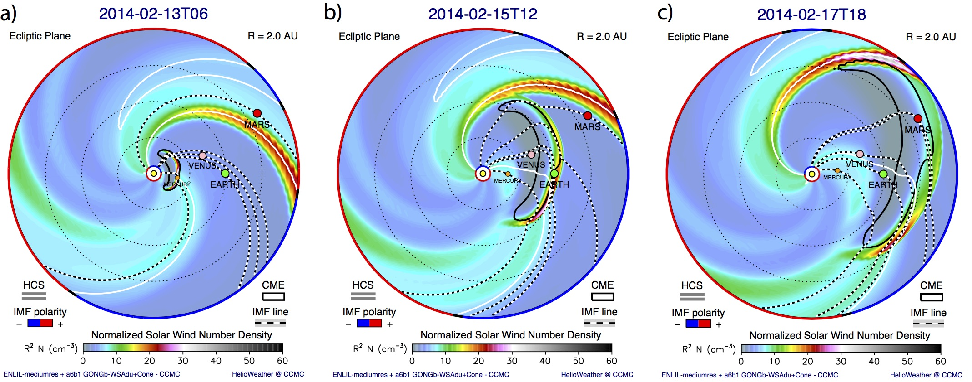
ICME launched on 12 February 2014 reached all inner solar system planets.
ICME reaching Mercury
ICME reaching Earth
ICME reaching Mars
ICME speed ~550 km/s at Mercury, ~470 km/s at Earth, ~410 km/s at Mars.

Slide 16
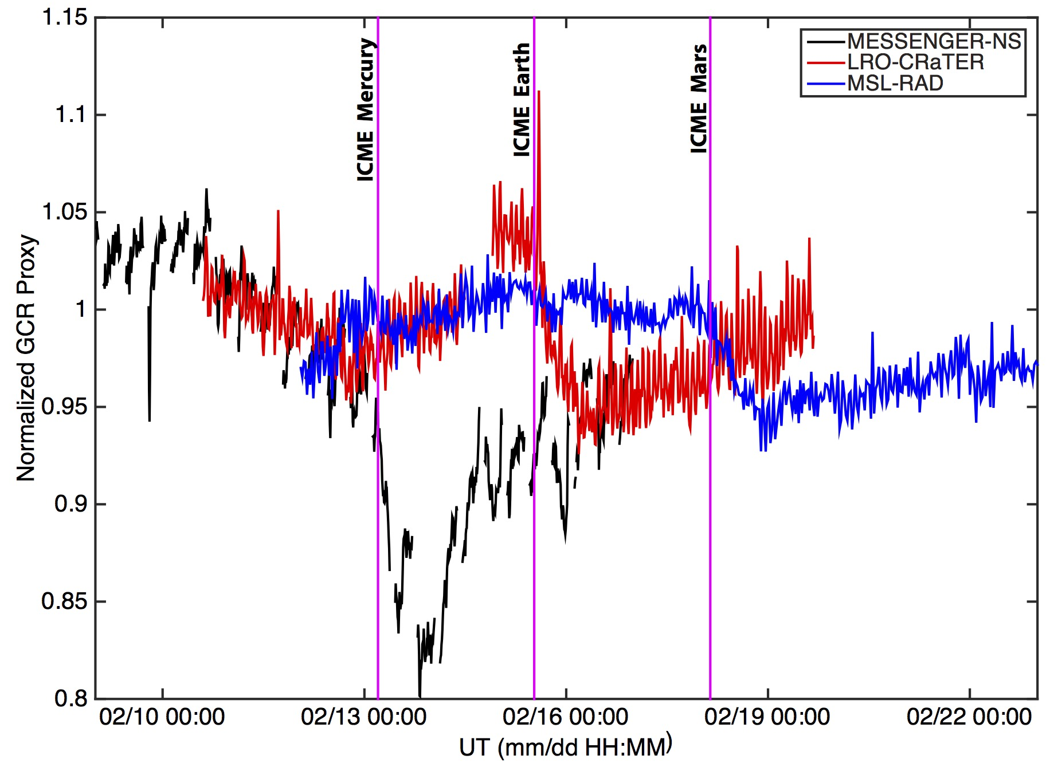
Comparison of Forbush decreases at the 3 planets
At Mercury:
Used MESSENGER NS data
2-step Fd (next slide).
At Earth/Moon:
Used LRO CRaTER data and SOPO NM data
1-step Fd.
At Mars:
Used MSL RAD data
1-step Fd.
Earth
Mars
Mercury

Slide 17
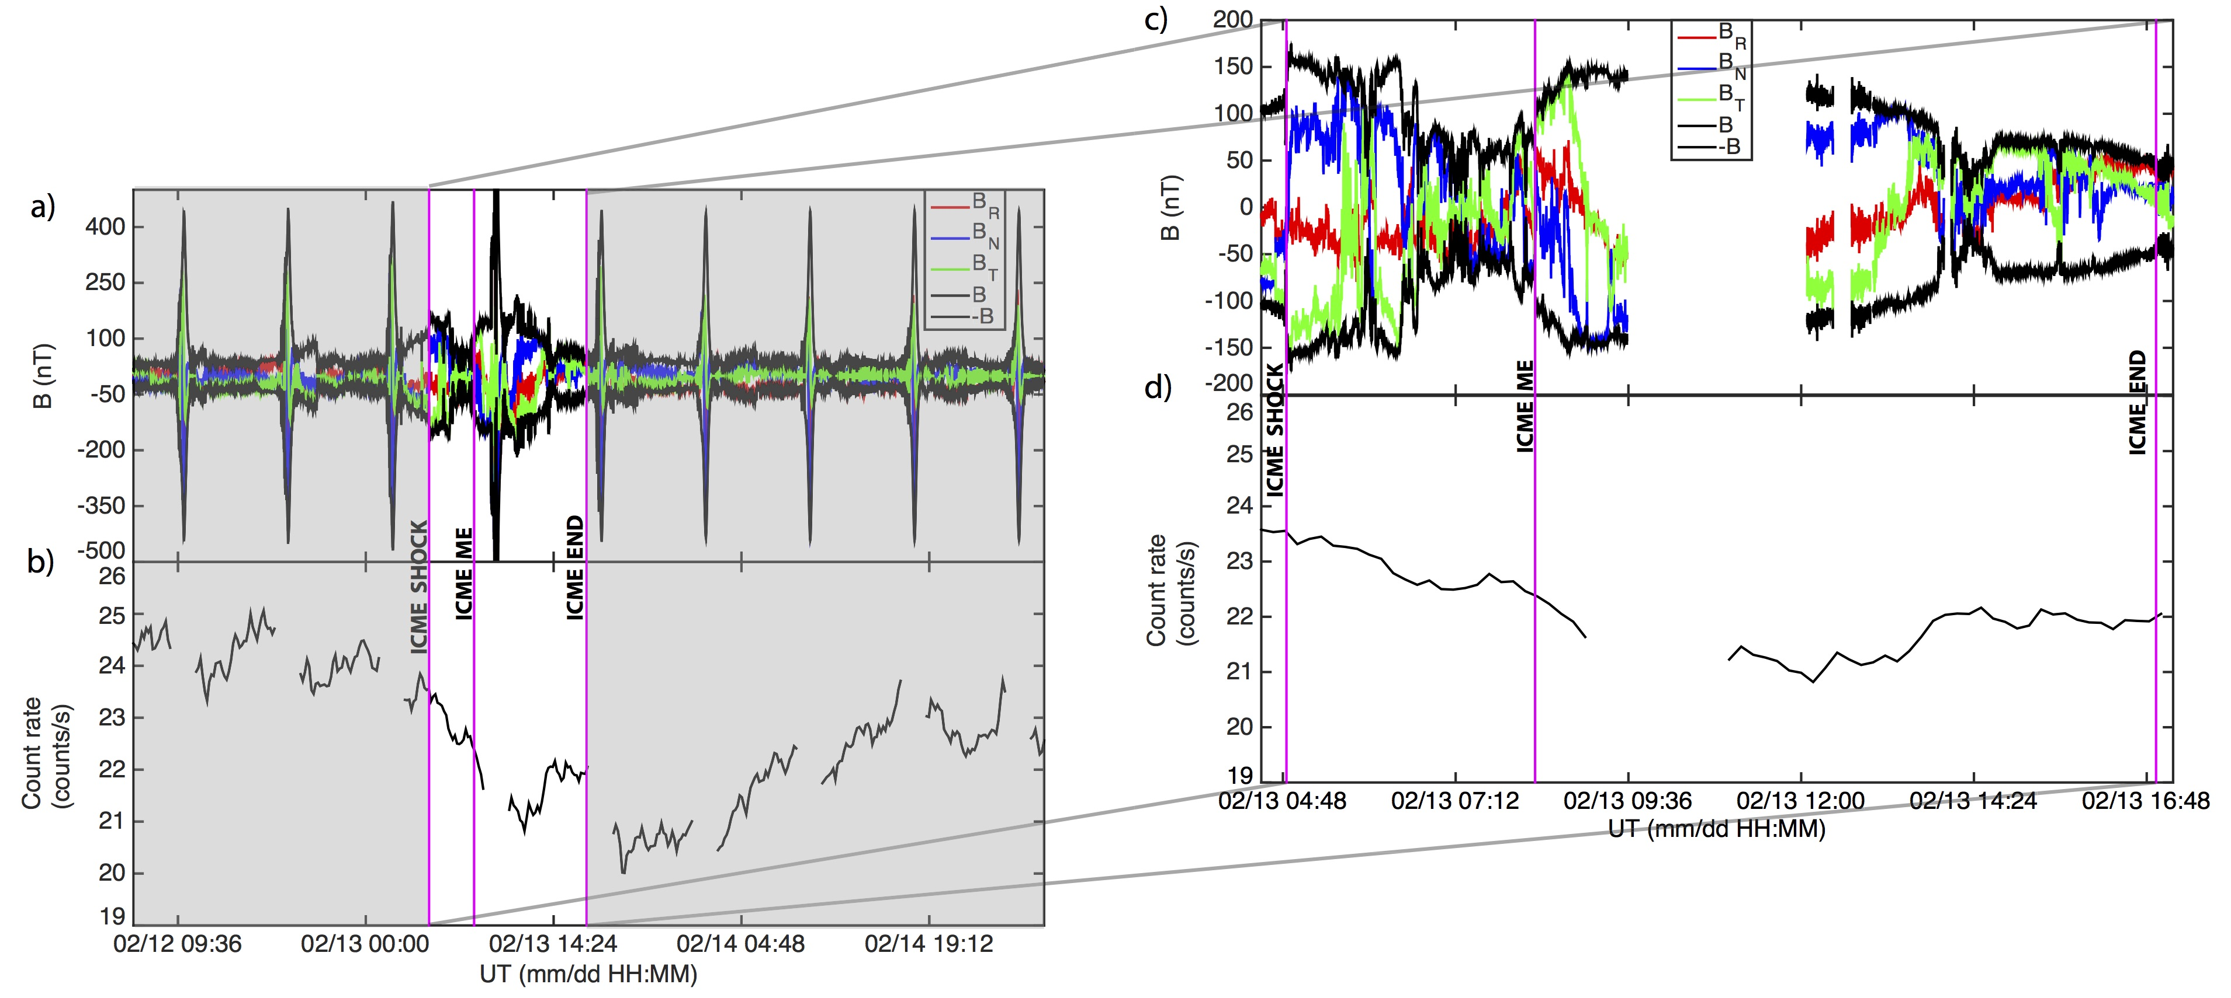
Comparison of Forbush decreases at the 3 planets
Earth
Mars
Mercury

Slide 18
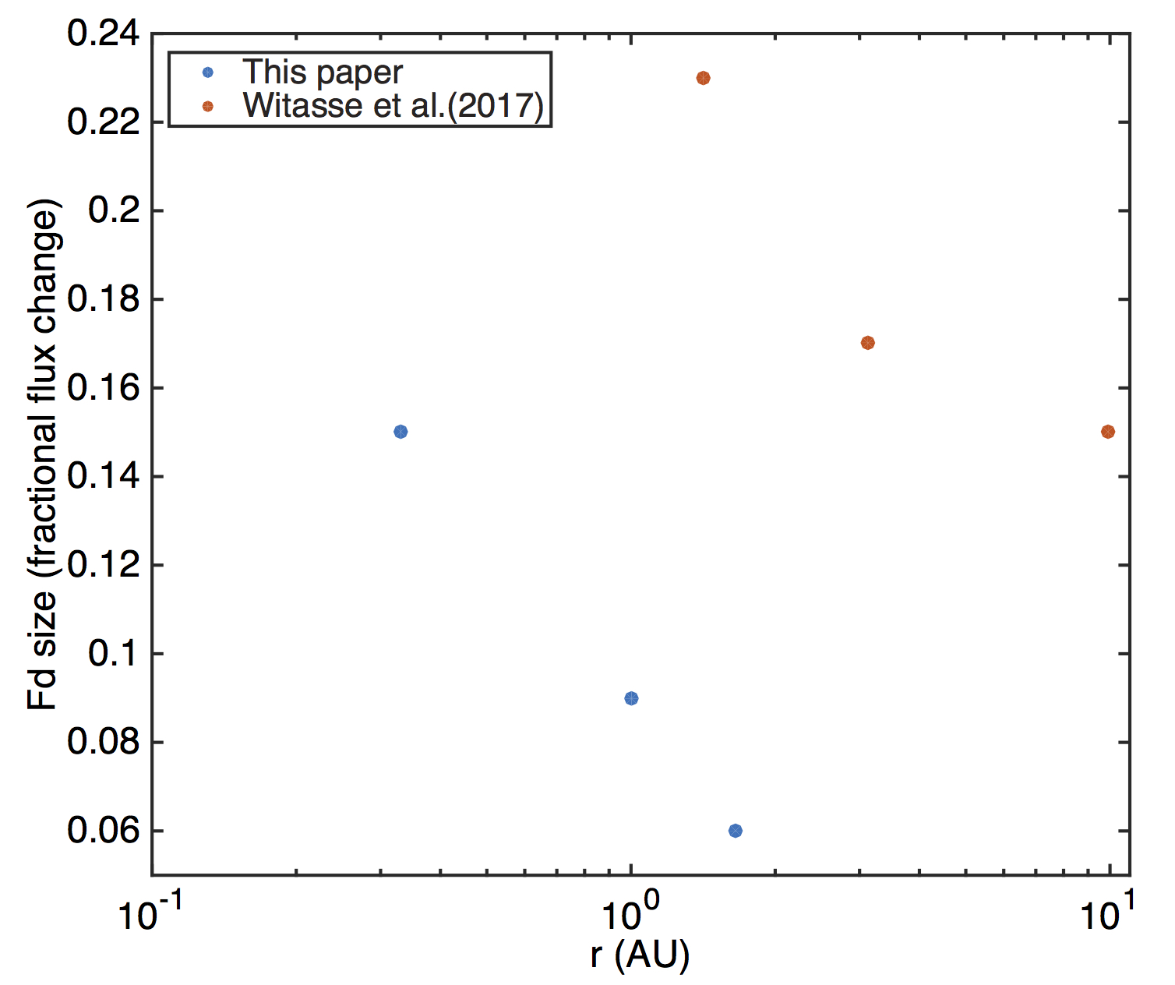
Comparison of Forbush decreases at the 3 planets
 | Magnitude of decrease | Duration of decrease (h) | Slope of decrease
Mercury | 15% | 59.2 | -0.16 (FD1: -0.21; FD2: -0.37)
Earth | 9% | 69.9 | -0.12
Mars | 6% | 206.6 | -0.07
Fds are steeper, deeper, and of shorter duration closer to the Sun.
Fd size strongly dependent on ICME B.
Witasse et al. (2017) looked at Fds associated with the same ICME in the outer solar system (at Mars, comet 67P, and Saturn).
Hint of possible exponential drop off of Fd size with distance.

Slide 19
Investigated how Fds evolve in time and radial distance, in the near-solar region, which has not been explored since Helios 1 and 2 in the 1980’s, and past 1 AU.
Find Fds steeper and deeper closer to Sun.
|B| in ICME plays a large role in modulating the depth of Fd.
2-step Fd at Mercury, 1-step Fd at Earth (despite longitudinal alignment) and Mars -> Strong field needed in magnetic ejecta to cause second GCR drop.
Hypothesis: PSP and SO will observe much stronger ICME-driven GCR modulation than has been observed before.
  Fd size decreases exponentially with heliocentric distance.
  2-step Fds are more common closer to the Sun.
Notes:
PSP and SO will give us a much better idea of how icmes change during propagation.
Prediction for PSP in terms of ICMEs: likely less magnetic complexity in the magnetic ejecta, probably cleaner flux rope -> as we see that complexity in the magnetic ejecta increases due to interaction with the solar wind. There will likely not be much indication of reconnection within ICMEs as we get closer and closer to the Sun.

Slide 21
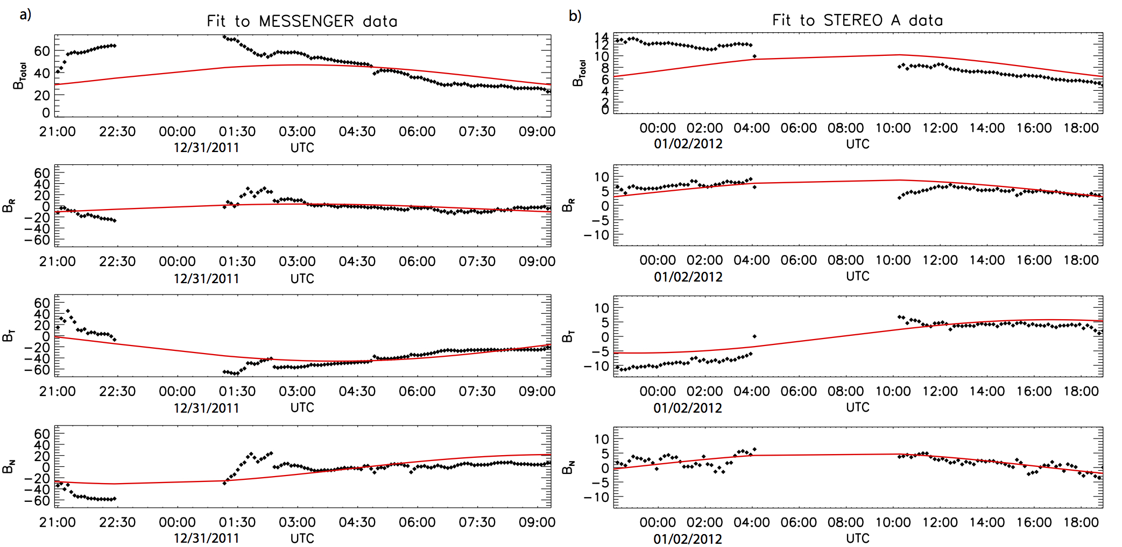
Flux rope fits
Notes:
From force-free field modeling, orientation of the underlying flux rope has undergone a rotation of ∼ 80◦ in latitude and ∼ 65◦ in longitude.

Slide 22
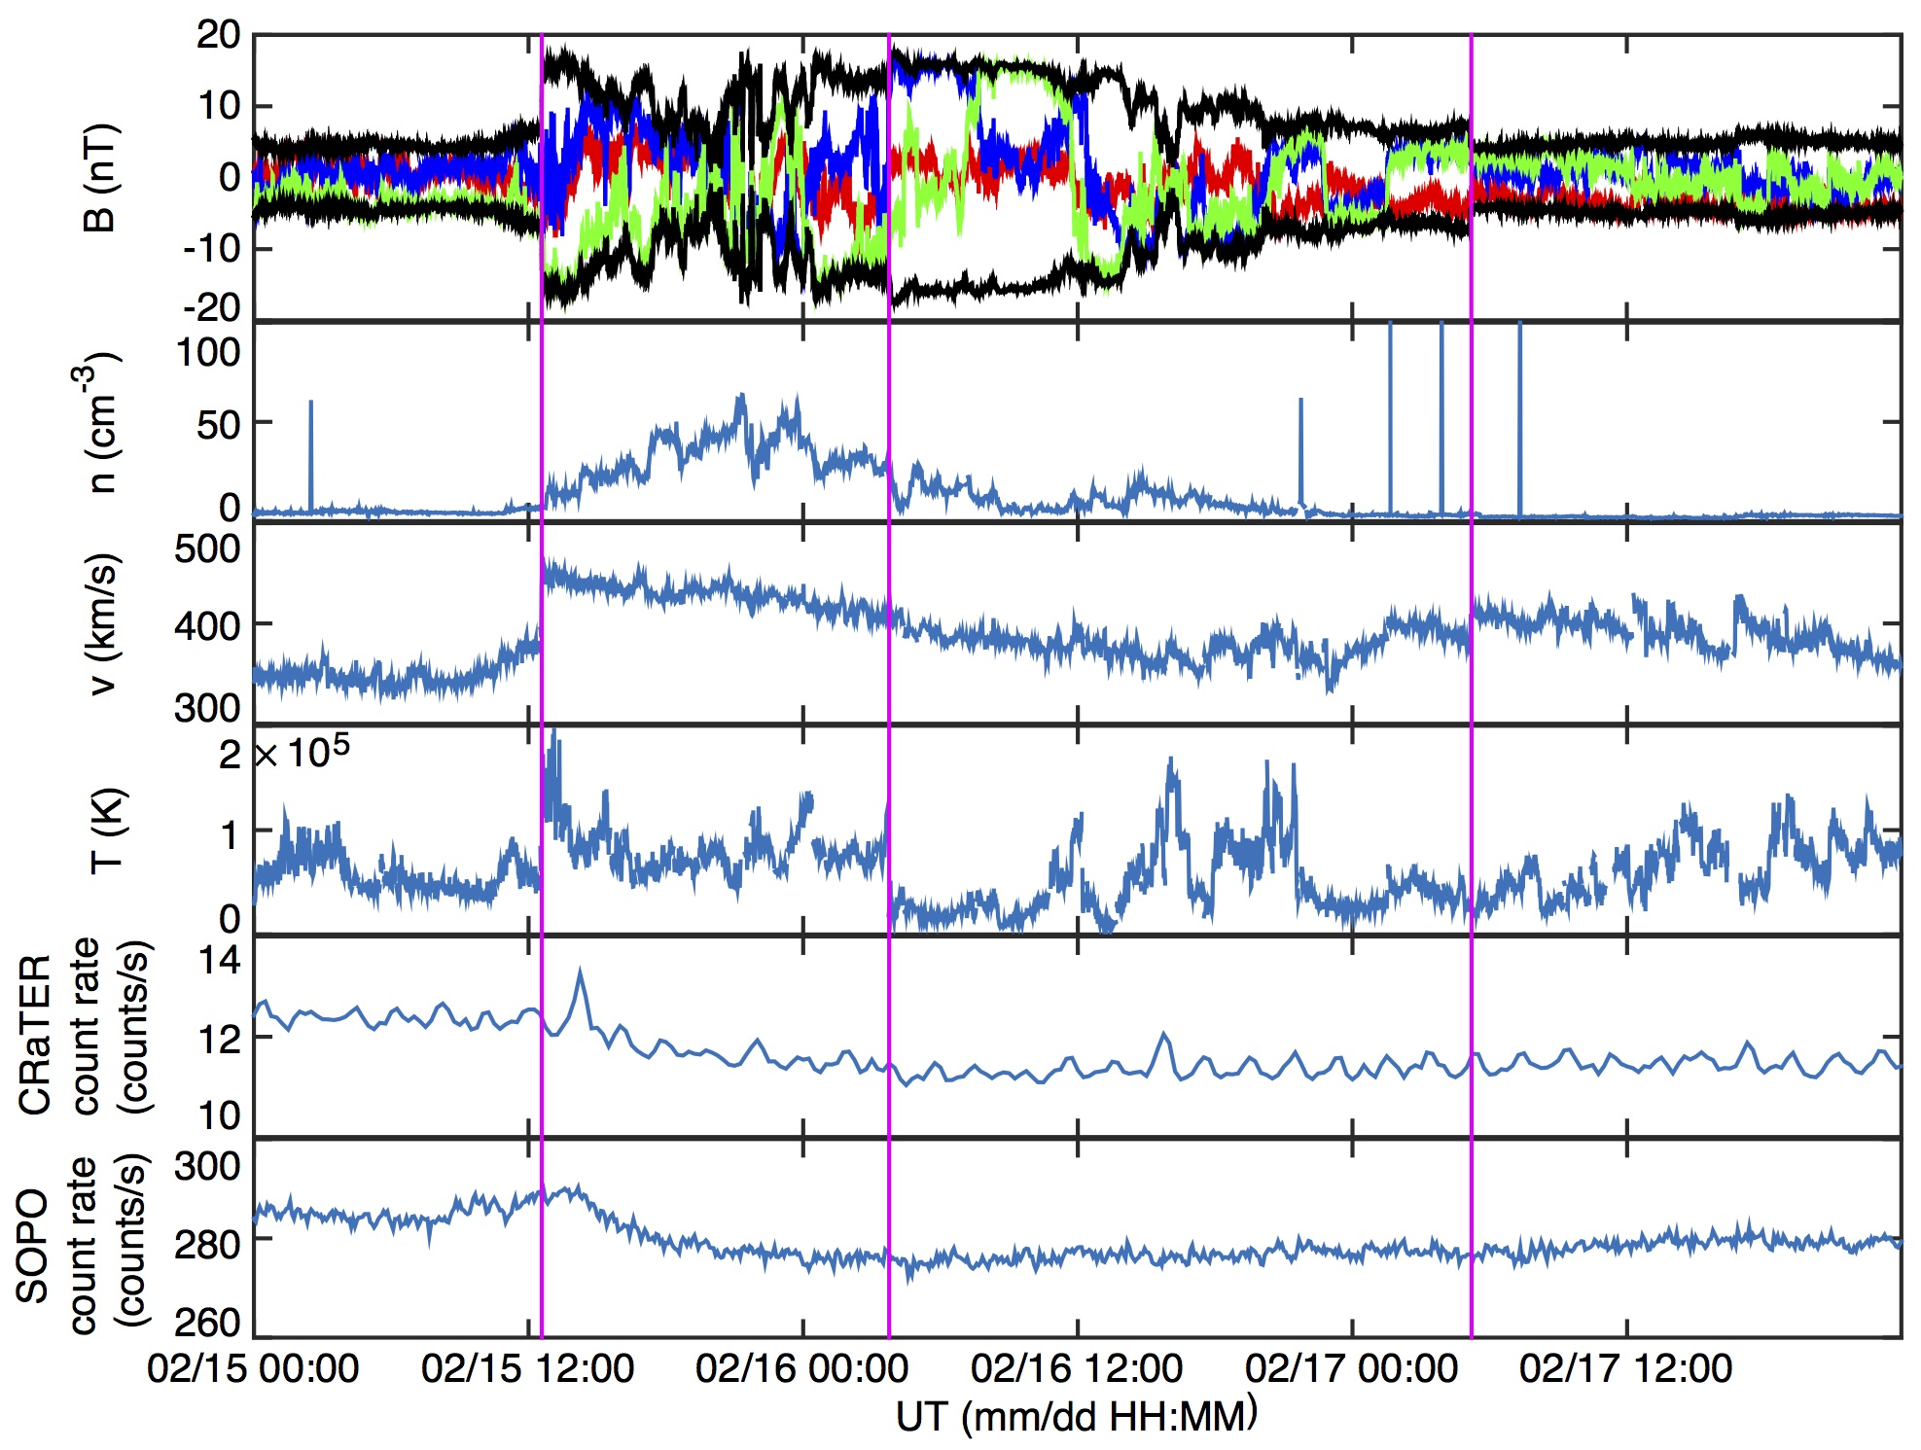
ACE and LRO observations at Earth/Moon
Used ACE fields and plasma data of the ICME; LRO CRaTER data (>100 MeV) of the FD.
FD starts ~2 h after ICME shock; likely due to slow density increase, lack of high variability in B at beginning of ICME sheath.
1-step FD only.

Slide 23
STEREO A Observations
Notes:
To take a more detailed look, I will Zoom in to magnetic ejecta portion, characterized by low variability B, low density, low beta, bidirectional suprathermal electrons.

Slide 24
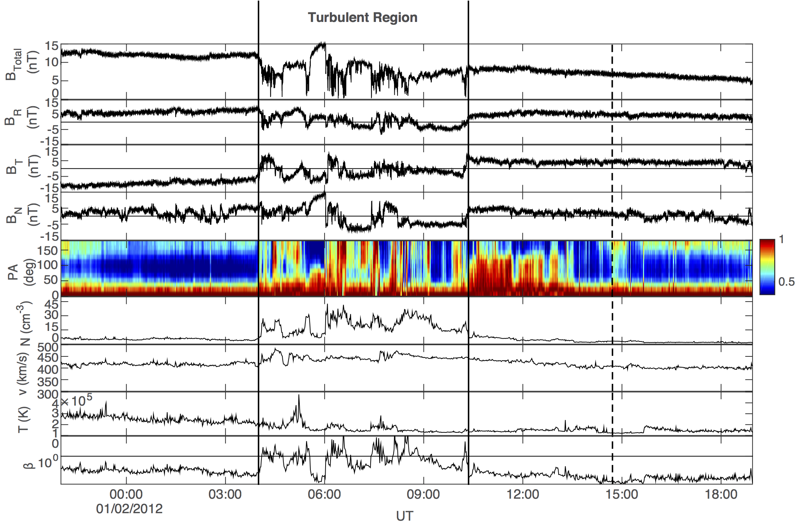
STEREO A – Magnetic Ejecta
B_{R} and B_{T} dominant components; smooth rotation in B_{T}.
No strong southward B as seen at MESSENGER.
Force-free field fit: flux rope rotated ∼ 80◦ in latitude and ∼ 65◦ in longitude from MESSENGER to STEREO A.
0.5 impact parameter at both S/C.
Notes:
From quick glance we can see that magnetic ejecta looks quite different at STEREO A than at Mercury. There is a region which I labeled here as a turbulent region which is distinct from all the rest of the ejecta, and was not observed at Mercury. I will discuss this region in detail shortly, but first I’ll focus on the magnetic ejecta overall, when this turbulent region is not taken into consideration. Br and Bt are dominant components; smooth rotation in Bt. BN is close to zero, no strong southward component observed, which was seen at MESSENGER. From looking at the data at MESSENGER one might predict a geomagnetic storm at 1 AU given the strong southward B component lasting over 5 hours, but by the time the ME reached STEREO A, this was not observed. From force-free field modeling, orientation of the underlying flux rope has undergone a rotation of ∼ 80◦ in latitude and ∼ 65◦ in longitude. Impact parameter of 0.5 obtained at both spacecraft. Also observed a highly turbulent region with distinct properties within the flux rope at STEREO A, not observed at MESSENGER.

Slide 25
STEREO A – Magnetic Ejecta
Turbulent region:
Bidirectional to unidirectional suprathermal electrons -> succession of closed to open field lines indicate reconnection.
Evidence for reconnection
Notes:
The turbulent region is characterized by high magnetic field fluctuations, high plasma density, an increase in velocity, fluctuating temperature, and a small increase in the average iron charge state. The increase in average iron charge state implies a different source for the plasma in this region than for the rest of the ME, while the overall increased value of plasma 𝛽 in the region strongly implies plasma heating. Within the ME, both before and after the turbulent region, STEREO A measured counter-streaming electrons, while within the region, the pitch angle distribution was highly variable. There are clear intervals when bidirectional flows are detected but they are interspersed with sharp drop-outs to unidirectional flows only. This alternating signature of short bursts of bidirectional then unidirectional flows implies the succession of closed to open field lines (i.e., both ends connected at the Sun or only one end connected), indicating interchange reconnection.

Slide 26
We focus on ICME evolution in the inner solar system
Case study 1 – Magnetic Ejecta (ME) Evolution:
Longitudinal conjunction between MESSENGER and STEREO A:
  Investigate ICME changes during propagation due to interaction with corotating structures in solar wind.
Case study 2 – ICME-driven GCR Modulation Evolution:
Longitudinal conjunction between MESSENGER and Earth, near-alignment with Mars:
  Investigate effects of an ICME on GCRs -> study changes in FDs at different locations as ICME propagated away from Sun.
Notes:
For the purposes of this talk, I will focus on 2 of my recent studies of ICMEs in the innermost heliosphere to showcase how messenger data can be utilized, and what we can learn from these data in preparation for PSP and SO.
In both case studies we made use of multiple spacecraft and planetary alignments to observe icmes at multiple distances from the sun.
The first case study is of an ICME that was observed in near perfect alignment between messenger and stereo a. We investigated changes in this icme during propagation that arose due to interaction with the solar wind in less than 1 au.
In the second case study we investigated changes in Forbush decreases from Mercury to Mars during an icme that reached all the terrestrial planets.

Slide 27
Part 2 Conclusions
We make testable predictions for Parker Solar Probe and Solar Orbiter
Hypotheses:
ICMEs are likely less complex closer to the Sun due to less time interacting with disturbances in the solar wind
ICME-driven GCR modulation is much stronger closer to the Sun;
  Fd size may decrease exponentially with heliocentric distance
  2-step Fds are likely more common closer to the Sun
These hypotheses are made based on 2 case studies, and therefore they will not account for all possible variation;
It remains to be seen with these upcoming missions if these hypotheses are correct or not.
Notes:
PSP and SO will give us a much better idea of how icmes change during propagation.
Prediction for PSP in terms of ICMEs: likely less magnetic complexity in the magnetic ejecta, probably cleaner flux rope -> as we see that complexity in the magnetic ejecta increases due to interaction with the solar wind. There will likely not be much indication of reconnection within ICMEs as we get closer and closer to the Sun.

