Slide 1
Solar Wind and Coronal Electron Temperature in the Protracted Solar Minimum, the Cycle 24 Mini Maximum, and Over Centuries
N. A. Schwadron
U. New Hampshire

Slide 2
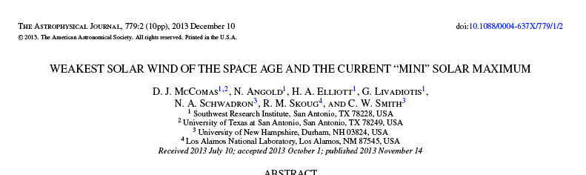
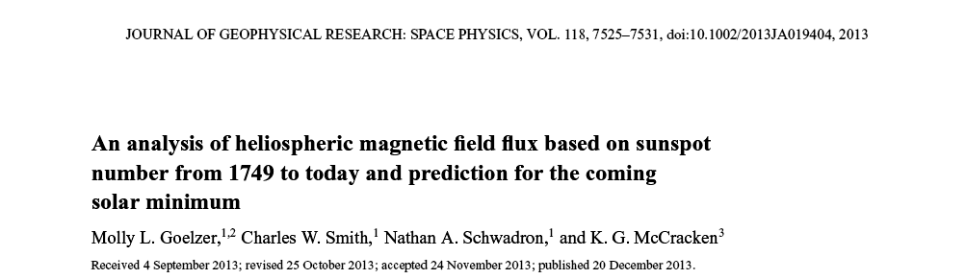
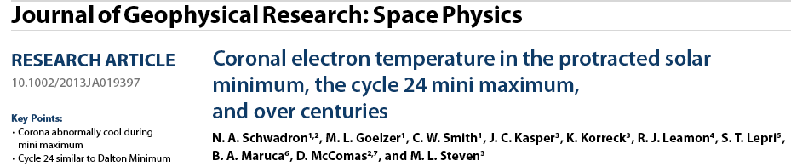
a

Slide 3
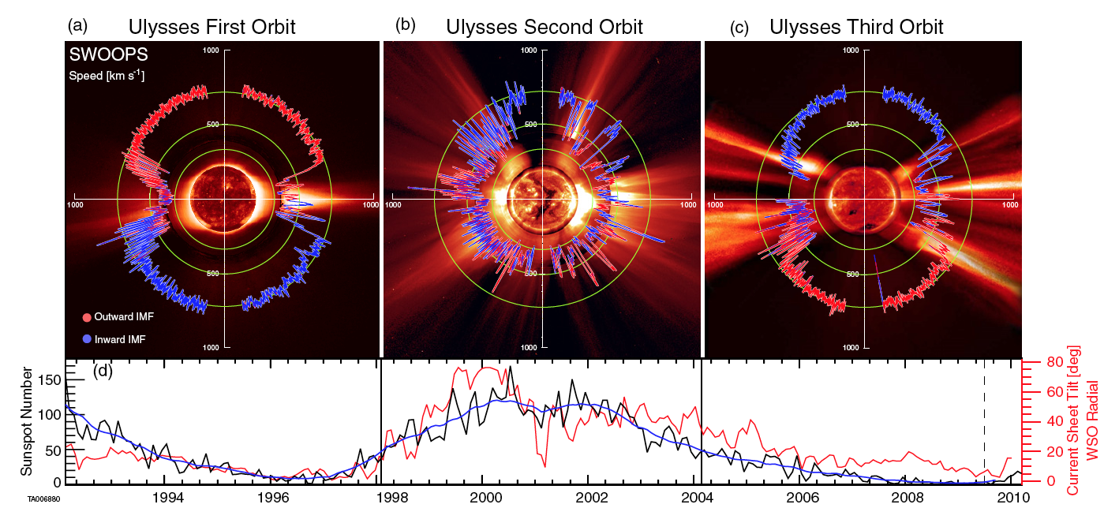
Background - Ulysses
McComas et al., ApJ, 2013

Slide 4
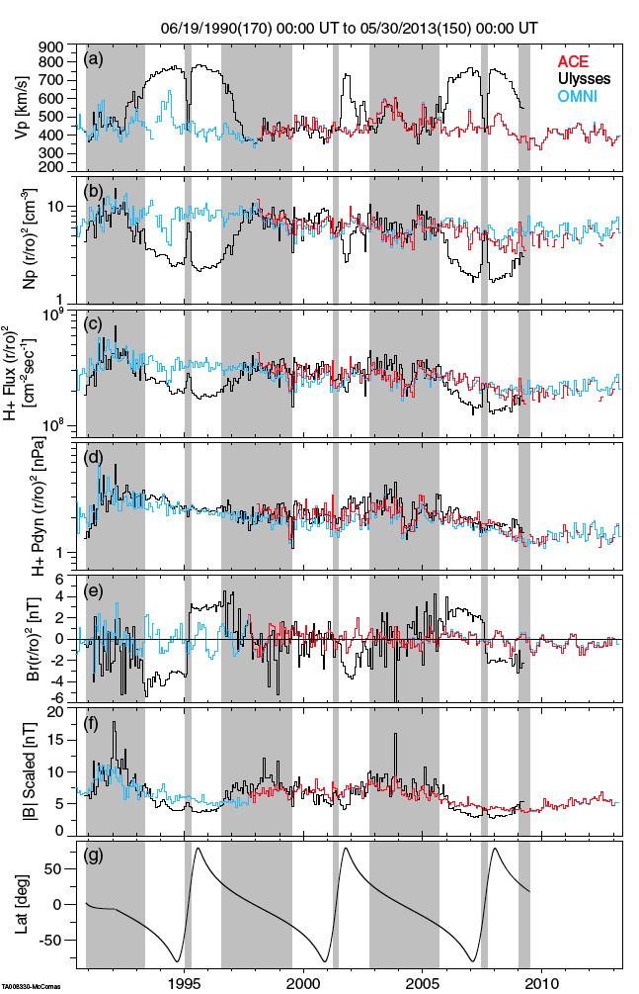
Protracted Min (23) and Mini Max (24)
Dropping solar wind
  Flux
  Pressure
  Magnetic Field
Continues trend observed by Ulysses
McComas et al., ApJ, 2013

Slide 5
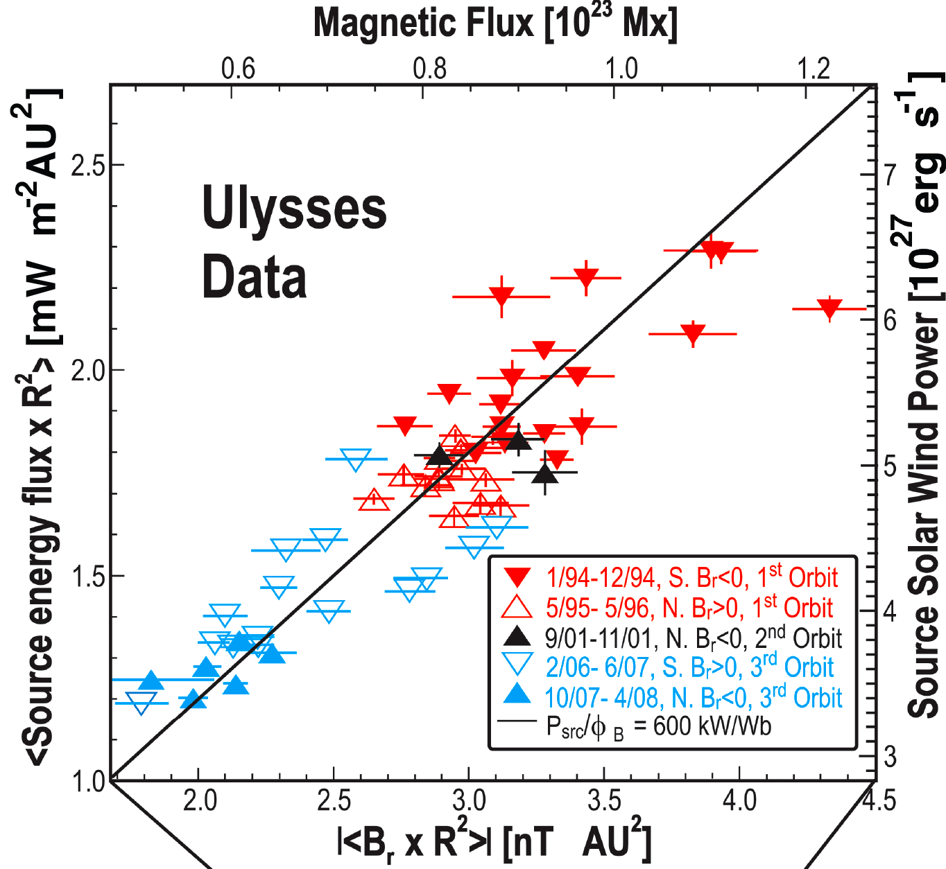
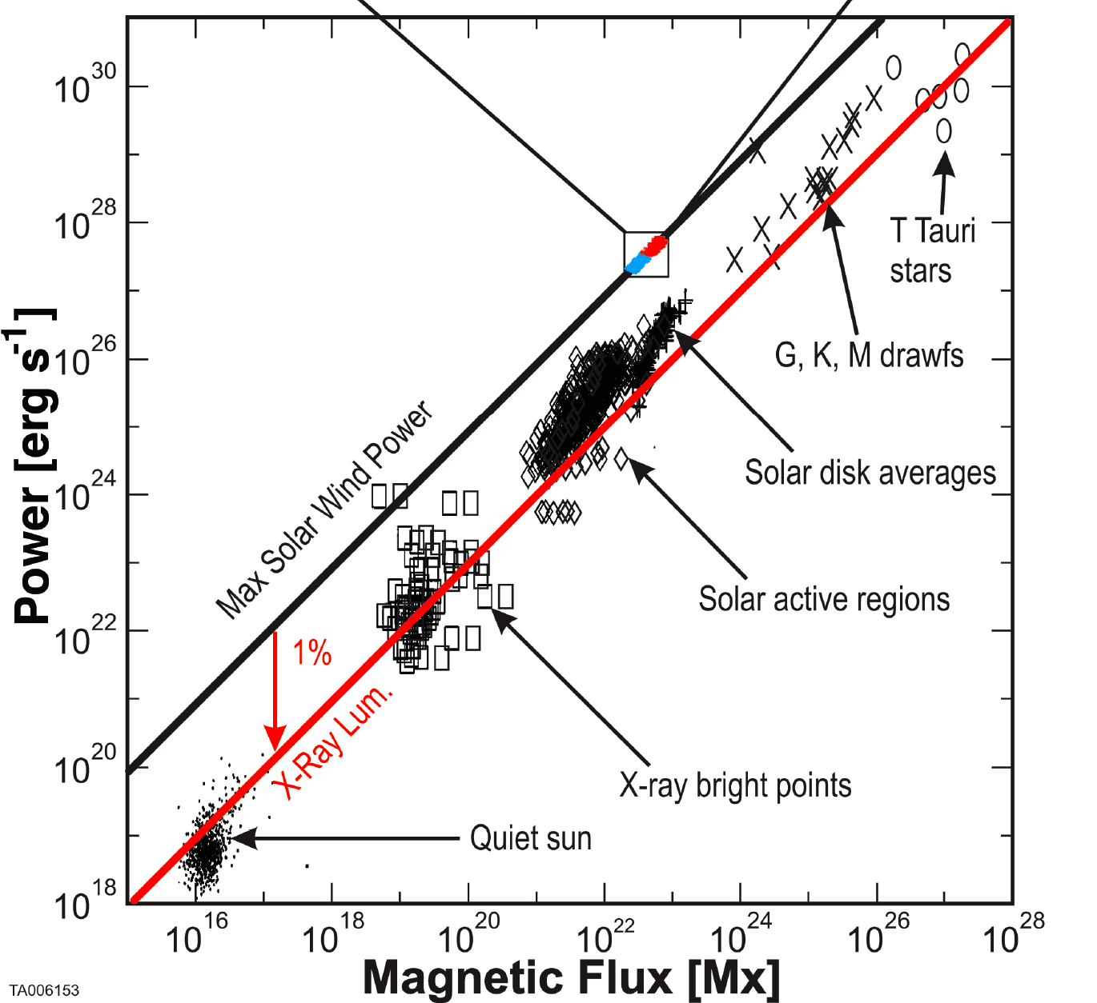
Energy-per-particle fixed from the Source
Pevtsov et al., 2003
Schwadron et al., 2008

Slide 6
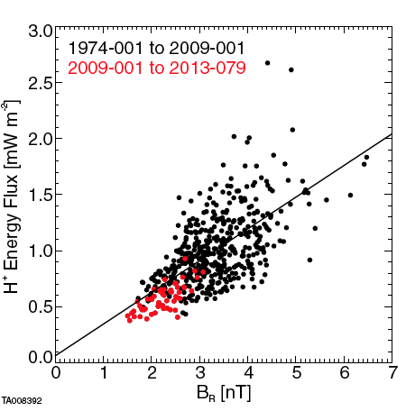
Correlated Reduction in Ram Pressure and Magnetic FLux
McComas et al., ApJ, 2013

Slide 7
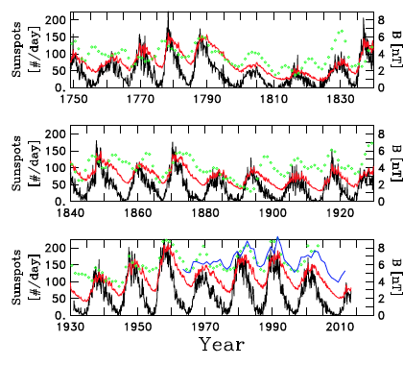


Reductions in Magnetic Field & SSN
SSN (black)
Predicted (red)
OMNI (blue)
¹⁰Be (green)
Magnetic Flux Balance (Schwadron et al.,, 2010)
Goelzer et al., ApJ, 2013

Slide 8
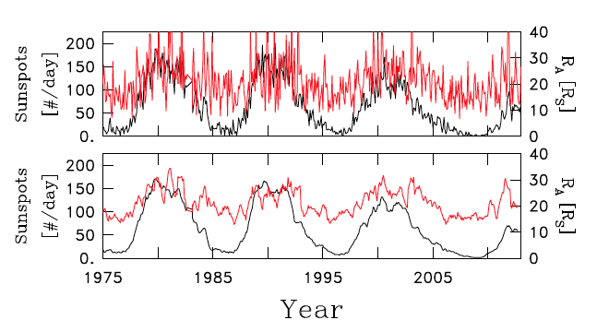
Alfven Radius in the Mini Maximum
A
Goelzer et al., JGR, 2014

Slide 9
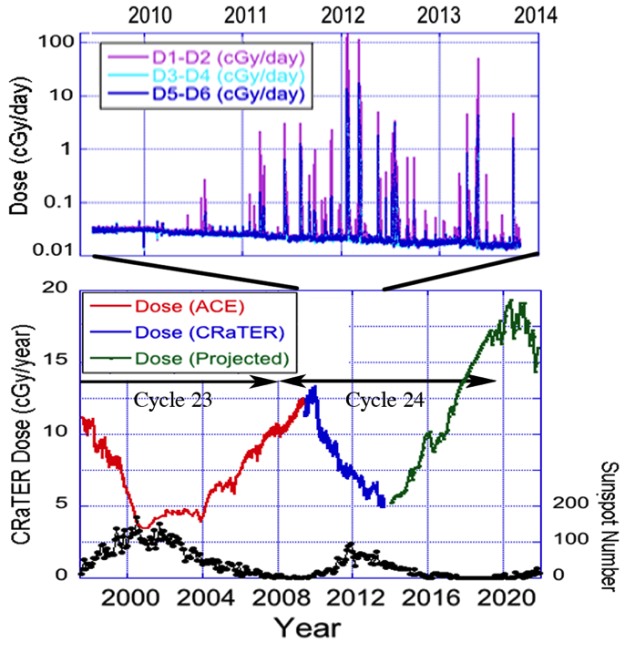
Significantly worsening space environment in Cycle 24
Schwadron et al., 2014

Slide 10
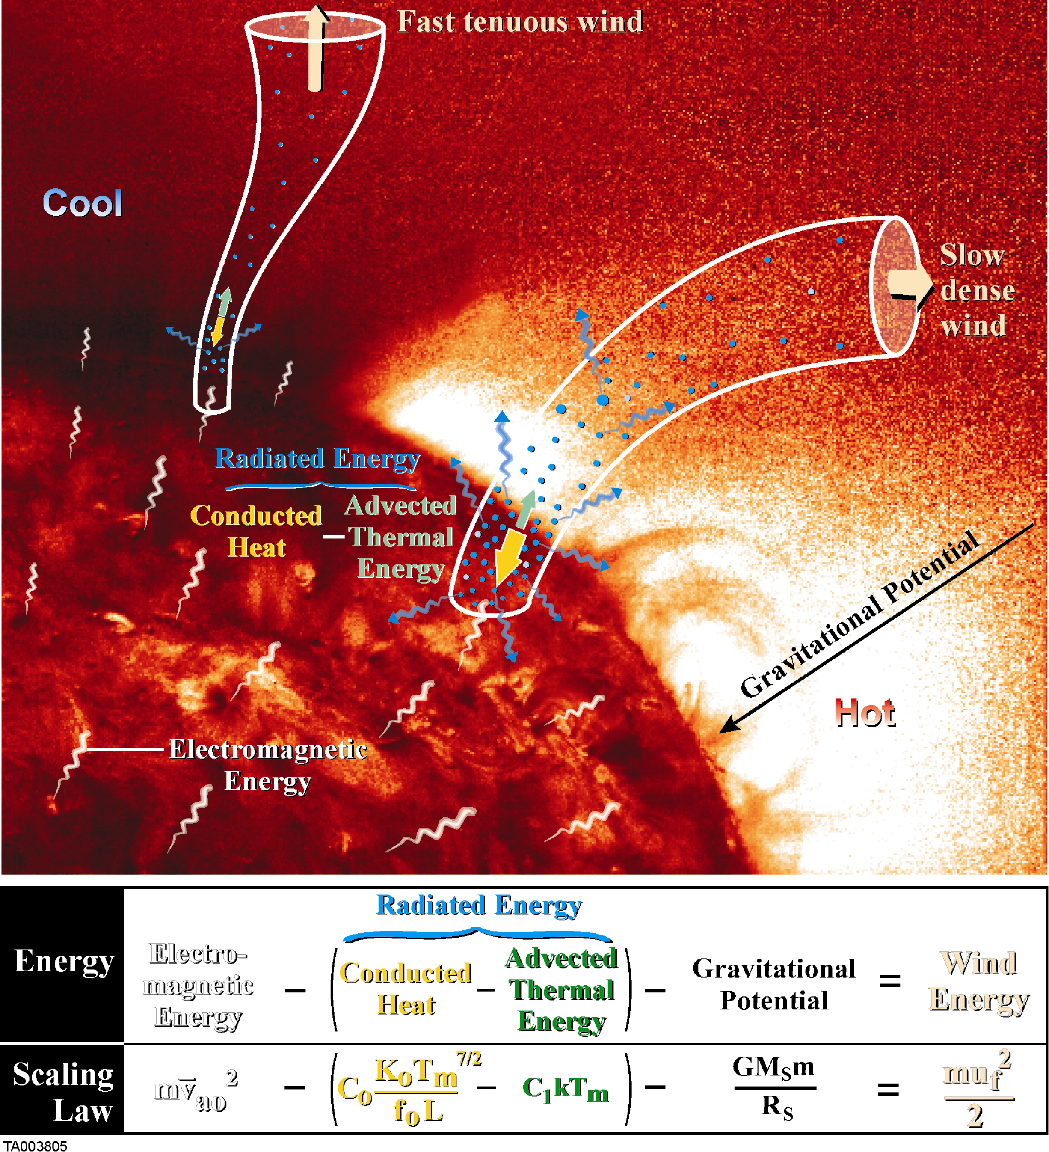
Paths of deposited Energy
Solar Wind Scaling Law
Electron heat conduction and radiative losses
  Fast wind
  Cool, Dark
  Slow wind
  Warm,Brighter
  Radiative Loss
  Hot, Bright
Schwadron and McComas, ApJ, 2003
Notes:
All of this comes to fruition in the solar wind scaling law. Here we take into account the detailed physics of the transition from the chromosphere (50,000 K) into the million degree corona. It turns out that in this transition, the plasma becomes highly ionized, and electrons efficiently funnel energy from the temperature maximum in the coronal down into the chromosphere. That electron heat condution truns out to be very sensitive to the electron temperature, so as I heat the corona to higher and higher temperatures I also lose more and more energy through radiation.
Now we wish to quantify this scaling law and and so I specify several parameters related to the base magnetic flux times the length and the injected energy per particle
At the end of specifying these parameters I derive a relation between final solar wind speed and the maximum temperature in the corona. As that base temperature goes up the wind speed slows.

Slide 12
Scaling Law Model - THEN
Only free parameter is expansion factor
= 6.2 taken here
Similar to 5.8 expansion factor found by Munro & Jackson [1977]
Maps to 8-12 G fields

Slide 13
Scaling Law Model - NOW
Not Observed rise in coronal temperature in cycle 24

Slide 14
Cycle 24 Decay in Coronal Temp

Slide 15
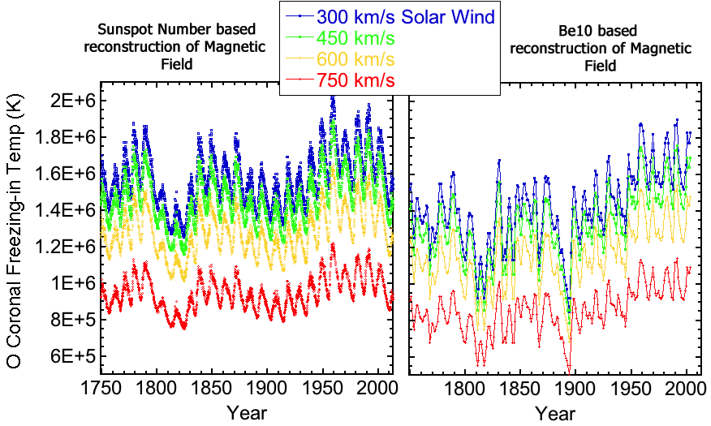
Historic Period – Dalton-like

Slide 16
Conclusions
Protracted Cycle 23 and Mini Max of 24 historic periods of low activity
Affect acting across all/most elements of system
Further more stringent test of coronal scaling law
Weak effect on Alfven radius
Worsening Radiation Environment

