Slide 1

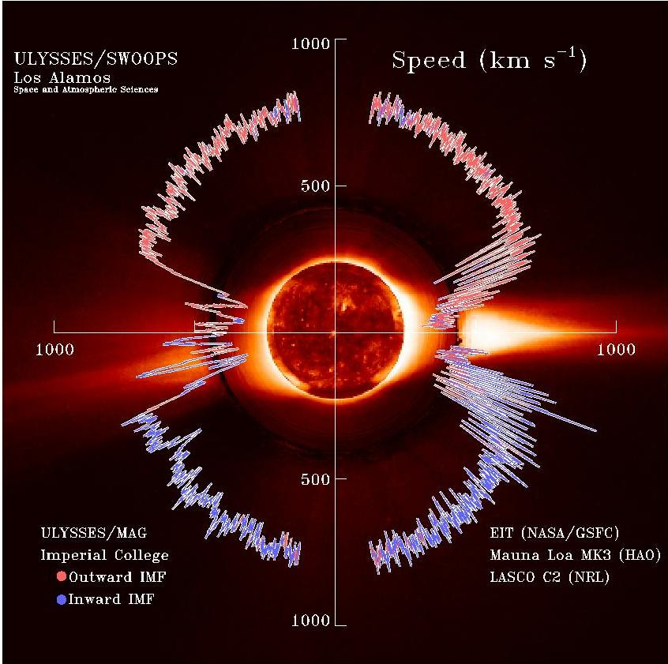
North-South Asymmetry in the Solar Wind
During Recent and Past Solar Cycles
Bertalan Zieger
Center for Space Physics, Boston University

Slide 2
Questions
  Is the solar wind distribution symmetric to the solar equator?
  What causes the asymmetry?
  How does the north-south asymmetry change during the solar cycles?
  Is Solar Cycle 24 exceptional?

Slide 3
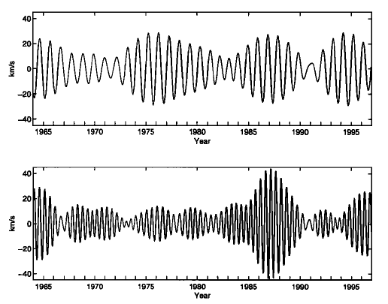
Annual and Semiannual Variation
in Solar Wind Speed
Zieger and Mursula, 1998

Slide 4
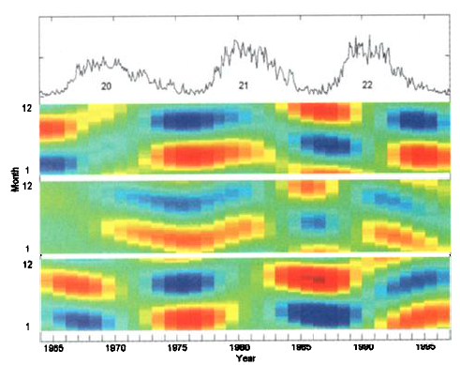
Alternating Phase Between Spring and Fall
V
K_{p}
B_{s}
Zieger and Mursula, 1998

Slide 5
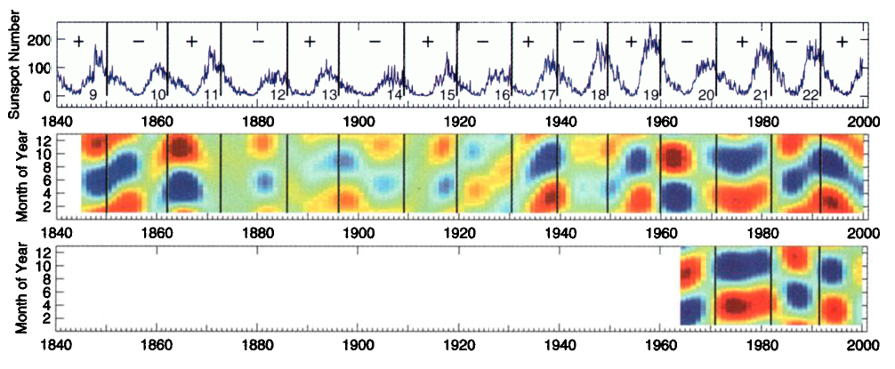
North-South Asymmetry in Past Solar Cycles:
SC 9 to 22 (Years 1840-2000)
aa
V
Mursula and Zieger, 2001

Slide 6
North-South Asymmetry in Recent Solar Cycles:
SC 20 to 24 (Years 1960-2014)

Slide 7
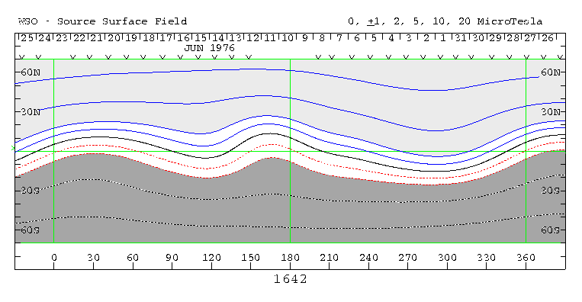
Coronal Magnetic Field During CR 1642
(June 1976)

Slide 8
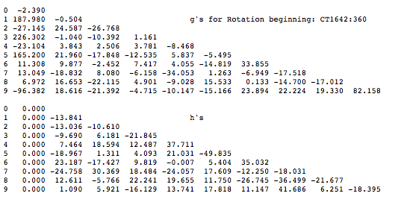
Harmonic Coefficients

Slide 9
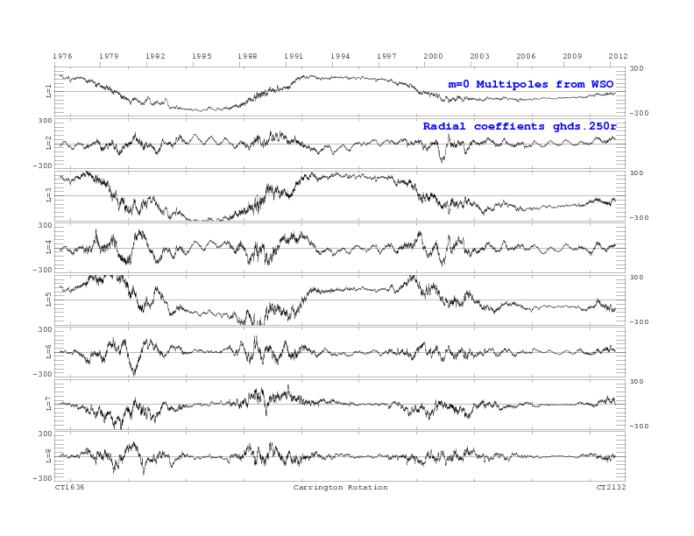
Axial Multipoles

Slide 10
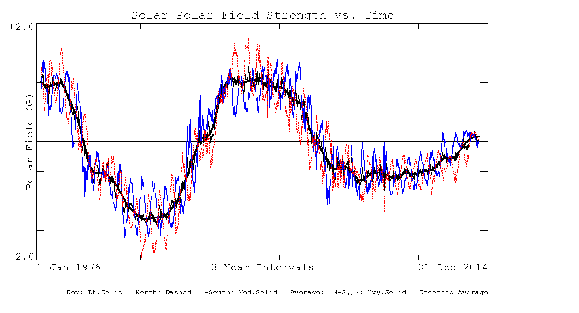
Polar Field Strength

Slide 11
Quadrupole Field Configurations
Axial quadrupole:
g_{2,0}, g_{2,1}, h_{2,1}
Tilt angle:
atan(g_{2,0}/sqrt(g_{2,1}²+h_{2,1}²))

Slide 12
Axial Dipole and Quadrupole Components

Slide 13
Dipole and Quadrupole Tilts

Slide 14
The Cause of the Solar Wind Asymmetry:
Axial Quadrupole

Slide 15
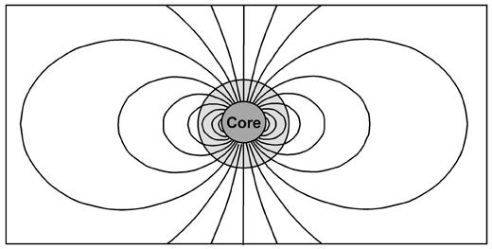
Superposition of a Positive Dipole Moment With a Negative Quadrupole Moment

Slide 16
Superposition of a Positive Dipole Moment With a Positive Quadrupole Moment

Slide 17
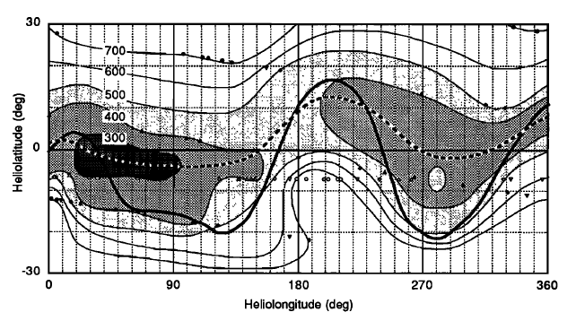
Solar Wind Speed Map in Early 1995
Crooker et al., 2007

Slide 18
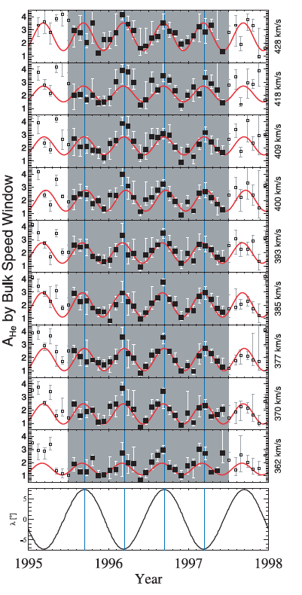
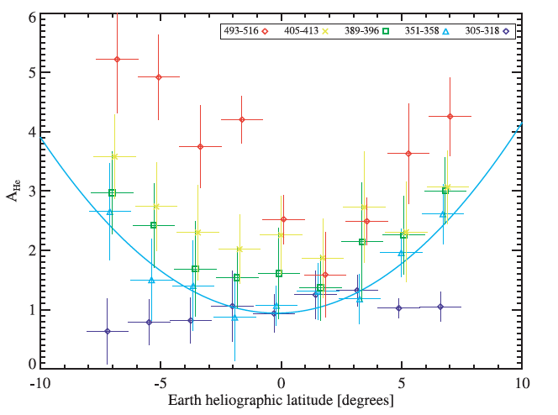
North-South Asymmetry in Helium Abundance
Kasper et al., 2007

Slide 19
Conclusions
  The latitudinal distribution of solar wind speed is asymmetric during solar minima.
  The north-south asymmetry shows a systematic 22-year pattern.
  The north-south asymmetry of solar wind speed is caused by the axial quadrupole component of the coronal magnetic field.
  The oscillation of the axial quadrupole component is equivalent with a north-south oscillation of the solar dynamo center.
  Cycle 24 is exeptional in that it brakes a century-long asymmetry pattern that has prevailed in the previous 7 cycles since 1930.
  The Sun is currently approaching a grand minimum.

