Slide 1
NEW ENGLAND SPACE SCIENCE CONSORTIUM
MEETING NO. 25
http://nessc.unh.edu/
LOC: David Webb, ISR, Boston College; david.webb@bc.edu
SOC: John Raymond, SAO/CFA; jraymond@cfa.harvard.edu
Nathan Schwadron n.schwadron@unh.edu
Chuck Smith Charles.Smith@unh.edu
Merav Opher mopher@bu.edu
Nick Murphy namurphy@cfa.harvard.edu
LOGISTICS
Parking
Laptops - Internet
Restrooms
Breaks / Cafeteria
Who needs to leave & when?

Slide 2
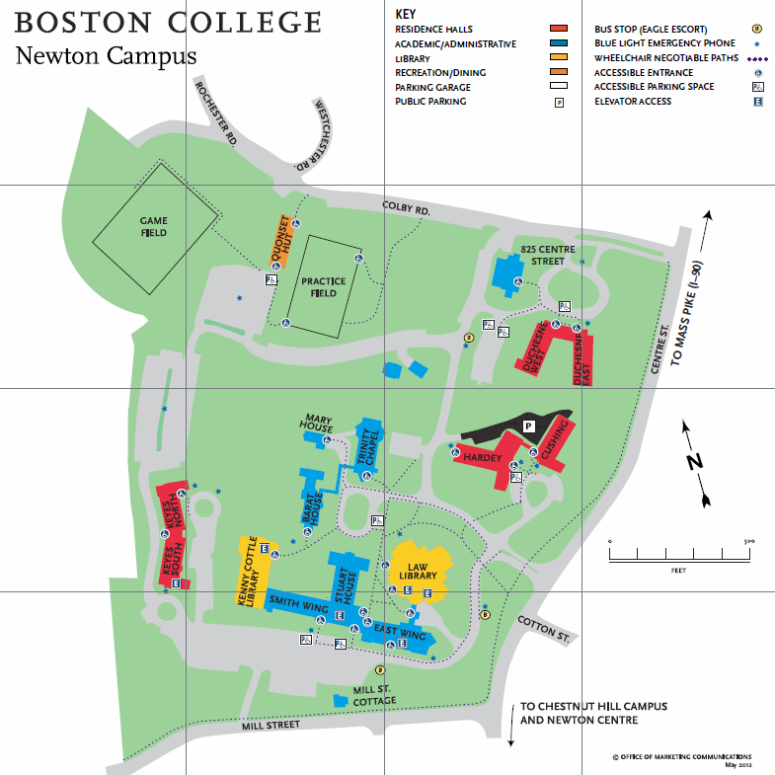
To visit ISR,
Rm. 106 or Rm. 204, follow purple instructions.
Guard’s Booth Turn left
Main Entrance off Centre St.
Enter here. Once inside open door on left and take stairs to the basement.
Park in white-lined spaces only. This lot is the closest. May park in any lot, but only in white-lined spaces.

Slide 3
NESSC Meeting Agenda; ISR, BC, Newton; April 17, 2014
~10:00 am: START
Ofer Cohen, CFA: "Solar Mass-loss and Radial IMF over the Last Three Solar Cycles"
Bertalan Zieger, BU: "North-south asymmetry in the solar wind during recent and past solar cycles"
Christina Kay, BU: "Implications of CME Deflection on the Fraction of ICMEs Observed as Magnetic Clouds"
Noe Lugaz, UNH: “New Views on Complex Events During SC24”
~12:30: LUNCH (nearby campus cafeteria)
Ken McCracken, University of Maryland: “Using the paleo-cosmic ray record to compare the solar activity during the sunspot minimum of 2006-9 with those during the Spoerer (1400-1540), Maunder (1645-1715), and Dalton (1790-1830) Minima”
Charles Smith, Nathan Schwadron, Ken McCracken and Molly Goelzer, UNH, "Solar Cycle Variation of the Heliospheric Magnetic Flux, Solar Wind Flux and Galactic Cosmic Rays".
Nathan Schwadron, UNH: “Weakest wind in the space age and comparison over centuries”
Nathan will also lead a discussion on the topic: “The Tipping Point: Avoiding Catastrophe for a New Generation of Solar and Space Physicists in an Era of Unparalleled Discovery”. This involves the recent decline in government funding for basic research and its effect on our community.
~4:00 pm: FINISH

