Slide 1
Observations and Magnetic Field Modeling of CMEs’ Source Regions
Yingna Su
Harvard-Smithsonian Center for Astrophysics
Collaborators: Adriaan van Ballegooijen, Bernhard Kliem, Vincent Surges, Edward Deluca, Leon Golub
Presentation at the NESSC Meeting on Oct 24, 2012, UNH, New Hampshire

Slide 2
Overview
Part I: Observations and modeling (Static and MHD) of an active region flare/CME event.
(Su et al. 2011, ApJ, 734, 53; Su et al. 2012, IAUs 294 submitted)
Part II: Observations and modeling of one eruptive polar crown prominence (Su et al. 2012b, ApJ, in preparation)

Slide 3
Part I: Observations and modeling (Static and MHD) of an active region flare/CME event. (Su et al. 2011, ApJ, 734, 53; Su et al. 2012, IAUs 294 submitted)

Slide 4
Observations of the Flare/CME Event
SDO/AIA 193
Time: 02:30 UT on Apr. 8, 2010
Location: AR 11060 (N25E16)
GOES B3.7 flare
CME: V=174km/s
Dimmings

Slide 5
Observations before the Event
Two sets of loops
Two filaments
Flux cancellations along the PIL

Slide 6
Flux Rope Insertion Method
Construct potential field model using an observed line-of-sight magnetogram.
Create a cavity, then insert a magnetic flux bundle along the selected filament path.
Allow the fields to relax using magneto-frictional relaxation, which leads to two possibilities:
1) The configuration reaches an equilibrium --NLFFF model.
2) The configuration erupts as a flare/CME – Unstable model.

Slide 7
Stability of the Model
Panels b-c: Stable; Panel d: Marginally Stable; Panels e-f: Unstable

Slide 8
Pre-flare NLFFF Model
The two free parameter, i.e., poloidal flux (twist) and axial flux (shear), are constrained by the observed non-potential loops.
The best-fit pre-flare model: axial flux =4e20 Mx, poloidal flux=1e10 Mx/cm. It contains a highly sheared and weakly twisted flux rope.

Slide 9
Model at the Event Onset
The unstable model (axi=6e20Mx, pol=1e10 Mx/cm) due to increase of axial flux closely matches the observations at the event onset.
The axial flux (4e20 Mx) in the best-fit pre-flare model is close to the threshold of instability (5e20 Mx).

Slide 10
Zero-beta MHD Simulations
Axi=4e20 Mx
Pol=1e10 Mx/cm
Stable Model
Axi=6e20 Mx
Pol=1e10 Mx/cm
Axi=6e20 Mx
Pol=1e10 Mx/cm
Unstable Model

Slide 11
Summary I
Our best-fit pre-flare NLFFF model (Axi=4e20 Mx, Pol=1e10 Mx/cm) contains a highly sheared and weakly twisted flux rope.
The axial flux of the flux rope in the best-fit pre-flare model is close to the threshold of instability (Axi=5e20 Mx).
The unstable model (Axi=6e20 Mx, Pol=1e10 Mx/cm) due to increase of axial flux closely matches the observations at the early phase of the flare.
All these results strongly support that this event may be due to the loss-of-equilibrium mechanism, which is caused by an increase of axial flux driven by the flux cancellations.
Using the aforementioned static models as initial conditions, the full 3D-MHD simulations confirm the statements that the best-fit flare model is stable, and the unstable model with axial flux of 6e20 Mx leads to a CME.
To Do: Further detailed comparisons of the CME observations and simulations.

Slide 12
Part II: Observations and modeling of one eruptive polar crown prominence (Su et al. 2012b, ApJ, in preparaition)

Slide 13
Polar Crown Prominence Eruption
On 2010 December 6 around 14:16 UT, filament in the active region core breaks apart.
Eruption of the quiescent filament
Eruption of the elevated active region filament
Several segments of the filament
CME speed: ~523 km/s

Slide 14
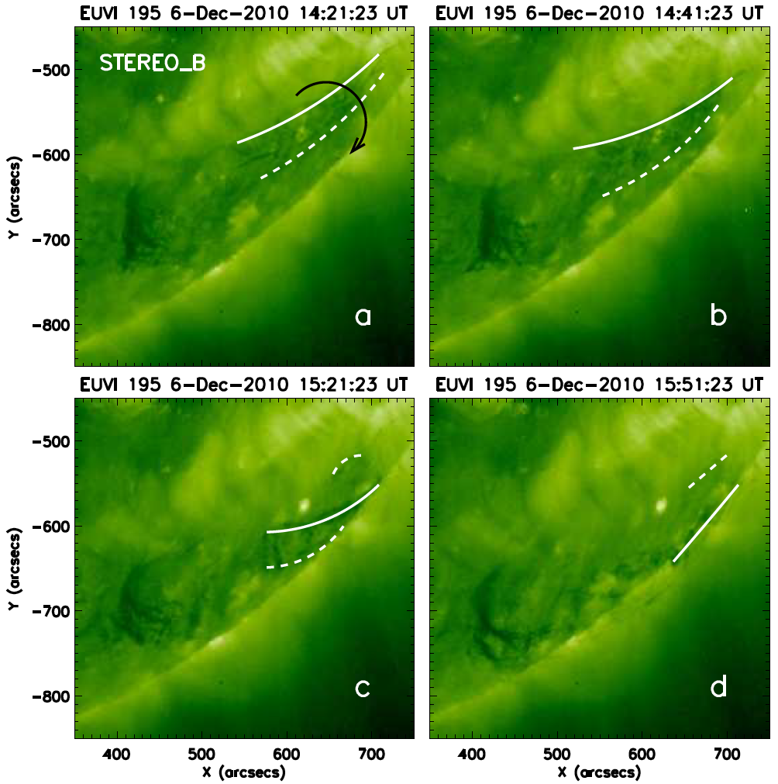
Rolling Motion: STEREO_B vs. Model
Observation: clockwise rolling motion around the filament axis
Model: Additional twist is injected to the flux rope from the west.
Prominence: discrete blobs---field lines---helical flux rope
Motion of blobs: equation of motion (gravity and friction)

Slide 15
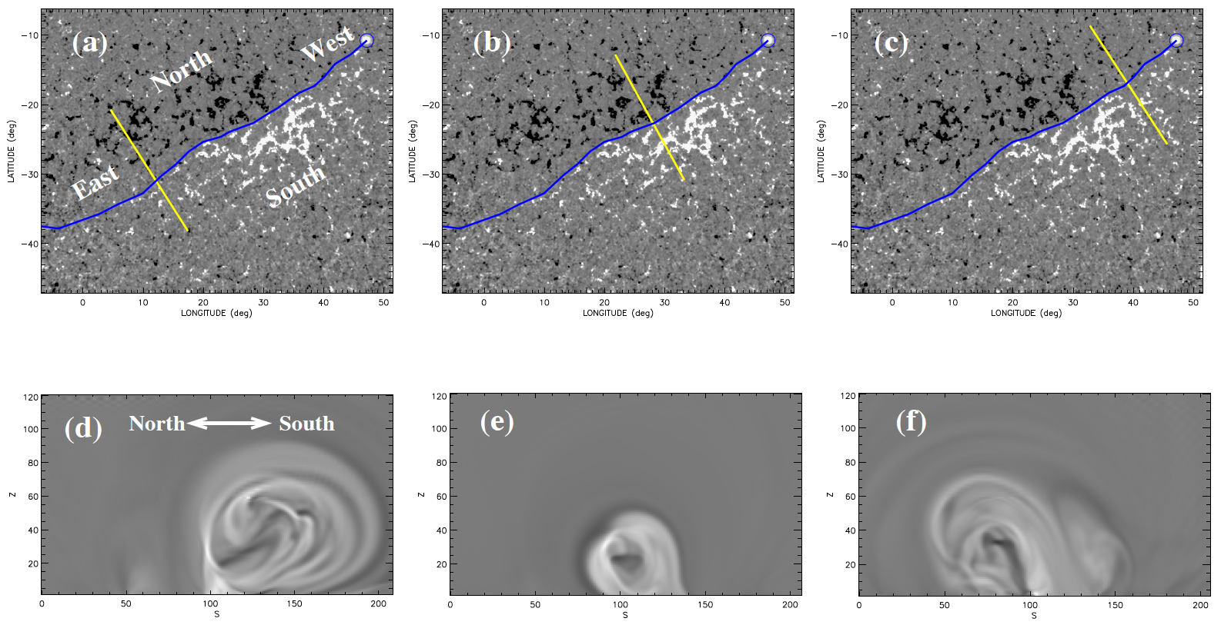
Asymmetric Current distribution

Slide 16
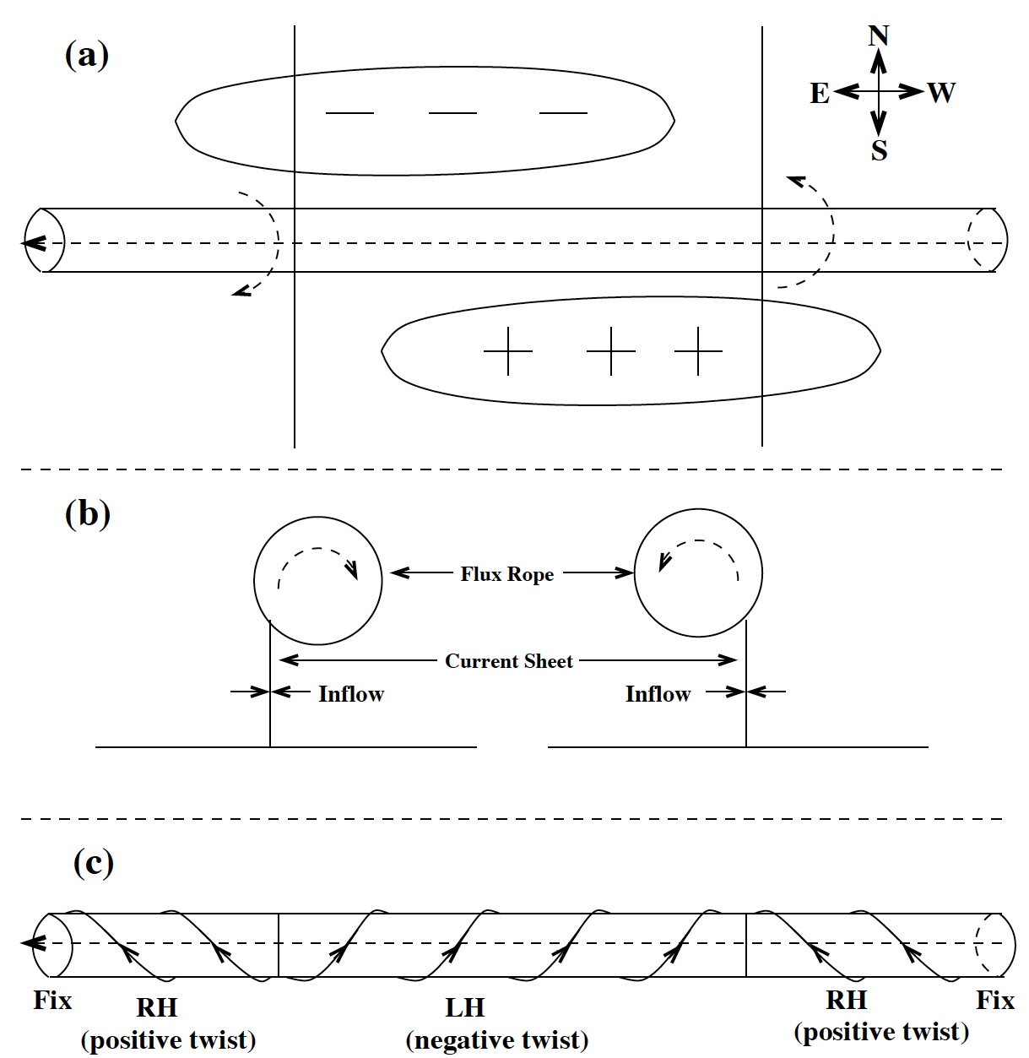
Asymmetric Reconnection
Murphy et al. 2012

Slide 17
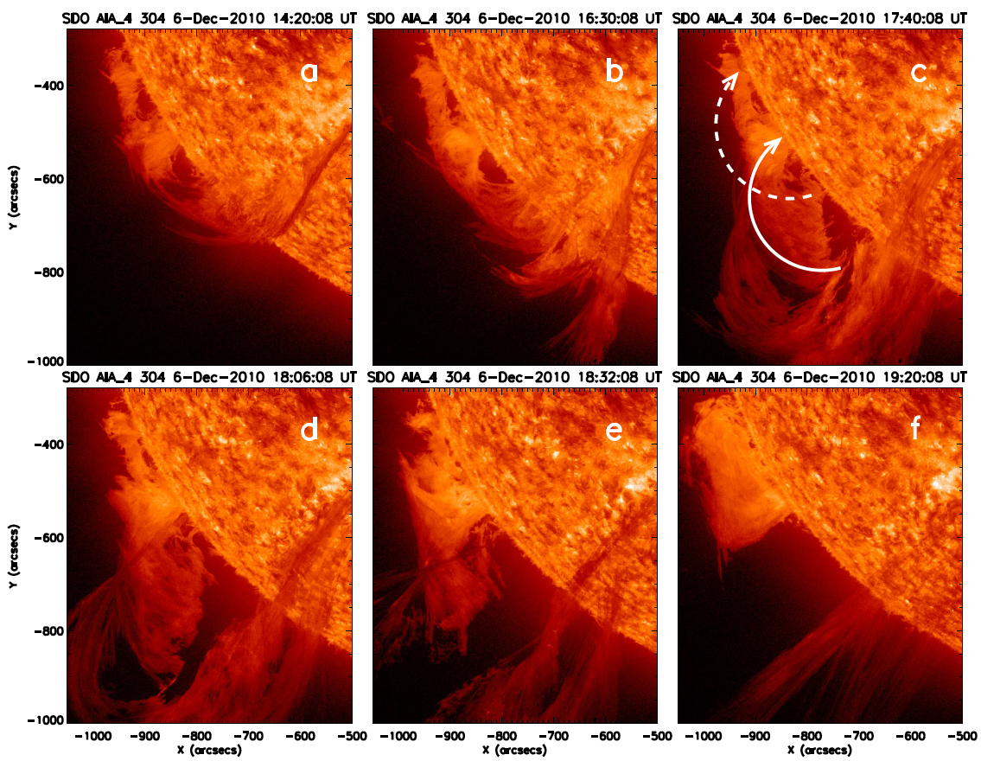
Rotating Motion: SDO vs. Model
Observations: rotational motion of vertical threads while falling down.
Model: removal of dips in the field lines from top down.

Slide 18
Summary II
Sideway eruption: begins in the active region core, then quiescent filament erupts, which is followed by the eruption of the AR filament.
The observed rolling motion around the filament axis is reproduced in our 3D model, which suggests twist injection. Kink instability?
The rolling motion may be caused by asymmetric reconnection.
Our model reproduced the observed rotational motion, which suggests removal of field line dips from top down.

Slide 19
Thank you!

Slide 20
MHD Simulations
Zero-beta MHD simulations using the static models constructed in Part I as initial conditions
Remove the flux imbalance
Static Model MHD simulation
Coordinate conversion
Spherical Coordinate
HIRES region: 43 (lon)x39(lat)
Resolution: 0.002Rsun
Domain: extends to 1Rsun
Side boundaries: Bn=0
Top boundaries: open field
Scaling factor: 1/16.97
Cartesian Coordinate
Domain: .72x.72x1 Rsun (41x41 degrees)
Closed top and side boundaries
Bz=const & U=0 in z=0
[Numerical diffusion params close to lower limits for num. stab.]

Slide 21
Position-time plot

Slide 22
Observations vs. Unstable Model

