Slide 1
Accelerating of Particles in Compression Regions in the Heliosphere , in the Heliosheath and in the Galaxy
George Gloeckler and Len Fisk
University of Michigan, Ann Arbor, MI
Implications of Interstellar Neutral Matter
Holloway Commons
Piscataqua Room
University of New Hampshire
November 16, 2011

Slide 2
Overview
Even during quiet times with few shocks present, the heliosphere contains some local compression regions that are effective in accelerating suprathermal particles
During active times compression regions which often but not always are accompanied by shocks accelerate particles (i.e. result in significantly increase the tail particle density)
In these local compression regions the observed spectra have the unmistakable common (F&G) shapes (-5 power laws with an exponential rollover at e-folding speed of (1.4-1.8)•10⁸ cm/s)
However, at lower tail densities, outside the local compression regions, where most of the hourly spectra are observed during quiet times, the spectral shapes are complex, a combination of pickup protons at the lowest energies and modulated spectra of remotely accelerated particles dominating the higher energies
As the tail densities increase, the spectra assume more and more the local F&G shape

Slide 3
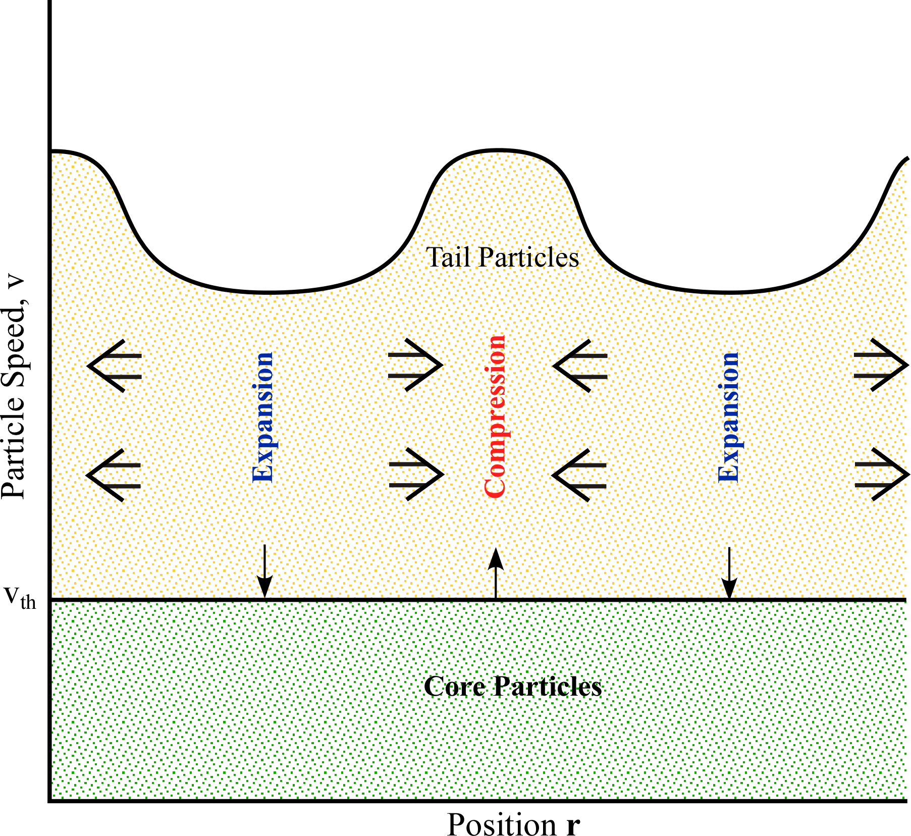
The Pump Mechanism — A new Acceleration Mechanism
The pump mechanism (driven by plasma turbulence) energizes particles (increases their energy) through a series of adiabatic compressions and expansions, in which the particles can escape from a compression region, or flow into an expansion region by spatial diffusion
The mechanism is a redistribution mechanism in which the energy in a low-energy, but hot (suprathermal) core particle population is redistributed to higher energies, without the damping of turbulence
The mechanism is shown to yield naturally a -5 spectrum independent of the plasma conditions
It contains a first-order acceleration that makes the mechanism particularly efficient and able to explain the observations of particles accelerated in compression regions often accompanied by shocks in the solar wind (Gloeckler & Fisk 2011)
It is NOT a stochastic acceleration mechanism
Tail
Particles
Particle speed v
Expansion
Expansion
Com-
pression
V_{th}
Core Particles
Position r
The pump mechanism extracts part of the energy from the core to create the GCRs, by moving some particles from the core to the tail without damping of the turbulence.

Slide 4



Governing Equation of Pump Acceleration Mechanism
See Fisk and Gloeckler, ApJ (in press)
The steady state equation for the distribution function f(p) of GCRs accelerated by the pumping mechanism in the interstellar medium is
The solution is
where is the mean square speed of the compressions and expansions,
is the value of f, and is the particle momentum where particles are injected into the acceleration mechanism, and
we take
r_{g}< l
For highly relativistic particles the rollover spectrum is a power law

Slide 5
Transformation to Solar Wind Frame
Start with velocity distribution F(V) (phase space density versus ion speed V in the spacecraft frame)
Compute power law spectral index, γ_{σχ−μ}, between any two adjacent points F(V_{m}) and
F(V_{m+1})
Find power law spectral index ιν τηε σολαρ ωινδ frame using blue curve γ_{σω−μ}= g(γ_{σχ−μ}|W_{m})
Find speed correction factor using red curve
ΔV = h(γ_{σω−μ}|W_{m})
Find speed in the solar wind frame, v_{m} = V_{m}-ΔV
Functions g and h are obtained applying an updated forward model for SWICS to isotripic power law spectra in the solar wind frame

Slide 6
Super Quiet Times

Slide 7
Conditions During Quiet Times
Solar Wind
Tail
Large increases in tail density (blue shaded regions) are associated with compression regions (rapid increases in solar wind speed, temperature or thermal speed and often solar wind density)
Shocks (thin vertical lines) that are not associated with significant compression regions produce at best small or no tail density increases, i.e. provide at best modest or no particle acceleration

Slide 8
Solar Wind Frame Velocity Distributions in 2009
Solar wind frame velocity distributions, assumed to be isotropic, as a function of particle speed
Left panel: one-hour averaged spectrum starting on DOY 24.83 during the highest, and a 19-hour averaged spectrum starting on DOY 15.13 during the lowest observed tail density in the first 82 days of 2009
Right panel: average of individual 1-hour spectra selected according to tail densities, n_{tail}: >3•10⁻⁴ cm⁻³ (diamonds), 1•10⁻⁴ < n_{tail} < 3•10⁻⁴ cm⁻³ (triangles), 3•10⁻⁵ < n_{tail} < 1•10⁻⁴ cm⁻³ (squares), and 1•10⁻⁷ < n_{tail} < 3•10⁻⁵ cm⁻³ (circles). Fits of the form f(v ) = f_{o}v^{–γ}εξπ(-(v/v_{o})^{α} to the visible portions of the local spectra (i.e. in speed range contained in the upper shaded region) give γ values of 4.95±0.013, 4.95±0.043, 5.06±0.03 and 5.01±0.04 for spectra shown by diamonds, triangles, squares and circles respectively. In each case v_{o} is fixed at 1.1•10⁸ cm/s, and α, the sharpness of the cutoff, at 1.5.

Slide 9
Super Disturbed Times

Slide 10
Hourly Values of Solar wind and Tail Parameters in 2001
Upper panel: Hourly values and uncertainties of spectral power law indices γ ₃₋₈ and tail density of suprathermal tails. This data product will be provided to the ACE Data Center for the entire mission (through July 2011)
Lower panel: Same as above but with addition of hourly values of solar wind bulk and thermal speed. Sixty shocks were recorded during this time period.

Slide 11
Hourly Values of Solar wind and Tail Parameters in 2001
Many major acceleration events (large increases in tail density) are associated with shocks
A smaller number, including the largest events (DOY 270 and 310), are not associated with shocks

Slide 12
Hourly Values of Solar wind and Tail Parameters during a three day time period
Upstream: γ values greater than -5 (e.g. -2 to -4) indicate that higher energy particles escape from the high tail-density acceleration region faster than lower energy particles
Before shock arrival the solar wind bulk speed and especially the thermal speed increase over period of hours
Downstream: As the tail density and the solar wind bulk and thermal speed gradually decrease, γ values lock in close to -5 and remain there for many hours

Slide 13
Classification of Tail Density and γ ₃₋₈ Profiles at 60 Shock in 2001
Type I |  | Type II
Tail density has local maximum within one hour of shock passage 40 cases |  | Tail density is flat hours before and after shock passage or has local minimum at shock passage (no acceleration) 20 cases
A 19 cases | γ₃₋₈ is between -4.8 and -5.2 at or within one hour of shock passage
B 13 cases | γ₃₋₈ is greater than -4.8 (e.g. -4) at or within one hour of shock passage
C 8 cases | γ₃₋₈ is less than -5.2 (e.g. -7) at or within one hour of shock passage

Slide 14
Hourly Values of Solar Wind and Tail Parameters Around Individual Type I Shocks
A
B
C
A
B
C
A
B
Shock compression ratios, r, and θ_{bn} range from ~1 to close to 4, and quasi-parallel to quasi-perpendicular respectively

Slide 15
Hourly Values of Solar Wind and Tail Parameters Around Individual Shocks
r ≈ 1
θ = 269, 135
Type II Profiles
Tail density is flat hours before and after shock passage or has a local minimum at shock passage
r = 2.55±0.25
r ≈ 1
θ = 66±5
θ = 176

Slide 16
Classification of Tail Density and γ ₃₋₈ Profiles at 60 Shock in 2001
Type I |  | Type II
Tail density has local maximum within one hour of shock passage 40 cases |  | Tail density is flat hours before and after shock passage or has local minimum at shock passage (no acceleration) 20 cases
A 19 cases | γ₃₋₈ is between -4.8 and -5.2 at or within one hour of shock passage
B 13 cases | γ₃₋₈ is greater than -4.8 (e.g. -3) at or within one hour of shock passage
C 8 cases | γ₃₋₈ is less than -5.2 (e.g. -7) at or within one hour of shock passage

Slide 17
Dependence of γ ₃₋₈ on shock compression ratio and θ_{bn}
No obvious ordering of data or functional dependence (e.g. around blue curve which shows the predicted dependence of standard diffusive shock theory) of γ ₃₋₈ on either the compression ratio or θ_{bn}

Slide 18
Classification of Tail Density and γ ₃₋₈ Profiles at 60 Shock in 2001
Type I |  | Type II
Tail density has local maximum within one hour of shock passage 40 cases |  | Tail density is flat hours before and after shock passage or has local minimum at shock passage (no acceleration) 20 cases
A 19 cases | γ₃₋₈ is between -4.8 and -5.2 at or within one hour of shock passage
B 13 cases | γ₃₋₈ is less than -5.2 at or within one hour of shock passage
C 8 cases | γ₃₋₈ is greater than -4.8 at or within one hour of shock passage

Slide 19
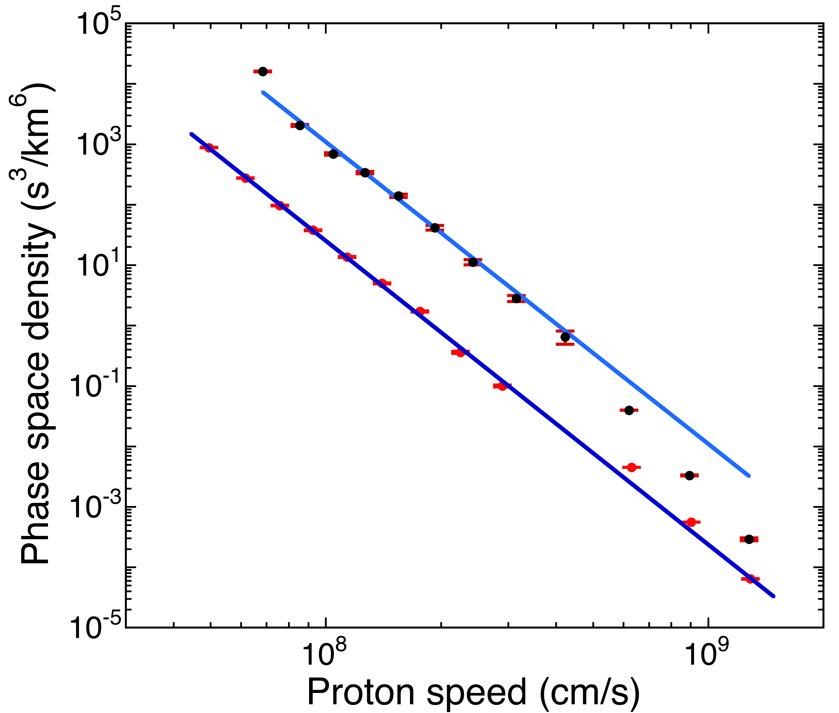
Sample Velocity Distributions during 2001
One-hour spectrum at shock
r = 2.92±43
θ = 95±6
DOY 196-250
Tail densities between 0.0001 and 0.001 cm⁻³

Slide 20
Double -5 Velocity Distributions during 2001

Slide 21
Summary and Conclusions (Quiet Times)
Suprathermal proton tails at 1 AU are observed during every hour (except for data gaps)
Hourly values of the tail densities range from ~5•10⁻⁷ to ~0.9 cm⁻³ and during super quiet times vary quasi-randomly by factors of ~2 to 10 over periods of one to several hours as well as quasi-periodically by ~20 to 50 over roughly a week

Slide 22
Summary and Conclusions (Quiet Times)
Suprathermal proton tails at 1 AU are observed during every hour (except for data gaps)
Hourly values of the tail densities range from ~5•10⁻⁷ to ~0.9 cm⁻³ and during super quiet times vary quasi-randomly by factors of ~2 to 10 over periods of one to several hours as well as quasi-periodically by ~20 to 50 over roughly a week
Most (~95% during quiet times) of the hourly spectra are not power laws, not exponential and not Maxwellians, but multi-component, complex spectra

Slide 23
Summary and Conclusions (Quiet Times)
Suprathermal proton tails at 1 AU are observed during every hour (except for data gaps)
Hourly values of the tail densities range from ~5•10⁻⁷ to ~0.9 cm⁻³ and during super quiet times vary quasi-randomly by factors of ~2 to 10 over periods of one to several hours as well as quasi-periodically by ~20 to 50 over roughly a week
Most (~95% during quiet times) of the hourly spectra are not power laws, not exponential and not Maxwellians, but multi-component, complex spectra
in cases of high tail densities (greater than 10^{‑4} cm⁻³) the tail spectra take on the common (F&G) shapes (-5 power laws with exponential rollovers at some higher speed)

Slide 24
Summary and Conclusions (Quiet Times)
Suprathermal proton tails at 1 AU are observed during every hour (except for data gaps)
Hourly values of the tail densities range from ~5•10⁻⁷ to ~0.9 cm⁻³ and during super quiet times vary quasi-randomly by factors of ~2 to 10 over periods of one to several hours as well as quasi-periodically by ~20 to 50 over roughly a week
Most (~95% during quiet times) of the hourly spectra are not power laws, not exponential and not Maxwellians, but multi-component, complex spectra
in cases of high tail densities (greater than 10^{‑4} cm⁻³) the tail spectra take on the common (F&G) shapes (-5 power laws with exponential rollovers at some higher speed)
Acceleration events (significant increases in tail density) are associated with solar wind compression regions and often occur in the absence of locally recorded shocks
None of the 8 shocks recorded locally outside the local compression regions during the 82-day quiet period increased the hourly tail densities significantly nor left any consistent signatures on γ.

Slide 25
Summary and Conclusions (Active Times)
Suprathermal proton tails at 1 AU are observed during every hour (except for data gaps)
Hourly values of the tail densities range from ~1.5•10⁻⁶ to ~0.9 cm⁻³ and relatively quiet times vary quasi-randomly by factors of ~2 to 10 over periods of one to several hours and have profiles similar to the solar wind bulk and thermal speeds over period of days to weeks
Acceleration events (significant increases in tail density) are associated with solar wind compression regions and are often observed to occur in the absence of locally recorded shocks
At the peaks of acceleration events (high tail densities the tail spectra take on the common (F&G) shapes (-5 power laws with exponential rollovers at some higher speed)
There is now obvious ordering or dependence of γ ₃₋₈ on the shock compression ratio or θ_{bn}
Of the 60 locally observed shock, 20 produced no obvious increases in the tail density
Of the 40 shocks that caused acceleration, 19 had power indices, γ ₃₋₈ = -5±0.2 at or within one hour of the peak densities that persisted downstream for hour to days

Slide 26
Conclusions
The common spectral shape is observed consistently in local compression regions as well as at all other times in more limited speed ranges when other spectral features become visible at the lowest and highest energies
This provides strong support for the Fisk and Gloeckler pumping mechanism for producing suprathermal tails
These tails, created in the quiet solar wind, are the seed spectra for further acceleration in stronger compression regions and shocks in the heliosphere, in the turbulent solar wind downstream of these shocks, by the termination shock and in the heliosheath producing the ACRs
The F&G pumping mechanism has recently been successfully applied to the long standing problem of Galactic Cosmic Rays acceleration, predicting the energy of the knee at ~8×10¹⁵ eV in the differential energy spectrum, the power law index of ~-2.7 below the knee and ~-3 above the knee and the rigidity dependence of the H/He ratio (Fisk and Gloeckler, ApJ, in press)

Slide 27
Anomalous Cosmic Rays

Slide 28
Heliosheath Proton Spectrum at Different Distances in the Heliosheath
Model differential intensities for four heliosheath proton populations as would be measured with a large field-of-view particle detector in the heliosheath
near the termination shock at ~91 AU (solid curve)
in the transition region
with high turbulence δu²
at ~140 AU (dashed curve)
near the heliopause at ~148 AU dotted curve)
Local Tail at 110 AU (blue circles, V-1)
Modulated ACRs at 104 AU (red circles, V-1 CRS)
GCRs are not shown
Populations (b) and (c) are
not measured by Voyagers.
Steady state model

Slide 29
Acceleration of Galactic Cosmic Rays by the F&G Pumping Mechanism
Brief Summary of
Fisk and Gloeckler, Astrophys. J. (in press)

Slide 30
Overview
In its simplest form, diffusive shock acceleration as the mechanism to produce GCRs
is faced with a number of challenges (e.g., Butt 2009)
Isolated, large supernovae remnants may be too rare, introduce anisotropies not observed
Supernovae remnants may not be sufficiently large nor have sufficient energy to accelerate very high-energy GCRs that have gyroradii larger than the supernovae shock (e.g., Lagange & Cesarsky 1983).
Recent observations from the PAMELA satellite instrument have revealed structure in the GCR spectrum in the magnetic rigidity range between 5 and 1000 GV that appears to be inconsistent with the expected spectra from diffusive shock acceleration (Adriani et al. 2011)
We have applied the pump mechanism to the acceleration of Anomalous and Galactic Cosmic Rays
With relatively straightforward assumptions about the magnetic field in the interstellar medium, and how GCRs propagate in this field, the pump mechanism yields
The overall shape of the GCR spectrum, a power law in particle kinetic energy, with a break at the so-called “knee” in the GCR spectrum to a slightly steeper power law spectrum
The rigidity dependence of the H/He ratio observed from the PAMELA satellite instrument

Slide 31
Conditions Required for the Pump Acceleration Mechanism
We require a suprathermal core distribution of particles, which contains sufficient energy to be redistributed and account for the energy in the GCRs
The core particle population that we invoke is the hot (>10⁶ K), low density (<0.01 cm⁻³) thermal plasma in superbubbles (e.g., Chu 2007)
Superbubbles appear to be expanding and thus have a pressure in excess of the average pressure in the interstellar medium, in excess of the ~1 eV cm⁻³ in GCRs
The thermal speeds of the hot plasma should readily allow the particles to be injected into the pump mechanism
The low plasma density will not result in significant ionization losses.
We also require that there be large-scale compressions and expansions of the plasma
The subsonic interstellar medium might readily contain such compressions and expansions

Slide 32
Assumptions and Expectations
We assume that particles accelerated by the pump mechanism in superbubbles then spread into surrounding denser regions
Because low-energy particles suffer ionization losses in these denser regions only particles with energies above several hundred MeV/nucleon, which should suffer negligible ionization losses (e.g. Gloeckler & Jokipii, 1967), can be expected to spread from the superbubbles into the surrounding Galaxy
At these higher energies the particles should spread roughly uniformly throughout the Galaxy, and then continue to be accelerated to higher energies throughout the entire Galaxy

Slide 33




Solution for the Differential Intensity of GCRs
Since the differential intensity j = p²f, for relativistic particles with kinetic energy T=cp
where for gyroradii r_{g}< l
For particles with gyroradii r_{g}> l that are also highly relativistic
where for gyroradii r_{g}> l
differs from by

Slide 34




Location of the Spectral Break and values of Power Law Indices
For the characteristic diameter l of our compression and expansion regions we take the spatial scale of 3.5 pc observed for interstellar turbulence changes (Minter & Spangler 1996; Minter 1999)
With l = 3.5 pc and an average magnetic field strength in the interstellar medium of 2 μG the break in GCR differential energy spectrum, j, for and that for the coincides with the location of the knee in the GCR spectrum at
~8×10¹⁵ eV
The observed escape lifetime for mildly relativistic particles is τ_{esc}~15 My (4.5×10¹⁴ s) (Mewaldt et al. 2001).
Using , in units of [pc/(km/s)]
If much of the acceleration occurs in superbubbles with their large thermal speeds, appropriate values for R_{g} and δu may be 300 pc and 45 km/s, respectively, and the resulting value of
β is 0.67, and of β’ = β = 1.19
Other combinations of R_{g} and δu are clearly possible.
r_{g}< l
r_{g}> l

Slide 35
Predicted and Observed GCR Spectrum
Predicted spectral break (knee) at
~8×10¹⁵ eV
Predicted power index
below the knee
-2.67
Predicted power index
above the knee
-3.19

Slide 36

Rigidity Dependence of H/He and GCR Modulation
(Adriani et al. 2011).
Predicted H/He ratio in the rigidity range from 5 to 200 GV, with a = -0.3, b = 1.3, and τ_{max} set equal to the acceleration time of a 200 GV proton (blue curve)
The rigidity dependence of the predicted H/He ratio provides a good fit to the PAMELA observations
Using the rigidity integral modifies the GCR but only noticeably at energies below ~5 GeV, where modulation by the solar wind is important
This modification is important for determining the level of modulation, e.g. how much modulation still lies beyond the Voyager spacecraft
Note that with this choice for a and b, the crossover between where there is an external source of the local GCRs and where there is escape of the local GCRs occurs at a few GV

Slide 37
GCR Composition and Gamma Ray Emission
The composition of the GCRs accelerated by the pump mechanism will reflect the
composition of the core particles, and thus should reflect the composition of superbubbles, consistent with observations
observed composition of GCRs indicates that particles are accelerated from well-mixed interstellar material and do not reflect the elemental anomalies of recent SNRs e.g., Wiedenbeck et al. (2001)
isotopic anomalies in GCRs are consistent with particles being preferentially accelerated in superbubbles, Binns et al. (2007)
Spatial variations in the acceleration of GCRs in the Galaxy by the pump mechanism are expected, just as observed in the heliosphere
In the solar wind, the pump mechanism is particularly effective immediately downstream from shocks, where the core population is heated crossing the shock and there is ample compressive turbulence (Gloeckler & Fisk 2011)
The pump mechanism should also be particularly effective immediately downstream from supernovae shocks, and provide there enhancements in the GCR intensity and thus in gamma-ray emission from such locations
Recent observations by the NASA Fermi Gamma-Ray Space Telescope (e.g., Abdo et al. 2011) are consistent with this prediction

Slide 38
Acceleration of GCR Electrons
The pump mechanism for accelerating GCRs should work on electrons equally well as it does on ions
The low-energy (<1-2 GeV) GCR electron spectrum can be determined from the non-thermal radio background (Goldstein et al. 1970) and is often used to estimate the extent to which cosmic rays are modulated by the solar wind (e.g. Webber & Higbie 2008)
The inferred low-energy GCR electron spectrum is consistent with j ∝T ⁻²
If electrons behave as do ions of the same speed, v, we would expect that the low-energy GCR electron spectrum is j ∝T ^{−2.67}
However, if electrons, with their much smaller gyroradii, are unable to effectively cross-field diffuse and escape from the galaxy, then the low-energy GCR electron spectrum should be the required j ∝T ⁻²

Slide 39
END

Slide 40
Hourly Values of Solar Wind and Tail Parameters Around Individual Shocks
r = 3.4±3.3
θ = 156±23
Type IA Profiles
Tail density has a local maximum within one hour of shock passage and γ ₃₋₈ is between -4.8 and -5.2
While shock parameters range from
~1 < r < ~3 and 10° < θ < 160°, the power law spectral indices are at or very close -5 at or within one hour of shock passage and remain close to -5 for 0 to tens of hours thereafter
Shock compression ratios, r, and θ_{bn} range from ~1 to close to 4, and quasi-parallel quasi-perpendicular respectively
r = 2.92±43
θ = 95±6
r = 3.09±0.18
r ≈ 1
θ = 12±5
θ = 92±2

Slide 41
Hourly Values of Solar Wind and Tail Parameters Around Individual Shocks
r = 1.8±0.3
θ = 48±10
Type IB Profiles
Tail density has a local maximum within one hour of shock passage and γ ₃₋₈ is less than -5.2 at or within one hour of shock passage
Upstream: γ values are at or less than -5 (e.g. -6 to -8)
No obvious changes in γ ₃₋₈ at shock passage
Tail density increases modestly or remains flat within one hour of shock passage
Generally weaker shocks
r = 1.7±0.4
θ = 50±30
r = 1.5±0.5
r = 2.8±0.5
r ≈ 1
θ = 30±5
θ = 87±2
θ = 2±9

Slide 42
Hourly Values of Solar Wind and Tail Parameters Around Individual Shocks
r = 2.4±0.2
θ = 30±4
Type IC Profiles
Tail density has a local maximum within one hour of shock passage and γ ₃₋₈ is greater than -4.8 at or within one hour of shock passage
Upstream: γ ₃₋₈ values are greater than than -5 (e.g. -3 to -4)
r = 3.9±0.8
θ = 56±20

Slide 43
Dependence of γ ₃₋₈ on shock compression ratio and θ_{bn}
Red and blue symbols represent 2 different estimates of θ_{bn}
No obvious ordering of data or functional dependence (e.g. around blue curve which show the predicted dependence of standard diffusive shock theory) of γ ₃₋₈ on either the compression ratio or θ_{bn}

