Slide 1
Messenger Observations Inside 1 AU of Low-Frequency Magnetic Waves due to Inner Source Pickup Protons
Charles W. Smith, Matthew R. Argall, Nathan A. Schwadron, Colin J. Joyce, Philip A. Isenberg, Bernard J. Vasquez, Haje Korth, and Brian Anderson
Fall AGU Abstract #SH54A-07.

Slide 2
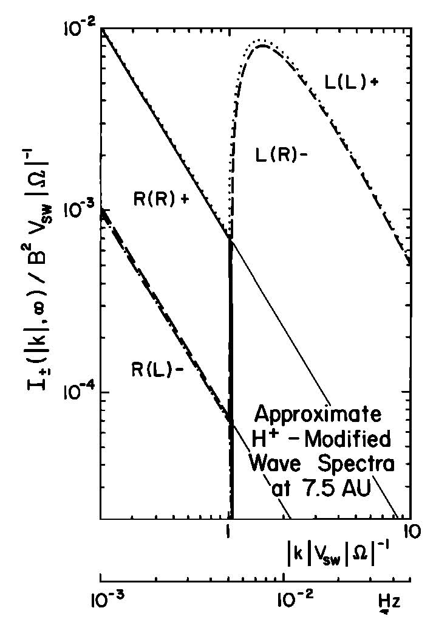
Lee & Ip, JGR, 92, 11041, 1987.
Neutral atoms have virtually no motion relative to the Sun. Their motion through the solar wind is the solar wind speed.
Once ionized, this motion is converted into streaming along the IMF and cyclotron motion about the IMF according to the local field orientation.
Resonance produces left-hand wave energy at the cyclotron frequency in the spacecraft frame.
Particle scattering produces waves at higher frequencies.
Unable to produce lower frequency waves without particle energization.

Slide 3
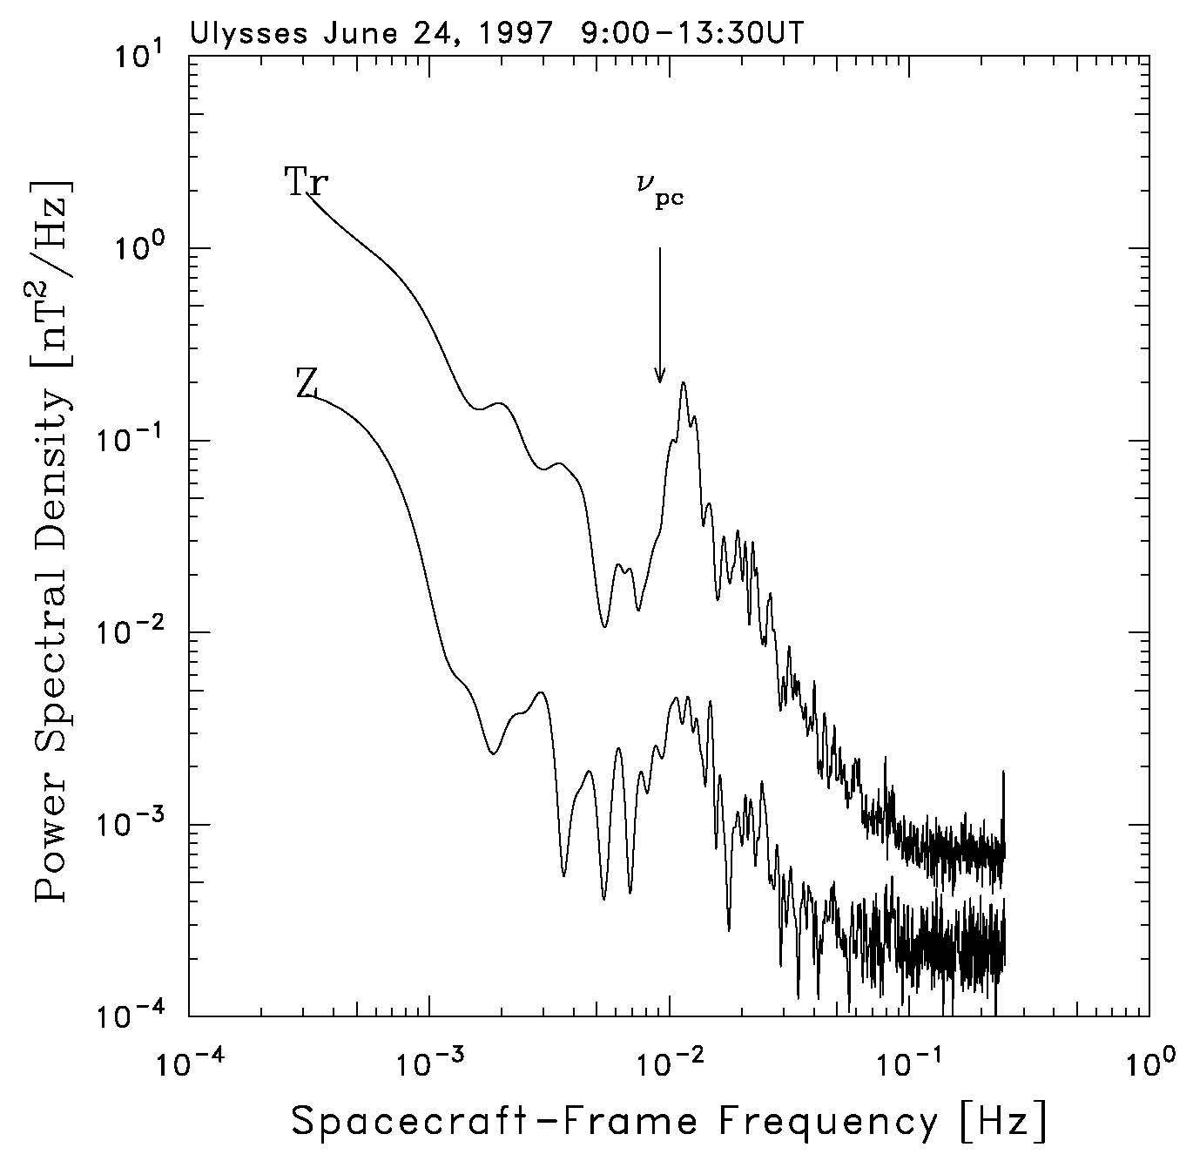
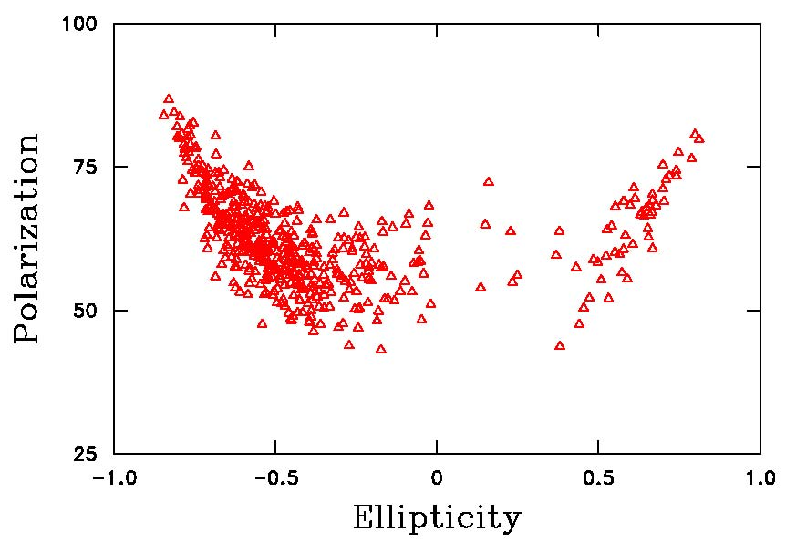
Cannon et al., ApJ, 784, 150, 2014 Cannon et al., ApJ, 787, 133, 2014
Waves appear at spacecraft frame frequencies slightly greater than the cyclotron frequency of the associated particle species.
They should be transverse, Sunward propagating, and left-hand polarized in the spacecraft frame.

Slide 4
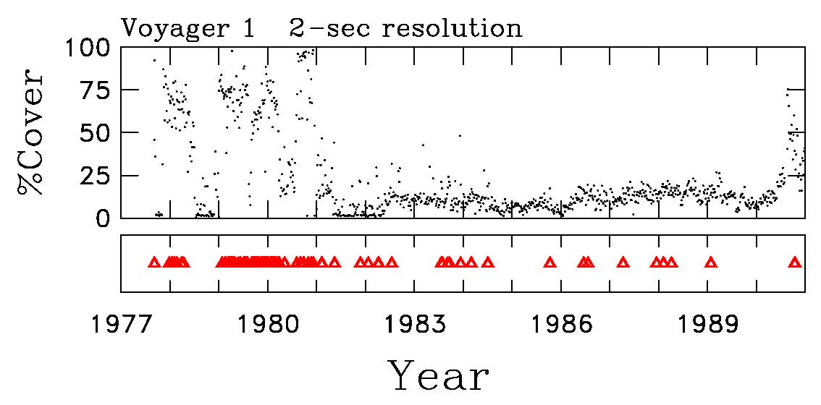
Hollick et al.: A Return to Voyager
43.5 AU
Presently studying 637 wave events in Voy1 and Voy2 through 1990.

Slide 5
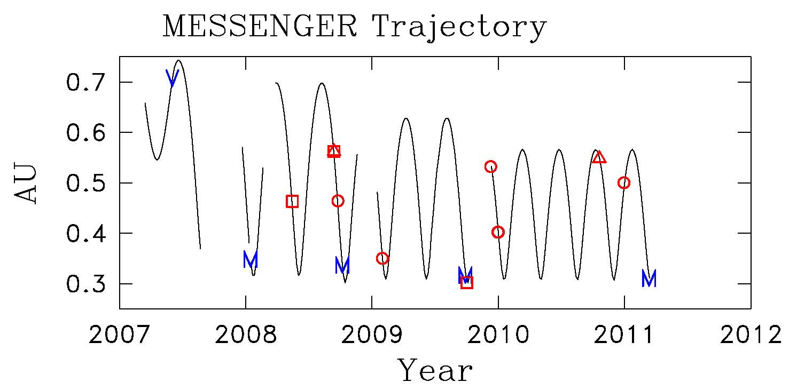
Beware the Planetary Flybys!
Only 1 event is found close to Mercury and the rest are far removed from either Mercury or Venus.
-----------------------------------------------------------------------------------------
Phase Start Date End Date Flyby Date
-----------------------------------------------------------------------------------------
Venus 2 Flyby 2007-05-23 2007-06-20 2007-06-06 (157)
Mercury 1 Flyby 2007-12-31 2008-01-28 2008-01-14 (014)
Mercury 2 Flyby 2008-09-22 2008-10-20 2008-10-06 (280)
Mercury 3 Flyby 2009-09-16 2009-10-14 2009-10-01 (274)
Mercury Orbit 2011-03-04 2011-03-18

Slide 6
Technique is to Make Daily Spectrograms:
We bulk-process 4 years of Messenger Magnetic Field data making daily spectrograms at ion cyclotron scales that include polarization.
We had 7 high school students in this summer’s Project SMART who needed a project.
We had a “Messenger Treasure Hunt”.
Available interplanetary data was 11 March 2007 to 17 March 2011.
Four years of data largely free of planetary contamination.
We concentrated on wave activity at kinetic (ion cyclotron) scales.
We expected to find a few events due to interstellar He⁺.
We found none.
We found very few shocks.
We did not expect what we did find.

Slide 7
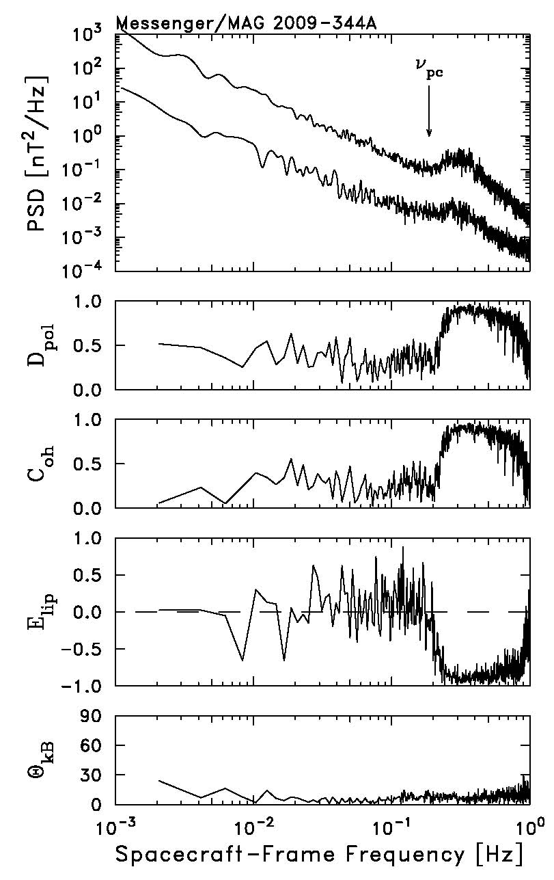
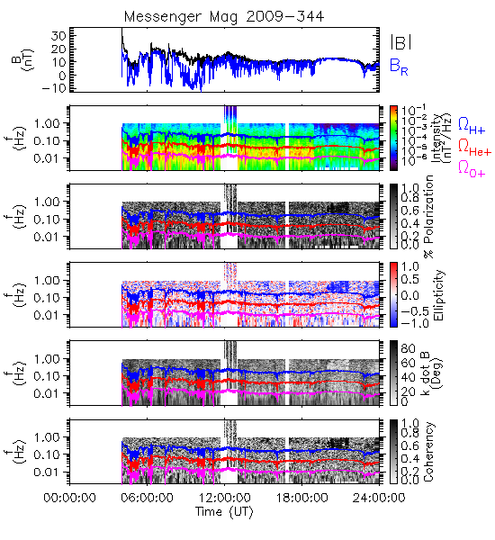
Left-Hand Example: 2009/344
70 days from Mercury

Slide 8
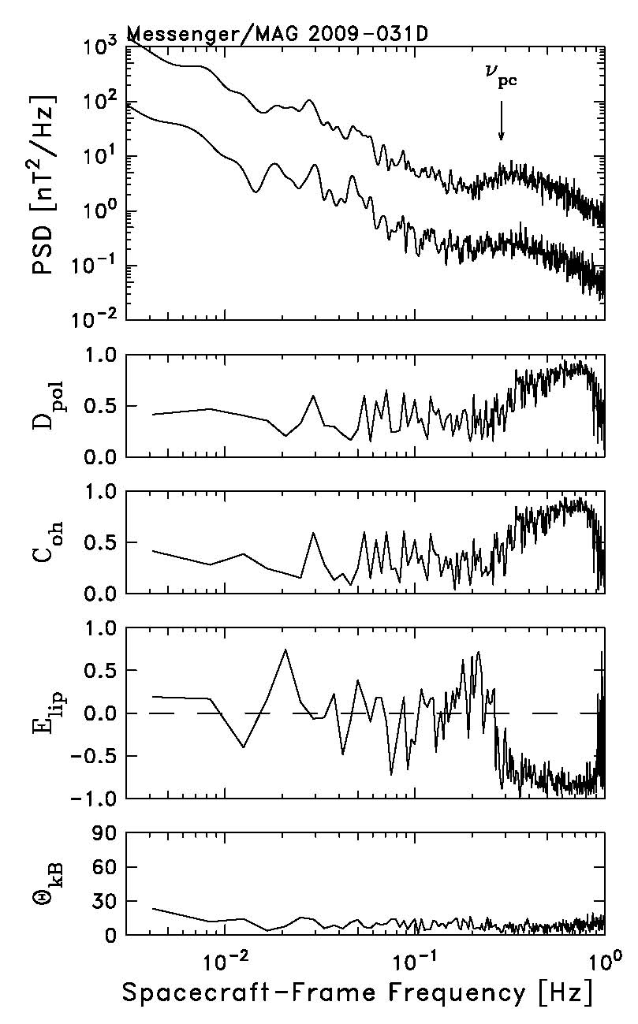
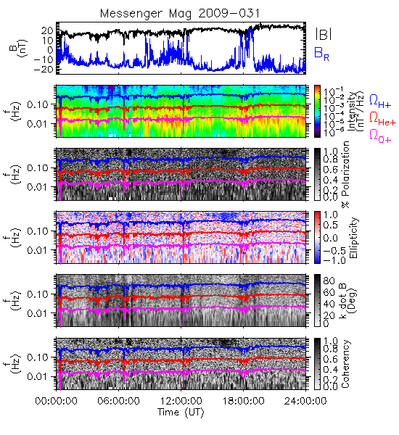
Left-Hand Example: 2009/031
115 days from Mercury

Slide 9
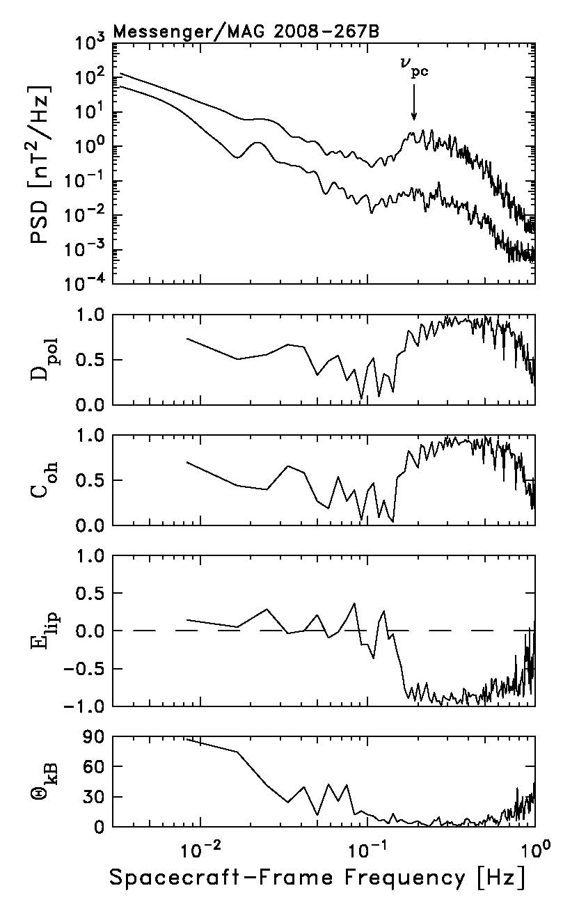
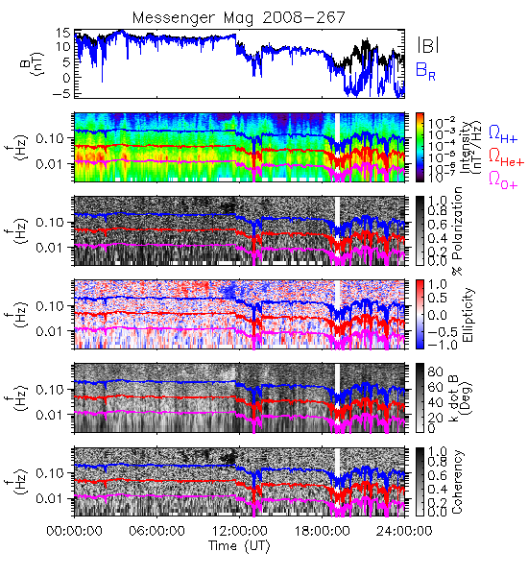
Another Example: 2008/267
13 days from Mercury

Slide 10
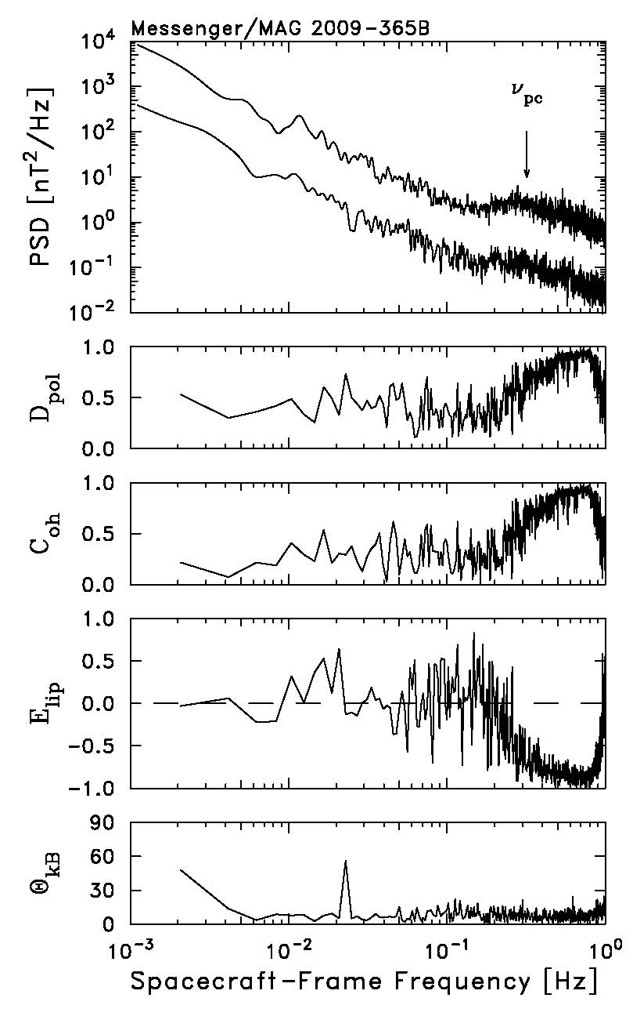
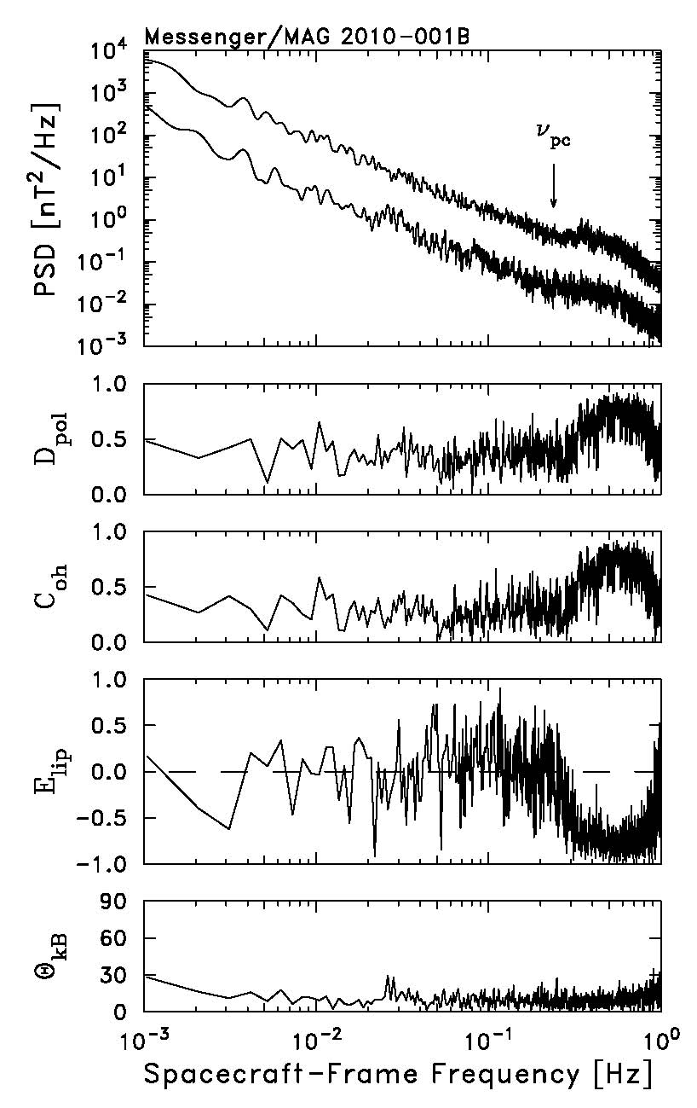
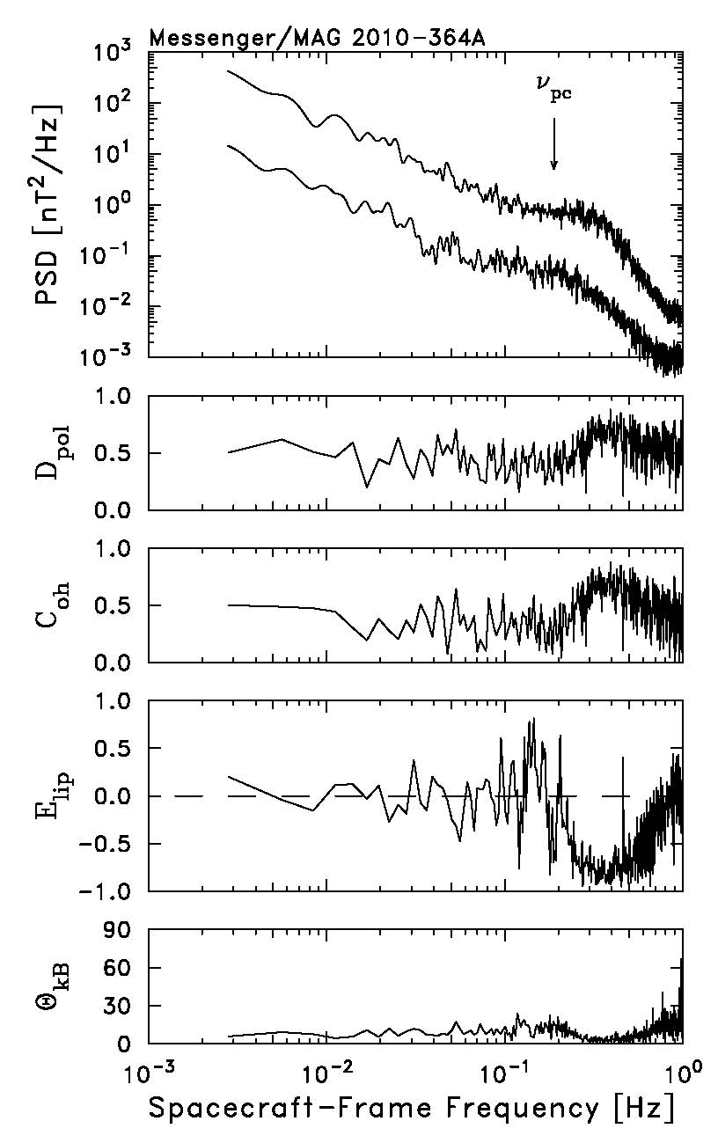
91 days from Mercury
92 days from Mercury
78 days from Mercury

Slide 11
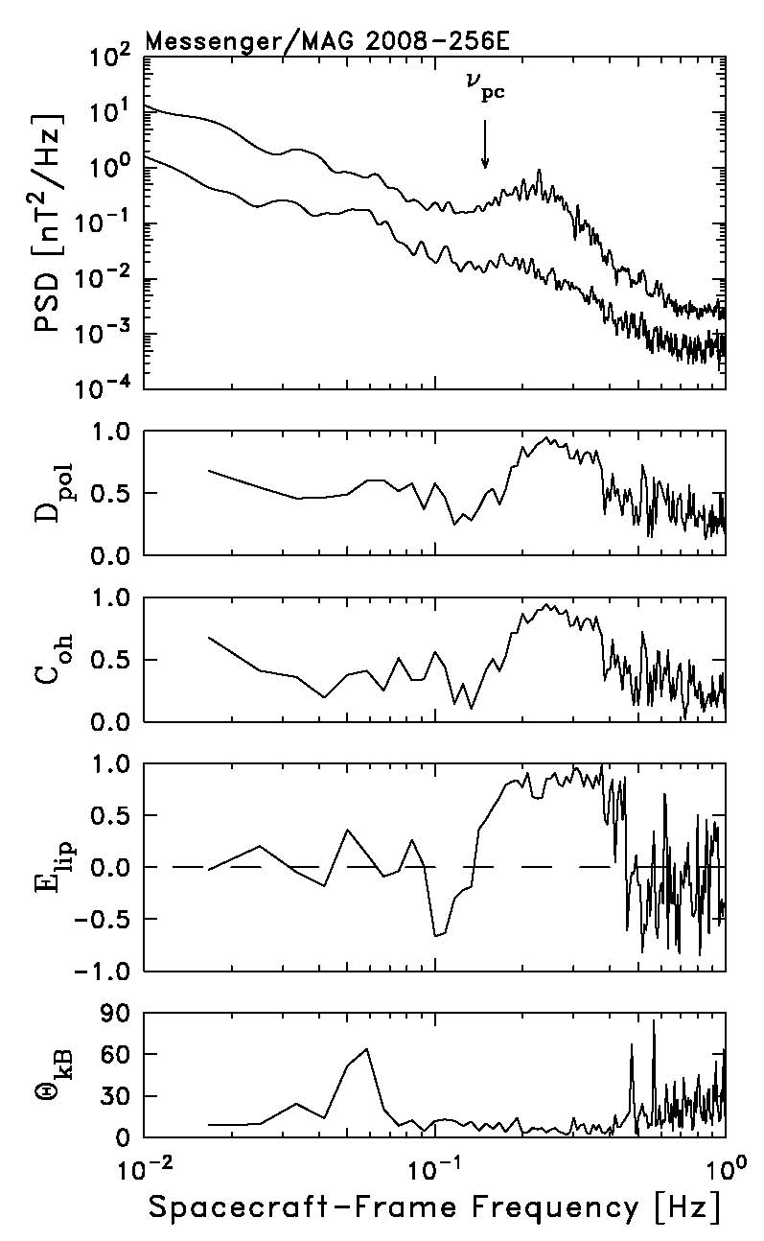
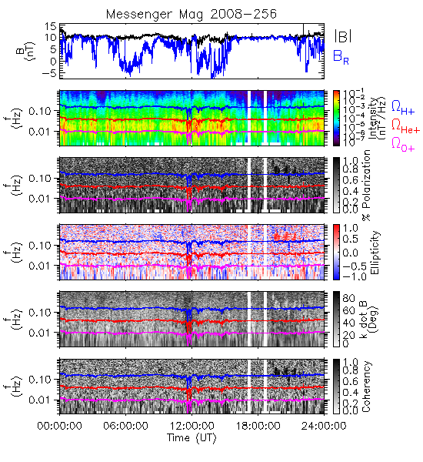
Right-Hand Example: 2008/256
24 days from Mercury

Slide 12
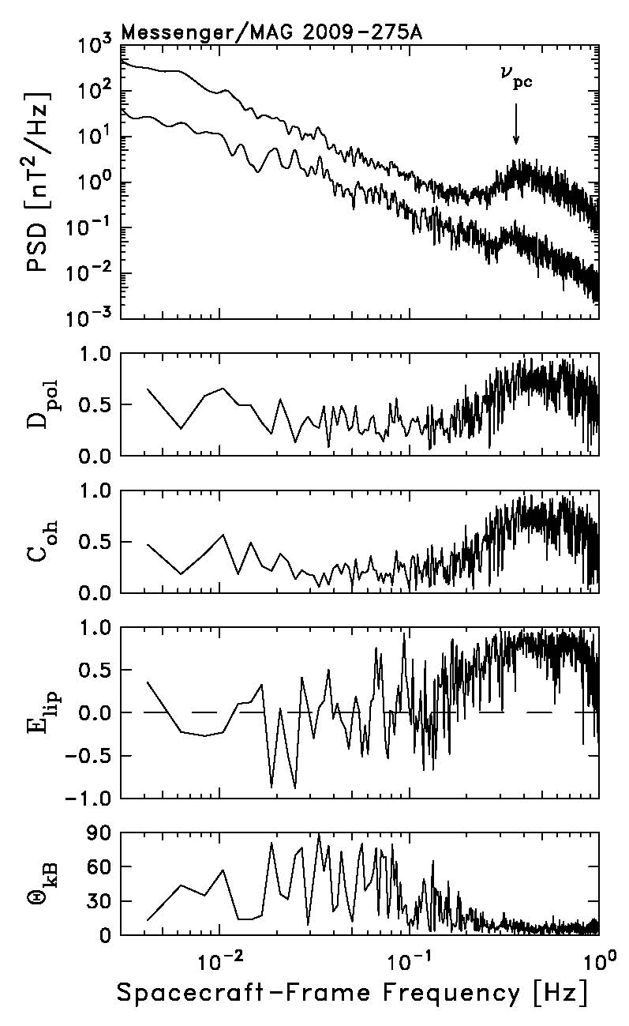
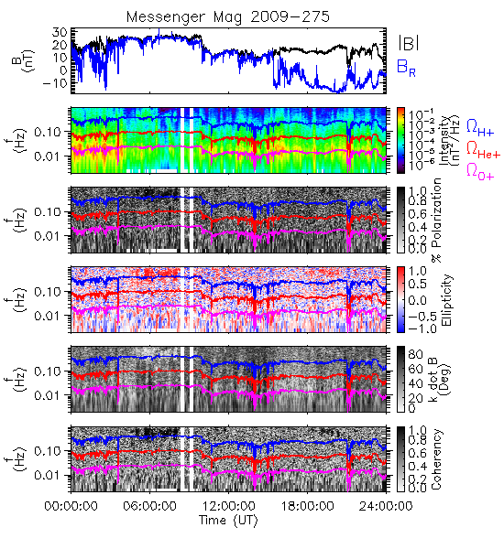
Another Example: 2009/275
1 day from Mercury

Slide 13
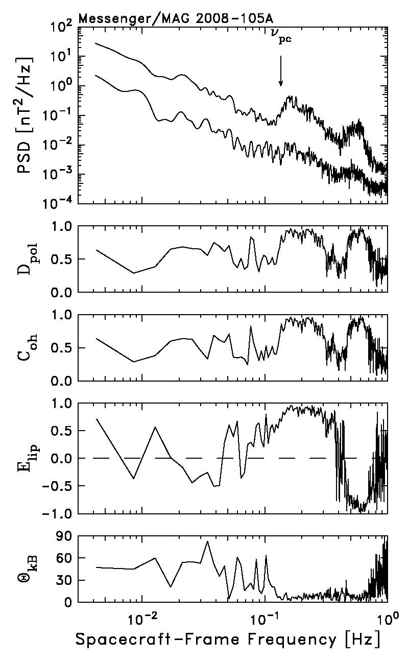
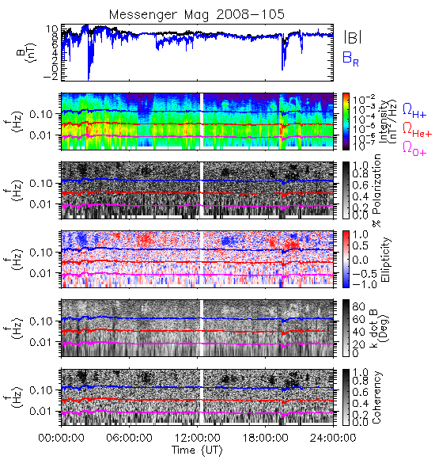
Exceptional Example: 2008/105
91 days from Mercury

Slide 14
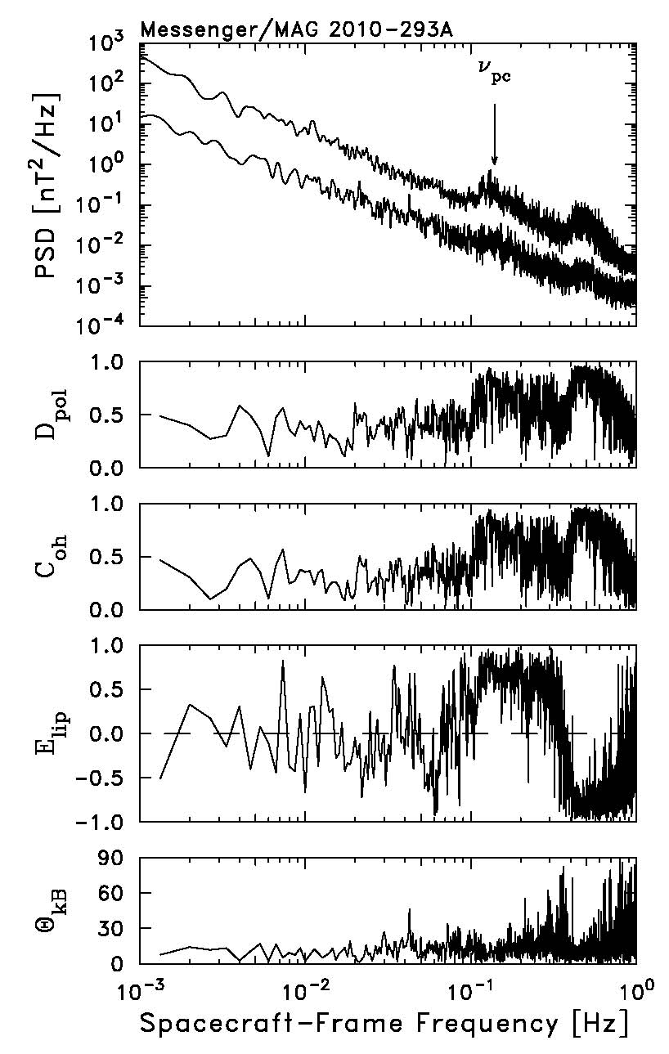
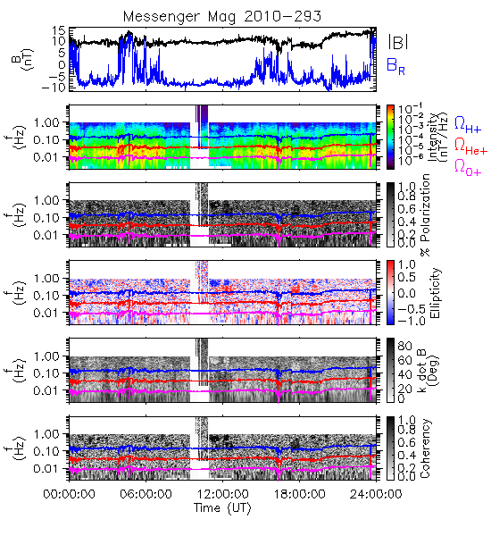
Another Double: 2010/293
235 days from Mercury

Slide 15
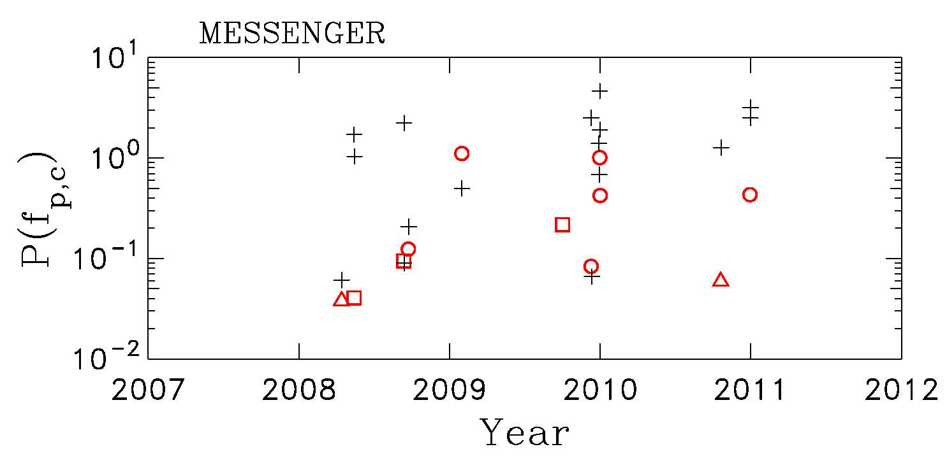
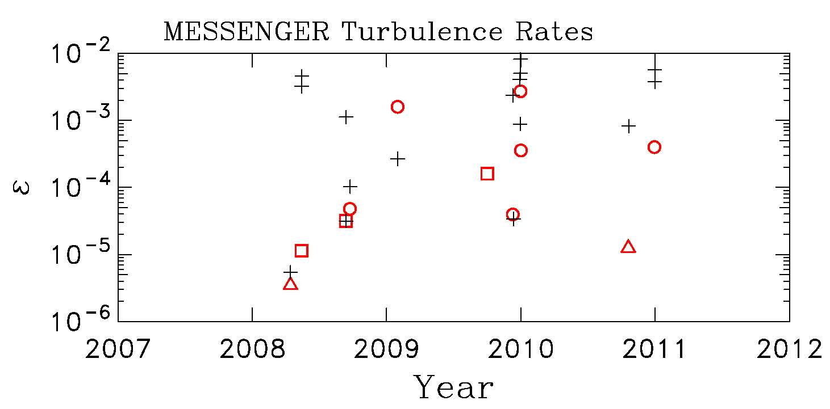
Is this a steady source?
We can select control intervals from nearby times when there are no waves evident.
And we can compare the power at f_{p,c}.
The control intervals tend to have higher power levels than the wave events.
We can compute turbulent cascade rates under the assumption that growth rates are generally small and time is required to accumulate the energy:
The relationship between waves and controls supports this view, but does not lead to a constant ion production rate.

Slide 16
Preliminary Event List (11 wave events):
Year/DOY Time from Mercury Polarization s/c frame
2008/105 91 days from Mercury Right/Left handed
2008/135 121 days from Mercury Right handed
2008/256 24 days from Mercury Right handed
2008/267 13 days from Mercury Left handed
2009/031 115 days from Mercury Left handed
2009/275 1 day from Mercury Right handed
2009/344 70 days from Mercury Left handed
2009/365 91 days from Mercury Left handed
2010/001 92 days from Mercury Left handed
2010/293 235 days from Mercury Right/Left handed
2010/364 78 days from Mercury Left handed

Slide 17
Summary
Evidence of waves due to pickup H⁺ in the Messenger/MAG data
Left-hand polarization in spacecraft frame is dominant.
Right-hand polarization does occur.
Some events show two distinct wave frequencies with different polarizations.
Interstellar pickup H⁺ inside 1 AU is not credible.
Cometary source lacks heavy ions.
Most likely origin is the “inner source” arising from solar wind collisions with dust or cometary neutrals.
Mercury source has not been ruled out, but is unlikely.
Source appears patchy in space and time.
Further analysis is ongoing.
More detailed comparison of growth rates, turbulence, and amplitude
Better analysis of spacecraft location

Slide 18
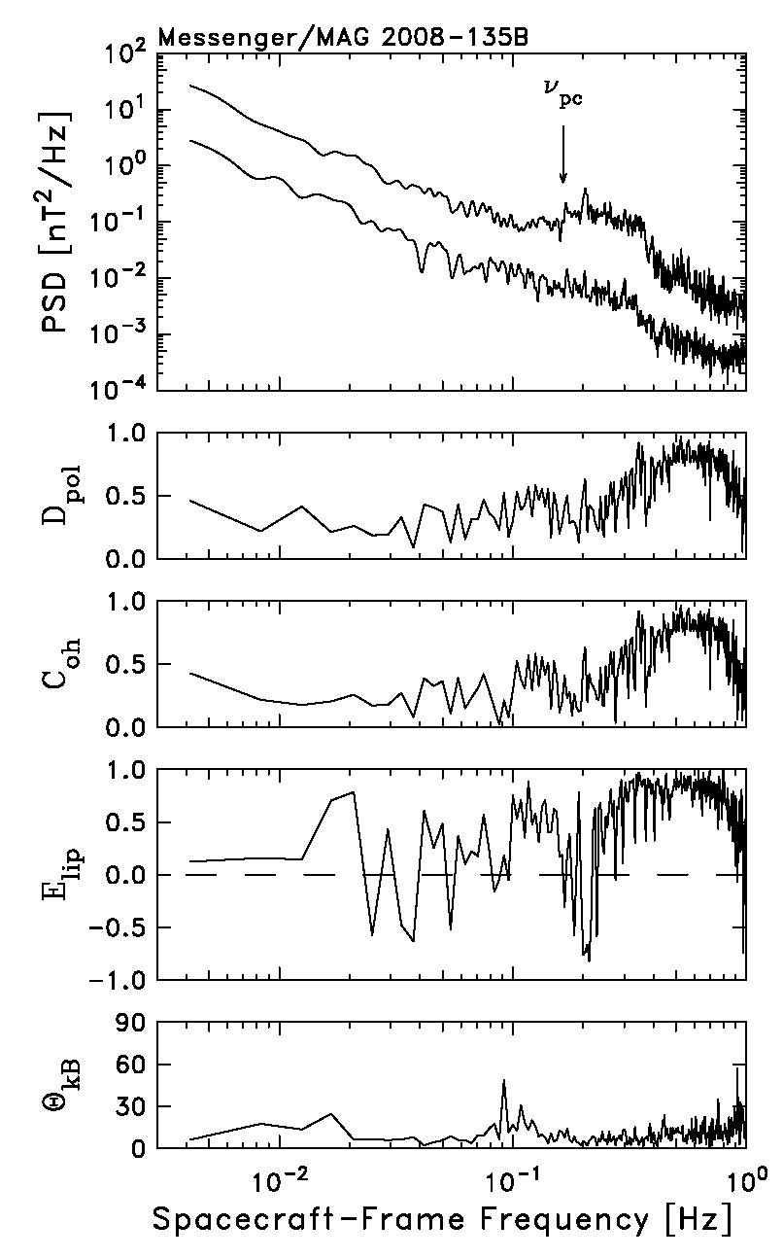
Right-Hand Example: 2008/135
121 days from Mercury

Slide 19
Beware the Planetary Flybys!

