Slide 1
Increased Galactic Cosmic Radiation From Historically Weak Solar Magnetic Fields
F. Rahmanifard, N. A. Schwadron, W. C. De Wet, L. W. Townsend, J. Wilson, A. Jordan, C. J. Joyce, H. E. Spence, A. W. Case, and C. W. Smith

Slide 2
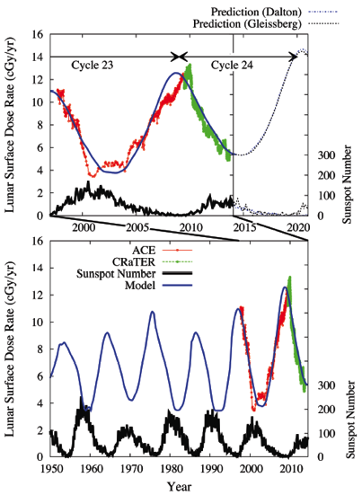
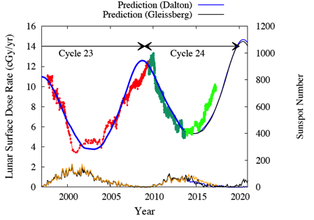
Worsening Galactic Cosmic Radiation Environment observed by CRaTER
The observed low solar activity causes:
highest fluxes of galactic cosmic rays in the space age
relatively few solar energetic particle events
The evolution of the interplanetary magnetic field can be used to
project dose rates from galactic cosmic rays:
predicting a ~ 20% increase in the dose rates
10% further increase comparing to dose rates observed by CRaTER
Schwadron et al. [2014, 2018]

Slide 3
Modulation Potential
Variation in the HMF affects the modulation of the GCRs.
Schwadron et al. (2012) inferred from fitting the modulation potential based on ACE data to the HMF from OMNI.
Using this power law, the correlation between and solar parameters (B and V) can be established [Schwadron et al., 2014]:

Slide 4
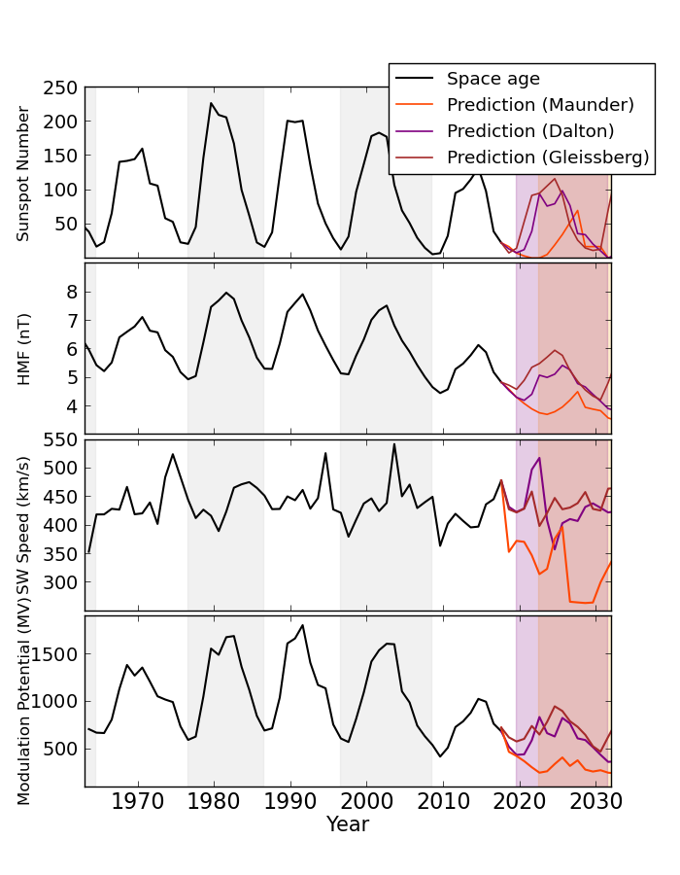
Next Solar Cycles
We use sunspot-based reconstructed HMF from Rahmanifard et al. [2017] and solar wind speed time series from Owens et al. [2017] to get modulation potential.
Assuming a Maunder- Dalton- or Gleissberg-like minimum for the coming years obtains worst-case scenarios for modulation of the GCRs that leads to dramatically high dose rates.

Slide 5
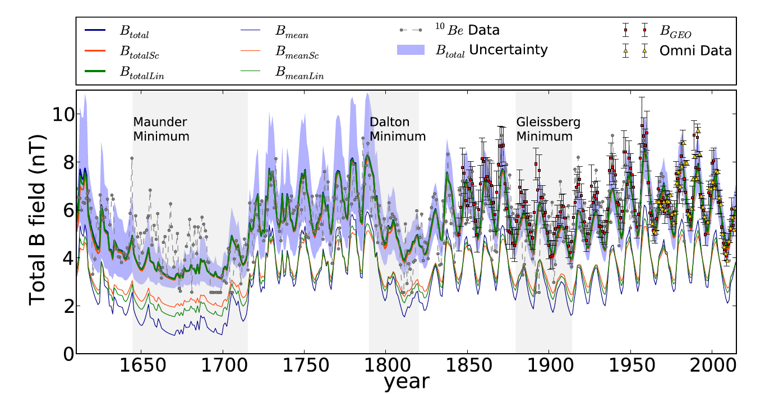

Slide 6
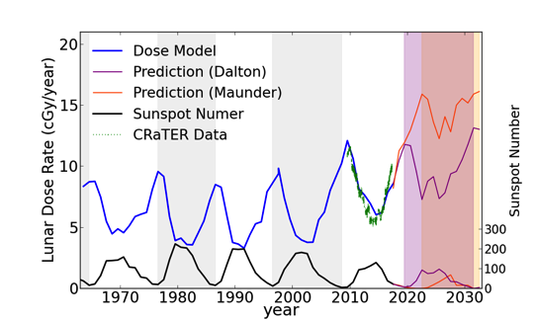
Dose Rates
Earth-Moon-Mars Radiation Environment
Module, EMMREM uses a three layer version
of HZETRN to provide look-up tables of
effective dose rates.
Behind 0.3 g/cm² Aluminum shielding equivalent to CRaTER D1/D2 detectors.
Schwadron et al. (2014)
Allowable mission durations can be calculated based on effective dose limits from NASA (2014) Human Integration Design Handbook (HIDH).

Slide 7
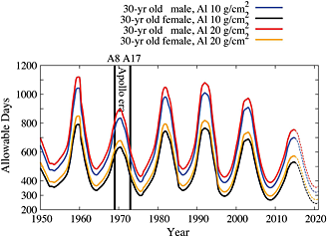
Allowable Days
These results can be used to:
predict the most conservative allowable mission durations
based on 3% risk of exposure-induced death(REID)
at 95% confidence level
Schwadron et al. [2014] (based NRC, 2008)

Slide 8
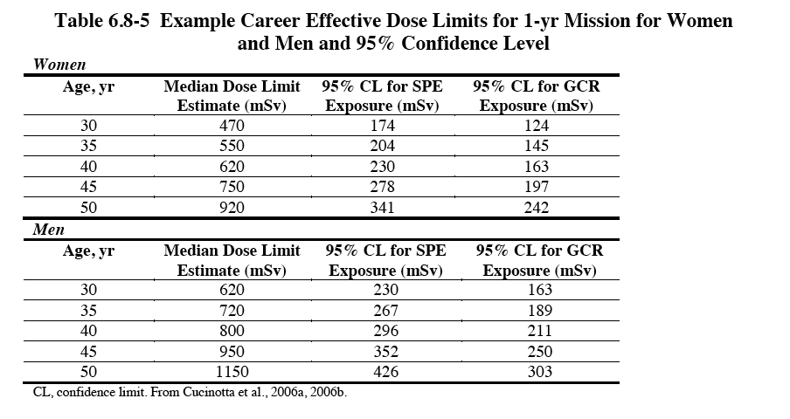
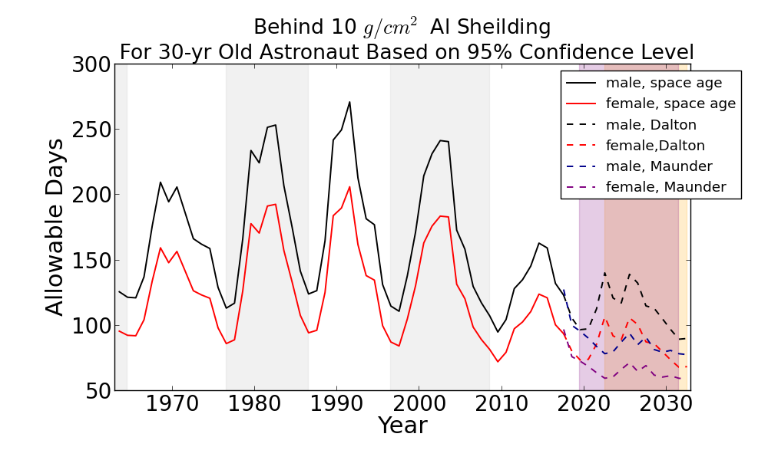
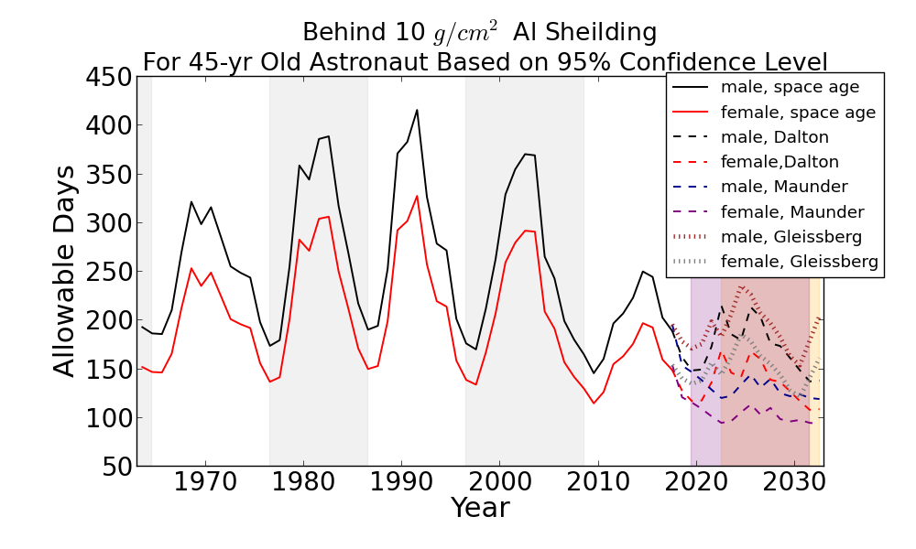
Allowable Days for the Next Solar Cycle
d
NASA HIDH (2014)

Slide 9
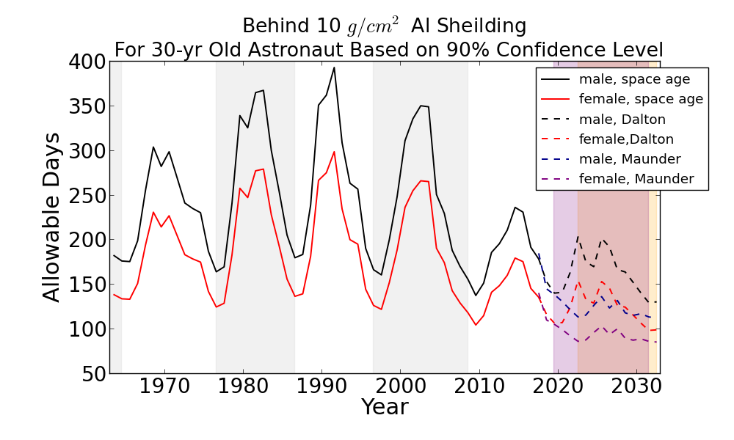
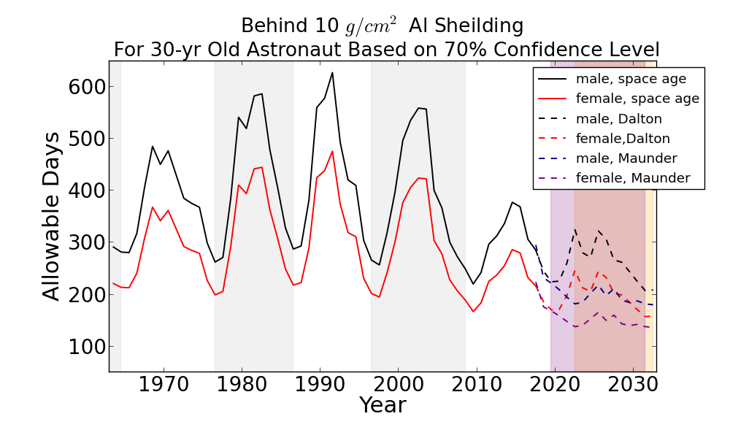
Allowable Days for the Next Solar Cycle
Confidence level | Female | Male
95% | 12.4 | 16.3
90% | 18.0 | 23.6
80% | 24.4 | 32.1
70% | 28.6 | 37.7
Dose limits for 30-year old astronauts based on different levels of confidence

Slide 10
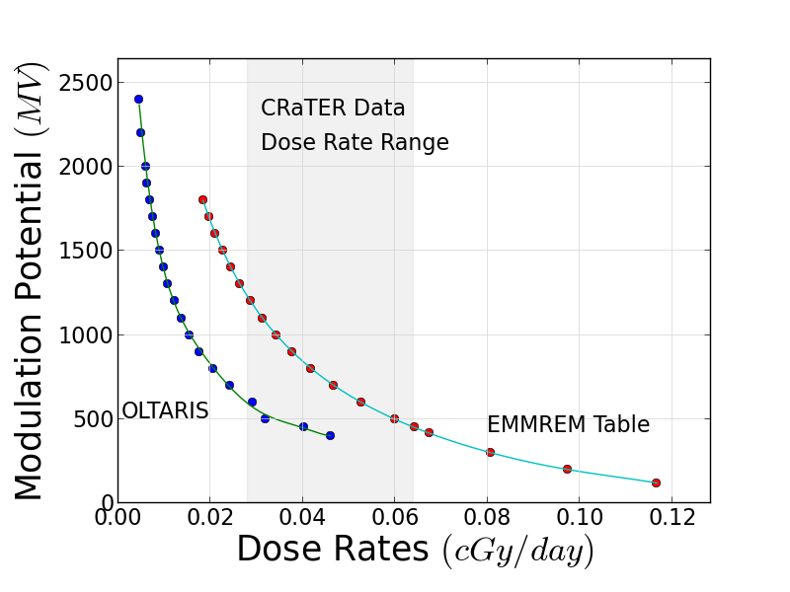

Slide 11
Past Solar Grand Minima

