Slide 1
Update on the Worsening Particle Radiation Environment
Observed by CRaTER
N A Schwadron, F Rahmanifard, J. Wilson, A P Jordan, H E Spence, C J Joyce, J B Blake, A W Case, W d Wet, W M Farrell, J C Kasper, M D Looper, N Lugaz, L Mays, J E Mazur, J Niehof, N Petro, C W Smith, L W Townsend, R Winslow and C Zeitlin

Slide 2
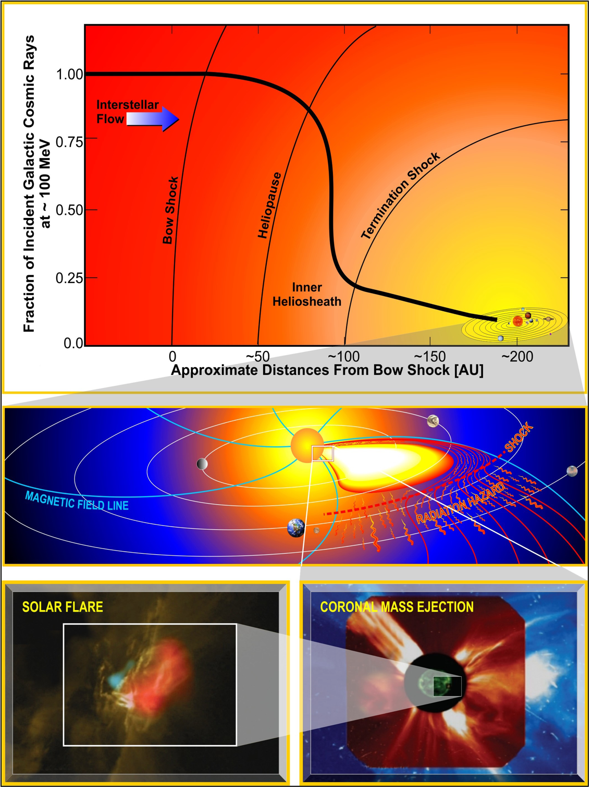
Radiation Hazards, Interactions
Galactic Cosmic Rays (GCRs)
  Steady Background
  Career limit in ~ 1-3 years
Solar Energetic Particles (SEPs)
  Acute Sources
  ESPs versus impulsive component
  Time-dependent response

Slide 3
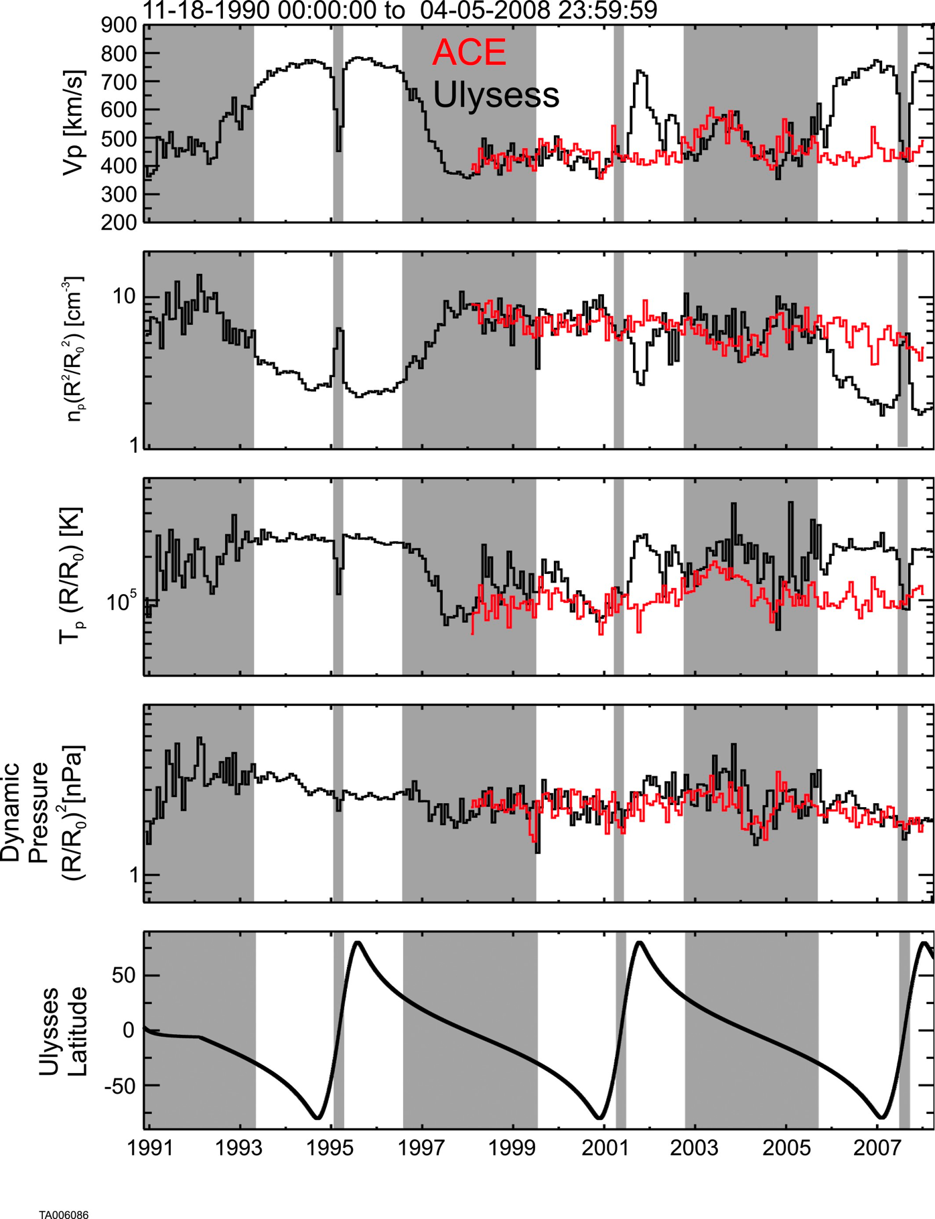
ACE & Ulysses Comp.
Proton
speed
Normalized
density
Reduced
Density
and
Dynamic Pressure
Normalized
temp
Dynamic
pressure
McComas et al., 2008

Slide 4
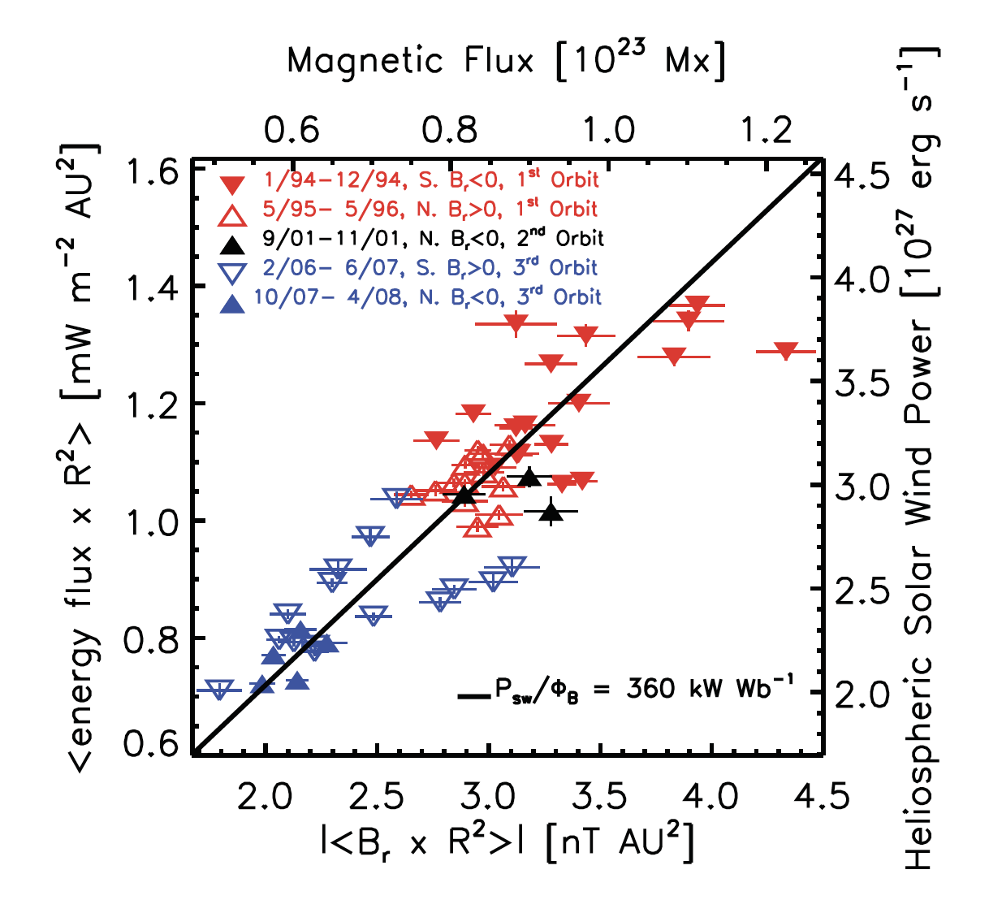
Schwadron and McComas, 2008

Slide 5
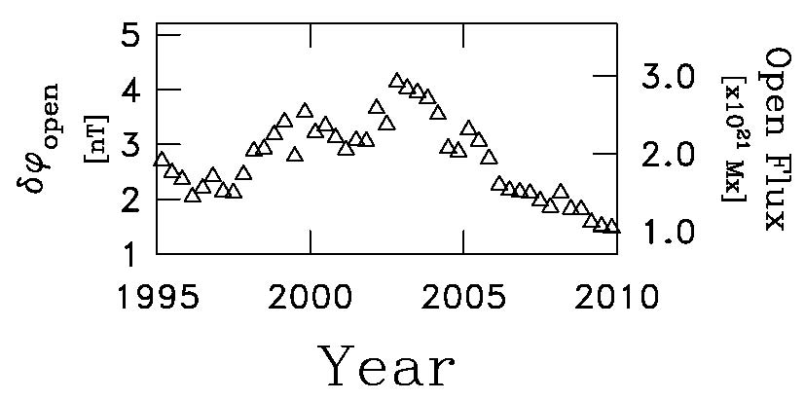
Open Flux Depletion
There is a 2-phase depletion of open field lines: first during the “normal phase” of solar min when ICME activity is small, and then later when ICME activity is virtually zero.
Connick et al., Astrophys. J., 2011.

Slide 6
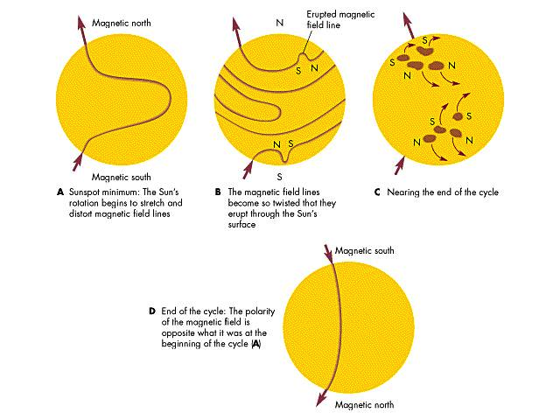

Slide 7
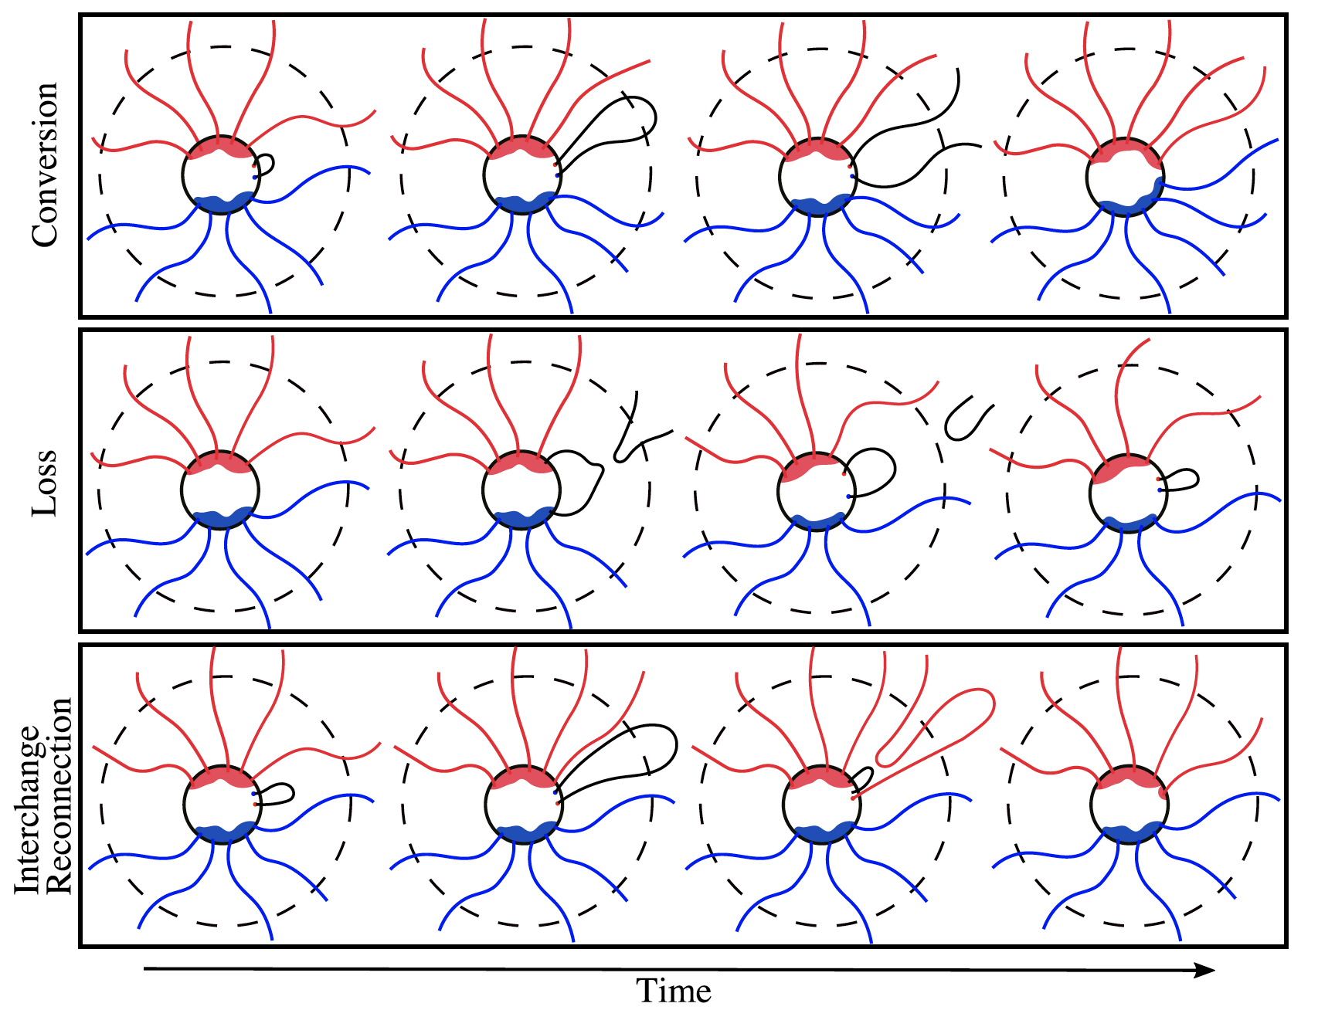
Rahmanifard et al., 2016

Slide 8
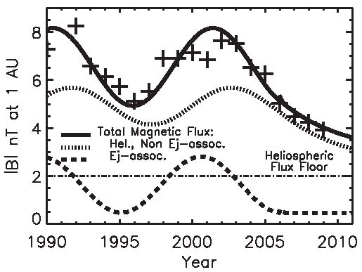
Integration into Heliospheric Models
|B| = √2Φ/4πR₁² where
R₁ = 1 AU;
φ_{ICME} = 1 x 10¹³ Wb;
D = 1/2;
τ_{ic} = 40 days;
τ₀ = 2.5 years;
τ_{d} = 4.4 years;
F_{lo} = 0.5 day⁻¹;
f_{hi} = 3 day⁻¹;
Φ_{flr} = 4 x 10¹⁴ Wb (|B| = 2 nT).
More recent theoretical coniderations are predicting a lower flux floor.
Schwadron et al., Astrophys. J. Lett., 722, L132, 2010.

Slide 9
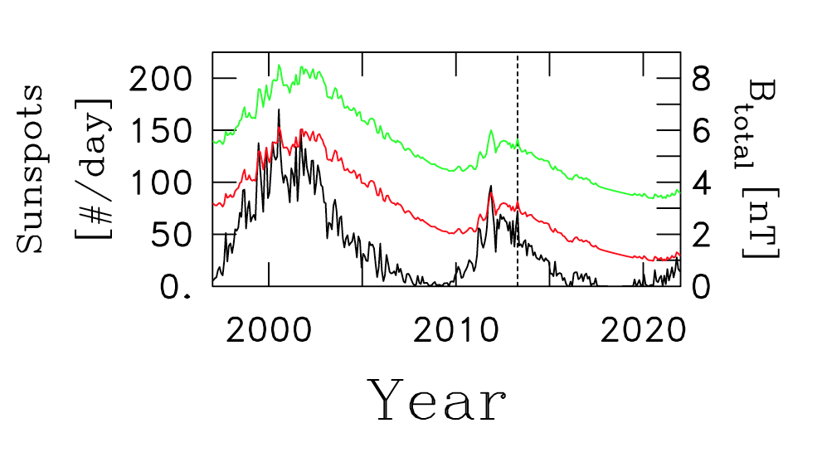
Continued Decay of Magnetic Flux in the Dalton-like Minimum
Goelzer et al., ApJ, 2013

Slide 10
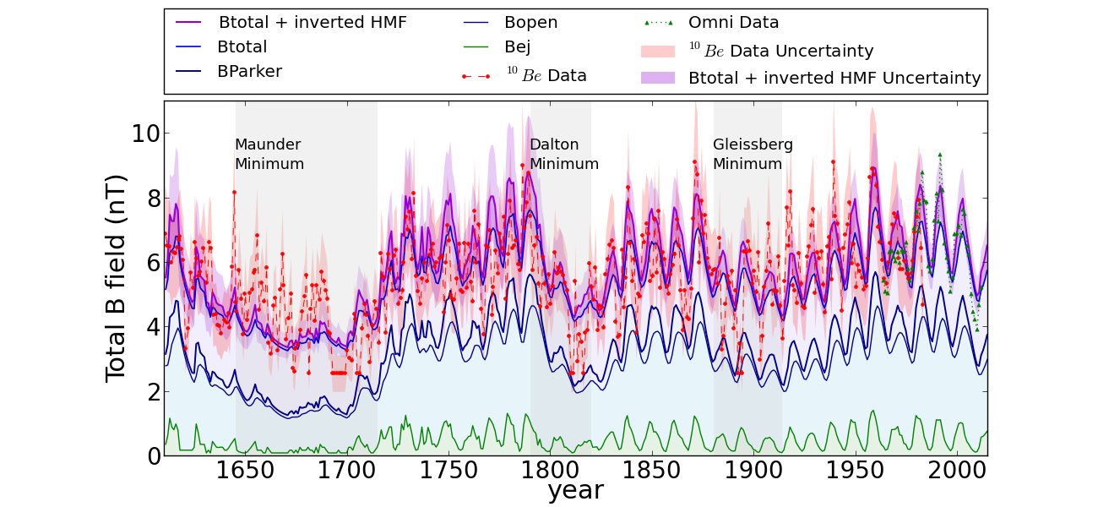
Strong Reduction in Field Possible – Much Higher GCR Flux
Rahmanifard et al., 2016

Slide 11
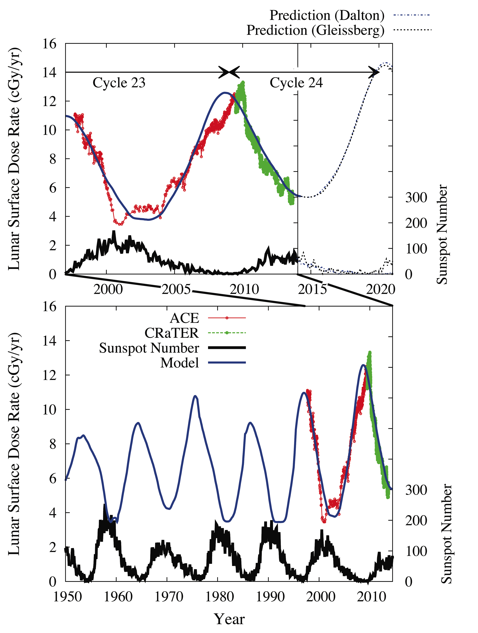
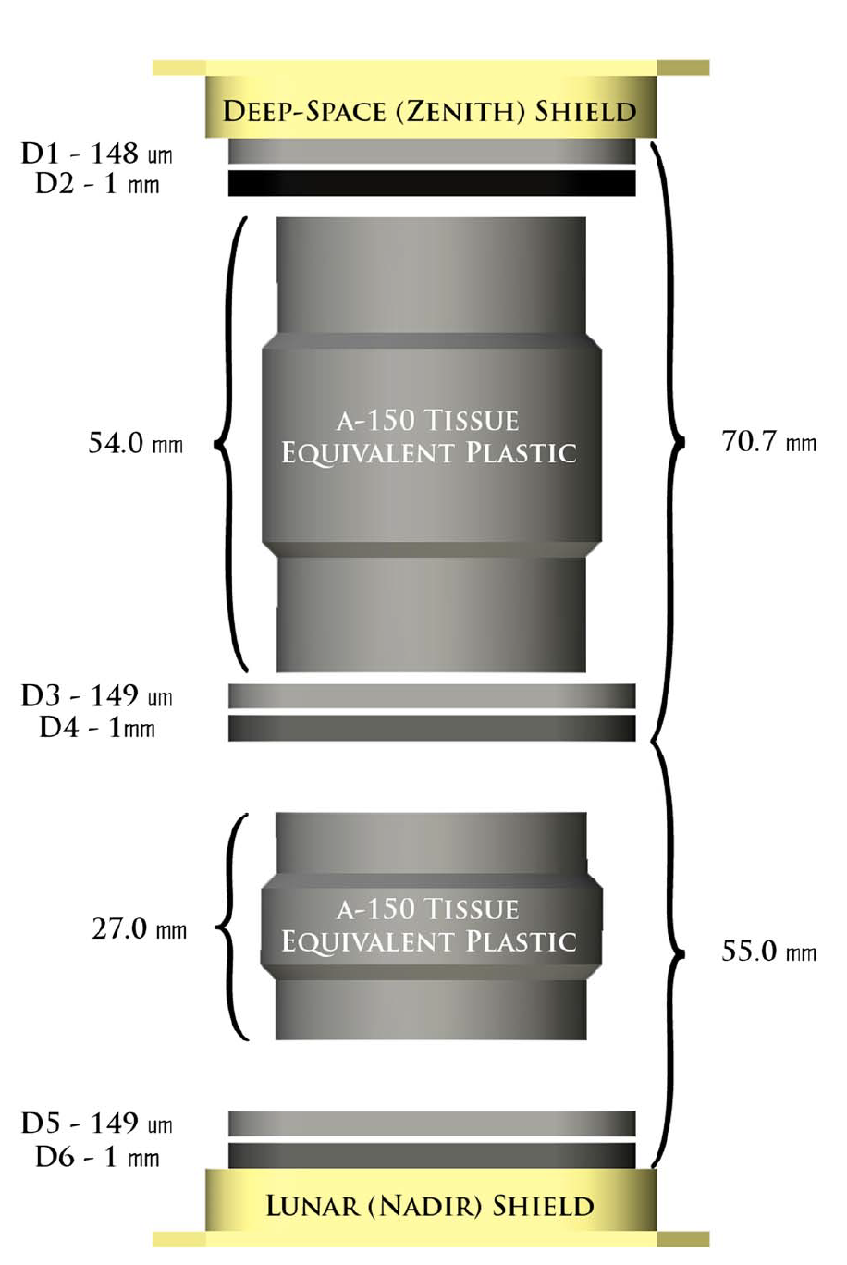
Highest GCR doses in space age in recent cycle 23 solar minima
Continues trend observed by Ulysses, ACE
SCHWADRON ET AL., SPACE WEATHER, 2014a

Slide 12
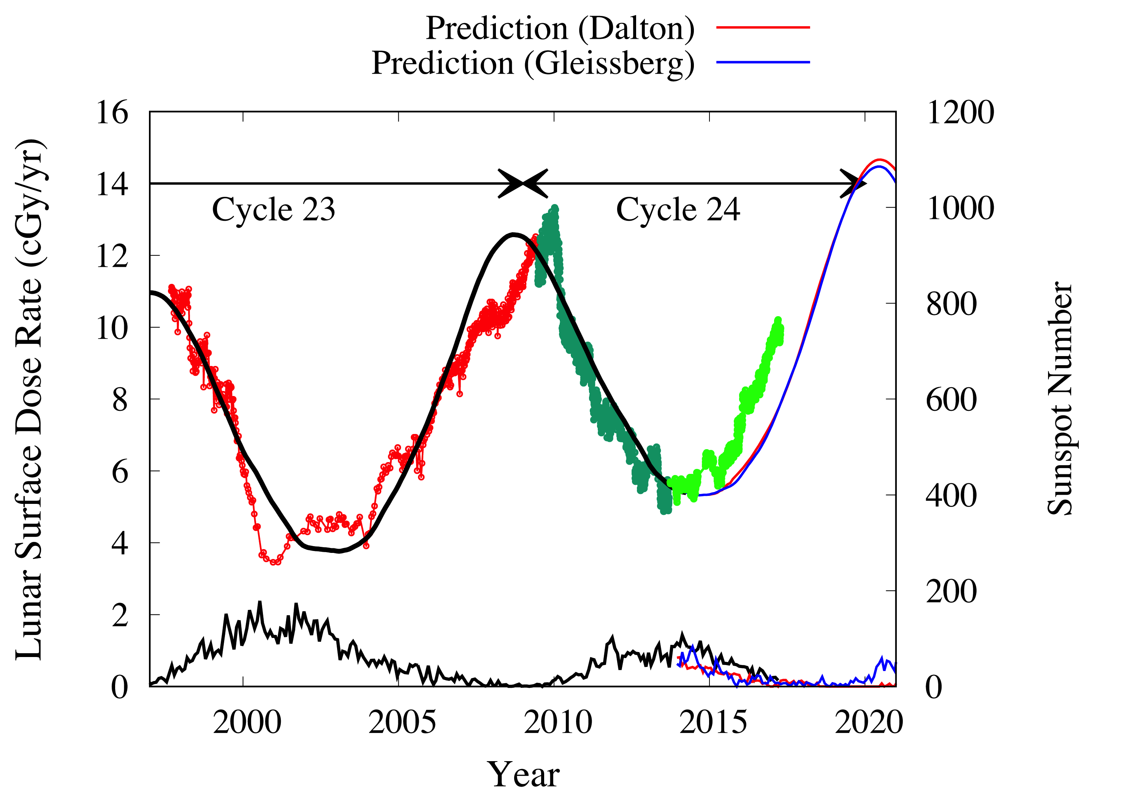

Slide 13
Schwadron et al., Space Weather, 2017

Slide 14
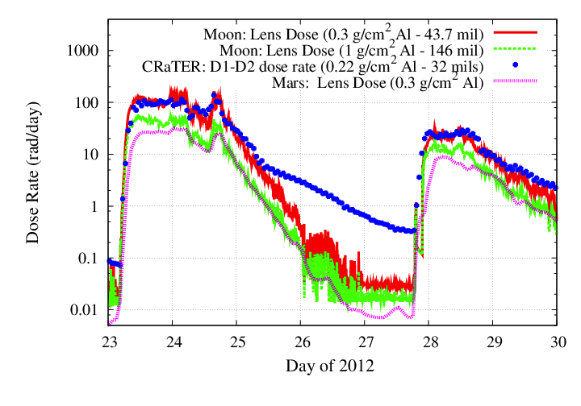
Solar Proton Model Prediction/Validation
After Schwadron et al., 2012
SEP Events During 2012: Indicators of Larger SEP Events in the New Cycle (24)
Shown here are the major SEP events of 2012 and the comparisons between CRaTER observations (blue) and prediccs predictions (red and green).
Agreement reveals overall accuracy of models, while deviations likely reveal heavy ion contributions to dose observed by CRaTER
Mar 7, 2012 Event
Jan. 23rd , 2012 Event
May 16, 2012 Event

Slide 15
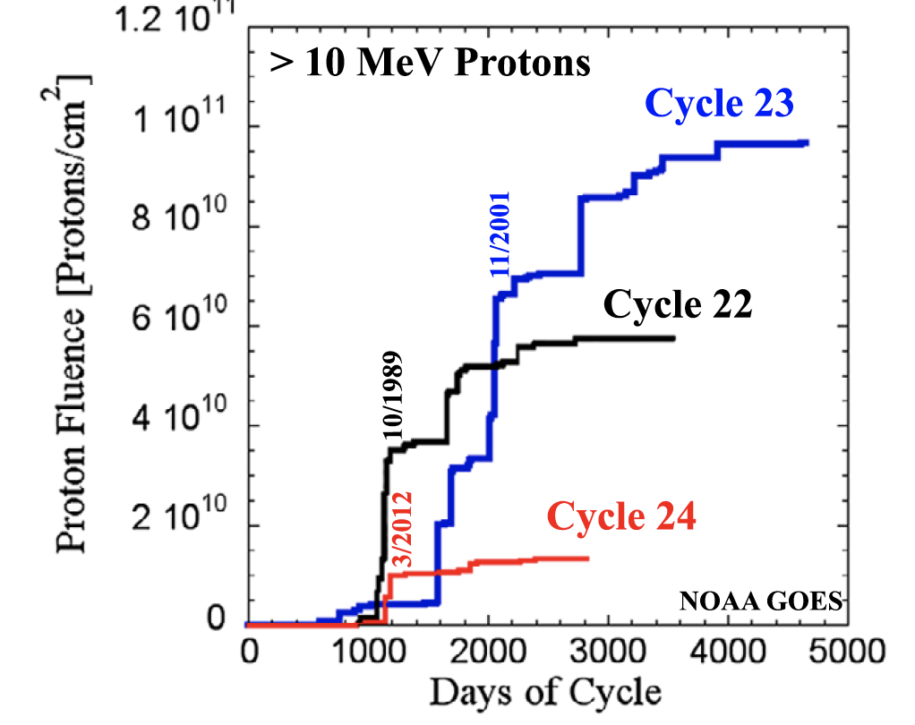
MeWaldt et al., 2015 Schwadron et al., 2017

Slide 16
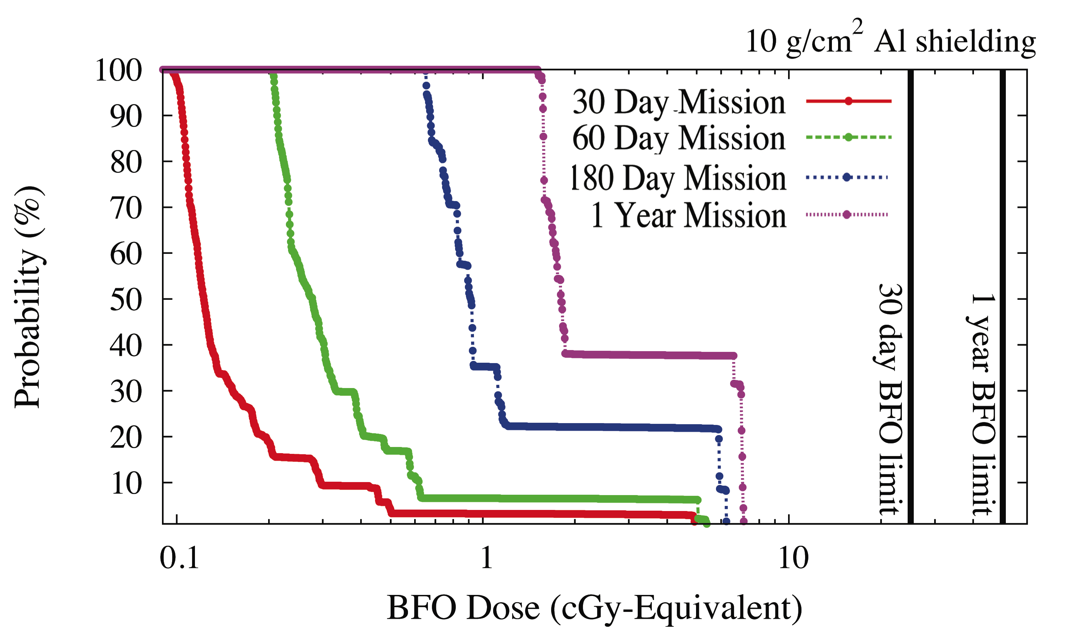
SCHWADRON ET AL., SPACE WEATHER, 2014a

Slide 17
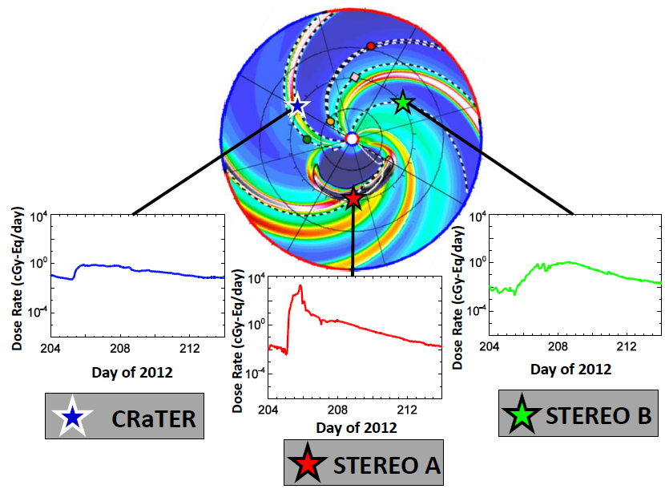
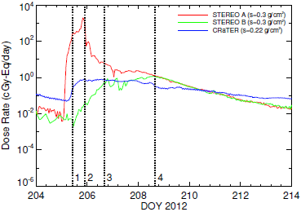
Joyce et al., 2015

Slide 18
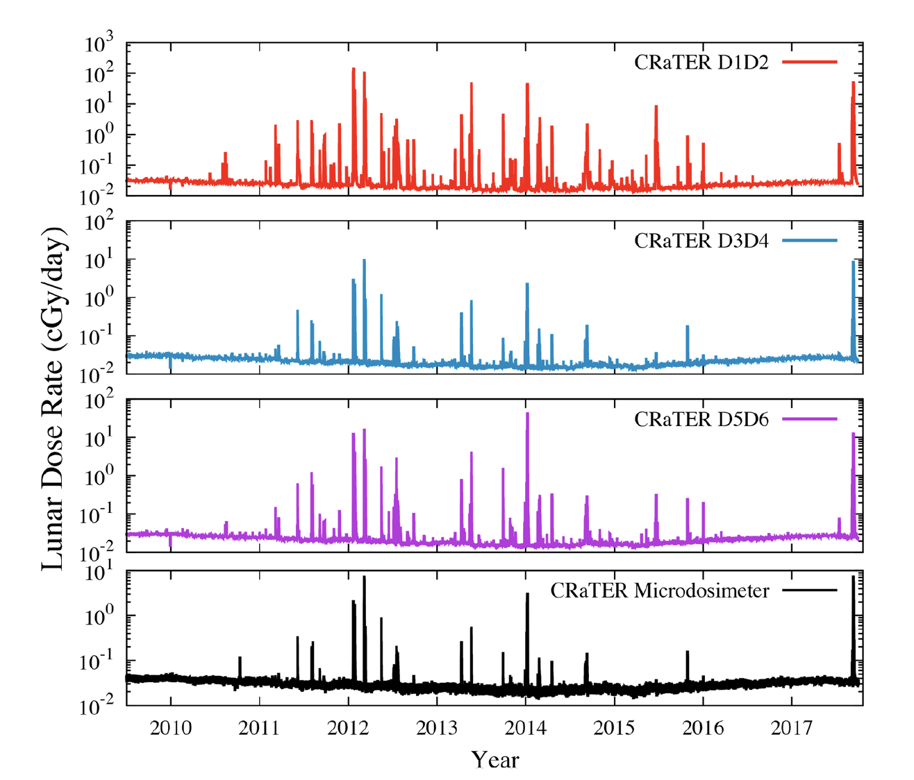
Schwadron et al., 2017

Slide 19
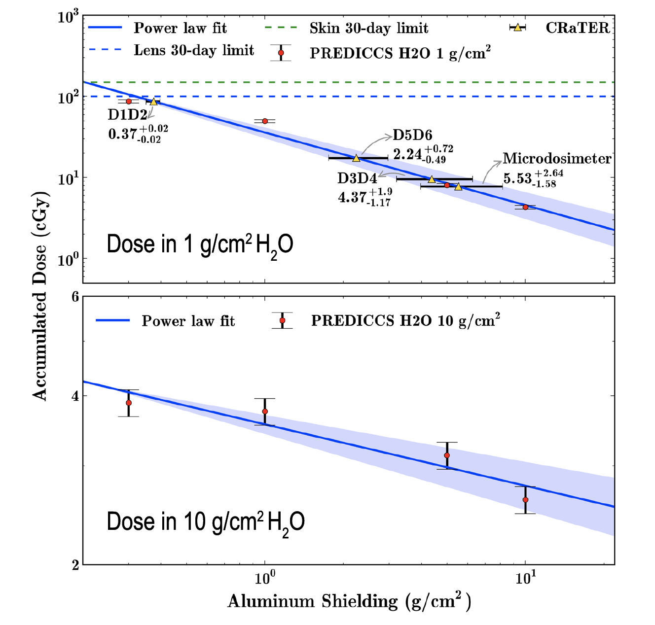
Schwadron et al., 2017

Slide 20
Example of a large event during decline of cycle 24
Note importance of seed population
Schwadron et al., 2017

Slide 21
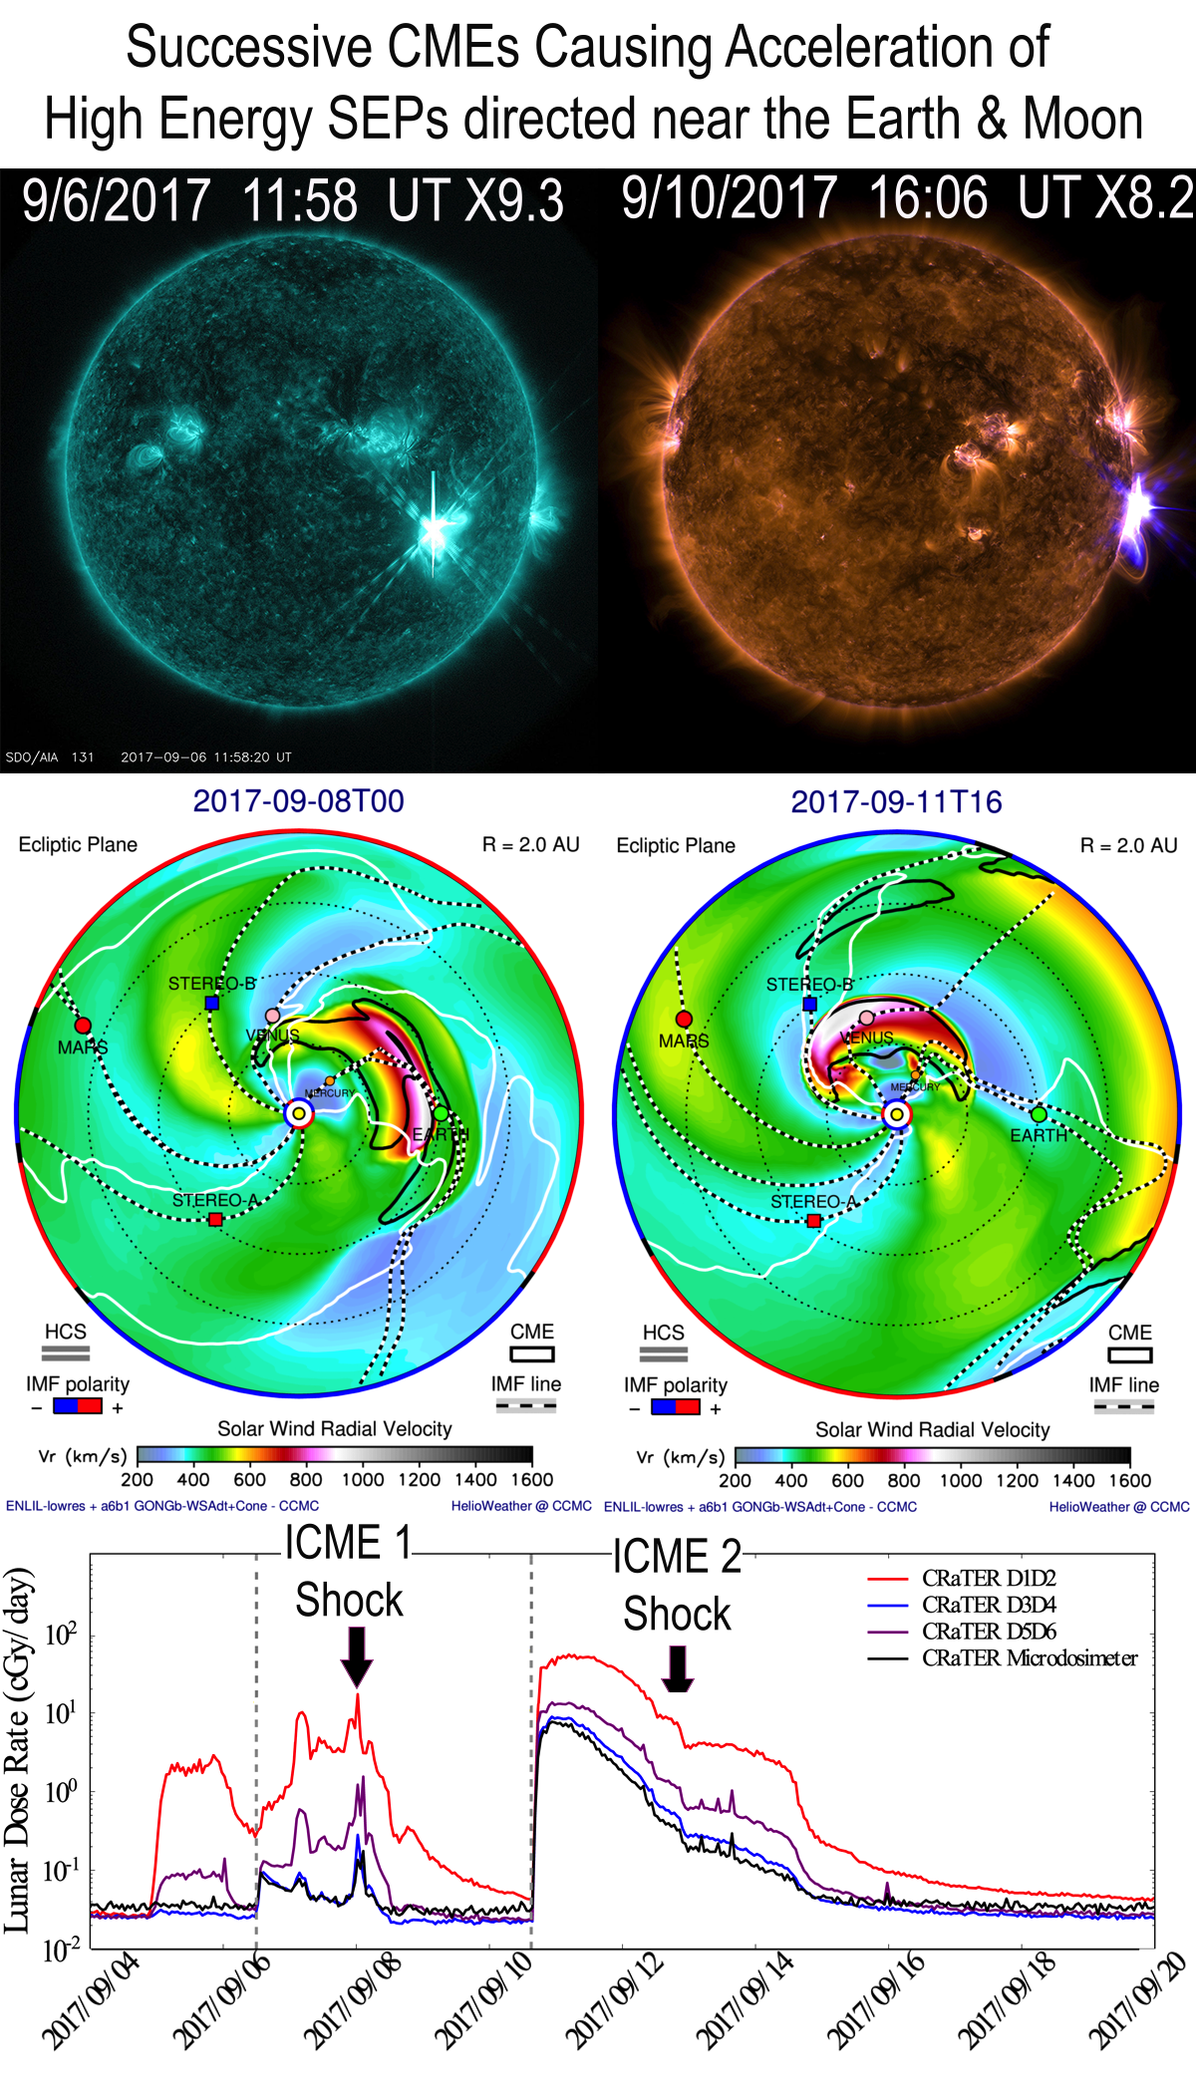
First event had clear shock, and ESP
Second event shows prompt acceleration
Schwadron et al., 2017

Slide 22
Conclusions
Radiation levels continue to increase due to weakening solar activity
Dose rates even higher than predicted in 2014
Large events (Sep 2017) in decline of cycle 24 indicate that weak activity does not exclude large SEP events
Overall, SEP event probabilities still quite low during cycle 24

