Slide 1
Non-Equilibrium Ionization Modeling of the Current Sheet in a Simulated Solar Eruption
Chengcai Shen
Co-authors: K. K. Reeves , J. C. Raymond, N. A. Murphy, Y-K. Ko, J. Lin, Z. Mikić
2013-2-11
Notes:
Good morning every one, I’m going to talk non-equilibtium ionization process in a simulation solar eruption model.

Slide 2
Contents
Introduction: CME/flare current sheets
Calculation of non-equilibrium ionization
Results
Ionization features in current sheets
Predicted SDO/AIA images
Predicted SOHO/UVCS intensity
Conclusion
Notes:
My talk include four parts. First, I’ll introduce the research background. The cme/flare current sheet is my interesting region fro considering the non-equilibrium ionization process.
In the second part, I’ll introduce the calculation method of time-dependent ionization.
Then I’ll show the main results of these calculation, including ionization features in current sheets, and show predicted AIA images and UVCS intensity according this numerical eruption model.
Finally, I give a summery in conclusion.

Slide 3
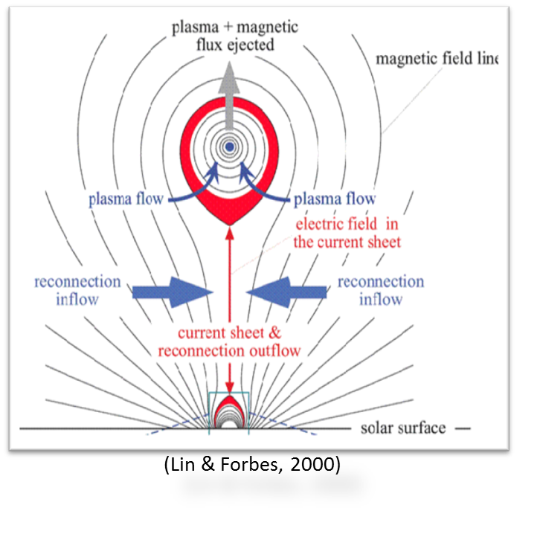
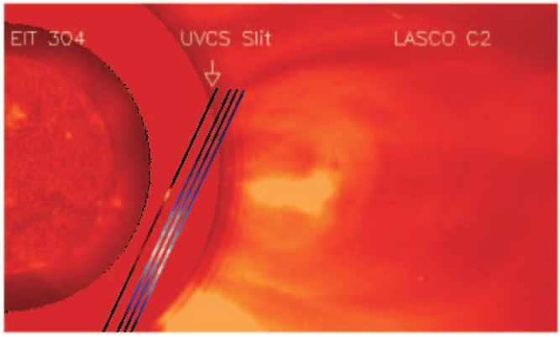
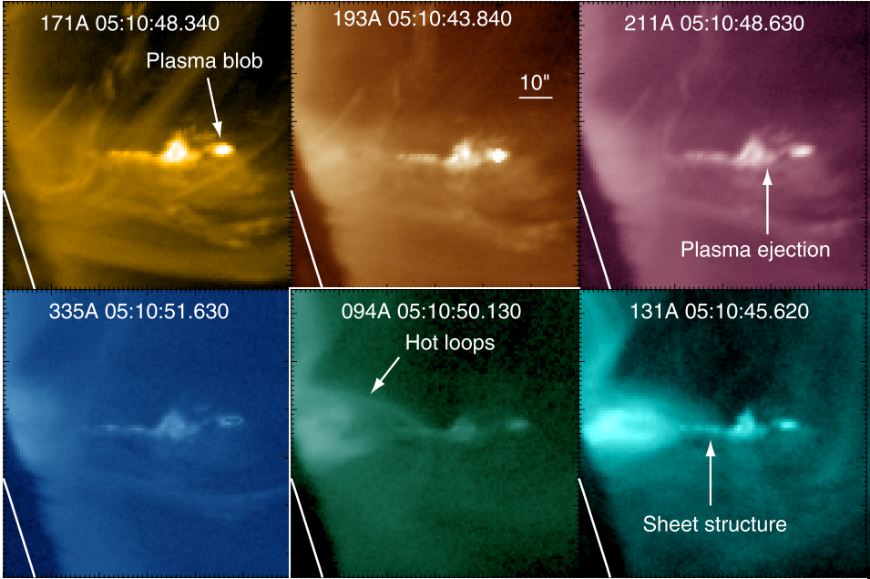
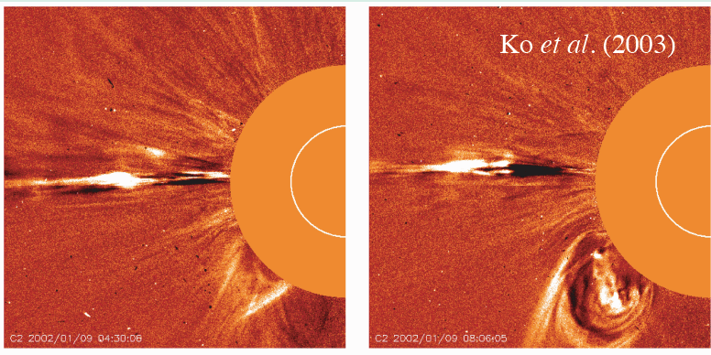
The CME/flare current sheet
Ciaravella et al. 2002
The current sheet is thin due to the high conductivity.
High temperature because of magnetic reconnection heating.
High speed magnetic reconnection outflow.
Takasao et al. 2012
UVCS observation (e.g., Ciaravella et al. 2002).
LASCO white light observation (e.g., Webb et al. 2003 , Ko et al. 2003)
XRT observation (e.g., Savage et al. 2010)
AIA observation (e.g., Savage et al. 2011, Takasao et al. 2012,)
Notes:
The larger scale current sheet is a common structure in solar eruption. This kind of current sheet appears as thin structure because of high conductivity in corona. And it has high temperature and high speed magnetic reconnection outflow. Some therity model have suggest that it could develop during the eruption process and is important to the magnetic energy release and for high energy particle acceleration. Like the Lin & Forbes 2000 report a model inwhich the current sheet forms between the CME and flare loops. The current sheet is also confirmed by mutilple wave observations. For example, ciaravelia et al 2002 reported the current sheet structure in UVCS observation. And Webb et al., Ko etal 2003 show found the thin and bright structures on LASCO white light observation. On XRT and AIA observations, Savage et al. 2010 and 2012, Takasao et al. 2012 also reported some events about cme/flare current sheets. Our works focus on this kind of current sheet and show some predicted emission features.

Slide 4
Time-dependent ionization process
Time-dependent ionization processes are important in the current sheet because that the dynamic time scale could be shorter than the ionization time scale.
Several recent studies of flares and CMEs have investigated time-dependent ionization process
Rakowski et al. (2007) studied the charge state distributions of the ions of various elements in ICMEs.
Ko et al. (2010) modeled UV and X-ray emission by considering time-dependent ionization in a steady state Petschek-like reconnection scheme for the post-CME current sheet
Lynch et al. (2011) focused on the charge states of several heavy elements in the flux rope using two diﬀerent asymmetric MHD simulations of CME on several AU.
Murphy et al. (2011) discussed the consistency between the modeling results and the observation by performing time-dependent ionization analysis .
Imada et al. (2011) reported the eﬀects of time-dependent ionization and recombination in magnetic reconnection in the solar corona.
Notes:
Because of the high temperature and high flow speed in the current sheet. It is important for discussing the time-dependent ionization process. For some chemical elements, for examle, element iron and oxgen, the dynamic time scale could be shorter than the ionization time scale. This means the current sheet is on the non-equilibrium ionization state, and to get the emission lines of these elements, we need to consider time-dependent ionization process. There are several recent studies of flare and CMEs have investigated time-dependent ionization process. For instance, Rakowski et al studied the charge state distributions of various elements in interplanetary.

Slide 5
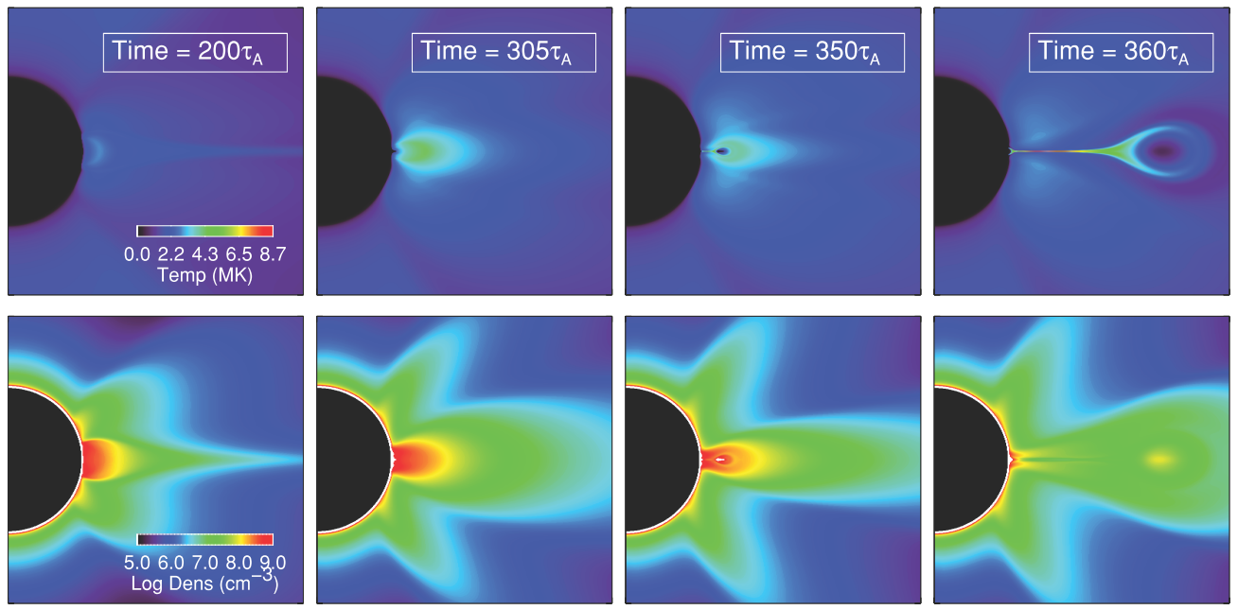
In this work, we focus on time-dependent ionization inside a large scale and dynamically developed CME/flare current sheet.
We use the 2.5D simulation results of CME eruption model developed by Reeves et al. 2010.
This model includes Ohmic and coronal heating, thermal conduction, and radiative cooling in the energy equation.
The evolution of the CME/flare with time and the distributions of temperature and plasma density around the CME/flare current sheet are known on the 2D plane.
(Reeves et al. 2010)
Notes:
Here, we use the two point five dimensional numerical results of CME eruption developed by Reeves etal. 2010. In this model, the energy equation includes Ohmic and coronal heating, thermal conduction, and radiative cooling terms. After the flux rope erupted, a long, thin and hot current sheet structure are clear. See this figure, until time three sixty alfven time, the current sheet formed clear. Following this model, we can get the detail evolutions of temperature and density in the current sheet region. This gives our an dynamically developed current sheet, so we can perform the ionization studies for cme/flare current sheets and could compile its ionization features with the observations, such as SDO/AIA and SOHU/UVCS.

Slide 6
2. Calculation of non-equilibrium ionization
Solve time-dependent ionization equation:
$\frac{df_{i}}{dt}=n_{e}\left(C_{i−1}f_{i−1}−\left(C_{i}+R_{i}\right)f_{i}+R_{i+1}f_{i+1}\right)$
where f_{i} is ionic fraction, n_{e} is electron density, C_{i} and R_{i} are the ionization rate and recombination rates for this ion.
The second-order implicit scheme or the fourth-order explicit Runge-Kutta method are used.
C_{i} and R_{i} depend strongly on the temperature.
Notes:
Here is our method. We need solve the time-dependent ionization equation first. Fi is ionic fraction, ne is electron density and Ci,Ri are ionization rate and recombination rate for this elements. We use difference method to solve this equation, and the second-order implicit scheme and the fourth-order explicit are used. Because the Ci and Ri depend strongly on the temperature, so we need kwon the temperature and electron density at each time during the evolution of the current sheet.

Slide 7
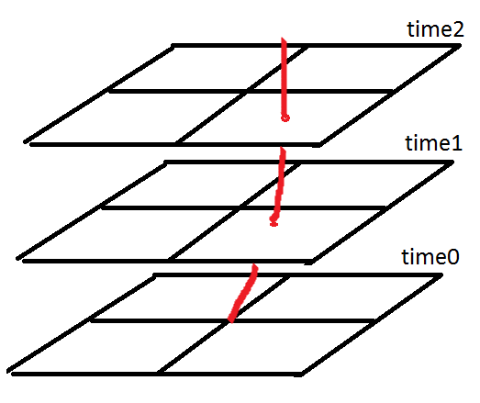
2. Calculation of non-equilibrium ionization
Get history of temperature and density for each plasma cell in the Lagrangian framework.
Using a predictor-corrector method, we solve the motion equation and integrate the velocities backwards in time to get the plasma trajectories
According to the position of trajectory at different time, get temperature and density through bilinear interpolation in space.
Spline interpolation with time.
Notes:
This figure shows the process how get temperature and density history. We trace the moving plasma cell in the lagrangian framework and get each trajectory of these cells. We use two-step scheme to solve motion equation and integrate the velocity backwards in time. The red curve shows one trajectory in this picture. In order to obtain the T and rho at any location and time, we use bilinear and spline interpolation for space and time.

Slide 8
The calculation process
$\frac{df_{i}}{dt}=n_{e}\left(C_{i−1}f_{i−1}−\left(C_{i}+R_{i}\right)f_{i}+R_{i+1}f_{i+1}\right)$
Trajectory in Lagrangian framework
History of Temperature & plasma density
Ionization & recombination rate (C_{i}, R_{i})
Solve: Time-dependent ionization equation
Line Emissivity
AIA count rate images
UVCS intensity
Ion charge state

Slide 9
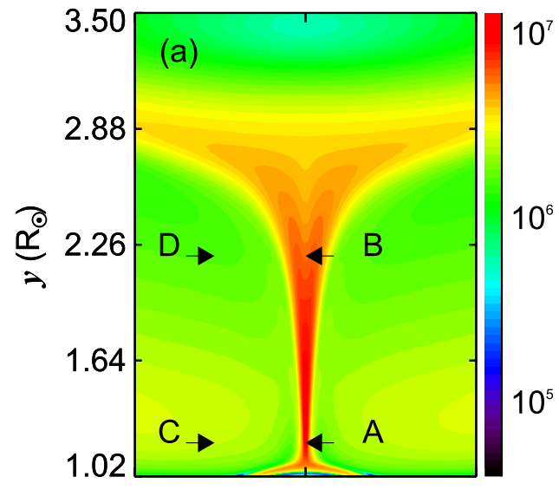
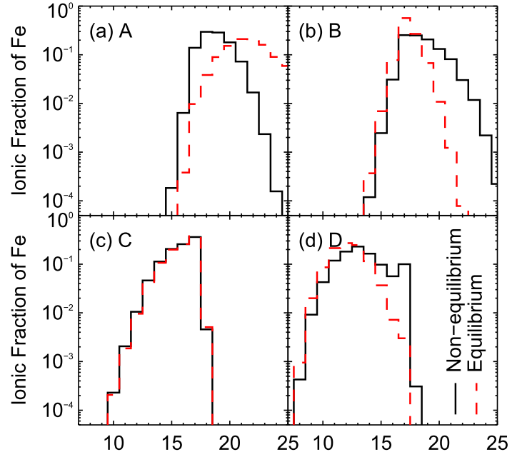
4. Results
The ionization properties of the current sheet
Near the low end of the sheet (e.g., point A), the charge state distribution is skewed toward lower charge states compared to equilibrium ionization results .
At the top end (point B), on the other hand, the profiles are shifted toward higher charges states
Temperature
Notes:
This slide shows the ionization properties in the current sheet. The left picture sign four sample points, they are point A,B,C, and D. The color indicate temperature. Points A and B are in center of the sheet, and C, D is outside the sheet. Performed the time-dependent ionization calculation, the ionic charge state is shown on right figure. This is for element iron. The solid lines are for time-dependent ionization, and the red lines are for equilibrium ionization assumption.
Along the current sheet, there are significant differences between solid line and red line. For instance, for point A, the solid line shift to left. That means time-dependent ionization shows more lower ion charge stat than equilibrium assumption. While, for the point B, the solid line shift to right and shows higher charge state. But, in the ambient region, ion charge state are similar on two case.

Slide 10
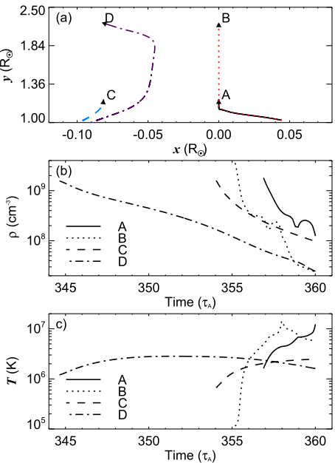
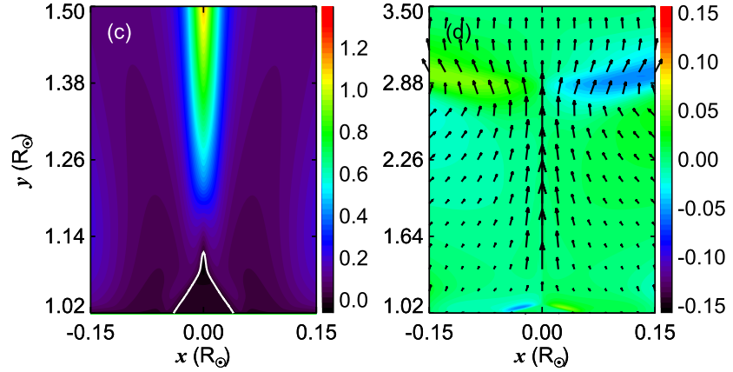
Results
Velocity V_{y}
Velocity V_{x}
The features of the reconnection inflow and outflow aﬀect the properties of the ionization processes.
The current sheet plasma is under-ionized at low heights and over-ionized at large heights.
Notes:
Here we show how the reconnection flow affect the ion charge state. This moving feature could be seen on velocity figure. You can see upward outflow dominant the most part of the sheet. The left figures show the trajectory of these four sample points. And the their temperature and density evolutions are also plotted in here. You can see that these four sample points are flow upward from the low height because the reconnection outflow and the solar wind solution. At low altitude within the current sheet, the ionic charge states
correspond to lower temperatures because the plasma started out relatively cool and was
heated rapidly. On the other hand, the top-end of the current sheet shows high temperature
ionization features although it is now located at the lower temperature state.

Slide 11
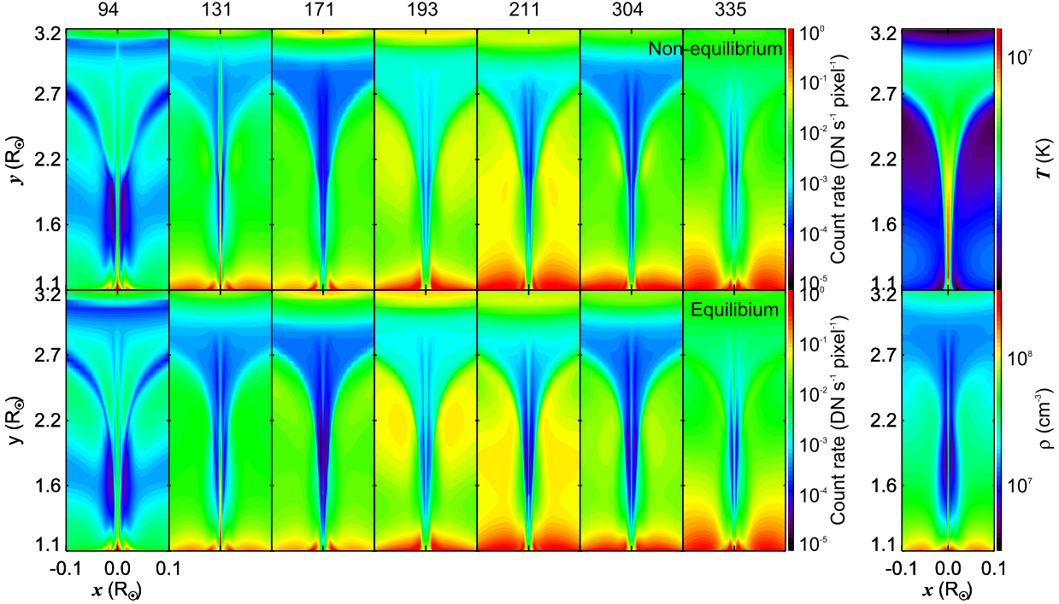
Results: Predicted AIA images
The total AIA count rate includes He, C, N, O, Ne, Na, Mg, Al, Si, S, Ar, Ca, Fe and Ni.
The intensity of the current sheet center is significantly diﬀerent in the non-equilibrium result and the bright thin current sheet region extends higher in the AIA 94Å and 131Å channels.
Notes:
We make time-dependent ionization calculation for most chemical elements that contribute significantly to coronal emission. They are from He/’hiliem/ to Ni/n’ai/.
The total AIA count rate of all emission lines from these elements are calculated at each point on the 2D plane.
The AIA count rate is shown in this figure. The first row is for time-dependent ionization results and the second row is for equilibrium ionization. The main features of the current sheet are same fro two case, but on high temperature channels, such as AIA 94 and AIA 131, the different between two case are clear and the intensity extends higher in time-dependent ionization case.

Slide 12
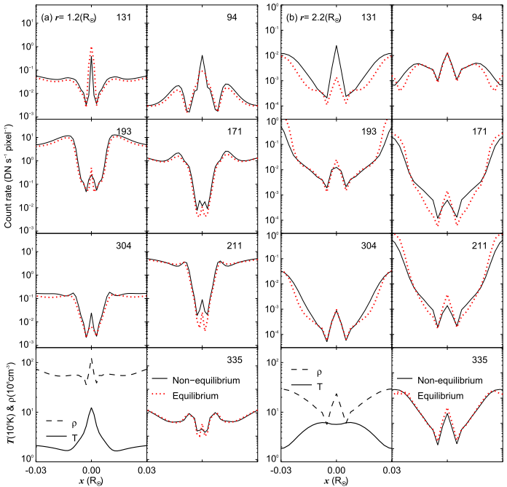
The intensity profiles along the x-direction across the sheet.
For hot AIA channels, the count rates reach the maximum at the center of the sheet.
For other channels, the intensity in the center is lower than the background plasma.
Notes:
In here, we show that the intensity from time-dependent ionization results and equilibrium case on different height. The left figure shows the AIA count rate on two heights one point 2 solar radii and two point two solar radii. The black line is for non-equilibrium case. For high temperature channels, the intensity reach the maximum on the center of the sheet, but it lower than the background plasma on other AIA channels.

Slide 13
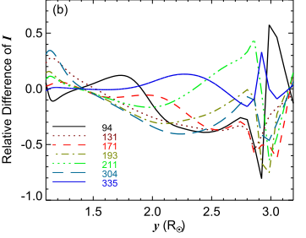
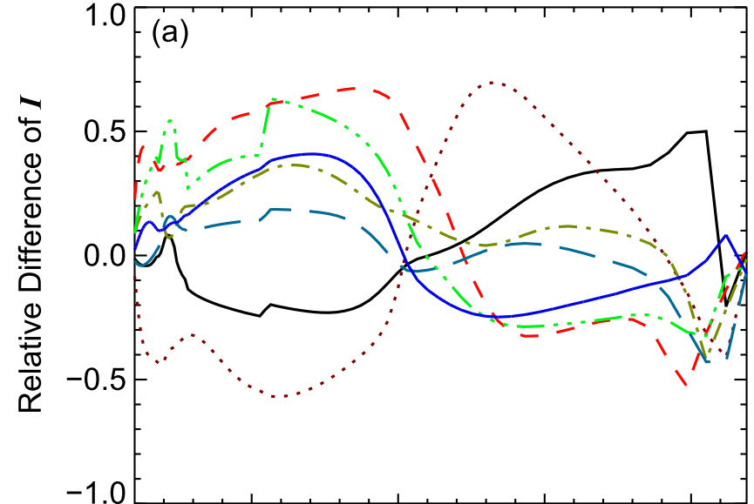
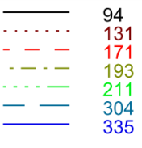
The diﬀerence between time-dependent ionization and equilibrium cases depends on height.
Define the relative diﬀerence of emission between time-dependent calculations and equilibrium ionization as:
Outside the current sheet
Center of the current sheet
(a) In the lower part of sheet, the
intensities are smaller for AIA 94Å & 131Å but larger for other AIA channels. In the higher part of sheet, the case is reversed.
(b) In ambient regions, the equilibrium assumption is not appropriate at higher altitude.
Notes:
To show the difference of time-dependent ionization results and equilibrium ionization assumption, we define the relative difference of emission as this formula. Along the sheet, we consider the average I_delta covering a width of five points and show I_delta changes with height.

Slide 14
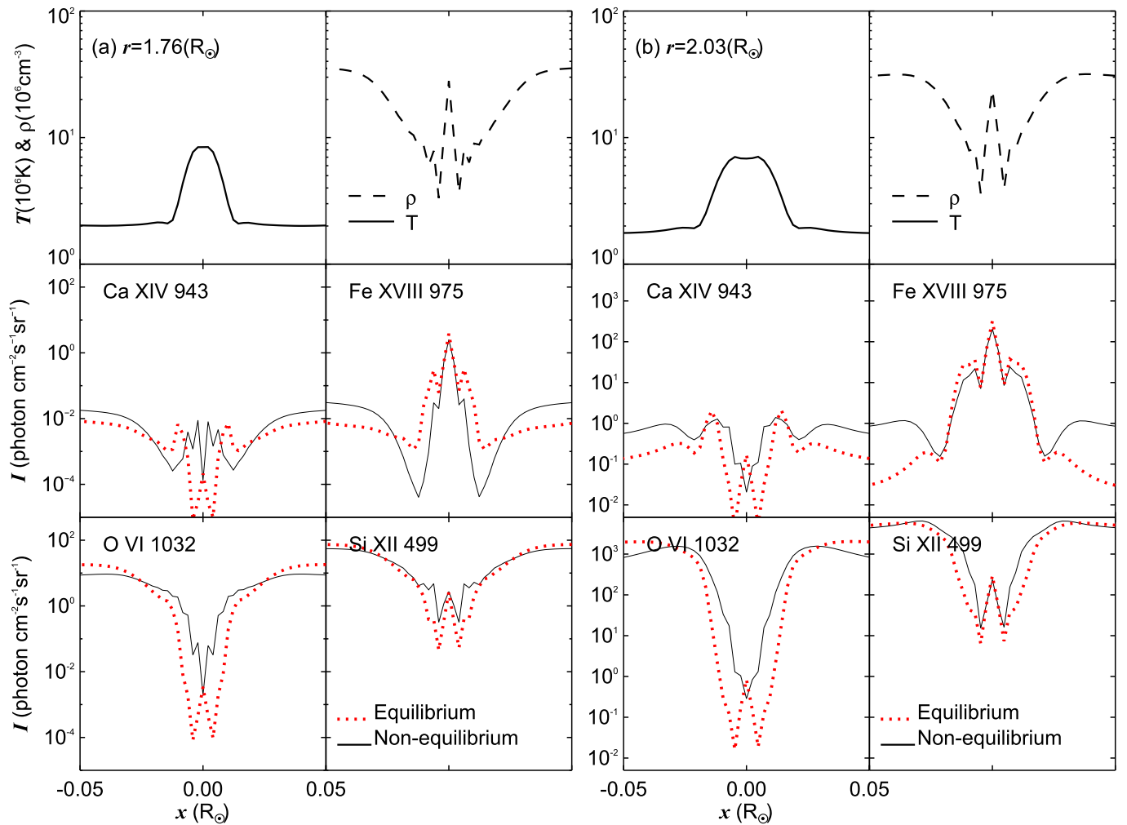
Results: Predicted UV intensity
Inside the current sheet, the Fe XVIII 975Å profile shows that the maximum peak is located in the center of sheet.
The Ca XIV 943Å, Si XII 499Å and O VI 1032Å profiles
are less bright.

Slide 15
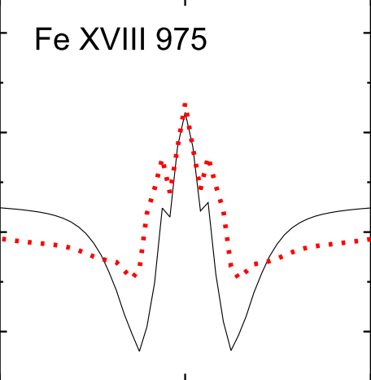
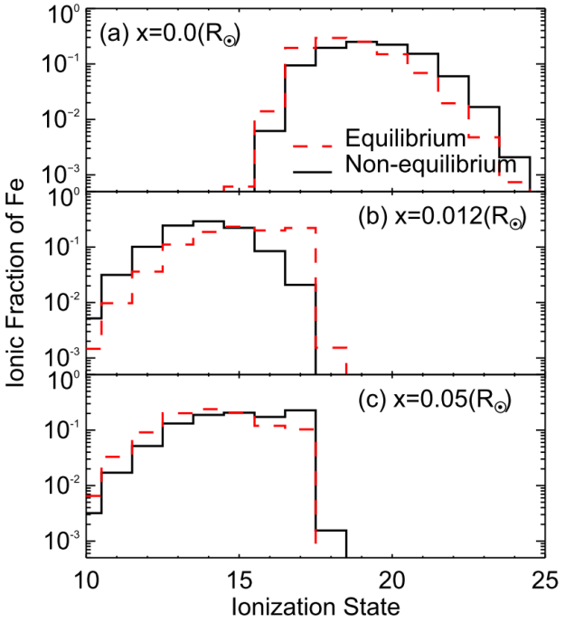
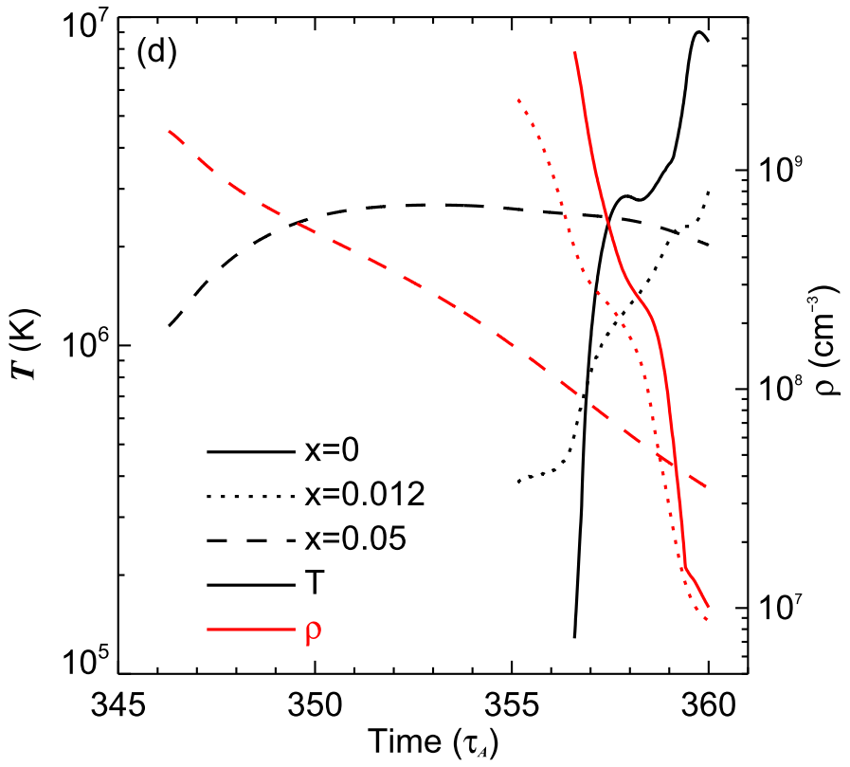
Predicted UV intensity
A low intensity region surrounds the current sheet.
The sheath is deeper in the non-equilibrium results than the equilibrium case.
The low intensity sheath feature can be enhanced by the time-dependent ionization process.
(b)x=0.012, the temperature increases to around 3x10⁶ K in a short period, the time-dependent ionization strongly aﬀects
the charge state profiles and causes the appearance of lower temperature (< 3 x 10⁶ K)
ionization features.

Slide 16
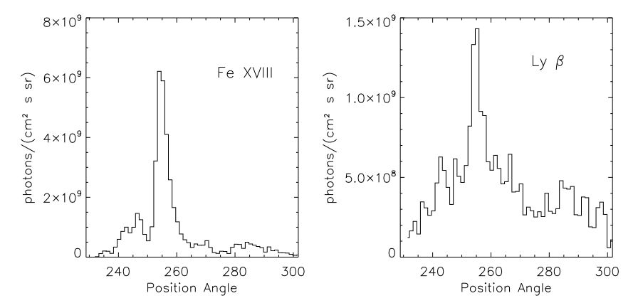
A similar low temperature sheath may be found in space observations.
For Fe XVIII, the center of the sheet is at a position angle 255 and the low ionization sheath is clear at about PA = 262.

Slide 17
4. Conclusion
The temperature will be underestimated at low heights and overestimated at large heights by about a factor of 2 if equilibrium is assumed.
Non-equilibrium ionization needs to be calculated even at low heights.
At low heights in the current sheet, the intensities of the hot AIA channels are lower for non-equilibrium ionization than for equilibrium ionization. At large heights, these intensities are higher for non-equilibrium ionization.
Fe XVIII 975Å profile shows that the maximum peak is located in the center of sheet, while the Ca XIV 943Å, Si XII 499Å and O VI 1032Å profiles are less bright at the sheet center.
Low intensity regions around the current sheet are found in several UV emission lines (Fe XVIII 975Å and Ca XIV 943Å) and AIA bands.
The current sheet plasma is under-ionized at low heights and over-ionized at large heights.
Thank you!

